Slide 1
Bridging the Gap to Leadership:
Developing Equity in Practice Placement Experiences
Helen Carr, Canterbury Christ Church University,
Mary Makinde, Canterbury Christ Church University,
Hansaka Seneviratne, University of Brighton Physiotherapy Graduate
July 2023

Slide 2
Context
Universities UK Report – ‘Closing the Gap: three years on’
‘There is still a concerning awarding gap
The gap between white and BAME students awarded a First for their degree is especially concerning at 9.5%, rising to 19.3% for Black students specifically.
White students are still more likely to be awarded higher grades for their degrees than students of all other ethnicities, even when prior attainment is controlled for.’

Slide 3
Anti-racism in AHP Education: Building an Inclusive Environment (Council of Deans, April 2023)
Key recommendations:
Flexibility and innovation in recruitment and teaching
Take a student-centred approach and include students in processes and decisions
Ensure effective community engagement
Diversify and decolonise learning materials and pedagogies
Create safe spaces for students
Embed comprehensive anti-racist training for teaching and practice staff
Utilise simulation and scenario-based training prior to employment
Across the student journey:
Recruitment and retention; University-based learning;
Practice-based learning; Transition to employment

Slide 4
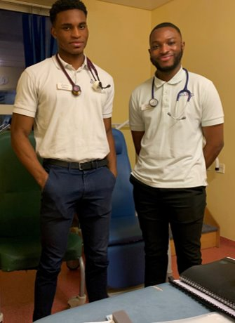
Leadership placements:
- Provide the opportunity to explore & understand the research process
- Develop presentation skills
- Give students an insight into non-clinical roles
- Managing a team & projects
Aims of this project:
To bridge the attainment gap for BAME students in higher education
To create resources for practice educators on how to support BAME students on placement
A Leadership Placement
Aims of this project:
To bridge the awarding gap for Black, Asian, Mixed Heritage and Minoritised Ethnic students in higher education
To create resources for practice educators supporting Black, Asian, Mixed Heritage and Minoritised Ethnic students on placement
To provide the opportunity to explore & understand own leadership style and to develop leadership skills, through e.g.
- developing presentation skills
- giving students an insight into non-clinical roles
- experience managing self, a team & projects

Slide 5
Members of Bridging the Gap to Leadership
Helen Carr, Senior Lecturer in Practice Learning, Canterbury Christ Church University
Mary Makinde, Senior Lecturer in Forensic Investigation / Strategic Lead: Closing our Gap, Canterbury Christ Church University
Dr Channine Clarke, Head of Practice Learning and Development, School of Sport and Life Sciences, University of Brighton
Sarah-Jane Ryan, Principal Lecturer in Physiotherapy, School of Sport and Life Sciences, University of Brighton
Isabel Martin, Project Administrator
Students - Canterbury Christ Church University
Ibrahim Fofanah, Emmanuel Alli, Emmanuel Ozowara, Japheth Rubiato, Aliza Ali, Phumuzile Sithole, Ralph Sevilla, Ayo Akinola, Sandra Lee, Kirsty Henderson, Joshua Fitzgerald-Smith, Shaka Abu, Layla Finch-Lora, Bartolomeu Cunha, Marie Rule, Emily Hawkins, Emily Dearden (film student), Millie Dutnall (film student), Mercy Akingube, Joshua Roberts, Becky Omoregie, Manpreet Sidhu, Fleur Hinds, Funmilola Odusi, Eriadura Odunlami, Louise Tomlinson
Students - University of Brighton Students
Hansaka Seneviratne, Issy Taylor-Gallardo, David Amarteifio, Kai Yan Chun Spirini, Dimple Harani, Tamsin Jesse, Harriet Atkinson, Saam Serafini, Jack Chan, Alka Biju, Emy Grolier, Angelo Serra, Blanky Wong, Anas Mansour, Bilal Mahomedally, Tony Decaux, Nazia Chowdhury, Emma Warde-Robinson

Slide 6
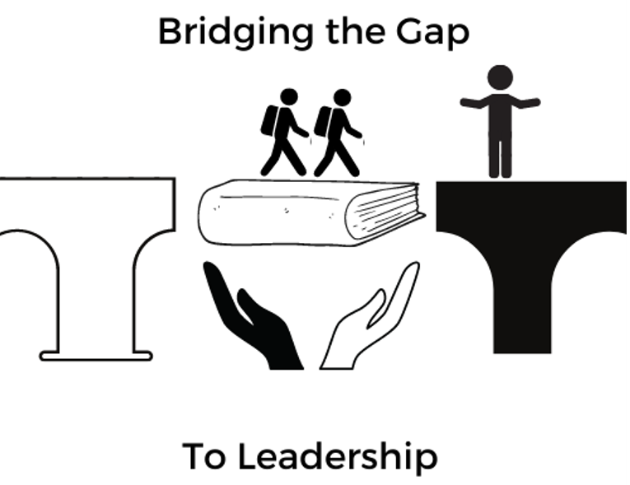
Sat
Giving the Placement an Identity

Slide 7
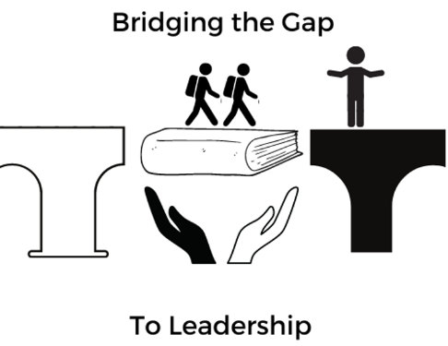
The bridge has two meanings. It symbolises the two universities working together and the filling of the gap between practice educator and student. The book represents leadership and how education can play an important part in helping two sides gain a mutual understanding. The people represent students and a practice educator. The students are on a journey through their placement while the practice educator is receiving them in open arms. Suggesting acceptance and willingness to help. We tried to keep the image as gender neutral as possible and so avoided putting any faces.
The logo was produced by Japheth Rubiato and Dimple Hirani, Physiotherapy students at Canterbury Christ Church University and University of Brighton, whilst on their Bridging the Gap to Leadership Placement (Mar 21). The aims of the project are to encourage inclusivity and support for our Black, Asian, Mixed Heritage and Minority Ethnic students whilst on their Health and Social Care placements. For further resources, please see: https://blogs.canterbury.ac.uk/bridgingthegaptoleadership/

Slide 8
Student-led Activities
Microaggressions
Active bystandership / upstandership
Allyship
Black history 365
Reciprocal mentoring and active allyship
Supporting culturally and linguistically diverse students (CALD)
White privilege, sanction & fragility
Support with a LSP/dyslexia on placement
Religious festivals
Cost of living impacts
Being a carer impacts
Structural advantage
Leadership styles
Podcasts
Posters
Videos/
animations
Photo display on microaggressions
Presentations/
conferences
Articles – e.g. RCOT journal
Linking with NHS Trusts
Participating in stakeholder meetings
Joining staff networks

Slide 9
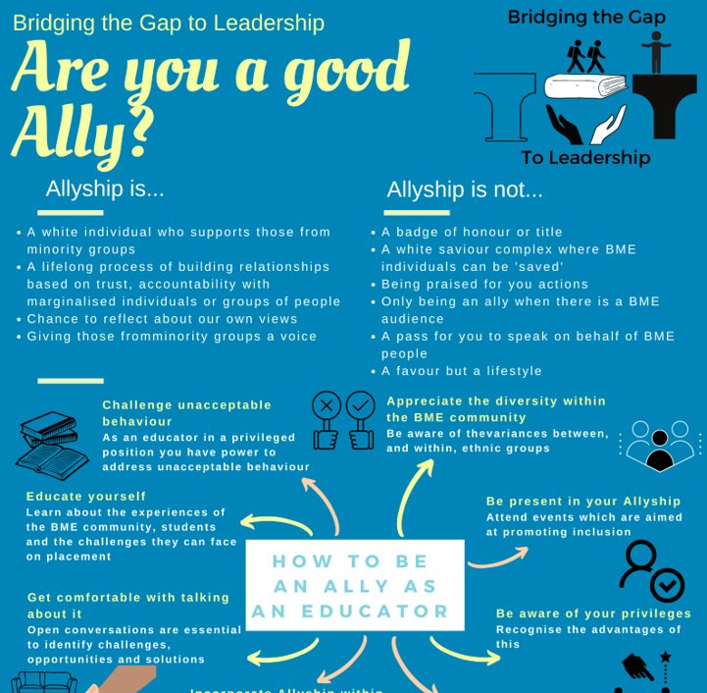
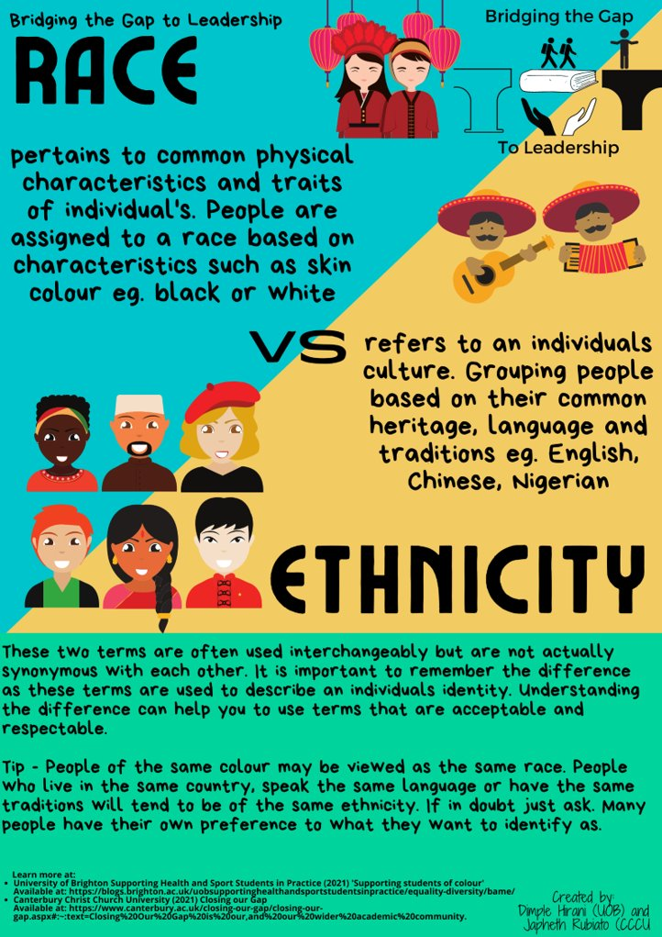
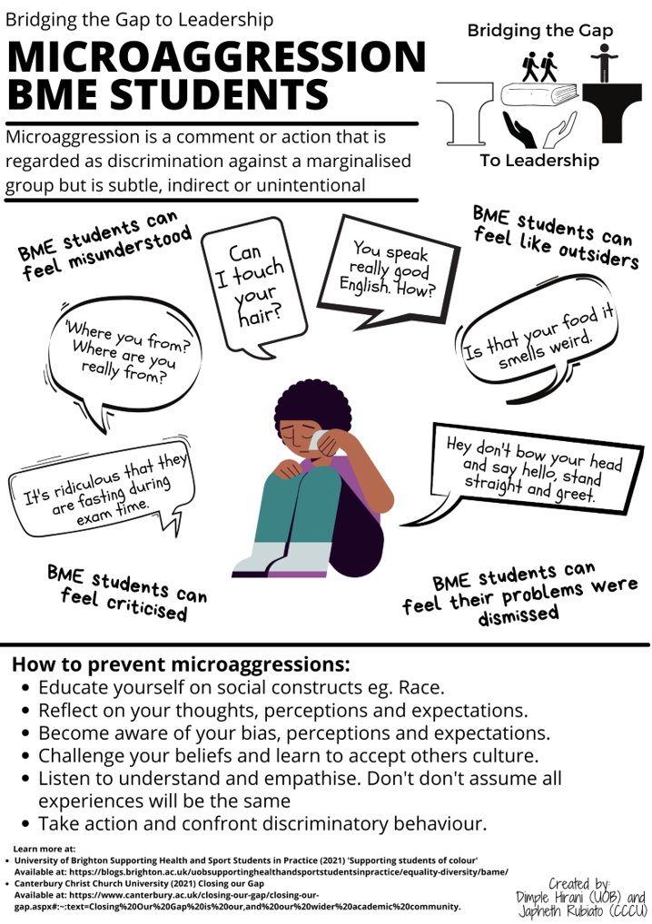
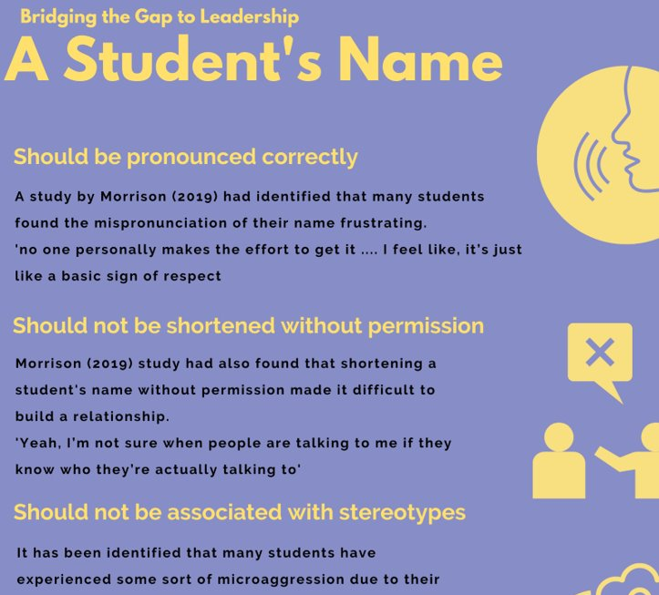
Sat
Resources for Practice Educators and Staff

Slide 10
Film Resources
Animation 1: Providing an inclusive learning environment and allyship for Black, Asian, mixed heritage and minority ethnic (BAME) students.
Click here to view the animation

Slide 11
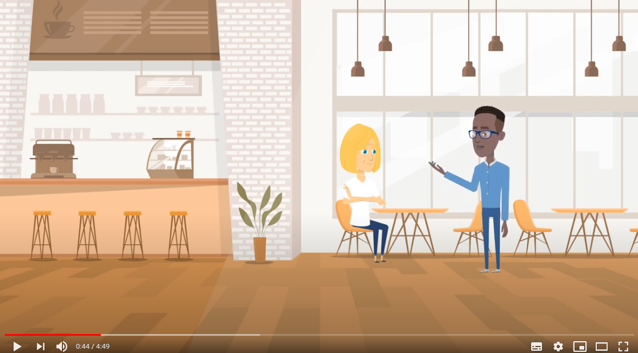
Animation 2: Microaggressions
Sat
This 2nd video (created by Kai Yan Chun Spirini, Aliza Ale and Emmanuel Ozowara) can be used in educator training and uses real case studies: watch here

Slide 12
Animation 3: English as a Second Language (ESL) to enhance support for culturally and linguistically diverse (CALD) students
https://www.youtube.com/watch?v=TrZS0pb2_cE

Slide 13
Bridging the Gap: Impact on Students
Sat
"As a person of colour, I'm glad to see these conversations are being had. It makes me feel less isolated."
"This placement provided brilliant opportunities to take the lead on a project and to build my confidence. "
"I felt like I was contributing to change."
"It's reassuring to see a role for "big picture" thinkers within the AHP workforce."
“It gave me the confidence to speak about race and my experiences."
"This was a valuable opportunity to learn new skills I would never have traditionally experienced on my course."
“I really enjoyed developing the posters and resources for PE."
"I would likely not have crossed paths with so many senior AHPs had it not been for this placement. This was a fantastic networking experience."
“It has been great to work with students from another university and learn about their experiences."
"I'm glad to have learned more about how to be a better ally and an active bystander."
“I felt like I could be myself."

Slide 14
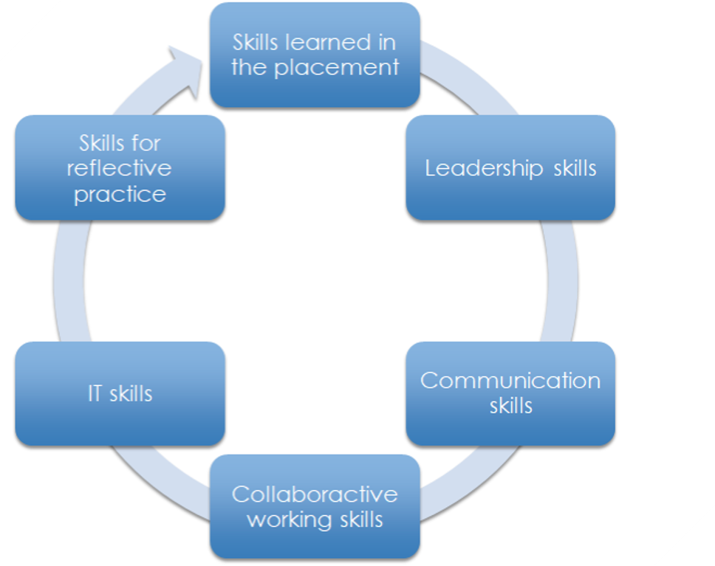

Slide 15
Fun
Creative
Best placement
Interactive
Self growth
Making a difference
Impactful

Slide 16
How to be an active bystander
It has helped me to understand the role I play in change.
Building Allyship: Reflections as a White Student
Educate myself and network with others from a variety of ethnic backgrounds to better inform my knowledge about the attainment gap and struggles health students have on placement and in workplaces.
Apply my research and share resources with my university and NHS organisations about the benefits and how this may facilitate active allyship.
For the first time I am having conversations with friends about their experiences
Acknowledge the link between reciprocal mentorship and organisational change for inclusion.
Have open communication with staff, fellow students and peers about race and ethnicity.
Recognise my own privilege as a White student.
Understand what mentoring means from different perspectives.

Slide 17
Bridging the Gap: Impact on Placement Providers
Sat
Really excellent, I’m now introducing this in to our student placement.
It was lovely to hear experiences from students and made you really think
my colleagues attended this one and then shared their knowledge and experience (even taking me on an empathy walk when we returned to practice - very powerful!)
How I can be a better ally and open the conversation
I really found the information on experiences in practice and how we could work together better to support students across academic and practice better. The presentation was fantastic and would be really useful for me to share with my team.
The discussion generated discussion with other members of the team and another MDT staff member
Advocating for BAME students
Really appreciating the extent to which BAME students are affected and how much we can all support and help change things within not just education but the workplace as a whole
A really positive discussion and I think so useful to raise practical approaches that practice educators can use. Really impressive work and well presented
It was challenging, in a good, growth kind of way.

Slide 18
Locating our Resources
Bridging the Gap to Leadership, a Health Education England funded project, sits within both universities’ strategies for closing the educational attainment gap. For CCCU’s Closing our Gap Strategy, please see:
Closing Our Gap - Canterbury Christ Church University
For more information on Bridging the Gap to Leadership and for the resources, please click here for our blogs:
Canterbury Christ Church University's Blog Link
University of Brighton's Blog Link

Slide 19
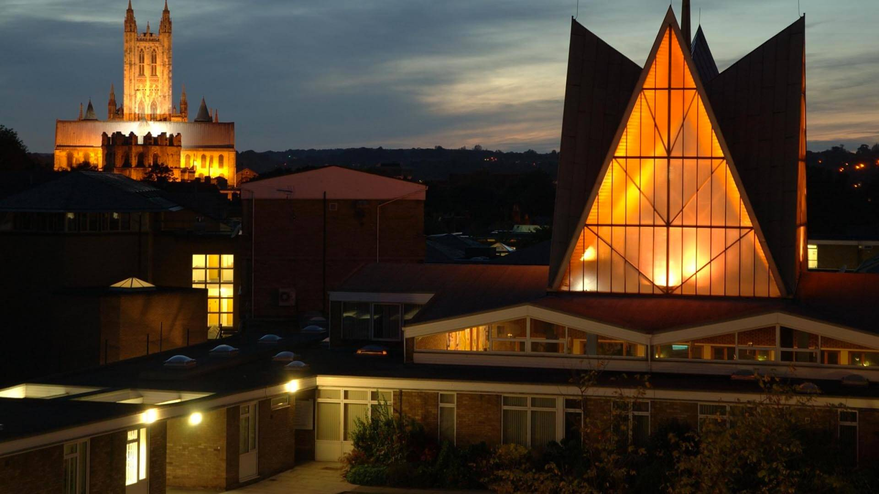
Sat
Continuing our Journey
Replicating placement model in other programmes
Research & Data collection
Gathering
Understanding
Monitoring
Action
Decolonising the curriculum, academic practice, the institution and professional practice
A process- tourist vs pilgrim
Cultural and mindset shift: Acknowledge, dismantle, relearn and rebuild
Collaborative working
Students - must be at the centre
Staff
Placement providers and our community
Building networks and communities
Allyship programme
Improvement of mental health and wellbeing resources

Slide 20
Allyship as a Pilgrimage Quotes collected by Sandra Lee, Canterbury Christ Church University
‘It is from numberless diverse acts of courage and belief that human history is shaped. Each time a man stands up for an ideal, or acts to improve the lot of others, or strikes out against injustice, he sends forth a tiny ripple of hope, and crossing each other from a million different centres of energy and daring, those ripples build a current that can sweep down the mightiest walls of oppression and resistance.’ (Hockenberry (2016) quoting Robert F. Kennedy)
‘If you’re a person with privileged identities and you want to be a true ally … Maybe you do have to engage in those uncomfortable emotions because you know its your job and responsibility to have those conversations so that other people of colour or women or LGBTQ folks won’t have to have those conversations for you’ (Limbong, 2020, p3).
‘Interrupting the forces of racism is ongoing, lifelong work because the forces conditioning us into racist frameworks are always at play; our learning will never be finished’ (DiAngelo, 2018, p. 9).

Slide 21
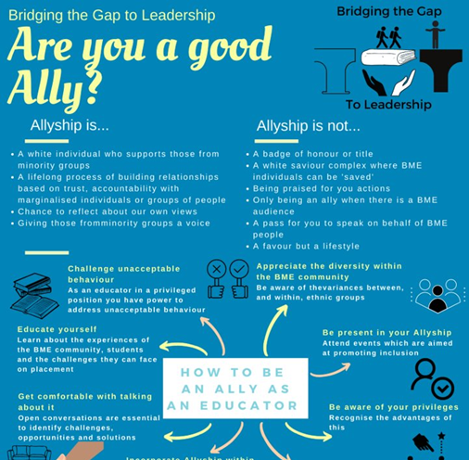
Beyond the Institution - Working with External Stakeholders and the Community
Sat
For our professional Health and Social Care course, students spend approx. 50% of their time on placements
Our students will go on to be leaders
Working to decolonising the professions
Asset based approach vs deficit model

Slide 22
Roundtable conversation
Consider the barriers to speaking up
How do we honour the accounts we are told?

Slide 23
Bridging the Gap to Leadership Placement Websites: CCCU AND UOB
For more information, please contact:
Helen Carr helen.carr@canterbury.ac.uk
Mary Makinde mary.makinde@canterbury.ac.uk
Channine Clarke c.clarke@brighton.ac.uk
Sarah-Jane Ryan s.j.ryan@brighton.ac.uk
And you can be directed to our participating student partners
Thank you

Slide 24
References for Quotes
DiAngelo, R. (2018) White Fragility Why its so Hard for White People to Talk about Race. United States of America: Beacon Press Books.
Hockenberry, J. (2016) RFK’s ‘Ripple of Hope’ Speech Still Touches the World, 50 Years Later. Available at: https://theworld.org/stories/2016-06-06/rfks-ripple-hope-speech-still-touches-world-50-years-later (Accessed 18 November 2021)
Limbong, A. (2020) Microaggressions are a Big Deal: How to Talk them Out and When to Walk Away. Available at: https://www.npr.org/2020/06/08/872371063/microaggressions-are-a-big-deal-how-to-talk-them-out-and-when-to-walk-away?t=1637661959502 (Accessed 23 November 2021).

Slide 25
References
Council of Deans (April 2023) Anti-racism in AHP Education: Building an Inclusive Environment, Available at: https://www.councilofdeans.org.uk/wp-content/uploads/2023/03/Anti.racism.in_.ahp_.education.report.pdf, Last accessed 14/4/23
Universities UK, Closing the Gap: three years on, Available at: https://www.universitiesuk.ac.uk/what-we-do/policy-and-research/publications/features/closing-gap-three-years/data, Last accessed 14/4/23

