Slide 1
Quality clinical leadership for improving patient safety with patients, carers and staff centre stage
Project Team
Professor Kim Manley; Carrie Jackson, Anne Martin
Christine McKenzie, Dr Toni Wright,

Slide 2
PROJECT AIM: Safety Culture, Quality Improvement, Realist Evaluation (SCQIRE)Project
What is the impact of the Patient Safety Collaborative (PSC) initiative on patient safety culture, quality improvement capability and leadership?
To understand what works for whom and why:
when working with frontline teams in acute NHS Trusts to embed a safety culture
when enabling facilitators to work with the PSC initiative with frontline teams

Slide 3
Patient Safety Collaborative (PSC) Initiative
Organisational Factors
SUPPORT
PROVIDED TO FOUR LARGE ACUTE HOSPITAL GROUPS BY THE
PATIENT SAFETY COLLABORATIVE
ACTION LEARNING for ORGANISATIONAL FACILITATION TEAMS
Teamwork Safety Climate Survey tool (Sexton et al 2006)
HUDDLES/LEEDS EXPERIENCES Quality
Improvement
Facilitator Factors

Slide 4
4 CASE STUDY SITES: Ten independent frontline teams
Case Study 1:: Overall project lead with clinical leads/managers for each of three teams:
Antenatal and post-natal ward
Respiratory ward
Clinical decision unit/urgent care
Case Study 2: One ward team previously experiencing a high fall rate & invested with intensive facilitation support, facilitator left leaving reminder members of facilitation team comprising clinical Lead for safety and organisational lead for safety. Organisational lead for safety took over immediate support role for ward.
Case Study 3: One overall project lead, with senior clinical lead for each of two teams:
Midwifery Delivery Suite
Emergency Department
Case Study 4: Four senior clinical leaders each facilitating one of four teams:
Frailty ward and safe discharge
Renal ward and sepsis
A &E and patient transfer to wards
Ambulatory Care – safety huddle

Slide 5
Research approach
Realist evaluation assumes both social systems and structures are real because they have real effects and human actors respond differently in different circumstances
Interaction between context (C) & mechanisms (M) produces outcome (O) i.e. C+M=O
Programmes (complex interventions ) occur in different contexts and trigger different mechanisms so can’t just be replicated
Theoretical understanding about what works and why can be transferred to different contexts
Practice development methodology because of:
Values: person centred, safe and effective care and effective workplace cultures at the microsystems (frontline teams) level and focus on context
Enabling stakeholder engagement and the use of tools that focus on what matters to people
Culture change
Notes:
Randomised Control Trials may produce statistically accurate statements but cannot identify where to target resources & how to maximise impact

Slide 6
Culture change
Underpinned by principles of EWC
Insights about how to change culture
Organisational systems enablers that need to be optimised
Implications for governance, infrastructure, critical mass of facilitators

Slide 7
Methods & Analysis
Interrogation of the literature
Patient safety
Safety culture , QI and leadership capacity building
Group processes within each frontline team towards collective action
Self assessment data - facilitators
Qualitative 360 degree analysis
Emotional Touchpoints with facilitators – focusing on what matters in relation to the QI skill set (Health Foundation)
Texas/other tool
Collaborative Observations of practice teams
Claims, concerns and issues with stakeholders including:
Frontline teams
Facilitators
Governance teams

Slide 8
Quality Improvement
QI Pyramid (Health Foundation)
SCQIRE feedback from emotional touchpoints making engagement, meaning of concepts, having conversations to complement technical skills

Slide 9
Methods & Analysis (1)
Interrogation of the literature
Patient safety
Safety culture , QI and leadership capacity building
Output
Identified individual, team & organisational:
enablers,
attributes
consequences
16 tentative CMO relationships

Slide 10
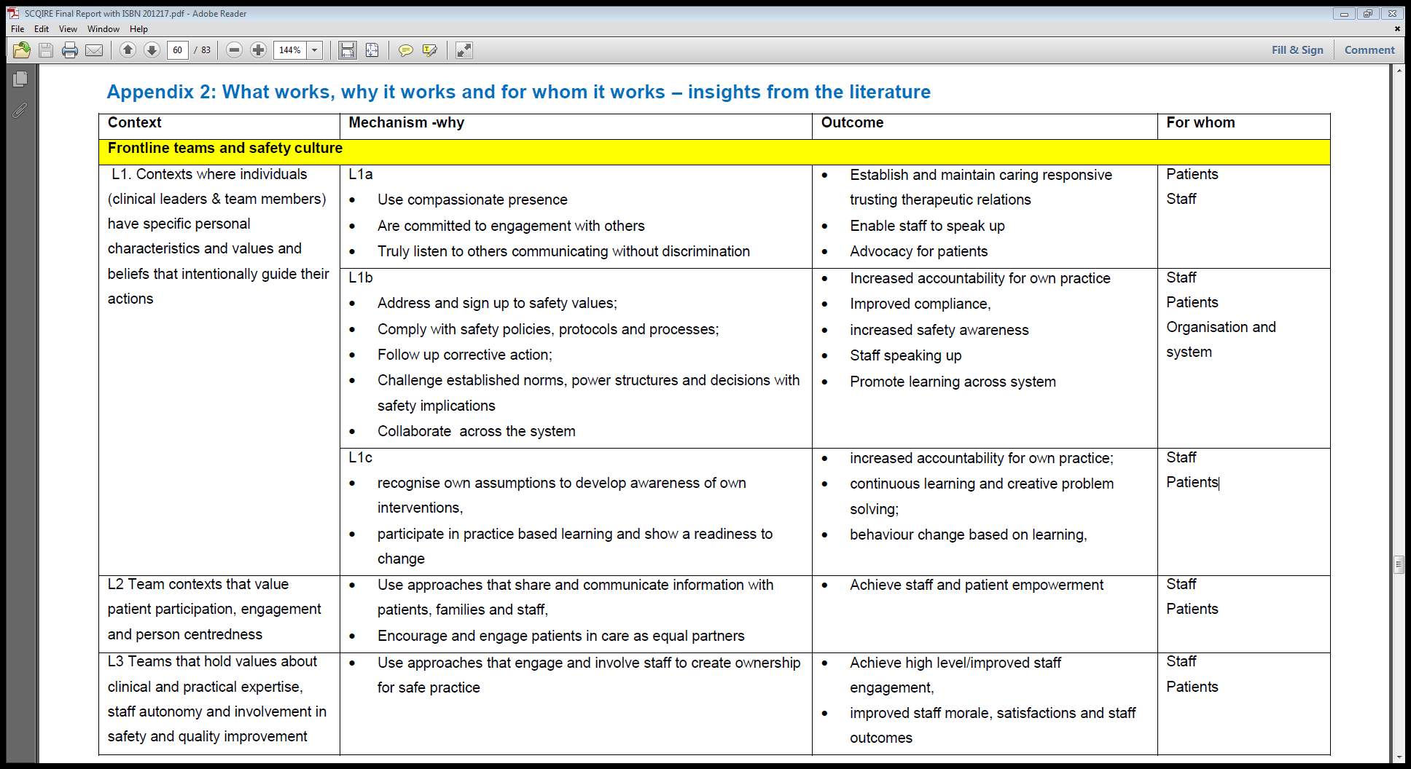

Slide 11
Specific INDIVIDUAL values, beliefs & characteristics for contributing to safety culture (Literature analysis)
Personal characteristics:
Person-centred, compassionate and caring
Authentic, open, honest and trusting with integrity
Supportive, valuing and empathetic
Motivated , showing perseverance, resilience
Are active and adaptive to the work system
Creative, passion with drive and self-efficacy
Enthusiastic and optimistic
Vision and systems thinking
Personal values and beliefs:
Respectful and ethical
Accountable, responsible and take pride in one’s work
Self and safety aware, reflective
A commitment to safety, quality, learning and a blame free approach to incident reporting
Positive commitment to adopting & implementing safe, ethical practice
Courage to speak up assertively

Slide 12
Methods & Analysis (2)
Unit of analysis = group processes within each frontline team towards collective action
Self assessment data from facilitators
Qualitative 360 degree analysis
Emotional Touchpoints with facilitators –Texas/other tool
Collaborative Observations of practice teams
Claims, concerns and issues
Output
CMO Relationships for each team and case study
Synthesised across all case studies to generate 25 CMO relationships about what works , why it works and for whom it works

Slide 14
Focus of Findings
What works, why and for whom when:
developing a safety culture in frontline teams
senior facilitators work with frontline teams to embed safety culture, QI in frontline teams
the Patient Safety Collaborative initiative is used by facilitators and frontline teams
using the patient safety collaborative initiative within acute hospital Trusts

Slide 15
SYNTHESIS FRAMEWORK - KEY INTERDEPENDENT THEMES
ORGANISATION
ACUTE HEALTHCARE PROVIDER ORGANISATION
Multiple initiatives & challenges
VALUES
LEADERSHIP &
ORGANISATIONAL READINESS
Clinical
Leadership
Safety behaviours/
environment
FRONTLINE TEAMS
(Microsystem)
Teamwork
FACILITATORS
Safety Culture
Values
Shared
Meaning
CO-ORDINATED
SYSTEMS
Action Learning
Patient Safety Collaborative Initiative
OTHER FACILITATORS
ACUTE CARE ORGANISATIONS

Slide 16
Transformational leadership Model the way Inspire a shared vision Challenge the process Enable others to act Encourage the heart (Kouzes & Posner 2012)
LEADERSHIP INSIGHTS AT TWO LEVELS – CLINICAL AND ORGANISATIONAL

Slide 17
Developing a safety culture in frontline teams. Theme 1: Clinical leadership
What works?
Clinical leaders (ward managers, clinical leads, team leads, shift leads) who:
Model respectful relationships and person- centred values
Are approachable, actively listens to and values patient and service user expertise, engagement and participation
Pay attention to both patient and staff wellbeing
Support teams with patient safety/improvement
Are clinically credible, model self-awareness, reflection and learning.
Creates shared vision/direction and embeds this
Connects everyone for the patient, encourages innovation
Possess personal attributes and qualities, and are transformational leaders
Why does it work?
Consistently endorses and enables:
Service users and staff to feel heard and listened to, to become empowered and this improves experiences
Person centred respectful relationships between all staff members and with service users, so people feel valued and respected
Impacts on a collaborative approach to developing workplace culture
Clinical
Leadership
FRONTLINE TEAMS
(Microsystem)

Slide 18
What works in relation to safety culture!
The strategies that optimize safe clinical decision making for patient and staff wellbeing are respectful multidisciplinary relationships formed through shared team values, clarity of purpose, clear communication and the ability to act on feedback for improvement, as well as listening to and valuing the contributions of team members when developing collaborative holistic action plans for patients and their families.
What does not work:
Poor clinical leadership was observed to have a negative effect on both staff and patient wellbeing and the safety culture. When this was rectified through providing experienced quality clinical leadership then a transformation in how the culture was experienced was dramatic

Slide 19
Stories to illustrate from observations of practice
Observations from same site and different teams
Doctor requesting to be the one to speak to the family following a death as he had been with the family all week
The team sharing and listening to each other, jointly making decisions regarding how to take things forward. The occupational therapist states the patient has “really been trying and he needs our support now” in response to the team who are not sure how to use the finite resources available to them.
Observations from same site and same team
‘The Dr on ward round praises the registered nurse for detecting the deteriorating condition in the patient which meant that patient needed to be transferred elsewhere’
‘Patient looks unkempt, he needs to take some medication and requests bottle water as cant take tap water which team gracefully accommodate without making a judgement – nurse comes back with bottled water for the patient from his own supplies.’
‘The pharmacy technician reviews medication interaction and highlights to senior doctor the two drugs prescribed by Dr should not be given together. Dr responded ‘thank you for pointing this out’ demonstrating respectful exchange’

Slide 20
Huddles- a microcosm for teamwork and clinical leadership ‘its not the title but what people do’
What works
Always happens at predetermined times
Agreed purpose & structure – adapted to own setting
Staff driven – staff co-create
Focus on staff safety + patient safety
Multi- disciplinary team work and culture of speaking up
Communication , comprehensive information in preparation
Why it works
Speeds up & escalates decision making, moves thought processes
Enables everyone to be involved and work together for solution and to know what is happening
Better communication and information
Enables staff and patient well being
Tangible difference in the structure of day ? Difficult to measure impact
Challenge – environment, confidentiality
Why it doesn’t work!

Slide 21
Huddles where there was no leadership
“Sometimes nurses are not involved in the Safety Huddles”.
“During busy periods Huddles may be omitted“.
“Staff didn’t know why they were doing Huddles within the context that the project was thought to be about bladder care, communication, teamwork, staff morale”.
“Staff not speaking up in a large group feeling intimidated”.
“Nothing gets followed up”.

Slide 22
Organisational leaders and leadership
Strong organisational values are required that are demonstrated at every level and modelled by senior managers and leaders,
Whole systems approach with highly integrated co-ordinated systems for enabling safety, quality improvement, learning and governance
Organisational readiness and leadership with buy-in from executive teams, reflected in genuine organisational commitment
Support for capacity and capability building in facilitators of learning, development and improvement.

Slide 23
360 Degree feedback illustrating qualities and values in action:
“You have very clear standards for the delivery of care and I have never known you to compromise these standards. This sends a clear message to staff, encourages and inspires similar standards.”
“You have a welcoming and enthusiastic personality that makes you easy to approach, ask questions and suggest solutions. This makes it easy for staff to report adverse incidents and support further learning and enhances safety.”
”You always make the time to listen and explain; this is a great trait in a manager and has been a great support.”
“Positive support and leadership to staff and listen to concerns”
“Always seeks to develop service and involves teams in actions”
“You involve staff in discussion and decision making about changes”
From different members of role set
Endorses the qualities, values and beliefs experienced of effective clinical leaders and facilitators

Slide 25
Quality Standards Realist Evaluation for evaluators & peer reviewers (Wong et al, 2017)
Standard 1: Evaluation Purpose
Standard 2: Understanding and applying the realist principle of generative causation in realist evaluations
Standard 3: Constructing and refining a realist programme theory or theories
Standard 4:Evaluation design
Standard 5: Data collection methods
Standard 6:Sample recruitment strategy
Standard 7: Data analysis
Standard 8: Reporting
Theoretical outputs
Standard 3
Led to the development of a refined theory for person-centred culture change in frontline teams
Standard 5
Use of practice development approach and methods e.g. Observations of Practice and Claims, Concerns and Issues led to wider uptake and application in participating teams not previously exposed to them

Slide 26
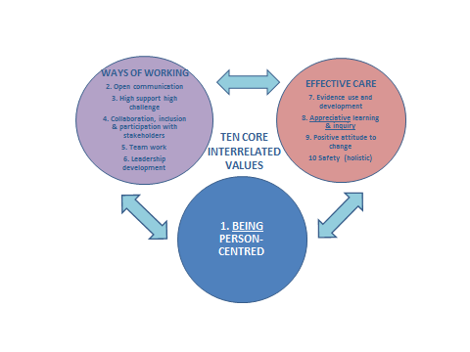
Theory of Person-Centred Culture Change in Frontline Teams Manley, Jackson, McKenzie, Martin, Wright,( 2017). Theory derived from: Effective workplace culture (Manley, Sanders, Cardiff, Webster 2011), tested and refined through the Safety Culture, Quality Improvement, Realist Evaluation (SCQIRE) Project
EMBEDDING TEN core values associated with:
being person-centred,
ways of working
effective care

Slide 27
Enabling factors: an effective workplace culture Manley K; Sanders K; Cardiff S; Webster (2011) refined from SCQIRE Project (Manley et al, 2017)
Individual
Transformational leadership
Skilled facilitation that engages staff in co-creating meaning and shared purpose
Role clarity
Organisational
Collaborative and authentic senior leadership;
Focus on supporting bottom-up change; organisational readiness; and human resource management’s role in recruiting for shared values
Embedding values in organisational systems for learning, development, and improvement, based on appreciation of what works, and growing organisational; capacity and capability in leadership and facilitation
Notes:
27
Understanding the enabling factors at both the organisational and the individual level provides direction towards where the focus on workforce development should be e.g. role clarity, transformational leadership ,facilitation in the workplace
We know from the concept analysis mentioned earlier that effective cultures can be enabled by individual and organizational factors. This means that if local workplaces are to be person centred then it is essential to have an organizational culture and systems that also enable this.
These enabling factors together with the use of values clarification around person centredness, what it means and other values around how we work together provides a range of different starting points to develop effective cultures or evaluate the workplace culture present

Slide 28
Limitations
Engagement of frontline teams varied due to three factors, i) the busyness of the areas; ii) the timeliness of the data collection; and iii) the relationships influencing the frontline teams.
Minimizing the burden on frontline staff required the research team to be as flexible and sensitive as possible in collecting data
Training the facilitators in how to use Observations of Practice and Emotional Touchpoints would have strengthened confidence in the usefulness of the tools in some sites
Application for ethical clearance coincided with the launch of the awarding body- the NHS Health Research Authority- which resulted in a time lag of three months
There was a lack of PSC initiative guiding principles and a common approach across case study sites for participating organisations and teams which made clarity of purpose more difficult.
Not all sites used the Teamwork Safety Climate Survey making comparison difficult

Slide 29
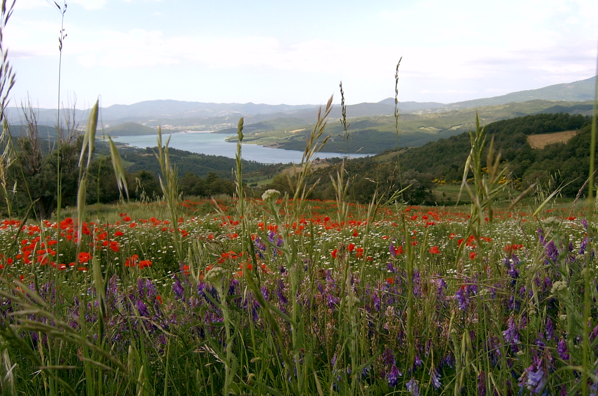
Practice Development approaches are key to leadership and developing person centred, safe and effective cultures
“a continuous process by which person-centred cultures for the delivery of safe, effective care are developed by skilled facilitators who engage authentically with both the interprofessional team and individuals within it to promote effective transformations in the workplace” (Manley et al., 2008)

Slide 30
Connect with us at:
Twitter:
@ECP4PD, @kimmanley8, @ECPDCarolyn
Website:
www.canterbury.ac.uk/englandcentreforpracticedevelopment
Email:
Kim.manley@nhs.net kim.manley1@canterbury.ac.uk
carolyn.jackson@canterbury.ac.uk
Facebook:
www.facebook.com/groups/ecpd1

