Slide 1
How to enhance the student experience and address the climate emergency: focus on commuter students
Presented at: Enhancing the Student Experience 2023. Universities UK, London, UK. 25 May, 2023.
Dr Susan Kenyon
Susan.Kenyon@Canterbury.ac.uk

Slide 2
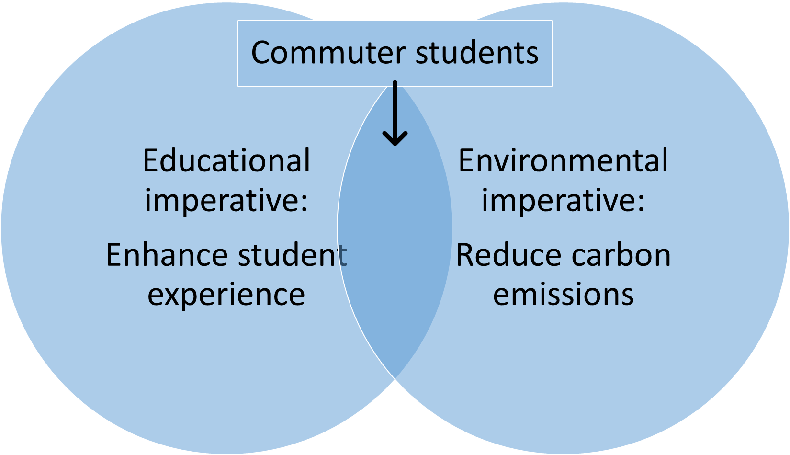
Overview
40%
35%

Slide 3
Commuter students: a WP success story?
‘Students who continue to live at home whilst studying, rather than moving into student accommodation’.
c.40% of the national student population.
c.1.1 million students.
Rapidly increasing in number.
Far faster than overall cohort increase.
Demographics.
‘Non-traditional’ to HE.
Unable/unwilling to relocate.
New universities.
76% CCCU student population.
Vocational courses.

Slide 4
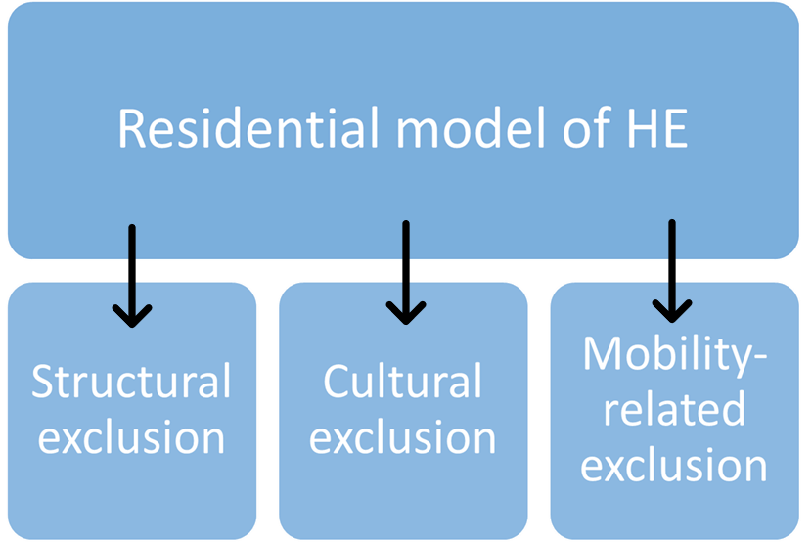
Commuters: the student experience
Poorer student experience.
Higher level of dissatisfaction.
Lower perception of value.
Lower feeling of belonging.
Lower engagement.
Learning activities.
Extra-curricular activities.
Social activities.
Learning community.
Poorer outcomes.
Lower attainment: ‘good degree’ and pass.
Lower continuation, retention.
Worse graduate outcomes.

Slide 5
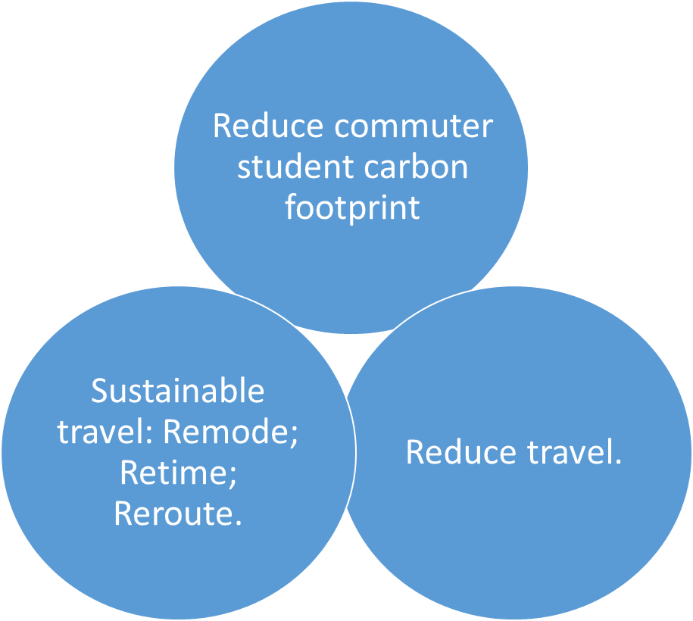
Commuters: the climate emergency
c.1.1m students = c.3.3m return journeys/week.
2005: 11% of total HEI emissions.
2023: more students; more commuter students = greater %; greater volume.
Demographics:
Car reliant.
Complex activity patterns.
Residential model:
Inaccessible university locations.

Slide 6
Lessons from the pandemic
Commuter students had a more positive student experience.
Reduced mobility, structural and cultural exclusion.
Increased community, engagement, participation, (attainment).
With caveats…
Experience
Emissions

Slide 7
Reconceptualising HE
Baselines
Existing CCCU data.
Primary data collection.
Targets
Student perceptions.
Policy analysis (CCCU / government).
Interventions
Travel behaviour science.
Student perceptions.
Transport accessibility analysis (TRACC).
HEI consultation, literature review.
Acceptable, Accessible, Affordable, Available.
From ‘Widening Participation to ‘Facilitating Access’.
Challenge the residential model.
Reduce the need to travel.
Major CCCU study.

Slide 8
References
Bowl, M. 2010. Experiencing the barriers: non-traditional students entering higher education. Research Papers in Education. 16:2. 141-160.
Burke, P. 2012. The right to Higher Education: beyond widening participation. London: Routledge.
Burlison, M. B. 2015. Non-academic commitments affecting commuter student involvement and engagement. New Directions for Student Services. 150. 27-34.
Connell-Smith, A. and Hubble, S. 2018. Widening participation strategy in higher education in England. House of Commons Library briefing paper 8204. Available online, via: https://researchbriefings.files.parliament.uk/documents/CBP-8204/CBP-8204.pdf, viewed 27/07/2022.
Crawford, N. and McKenzie, L. 2022. Localised learning: mobilising belonging among mature-aged students in low socio-economic status regional and remote areas. Higher Education. DOI: 10.1007/s10734-022-00877-x.
Department for Education (DfE). 2022. Widening participation in Higher Education: 2022. Available online, via: https://www.gov.uk/government/statistics/widening-participation-in-higher-education-2022, viewed 28/07/2022.
Donnelly, M. and Gamsu, S. 2018. Home and away: social, ethnic and spatial inequalities student mobility. London: The Sutton Trust.
HEFCE. 2010. Carbon reduction target and strategy for Higher Education in England. Available online, via: https://dera.ioe.ac.uk/10659/1/10_01a.pdf, viewed 20/07/2022.
HESA. 2022a. Chart 4 Full-time and sandwich students by term-time accommodation. Available online, via: https://www.hesa.ac.uk/data-and-analysis/students/chart-4, viewed 15/07/2022.
Jacoby, B. 2015. Enhancing commuter student success: what’s theory got to do with it? New Directions for Student Services. 150. 3-12.
Jury, M., Smeding, A., Stephens, N., Nelson, J., Aelenei, C. and Darnon, C. 2017. The Experience of Low-SES Students in Higher Education: Psychological Barriers to Success and Interventions to Reduce Social-Class Inequality. Journal of Social Issues. 73: 1. 23-41.
Kenyon, S. 2015. Development and social policy: the role of transport in social development, in the UK context. Chapter 28 in Hickman, R., Givoni, M., Bonilla, D. and Baniser, D. 2015. Handbook on transport and development. Cheltenham: Edward Elgar. 430-440.
Kenyon, S. 2023. Commuter students: draft plan of work, Phase 2, 02-2023 to 11-2023. Paper submitted to CESIG, CCCU, April 2023. Unpublished.
Kenyon, S. 2023. Commuter students: applying lessons from the pandemic lockdown to enhance attainment, engagement and the student experience. Submitted to Higher Education.
Kretovics, M. 2015. Commuter Students, Online Services, and Online Communities. New Directions for Student Services. 150. 69-78.
Maguire, D. and Morris, D. 2018. Homeward bound: defining, understanding and aiding ‘commuter students’. HEPI report 114. Available online, via: https://www.hepi.ac.uk/wp-content/uploads/2018/12/HEPI-Homeward-Bound-Defining-understanding-and-aiding-%E2%80%98commuter-students%E2%80%99-Report-11429_11_18Web-1.pdf, viewed 27/07/2022.
Newbold, J. 2015. Lifestyle challenges for commuter students. New directions for student services. 150. 79-86.
Stalmirska, A. M. and Mellon, V. 2022. ‘It feels like a job…’ Understanding commuter students: motivations, engagement and learning experiences. Journal of Hospitality, Leisure, Sport and Tourism Education. 30. 100368.
Thomas, L. and Jones, R. 2017. Student engagement in the context of commuter students. London: The Student Engagement Partnership.
Thomas, L. 2019. ‘I am happy just doing the work…’ Commuter student engagement in the wider higher education experience. Higher Education Quarterly. 74. 290–303.
Valls-Val, K., Bovea, M.D. 2021. Carbon footprint in Higher Education Institutions: a literature review and prospects for future research. Clean Techn Environ Policy 23, 2523–2542. https://doi.org/10.1007/s10098-021-02180-2.
Wakeling, P. and Jefferies, K. 2013. The effect of tuition fees on student mobility: the UK and Ireland as a natural experiment. British Educational Research Journal. 39: 3. 491-513.
White, P. M. and Lee, D. M. 2020. Geographic inequalities and access to higher education: is the proximity to higher education associated with the probability of attendance in England? Research in Higher Education. 61. 825-848.
Whyte, W. 2019. Somewhere to live: why British students study away from home – and why it matters. HEPI report 121. Available online, via: https://www.hepi.ac.uk/wp-content/uploads/2019/11/HEPI_Somewhere-to-live_Report-121-FINAL.pdf, viewed 28/07/2022.

Slide 9
How to enhance the student experience and address the climate emergency: focus on commuter students
Presented at: Enhancing the Student Experience 2023. Universities UK, London, UK. 25 May, 2023.
Dr Susan Kenyon
Susan.Kenyon@Canterbury.ac.uk

