Slide 1
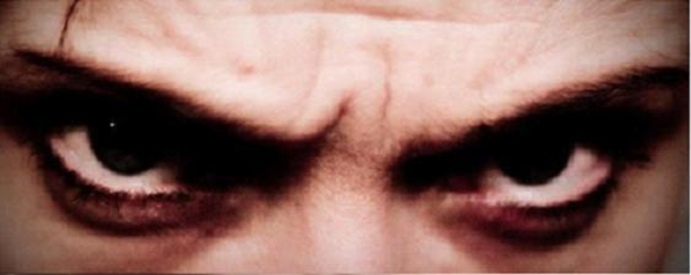
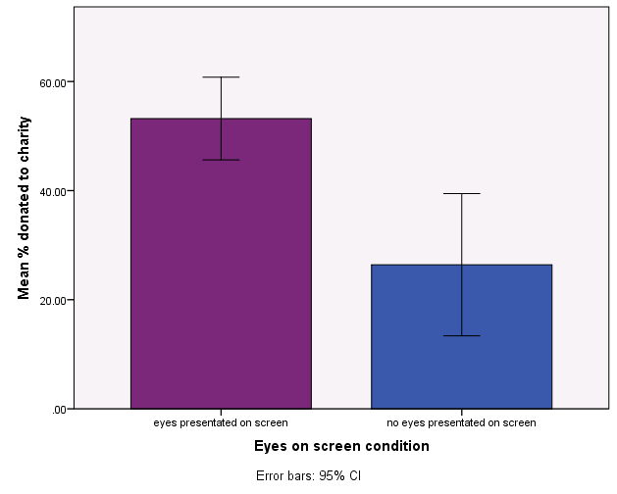
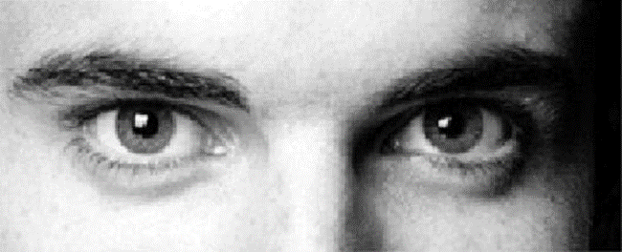
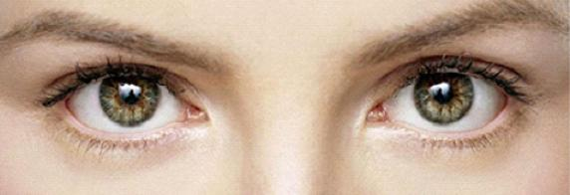
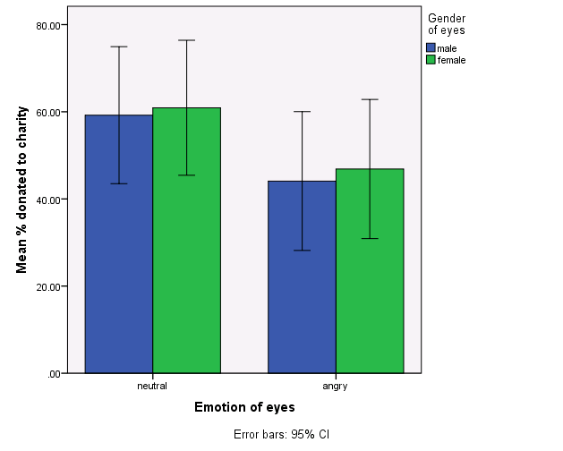
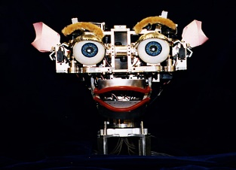
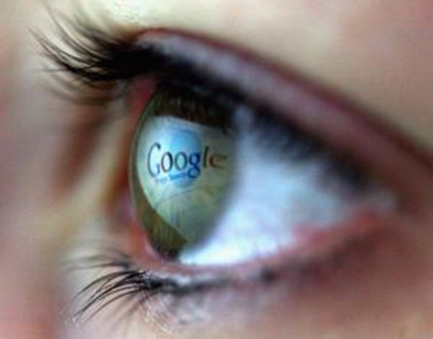
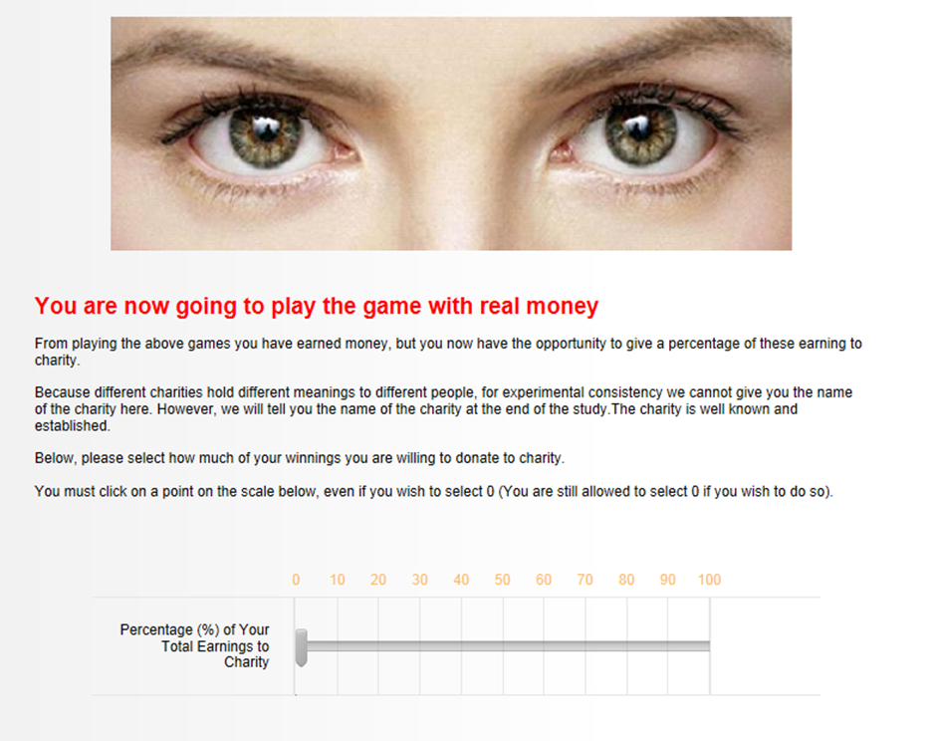
The emotion of eyes presented on charitable websites impact on giving behaviour -
Angry eyes decrease charitable giving
Dr Wendy Iredale
Canterbury Christ Church University
Background
Results
Although online activity is increasing, the amount of money that is donated online is decreasing (ONS, 2013). Research suggests that online donations may be lower because the donations are not observed by others (Van vugt & Hardy, 2010).
One way in which people can ‘feel as though they are being watched’ is by presenting them with photographs of eyes. Photographs of eyes have been shown to reduce crime, increase honesty behaviour and to increase charitable donations in lab and field experiments (Bateson, et al, 2006; Haley & Fessler, 2005; Nettle, et al 2012; Nettle et al, 2013; Powell et al, 2012 ).
Being seen to help others may explain why people give to charity in the absence of kin or reciprocal benefits (Hardy & Van Vugt, 2006; Roberts, 1998).
This is consistent with research which has shown that people are more likely to act in a pro-social manner when in the presence of eyes (Ekström, 2011) and when reputation is at stake (Izuma, 2012, Kratky et al, 2016).
By making people feel as though they are being watched, costly signalling theory can aid charities increase donations (Zahavi, 1977). Even computerised eyes presented on computer screens have been shown to increase generosity behaviour (Burnham & Hare, 2007).
However, very little has been done to explore the characteristics of these eyes, and yet we know that gender (Barclay, 2010, Farrelly, et al 2007, Iredale et al, 2008, Phillips, 2010 ) and emotion (Webb & Wong, 2014) both play a role in initiating altruistic acts.
This study tests whether the characteristics of eyes presented on screen in terms of gender (male/ female) and emotion (angry/ neutral) would impact on peoples willingness to give to charity.
Three main hypotheses were tested:
Hypothesis 1 – eyes on screen would illicit higher charitable donations
Hypothesis 2 - the gender of the eyes would impact on charitable donations
Hypothesis 3 – the emotion of the eyes would impact on charitable donations
People gave significantly more to charity when eyes were presented on screen (M = 53.21, SD = 35.34) compared to when no eyes were presented on screen (M = 26.42 , SD = 30.88), F(1, 109) = 11.27, p = 0.001. See figure 1.
Figure 1. Higher % of donations made when eyes
presented on screen
Figure 2. Higher % of donations when eyes presented on screen were not angry compared to angry eyes
Donations were significantly higher when the eyes were neutral and not angry (M = 60.07, SD = 35.70) compared with angry (M = 45.51, SD = 34.61), F(1,83) = 3.68, p = 0.05. See figure 2. Gender of the eyes did not significantly affect charity donations, F( 1,83) = 0.70, p = 0.80 nor was there an interaction between emotion and gender of eyes presented on screen, F(1,83) = = 0.01, p = 0.94.
No eyes presented
Eyes presented on screen increase charity donations. Although the gender of the eyes presented on screen did not impact on donations, the emotional expression of eyes did.
Aggressive eyes were less effective at eliciting charitable donations and suggest that charities should use non aggressive eyes on websites when encouraging donations.
Method
Conclusions and Implications
To test whether the emotion (angry vs. neutral) and gender (male vs. female) of eyes affects charity donations, 111 participants played economic games in which they could earn money (up to £3).
On completion of these games, a computer screen presented participants with a photograph of either angry eyes (male or female), neutral eyes (male or female) or none, and asked participants if they would like to donate a percentage of their earnings to an anonymous charity.
Acknowledgements
With special thanks to Ruhul Khan and Stephanie Peek, MSc Psychology students at the University of Kent who collected the data
References
Barclay, P. (2010). Altruism as a courtship display: Some effects of third‐party generosity on audience perceptions. British Journal of Psychology, 101(1), 123-135.
Bateson, M., Nettle, D., & Roberts, G. (2006). Cues of being watched enhance cooperation in a real world setting. Biology letters, 2, 412- 14. doi:10.1098/rsbl.2006.0509
Burnham, T. C., & Hare, B. (2007). Engineering human cooperation: Does involuntary neural activation increase public goods contributions? Human Nature, 18(2), 88-108. doi:10.1007/s12110-007-9012-2
Ekström, M. (2011). Do watching eyes affect charitable giving? Evidence from a field experiment. Experimental Economies, 15(3), 530-546. doi: 10.1007/s10683-011-9312-6
Farrelly, D., Lazarus, J., and Roberts, G. (2007). Altruists attract. Evolutionary Psychology, 5, 313-329.
Haley, J. J., & Fessler. C. M. T. (2005) Nobody‘s watching? Subtle cues affect generosity in an anonymous economic game. Evolution and Human Behaviour, 26, 245-256.
Hardy, C., & Van Vugt, M. (2006). Nice guys finish first: The competitive altruism hypothesis. Personality and Social Psychology Bulletin, 32, 1402-1413
Iredale, W., Van Vugt, M., & Dunbar, R. (2008). Showing off in humans: Male generosity as a mating signal. Evolutionary Psychology, 6(3), 147470490800600302.
Izuma, K. (2012). The social neuroscience of reputation. Neuroscience Research, 72(4), 283-288. doi: S0168010212000041
Krátký, J., McGraw, J. J., Xygalatas, D., Mitkidis, P., & Reddish, P. (2016). It Depends Who Is Watching You: 3-D Agent Cues Increase Fairness. PloS one, 11(2), e0148845.
Nettle, D., Harper, Z., Kidson, A., Stone, R., Penton-Voak, I. S., & Bateson, M. (2013). The watching eyes effect in the Dictator Game: it's not how much you give, it's being seen to give something. Evolution and Human Behavior, 34(1), 35-40.
Nettle D., Nott K. & M. Bateson (2012) ‘Cycle Thieves, We Are Watching You’: Impact of a Simple Signage Intervention against Bicycle Theft. PLoS ONE 7(12): e51738
Office for National Statistics (2013). Internet Access – Households and Individuals, 2012 part 2. Retrieved from http://www.ons.gov.uk/ons/rel/rdit2/internet-access---households-and-individuals/2012-part-2/stb-ia-2012part2.html
Phillips, T., Barnard, C., Ferguson, E., & Reader, T. (2008). Do humans prefer altruistic mates? Testing a link between sexual selection and altruism
towards non-relatives. British Journal of Psychology, 99, 555-572
Powell, K. L., Roberts, G., & Nettle, D. (2012). Eye images increase charitable donations: Evidence from an opportunistic field experiment in a supermarket. Ethology, 118(11), 1096-1101.
Van Vugt, M., & Hardy, C. L. (2010). Cooperation for reputation: Wasteful contributions as costly signals in public goods. Group Processes & Intergroup Relations, 13(1), 101-111. doi:10.1177/1368430209342258
Webb, D., & Wong, J. (2014). Exploring antecedents of charitable giving and their impact on subjective well-being in Singapore. Social Indicators Research, 117(1), 65-87. doi: 10.1007/s11205-013-0331-x
Zahavi, A. (1977). The cost of honesty (further remarks on the handicap principle.
Journal of theoretical Biology, 67, 603-605
CCCU

