Slide 1
Accessing Slow Food Earth Markets: challenges and opportunities
Dr Zanda Serdane, Canterbury Christ Church University, UK
Dr Ana Isabel Polo Peña, University of Granada, Spain
Dr Adenike D. Adebayo, Liverpool John Moores University, UK
Dr Burcin Hatipoglu, UNSW Canberra, Australia

Slide 2
Slow Food concept
A global, grassroots organization, founded in 1989 to prevent the disappearance of local food cultures and traditions, counteract the rise of fast life and combat people’s dwindling interest in the food they eat.
A global movement involving millions of people in over 160 countries, working to ensure everyone has access to good, clean and fair food.
(Slow Food, 2022)

Slide 3
Slow Food philosophy
Slow Food envisions a world in which all people can access and enjoy food that is good for them, good for those who grow it and good for the planet.
Our approach is based on a concept of food that is defined by three interconnected principles: good, clean and fair.
GOOD: quality, flavoursome and healthy food
CLEAN: production that does not harm the environment
FAIR: accessible prices for consumers and fair conditions and pay for producers
(Slow Food, 2024)

Slide 4
Slow Food critique
The language used in the official websites of five international food festivals, which are branded as ‘slow’ or which incorporate Slow Food elements, conveys the message of ‘prestige and status’ and ‘elitism’ (Frost and Laing, 2013)
‘The movement’s bourgeois appeal’ (Germov, Williams, and Freij, 2011)
Physical availability – limited
‘Fair price’ = expensive
Judgemental, dogmatic

Slide 5
Accessibility
Accessibility can be understood in terms of the measures put in place to address participation by those with impairments, both permanent and temporary, as well as both physical and mental, including perceived class and cultural barriers (Finkel, Sharp & Sweeney, 2019, p.2).
There is a call to consider accessibility from various perspectives – physical, social, cultural, economic and even political (Finkel & Dashper, 2020).

Slide 6
Accessibility barriers
Access is defined through the barriers that limit individual’s participation in an activity or event.
Physical
Financial
Psychological
Social
Information
Actual vs. Perceived

Slide 7
Slow Food Earth Markets
An international network of farmers markets that work in accordance with the principles of Slow Food
Accredited by Slow Food International
Established in 2004
104 accredited Earth Markets in 22 countries (January, 2025)
Spaces to build communities, create exchange and education.

Slide 8
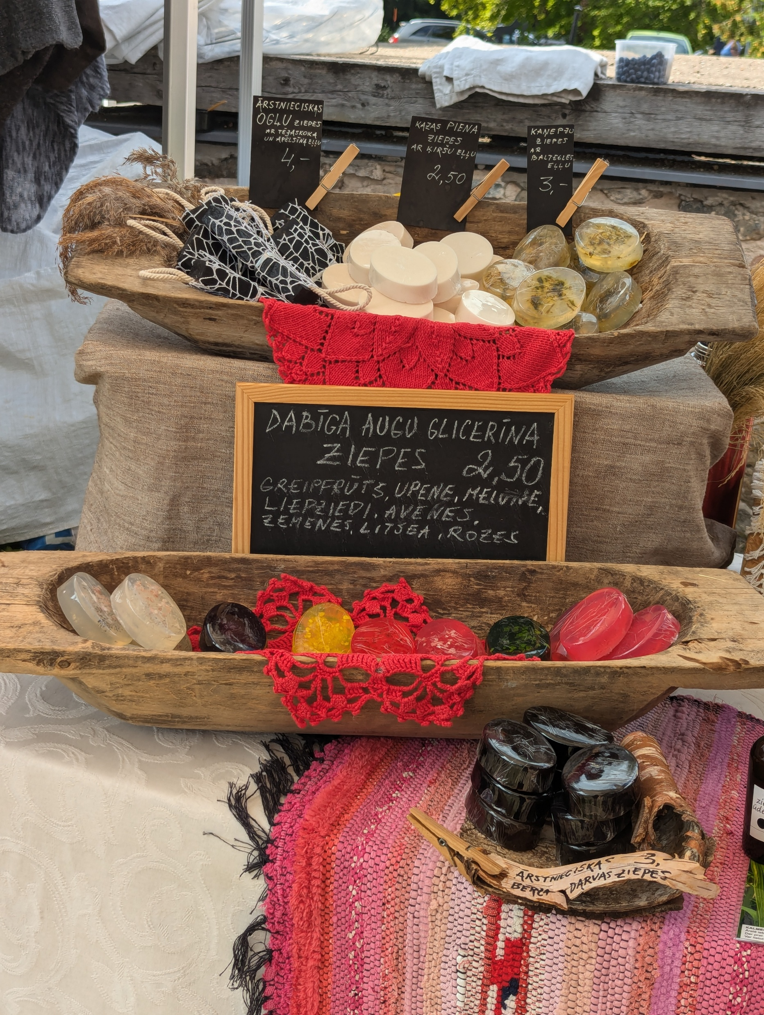
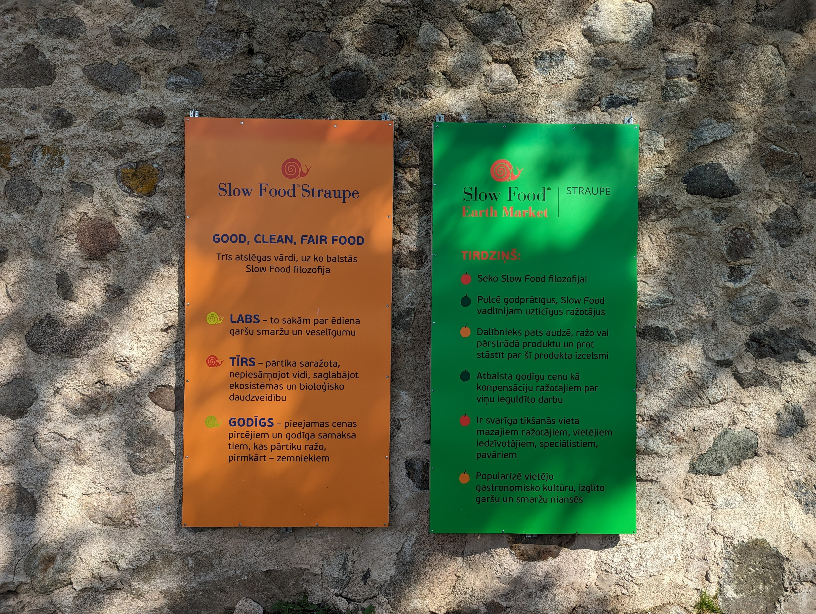
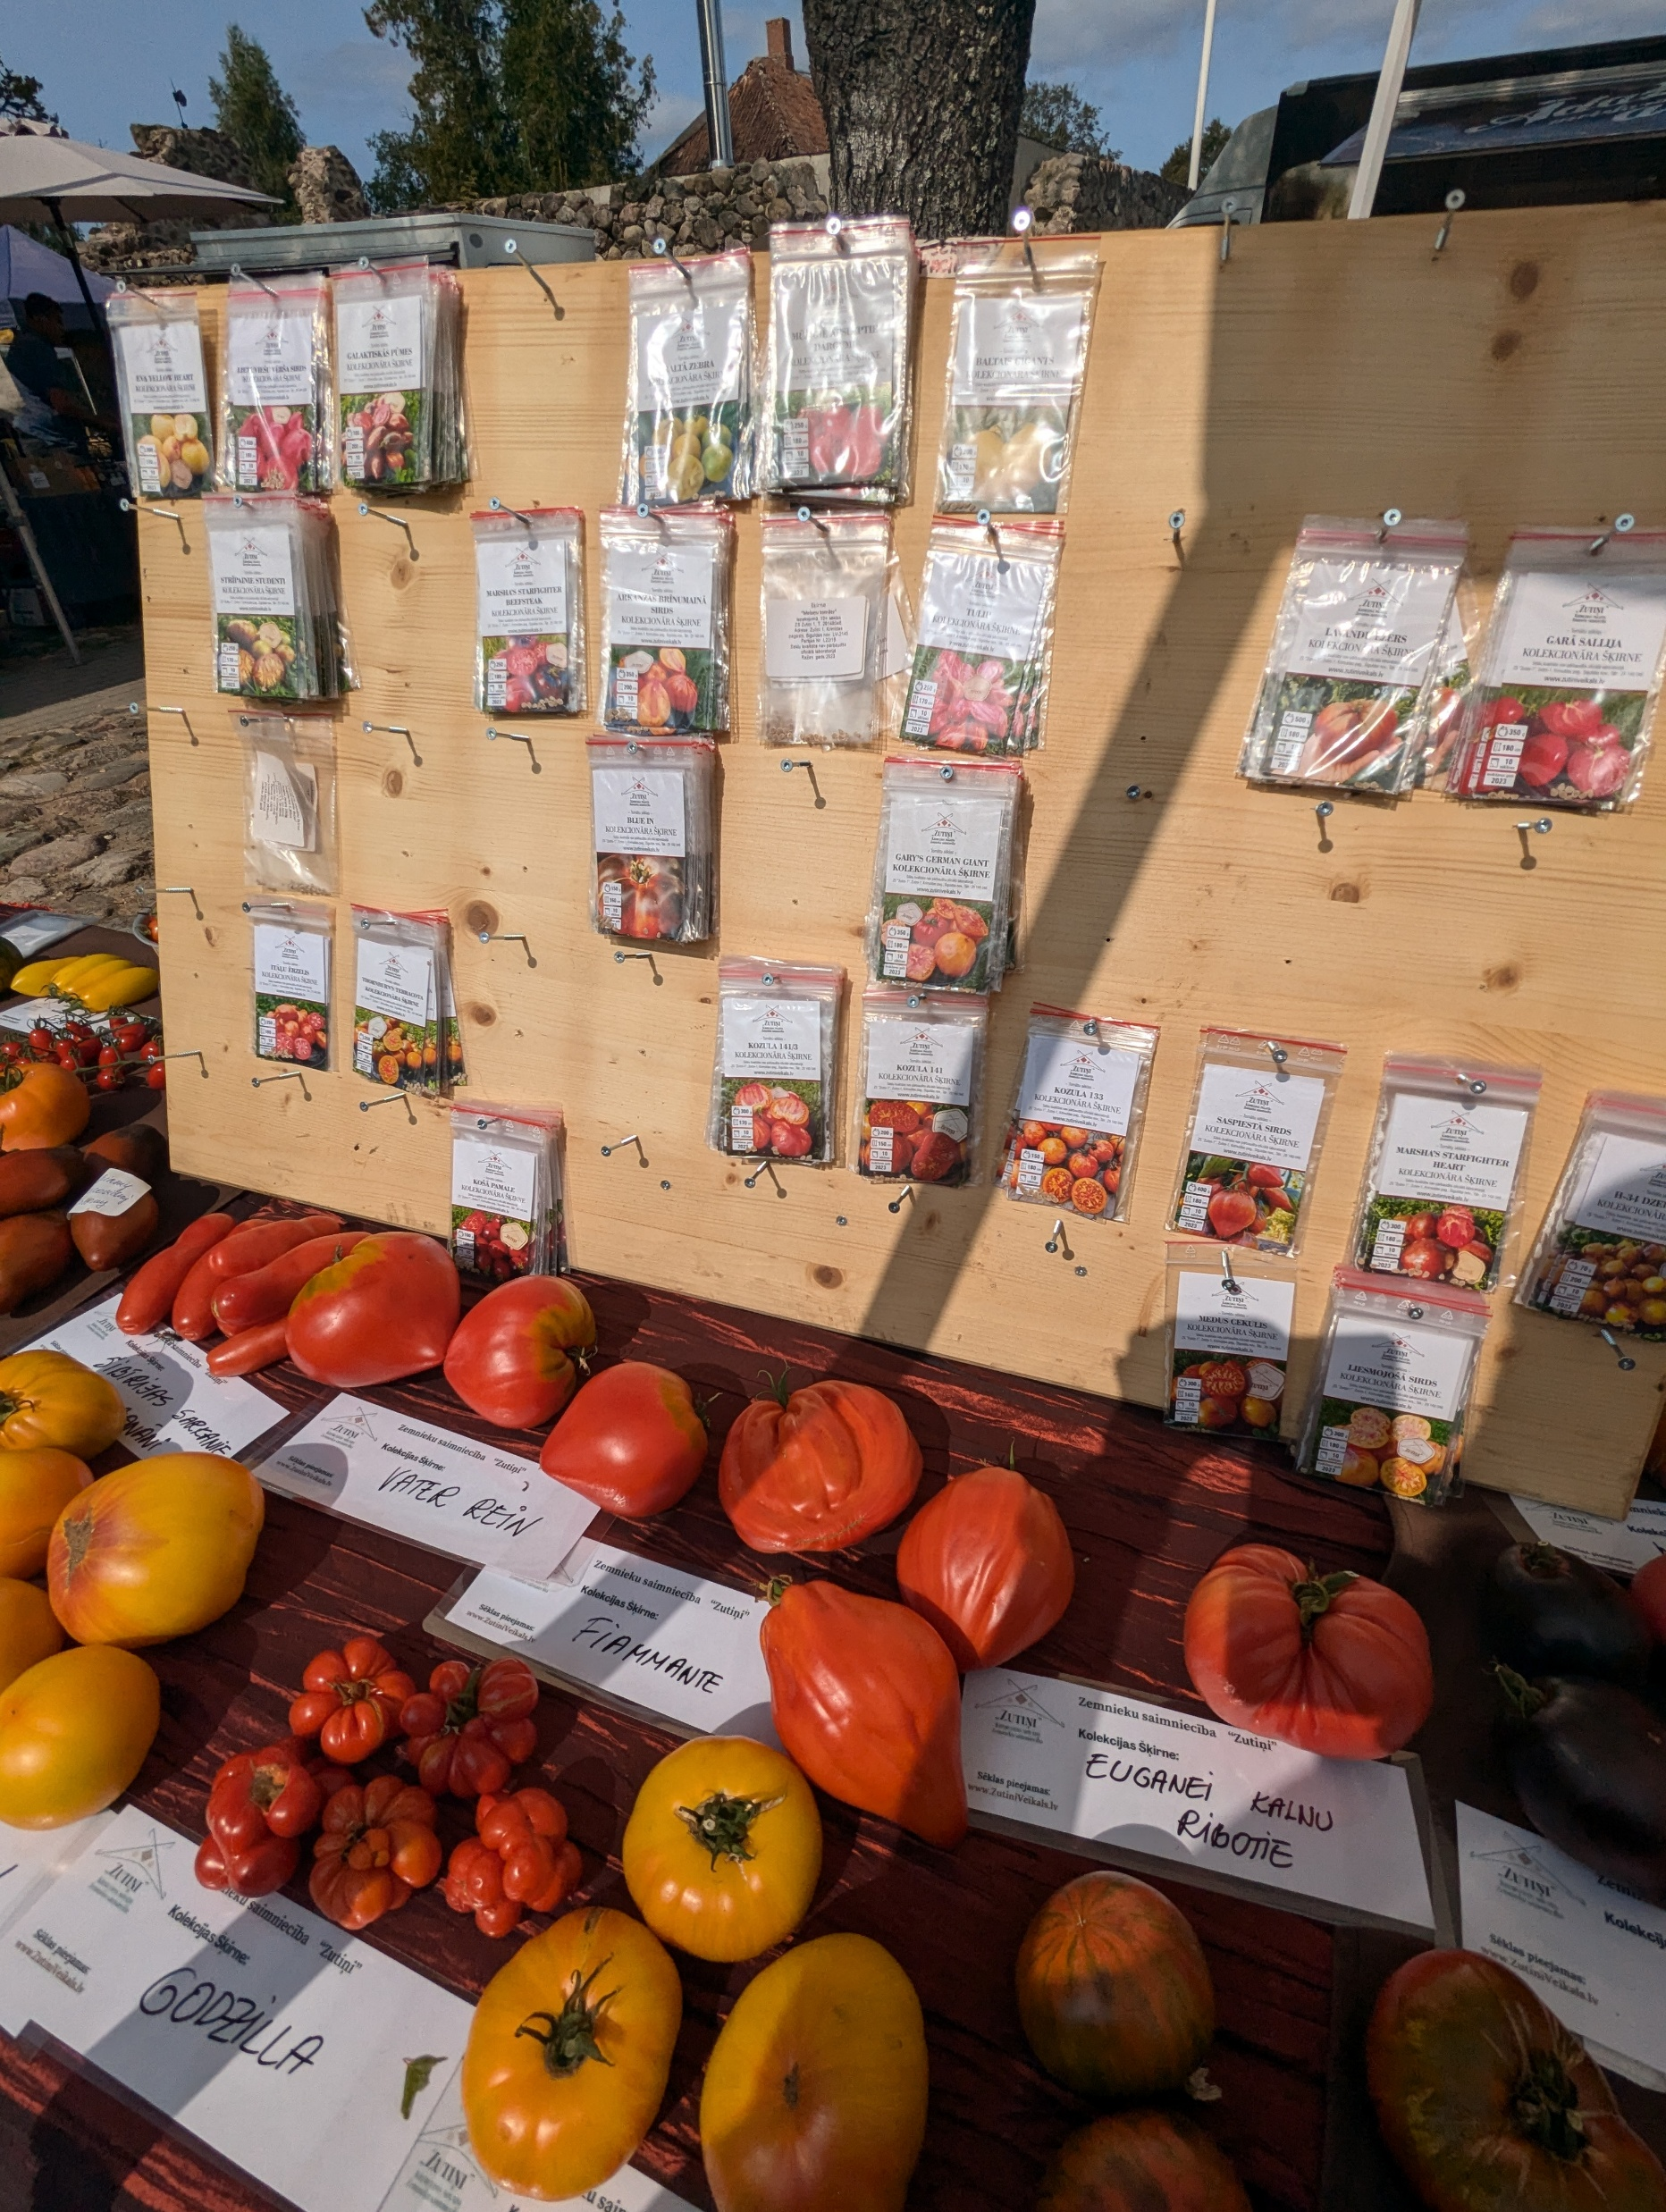
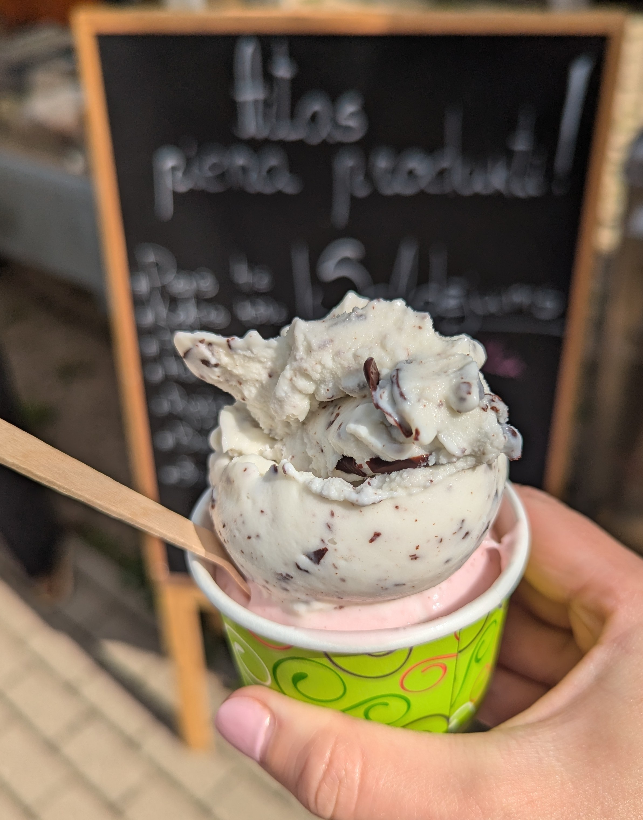
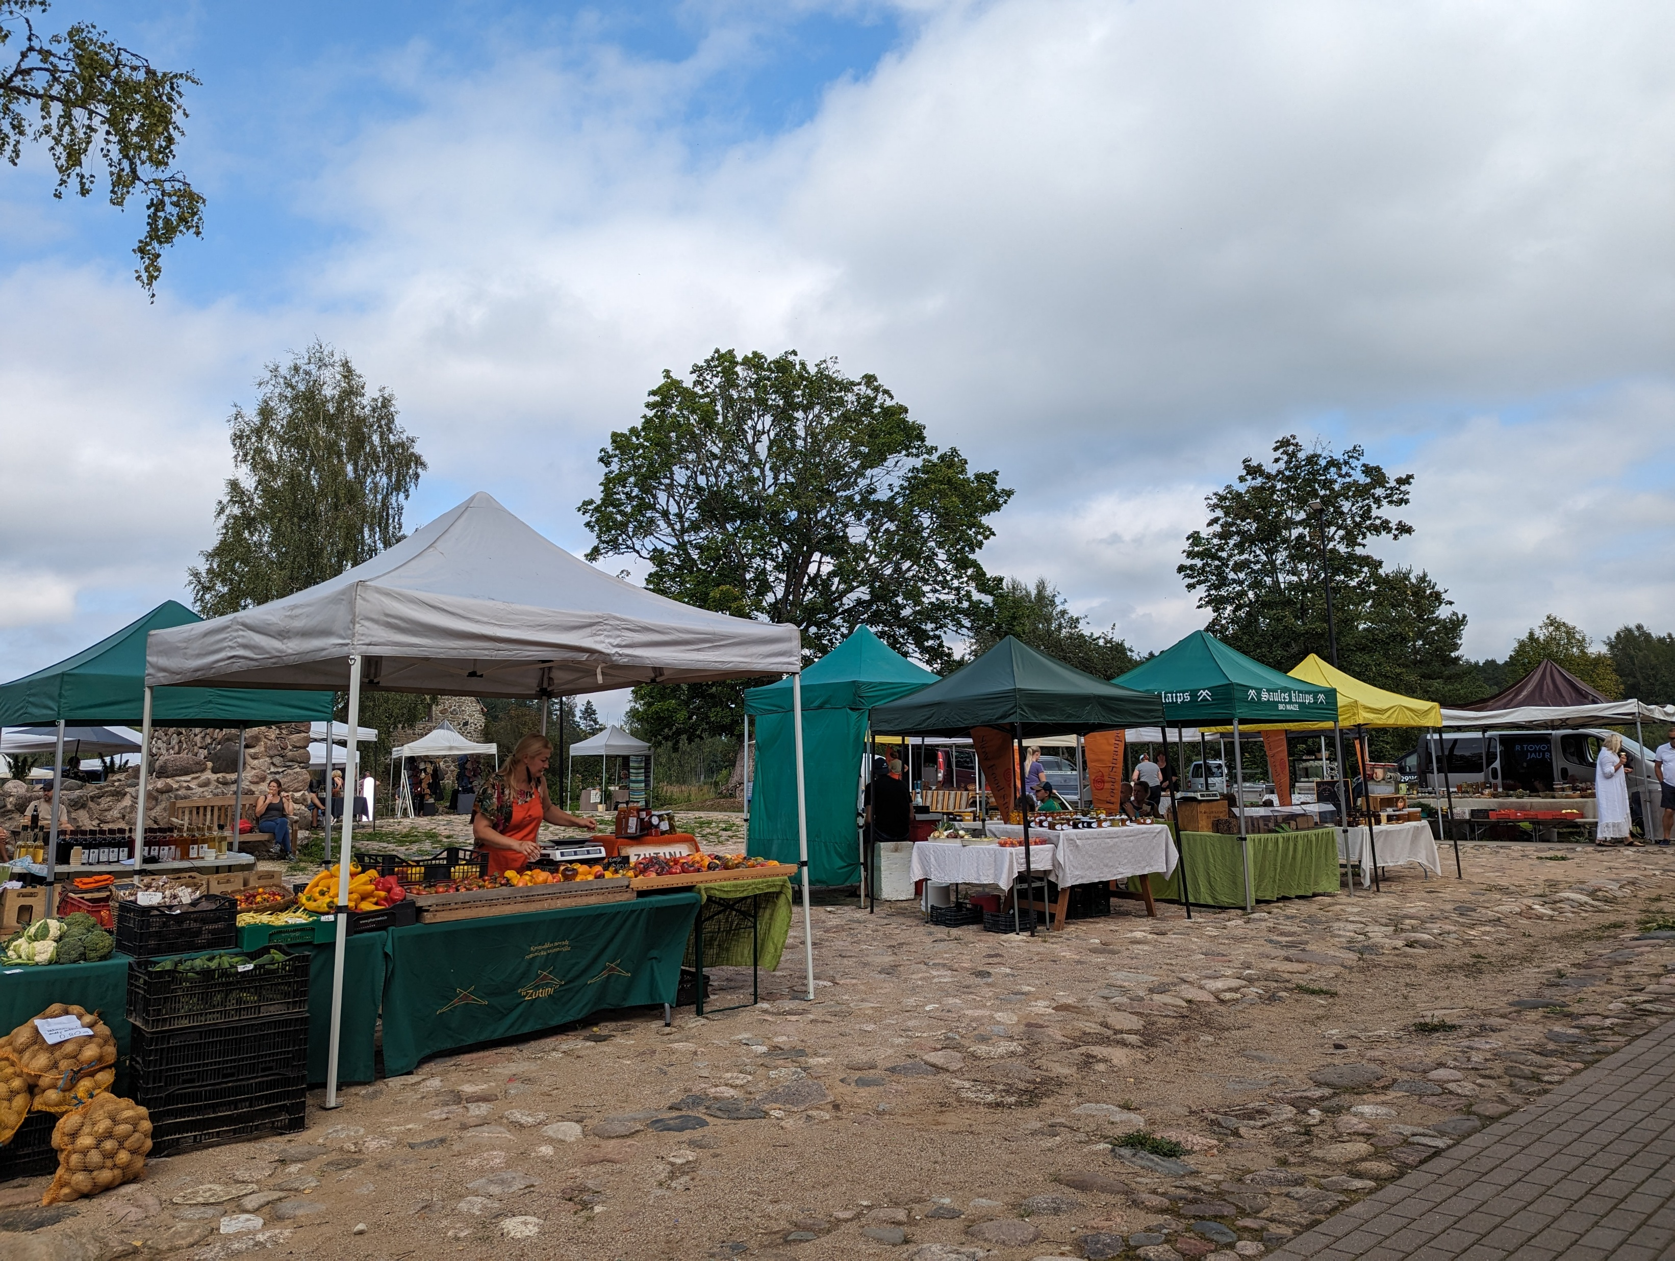
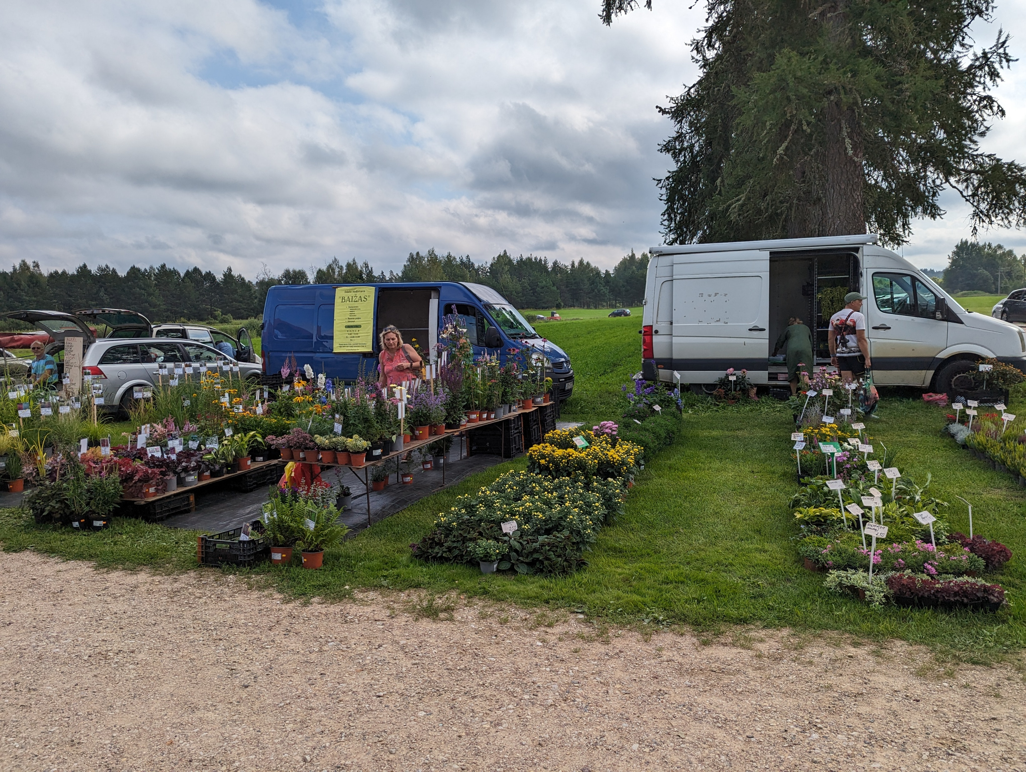

Slide 9
Research questions
What are the main accessibility barriers for Earth Markets?
How is accessibility understood in the context of Earth Markets?
How can the accessibility for of Earth Markets be improved?
For the purpose of this study, accessibility barrier is understood as anything that limits / prevents an individual’s participation in an event (in this case – Slow Food Earth Market).

Slide 10
Research design
Qualitative study
Inductive approach within an interpretivist paradigm
Data collection: January-March 2024
Interviews conducted in English, Latvian, Spanish, and Turkish
Thematic analysis
In-depth interviews with Earth Market organisers
Ten markets from nine countries:
Australia
Canada
Chile
Latvia
Mexico (2)
Spain
Tanzania
Turkey
Uganda

Slide 11
Findings: Understanding accessibility
Accessibility is an opportunity to participate in the market for producers and consumers.
Earth Markets are places where customers have an opportunity to access food that is healthy, nutritious, and meets the Slow Food criteria of good, clean, and fair.
The importance of location and financial accessibility.
Earth Markets provide direct access to food meaning that consumers can buy the food directly from the producer without intermediaries which makes it more affordable and hence accessible.

Slide 12
Findings: Audience
Very inclusive and open to any customer.
Tend to attract an audience that is more likely to be middle-aged, with medium to medium-high income, educated, and knowledgeable about food.
The customers are not necessarily affluent, but they are people who care about their health, sustainability, and the environment.
The customer base varies quite significantly across the markets from local, indigenous to ‘global’ customer base.
Local customers generally account for 80-90% of the visitor numbers for many markets
The proportion of tourists in the holiday season can reach up to 50% of the market visitors in some markets
The customer profile can change throughout the year, especially in the summer when locals go on holiday and more tourists visit the markets.

Slide 13
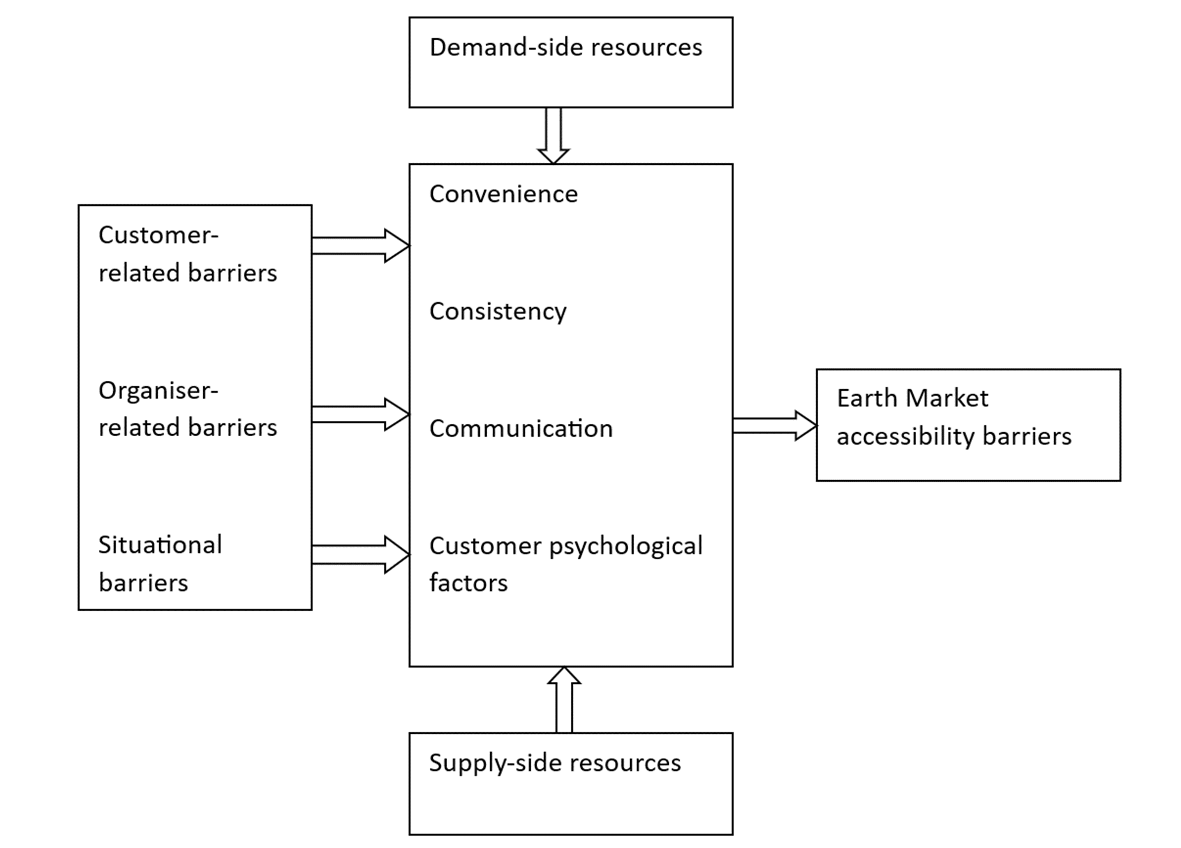
Findings: Accessibility barriers

Slide 14
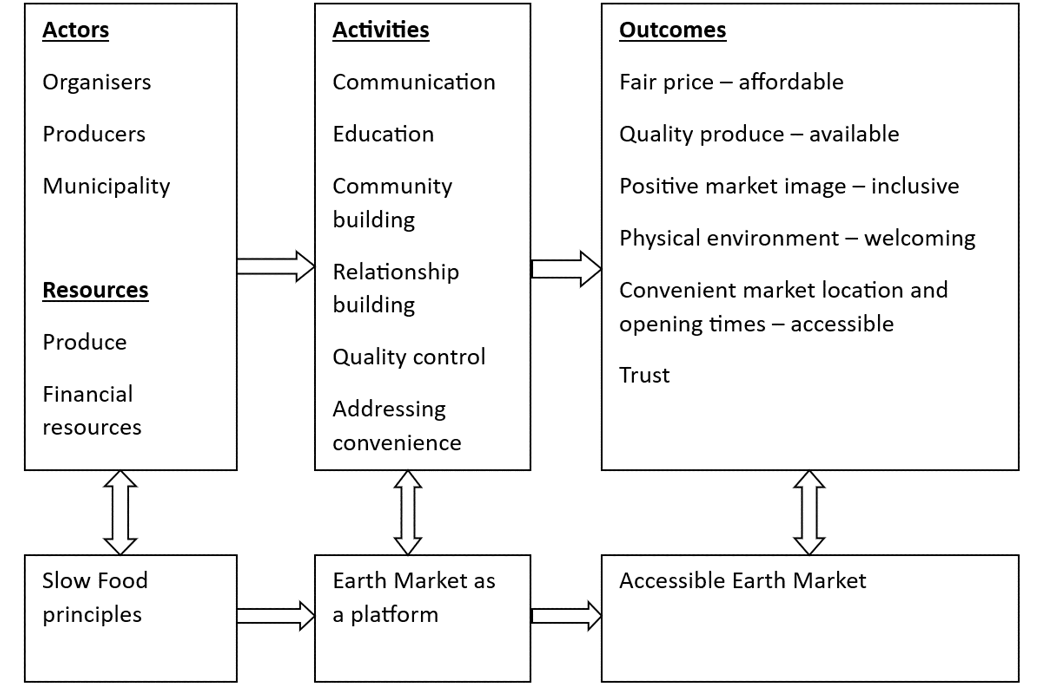
Findings: Accessibility enablers

Slide 15
Discussion
Changing customer base and need to cater for various audiences (e.g., residents, temporary residents, visitors).
Remaining authentic while also being inclusive and accessible to a variety of audiences.
Earth Markets as attractive tourism products offering authentic experiences.
Marketing communication – push or pull?

Slide 16
Zanda.Serdane@canterbury.ac.uk
Research Article (Open Access)
Serdane, Z., Polo Peña, A. I., Adebayo, A. D., & Hatipoglu, B. (2024). Accessing Slow Food Earth Markets: Barriers and Enablers. Tourism Planning & Development, 1–22. https://doi.org/10.1080/21568316.2024.2412065

