Slide 1
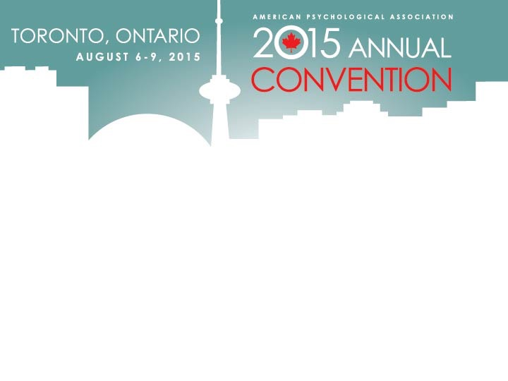
Applying Structured Techniques in a Problem Construction Task
Dr Ian Hocking (ian.hocking@canterbury.ac.uk)
and Dr David Vernon
Canterbury Christ Church University, UK
http://bit.ly/apacccu

Slide 2
Structured Techniques Ian Hocking and David Vernon
Canterbury Christ Church University, UK
Overview
Problem Construction/Finding
Are mental ‘tools’ helpful?
‘Yes’ but with caveats
Notes:
We’re going with the three part model of creativity here. Finding / generating solutions / selecting solutions
Some evidence that programmes are useful, but what about randomised control studies of tools themselves?
Tools could help by breaking schemata; providing resource support; giving expertise

Slide 3
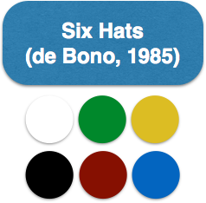
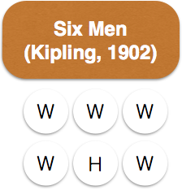
🎩
Participant puts on metaphorical hats coloured white, green, yellow, black, red, blue (for information, creativity, positives, negatives, emotions, meta)
👤
Participant applies the question words who, what, when, where, how and why

Slide 4
★ p < 0.05
Study 1 Can 🎩 or 👤 boost problem finding against a non-intervention control?
★★ p < 0.01
• p = 0.079
Training
Six Hats (34) 🎩
Six Men (32) 👤
Control
(34)
Testing
I’m in a new city and need dinner
Fluency
Quality
Originality
•
★★
★★
★
Study 1: Six Hats vs Six Men vs Control
Task: Problem construction scenario: ‘I’m in a new city and need dinner’
Six Hats (metaphorical ‘creativity’ caps); Six Men (qustion words)
Compared to control, tols helped originality and fluency, not quality
Notes:
Suggestion that Six Men better mainly helps fluency
Six Hats better for originality, but Six Men still useful for this
But is the control group a meaningful comparison?
It could be:
Placebo
Forced iteration (of at least six elements in the structured conditions)
We investigated this by creating a placebo condition that had the forced iterative element: ‘brain breathing’
Notes
Staff based sample; higher mean age; likely to be a little more intrinsically motivated

Slide 5
What if we change the non-intervention control (an article about memory) to a sham technique matched for:
Structure: 6 elements
Belief: Ps think this is a creativity technique
Is it just as good?

Slide 6
Study 2 Can 🎩 or 👤 boost problem finding against a sham technique?
★★ p < 0.01
✪✪ p < 0.01 post hoc
Training
Six Hats (40) 🎩
Six Men (40) 👤
Sham
(38)
Testing
I’m in a new city and need dinner
Fluency
Quality
Originality
Flexibility
★★
✪✪
★★
✪✪
★★
✪✪
★★
Notes:
Six Men comes out on top in this study; Six Hats comes in second place
The important thing is that structure and placebo aren’t enough; some element of the technique independent of structure and placebo is helping
Notes
New measure of orignality (sample-based – how infrequent is this in the sample?)
Student sample, lower mean age; perhaps less intrinsically motivated

Slide 7
Conclusions Structure and belief useful; fit goes beyond sham
👤 boosted fluency, originality and flexibility in both studies
🎩 boosted originality in both studies; but no boost for fluency or flexibility against sham
Perhaps participants need not only structure, or belief, but elements that fit the scenario best (👤)
‘Fitting’ tools may help break schemata; reduce resource overhead; ‘loan’ expertise
Ease of use may be crucial (👤 rated easiest)

Slide 8
References
Baer, J., & Kaufman, J. C. (2005). Bridging generality and specificity: The amusement park theoretical (APT) model of creativity. Roeper Review, 27(3), 158-163.
Bartlett, F. C. (1932). Remembering. New York, NY: Cambridge University Press.
de Bono, E. (2009). Six thinking hats. London: Penguin.
Paletz, S. B. F., & Peng, K. (2009). Problem finding and contradiction: Examining the relationship between naive dialectical thinking, ethnicity, and creativity. Creativity Research Journal, 21(2), 1–13.
Vernon, D. & Hocking, I. (2014). Thinking hats and good men: Structured techniques in a problem finding task. Thinking Skills and Creativity, 14, 41-46.

Slide 9
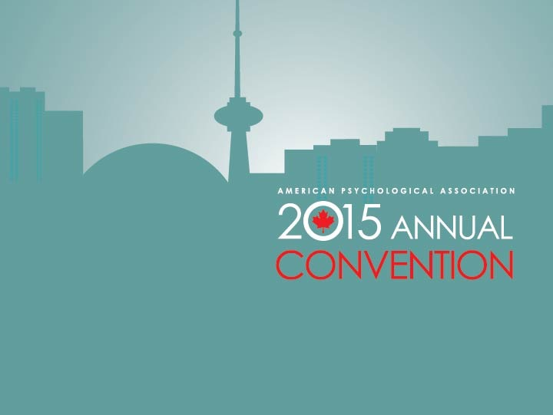
Dr Ian Hocking
Canterbury Christ Church University, UK
www.canterbury.ac.uk
ian.hocking@canterbury.ac.uk

