Slide 1
Using Wikis For Group Work/Collaboration
Joanne Woodman
Department of Media
Faculty of Arts and Humanities Conference on Using TEL to Enhance the student experience

Slide 2
Structure
Background and Basics
Student Work
Student Comments
Reflection
Stop me any time for questions

Slide 3
What is a Wiki? Why Blackboard?
A web page where people can add pages, links, materials and comments.
The Blackboard wiki is Safe
You can export your work as a .zip file use it as a portfolio, or share it over the web.
Notes:
backed up every night and under our control so will not vanish.

Slide 4
Background Wiki used on Public Relations Level 6 Module
Students work in groups to create a Public Relations Campaign
Group Presentation of Campaign Materials
Individual Report (discussing rationale and theoretical underpinning, critical analysis of the group work)
Group work done via the wiki
All students can contribute
Tutor can monitor contributions
Notes:
Students complained of not being able to meet up (combined honours timetable clash,working on days not in uni) people not contributing, not having access to other people’s materials.
Asked glenis to help me set upa a discussion board and she terrifyingly suggested a wiki – what’s that???? I asked very scared a web page where everyone can add what they want – let me come and show you – it will only take 5 minutes – this was the best thing that ever happened to me and my groups

Slide 5
Mission Statement
Sample Student Work on wiki
New Mission Statement
Here at French Connection it is not only our responsibility to provide a fashion-forward range of clothing, but also to promote health and wellbeing for our customers and to those who work for the French Connection brand. Whilst expressing our unique design and a true sense of style we provide a safe shopping and working environments. Our aim is to keep the customers feeling beautiful on the inside and stylish on the outside.
Notes:
. . . We have changed our mission statement to reflect the new attitude of french connection. Having an emphasis to ‘promote health and wellbeing’ and have the ‘aim to keep the customers feeling beautiful on the inside and stylish on the outside’

Slide 6
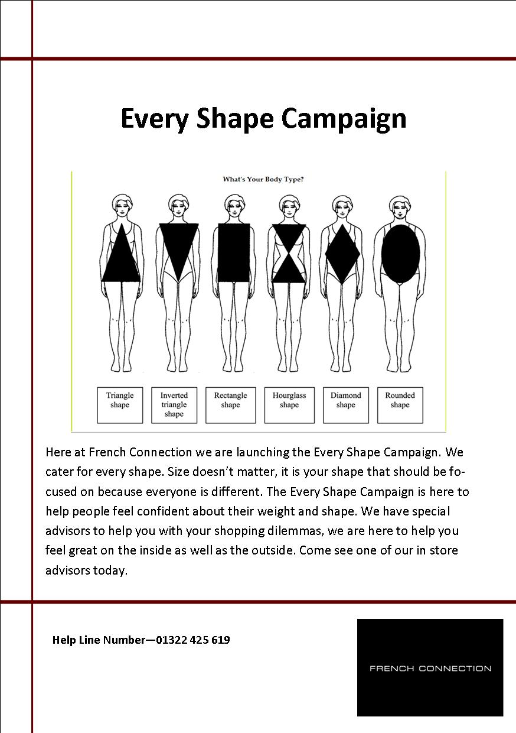
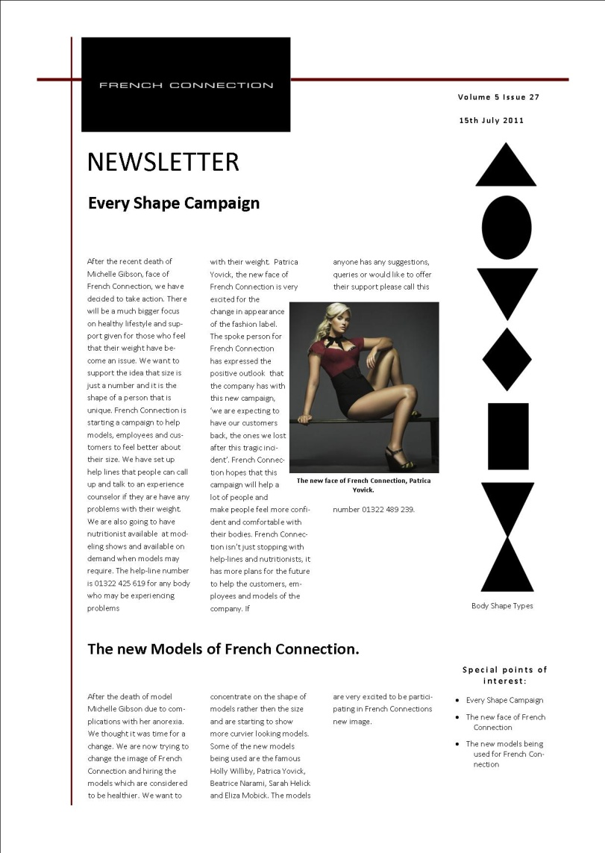
Leaflet and Newsletter
Notes:
Newsletter a more corporate and professional look whereas the leaflet is meant to look more friendly.

Slide 7
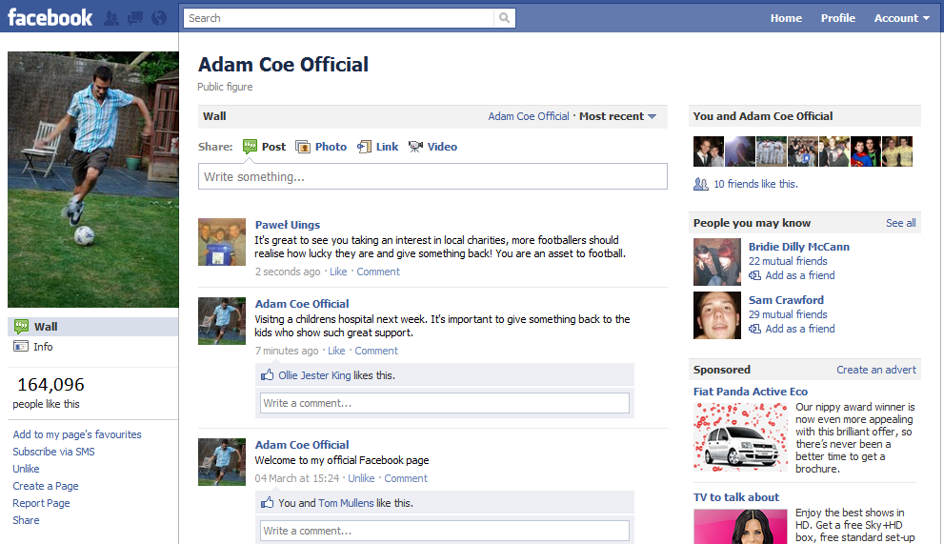
Social Networking
‘Social Networks allow companies to cross boundaries’ (Breakenbridge, 2008) Mock up of Crisis management Campaign for a fictional footballer

Slide 8
Strategy
‘
What should we do, say and why?’
(Broom, 2009, p.287)
Mission Statement
Logo
Press Release
Website
Leaflet
Billboard
“Non-personal channels of broadcasting a message to the general public, principally the national newspapers, radio, and television. “ (Business Dictionary, 2011)
Notes:
Josh
Speak about our chosen media forms...what we have chosen and why we have chosen them.

Slide 9
Bibliography
Broom, G. (2009) Cutlip & Center’s Effective Public Relations. 10th edn. London: Pearson.
Cutlip, S. M. et al (2000) in Tench, R. & Yeomans, L. (2009), Exploring Public Relations. 2nd edn. Harlow: Pearson.
Davies, A. (2007), Mastering Public Relations. 2nd edn. Hampshire: Palgrave Macmillan.
Heath, R. (2000), Handbook of Public Relations, London: SAGE.
Macnamara, J. R. (1992) in Tench, R. & Yeomans, L. (2009), Exploring Public Relations. 2nd edn. Harlow: Pearson.
Oliver, S. (2010) Public Relations Strategy, 3rd edn. London: Kogan Page.
Regester, M. And Larkin, J. (2008), Risk Issues and Crisis Management in Public Relations. 4th Ed. London and Philadelphia: Kogan Page.
Tench, R. & Yeomans, L. (2009), Exploring Public Relations. 2nd edn. Harlow: Pearson.
Unilever (no date) Available at: http://www.unilever.co.uk/aboutus/purposeandprinciples/?WT.LHNAV=Purpose_&_principles (Accessed: 29 January 2011).

Slide 10
The Wiki

Slide 11
Student Feedback
After the seminar we had no problem using it
Very helpful in our group work, we still used email but great for sharing bigger files and user friendly
the wiki helped group work to be more organised as if there were any documents or materials needed it was in one access place.
At first I was dubious about the Wiki and whether it would work or whether it would be just one member posting like the one member sending numerous e -mails to find/contact the other members, however this was not the case. All the group members interacted, I think this is partly the case of the Wiki being an interactive tool and so easy to use.

Slide 12
Student Comments
It was much easier to email you and ask you check on our progress and provide us with feedback rather than trying to arrange a tutorial that every group member could attend.
Many times you emailed/posted feedback without us asking as you could see when we posted things

Slide 13
Student Comments
we could keep track of what stage we were at, how much work we had done, and how much there was still left to do.
it encouraged everyone to contribute as the rest of the group- and you the lecturer were able to see how much time and effort each person was dedicating to the project. PR is the only module where I have ever used a wiki, and I think students should be encouraged to use them for all group work projects.

Slide 14
Reflection
Easy to set up and Manage (but include this as seminar activity and assess usage/contributions to encourage use)
Virtual Group –facilitates collaboration - Students don’t have to always meet physically
Facilitates feedback and improved performance
Can get cluttered – advise groups to create headings
Manage student expectations re feedback – some students expected feedback instantly

