Slide 1
COMMEMORATION & SACRIFICE
ST. GREGORY’S WAR MEMORIAL & THE GREAT WAR

Slide 2
COMMUNION & SACRIFICE
St. Gregory the Great consecrated as a new parish church in 1852
Designed by George Gilbert Scott and dedicated to Archbishop William Howley
Great War Memorial commissioned for the fallen of the parish
144 Names are eventually added to the Memorial
Memorial saved after the damage caused by the Baedecker raid on Canterbury in June 1942
Church re-opened in February 1944 – fully functional from 1949
1975/76 Parish absorbed into new All Saints parish, based on the former garrison church of St. Albans in Military road.
Final service held 31 October 1976
Canterbury Christ Church University - Concert hall with War Memorial preserved

Slide 3
COMMUNION & SACRIFICE
144 names recorded on Memorial - 123 records traced – 122 men and 1 woman
At least 15 were baptised in St. Gregory’s, and only 3, Edwin Axten (parents resided 27 St. Martin’s Road), George Argrave (previously of 36,Sturry Road) and Arthur Styles (parents 61, Sturry Road) were non-resident
1 Irishman, Samuel Howson, born Tipperary, enlisted in Canterbury before 1911
Records show 28 married 70 single
113 served in British army, including at least 7 regulars, plus 1 in Canadian Army and 1 in New Zealand Army
33 joined The Buffs – ( Royal East Kent Regiment) – local infantry unit
5 served Royal Navy, 1 Royal Flying Corps and 1 Queen Mary’s Army Auxiliary Corps
104 died in France/Flanders, 4 in Mesopotamia, 3 in India , 2 in Palestine, 2 in Gallipoli and 1 in Egypt

Slide 4
COMMUNION & SACRIFICE
108 dates of birth identified with average age at time of death 27 years
Oldest died on home service: George Cheeseman 5 July 1918, Royal Defence Corps, aged 62, of 40 Union Street leaving wife Clara and family.
Oldest died on overseas service: Charles Frederick Willey aged 44, of 21, Union Street, leaving wife Emma. France/Flanders 11 February 1915 whilst serving with 2 Bn The Buffs.
Youngest died at 17 years : Edward John O’Mahony, France/Flanders 13 October 1914, 1 Bn Royal Lancaster. Lewis Albert Lyons, 19 March 1915, of 37, St. Martin’s Road, France/Flanders, 8 Bn The Buffs. Cyril Arthur Gill, 26 May 1915, France/Flanders, 2 Bn The Buffs, Charles Bertram Maxted, 31 May 1916, of 5, Albion Terrace, HMS Black Prince. Frank William Powell, 30 September 1916, of 91, Military Road, France/Flanders, 7 Bn QORWK.

Slide 5
COMMUNION & SACRIFICE

Slide 6
Ethel Frances Mary parker
Daughter of William George Parker , 6, East Street, Sturry Road, Canterbury
Served as a waitress ( officially, ‘worker’) with Queen Mary’s Army Auxiliary Corps
Worked at Army base depots in Abbeville
Killed by a German air raid on the night of 29/30 May 1915, when a direct hit killed nine women sheltering in trenches at the women’s camp.
Commemorated at the Commonwealth War Graves Commission Cemetery adjacent to Abbeville Communal Cemetery.

Slide 7
Ethel Frances Mary Parker

Slide 8
Ethel Parker & Comrades

Slide 9
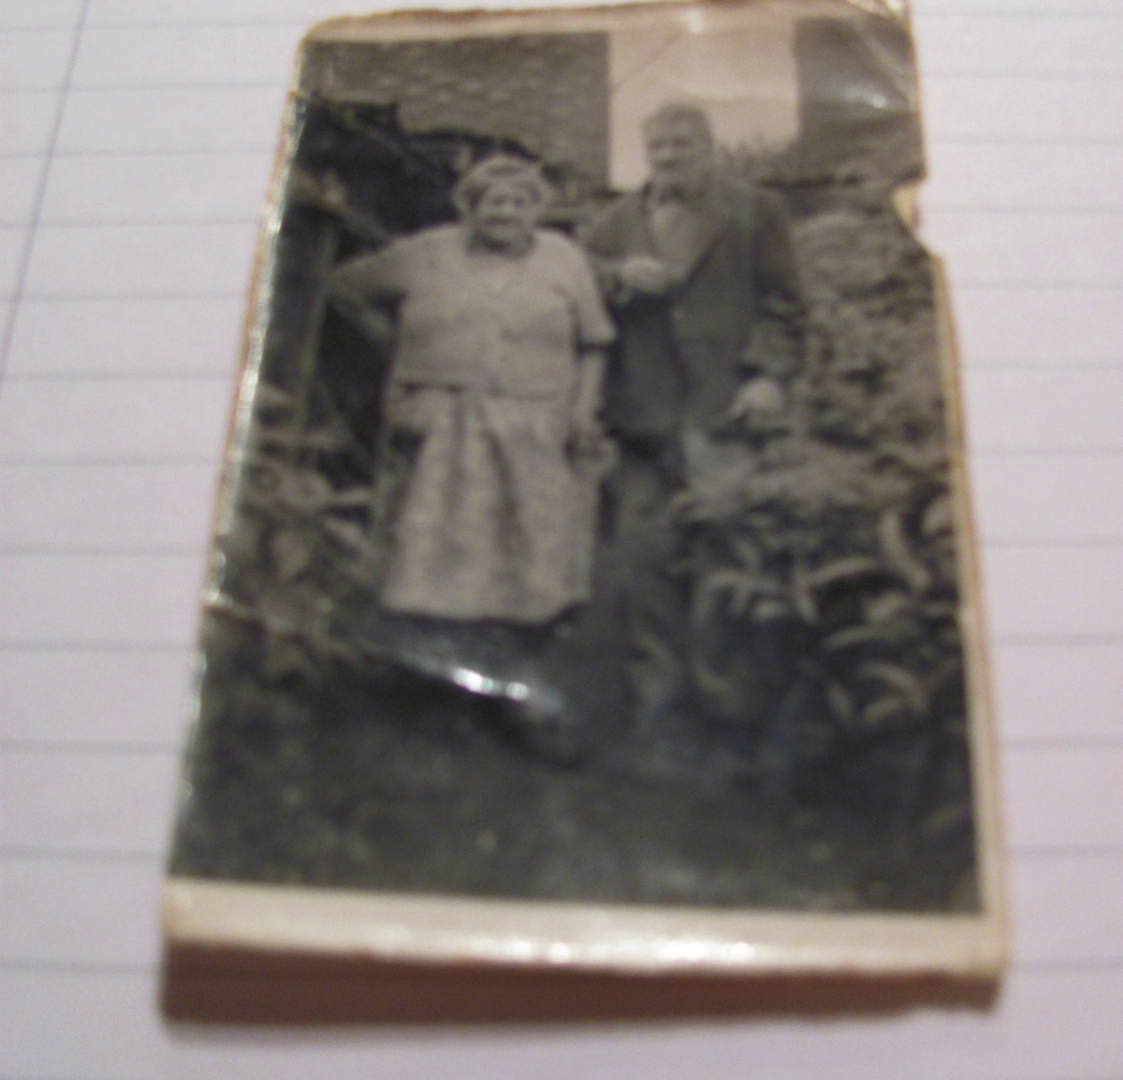
Thomas & William Gibbs Thomas & Edith Gibbs
Thomas a bricklayer. 2 sons 3 daughters, Violet, Ada & Rita.
Family lived at 15 Military Road

Slide 10
Thomas Walter Gibbs

Slide 11
Grenadier Guards Mess 1914

Slide 12
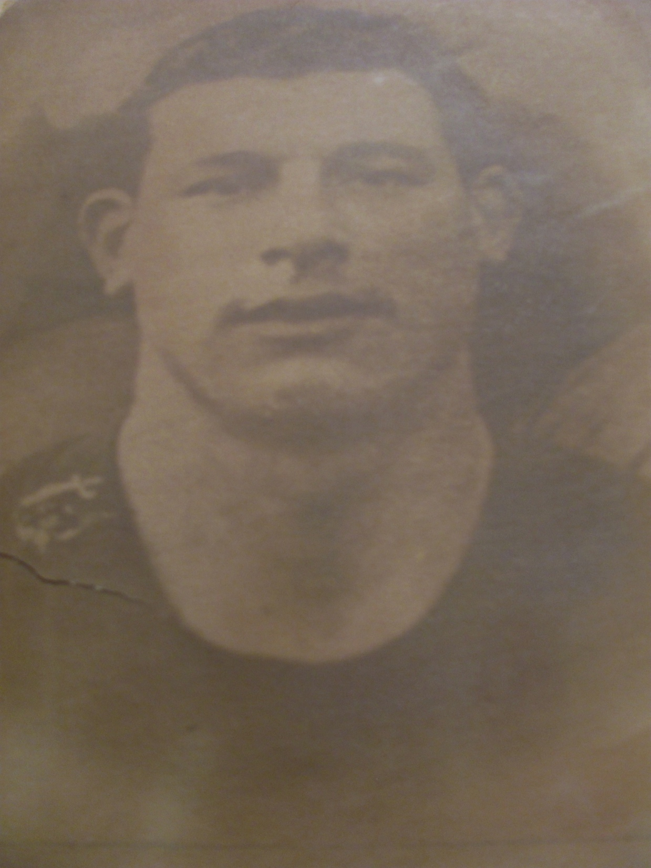
William & Thomas GIBBS
WILLIAM DIED OF WOUNDS 15 MAY 1919 EAST SURREY REGIMENT. AGED 19
THOMAS KILLED IN ACTION 5 NOVEMBER 1914 GRENADIER GUARDS. AGED 23.

Slide 13
EDWARD ‘MICK’ MANNOCK VC
Born 24 May 1887 Ballincolllig (Birth certificate shows Brighton)
1913 Secretary of Wellingborough Independent Labour Party
1914 Interred in Turkey whilst working as telephone engineer
1915 Repatriated due ill health and enlisted RAMC then commissioned RE
1916 August – joins Royal Flying Corps
1917 February joins 40 Sqn., July made Flight Commander & awarded MC
1917 October promoted Captain receives bar to MC. Home leave January 1918 with 23 ‘kills’.
1918 March to May takes total to 59 . Awarded DSO and Bar.
1918 June promoted Major and CO of 85 Sqn. Shot down 26 July and awarded posthumous VC

Slide 14
EDWARD ‘MICK’ MANNOCK VC

Slide 15
Hms black prince Sunk with all hands – 857 - at battle of Jutland 31 May 1916
Charles Bertram Maxted, Boy Telegraphist, 5 Albion Terrace, son of Fred & Emily

Slide 16
Arthur frederick styles late 61, sturry road canadian resident
Resided Quebec enlisted Quebec Regiment, killed in France 4 April 1918 aged 28
Canada’s population 1914 7.8 million
Canada’s Expeditionary Force sent overseas 425,821 including 25,000 conscripts Casualties: 209,412 including 59,680 killed

Slide 17
GEORGE PALMER ARGRAVE LATE 36, STURRY ROAD NEW ZEALAND RESIDENT
Resided Wellington enlisted Wellington Regiment, killed in Gallipoli 8 August 1915 aged 29. Mother Alice Maud.
New Zealand’s population 1914 1.15 million
N Z Expeditionary Force sent overseas 100,000 including 30,000 conscripts. Casualties: 60,000 including 18,000 killed

Slide 18
The buffs global service 1914 -1918

Slide 19
THE GREATEST LOSS THE LEMAR FAMILY 2 NORTH HOLMES ROAD
Parents Alfred James & Sarah Jane had five sons & two daughters. The youngest son, Joseph, was too young to serve in the war. All males in the household worked as domestic gardeners, with Alfred listed as ‘Head Gardener’ in 1911 census.
David Lemar, fourth son, served in the 1/18th Bn London Irish Rifles and was killed in France/Flanders on 7 April 1917, aged 21.
Frederick Lemar, second son, also served in the 1/18th Bn London Irish Rifles and was killed in France on 21 March 1918, aged 30.
Thomas Lemar, oldest son, served initially with The Buffs, then with 270 Company Machine Gun Corps based in Quetta, India, where he died of disease 14 October 1918, aged 33.

Slide 20
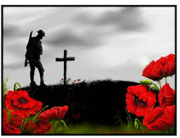
WE WILL REMEMBER THEM

