Slide 1
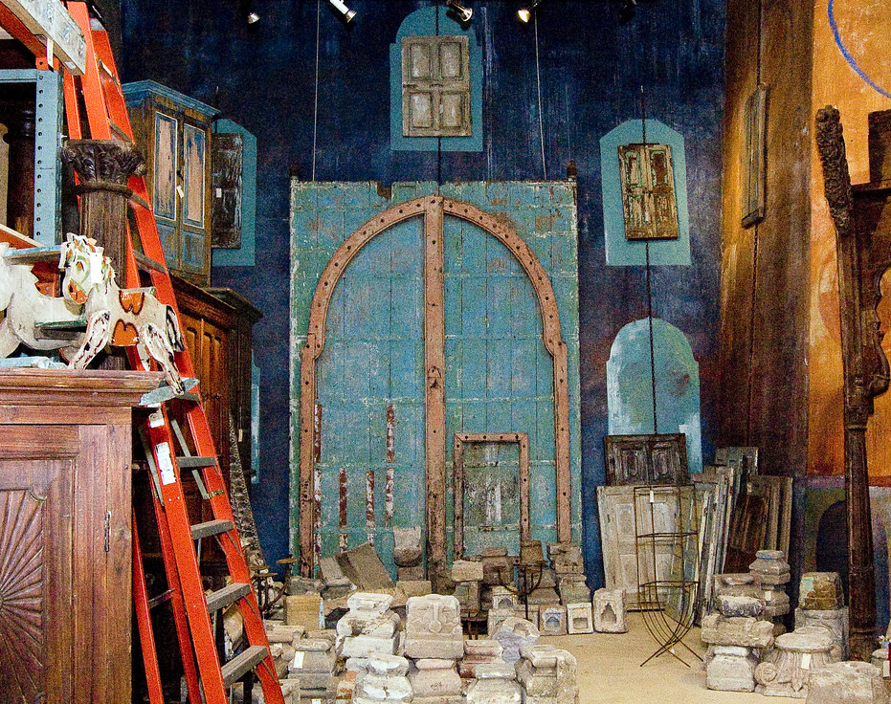
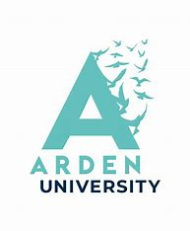
Objects are not just a thing (re)negotiating identity through using material objects within the Kurdish diaspora in the UK
Chra Rasheed Mahmud (Ph.D.)
Lecturer – Arden University
Research Associate – Canterbury Christ Church University
Notes:
Material belongings profoundly influence the formation of one's identity. They serve as crucial identity markers and tools for distinguishing among diverse communities, particularly for migrants.
Welcome, everyone, and thank you for joining me. I am delighted to present at the PGRA conference for the second time since I embarked on my Ph.D. journey.
In today’s talk, I will examine the role of material culture in identity negotiation, focusing on Kurdish migrants in the UK. This presentation explores how a group of Iraqi Kurds in the UK negotaiate, navigate and shape their cultural identity through their valued possessions.
Today’s discussion is a segment of a broader Ph.D. project investigating the lived experiences of Kurdish migrants in the UK, particularly focusing on their identity negotiation and navigation within the third space.

Slide 2
Research question
How Iraqi Kurdish (im)migrants negotiate and navigate their identities through material culture/objects?
Notes:
The idea to explore this theme arose during my visits to participants’ homes while collecting data for my Ph.D. project in 2020. As I sat in their homes and private spaces, including offices, I encountered a wide range of material objects such as vintage cameras, musical instruments, artwork, apparel, clothing, and accessories. As a Kurdish researcher, these objects resonated with my cultural memories of family and childhood, prompting me to pay close attention to the stories behind each item and investigate their relationship with their owners.

Slide 3
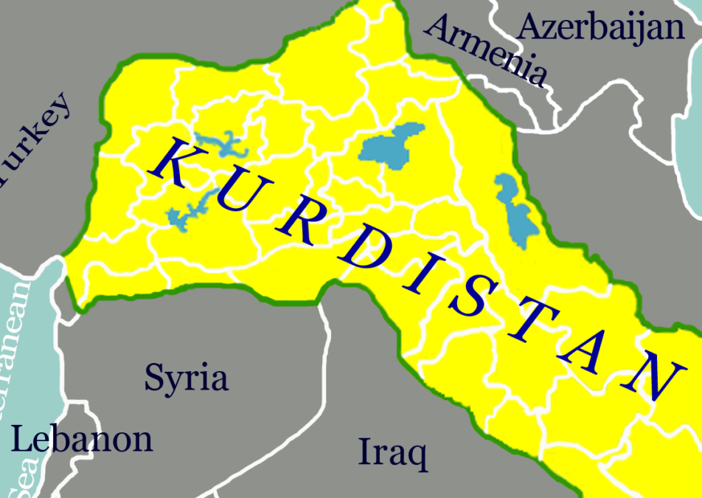
Kurds – A Short Introduction
Kurds, ranked as the fourth-largest ethnic group by population (McDowall 2021), also stand out as the largest ‘linguistic minority’ (Mahmud 2023a) in the Middle East.
Recent estimates place the global Kurdish population at around 34 million (McDowall 2021: 4). In the UK, the Kurdish community, primarily hailing from Iraq, was previously thought to number between 200,000 and 250,000 (Zalme 2021: 61).
The latest figure from the 2021 office for National Statistics reveal a notable discrepancy, indicating the Kurdish population.
In 2021 the number of Kurds in the UK are estimated at around 93,174 (Office for National Statistics, 2021).
Notes:
Let’s briefly discuss the Kurds and their history to provide some context.
Kurds, ranked as the fourth-largest ethnic group by population, also stand out as the largest “linguistic minority” in the Middle East. Geographically, they inhabit the strategically significant Kurdistan, spanning portions of Turkey, Iraq, Syria, Iran, Azerbaijan, and Armenia.
Denied statehood, Kurds faced over six centuries of marginalisation and persecution, depriving them of fundamental rights, including language and freedom to express their Kurdish identity. As a result, no reliable figures exist for the Kurdish population in their homeland and diasporas worldwide. Recent estimates place the global Kurdish population at around 34 million. In the UK, the Kurdish community, primarily hailing from Iraq, was previously thought to number between 200,000 and 250,000. The latest figure from the 2021 Office for National Statistics reveal a notable discrepancy, indicating the Kurdish population in the UK to be 93,174. While this marks a slight increase from the 2011 national statistics, it significantly contrasts with Zalme’s earlier estimate.

Slide 4
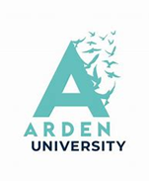
Diaspora: Locating Material Culture
Derived from the Greek noun diaspora,” meaning ‘to scatter,’ ‘spread,’ or ‘disperse,’ it evokes the idea of multiple journeys across various places (Knott and McLoughlin 2013: 27).
Diaspora is a ‘locas’ and ‘home’ from where the dispersion accurs (Brah, 1996: 181).
‘Home’ or ‘Away’ (Knott, 2010 cited in Knott and McLoughlin 2013).
Eisenlohr (2016: 88) views diaspora as more than a mere movement or displacement; it involves ‘diasporisation,’ a post-migration process of creating a network of diverse cultures and identities.
diaspora is a ‘malleable category,’ and dispersion does not necessarily entail a continued relationship with a homeland (Eisenlohr 2016: 89).
Diasporisation represents individuals defining themselves through shared experiences with other community members (Sieber and de Toro 2021).
Notes:
To provide some foundational data, let’s first explore key literature that underpins this study.
The concept of diaspora is a widely debated term in academia, drawing significant theoretical and analytical attention. Over the past two decades, the number of studies exploring this notion has nearly doubled according to Clifford.
Diaspora derived from the Greek, meaning “to scatter,” “spread,” or “disperse,” it evokes the idea of multiple journeys across various places (Knott and McLoughlin 2013: 27).
The concept defined differently in various fields. Brah sees it as a “locus” and “home” from where dispersion occurs.
Knott emphasises the tension between “home” and “away” but suggests further investigation.
Eisenlohr views diaspora as more than a mere movement or displacement; for him, diaspora involves “diasporisation,” a post-migration process of creating a network of diverse cultures and identities. He further adds that diaspora is a “malleable category,” and dispersion does not necessarily entail a continued relationship with a homeland (Eisenlohr 2016: 89).
In this study, diasporisation represents individuals defining themselves through shared experiences with other community members.

Slide 5
Material Culture and Identity
Culture is an action, something that is done rather than possessed (Holliday 2013; Piller 2017: 15)
It is constantly negotiated (Holliday 2013).
It can be ‘real’ or ‘imagined’ (Anderson 1983) and can be examined from a top-down (Hofstede 1991) or bottom-up approach (Hall 1991; Holliday 1999).
there are “countless versions of you out there in the mind of others, each different from the persona you imagine for yourself. Because everyone brings their own life Objects are not just a thing 7 experience, and of reading other[s] to bear … in interpreting the identity of those we meet (Joseph, 2013: 28).
The nonessentialist and postmodernist perspectives view identity as fluid and subject to discourse (Gaglar and Karababa 2016; Hall 1996, 1986; Nemoianu 2010; Norton 2013).
Third space (Bhabha, 1994) challenges essentialism, emphasising migrants’ hybrid identities in in-between spaces.
In this study, the ‘third space’ denotes a place for exploration and reflection in a new cultural reality (Holliday 2018).
Notes:
To comprehend the connection between material culture and identity, it is crucial to explore the concept of culture as a social phenomenon. Culture is seen as an action, something that is done rather than possessed and is constantly negotiated. It can be ‘real’ or ‘imagined, and can be examined from a top-down or bottom-up approach
This study adopts Holliday’s notion of ‘small culture,’ focusing on the micro perspective rather than the macro perspective. By understanding individuals’ daily practices, such as specific clothing choices or adherence to societal rules, we gain insights into their “small cultures” (Holliday 1999).
Identity is a complex and multi-faceted concept with no fixed definition. It varies based on individuals’ perceptions of themselves in the social and cultural context, better comprehended in its plural forms, with multiple “I”s defining individuals. As Joseph aptly puts it, there are “countless versions of you out there in the mind of others, each different from the persona you imagine for yourself. Because everyone brings their own life experience, and of reading other[s] to bear … in interpreting the identity of those we meet.”
Joseph’s statement highlights this study’s view of identity as multifaceted and evolving, shaped by society, self, and culture. It is not fixed, but rather a socially and culturally constructed collection of attributes.
Identity construction is a complex process, influenced by self-imposition and societal attributions, leading to intricate and evolving identities situated within cultural and social contexts. The nonessentialist and postmodernist perspectives view identity as fluid and subject to discourse (Gaglar and Karababa 2016; Hall 1996, 1986; Nemoianu 2010; Norton 2013).
Apart from the notion of culture and identity, the idea of ‘third space’ is vital for this study. Third space challenges essentialism, emphasising migrants’ hybrid identities in in-between spaces.
In this study, the “third space” denotes a place for exploration and reflection in a new cultural reality. Cultural realities define individuals as part of a group, attributing social meaning to their identities.

Slide 6
Hybrid Narrative Approach
Multimodal data collection methods - ethnographic observation (Sharma and Sarkar 2019), photovoice (Wang and Burris 1997: 369 and narrative interviews (Jovchelovitch and Bauer 2000).
4 participants in total 2 males and 2 females
Thematic Analysis (Braun and Clarke, 2006)
Notes:
This research involved multimodal qualitative data collection techniques: ethnographic observation that aims to explore the world from the standpoint of its social relations. A photovoice – a process by which people can identify, represent and enhance their community through a specific photographic technique and narrative interviews – a method whereby a story is generated through the interview.

Slide 7
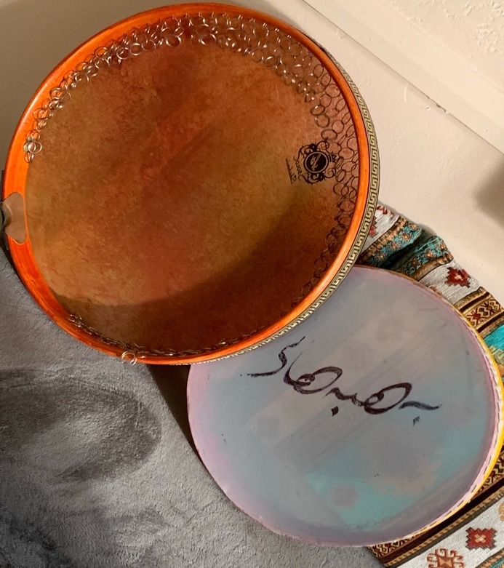
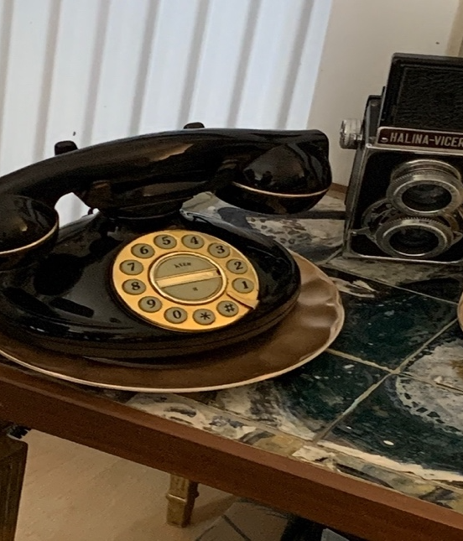
Possessions and Performing Identities
I have collected many items that have a special meaning to us. For example, the telephone initially belonged to my brother, who gave it to me as a gift. There is a funny story behind the phone. I remember we had one of those, and the girls in our neighbourhood used it to talk to their lovers. My family used to secure it with a mini padlock to prevent people from misusing it [the girls in her neighbourhood]. Also, the Dafs are essential in our living room because they signify our culture. When we get visitors, they immediately know who we are and where we come from
(Kani – Interview 1)
Notes:
The first theme delves into how possessions and identity are intertwined.
Throughout the interviews, participants highlighted the significance of material artifacts in creating a sense of “home atmosphere.” They spoke of hanging pictures and carefully placing personal objects in their private spaces to foster a feeling of belonging and familiarity. These possessions hold hidden meanings, deeply tied to emotions and memories, making their recognition crucial. For instance, Kani and her husband, refugees who migrated to the UK over two decades ago, left behind all their belongings in search of a safe home. Once settled in West London, they sought out objects that resembled or evoked memories of their cherished possessions from back home.
While in Kani’s living room, my attention was drawn to three distinct objects: a camera, a telephone, and two Dafs. These items were thoughtfully arranged in her living room, prompting my curiosity about their significance and the stories attached to them.
In Kani’s living room, the objects serve as expressions of her identity, encompassing both personal (the telephone) and social and cultural aspects. Through these items, she showcases her true self, her preferences, and aesthetic sensibilities. In essence, her living room, adorned with these objects, becomes a social space where she externalises and reveals her personal and social identities to both familiar guests and strangers. Throughout her narrative, Kani employs personal pronouns like ‘we’ and ‘us’ when describing the significance of the objects (e.g., ‘our living room,’ ‘our neighbours,’ ‘special meaning to us’). These pronouns signify a sense of group cohesiveness, creating a connection with the audience (Bramley 2001).
Additionally, ‘us and ours’ reflect her shared responsibility and commitment to her family and culture. They also act as collective identity markers, representing the cultural artifacts embraced by her family, community, and nation.

Slide 8
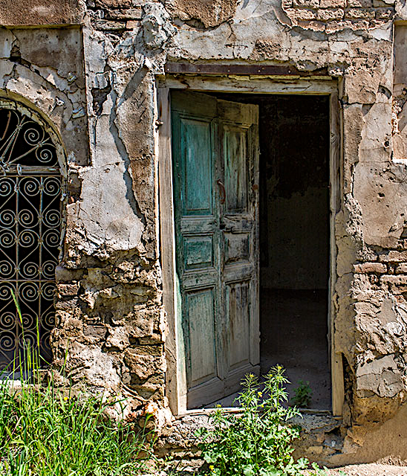
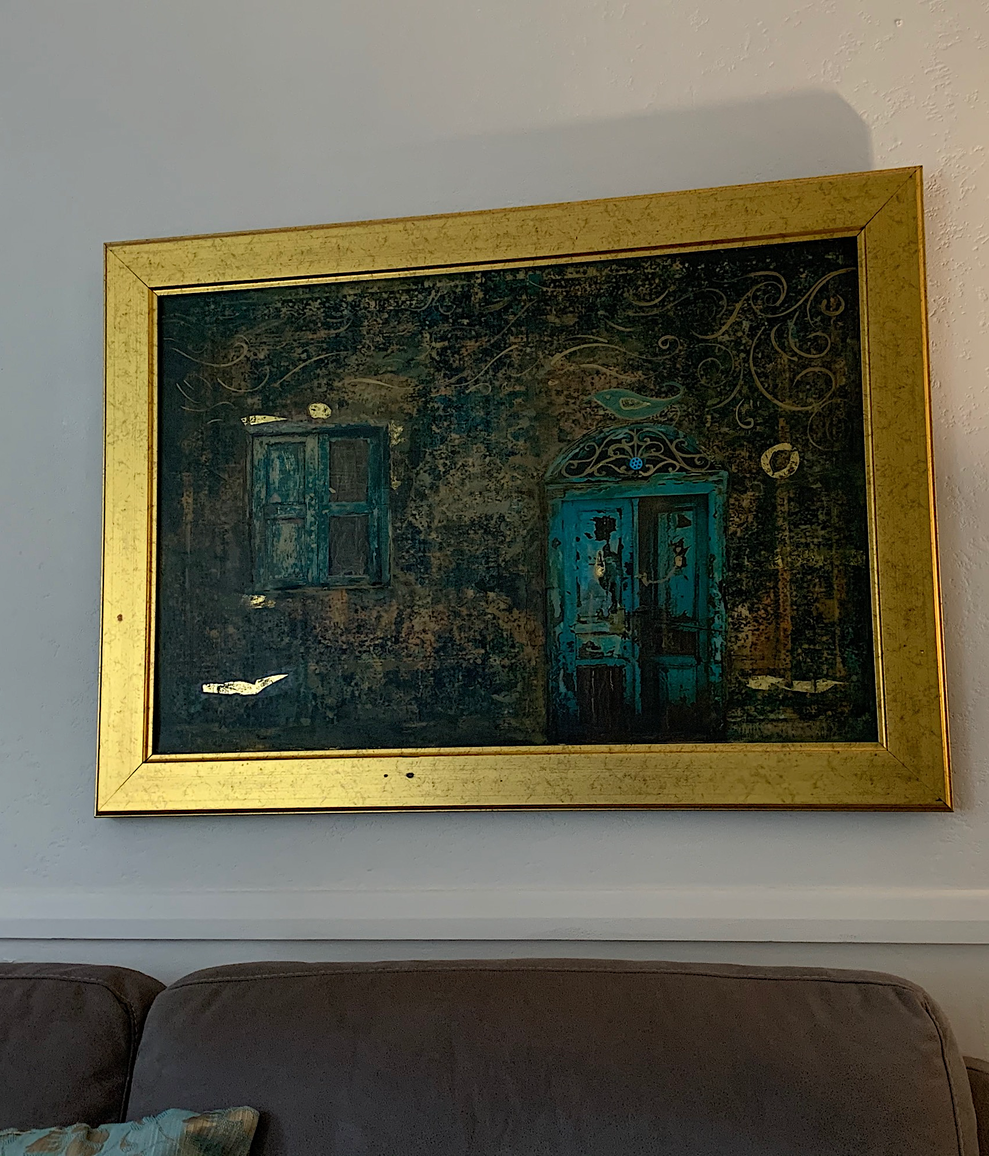
Possessions and Performing Identities
The artwork behind me, I specially designed for my wife. I used two features, a door, and a window, because I picture past stories behind them, and we [Sam and his wife] embrace our childhood memories […] and cherish the good old days. So, the painting is the medication that helps us overcome the grief we have experienced due to leaving everything behind. […] You can’t imagine how often I went past that door and ended up in my grandparents’ house. So, every time I travel through the door, it feels special, and I see a different ‘me’
(Saman – Interview 1)
Notes:
Likewise, other personalised objects, such as paintings and artworks, embody cultural resistance for certain participants. Saman, an artist from Suleimani in Northern Iraq, employs his artistic skills and imagination to reinterpret elements of his past. His paintings and ceramic creations serve as a medium to revive his memories, with each piece reflecting his emotions and attachment to his childhood experiences. One notable artwork hanging in Sam’s living room is a piece specially crafted for his wife. In an interview conducted in Kurdish Sorani, Saman explained the idea behind the painting.
The artwork contains multiple narratives, reflecting his memories and experiences in two liminal spaces. Metaphorically, the painting embodies life, conveying his emotions and conveying specific ideas and principles. Saman sees the painting as medicinal, a cure for the trauma of migration and resettlement. Through the artwork, he delves into the depths of his inner self, uncovering a hidden reality. Using a blend of English and Kurdish Sorani, he passionately shares his artistic expression.
In Sam’s artwork, the window and door hold more significance than just a background composition. The open door serves as a powerful metaphor for hope, symbolising a gateway to the past and a transition into the unknown. Sam’s choice of words conveys the emotions he experiences while traveling through the door, reminiscing about his childhood memories. The intricate details in the painting reflect a profound emotional investment, forging a connection between the speaker and his memories, bridging the spatial and chronological gaps between the present and the past. Metaphorically, Saman navigates between two temporal spaces through the door, revealing various evolving versions of himself. The emotional qualifier “good old days” hints at his feelings of nostalgia, homesickness, and yearning for bygone moments. Ultimately, the artwork portrays the complexity of human identity, demonstrating the multifaceted nature of oneself within their inner world and in the eyes of others.

Slide 9
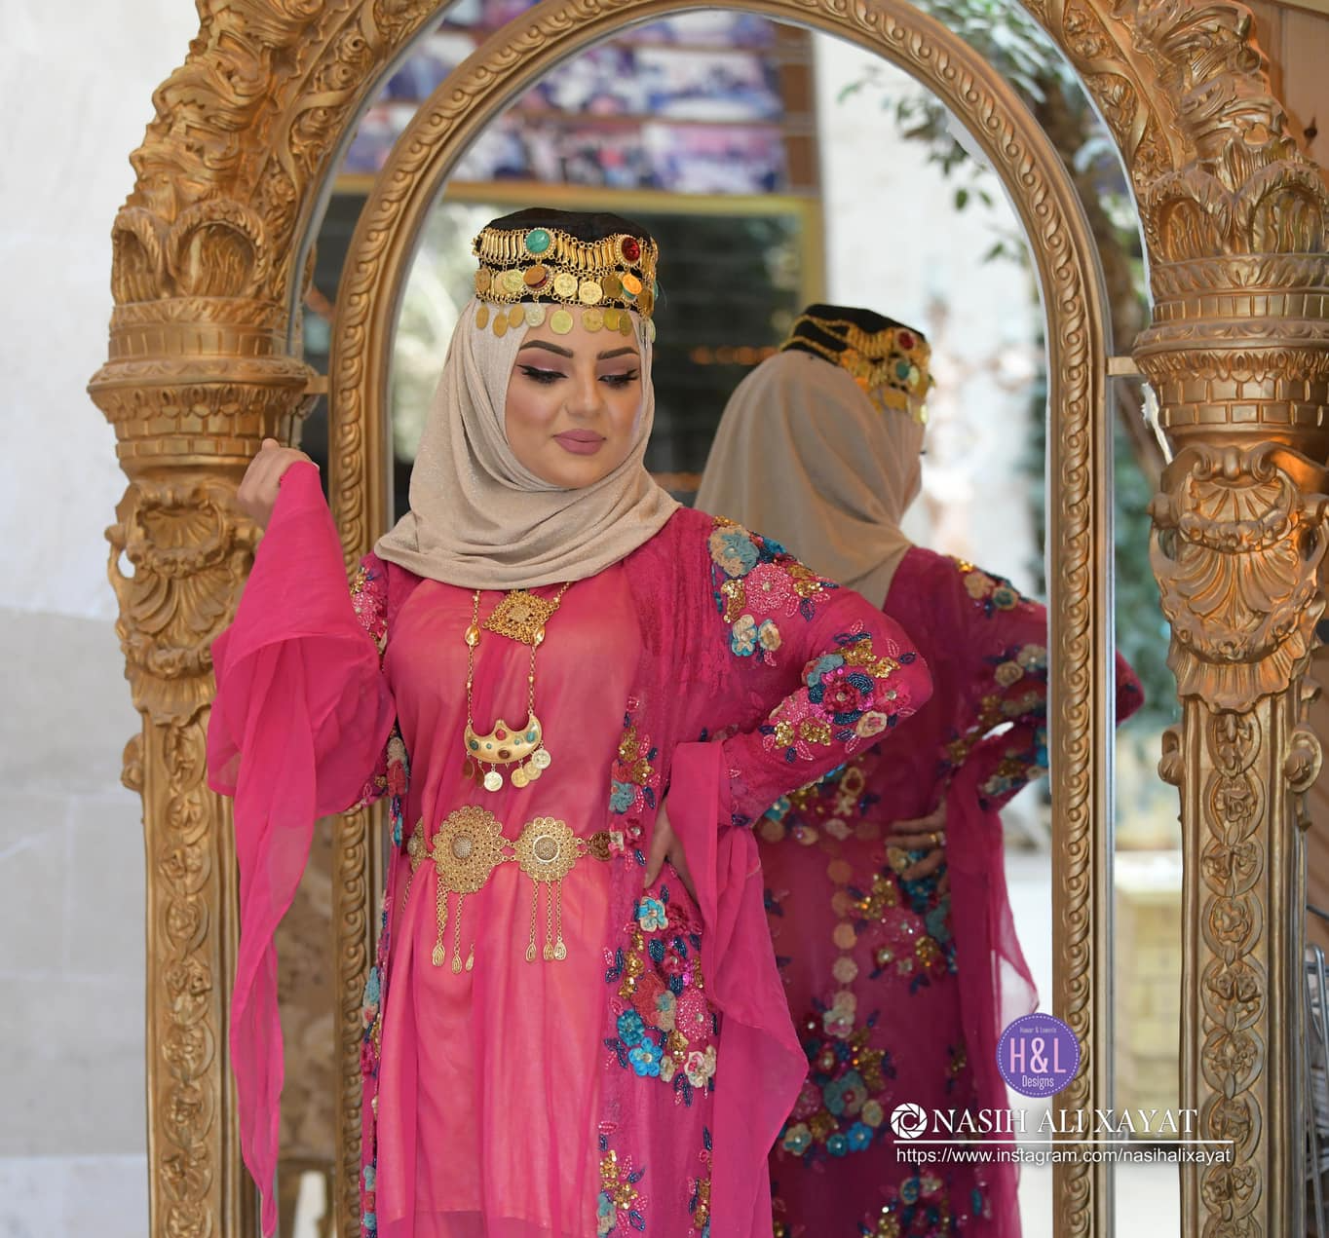
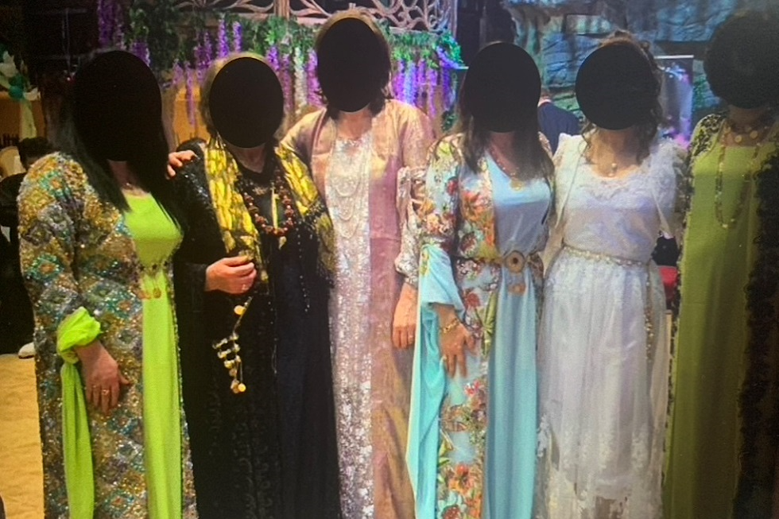
Closing as Personal, Social and Cultural Markers
What you wear does reflect you to a certain extent. Do you know how some people dress? They say, oh, it is an art, and that is their form of expression. Sometimes it gives you a bit of the person’s character. I like wearing traditional clothing because it is nice and pretty. I like the colours, and it reminds me of Indian clothes but is slightly different. (Kani – Interview 1)
Wearing traditional clothes makes me feel different. They give me a sense of happiness and pride, and I think I belong somewhere. So many people have started to look up to and learn about my culture through me. My friends have also learned who we are and understand our struggles as a nation.
(Nina – interview 2)
Wearing traditional clothes makes me feel different. They give me a sense of happiness and pride, and I think I belong somewhere. So many people have started to look up to and learn about my culture through me. My friends have also learned who we are and understand our struggles as a nation.
(Nina – interview 1)
Notes:
Personal possessions, including apparel, clothing, and accessories, hold significant value as identity markers and memory objects. Participants perceive ethnic clothing as a means to distinguish themselves from others and emphasise their distinct identities. However, there is no unanimous agreement on when and where to wear such clothing in the diaspora. For participants, ethnic clothing goes beyond mere fabric and accessories; it is a symbolic rite of passage that influences their identity construction and negotiation. The clothing’s semiotic effect plays a crucial role in shaping their perspectives in various sociocultural settings. In her first interview, Nina eloquently describes clothing as an art form, capturing its artistic and expressive essence.
Nina values traditional clothing as a visual representation of her unique cultural background, fostering a sense of pride in her heritage she states this explicitly “I like wearing traditional clothing.” These garments serve as a powerful means of connecting with her roots and ancestors. Additionally, she uses Kurdish ethnic attire to establish a bridge between her culture and others, like Indian culture, enabling effective communication of her cultural identity to individuals unfamiliar with Kurds but acquainted with other foreign cultures. During the follow-up interview, when asked about the purpose of traditional clothing in the diaspora and how she feels wearing it while socialising with people from different ethnic groups.

Slide 10
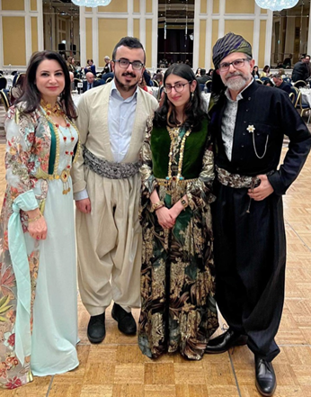
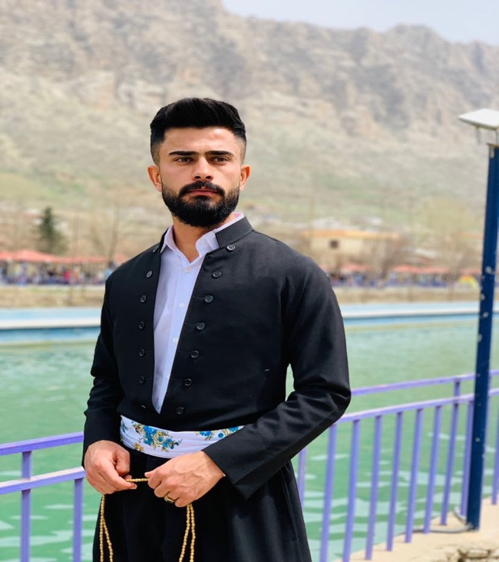
Clothing as Identity Marker
I like traditional clothing, but it is not easy to work with them, because my job involves a lot of movement and playing with colours. So, I don’t think working while wearing traditional clothing is practical or even a good idea
(Saman – follow up interview)
What is the point of wearing a piece of fabric to define who you are? In my opinion, we need to preserve our language. Because, through language, we can protect our cultural identity, tradition, and cultural heritage.
(Omer – interview 1)
Notes:
However, traditional closing or the male participants is less pronounced. His focus leans towards cultural heritage preservation through gastronomy and communal events, whereas he regards traditional clothing as less pragmatic, characterising it as ‘infectious’ or ‘pointless’ during subsequent interview interactions. Notably, he exclusively communicates his sentiments in the Kurdish language.
Saman appreciates Kurdish clothing as a cultural marker but finds it unfeasible to wear regularly. He states, ‘I like traditional clothing,’ emphasising his positive sentiment towards it, but not feeling obliged to wear it for proving his Kurdish identity. The use of ‘like’ instead of ‘love’ highlights his attitude. Sam believes other means, like language, can effectively convey ethnic identity. Similarly, Omer shares this perspective, considering traditional clothing unnecessary. He believes people can express their ethnic identities through language, stating in Kurdish Sorani, ‘It is not necessary to wear Kurdish clothing; we can show our identity by speaking our language.’ Both Sam and Omer recognise alternative ways to preserve their cultural heritage beyond wearing traditional attire.
These narratives highlight a notable contrast in how male and female participants perceive ethnic clothing. Sam and Omer demonstrate a lack of enthusiasm towards wearing traditional attire, evident in their use of the word ‘like’ rather than ‘love’ to describe their feelings towards such clothing. For Sam, the concept of ethnic costumes seems futile, questioning the purpose of wearing a piece of fabric. This implies that Omer believes alternative means, like language, are sufficient for expressing one’s identity. On the other hand, women actively embrace and preserve cultural Objects are not just a thing 17 traditions, associating themselves closely with idealisations of their heritage. Another possible explanation for men’s less enthusiastic attitude towards ethnic clothing could be attributed to their increased social engagement and adaptability to the new culture. Men, being more outgoing, tend to integrate more easily with the host culture, which may result in a reduced emphasis on adhering strictly to their ethnic clothing, both within their homes and in social settings. These distinct perceptions regarding clothing shed light on its role in the construction and expression of cultural identities

Slide 11
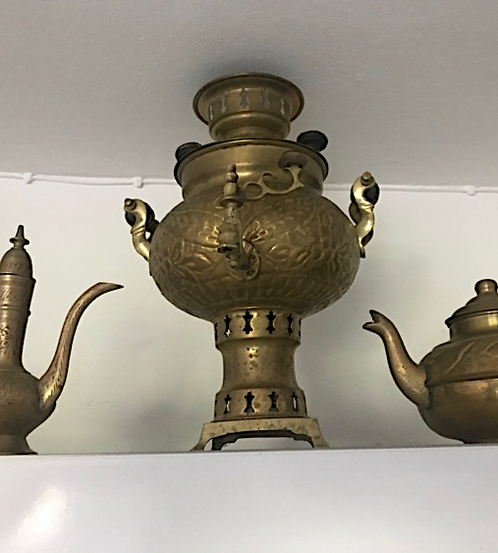
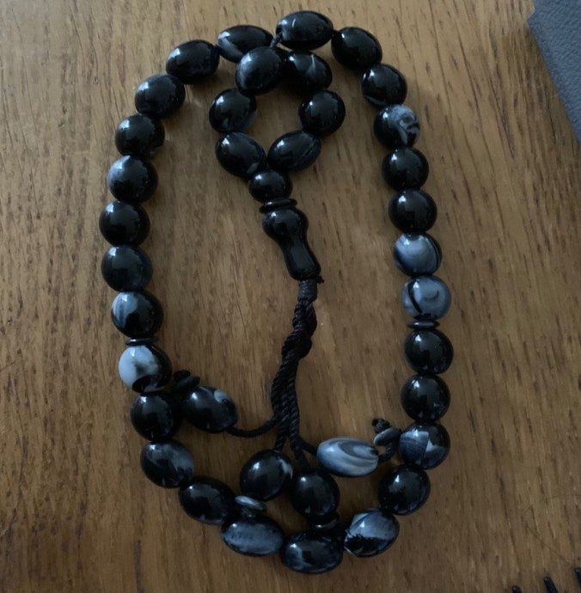
Heirloom and Memory
I brought the Tasbih because it belonged to my father. Touching it was so unique. It gave me an extraordinary feeling. When I held it in my hand, I felt like I was touching my father’s fingers, and I am sure I will get the same sense if I use it again.
(Kani – Follow up interview)
When I moved to the Netherlands, I bought the samawar or [səmɐˈvar] as a reminiscence of my grandfather. I remember he had one in his diwakhan7 (or parlour). I used to see and use them daily. After so many years, this memory still lives with me.
(Omer – Follow) up interview)
Notes:
Other objects like heirlooms can provide a sense of attachment and connection to people’s memories. For example, some people consider materialistic inheritances a precious asset, as they might signify personal and collective selves. Following Tolia-Kelly’s assertion who postulates that objects act as a “trigger” facilitating memory; they are also ‘souvenirs from the traversed landscapes of the journey, signifiers of narrations of the past’. During her visits to Kurdistan, Kani brought a few items like tasbih and a metal bowl. Both possessions are precious to her because they belonged to her parents. The tasbih is a remembrance of Kani’s father, who has passed away, and the bowl is a gift from her mother.
The lexicon utilised in Kani’s narrative, comprising words like ‘belong, touch, feel, felt, and get,’ serves to accentuate the profound emotional bond she shares with the inherited objects. To Kani, the Tasbih transcends mere physicality, adopting a role akin to a social actor that triggers act of remembrance. The expressions “I felt” and “touching my father’s fingers” offer insight into how the Tasbih has metamorphosed into an evocative entity, fostering a spiritual connection between Kani and her late father. This change in ownership, from her mother to Kani, imbues the object with a profound emotional significance, making it an emotive companion and the focal point of ‘contemplative memory, generating a sense of love’. Furthermore, Kani recounted a significant vintage metal bowl adorned with Quranic verses, gifted to her by her mother. As per Kani’s account, her mother acquired the bowl during her pilgrimage to Makkah or Mecca. While Kani perceives the bowl as a modest material item that triggers memories of her parent, her mother attributed healing properties to it, insisting that Kani preserve the bowl as a safeguard against distress and affliction.
In a similar fashion, Omer chose to retain certain objects that he either purchased or received as gifts. For instance, after our initial interview, Omer shared images of two such objects: a samovar (samawar or [səmɐˈvar]) and a piece of artwork. The samovar holds a sentimental value, as it serves as a memento of his grandfather. On the other hand, the artwork was a gift from his daughter. Despite its origins in Russia, [səmɐˈvar], in Omer’s perception, becomes a symbol of Kurdish culture and an embodiment of his national identity. In his eloquent narrative, Omer skilfully intertwines the significance of the artifact with his family heritage, forming a profound connection to his grandfather’s memory. For him, this object transcends mere decoration; it serves as a cherished vessel of memories, evoking precious moments spent with his beloved family member.

Slide 12
Conclusion
The participants’ accumulated objects serve as ‘aide-mémoires’ linked to memories of loved ones, enabling them to navigate between reminiscences and the challenging reality (Marschall 2019: 254).
These objects act as identity markers, facilitating a delicate balance and negotiation between their home country and the new environment (Giorgi and Fasulo 2013).
The collected objects enabled participants to construct a novel way of living, creating a discursive “third space” (Bhabha 1994) where they expressed emotions and negotiated their ‘hybrid’ or ‘in-between’ identities.
These objects also facilitated the formation of ‘diasporic identities’ (Marschall 2019: 3).
The accumulated objects are a bridge between the participants’ ‘actual’ and ‘ideal’ homes.
Reimagine their homeland while establishing a new ‘home away from home’
Traditional clothing, symbolising ethnic heritage, served as a means of showcasing loyalty and affiliation to one’s cultural group. Interestingly, the data revealed gender disparities, as women viewed clothing as both a form of beauty and an essential element in preserving their Kurdish national identity, while men regarded traditional attire as impractical and not strictly indispensable as an identity marker.
Notes:
Despite diverse personal histories and migration motivations, the participants arrived in the UK with limited belongings, aspiring to establish a sense of home in a foreign land (Tolia-Kelly 2010).
Consequently, they engaged in the acquisition, replication, and preservation of specific items like retro dial telephones, dafs, artwork, heirlooms, and clothing, all of which played pivotal roles in shaping their personal, social, and cultural identities (Marschall 2019).
These collected objects served as carriers of meaningful symbols, revealing the underlying complexities and contradictions of their migration experiences. Moreover, these familiar objects acted as bridges between the past and present, enabling participants to re-examine their material belonging in the context of their new realities.
The participants’ accumulated objects serve as ‘aide-mémoires’ linked to memories of loved ones, enabling them to navigate between reminiscences and the challenging reality. For instance, the telephone signifies Kini’s personal identity, while the dafs and ethnic clothing symbolise her social and cultural identity. These objects act as identity markers, facilitating a delicate balance and negotiation between their home country and the new environment. The collected objects enabled participants to construct a novel way of living, creating a discursive “third space” (Bhabha 1994) where they expressed emotions and negotiated their ‘hybrid’ or ‘in-between’ identities. These objects also facilitated the formation of ‘diasporic identities’.
Items like tasbih, artworks, and samovar held profound emotional significance. They contributed to the creation of a home atmosphere, with participants designating specific spaces within their homes to display these objects, symbolising the interplay between their memories and their current living conditions. Furthermore, these accumulated possessions served as a bridge between the participants’ actual and ideal homes.
They allowed the participants to reimagine their homeland while establishing a new home away from home. The collected items evoked nostalgia, facilitating a sense of authentic self and emotional attachment to their new surroundings. Thus, each object underwent a re-contextualisation process, acquiring additional layers of meaning in the participants’ live

Slide 13
Reference List
Bhabha, Homi. 1994. The location of culture. London, UK: Routledge.
Brah, Avatar. 1996. Cartographies of diaspora: Contesting identities. London and New York: Routledge.
Braun, Virginia & Victoria Clarke. 2006. Using thematic analysis in psychology. Qualitative Research in Psychology 3. 77–101.
Eisenlohr, Patrik. 2016. Religion and diaspora: Islam as ancestral heritage in Mauritius. Journal of Muslims in Europe 5(1). 87–105.
Gaglar, Irfan & Reyhan Karababa. 2016. Postmodernist identity construction and consumption. Journal of Economic Development, Environment and People 5(3). 21–28.
Giorgi, Sabina & Alessandra Fasulo. 2013. Transformative homes: Squatting and furnishing as sociocultural projects. Home Cultures 10(2). 111–133.
Hall, Stuart. 1986. On postmodernism and articulation: An interview with Stuart Hall. Journal of Communication Inquiry 10(2). 45–60.
Hall, Stuart. 1991. The local and the global: Globalisation and ethnicity. In Antony D. King (ed.), Culture, globalisation and the world-system, 19–39. New York: Palgrave.
Hall, Stuart. 1996. Who needs ‘identity’. In Stuart Hall & Paul DuGay (eds.), Questions of cultural identity. London, Thousand Oaks, New Delhi & Singapore: Sage Publications.
Holliday, Adrian. 1999. Small culture. Journal of Applied Linguistics 20(2). 237–264.
Holliday, Adrian. 2013. Understanding intercultural communication. London & New York: Routledge.

Slide 14
Reference List
Holliday, Adrian. 2018. Understanding intercultural communication: Negotiating a grammar of culture, 2nd edn. New York: Routledge.
Joseph, John. 2013. Identity work and face work across linguistic and cultural boundaries. Journal of Politeness Research: Language, Behavior, Culture 9(10). 35–54.
Knott, Kim & Sean McLoughlin. 2013. Diasporas: Concepts, intersections, identities. United Kingdom: Zed Books Ltd
McDowall, David. 2021. A modern history of the Kurds, 4th edn. UK, US & Ireland: I.B. TAURIS, Bloomsbury Publishing Plc.
Mahmud, Chra Rasheed. 2023a. Why do “things” matter? – Kurdish material culture and identity. In Linda Kean, Sachiyo Shearman, Mary Tucker-McLaughlin & Władysław Witalisz (eds.), Freedom of expression across the borders: Communication, culture, and language. North Carolina: East Carolina University Press.
Marschall, Sabine. 2019. Memory objects: Material objects and memories of home in the context of intraAfrican mobility. Journal of Material Culture 24(3). 253–269.
Nemoianu, Virgil. 2010. Postmodernism and cultural identities: Conflicts and coexistence. United States: Catholic University of America Press. Norton, Bonny. 2013. Identity and language learning: Extending the conversation, 2nd edn. UK, US & Canada: Multilingual Matters.
Sieber, Cornelia & Alfanso de Toro. 2021. On migration: Diasporization - transculturality - transmediality. Hildesheim: Georg Olms Verlag AG.
Sharma, Hemant Lata & Chiranjit Sarkar. 2019. Ethnography research: An overview. International Journal of Advance and Innovative Research 6(2). 1–5.
Wang, Caroline & Mary Ann Burris. 1997. Photovoice: Concept, methodology, and use for needs assessment. Health Education and Behaviour 28(5). 560–572
Zalme, Ali. 2021. Home and sense of belonging among Iraqi Kurds in the UK. United States and United Kingdom: Lexington Books

Slide 15
Contact Information: Email: cmahmud@arden.ac.uk Twitter/X: @MahmudChra LinkedIn: Dr. Chra Mahmud ResearchGate: Chra Rasheed Mahmud ORCID: https://orcid.org/0000-0003-4012-2603
Thank you for your attention! ☺

