Slide 1
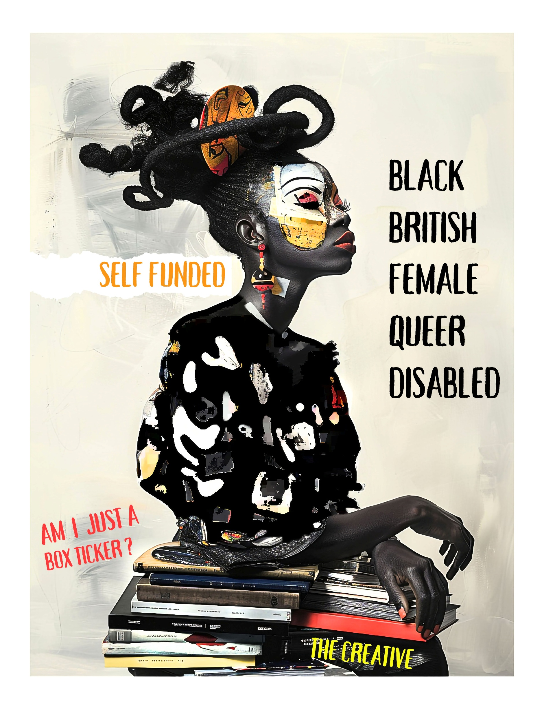
ART, ACTIVISM
AESTHETICS & AI
A PRACTICE-BASED INTERSECTIONAL EXPLORATION OF IDENTITY (360)
MICHI MASUMI. BA.MA
Canterbury Christ Church University
April 2025

Slide 2
PRESENTATION
OVERVIEW
Duration: 30 minutes (20 min talk, 10 min Q&A)
1. The Person & The Artist (Autoethnography)
2. Community & Business (Visual Ethnography)
3. ADN Framework & EthnoGo (Activism)
4. AI Ethics & Mixed Media Art (Resistance)

Slide 3
SECTION 1:
THE PERSON & THE ARTIST
“Billie's ghost in code
Eyes trained on the algorithm
Still, I sing in light”
Anthropology and Autoethnography
Artistic Tools
Inspirational influences
Activism/ Artivism
Digital Narratives
The Research Exploration
Self-portrait and Haiku, inspired by Billie Holiday and my lived experiences, the physicality of identity, hair, expression, posture, capturing trauma and pride.
Notes:
Autoethnography is a method I use to explore how my gender identities intersect with other aspects of my identity, such as race, ethnicity, socioeconomic status, abilities, and sexuality.
This approach utilises photography, poetry, and AI art as tools for anthropological documentation and promoting cultural inclusion. Influenced by Irving Penn and merging art forms like abstract, Baroque, and Renaissance with surrealism, symbolism, and post-impressionism, my work is stamped with activism through AI art, aiming to enhance the visibility of Black British women in creative tech and create a platform for lived narratives via digital platforms.
My exploration spans self, community, business, and technology.

Slide 4
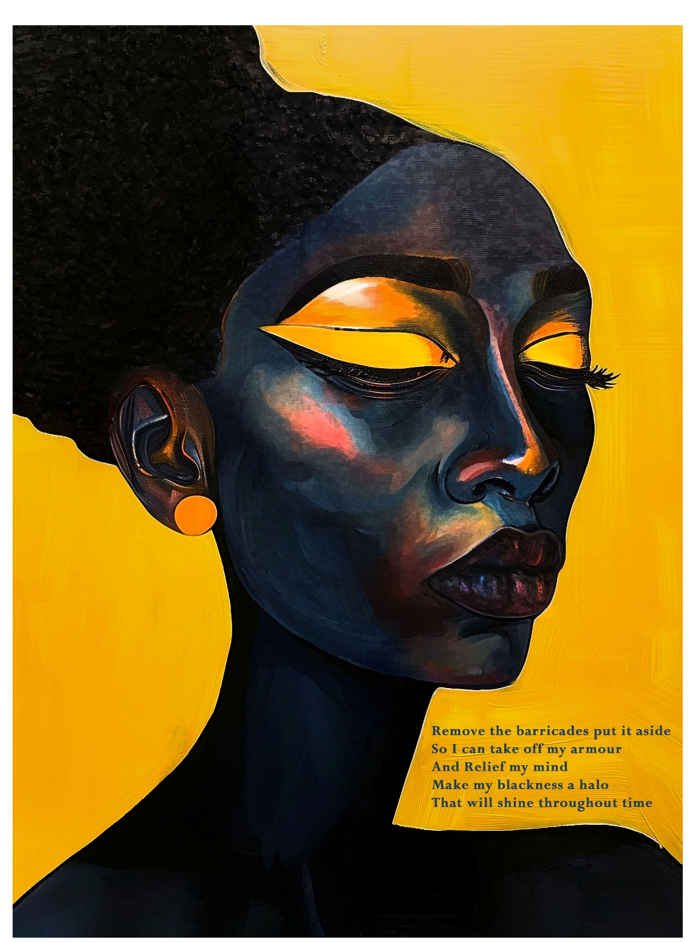
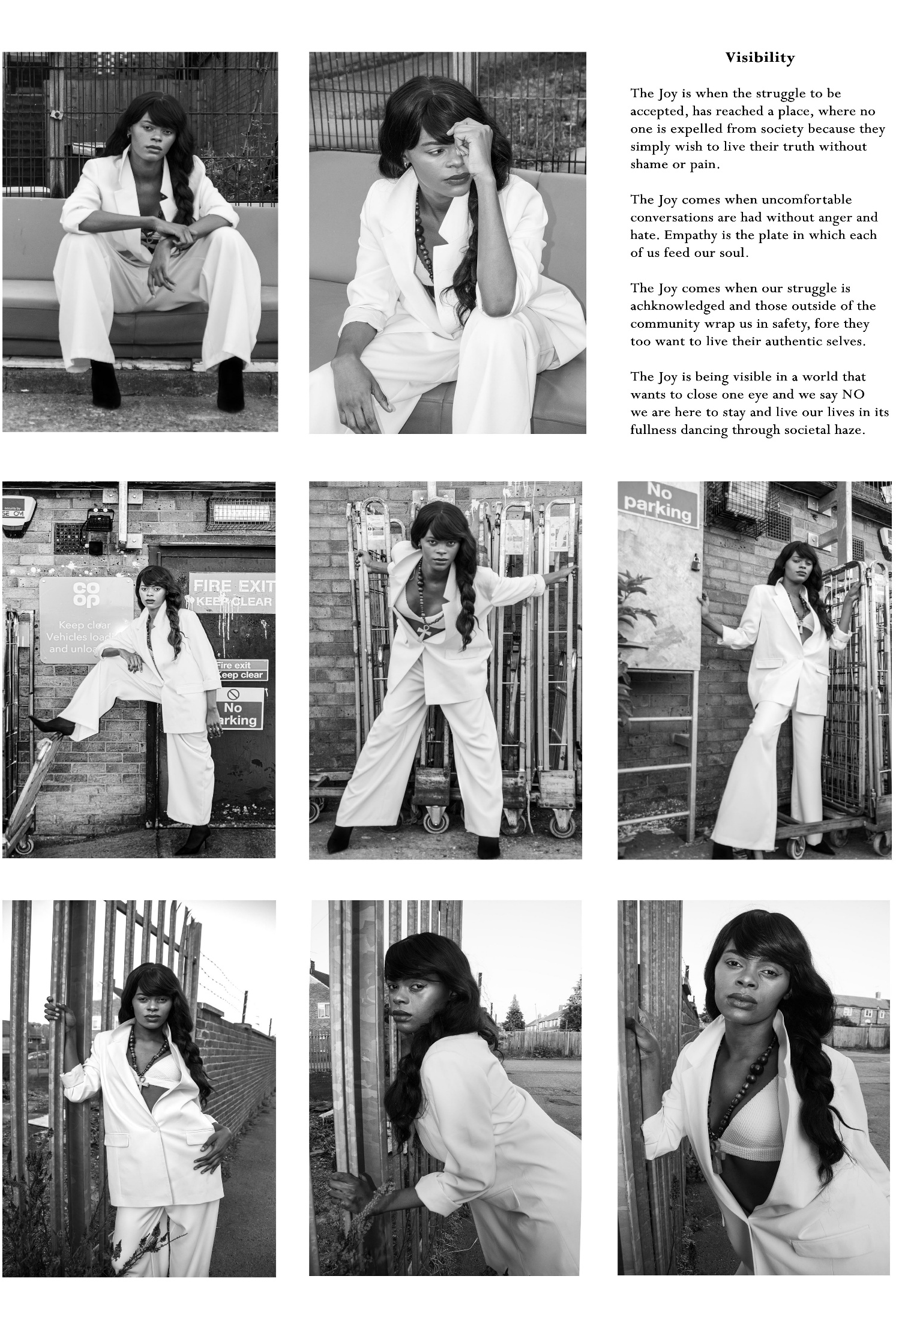
CREATIVE PRACTICE
Poetry in English & Jamaican Patois
Photographic self-expression and 'Phoetry’
Personal and cultural identity exploration
Sociocultural and Linguistic anthropology
Notes:
My art blends sociocultural anthropology and linguistics to explore how cultural practices and language shape the lives of Black British women.
I use a mix of visual and written forms, including the cherished non-verbal arts like visual art and poetry, to share and celebrate the rich, complex experiences of this community. It highlights the powerful impact of non-audio expressions and the beautiful hybridity of cultures that define and enrich these identities."

Slide 5
Cracks & Gaps
Seems like every day, there’s new cracks and gaps
I tell myself don’t watch it
Live life like you mek a pak
Stand Tall, member you don’t give a jack
Mek dem chat
Gunning for you like raw meat
Hanging on da rack
Talking to you like your wacky wacky wac
Give dem a light
Mek dem bun pon dat
RATS,
You fe stay on track
You can’t afford fi lack
No money inna da sack
You have fe work hard
Bruk fe your back
Their time will come
Member that
Don’t get trapped
Leave dem mouth fe run like tap
Cos me a tell you
There is always someone else
Dem find fe chat
Life is always full of new cracks and gaps
Michi Masumi
Notes:
Cracks & Gaps
Seems like every day, there’s new cracks and gaps
I tell myself don’t watch it
Live life like you mek a pak
Stand Tall, member you don’t give a jack
Mek dem chat
Gunning for you like raw meat
Hanging on da rack
Talking to you like your wacky wacky wac
Give dem a light
Mek dem bun pon dat
RATS,
You fe stay on track
You can’t afford fi lack
No money inna da sack
You have fe work hard
Bruk fe your back
Their time will come
Member that
Don’t get trapped
Leave dem mouth fe run like tap
Cos me a tell you
There is always someone else
Dem find fe chat
Life is always full of new cracks and gaps

Slide 6
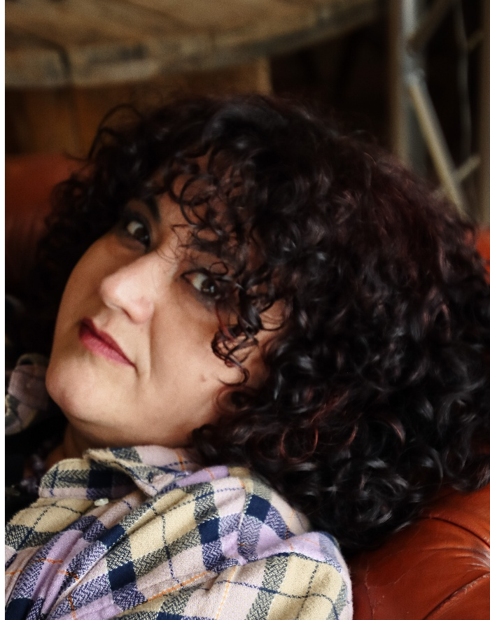
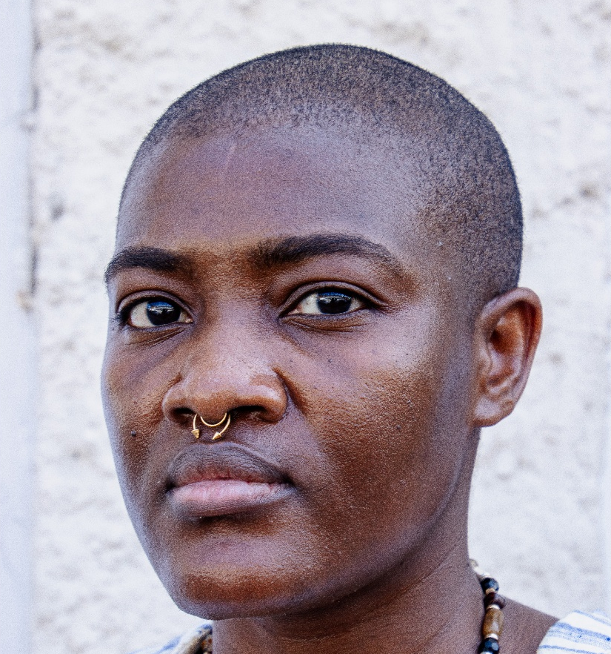
Black British Female Visual Arts & Poets
The importance of diversity and representation within the mainstream that reflects the real length and breadth of Black Britain
THE PEERS
Notes:
Activism and artivism can be subtle, as demonstrated here. There is diversity within diversity, yet for marginalised groups, this is often overlooked.
All these women identify as Black British, hailing from across the Southeast of England. They are artists and poets, with many embracing both roles. Nine of these women are grassroots creatives, constrained by social and digital frameworks. How do we navigate the biases and discrimination to achieve equity as British creatives?
A good place to start is here, in academia, I had very little exposure to Black Creatives, even less still Black British Female creatives if I am honest, anyone who was black in any field of study, and I have done seven years of Higher education. So just having this slide during a presentation and, also deposited into the CCCU repository is both a student and cultural form of activism and the form of photography is artivism.
Himid in 2017 stated, "Visibility is a political act; to be seen is to exist on your own terms" (Himid, 2017, p. 34).

Slide 7
Real-time feedback from Black creators (my peers)
Google meet with captions, translation and notetaker
The Podcast features interviews with Black British visual artists and poets (a public-facing extension of academic work and social commentary, this is a digital oral history project).
Available on CCCU Repository, YouTube, The Benjamin Zephaniah Library webpage and social media
97% Black British Women | 3% Non-British | 7% Men
"Capturing the spectrum of Black British creativity.“
The recently launched accompanying research questionnaire/survey will generate new data
Data analyses for similarities and keywords using NVivo and other software
Completed small tester sample analysis will be included in upgrade documentation
Research captures both artistic practices and participants' lived experiences
Using Otter.AI for Transcribing
For basic video editing
Notes:
The "Tats & BLACK Podcast" enriches my research and anthropology by providing a platform for Black British women's experiences.
Here’s how it contributes:
Cultural Documentation: It records contemporary cultural narratives, focusing on underrepresented stories in mainstream media.
Community Engagement: Interviews with artists and community figures foster a deeper understanding of Black British cultural dynamics.
Visibility and Representation: The podcast highlights the contributions of Black women, challenging stereotypes and promoting visibility.
Integration of Arts and Social Sciences: It merges artistic expressions with social issues, demonstrating how the arts can reflect and influence culture.
Dissemination of Research: It spreads my PhD findings to a broader audience, increasing the impact and engagement with academic research.
Feedback Mechanism: Audience feedback helps refine research approaches, ensuring they remain relevant to the community.
This makes the podcast a dynamic tool for exploring complex cultural identities and enhancing the understanding of these communities within the social sciences.

Slide 8
Section 2:
The Arts & My Local Art Community
Visual Ethnography: British Art Institute’s Observation Field Trips
Visual Ethnography: Facilitating Black-led Activities

Slide 9
Gallery and Museum showcasing Black Artists 2024
Using my Canon M3 and 90D cameras to collect data through visual ethnography observation fieldwork.
OBSERVATION FIELDWORK
Yinka Shonibare
Alvaro Barrington
Lubaina Himid
Zanele Muholi
Notes:
Photos from gallery visits are key for your research, serving as visual evidence and giving deep insights into cultural artifacts and behaviours.
They make my findings clearer, helping me to reflect on biases, provide varied perspectives from different study fields, and track changes in art trends over time.
Black British female artists often use visual ethnography to interrogate sociocultural hierarchies. Sonia Boyce, a pioneering Black British artist, asserts that her work "is about negotiating the complexities of cultural hybrid, where the personal and political collide" (Boyce, 1996, p. 12).

Slide 10
COMMUNITY
PRACTICE
Partnerships, Events and Exhibitions
Notes:
How do I fit into local creativity, and am I included and valued? Are there genuine opportunities for me as a Black British female artist focused on Black British female narratives?
Visibility isn't just about how the art sector acts; it's also about standing strong in representing Black British female stories as a vital part of the British art scene. I'm no longer just trying to break through barriers.
I actively make myself visible, often as the only Black woman, or even the only Black person, in the room.
This can be daunting, and micro-aggressions are real, but I persist for my Medway community and for future generations of Black British female artists from smaller towns who might feel invisible, isolated, or misunderstood.
Change requires effort from everyone. Instead of just complaining, I choose to be proactive and work towards this change.
These photos include my work as the creator, designer and co-maker of Medway Pride 2023,
A workshop on the English Empire with Margate’s Marine Studios, an educational exhibition on Resistance as Black British men and how the arts and politics entwined has been used as a vehicle for change.
A solo Telephone Box exhibition on what women mean to the British public in 2024 called ‘I woman’, along with a documentary about STEM women studying in Medway, the impact of race and gender within this sector, visual ethnography and lived experiences.
Just being Black British and Female visible within the community is a way to break stereotyping. Black Led does not mean for Blacks only.

Slide 11
AI & Digital Platforms
for Black-Led/ Black owed Business
The Black Art Hub CIC and The Benjamin Zephaniah Library
Efficiency and accessibility for creative organisations
Using AI for marketing, admin and funding tools

Slide 12
AI & Digital Platforms for Black Brtish Art Organisations.
Video credits: Kateryna Baranenko ~The Black Art Hub
Notes:
The Black Art Hub, the Benjamin Zephaniah Library, and the Collective of African Diaspora Artists (CADA) are crucial components of my research, serving as pivotal platforms for the exploration and exhibition of Black British art and culture.
These entities support my anthropological inquiries into the ways cultural expressions shape identity and foster community cohesion among the Black British diaspora.
The Black Art Hub offers a dynamic space for artists to interact with the public and showcase their work, facilitating important dialogues and deeper understanding. The Benjamin Zephaniah Library acts as both a repository and educational hub, preserving and providing access to the works of Black British artists and poets, enhancing community engagement and learning. CADA links artists across the diaspora, encouraging diverse yet unified artistic expressions.
I utilised AI to enhance both physical and digital visibility, contributing to sustainability amid the financial challenges that many Black art organisations face in the UK. According to Arts Council England (2019), only 1% of regularly funded organisations are led by Black and minority ethnic groups, highlighting the financial and visibility struggles within the sector (Jones, 2019).
These institutions not only address research questions concerning cultural visibility and representation but also demonstrate the significant impact of artistic practices on community identity, providing rich ethnographic contexts for analysis.

Slide 13
Section 3:
ADN Framework & EthnoGo
ADN Framework bridging theory and practice
A mobile-first toolkit for marginalised researchers to collect multimodal data (photos, voice notes, interviews) ethnically and affordability.
Notes:
“Resistance is communal. To redesign technology is to reimagine who belongs in the future” (Race After Technology, p. 167).

Slide 14
ANTHRO-DIGITAL NARRATIVES (ADN)
A COMPOSITE THEORETICAL AND
METHODOLOGICAL FRAMEWORK
How EthnoGo Works
Step 1: Upload photos/voice notes → Step 2: Tag data with keywords → Step 3: Auto-generate transcripts → Step 4: Export to NVivo for analysis.
Composite model: Theory + tech + practice
Mobile-first: Real-time, multimodal data
Low-cost tools and accessible platforms
Ethical design: Consent and data ownership
Creative methods: Visuals, poetry, reflections
For the marginalised: Self-funded and disabled researchers
Notes:
Creating an app that addresses these intersectional barriers is significant because it tackles not only the specific challenges that Black British women face in academia and research, but also low-income students and students with disabilities,
A sector where they are underrepresented and often navigate systemic biases. As an academic and researcher, I am developing an app designed to mitigate these obstacles, not only serves my personal needs but also supports a broader community facing similar issues.
This initiative not only facilitates access to resources and networking opportunities tailored to the unique needs of marginalised academics but also raises awareness and fosters change within the academic community about the diverse challenges faced by its students
.
Such an app underscores the importance of representation and bespoke solutions in technology and academia, advocating for a more inclusive environment that acknowledges and addresses the varied experiences of their sectors.
By spearheading this project, I am actively contributing to breaking down the barriers that hinder the full participation of Black British women in academic and research fields, setting a precedent for future interventions that aim to make these spaces more equitable and supportive.
Student activism is just as important as cultural and gender activism.
Remember, Bacon said, “Knowledge is Power” (Bacon, 1597)

Slide 15
ADN & ETHNOGO
"EthnoGo lets us archive our stories without relying on gatekept platforms."
Photographs and Videos
Reflection voice notes
Interviews. Oral History
Tasks and Mood Board
Observation field notes
Adheres to university ethics guidelines
Encourages data protection
Remote locations
Accessible for disabled students/researchers
Flexible and affordable
Autoethnography
Ethnography with Visuals
Integration with social media, art apps, transcription software, and more.
Notes:
EthnoGo is versatile, suitable for business and community development, academic research, and genealogy, its applications are vast.
Despite the challenge of limited funding and sponsorship which has constrained the development stage I envisioned, I've come to terms with this reality and take pride in my initiative.
EthnoGo is my creation and represents a part of my legacy, however modest.
I am immensely proud of reaching this early stage of development without significant financial resources.
Securing £4,000 for a first-stage prototype of a mobile app like EthnoGo is a reasonable start, especially if the initial development focuses on basic functionality and proof of concept. This amount could enable me to build a starter version of the app to showcase its potential to investors or grant committees. After completing my PhD, I might consider launching a crowdfunding campaign on platforms like Kickstarter or GoFundMe to raise additional funds and further develop the app. This strategy could help bridge the gap between the initial prototype and a more advanced version, allowing for broader functionality and a better user experience.
What ever happens I will leave this as a licensed creative works that can be developed by the next round of researchers.

Slide 16
Notes:
While many existing apps offer features for accessing established data and taking notes, I am developing a mobile app specifically designed to facilitate anthropological data collection.
This app will incorporate tools tailored for fieldwork in anthropology, enabling users to collect, organise, and analyse data directly through their mobile devices.

Slide 17
This remains under development. EthnoGo is currently at the prototype V1 stage, and later this year, I will conduct a three-month case study utilising ADN solo with EthnoGo on digital platforms.
Securing funding for a V2
The prototype has proven difficult, exemplifying the exclusion of Black British females in Art and Tech.
I'm using Glide-based non-coding solutions whilst self-teaching API and no-code development. Long-term funding is essential for offline compatibility for global research use.
Notes:
In the future, the app will harness mobile phone cameras for capturing videos and photos, integrate with voice recorder apps for audio field notes, and support platforms like Google Meet, Zoom, and Teams for conducting interviews.
It will also connect with social media platforms to facilitate live research talks and to generate research-focused posts, reels, and stories. For transcription, it will utilise tools like Otter AI. Additionally, the app will include features focused on safety and health, and will be able to search for and store existing knowledge into a mobile library using applications such as Scispace

Slide 18
Section 4: AI Ethics & Mixed Media Art
Algorithmic Bias and Representation
Showcasing AI photographic-based artworks
Examples of photographic AI remixes
Reclaiming the visual narrative

Slide 19
AI MIXED MEDIA
PHOTOGRAPHIC BASED ART
DSLR Canon 90D: 30mm lens for model
Photos of historical dresses during a gallery visit.
Lightroom Cloud using my bespoke presets
Photoshop, further editing
Midjourney, blending with 15 photographs
Photoshop, layering and final edits
Model: JulieAnn Atwal
Notes:
This artwork uses visuals to discuss women and ageism.
Often, the conversation around ageism overlooks Black British women due to stereotypes like 'Black Don't Crack,' implying they are unaffected by aging, which can exclude them from discussions they are indeed part of.
Menopause and aging are real experiences for Black British women. By incorporating historical clothing and featuring a younger version of my model, JulieAnn, I aim to initiate dialogue.
Challenge colonial perspectives, and this piece is an example of how subtly activism and artivism can manifest in art.
“The oppositional gaze is a site of resistance. It dares to look back, to reinterpret, to invent” (hooks, 1992, p. 130)

Slide 20
CREATIVE
PROCESS
AI Blending and Prompting
Style Prompts:
(Based on real-time emotions, reflective practice).
fragmented
Cubism
Geometric
Expressionism
Model: Jay
Notes:
My practice art works align with Stuart Hall’s concept of "diasporic aesthetics," where art becomes a site of "cultural resistance and reinvention" (Hall, 1990, p. 225).
Hall is a cultural theorist, a Political Activist and one of the founding figures of the Birmingham School of Cultural Studies.

Slide 21
AI ETHICS
Whilst Reclaiming Narratives
I exclusively use my photographs and poetry as the foundation for my AI art.
Ensures I am working with authorised images whilst implementing the blending technique.
During the creative process, I provide real-time feedback and reports to the LLM (large language models)
Helping to re-educate the training datasets used for generative art in the future.
Notes:
AI Ethnics and moral behaviors as an artist, means for me that I do not want to be involved with stealing or taking other creatives works without their knowledge or permission.
Artists must be paid for their contribution to Creative Tech if their work is being used to either train datasets or provide contribution to a final AI generative creative output.
It is very important to Identify and report bias and stereotyping in real time, but most importantly, explain ‘why’.
Reporting Bias: If biases are reported, they do not immediately change the LLM’s behaviour. Instead, these reports can inform developers about potential issues, who can then adjust in future updates or retraining sessions.
Feedback Loop: While an LLM itself does not learn directly from user feedback in its deployed state, continuous feedback can lead to improvements in model design, training datasets, and algorithm adjustments during periodic updates.
Therefore, while frequent reporting of bias won’t immediately alter an LLM’s behaviour, it is crucial for the long-term improvement and ethical development of these models. It ensures that future versions are fairer, less biased, and better aligned with societal values.

Slide 22
ALGORITHMIC BIAS
Data activism forms a crucial component of my practice.
Highlight Unique Perspectives through my digital platforms by posting regularly, my cultural art
Use cultural hashtags
Create content that educates about Black British history, culture, and the arts.
Share, like and follow others that are posting Black British lived experiences and creativity.
Notes:
Algorithmic bias refers to systematic errors in an algorithm's output, stemming from biased data, design choices, or the way it's used.
These biases can lead to unfair or discriminatory outcomes, often reflecting societal discrimination.
I actively engage with digital platforms and participate in AI-related online workshops and forums like 'We and AI' and the Alan Turing Institute. Last year, I facilitated two workshops in partnership with Better Images of AI and We and AI, at the Leverhulme institute (Cambridge University) focusing on how I utilise AI as a disabled person and as a Black British artist. These workshops provided a platform to engage with global AI and tech companies, including Microsoft and Apple, helping to raise awareness about the importance of inclusion for my personal independence and professional pursuit of equity.
Later this year, I am scheduled to conduct a three-month study to monitor algorithmic bias on digital platforms while implementing the ADN framework and testing the V1 prototype of EthnoGo.

Slide 23
KEY TAKEAWAYS
Artivism reclaims narratives erased by tech.
EthnoGo empowers marginalised researchers.
Community is the heartbeat of resistance.

Slide 24
Q&A + REFLECTIONS
10 minutes for questions and discussion
Let’s reflect, connect, and share knowledge
mm1938@canterbury.ac.uk
michimasumi.co.uk
theblackarthub
instagram.com/michimasumiphotography/
Notes:
Himid (2017) states on visibility, that “To place Black women at the centre of a visual narrative is to demand recognition in a world that insists on our silence” (Invisible Strategies, p. 34).
Thank you for your time this evening.

Slide 25
REFERENCES
Algorithmic Justice League (n.d.) Coded Bias Spotlight. Available at: https://www.ajl.org/spotlight-documentary-coded-bias (Accessed: 20 March 2025).
Benjamin, R. (2019) Race After Technology: Abolitionist Tools for the New Jim Code. Cambridge: Polity.
Boyce, S. (1996) ‘Reinventing Britain: A Forum’, Third Text, 10(35), pp. 9–18.
Collins, P.H. (2000) Black Feminist Thought: Knowledge, Consciousness, and the Politics of Empowerment. 2nd edn. New York: Routledge.
Crenshaw, K. (1989) ‘Demarginalizing the Intersection of Race and Sex: A Black Feminist Critique of Antidiscrimination Doctrine, Feminist Theory, and Antiracist Politics’, University of Chicago Legal Forum, 1989(1), pp. 139–167.
Eddo-Lodge, R. (2017) Why I’m No Longer Talking to White People About Race. London: Bloomsbury.
Hall, S. (1990) ‘Cultural Identity and Diaspora’, in Rutherford, J. (ed.) Identity: Community, Culture, Difference. London: Lawrence & Wishart, pp. 222–237.
Hall, S. (1997) Representation: Cultural Representations and Signifying Practices. London: Sage.
Himid, L. (2017) Lubaina Himid: Invisible Strategies. London: Modern Art Oxford.
Hooks, B. (1992) Black Looks: Race and Representation. Boston: South End Press
Jones, D. (2019) Financial Struggles of Black Art Organizations in the UK. London: Arts Council England.
Noble, S.U. (2018) Algorithms of Oppression: How Search Engines Reinforce Racism. New York: NYU Press.
Pink, S. (2015) Doing Visual Ethnography. 3rd edn. London: Sage.
For the Cowrie Scholarship Foundation: Cowrie Scholarship Foundation (no date) About Us. Available at: https://cowriescholarshipfoundation.org.uk (Accessed: 31 March 2025)
For the Office for Students and Research England collaboration: Office for Students (no date) Funding for Projects to Improve Access and Participation for BAME Students in Postgraduate Research. Available at: https://officeforstudents.org.uk (Accessed: 31 March 2025)

