Slide 1
Encountering the ‘Other’- identity display
Amina Kebabi
School of Language Studies and Applied Linguistics

Slide 2
‘The Other’
Intercultural Exchange
shared space

Slide 3
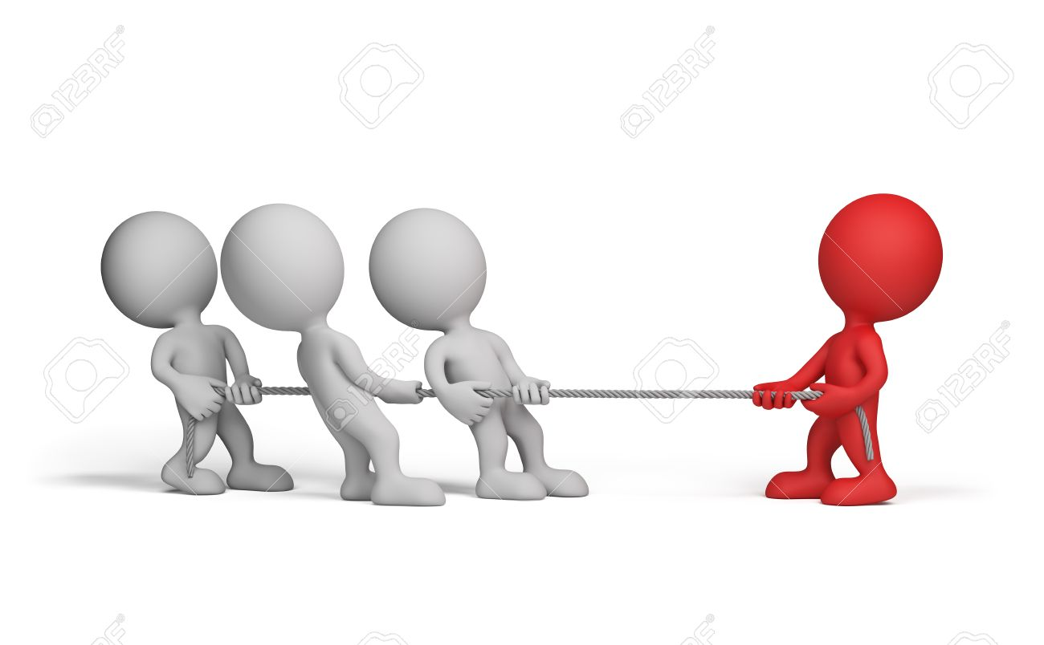

Slide 4
The ‘West’
Up to Bottom
‘Non-West’
Bottom to Up

Slide 5
A ‘Why do women in your culture cover their head ?’
B Not all women in ‘my culture’ wear Hijab
A ‘ Do you wear it in your country?’
B No, I do not, in ‘my culture’ it is optional to wear Hijab or not to.
A ‘Maybe, because you are you are different to them, or because you have changed when you came here’

Slide 7
Thank you

