Slide 1
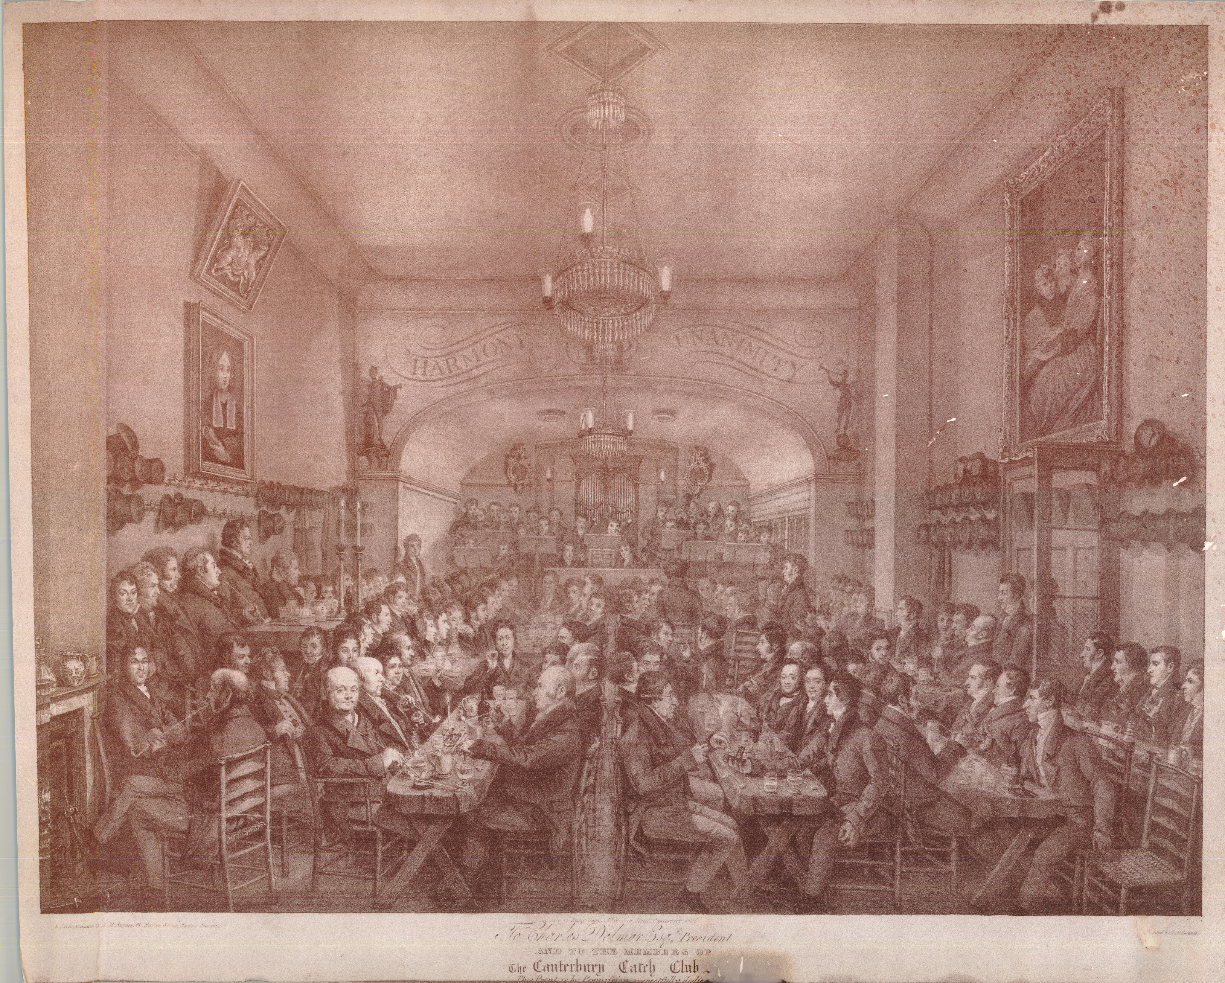
The Serpentine River…:
Rediscovering the Music
of the Canterbury Catch Club
Notes:
Sing: “Sirs, Sirs…”
Explain: What you have just heard is a catch, by one George Berg.

Slide 2
The City in 1768
Notes:
Cby late 18th c.
c. 10,000 people;
Quiet market town, a focus for agricultural activity around;
main industries were silk weaving (thanks to the Huguenots) and brewing, centering on the hop fields of Kent;
there were 13 breweries and over 100 pubs;
Hasted History of 1800 – citizens healthy and respectable, gentle people, clergy of superior rank and fortune;
and in 1779, in the Prince of Wales tavern in ‘Prince Orange’ Street, the Canterbury Catch Club was founded.

Slide 3
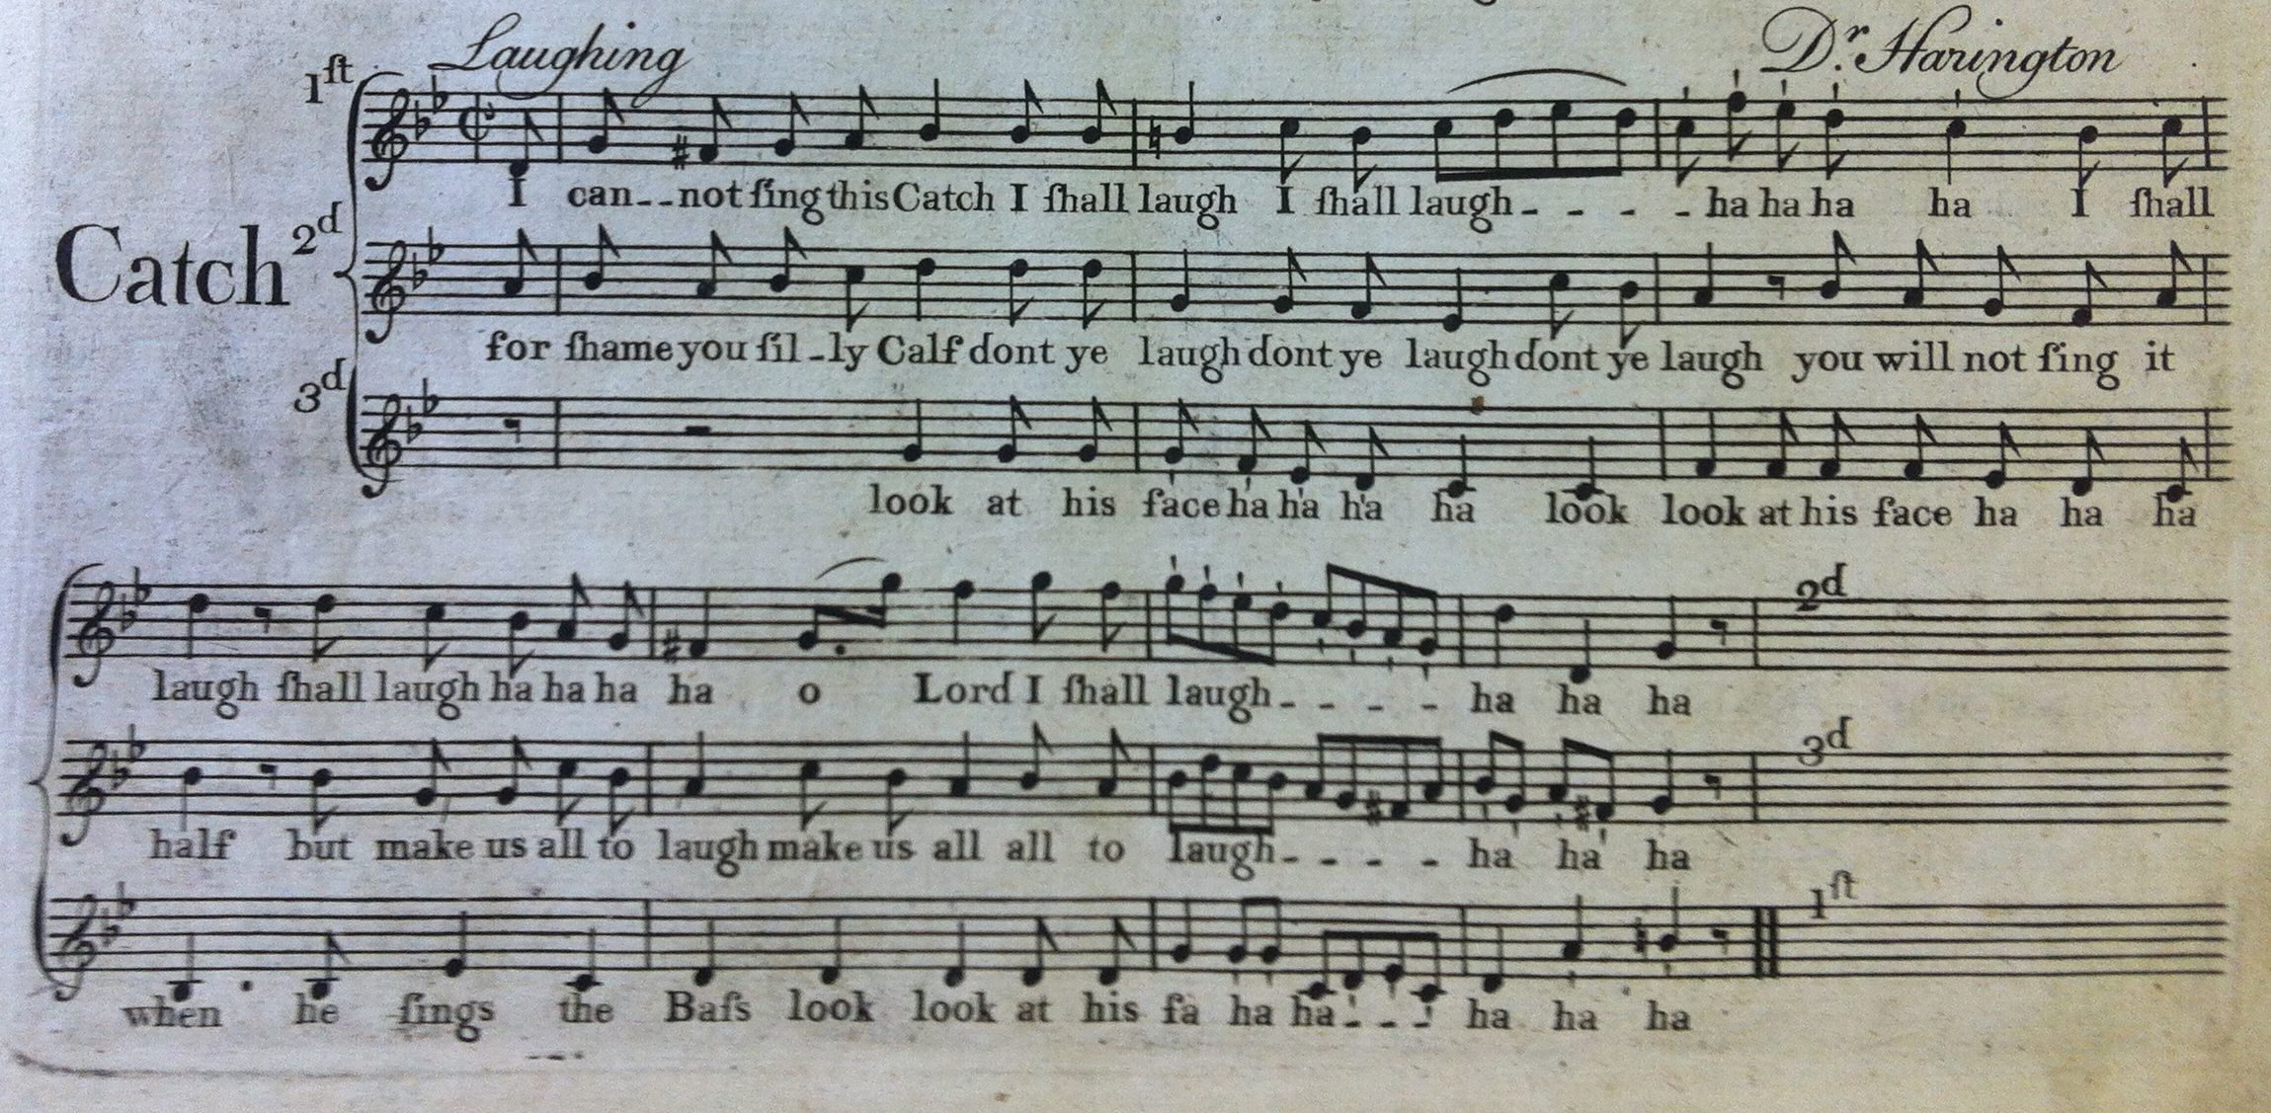
The Music: 1 - Catches
Notes:
The Catches:
this was a tradition dating back at least to the late 16th c., …
the catches were never intended to be a spectator sport; a very participatory form of music-making;
they work like a round;
Harington: I Cannot Sing this Catch on the difficulties of, well, singing catches; sing it!

Slide 4
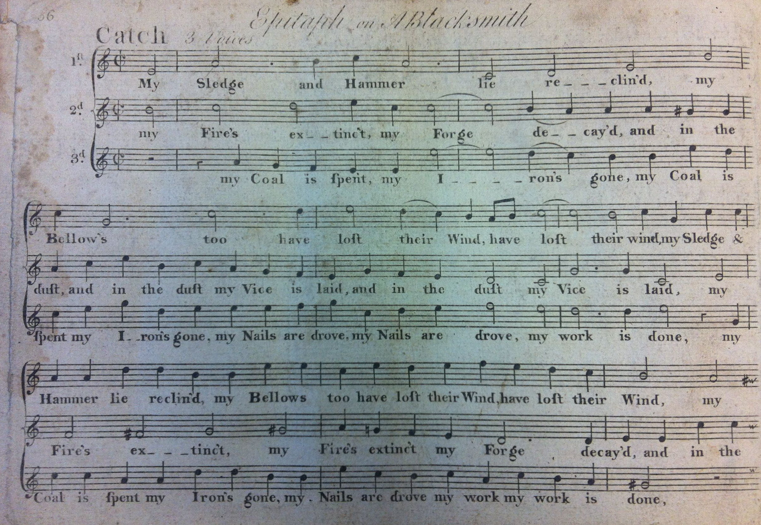
The Music: 1 - Catches
Notes:
Hayes Preface 1757 (NB connection with Cathedrals): “I found [catches] to be productive of the most desirable effects: viz. Cheerfulness and Good Humour, Friendship and a Love of Harmony; not to mention how much [their singing] contributed to the improvement of the younger practitioners, enabling them to sing readily at sight, by being accustomed to a variety of clefs and movements, and this, not by compulsion or drudgery, but by allurement, and the gratification of the pleasure they found in it themselves... Thus much may suffice as to the utility and laudable practice of frequently singing catches, and other little detached pieces of Vocal Harmony; and I cannot help wishing it may prove an inducement to others, my brethren of cathedrals especially, to encourage and promote such societies as the above; well knowing it will contribute greatly to their own satisfaction, the improvement of those who may stand in need of their assistance, and thereby, not a little, to the just execution of Church Music, or the support of any other Choral Performance…” He goes on to explain his practice of writing out catches in the modern manner: “I have often been witness to great difficulties…”; and then compares the Catch to the poetic Epigram: “much is to be expressed within a very small compass; and unless the term is neat and well appointed, it is of little value …Perhaps too, the poet’s compliment to the Epigram, might not undeservedly, in some respects, be applied to the Catch:
How does the little epigram delight
And charm us with its miniature of wit!
While tedious authors give the reader pain,
Weary his thoughts, and make him toil in vain;
When in less volumes we may pleasure find;
And what diverts, still best informs the mind.
Yalden"
We’re going to sing three more now: one, to demonstrate the delight in wordplay you often find:
Baildon: Epitaph on a Blacksmith (at least read the words…)

Slide 5
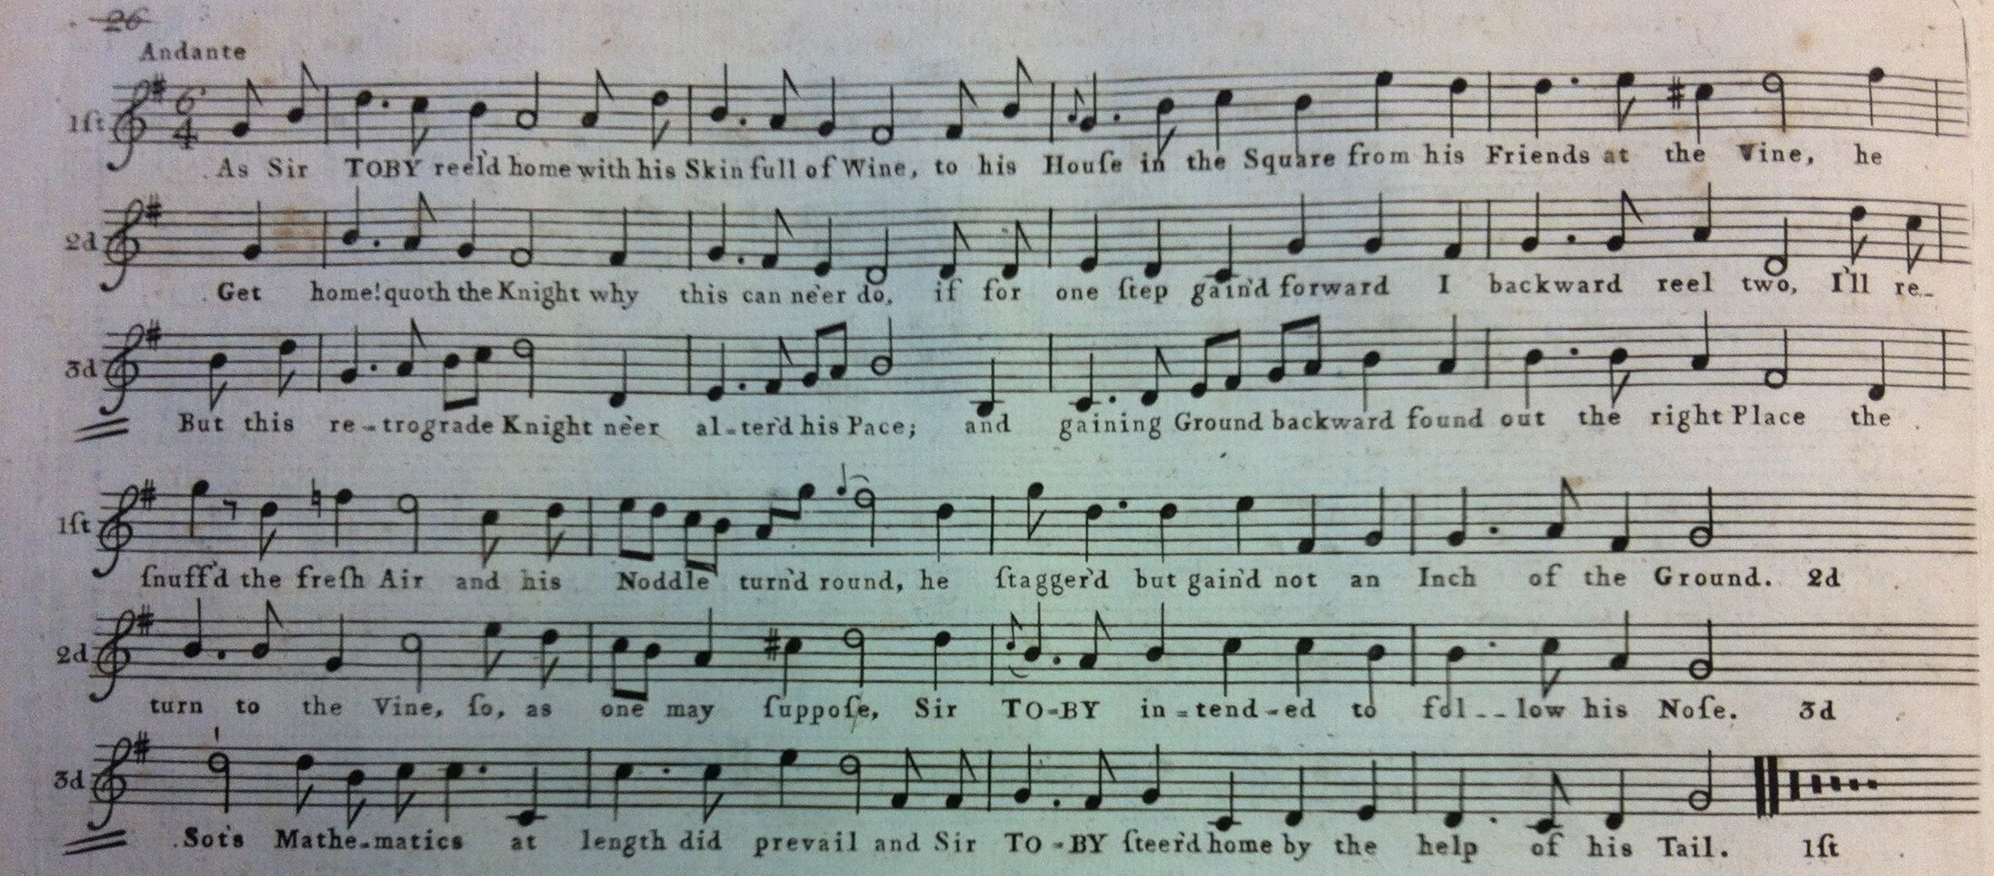
The Music: 1 - Catches
Notes:
There may also be a certain lack of respect for members of the upper classes:
As Sir Toby Reel’d Home

Slide 6
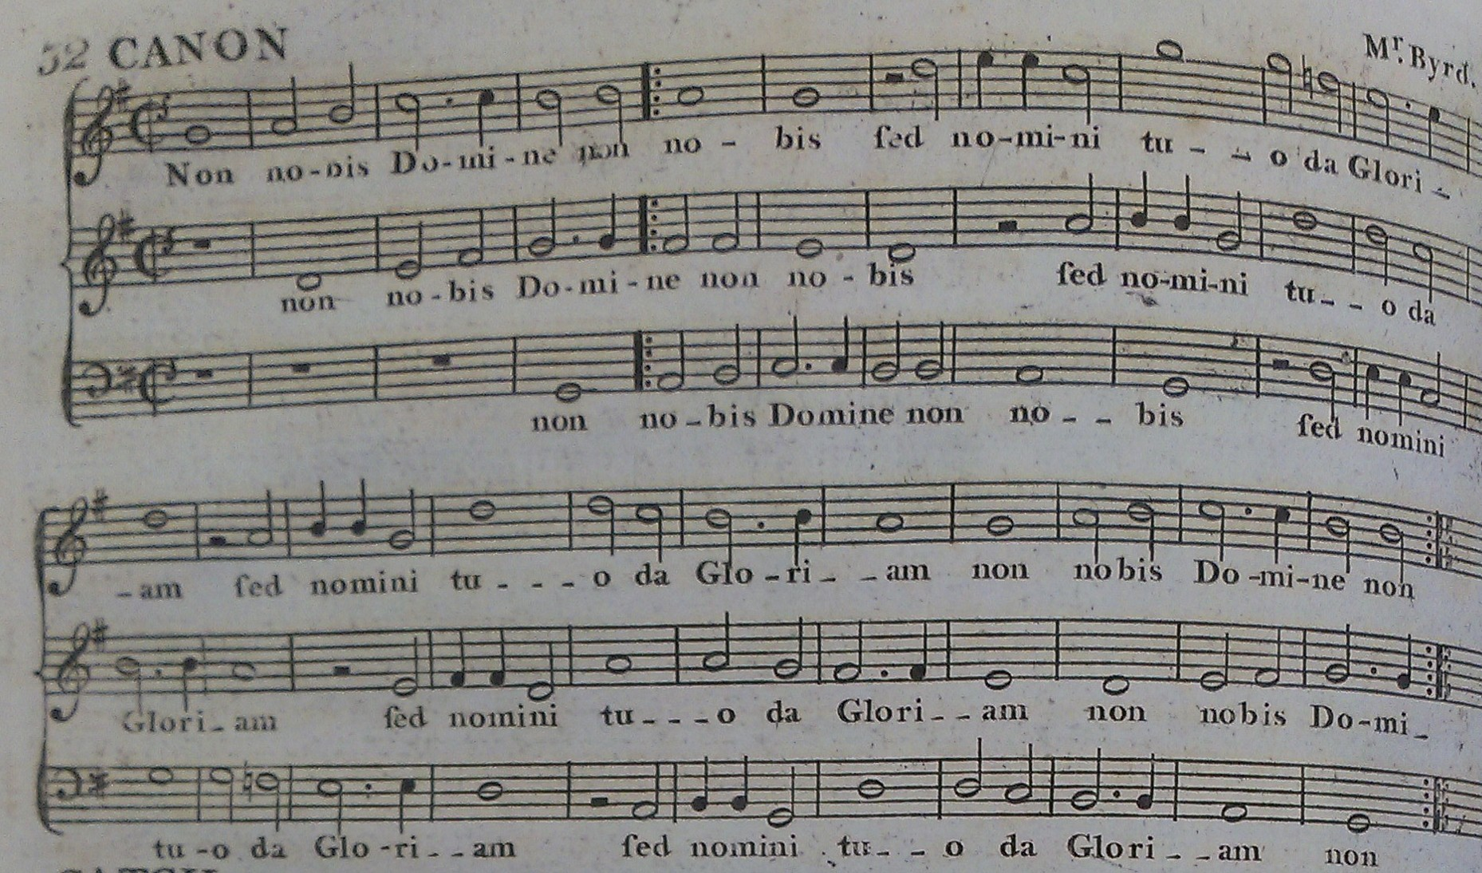
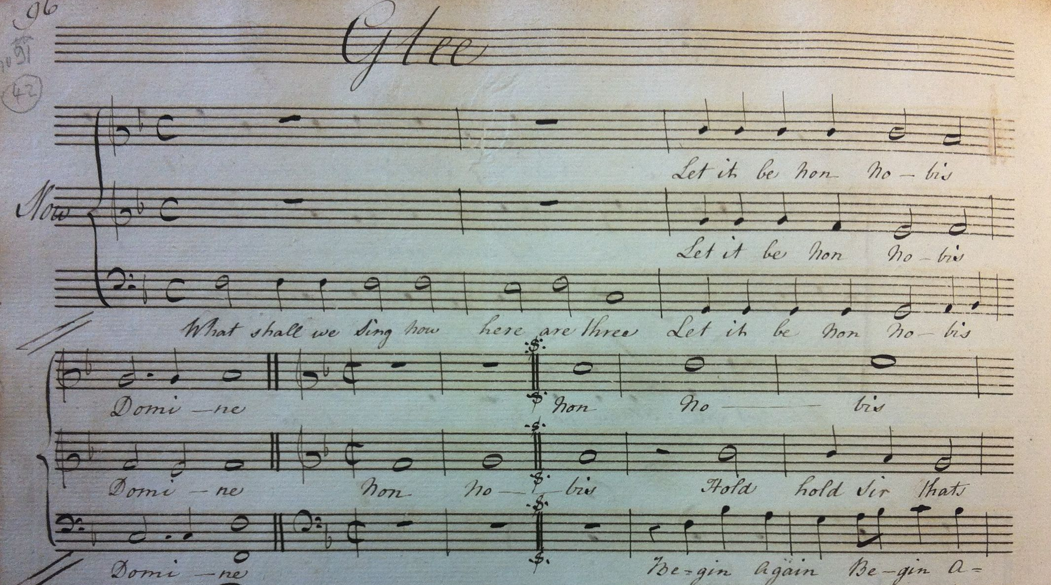
The Music: 1 - Catches
Notes:
The English character: a character of contradictions: if these catches are to be believed, we can be extremely salacious or sincerely reverent; cynical of social status or depressingly sycophantic - especially with respect to the monarchy, despite the general loathing of the Hanoverians; resolutely hedonistic whilst grimly aware of the frailty of human existence;
Here’s a very serious canon, treated not so seriously: Byrd’s well-known Non Nobis, Domine, followed by a much less reverent version in a little glee by Harington, in which a performance goes horribly wrong:

Slide 7
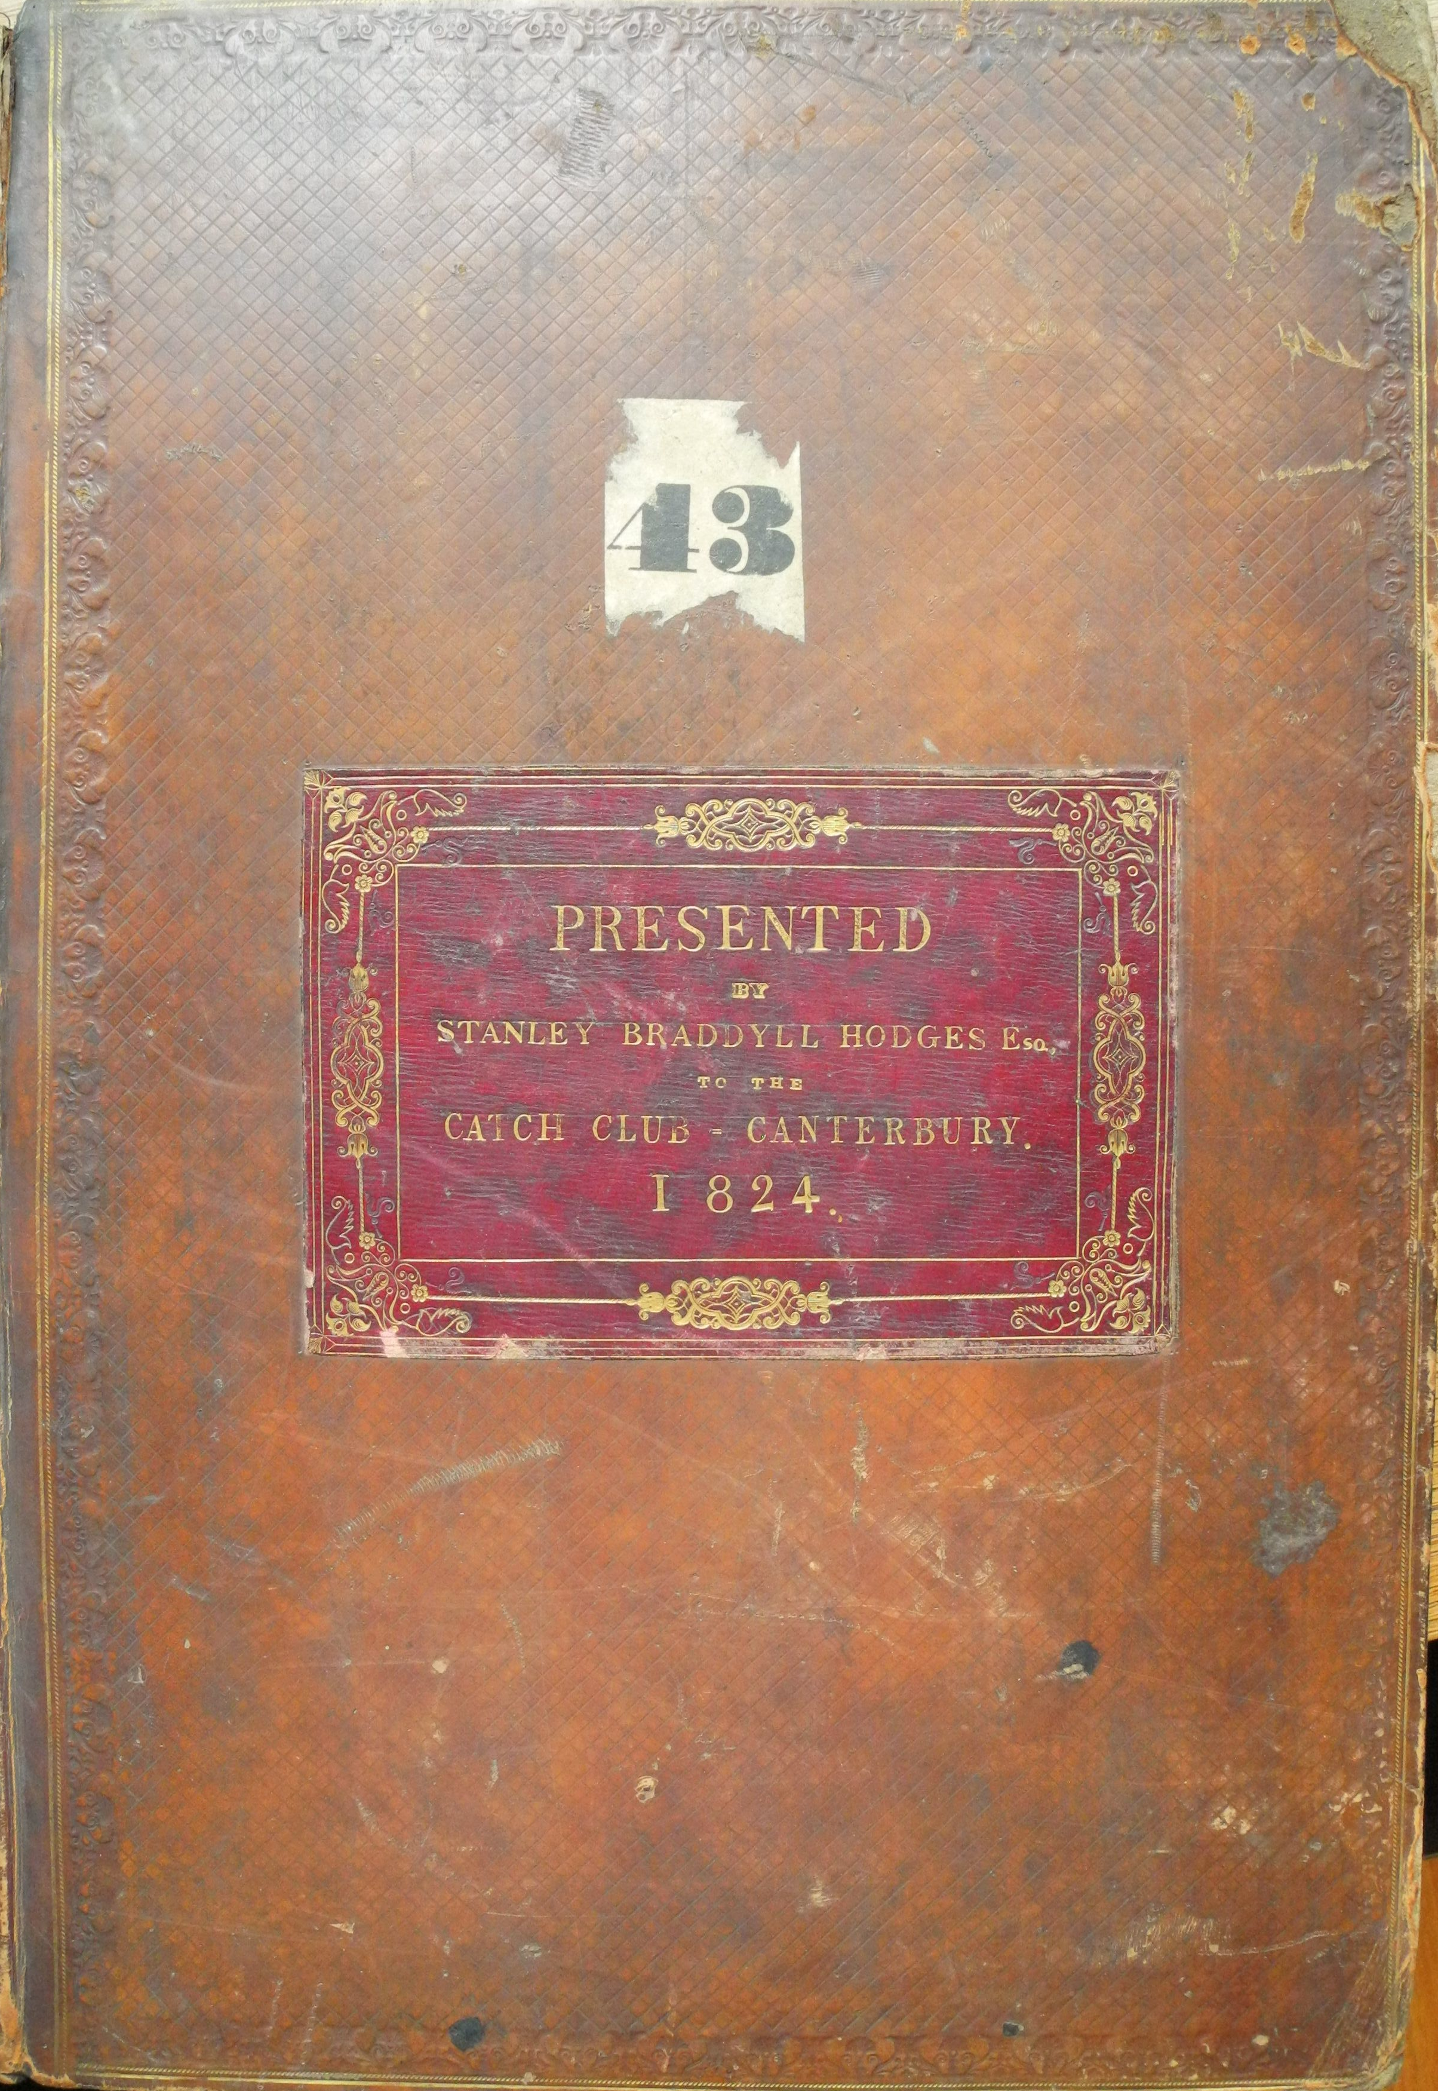
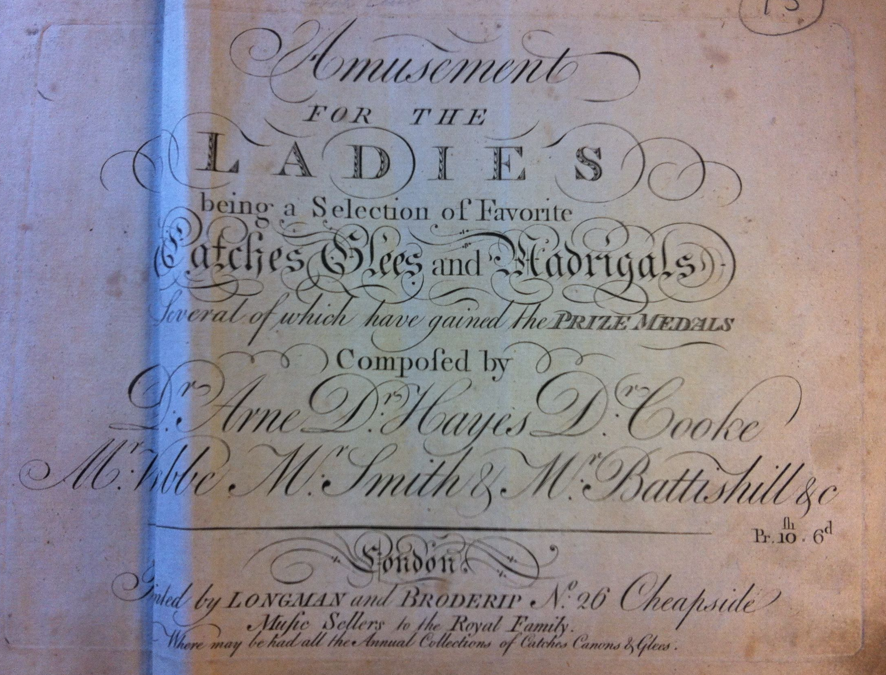
The material - 1
Notes:
The material (miraculously preserved thanks to an anonymous donation in 1915 - 50 years after the Club disbanded):
70 vols of vocal music in bound volumes, some dilapidated, some beautifully-preserved;
100+ vols of orchestral parts;
inside the vocal volumes:
single pieces, and collections of pieces…

Slide 8
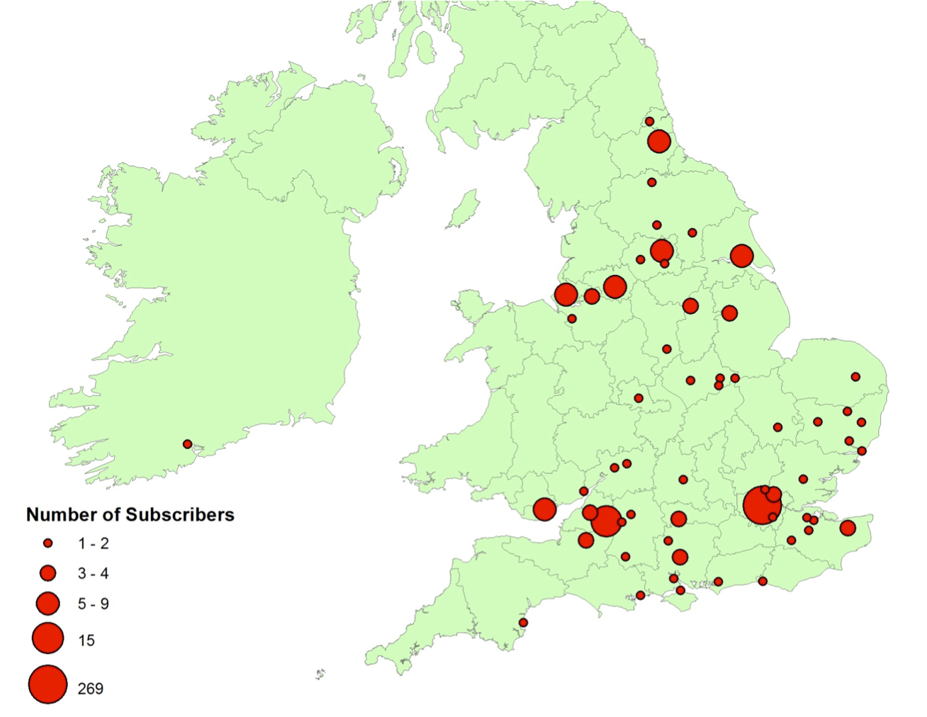
Notes:
And by the way: this shows the geographical distribution of the subscribers list for that 2-volume set.

Slide 9
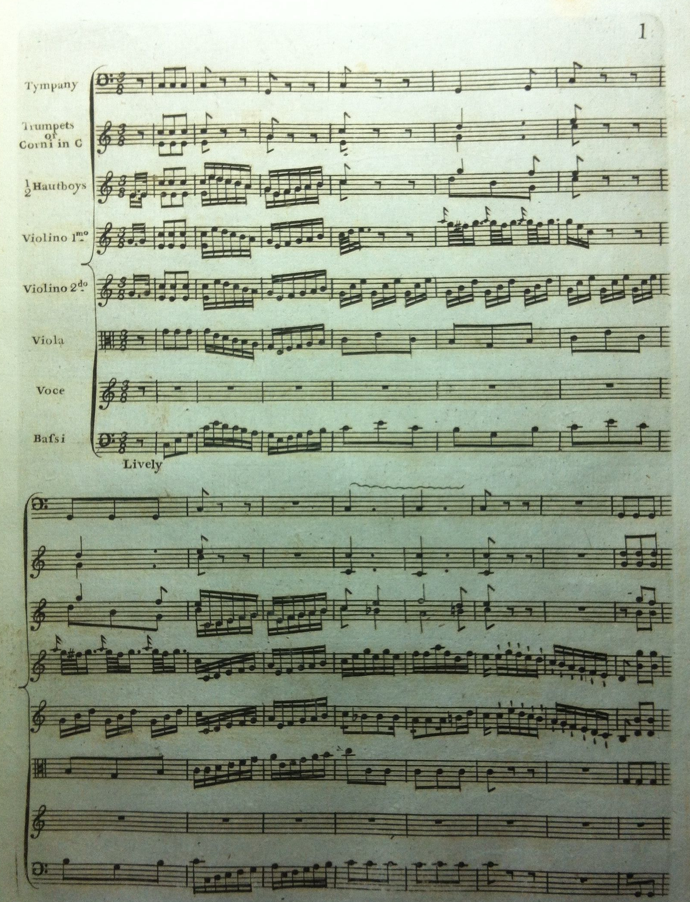
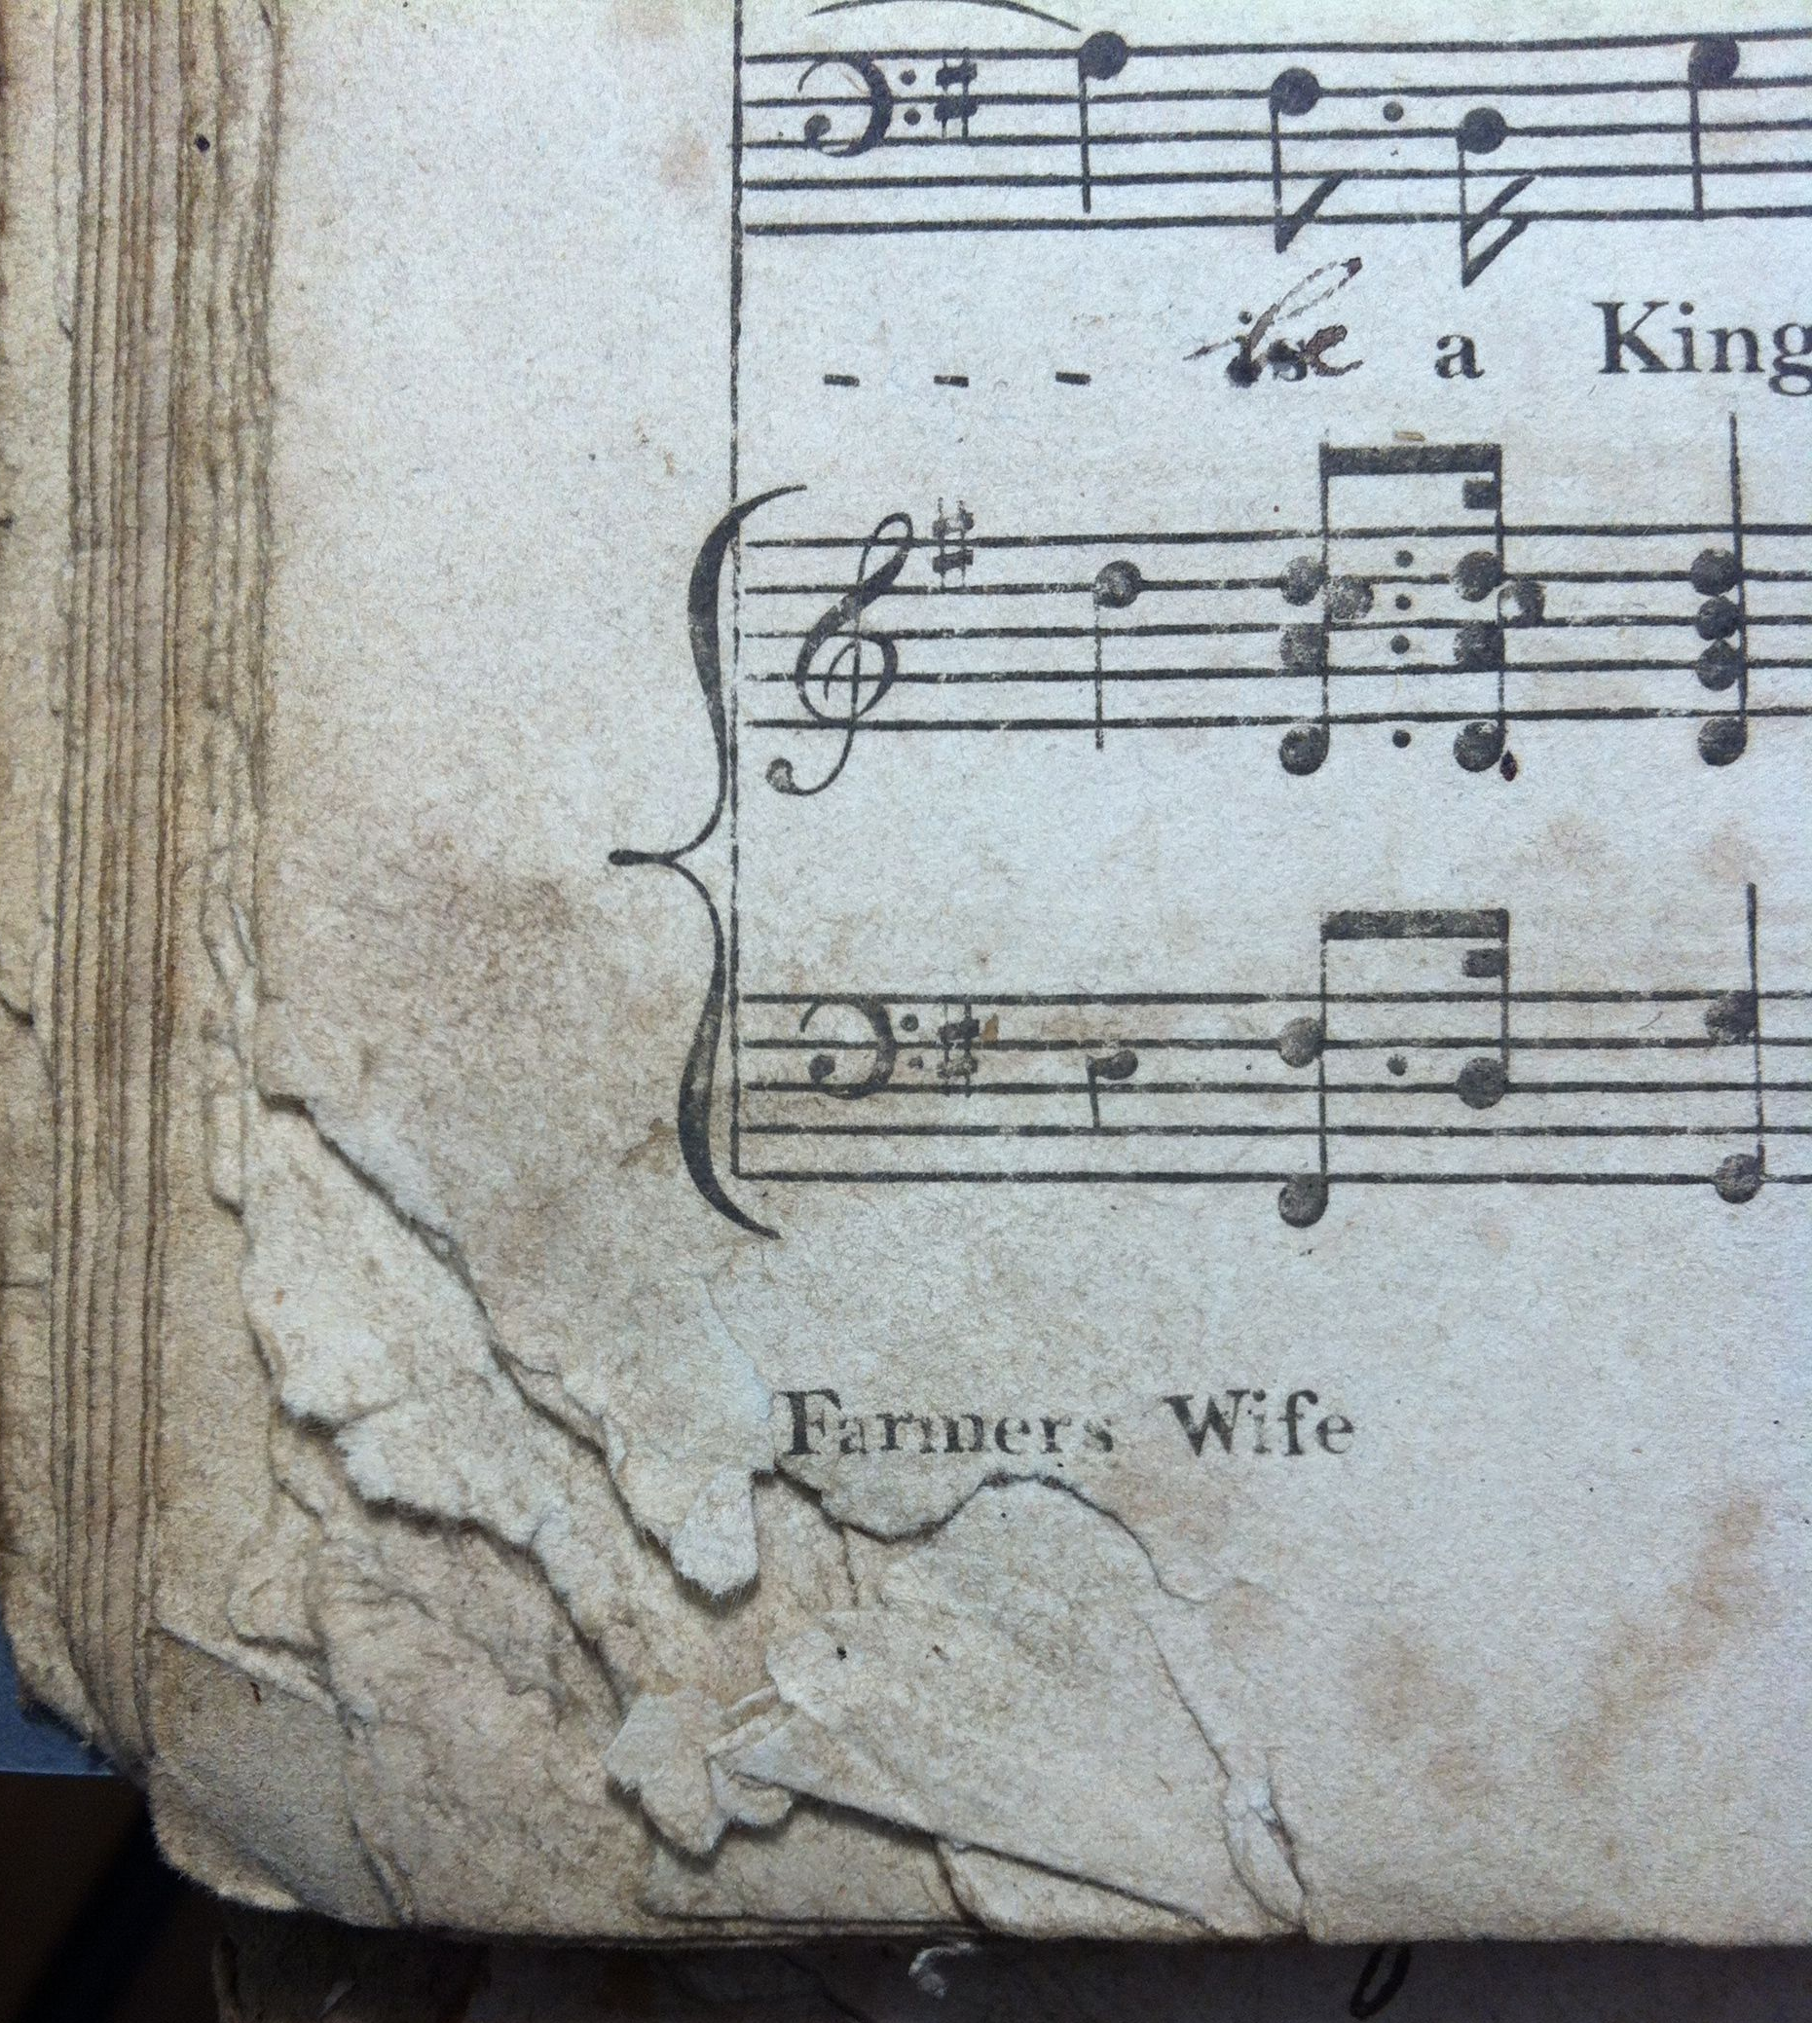
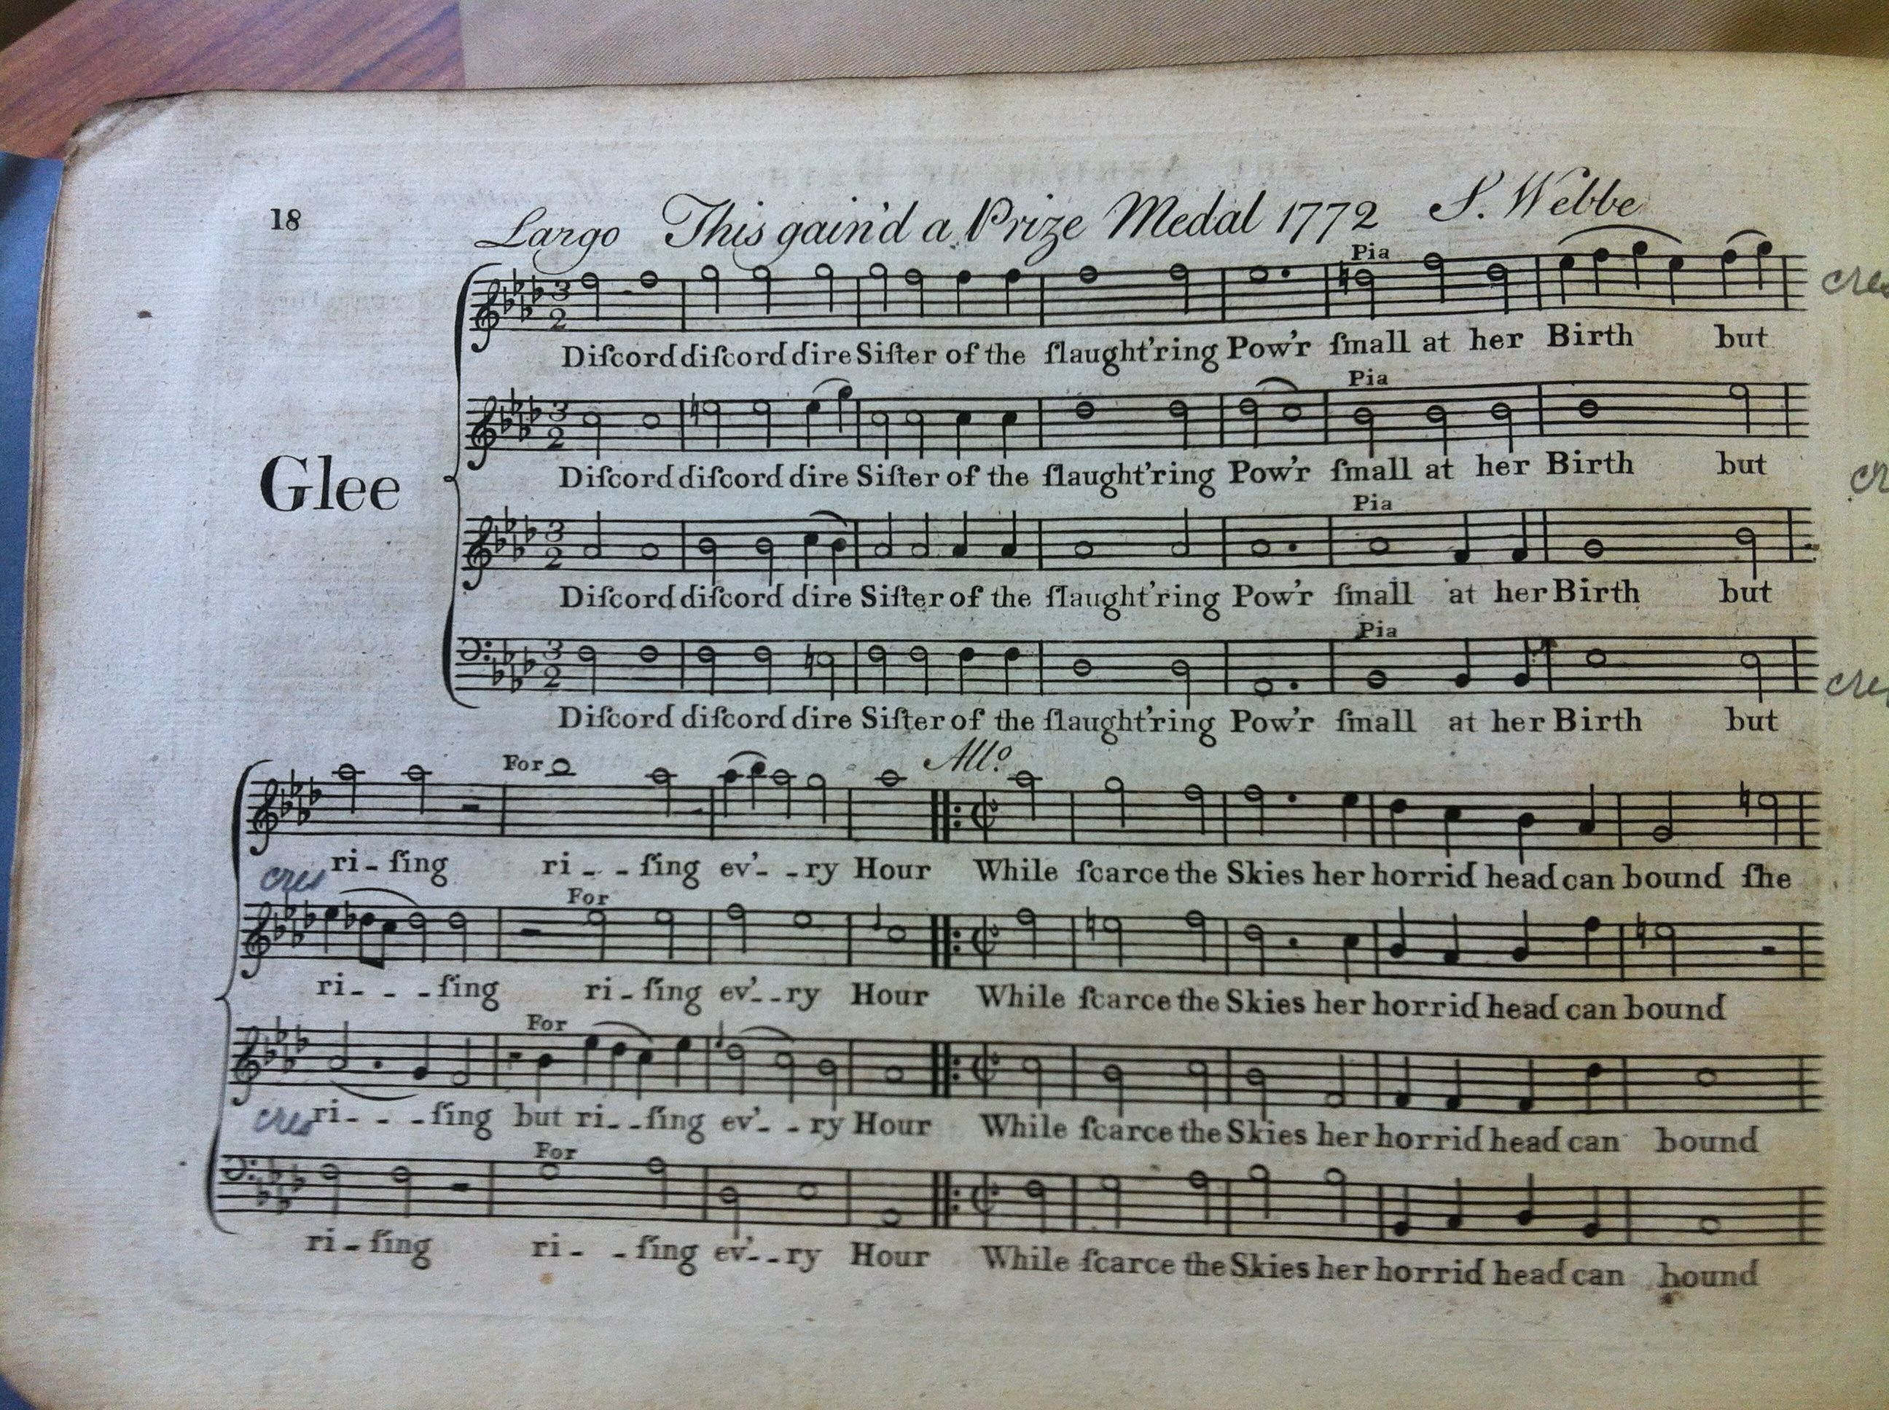
The material - 1
Notes:
inside the vocal volumes:
handwritten catches and glees in the early volumes;
printed editions collected indiscriminately in the later vols;
full scores in the last vols;
but intended to be used - see the well-thumbed corners…;
some original pieces by local musicians (Goodban, Porter, Saffery, Marsh);
and…

Slide 10
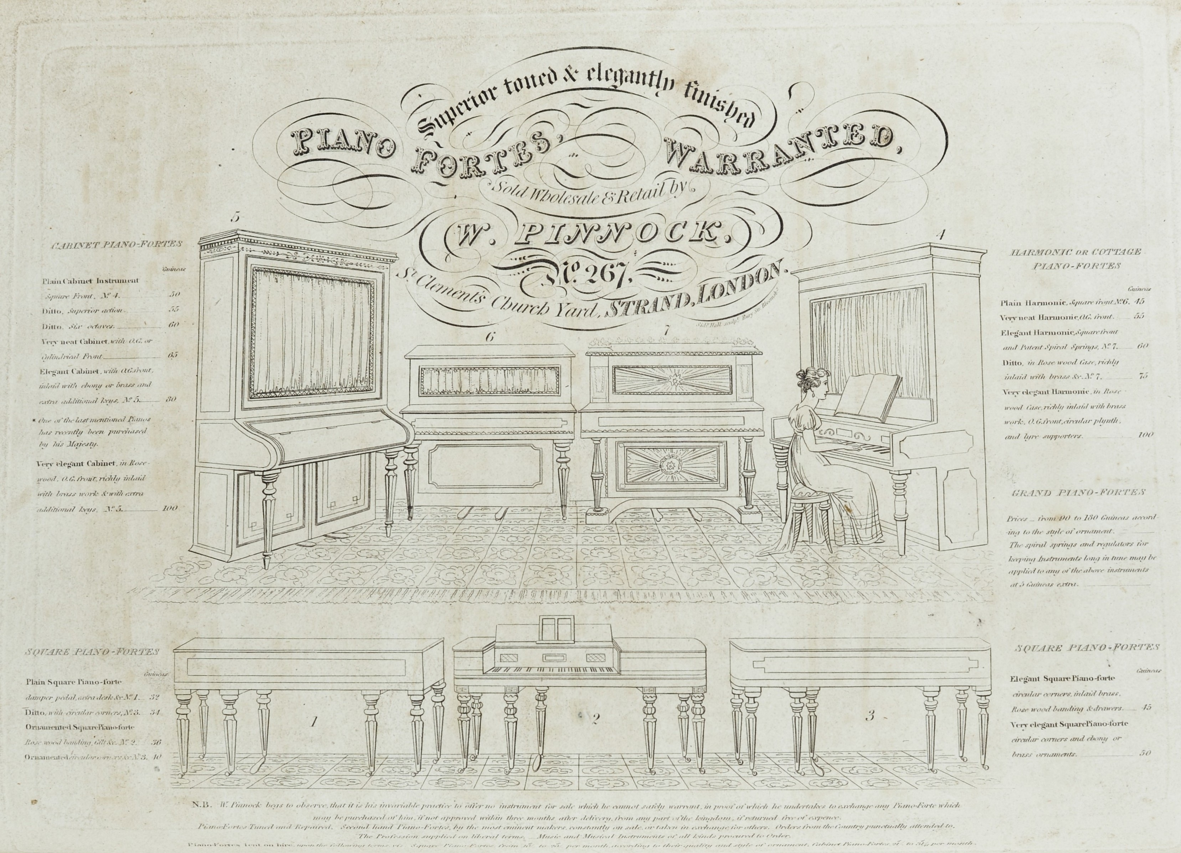
Notes:
… some beautiful advertisements!

Slide 11
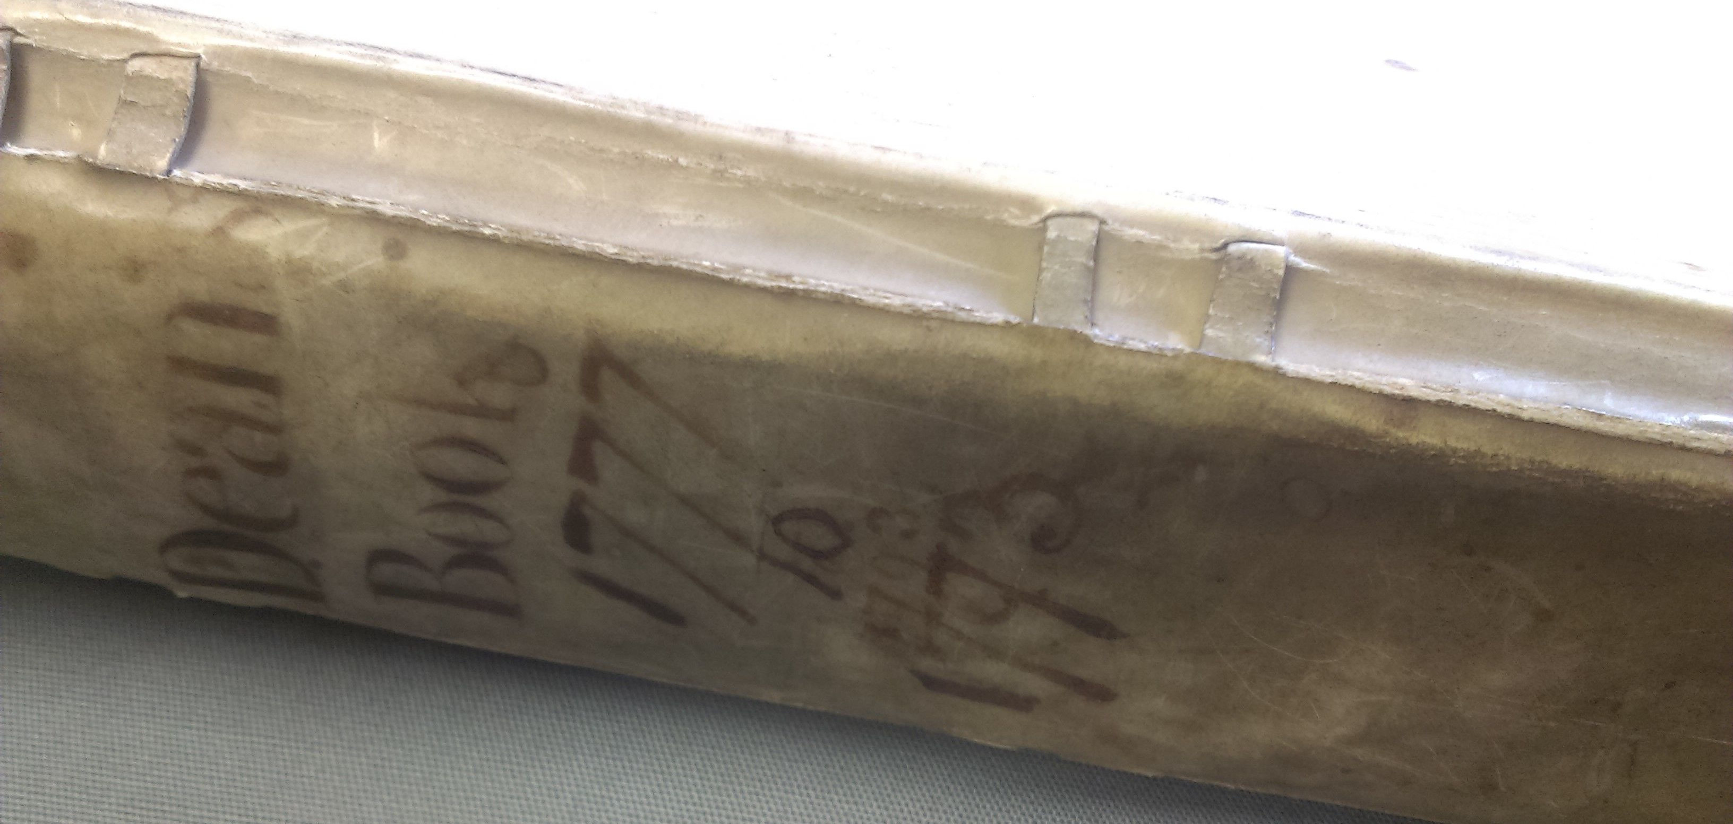
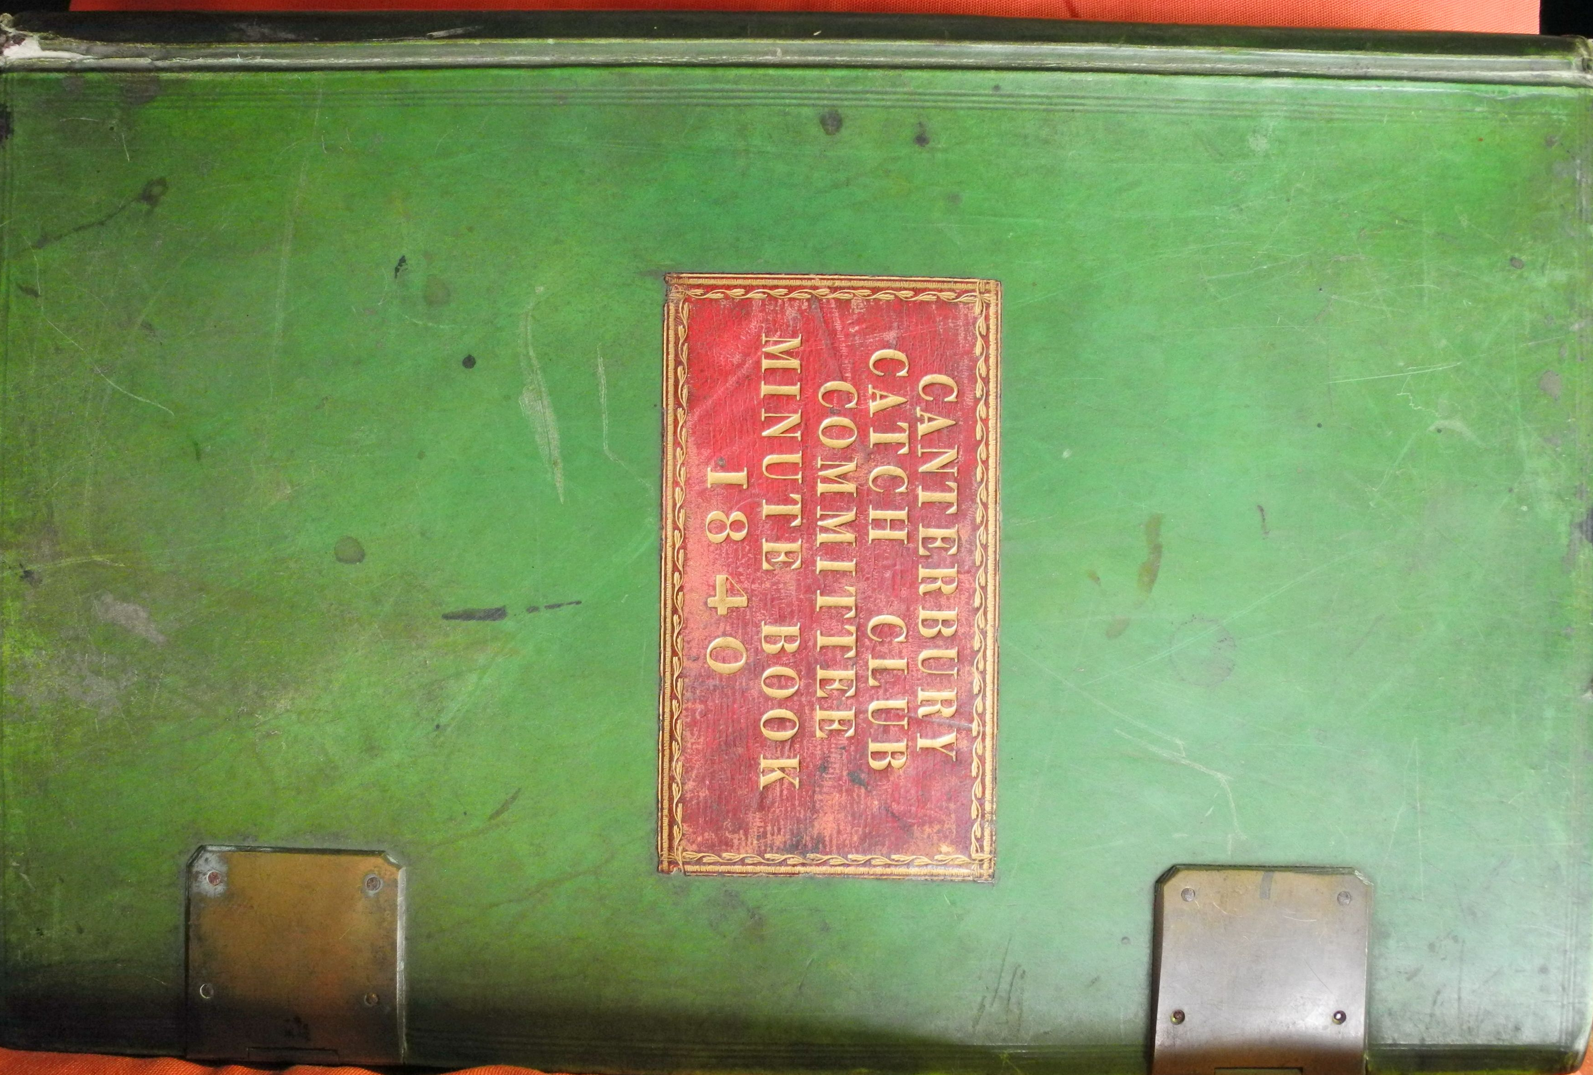
The material - 2
Notes:
The material Part 2:
from 1802:
Minute Books recording the Committee’s workings
Concert records x 2 (CCC and Longhurts’s volume in the Beaney)
and in the Cathedral Archives:
Dean’s and Precentor’s books - more later…
all this supplemented by the diaries of John Marsh (who lived in Cby 1783-7 and describes the CCC in great detail) and R.J.S. Stevens

Slide 12
The Catch Club Tradition
Notes:
What’s it all telling us?
The continuation & evolution of a tradition;
Marsh describes the CCC in great detail: “The price of admission to this club was only 6d., for which besides the music an unlimited quantity of pipes and tobacco and beer was allowed, in consequence of which many of the members, amongst the lower kinds of tradesmen, etc., used some 40 or 50 pipes (which was always enough to stifle a person at first entering the room, and was very disagreeable to the non-smokers); there were three ventilators in the ceiling in order, in some degree, to get rid of the smoke, but the room was so low-pitched and bad that notwithstanding this, it appeared as if we were all in a fog there.”
But if you’re looking at this picture and thinking, that doesn’t seem to go with the description, you’d be right: Marsh (remember, 1790s) was describing the tavern-based Catch Club (run by Goodban in Prince of Orange Street) which had been familiar to England for a couple of centuries – or more - and which was never the subject of a classy print like this, which shows the Club in its later accommodation, in the Guildhall; this Club seems to have gone up in the world.
Consider the 1802 Rules (NB - transition pic!):
First, that a Catch Club be established for the ensuing season.
Second, that every gentleman wishing to become a member of this club do on his submission subscribe half a guinea (NB: average wage in 1802: just over £1 a month) towards the liquidation of the present debts incurred by the purchase of the organ, other musical instruments, books, etc., in consequence of which the gentleman of the orchestra, in whom the property is at present vested, do agreed to transfer their rights in the said property to the members of the club at large.
Third, that every member do on his entrance each evening pay one shilling for which he will receive a sixpenny token; the other sixpence to be appropriated towards the necessary expenses of the club.
Fourth, that every member be subject to the forfeiture of sixpence for non-attendance on the club evening.

Slide 13
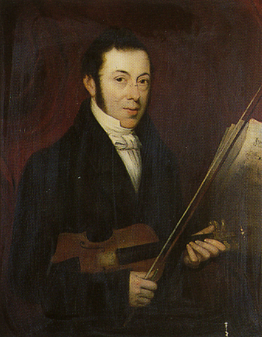
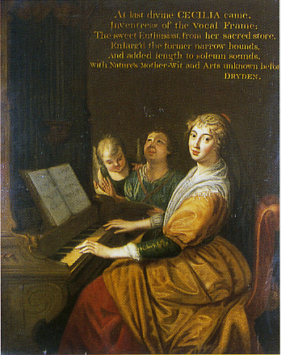
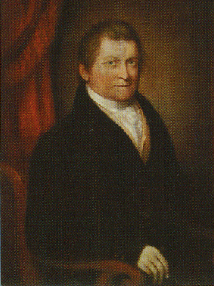
Thomas Goodban
Charles Delmar
Notes:
Portraitising - St Cecilia (Feast Day Nov 22), and the Club luminaries:
gentrification writ large…

Slide 14
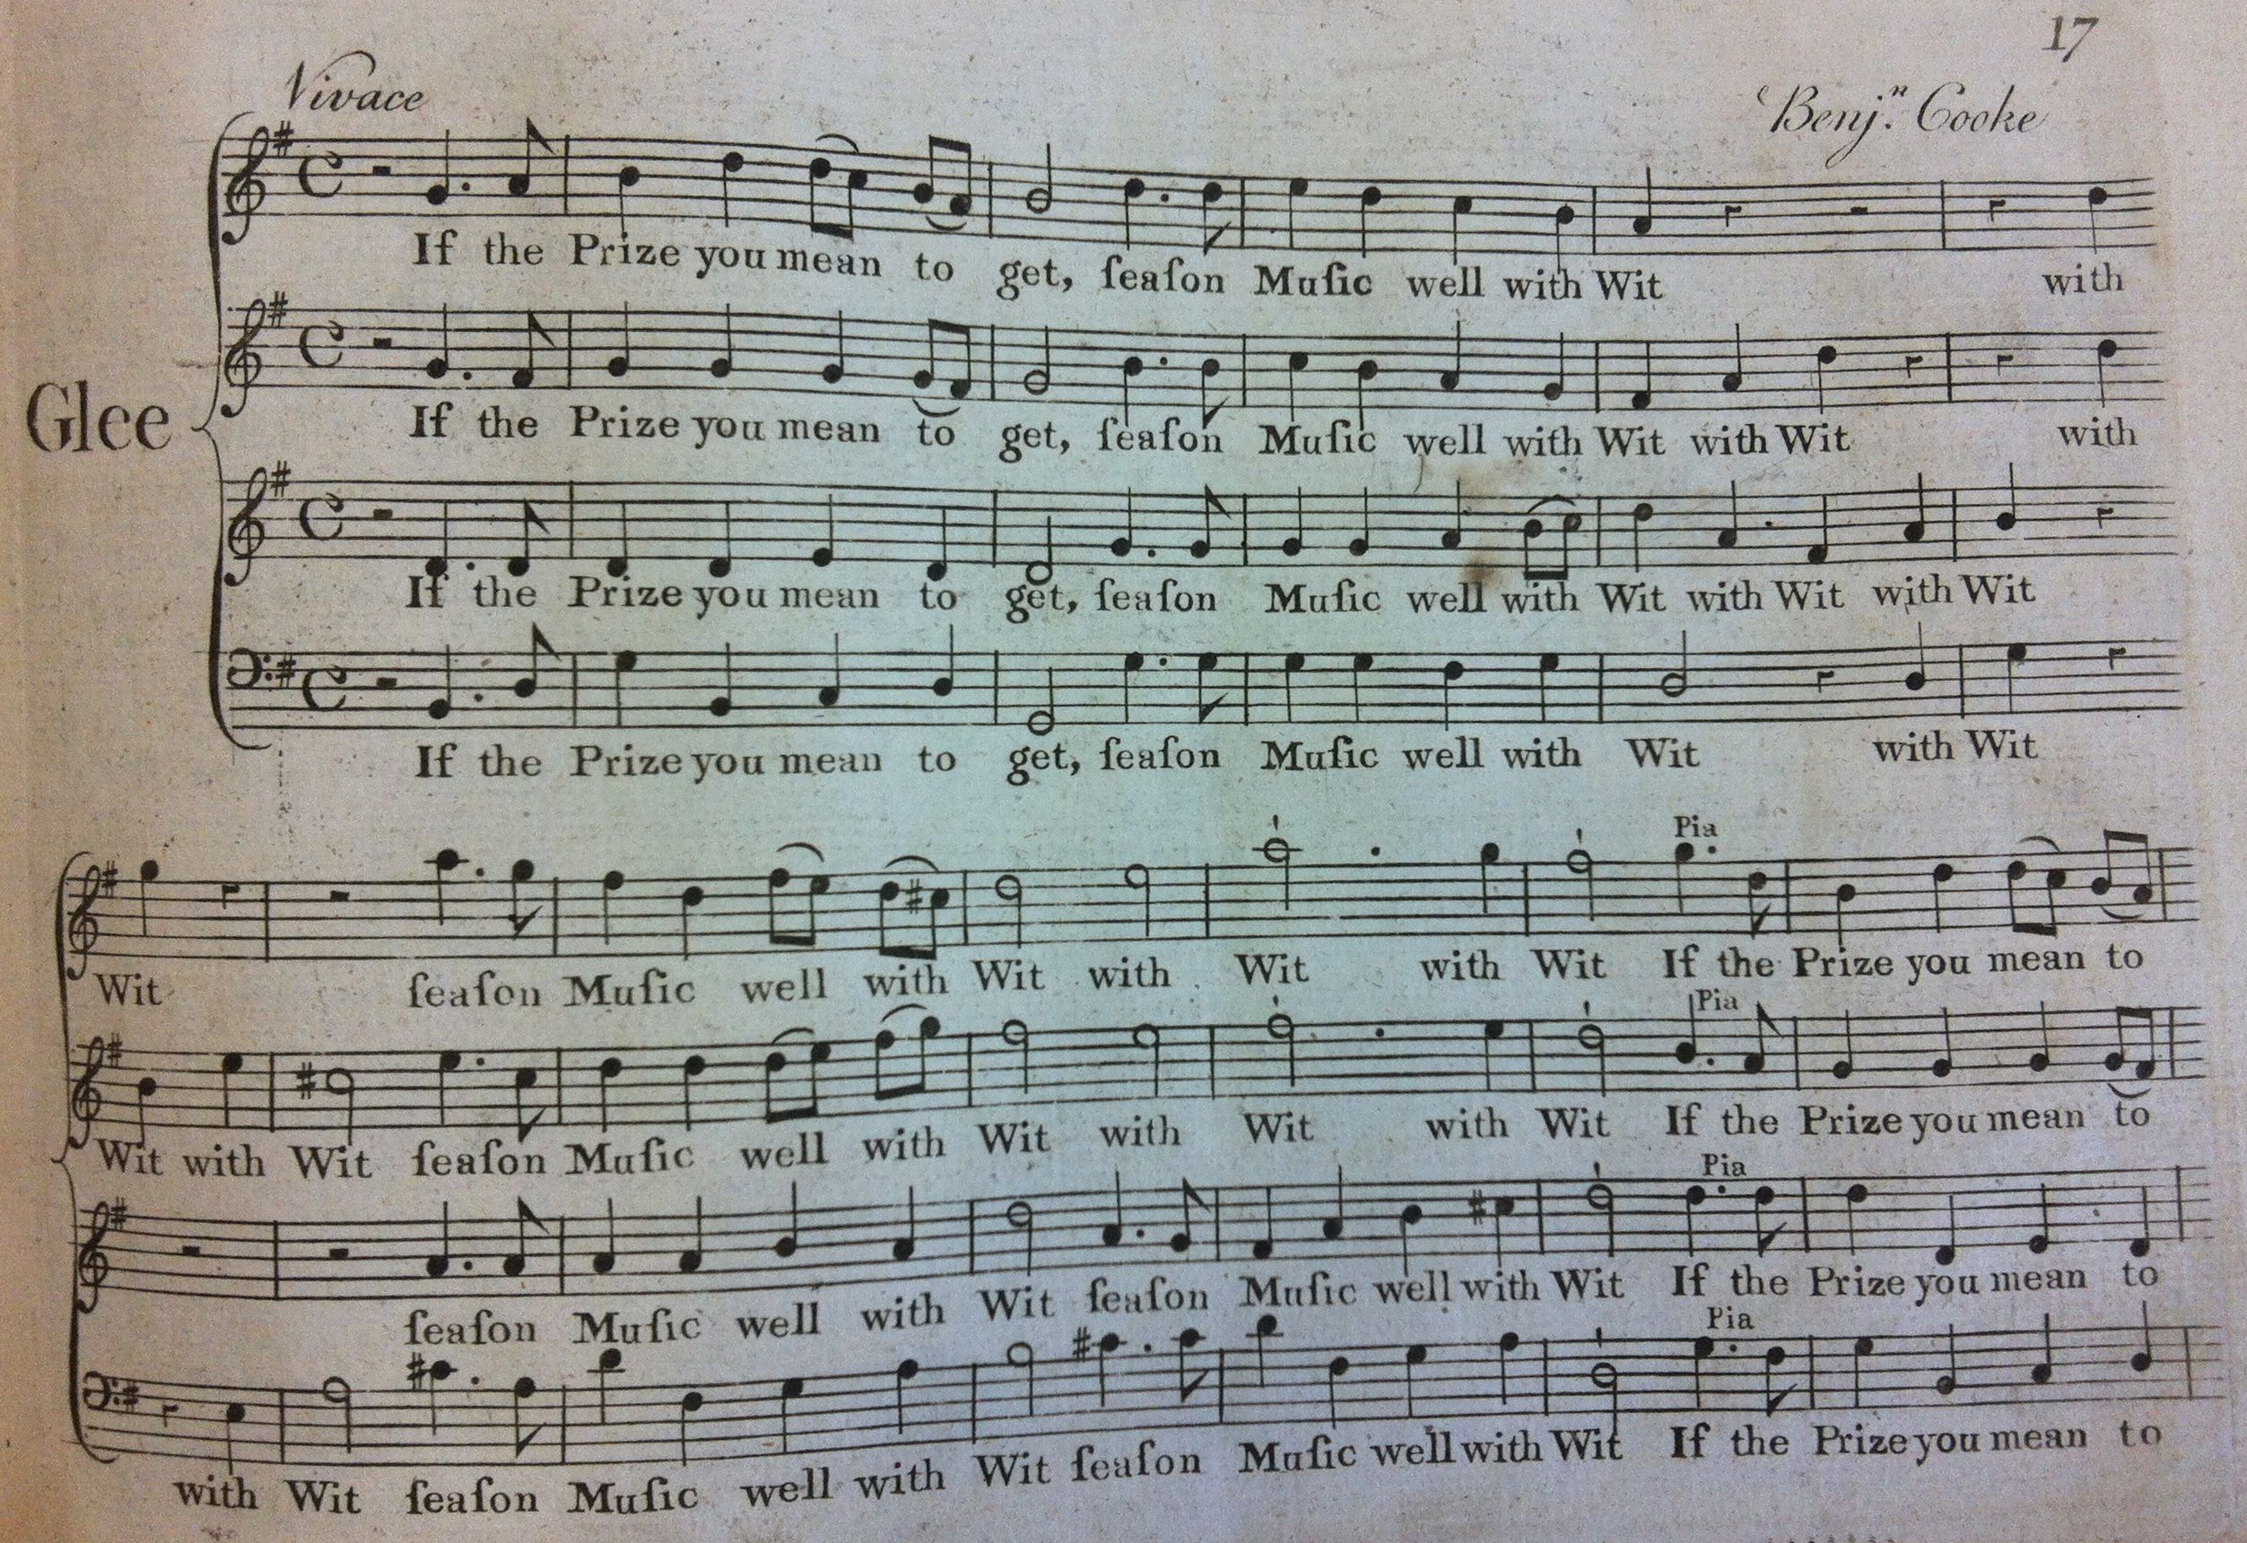
The Music: 2 - Glees: Cooke - If The Prize You Mean to Get
Notes:
Glees:
VW: “the 18th century, undistinguished as it undoubtedly was in the annals of music - oppressed as it was by the foreign fashionable domination of Italian operas and singers - was yet responsible for two exclusively English art forms - forces small in scope, and not of heroic build, but it was just in such forms as these that the English character found its true utterance; directly it went further it began to lose itself. These two forms are the Anglican chant and the glee… The glee is another purely English invention. It differs from the madrigal in that it moves in blocks of harmony rather than contrapuntally, and, rather like the ‘verse’ anthem, consists of several short movements. The glee is written for solo voices, usually those of men, the top voice being almost invariably an alto. It is this alto voice which largely helps to give a special character to the glee, and to distinguish it honourably from the flood of music for tenor and bass chorus, which swept over Germany a little later.”.
some 3,000 published between 1760-1830
Cooke (NB biog detail, from Anecdotes, Biographical Sketches, and Memoirs, collected by Letitia Matilda Hawkins - daughter of John Hawkins; reproduced in The Harmonicon 1823): “one of the worthiest and best-tempered men that ever existed; and though at an early period of life he had obtained a very high-rank in his profession, he had escaped all the ills connected with music and prosperity.”
Sing If the Prize You Mean to Get: how to win one of the N&GCCoE prizes (10 guineas; NB. organist’s salary £30 per annum)

Slide 15
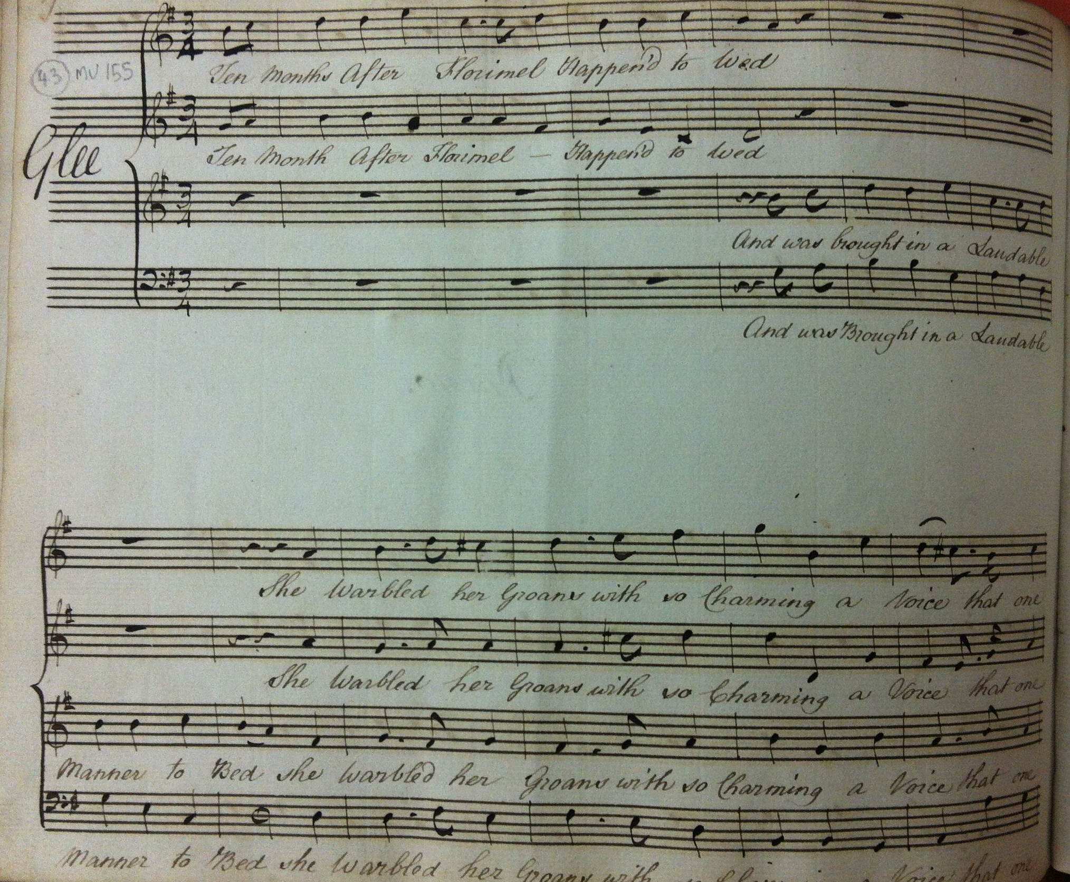
Marsh - Ten Months After Florimel Happen’d to Wed
Notes:
Saucy as a catch could be, this piece by Marsh notes the difference between a ‘maid’ and a wife…

Slide 16
Webbe - Discord
Notes:
Here’s one which DID win a prize: note the sectional structure (like a tiny Baroque suite, jammed together), and light-hearted triple-time ending. A real feel for the words - also his own work.
Sing Webbe: Discord

Slide 17
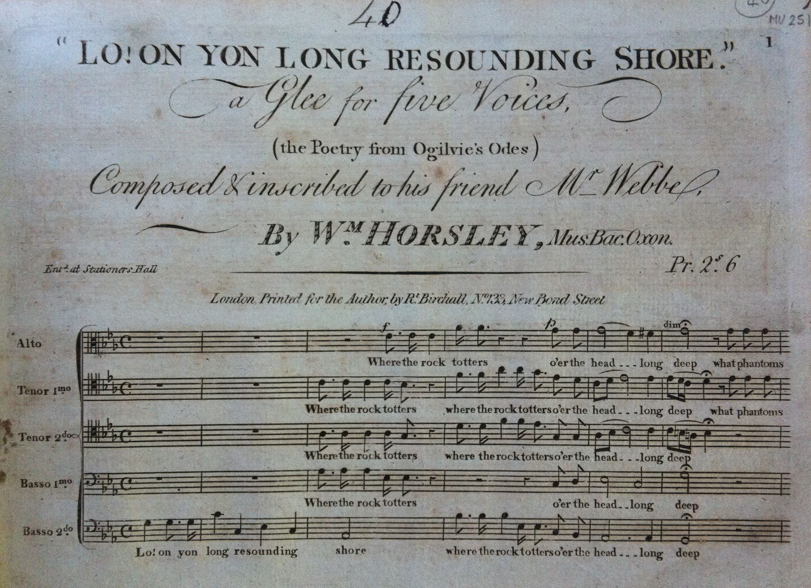
Horsley - Lo On Yon Long-resounding Shore
Notes:
Webbe was universally respected for his achievement. He took over as Secretary to the Nobs and Gents when Thomas Warren, who later took to calling himself Warren Horne, very confusingly, retired.
So it’s not surprising that the younger generation of composers might show their reverence by dedicating their work. It wouldn’t have harmed their chances of being noticed, either, though being Callcott’s son-in-law was a good start for William Horsely.
The choice of texts was interesting; Ogilvie is not often anthologised these days…

Slide 18
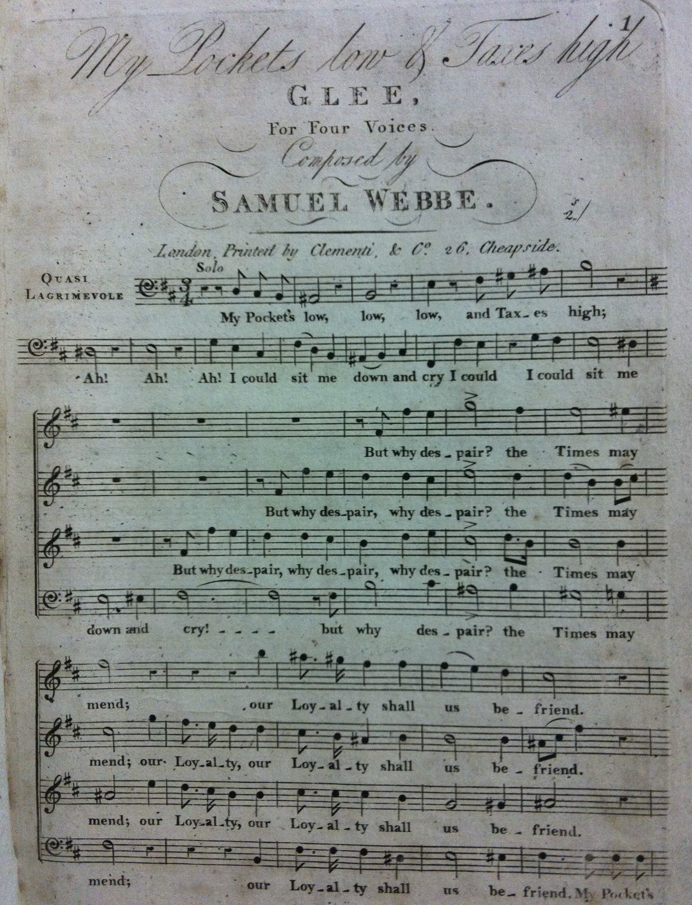
Webbe - My Pocket’s Low
Notes:
Webbe: My Pocket’s Low

Slide 19
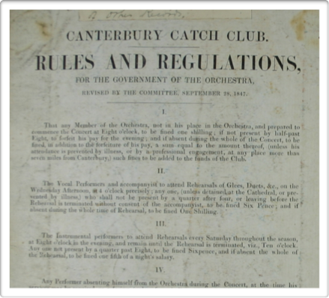
The Cathedral musicians
Notes:
The Musicians:
lowly status, cf:
Earles’ Microcosmographie (1628): “The common singing men in cathedral churches are a bad society and yet a company of good fellows, that roar deep in the Quire, deeper in the Tavern… their skill in melody makes them the better companions abroad, and their anthems abler to sing catches.”
Cathedral admonition of all the Lay Clerks in 1770 for ‘neglect of duty’, en masse;
CCC treatment of the orchestral players as ‘honorary members’ - but NOT to mix with the membership in the concert-hall when not playing…
…following the example of the London Noblemen and Gentlemen’s Catch Club (the ‘Nobs and Gents’).
NB: one such club advertised the fact that they were NOT going to engage ‘honorary members’!;
NB: the Orchestra Rules: “2: The vocal performers and accompanyists to attend rehearsals of Glees, Duets, &c., on the Wednesday Afternoon at 4 o’clock precisely; anyone, (unless detained at the Cathedral, or prevented by illness,) who shall not be present by a quarter after four, or leaving before the Rehearsal is terminated without consent of the accompanyist, to be fined Six Pence; and if absent during the whole time of Rehearsal, to be fined One Shilling.”
…so the Cathedral connection is clear; and we get a more detailed view of that if we look more closely at those other books I mentioned earlier…

Slide 20
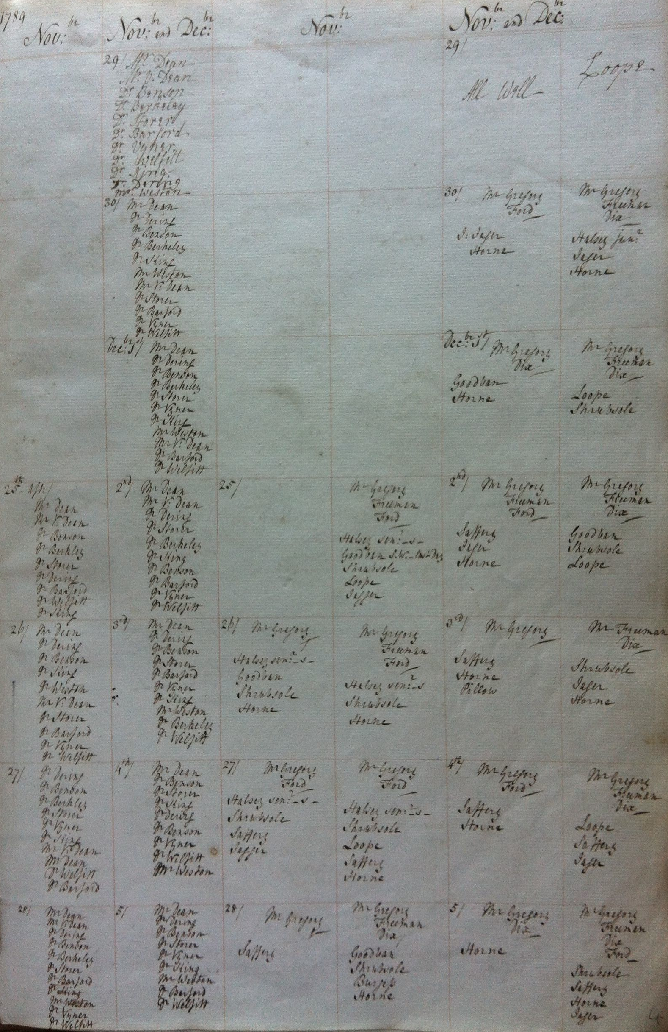
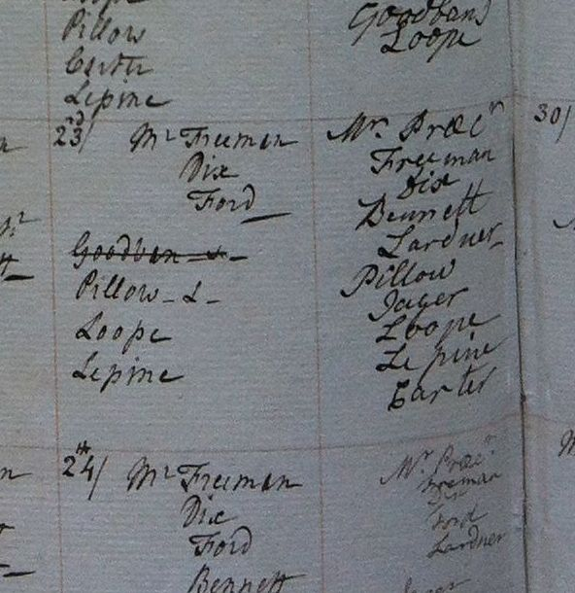
The Cathedral musicians
Notes:
from 1802:
Minute Books recording the Committee’s workings (we know there was a Committee from inscriptions like this one at the back of Vol 5 of the music, but we don’t have the records before 1802.
Concert records x 2 (CCC and Longhurts’s volume in the Beaney)
and Dean’s and Precentor’s books:
note the death of Goodban in 1802

Slide 21
Notes:
We’re taking our leave of the Canterbury Catch Club now. Only a generation after its passing, the Kentish Gazette wondered at them, in 1900: “What manner of men they were in those early days we can only surmise, but about 1830 a historic print of the Catch Club was executed … and it is impossible to help smiling at the rows of sedate-looking citizens, all wearing the dress coat and white “neckcloth” of the period, and each one puffing at a church-warden clay pipe full half a yard long. In this print the room represented was called the Apollonian Hall and was then attached to the Prince of Orange Inn; it is now the Odd Fellows Hall.”
There is no doubt that we are looking at a little bubble of time, place and society. Ideas of democracy were no more advanced than the Ancient Greeks - at the time of this print, slavery had not yet been abolished, though the trade had, and their consideration of the lower orders was not much more inclusive – remember this was the age E.P. Thompson described as one which moved from a moral to a monetary economy; attitudes to women seem primitive to us now, and their sycophantic support of the monarchy has any Republican weeping. Enjoyable as their repertoire is, it cheerfully ignores the destruction of the English countryside by means of the Enclosure Acts, the dehumanisation of the vast majority of the population as a result of industrialisation, the flat refusal to empower and enfranchise women… this really doesn’t stand up to scrutiny by any modern political, social or philosophical measure.
But, for the defence, they bequeathed to us an important part our enlightened humanity: a love of music for its own sake, for its worth as a vehicle for communal, participatory conviviality, coupled with an acceptance of a truth we would nowadays prefer to forget: that life, if not entirely nasty and brutish for them - or us, now – is short, and in response to that certainty, the only thing worth taking seriously in our brief span upon this mortal coil is the fact that there is nothing worth taking seriously.
So let’s end with a suitably roisterous song: As Thomas was Cudgell’d One Day By His Wife, specially arranged for a non-participatory audience: we sing the lines individually, with a delicate accompaniment (safety in numbers), then you’ll hear it as one mass (morass?) of melodies at once - try and get an idea of what the Catch Club meeting would have sounded like as they all bellowed this at one another, late into the evening…

Slide 22
Any Questions?
www.canterburycatchclub.org

