Slide 1
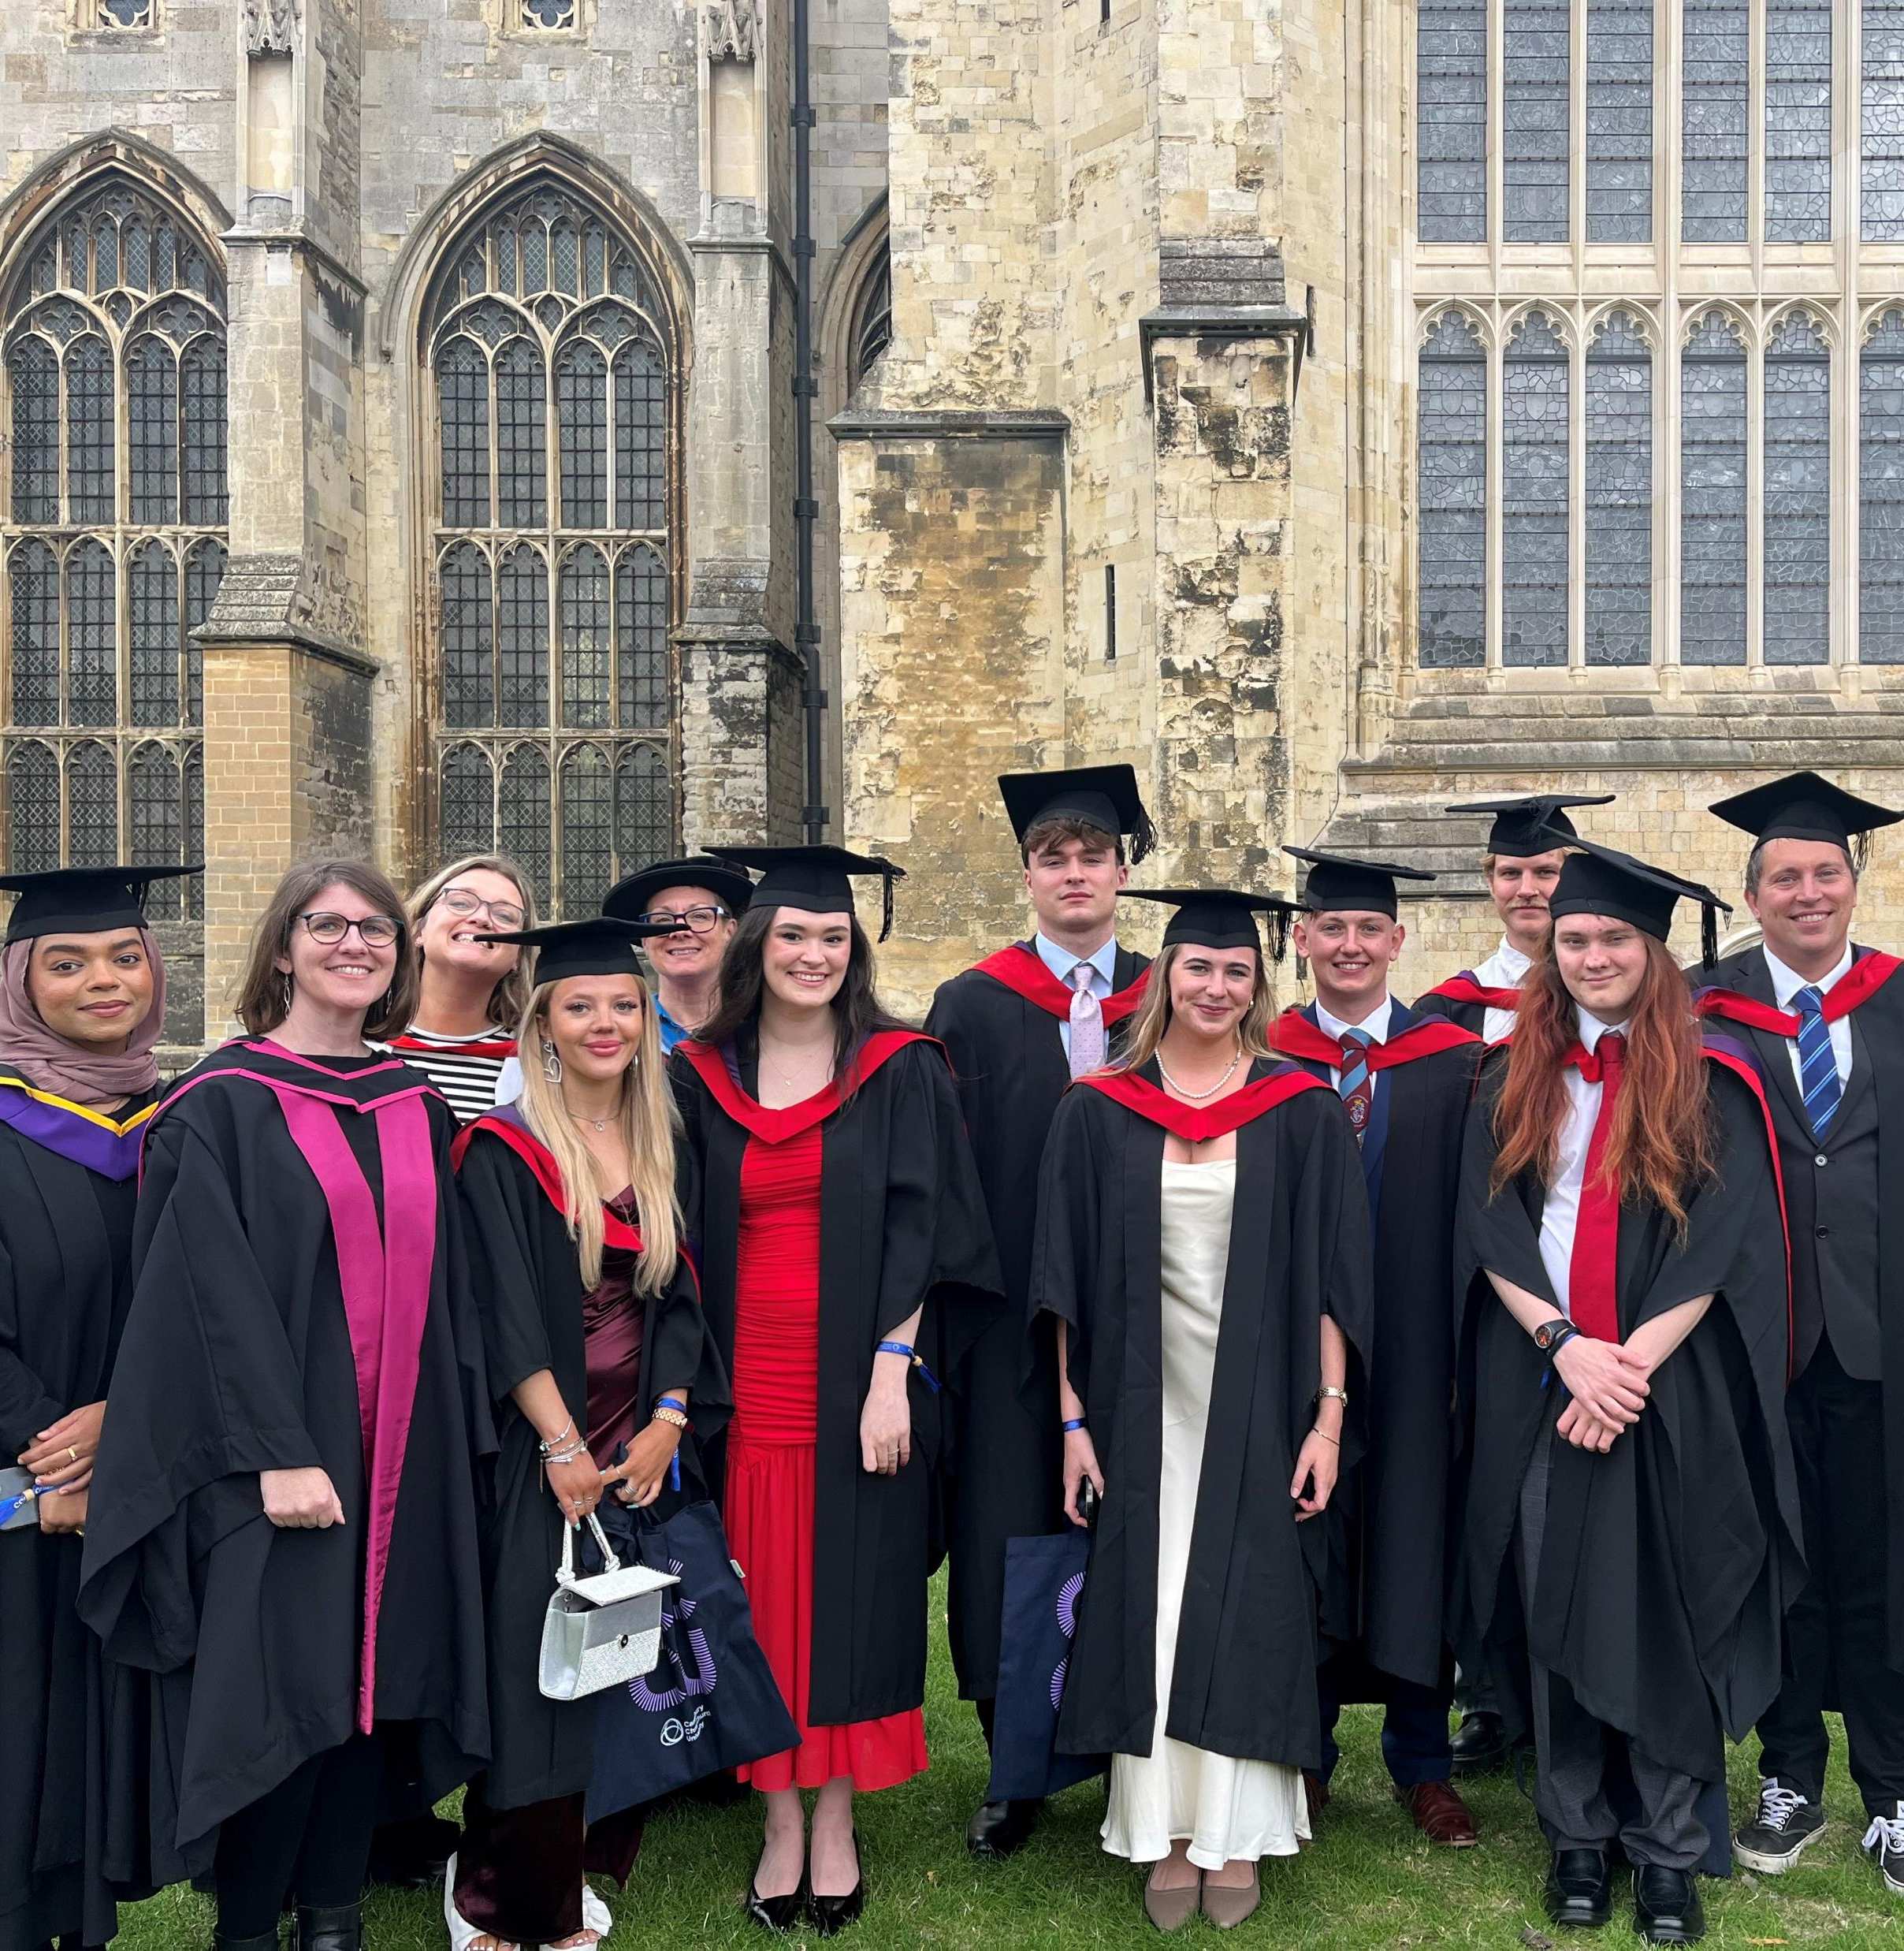
Adapting HE provision for the commuter student market: Increasing financial stability and meeting our educational and environmental obligations
Learning and Teaching Conference 2024, Canterbury Christ Church University, Canterbury, UK. 13 November, 2024.
Dr Susan Kenyon
Susan.Kenyon@Canterbury.ac.uk

Slide 2
‘Students who continue to live at home whilst studying, rather than moving into student accommodation’ (Kenyon, 2024a).
63%
CCCU 2022
Commuter students are central to our future sustainability
51%
Nationally 2023
We must adapt our provision to meet their needs

Slide 3
Evidence-based recommendations
* Peer reviewed and published
Institutional research
Secondary analysis: HESA data+.
Student survey.
Accessibility analysis (TRACC).
Depth interviews*.
Focus groups.
National research
National HESA dataset.
Review of online information provision.
Sector-wide consultation.
Sector-wide policy review.
Literature review*.
Transport sector partnerships.

Slide 4
Why adapt?
Financial
Recruitment: an increasing market.
Educational
Retention.
Environmental
Vision 2030.
Cost of living.
Widening participation.
Transport barriers.
Tuition fees.
15% CCCU CO2 emissions from student commute.
Regulation (OfS A1, B3).
Intrinsic good.
League table position.

Slide 5
How to adapt
Your actions
CCCU actions
Compress your timetable.
Blend online and in-person learning.
Include on-commute learning options.
Rethink in-person learning.
  Make attendance ‘worth it’.
Build social/learning community in class.
Accessible office hours.
  Booking; online.
Refocus recruitment on commuters.
Pre- and post-application information.
Review all policies for accessibility.
  Timetabling, attendance, L&T.
Repurpose the estate.
  Commuter student common room; sleep?
Accessibility-focussed transport solutions.
Avoid hybrid learning.
Support and skills development.

Slide 6
Conclusion
See them.
Accept them.
Adapt for them.

Slide 7
Selected references
Canterbury Christ Church University (CCCU). 2024. Vision 2030. Available online, via: https://www.canterbury.ac.uk/about-us/our-story/vision-2030, viewed 11 November 2024.
Kenyon, S. 2023. Conceive-Design-Implement-Operate: pedagogical innovation to enhance attainment, engagement, satisfaction and employability in political science. Journal of Political Science Education. 10.1080/15512169.2023.2284170.
Kenyon, S. 2024a. Commuter students: does reducing the need to travel enable more inclusive, equitable participation? Widening Participation and Lifelong Learning. 26: 3.
Kenyon, S. 2024b. Commuter Students: Understanding Their Travel Behaviour and Reducing Their Environmental Impact. In Leal Filho, W., Sima, M., Lange Salvia, A., Kovaleva, M. and Manolos, E. Eds. 2024. University Initiatives on Climate Change Education and Research. London: Springer, Cham. https://doi.org/10.1007/978-3-031-25960-9_41-1.
Office for Students (OfS). 2023. Access and Participation Plans. Available online, via: https://www.officeforstudents.org.uk/for-providers/equality-of-opportunity/access-and-participation-plans/, viewed 11 November 2024.

