Slide 1
Learning from PEQF Delivery:
Balancing the Academic with the Practical
Richard Honess
CCPR / UCL Seminar Series
14th November 2023

Slide 2
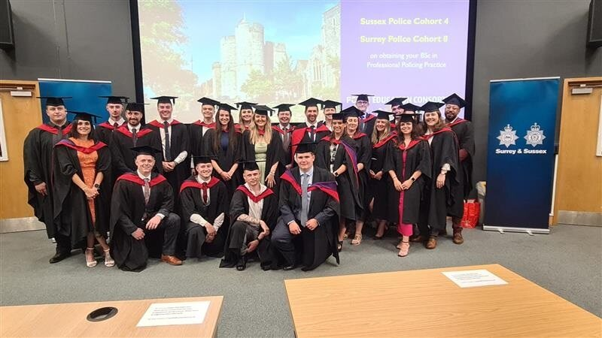
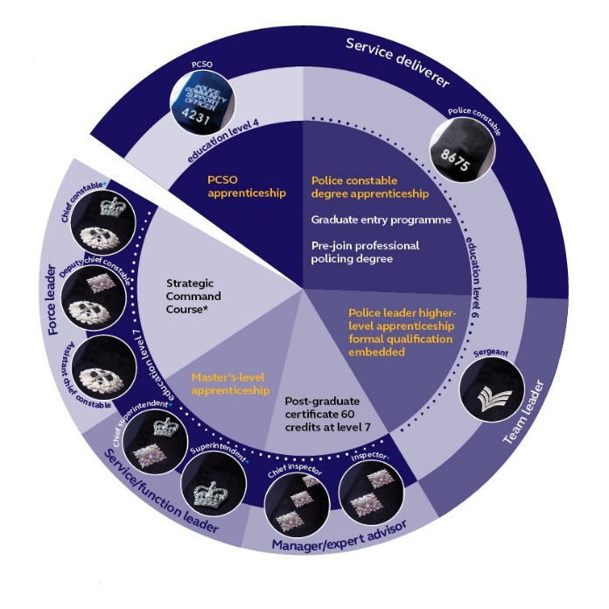
Background
UK College of Policing (2016)
Announces the Policing Education Qualifications Framework (PEQF)
In place by 2020
Making the police a “Graduate Profession”
CCCU Part of the Police Education Consortium (4 HEIs delivering to 3 forces in the South of England).
First PCDAs and DHEPs completed/Graduated
College of Policing (2023a)

Slide 3
Feedback and Research
Action Research Built into Feedback Mechanisms (Honess et al., 2021)
Multiple Feedback Mechanisms
Student Reps
Periodic Questionnaires
Tri-Partite Reviews
Padlet
Ad-hoc feedback
Health Warning!

Slide 4
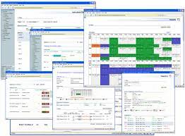
Initial Learning – Teething Troubles
Initial Timetabling
Standard Timetable
Availability of Rooms / Staff
Information Technology
Force HQ
For Students
For Staff
Protected Learning Time
Initial organisational knowledge
Duties office issues
Marking Consistency
Rubrics
COVID

Slide 5
Next Level Learning
Shift Patterns to accommodate effective PLT
Need to maximise effectiveness of PLT/Operational Duties
Student Officer Workloads
80% Operational Workload
Assessment Workload/Number of Assessments
Spacing of Assessments
Effective Assessment Styles
Presentations
Too Academic?
Supporting Operational Policing?
IPS as Academic Credit

Slide 6
For the Future – Changes and Challenges
Incorporating FOC as Level 5 for Academic Credit (PCDA)
Is there a way to incorporate this and IPS into the DHEP?
Overbroad Curriculum
CoP Curriculum Optimisation
CPD for Operational Supervisors (and others)
Supervisors still do not know requirements of students (Casey, 2023)
Police Constable Entry Programme (PCEP) (College of Policing, 2023b)
Non-Degree Route
Non-Accredited but taught to Level-5

Slide 7
Consortium Successes
3300+ Starts
91% DHEP Distinction and Merits
80% PCDA 1st and 2.1 Degrees
110 Cohorts
61% PCDA Average Module Mark
64% DHEP Average Module Mark

Slide 8
Conclusion
Anecdotally officers coming through PCDA and PEQF have seen improvements in some professional practice. This needs to be formally researched to confirm.
PEQF Delivery (or Police Constable Entry Programmes) are a balancing act between the Academic and the Practical (Honess & Clarke, 2023)
BOTH are necessary
Communication between providers and forces is key.
New developments such as inclusion of FOC as academic assessment must be closely monitored.
Outcomes of new PCEP must also be monitored.

Slide 9
Questions

Slide 10
References
Casey, L. (2023) Final Report: A review into the standards of behaviour and internal culture of the Metropolitan Police Service. London: Metropolitan Police Service
College of Policing (2016). Policing Education Qualifications Framework Consultation 2 February to 29 March, Ryton-on-Dunsmore: College of Policing.
College of Policing (2023a) PEQF diagram_FINAL [Online] Downloaded from: PEQhttps://profdev.college.police.uk/recognition-prior-experience-learning/peqf-diagram_final/
College of Policing (2023b) Police Constable Entry Routes [Online] Downloaded from: https://www.college.police.uk/article/police-constable-pc-entry-routes (Accessed 7/11/2023)
Honess, R. and Clarke, S., (2023) ‘ʻItʼs Not “Uni” Work, itʼs Essential Learning to be a Police Officerʼ: Examining the Higher Education Elements of Police Education Qualifications Framework Programmes.’ Policing: A Journal of Policy and Practice, 17.
Honess, R., Clarke, S., Jones, G. and Owens, J., (2022). ‘Using technology to improve assessment facilitation on a policing apprenticeship programme: from COVID-19 contingency to best practice.’ Policing: A Journal of Policy and Practice, 16(1), pp.63-72.

