Slide 1
A student-led evaluation of flipped learning
Dr Susan Kenyon, Rebekah Dawes and Joe Inge
Proc. Summer 2021 Learning and Teaching Conference, Canterbury Christ Church University, Kent, UK. 24 June 2021.
Susan.Kenyon@Canterbury.ac.uk

Slide 2
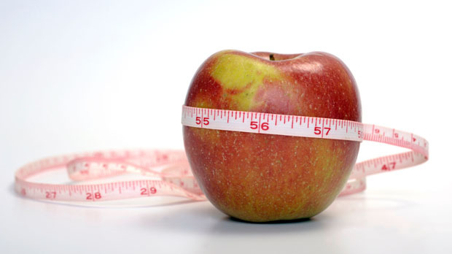
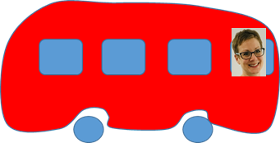
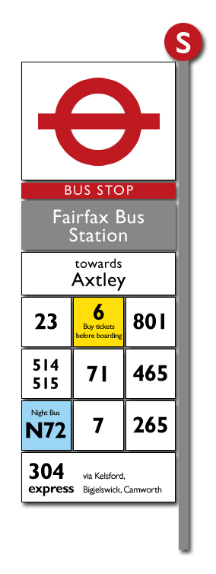
The TPS module
Decrease mobility
Too much mobility
Too little mobility
Assessment 1
Increase mobility
Assessment 2
£

Slide 3
How do we learn?
'Feeling' learning v. functional learning.
The importance of relationships.
The importance of structure.
Passion, excitement and relevance.
Power sharing and cooperative learning.

Slide 4
Did flipped learning on the TPS module meet our needs?
Yes!
Highly structured.
Less pressure.
Time to form opinions and clarify learning.
Lots of different media and tasks.
There when you need it.
Value for money.
Equal participation.
Real life.
But something was missing…

Slide 5
How could flipped learning better meet our needs?
Thinking about our learning needs…
Improvements that could be made
'Feeling' learning v. functional learning.
The importance of relationships.
The importance of structure.
Passion, excitement and relevance.
Power sharing and cooperative learning.
Face to face tutorials (but keep lecture pre-records).
Devote time to constructing relationships.
Students recap learning.
Cameras on.
Be visible and excited in the pre-records!

Slide 6
A student-led evaluation of flipped learning
Dr Susan Kenyon, Rebekah Dawes and Joe Inge
Proc. Summer 2021 Learning and Teaching Conference, Canterbury Christ Church University, Kent, UK. 24 June 2021.
Susan.Kenyon@Canterbury.ac.uk

