Slide 1
Exploring the Connection between Migration and Terrorism: Does the risk justify potential human rights abuses
Dr Erika Brady
erika.brady@canterbury.acuk
22 June 2023
BISA Conference, Glasgow UK

Slide 2
Contents
Key Issues
UK Migration in Focus
Immigration and Terrorism in the UK
Proposed Framework and Conclusions

Slide 3
Key Issues

Slide 4
Legal, Illegal and Irregular Migration
“To claim asylum in the UK, a person must be physically in the UK. It is not possible to apply from outside the country, and there is no asylum visa. A person cannot obtain a visa with the explicit purpose of seeking asylum. Claiming asylum is not illegal but entering or remaining in the UK without the required permission has been an offence for many years. Therefore, for individuals who do not have visa-free travel to the UK, they must enter either irregularly, such as by a small boat; by using false documents; or on a visa for some other purpose, such as tourism or study.”
(House of Lords 2022)

Slide 5
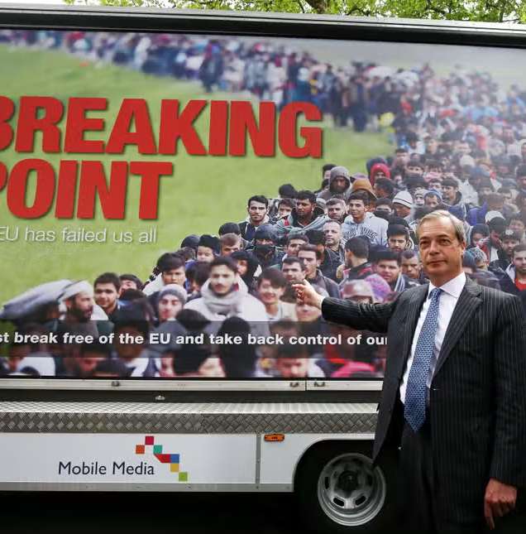
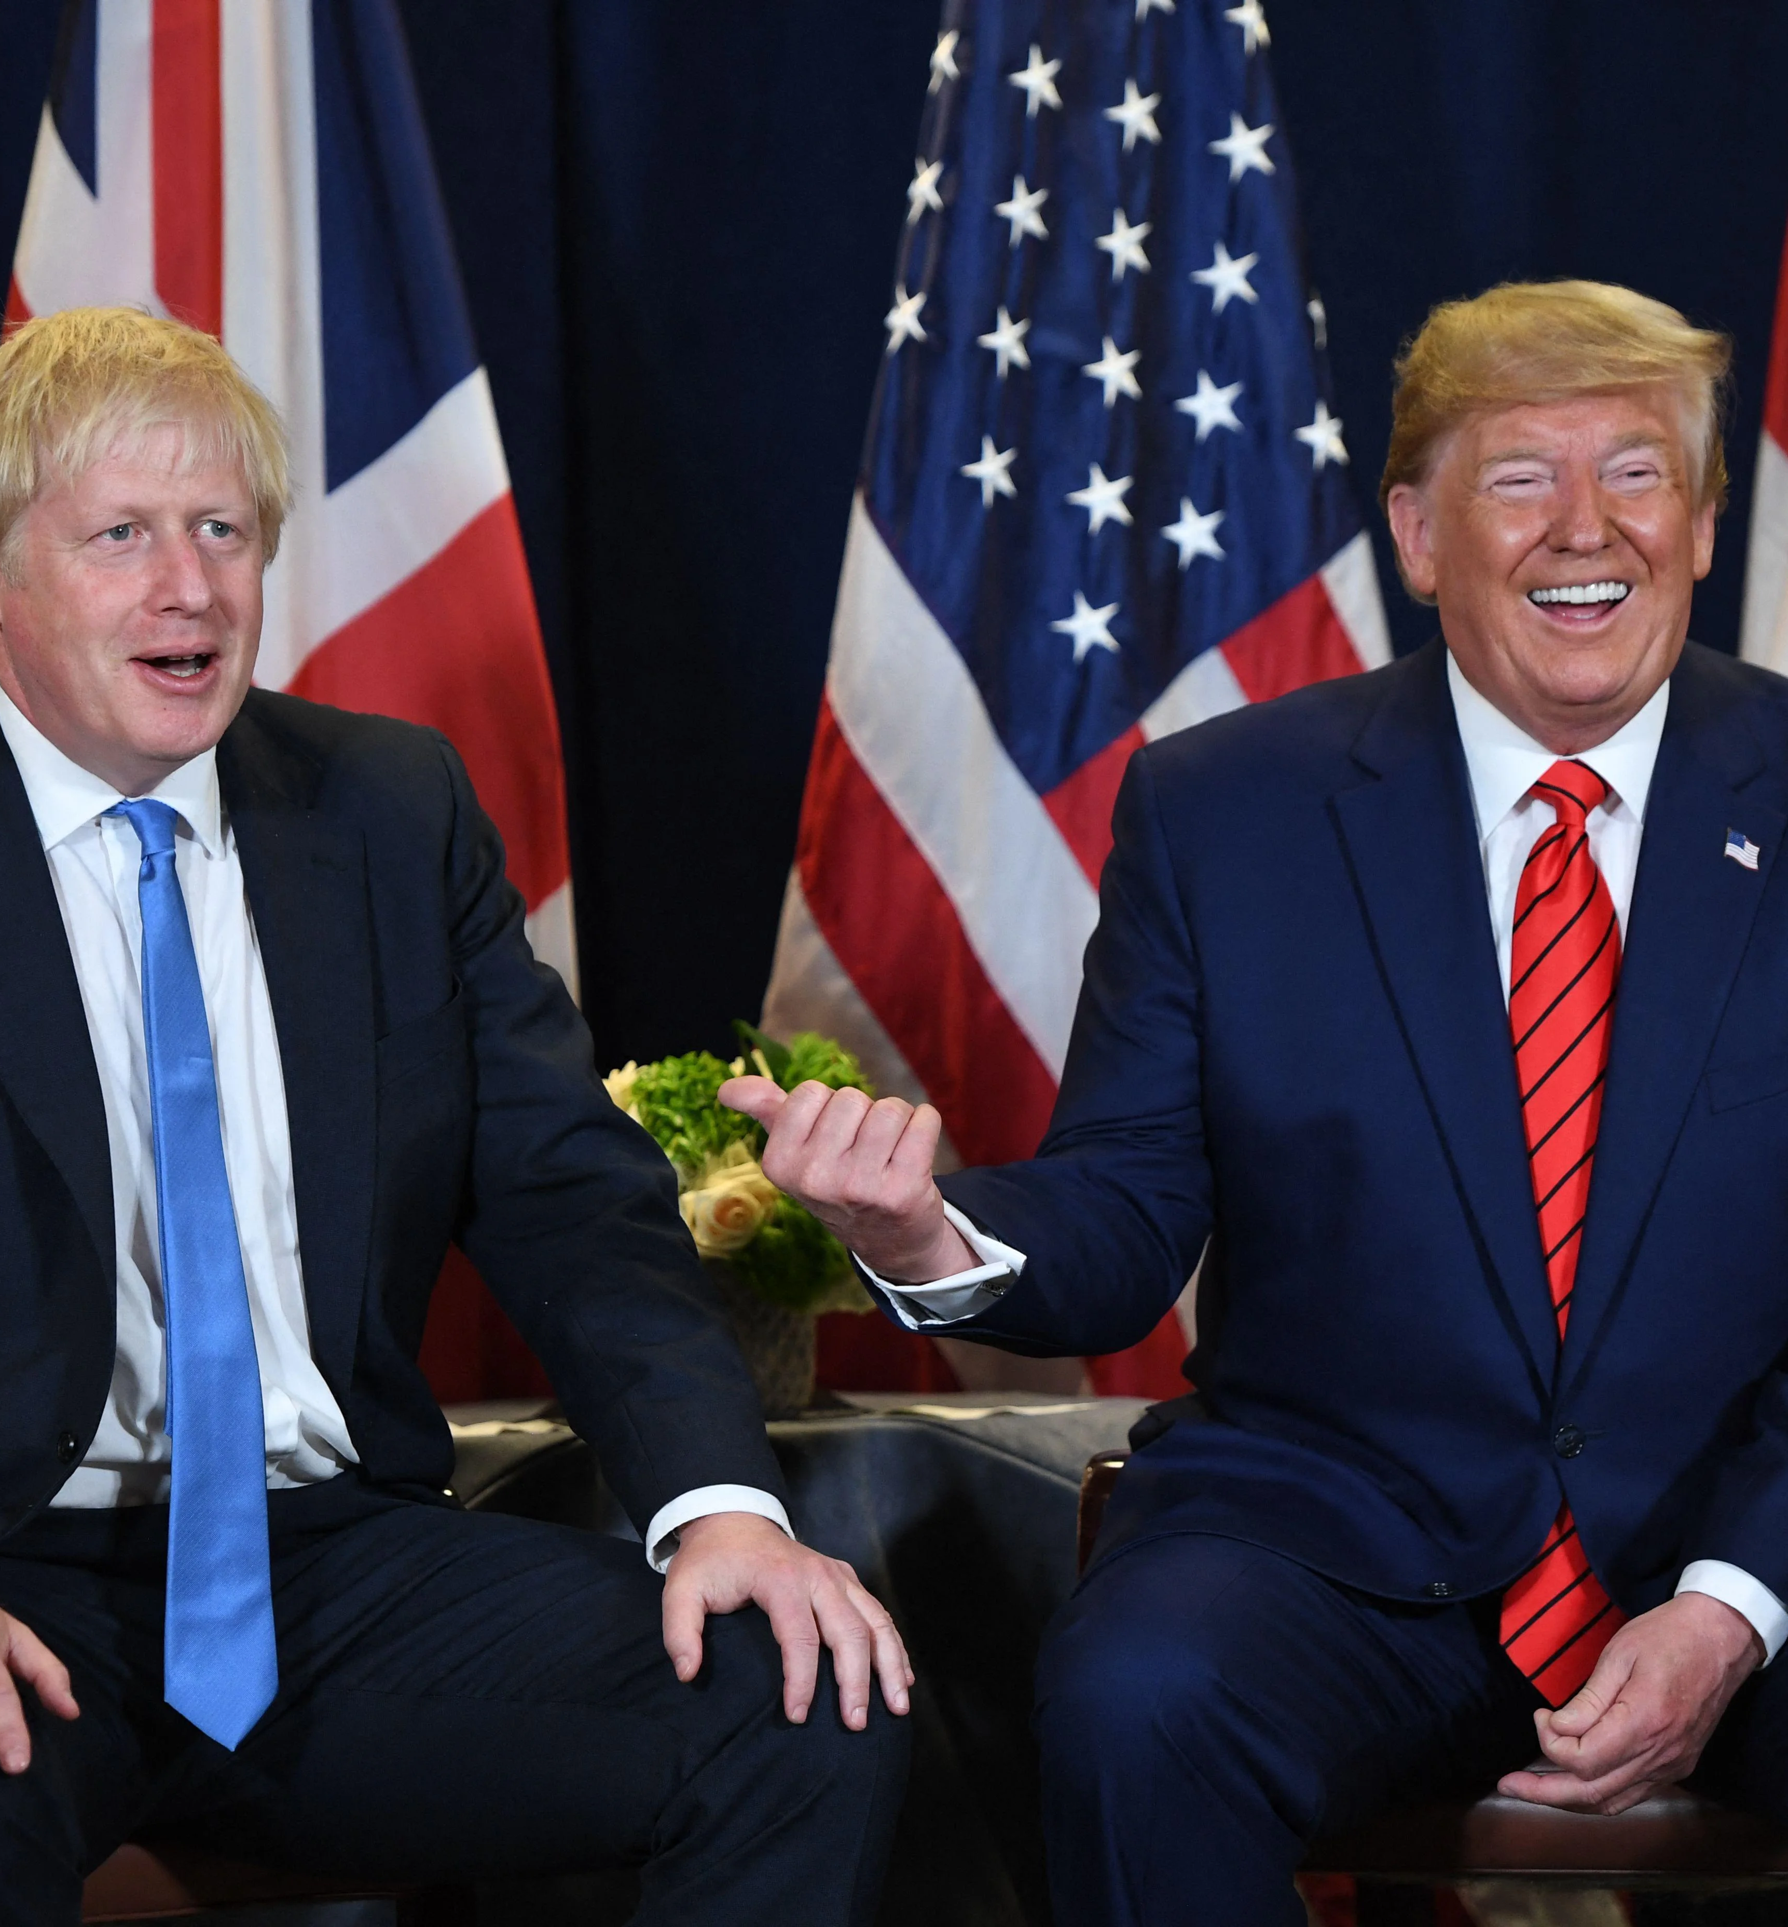
Contexts
Notes:
https://www.google.com/url?sa=i&url=https%3A%2F%2Fwww.coolmed.co.uk%2Fknowledge%2Fnews%2Fcovid-19-vaccination-update-the-increased-need-for-medical-fridges%2F&psig=AOvVaw16Ylr9ZAUHpxrO8QQF-R_c&ust=1687361354573000&source=images&cd=vfe&ved=0CBIQjhxqFwoTCODUx4KV0v8CFQAAAAAdAAAAABAE
https://www.google.com/url?sa=i&url=https%3A%2F%2Fwww.standard.co.uk%2Fnews%2Fpolitics%2Feu-referendum-nigel-farage-slammed-over-brexit-poster-showing-queue-of-migrants-a3273836.html&psig=AOvVaw2f2y-vFSWtT6341i0ssm3O&ust=1687361253459000&source=images&cd=vfe&ved=0CBIQjhxqFwoTCIiM_5uV0v8CFQAAAAAdAAAAABAE
https://www.google.com/url?sa=i&url=https%3A%2F%2Fthefulcrum.us%2Fbig-picture%2FLeadership%2Fboris-johnson-uk-prime-minister&psig=AOvVaw19cMBU_W6RKWQc3810_nn5&ust=1687361432560000&source=images&cd=vfe&ved=0CBIQjhxqFwoTCMj6y6eV0v8CFQAAAAAdAAAAABAE
https://www.google.com/url?sa=i&url=https%3A%2F%2Fwww.glamourmagazine.co.uk%2Farticle%2Fcost-of-living-crisis-tips-to-survive&psig=AOvVaw1XrUGN6QR03Jr-sbCMyTtf&ust=1687361496114000&source=images&cd=vfe&ved=0CBIQjhxqFwoTCJj8xsaV0v8CFQAAAAAdAAAAABAE

Slide 6
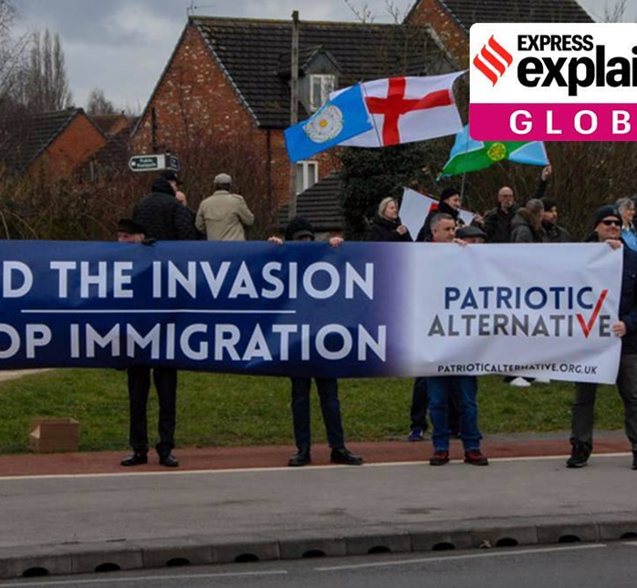
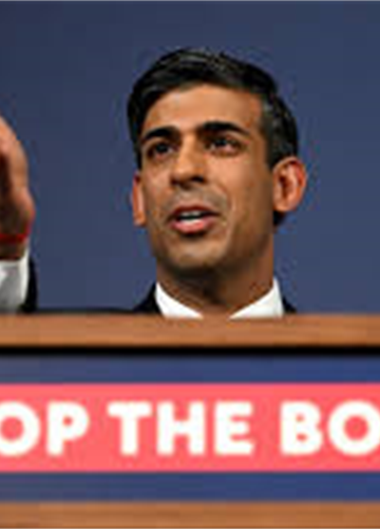
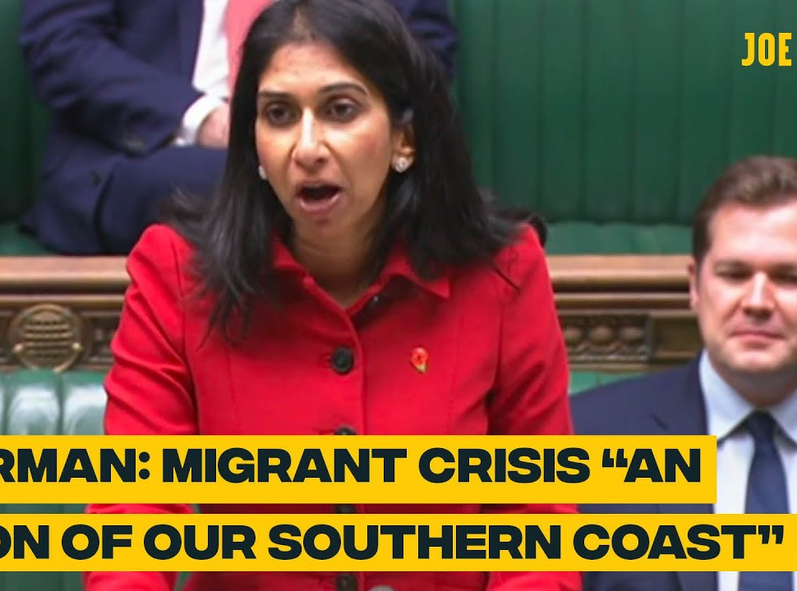
Terminology and Narratives
The context of Brexit and COVID-19 has empowered populist narratives in the UK
It is difficult to know if the UK Government’s narratives and rhetoric have impacted the wider understanding of the issue of migration, or if the Government’s policies and narratives are responding to the far right, nationalist and populist narratives

Slide 7
UK Migration in focus

Slide 8
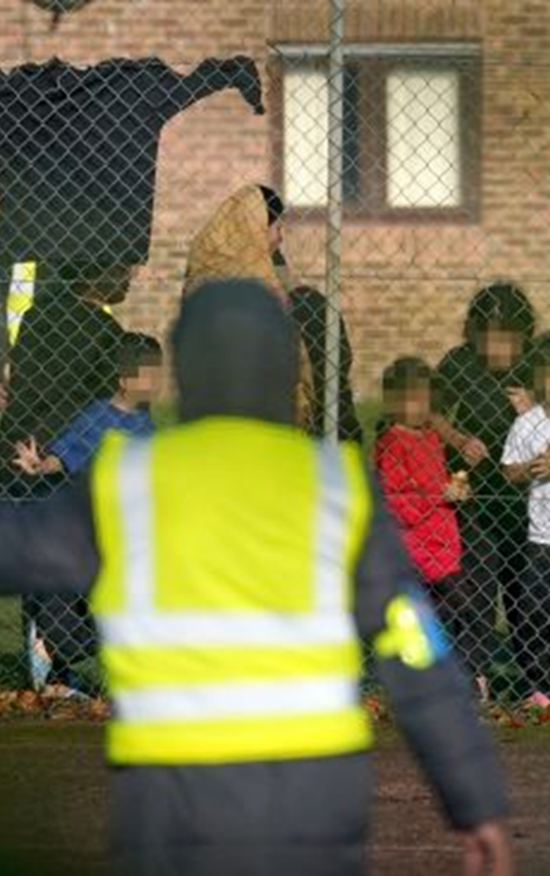
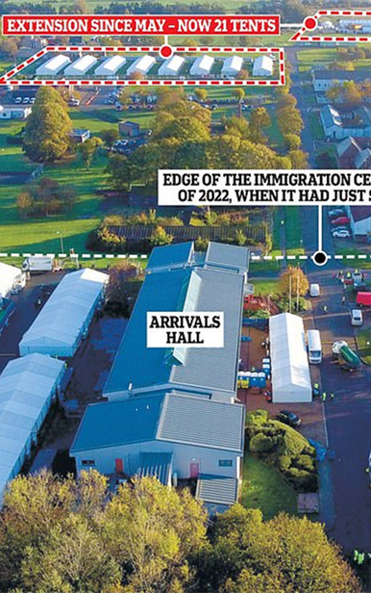
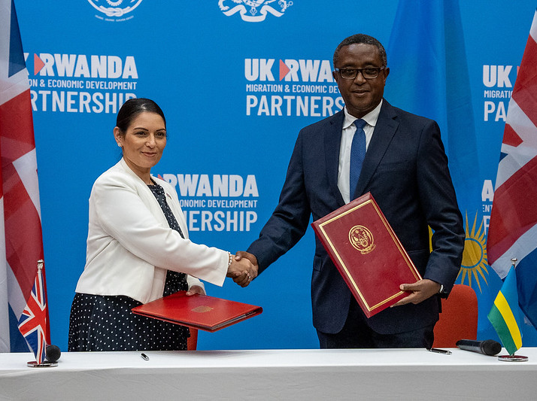
UK Legislation (migration)
UK Migration Legislation
Nationality and Borders Act 2022
Illegal Migration Bill (2023)
Detention Centres and the Small Boats Crisis
Manston Detention Centre in Kent
Slow processing times, overcrowding, lack of appropriate training
Memorandum of Understanding with Rwanda
Received criticism from a wide range of actors including the House of Lords
Intended to act as a deterrence, but this does not seem to be working

Slide 9
Issues with Manston Detention Centre
"I spoke to an Afghan family who had been in a marquee for 32 days.“ (Independent Chief Inspector of Borders and Immigration, David Neal)
He reported that migrants were being guarded by untrained custody officers and said: "What is really concerning and alarming is that the numbers, as described, are clearly outstripping the capacity of the site."
Lucy Moreton, head of the Immigration Services Union, which represented some staff at Manston, told Today on BBC Radio 4 on 27 October: "Staff face on a daily basis sit-down protests, being shouted at... improvised weapons are always being found... no prison in the UK has over 4,000 people uncontained, face-to-face with those who are responsible for controlling them."
(BBC, 2022)
Notes:
https://www.bbc.co.uk/news/explainers-63456015

Slide 10
Immigration and terrorism in the UK

Slide 11
The Migration-Terrorism Nexus
“The study of terrorism and the study of migration have been two separate fields. While there is a huge literature on both, migration and on terrorism, there are no in-depth studies on the intersection of the two phenomena.”
“The arrival of large refugee populations, when not properly handled, increases the risk of attacks in the recipient country by both domestic and transnational terrorists.”
“Historically, the number of criminals and terrorists in mass migration movements has been low - but terrorists often have a criminal background to begin with.”
(Schmid 2016)
Notes:
Links between terrorism and migration: an exploration Schmid 2016, ICCT Research Paper

Slide 12
Of the 22 successful attacks in the UK since 2005 (regardless of ideology), six have been carried out by those who were refugees or asylum seekers
Month and Year | Name of Perpetrator | Attack Information | Status
November 2021 | Emad Al-Swealmeen | Liverpool Womens Hospital | Failed asylum seeker
June 2020 | Khairi Saadallah | Reading Stabbings | Libyan Refugee
December 2019 | Mahdi Mohamud | Manchester Victoria Stabbing | Originally from Somalia – ten years in UK at time of the attack (Mental Health Act)
August 2018 | Salih Khater | Westminster car attack | Refugee from Sudan
September 2017 | Ahmed Hassan | Parson’s Green Attack | Arrived illegally in October 2015
June 2017 | Rachid Redoune | One of the London Bridge Attackers | Failed asylum seeker

Slide 13
The Migration-Terrorism Nexus
There is no doubt that there is a risk that criminals and terrorists might come into the UK embedded within large refugee flows
ISIS itself sewed some of these seeds of concerns when it claimed it would embed its terrorists in the refugee flows
And yet, while 6 out of 22 attacks is high, 6 out of more than 541,200 asylum applications made in the UK during that time period is not (0.0011%)
The UK Government itself steers clear of saying that terrorists are coming in amongst the asylum seeking population, instead focusing on criminality and the legality of the routes taken to get here

Slide 14
Proposed framework and Conclusions

Slide 15
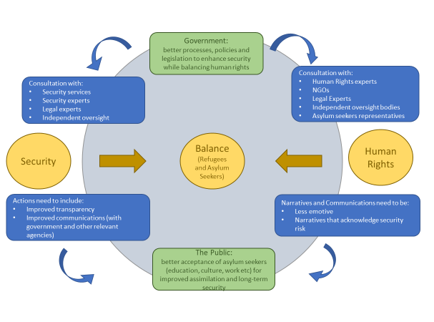
Proposed Framework for Improving the Response to Asylum Seekers in the UK
Key themes:
Consultation and genuine learning
Transparency
Shift in narratives resulting in better understanding across the two main actors concerned with refugee populations

Slide 16
Summary
There is a risk that terrorists enter the UK through the inflow of those who are considered ‘illegal’ or ‘irregular’ migrants
However, that number is incredibly small in the wider context of asylum seeker numbers and other security threats are more urgent (including self-starting terrorists, far right extremism)
The ability of asylum seekers to enter the UK through “safe routes” is either impossible or highly limited – therefore the breaches in legality do not correspond with international human rights obligations
Almost all of the activities implemented by the UK Government to address the migration crisis in the UK are widely opposed by legal entities, parliamentary entities, human rights groups and the UN

Slide 17
Recommendations
Both the UK Government and those focused on breaches in human rights need to improve considerations and understanding of the other’s ‘side’. This will reduce polarizing rhetoric and politicization of the issue and will allow for better processes to be implemented
I propose that an inter-agency collaborative risk analysis is essential to provide better oversight on how much security risk is worth the breaching of international law in terms of human rights, particularly refugees

Slide 18
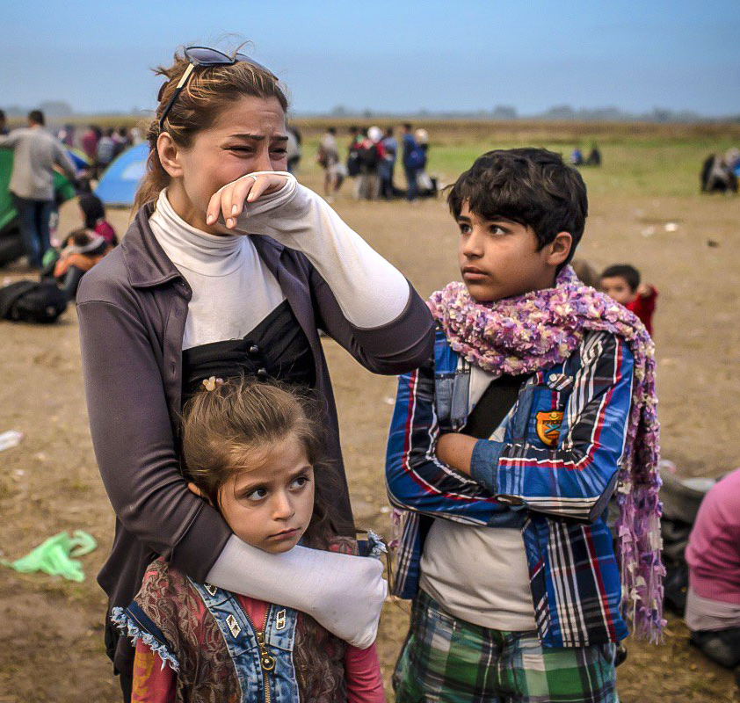
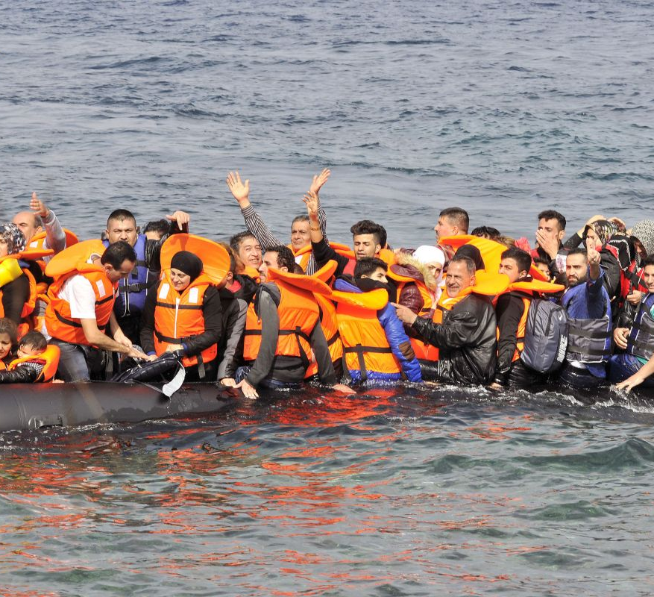
Conclusion
At the heart of the matter are hundreds of thousands of men, women and children who are desperate for a safe and better life
The UK needs to protect British people from terrorist and criminal threats, but it needs to do so in a way that upholds its obligations as a signatory of the 1951 Refugee Convention
Notes:
https://www.google.com/url?sa=i&url=https%3A%2F%2Fmigrants-refugees.va%2F&psig=AOvVaw09t-5giO_w1sI6lUJAnXVi&ust=1687457681329000&source=images&cd=vfe&ved=0CBEQjhxqFwoTCKiy5_H71P8CFQAAAAAdAAAAABAJ
https://www.google.com/url?sa=i&url=https%3A%2F%2Fwww.migrationwatchuk.org%2Fnews%2F2022%2F02%2F24%2Fgovernment-admits-illegal-immigration-nearly-tripled-in-four-years&psig=AOvVaw3pPVQW-uCZ0zr6GW6qFqAZ&ust=1687457752480000&source=images&cd=vfe&ved=0CBIQjhxqFwoTCKjgy5H81P8CFQAAAAAdAAAAABAE

Slide 19
Thank you
Any questions: erika.brady@canterbury.ac.uk

