Slide 1
Organisational culture within local media and how cultural beliefs shape strategic decisions
Sarah O’Hara
Canterbury Christ Church University

Slide 2
The key research questions set out to understand:
Organisational culture within local news media companies.
The conflict faced by local news companies between commercial and non-commercial imperatives.
How cultural beliefs within organisations shape strategic decisions.
Taking Schein’s theoretical approach that the cultural paradigm of an organisation could shapes its future strategies in the digital age.
Notes:
This paper is concerned with understanding organisational culture within local news media organisations. It explores the conflict faced by local news organisations between journalistic values and commercial imperatives. The paper considers how cultural beliefs within organisations shape strategic decisions and is based on the theoretical approach that the cultural paradigm of an organisation shapes its future strategies in the digital age.
(Kung and Picard reference on importance of cultural strategy) (Quote on importance of regional media within the study of media)
Empirical study carried out in the south east of England using case study analysis of two local media organisations: Interviews with stakeholders working within the media organisations Freely accessible company data
Observational data (office location, branding). Based on Schein’s theory on Organisational Culture and Leadership and Kung’s work on the BBC and CNN there is the theoretical approach that the cultural paradigm of an organisation shapes its future strategies . The methodological approach was based on case study analysis looking at two regional media organisations. Mainly qualitative with some quantitative secondary data and triangulation. The theoretical approach is not to compare and contrast the organisations but to give insight into how different legacy elements, management and ownership models have shaped the organisations digital transformation and strategies today. To try and understand how the hidden or unconscious or hidden beliefs shape the business and ultimately the strategic decisions made. Data was analysed using grounded theory identifying key themes that emerged from qualitative data. Interviews participants were recruited from across both organisations in commercial, journalistic and support roles to develop insight into sub cultural differences within an organisation. In addition interviewees were selection to represent the views of new joiners v ‘old timers’.

Slide 3
Digital adoption strategies vary by sub-cultural (occupational) group
My team (journalists) get it now – they had to, we had to ….it was the reader pushing us to move online – we didn’t really want to do it’
‘Digital is the way forward – the sales team aren’t there yet – they’re moving towards it, but they still aren’t there yet’
‘They wouldn’t need me (specialist digital rep) …if people understood the digital sale’
‘We were trained last week on SEO – the need to make the headline searchable’
‘They (editorial) didn’t really get it when I first joined, they didn’t want to put copy online but we’ve worked at that, learning to write something for online and then ‘copy and paste’ for the paper’
Notes:
Understanding the cultural layers within an organisation helps – cultural overview, sub cultures. One key emerging theme is that digital adoption varies by sub-cultural or occupational group. So whilst the organisation as a whole will be driving the digital sale, renaming and repositioning themselves as Media Groups or multi-media companies rather than press companies, digital take up varies enormously within from occupational group to occupational group, as well as from location to location. In smaller towns and communities where the paper is firmly embedded within the community and copy sales ratio are higher amongst the local population digital adoption has been slower that in larger towns where the relationship is not so tight and the population may be more transient. The journalists get it now! They are all multimedia, they write copy for the web, they tweet, they use Facebook to gather stories and develop leads. For some the paper is now the after thought. As a collective body they have brought into digital they understand the potential it gives them as journalists to move quickly and gather stories and community news. The commercial teams are still getting there – this may be because they are not such a tight occupational group, they have been slower to adopt the multimedia practices. One organisation still have paper and digital sales teams with the digital sales team as educators as much for the sales team as for the advertiser. The commercial drive seems to be slower with digital seen as ‘bolt on’ for some. An example of this could be the new branded car livery which still favour prominently the papers name with the mere tagline line of online rather than the website URL.

Slide 4
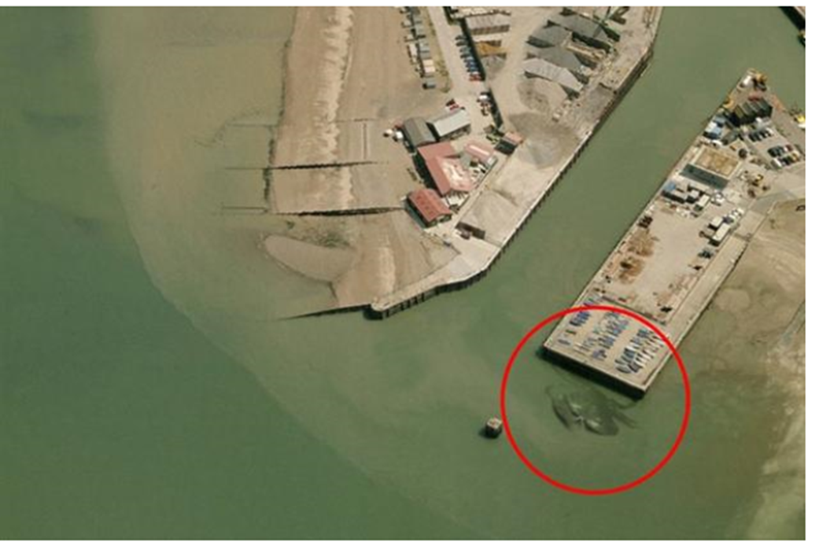
Digital newsroom driven by the digital audience
Building the
online
audience is
seen as the
core strategy
‘Crabzilla was our biggest story yet – it was only a sandbank but we got coverage from all over the world’
Notes:
There can be no doubt that across both organisations driving the digital audience has been seen as crucial but there are cracks appearing within some of the occupational groups about that strategy. The organisational strategies are the same for both organisations to drive online audience so that this can be monetarised there the strategy falls down. Varying levels of digital adoption within the sales team means there is no clear strategy to drive revenue.

Slide 5
Digital imperatives v journalistic values
‘No longer called journalist, now we’re content curators’
The director thought ‘crabzilla’ was stupid and not what local media is about…the digital sales team were happy though!
‘Sometimes we forget to actually put it in the paper once it’s gone online’
‘Tweets are pre-timed to send out stories
whether they are relevant or not’
Notes:
Importantly the core values of a local newspaper to support the local community are now being undermined. Readers are quite open about the stupidity of some of these stories and quite freely, more freely, now they can quote online push back. The journalistic values are also under minded – sensational stories are not what local journalism is about. Are they listening to their readers and audience and how do stories like this undermine journalistic values and principles.

Slide 6
Digital audience strategy is driven by ‘top-down’
‘They send down an email with the top 10 stories or lists we could cover – we try and find a local angle on them’
‘I was asked why was I bothering to attend council meetings which might only bring in a few hits. Show more videos of fluffy kittens…..people like fluffy kittens
‘We get a daily email about hits and coverage on the website from head office and our hits are recorded hourly’
Notes:
Strategic decisions are managed centrally for digital change, but traditional press decisions and strategies are controlled locally or even hyperlocally.

Slide 7
Paid for newspaper sales revenue is crucial but strategy is managed ‘locally’
‘My main stakeholder for the paper is the newspaper sales manager – she knows what the community wants and she will say whether a front page works or not’
‘The paper sales accounts for a big revenue stream. We make nearly as much in that as we do advertising so maintaining that sale is important’
‘The papers are £1.10 now. We make a lot of money from the copy sale’
Notes:
Paid for copy sale is crucial and is currently underpinning revenues for both organisations whilst they try to monetarise the digital audience. However this area is managed very locally within one occupational group – the Newspaper Sales Managers for both organisations weld quite consider power and budgets to support this sale, in many ways left to their own ‘devices’ to continue to support this important revenue stream. Their loyalty is as much to the retailers – newsagents as it is to the media organisations. Both organisations are using newsagent shop windows are billboards for brand exposure and returning to old fashioned community newspaper techniques to keep the brand alive. Marquees in the High Streets, mascot costumes and prescence at county shows, school fetes are all there. Traditional newspaper sales drivers like first class school photos and mothers day portraits are still being used. One commented ‘I’ve got more promotional money’ than I’ve ever had.

Slide 8
Digital has changed the regional media newsrooms
‘I get up early so I’m tweeting from 6am, my News Editor is a night bird so he’ll take over after I’ve gone to bed and tweet into the early hours’
‘I was no longer working for a newspaper but a website’
‘We don’t have sales reps anymore they are not out there selling 3x1 and collecting cheques they are managing territories, selling websites, twitter campaigns and providing a consultancy service’
‘We’ve changed a lot since the bad times, we’ve had to. Our sales team are dedicated and motivated. If they want to be still out there collecting cheques everyday they left to join the others…’
‘Copy sales don’t come out for two weeks, I can look on the phone and see which story people are looking at and tweak it now’
Notes:
Core values of the occupational groups and changing and working practices made more difficult. Multimedia journalist have constant deadlines and the organisations are reliant on good will. Journalist report and tweet I their own time, or pretimed tweets with little or no local interest. In some way these sub cultural groups are driving organisational strategy more than the exec teams. At a local level still they tweak a story or decide whether to go live online or hold for the paper. The slow adoption of digital within the sales teams in one organisation means it is still headcount heavy, whereas in the other sales people are now consultants, managing a consultancy service. These are very different skill sets than those requires to sell a 3x1 recruitment advertisement which used to be the backbone for local media.

Slide 9
Conclusion
Digital is fully embedded and now second nature in regional news rooms
Paper is not dead but is managed locally
Commercial teams are not digitally ‘ambidextrous’
Grass roots local journalism values still exist and conflict with the ‘click bait’ addiction
Local cultures drive local strategies
Notes:
This is still work in progress, there are other key themes emerging from the case studies and they continue to change as the organisations evolve and restructure. The importance of occupational cultures within regional organisations is crucial and the need to break down these ‘silo’ type so management was a core comment that came up in the interviews. Are journalists working for the greater good of the organisation they work for, their local audience or the world wide online audience. Do we seem the same patterns in local media companies in other parts of the country or have other organisations been better at pulling together organisational culture? Do we still the same themes within other areas of local media like radio where the presenter is different from the news editor. The research have produced a lot of data and insight but there is still the need to develop better frameworks to analysis and understand organisational culture with many of its hidden artifacts.

Slide 10
Next steps
Different regional groups across the UK
International comparisons
Different platforms – radio?

