Slide 1
WHY RICHBOROUGH?
LOGISTICS LOG JAM BY 1916
SHIPPING PRIORITY FOR USA MANPOWER
SECRET, SHELTERED & SECURE LOCATION
ROMAN & MEDIAEVAL
RIVER STOUR – LOW TIDAL RANGE
SUITABLE FOR BARGES
LARGE GRAVEL BEDS - BUILDING
AMPLE SPACE

Slide 2
RICHBOROUGH PORT

Slide 3
PURPOSE
ESSENTIALLY A MILITARY FERRY TERMINAL
LARGE TROOP & STORES DEPOTS
CONNECTION TO MAIN LINE – SE & C RAILWAY
RELIEVING PRESSURE ON SHIPPING – UBOAT LOSSES
TROOPS & EQUIPMENT OUT – CASUALTIES & SCRAP BACK

Slide 4
OPERATION (1)
RICHBOROUGH RAILWAY WORKED OVER 1 MILLION TONS IN 1917 WITHOUT MAJOR ACCIDENT
35 LOCOMOTIVES ON INTERNAL TRAFFIC
WORKSHOPS & BARGE BUILDING
TRAINING SCHOOLS ON SITE
MANY TRAINEES SENT TO FRANCE & MIDDLE EAST FOR PORT CONSTRUCTION & DOCK WORK

Slide 5
OPERATION (2)
10,000 BARGES CARRYING1.3 MILLION TONS ENTERED CANAL SYSTEM IN FRANCE DEC16 – DEC18
750,000 TONS AMMUNITION
70,000 TONS OF SUPPLIES
25,000 TONS FOR RFC
18,000 TONS GUN CARRIAGES & LIMBERS
SMALL LOSSES DUE TO WEATHER ONLY
IMPORTED 150,000 TONS OF SALVAGE FOR REPAIR OR SCRAP

Slide 6
OPERATION (3)
SCRAP SORTED BY LOCAL FEMALE WORKFORCE
TRANSHIPPED TO FACTORIES & DEPOTS ACROSS UK
RECYCLING – ADDED VALUE
ACCOMODATION BUILT FOR 15,000 TROOPS
FULL MESSING & RECREATIONAL FACILITIES
OWN POWER STATION
24 HR AVAILABILITY OF HOT MEALS
EXTENSIVE DRAINAGE SYSTEM

Slide 7
IN SUMMARY
AT PEAK RICHBOROUGH HOUSED AND FED 19,000 MEN & 800 WOMEN
TELEPHONE EXCHANGE, HOSPITAL & FIRE SERVICES
THE BIRTH OF THE ARMY CATERING CORPS
200,000 TONS OF EXPORT CARGO TO END 1918.
IMPORTS 160,000 TONS
£98, 000 POUNDS SPENT ON FERRY SPAN/BRIDGE – OPTIMUM TURNROUND TIME 20 MINUTES.

Slide 8
BARGES

Slide 9
BARGES

Slide 10
RO RO FERRIES (1)
THE WORLD’S FIRST – TRAINS & VEHICLES
ORDERED JAN 17 IN SERVICE DEC 17
2 BUILT ON TYNE & 2 BUILT ON CLYDE
BESPOKE DESIGN
LOA 363 FT 6 INS, BEAM 63 FT, CARGO 850 TONS, SPEED 12 KNOTS
54 FULLY LOADED 10 TON WAGONS -1080 FT OF TRACK
TRUCKS & AMBULANCES

Slide 11
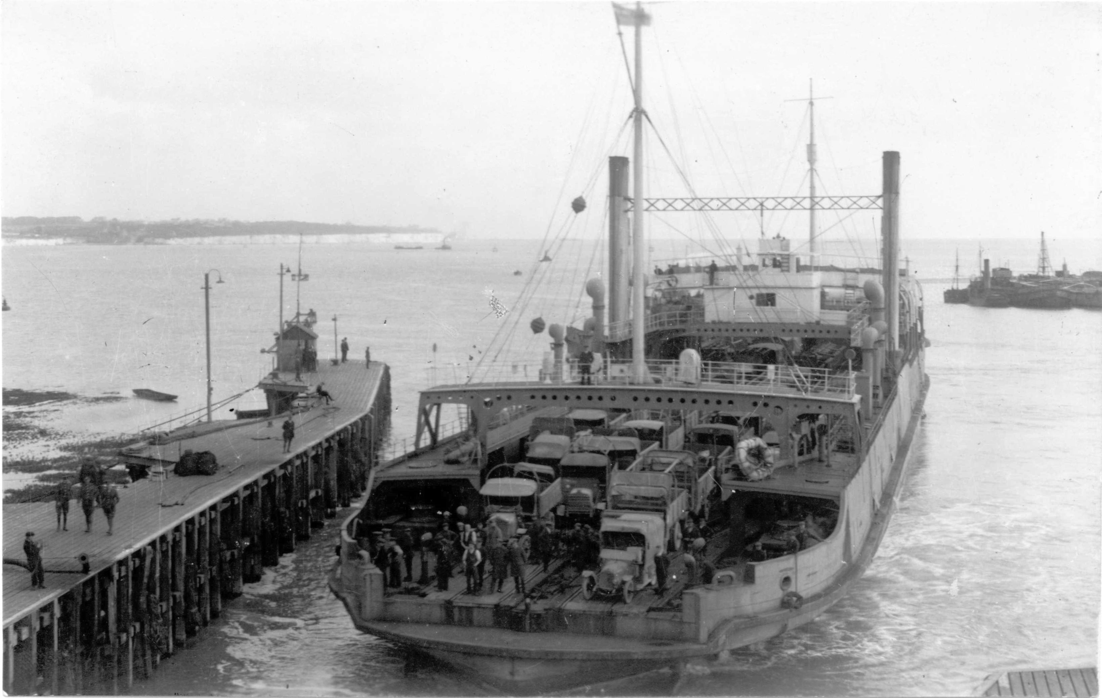

Slide 12
RO RO TRAIN FERRY

Slide 13
RO RO TRAIN FERRY

Slide 14
RO-RO- TRAIN FERRY

Slide 15
RO RO FERRIES (2)
SOUTHAMPTON – CHERBOURG
RICHBOROUGH – CALAIS & DUNKIRK (35 & 54 MILES)
OPERATED INDEPENDENTLY OF ADMIRALTY
NO LOSSES
200,000 TONS OF EXPORT CARGO TO END 1918.
IMPORTS 160,000 TONS

Slide 16
COMMAND
WHO COMMANDS? WAR OFFICE OR EASTERN COMMAND?
WAR CABINET SHIPPING PRIORITY FOR VESSELS TO CARRY US TROOPS & SUPPLIES
INLAND WATERWAYS & DOCKS (ROYAL ENGINEERS)– DEPUTY DIRECTOR OF IWD BRIG. ALLEN-WILLIAMS FROM 5 JUNE 1917
COL W.H.BRIGGS REGULAR STAFF OFFICER LATE DLI RESERVES APPOINTED BY EASTERN COMMAND TO INVESTIGATE PORT - SEPTEMBER 1918

Slide 17
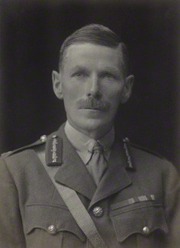
COL BRIGGS & BRIG ALLEN-WILLIAMS

Slide 18
HORACE & HENRY COOK

Slide 19
RE IWT FOOTBALL TEAM

Slide 20
THE BRIGGS REPORT - OFFICIAL
REPORT COVERS PERIOD 9 SEPTEMBER – 16 OCTOBER 1918
ACKNOWLEDGES QUICK, EFFECTIVE CONSTRUCTION
DESCRIBES OBSTRUCTION FROM INCUMBENTS, & ANOMALIES IN PAY & CLASSIFICATION
MAKES DETAILED RECOMMENDATIONS FOR EFFICIENCY, TRAINING & REORGANISATION – REFLECTING STAFF COLLEGE (1912)BACKGROUND
NOTES ‘LUXURY’ WORK AS IF BASE TO BE PERMANENT RATHER THAN TEMPORARY
THE OBJECTIVE IS TO COMB OUT OFFICERS & MEN FOR FRANCE

Slide 21
THE BRIGGS REPORT - CONFIDENTIAL
GIVES HISTORY & COMMENTS ON THE LAVISHINGS & ANOMALIES
WO ROLE IN ALLOCATING MORE & DIVERSE TASKS TO IWD
NOTE RECRUITMENT OF NEW ARMY TECHNICAL OFFICERS FOR CONSTRUCTION, WHO ARE RETAINED AFTER COMPLETION
‘OFFICERS SEEM TO HAVE A DIRECT LINE OVER THEIR CO’S HEAD TO THE WO AND THIS IS BAD FOR DISCIPLINE.’
MANY JUNIOR OFFICERS ARE EITHER SURPLUS OR NS (NOT SATISFACTORY)
THE MAIN OBJECTIVE IS TO COMB OUT OFFICERS & MEN FOR FRANCE

Slide 22
INITIAL JUDGEMENT SEPTEMBER 1918
SIR MAURICE FITZMAURICE, SIR R ELLIOTT COOPER & BASIL MOTT – INSTITUTION OF CIVIL ENGINEERS
‘AS A WAR UNDERTAKING THE SERVICES RENDERED AT RICHBOROUGH ARE OF GREAT NATIONAL VALUE; THERE HAS BEEN NO UNDUE EXTRAVAGANCE OR WASTE OF PUBLIC MONEY....’

Slide 23
THE BRIGGS REPORT - AFTERMATH
BRIGGS SUDDENLY POSTED TO IRELAND OCTOBER 16TH 1918 BEFORE REPORT FULLY COMPLETED
SUMMARY SENT TO SECRETARY OF STATE AT WO 3 NOVEMBER 1918 WITH COVERING LETTER FROM EASTERN COMMAND ARGUING FOR REMOVAL OF COMMAND AMBIGUITY
WO MEMO TO BRIGGS – BASICALLY NOT INTERESTED ‘NOBODY BELONGING THERETO HAS ANY CONCERN WITH THE MYSTERIOUS WORK WHICH WAS BEING CARRIED OUT BEHIND THE CONCRETE WALL THAT HID IT FROM PUBLIC VIEW’
ARTHUR JOHN ALLEN-WILLIAMS MADE KBE (CIVIL DIVISION) 5 JUNE 1920 FOR ’WORK IN CONNECTION WITH MILITARY TRANSPORT AT THE PORT OF RICHBOROUGH’

Slide 24
DISPOSAL
PARLIAMENT SELECT COMMITTEE AGREED TO KEEP RO-RO TRAIN FERRY WITH 10 YEAR TRANSITION PERIOD TO BE MANAGED BY SECR
1919 RICHBOROUGH RO-ROs CARRIED 50% MORE IN 1918
DECEMBER 1919 PORT TRANSFERRED FROM WO TO MINISTRY OF MUNITIONS & PUT UP FOR SALE
GOVERNMENT OWNED BUILDINGS AND ALL BUT 205 ACRES OF LAND OWNED BY INDEPENDENT LAND OWNERS
WITH NO BUYERS PORT OFFERED IN PARTS & AGREEMENT REACHED WITH QUEENBOROUGH CO. (SANDWICH HAVEN) 24 MARCH 1921. DEAL COLLAPSES IN 1922

Slide 25
THE SHIPS
THREE TRAIN FERRIES – TF1 TF2 & TF3
LAID UP IN 1922 PURCHASED BY GREAT EASTERN 1923 AND SET ON HARWICH – ZEEBRUGGE ROUTE
1939- REQUISITIONED BY RN – TF2 SENT TO ST VALERY EN CAUX FOR HD BUT WAS SUNK BY SHELLING LOSING 50% CREW
TF1 AND TF3 CONVERTED TO LANDING CRAFT CARRIERS AS HMS IRIS AND HMS DAFFODIL TAKING PART IN D DAY
DAFFODIL LOST TO A MINE IRIS REFITTED IN 1946 AND CONTINUED ON THE HARWICH – ZEEBRUGGE ROUTE AS TSS ESSEX FERRY UNTIL SCRAPPED IN 1957 – A 40 YEAR CAREER.

