Slide 1
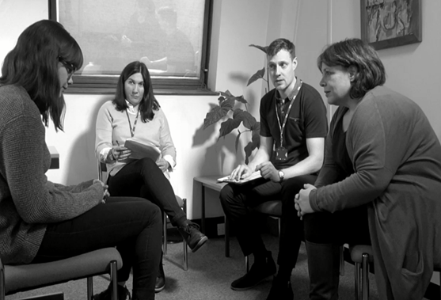
Collaborating with services users and carers: Using film to promote reflective practice in the classroom
Collaborating with service users and carers: Using film to promote reflective practice in the classroom.
Sarah Harvey: Senior Lecturer in Occupational Therapy
Sarah Harvey

Slide 2
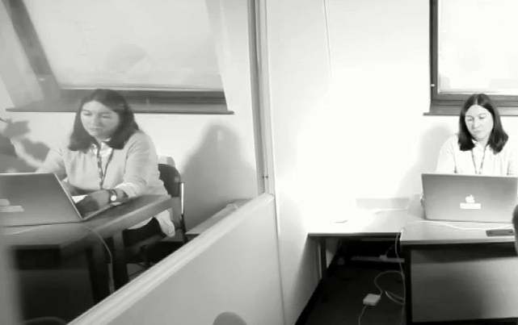
Session Plan
Reflecting from a different perspective
Film as a reflective tool
Occupational therapy student feedback
Conclusions
Do I look like I am interested or engaged with the discussion taking place?
We always type our notes in multidisciplinary meetings to save time
REFLECTION: Individuals with personal experience of illness and disability can challenge student reflexivity, (Yalon-Chamovitz et al, 2017)

Slide 3
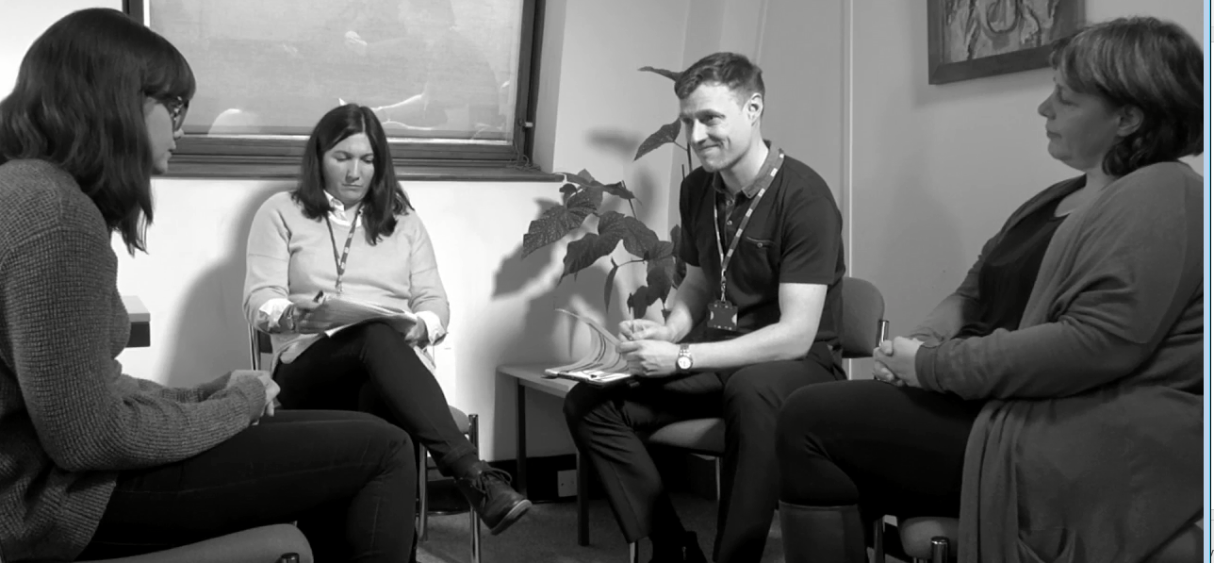
“I often don’t know the names, what profession they are and what they do?” Claire (mother)
“The anxiety is not only relevant to the first meeting , I get a feeling of being out of control in all meetings” Beth
Thinking about your practice from an external perspective promotes critical thinking and client centred practice (Whalley Hammel, 2015: Wright and Bolton, 2012)

Slide 4
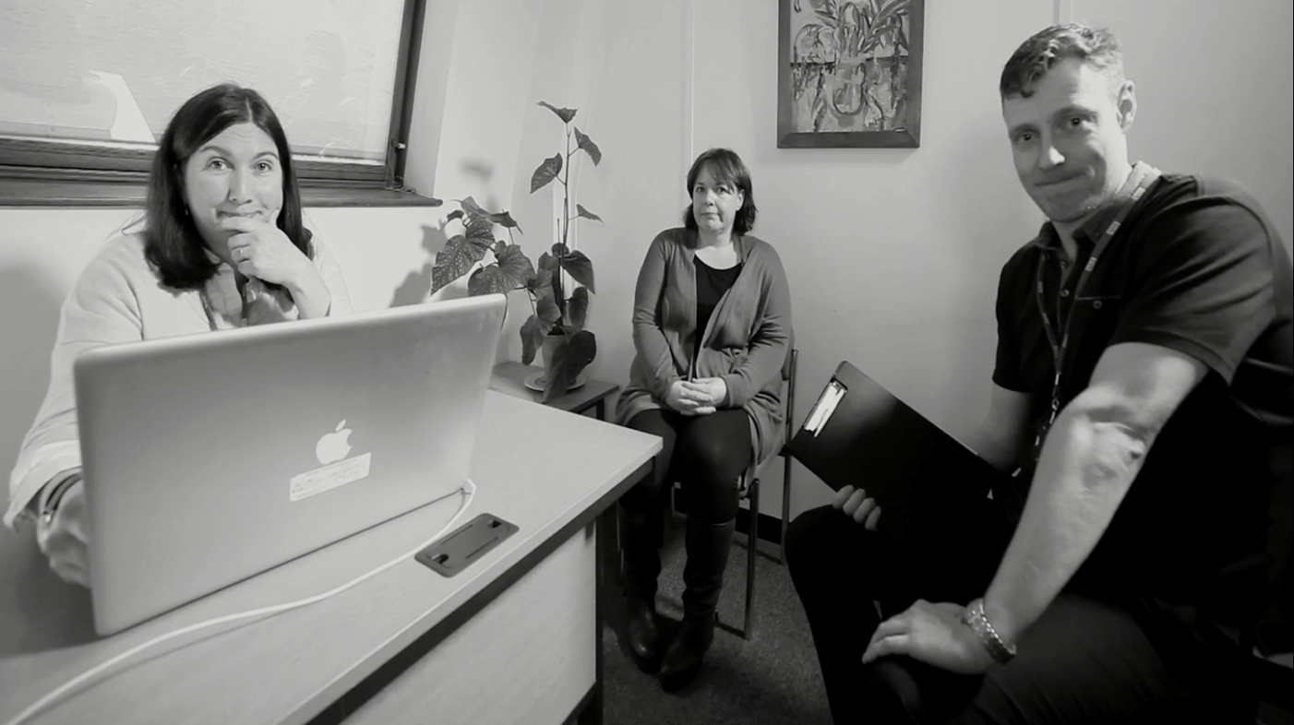
How to promote reflective practice in a classroom environment?
How is this perspective of your multidisciplinary meeting for you?

Slide 5
Project: Developing an empathy
raising film
FOCUS GROUPS
People who had experience of mental health services, their carers, families and mental health professionals were invited to focus groups.
Narratives were gathered in order to understand their personal experience.
Information collated from focus groups helped prioritise topics for the film.
Quotes and reflective questions were integrated in the film to encourage reflective practice.

Slide 6
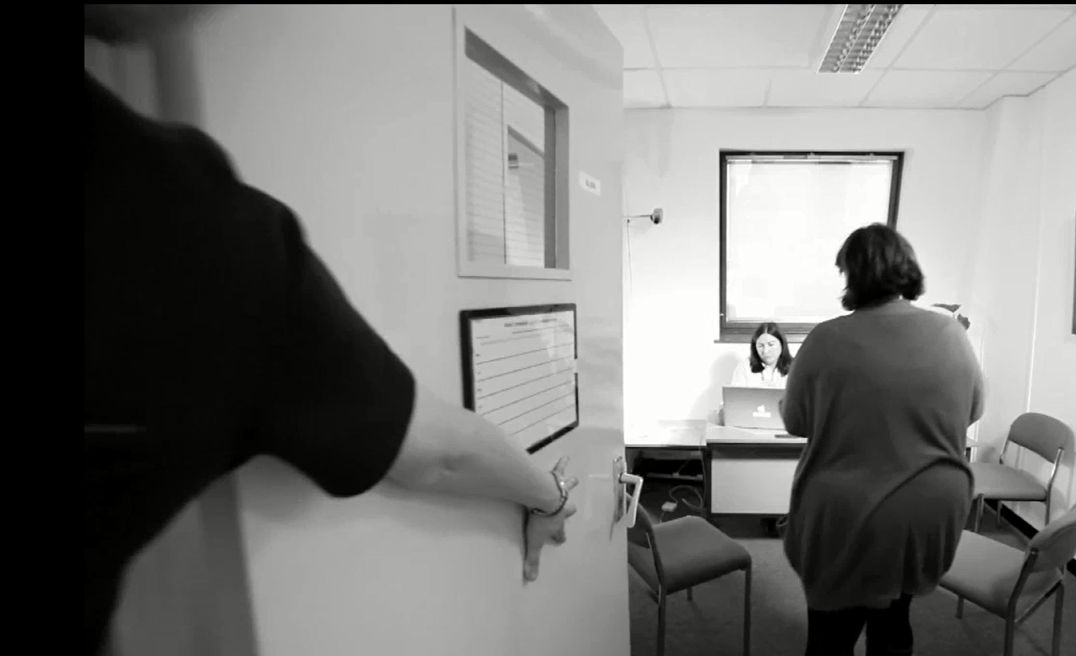
Service users wanted to get across how anxiety provoking meetings are.
“It looked like the lady has the dominant power because she is sitting behind the computer.”
“Sense of fear, everyone looks very serious”
“….the staff could re-assure Beth more”

Slide 7
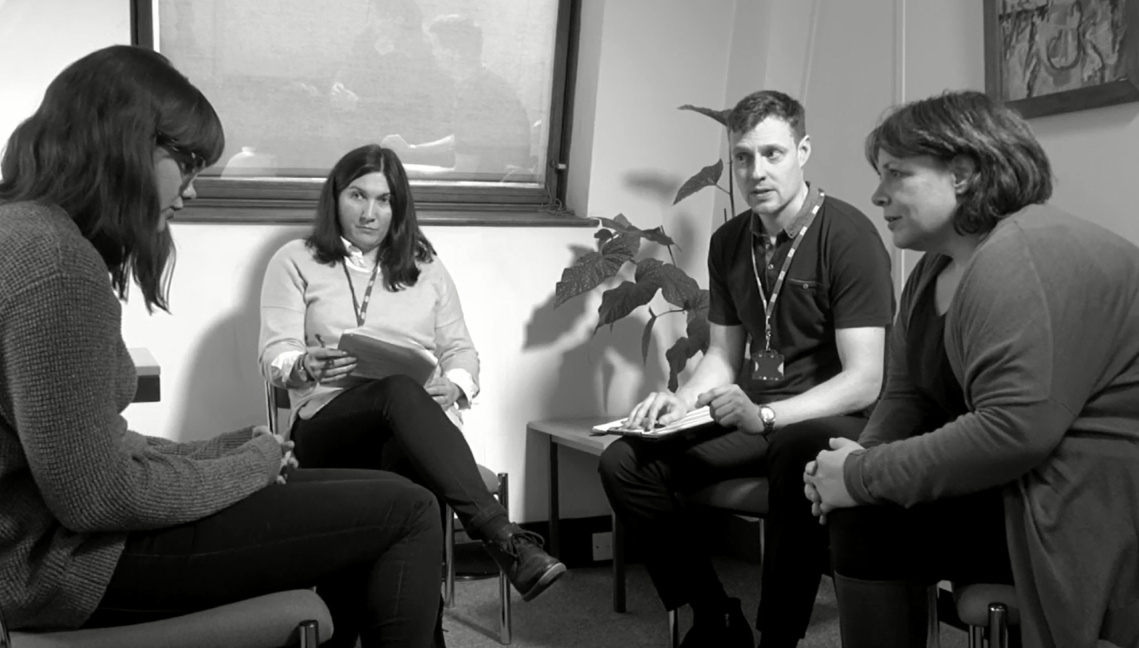
Carers wanted staff to understand their perspective and their concerns about managing risk.
“The carer doesn’t really know what is going on, she doesn’t really know what is happening”
“The mother is being dominating and overbearing”
“I think the mother is hopeful”
“I think she needs more support”

Slide 8
Conclusion
The classroom provided a safe place to discuss practice issues
The scenario enabled group reflection to take place.
Assumptions were challenged
students reflected from the service user’s perspective and considered how to improve the situation.
References:
Whalley Hammell. K, (2015) Client centered occupational therapy: the importance of critical perspectives. Scandinavian Journal
of occupational therapy, 22, (2) pp.237-243, Available at: http://www.tandfonline.com/doi/full/10.3109/11038128.2015.1004103.
(Accessed: 04.11.17)
Wright. J, Bolton.G, (2012) Reflective writing in counselling and psychotherapy, London, Sage
Yalon-Chamovitz. S, Kraiem. Y and Gutman. C, (2017) Deconstructing hierarchies: Service users as co-teachers in
occupational therapy education, Work, 56, 3, pp.1-6, Available at: https://www.ncbi.nlm.nih.gov/pubmed/28269798, (Accessed:
05.11.17)

