Slide 1

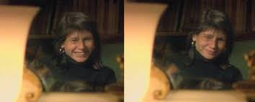
Learning landscapes:
1. Prehensions of space in film and their pedagogical implications
Christian Beighton
Canterbury Christ Church University,
“Better to be a sweeper than a judge” (Deleuze and Parnet, p15/ p8 Eng)

Slide 2
plan
Space(s) in learning
Space in film
Practices
What?
Creativity and learning:
Antonioni
Pity
Chance
Error
Why?
Problems?
Improvisation
Loathing

Slide 3
So what?
Pedagogy = too often a cognitive question or an affective economy in experiences and feelings.
The spatial aspects of such affectivity in learning are often downplayed ( space as extension)
landscape and learning can and should be intertwined.
e.g. Action and space in cinema :Michelangelo Antonioni (L’Eclisse, The Passenger), Werner Herzog (Heart of Glass, Stroszek) and Bela Tarr (Werckmeister Harmonies; The Man from London)

Slide 4

So what?
these representations of space emphasize the emergence of place as a heterogeneous and creative phenomenon or, as A.N. Whitehead puts it, “prehension”.
what can pedagogy learn from these attempts to convey the dynamic relationships between non-euclidean space and lived experience?

Slide 5
So what? Pedagogically speaking,
the prehension of space dramatically shifts our focus of attention from given to emergent knowledge and its implications ( “better a sweeper than a judge”)

Slide 6
So what?
this provides us a with a critical perspective on pedagogical developments which fail to release this.
it provides us with a more constructive perspective on the relationships, technologies and practices of learning in these non-euclidean, affective spaces.
our understanding of the landscapes of learning is a question of ethics and our role in developing socially just education.

Slide 7
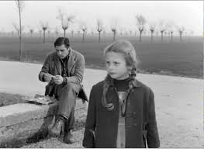
Antonioni on emergence
I believe that these little failures, these empty moments, these abortions of observation, are, all things considered, fruitful. When we have put quite a few of them together – not knowing how, not knowing why – a story emerges (Antonioni, in Cottino Jones: 1996: 59)

Slide 8
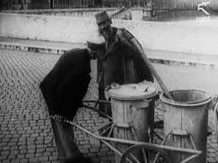
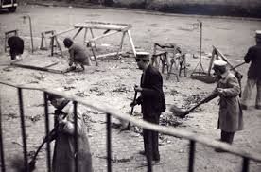
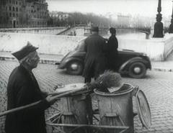
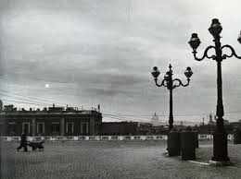
e.g. Nettezza Urbana (1948)
Ignored spaces
Materiality
Spaces of possibility
Mi-lieux and the prehension of subjectiles

Slide 9
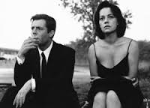
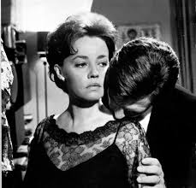
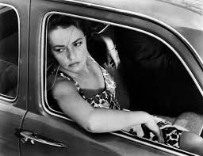
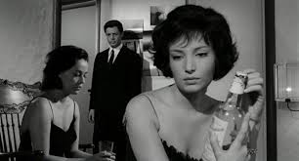
Eg: La Notte (1961)
Wasted space
Banausic lifestyle
Triviality
Casual relationships
Self-loathing

Slide 10
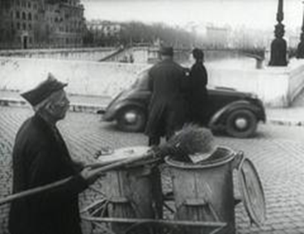
Nettezza urbana:
Value of this life
Ethics is a spatial practice
Criteria are immanent to life

Slide 11

Consequences: education & pity
The agony of a rat or the slaughter of a calf remains present in thought not through pity but as the zone of exchange between man and animal in which something of one passes into the other. This is the constitutive relationship of philosophy with nonphilosophy. (Deleuze and Guattari, WiP, 109)
Education is about spatial practices of material becoming:
Co-construction of mi-lieux
Physical building of objects.
Choosing the life of one who chooses

Slide 12
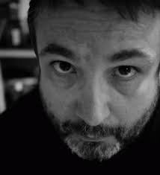
Bibliography
Beighton, C. (2018) Critical Ethnography: Investigating practice in Police Firearms Training, Sage Research Methods Case Studies. DOI: http://dx.doi.org/10.4135/9781526428486
Beighton, C. (forthcoming, 2018) Towards a Transversal University: globalisation, excellence and UK Higher Education in Cole, D. R. and Bradley, J.P.N. Principles of Transversality in Globalisation and Education, Springer
Beighton, C. (2017) Telling Ghost Stories with the Voice of an Ogre: Deleuze, Identity, and Disruptive Pedagogies, Issues in Teacher Education Special issue 26 (3) 111-127
Beighton, C. (2016) Expansive learning in Professional Contexts: A Materialist Perspective, London: Palgrave Mac.
Beighton, C. (2015) Deleuze and Lifelong Learning: Creativity, Events and Ethics, London: Palgrave Macmillan
Cottino-Jones, M. (ed) (1996) Michelangelo Antonioni. The Architecture of Vision. Writings and Interviews on Cinema, Chicago, The University of Chicago Press
NU : https://www.youtube.com/watch?v=wgYjjjeUNps
Whitehead, A.N. (1978 ) Process and reality. London: FAB

