Slide 1
National Teaching Repository & Social Media
Authors
Scott Turner (Canterbury Christ Church University) @scotturneruon
Suzanne Faulkner (University of Strathclyde) @SFaulknerPandO
Neil Withnell (University of Salford) @neilwithnell

Slide 2
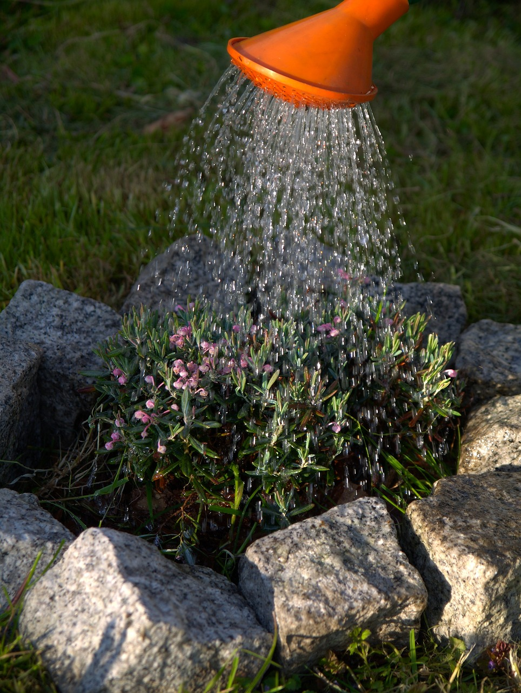
or……..Sharing is Caring

Slide 3
What is it?
This project is part of the 2020 Good Practice Grants, which helped Advance HE members to develop and share innovative practice.
The idea behind the National Teaching Repository is to create a central space where anyone with an interest in teaching and learning or supporting developments can view, download and share the very best ideas either to use off the shelf or with some slight adaptation to meet their needs as teachers, lecturers or researchers.
Led by Professor Dawne Irving-Bell.

Slide 4
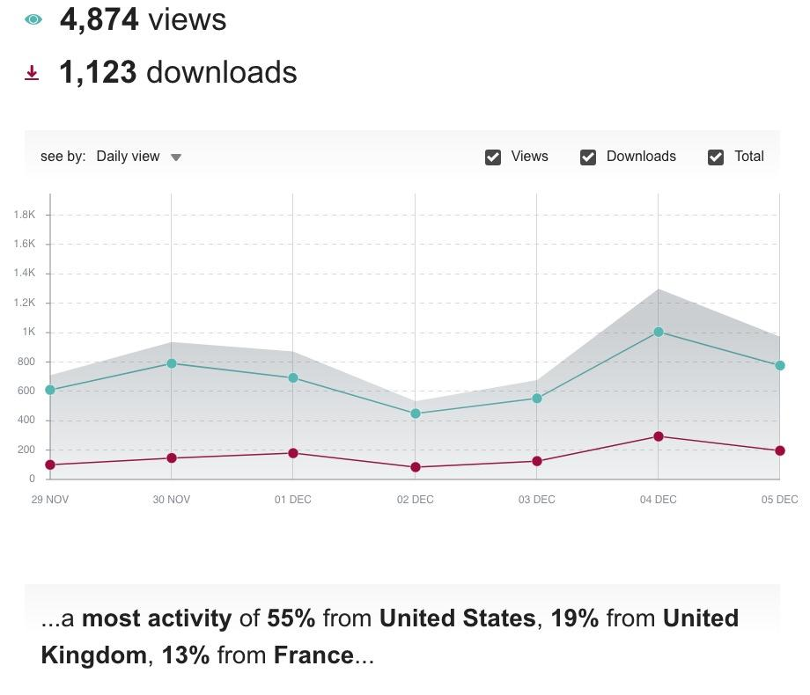
What is it in reality?
A friendly place to share your resources.
Built on Figshare so every resource gets a DOI so you can track it’s impact in terms of downloads, etc.
With Figshare research outputs are citabale, sharable and importantly discoverable.

Slide 5
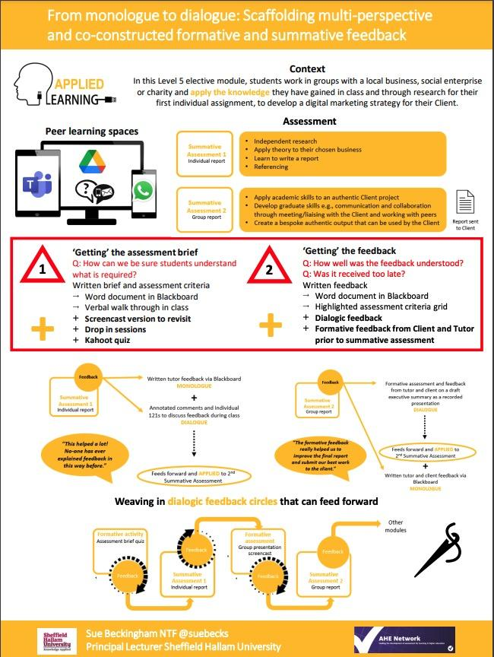
What types of resources are shared on the NTR?

Slide 6
The NTR is Award Winning
awarded the Open Education Global (OEGlobal) International Award for Excellence in Open Collaboration. Described by the judges as a ‘truly exemplary initiative,’

Slide 7
NTR awards!
OER Outstanding Contribution
OER Champions Award
Innovation
Award for Excellence
Award for Global Reach and Impact
Distinguished Service Award

Slide 8
The NTR board members:
Professor Dawne Irving-Bell, BPP University (Founder)
Dr Scott Turner, Canterbury Christ Church University (Data Analytics)
Dr Nathalie Tasler, University of Glasgow (Impact and Practice)
Dr Kate Cuthbert, Staffordshire University (Community and future)
Laura Stinson, Nottingham Trent University (Organisation and Events)
Sue Beckingham, Sheffield Hallam University (Social Media)
Professor Peter Hartley, Edge Hill University (Historian)
Neil Withnell, University of Salford (Awards and Recognition)
David Wooff, BPP University (Chair)
Liam Bullingham, University of Essex (Technical)

Slide 10
Why and How to take part
Submit something (hopefully more than one) https://figshare.edgehill.ac.uk/submit
You could be a critical friend https://figshare.edgehill.ac.uk/articles/presentation/Curator_and_Critical_Friend_Affiliations/12820727
To find out more:
Irving-Bell, Dawne; Irving-Bell, Dawne (2021). The National Teaching Repository Explained - An Advance HE Presentation. National Teaching Repository. Media. https://doi.org/10.25416/NTR.15152094.v2
https://ntrepository.com/

Slide 11
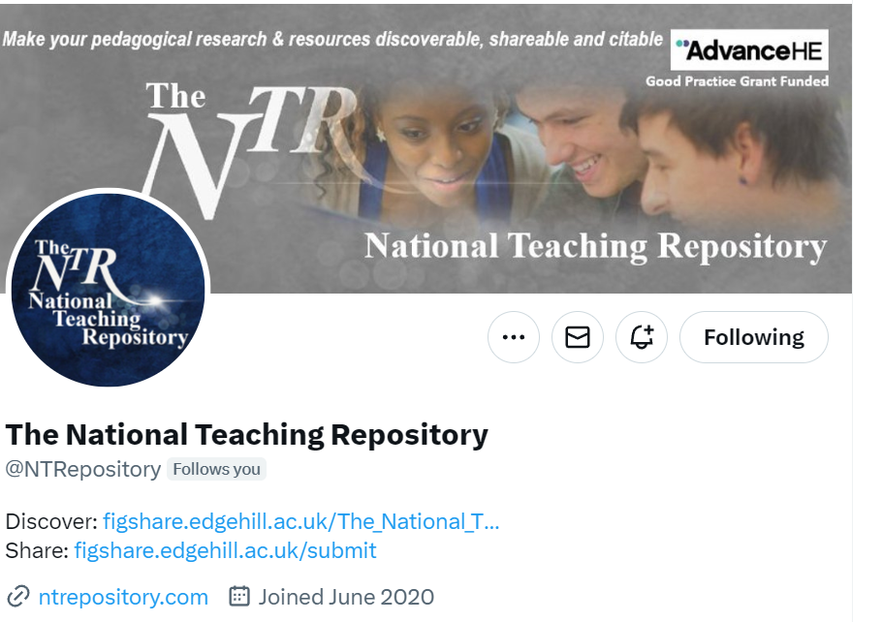
Social Media
https://twitter.com/NTRepository

Slide 12
Some stats
As of 18th December 2023 there has been
546,271 views
162,158 downloads
Up to the beginning of November 2023
488 authors or organisations (some posted as organisations)
902 connections between them
186 groupings identified (a lot single author in a group)

Slide 13
Method – authors connected by collaboration
Aim to investigate links between authors to see the connections
Method
Going through all submissions in the NTR.
Any author – author relationship is counted once
Size of a node (author) linked to number of connections

Slide 14
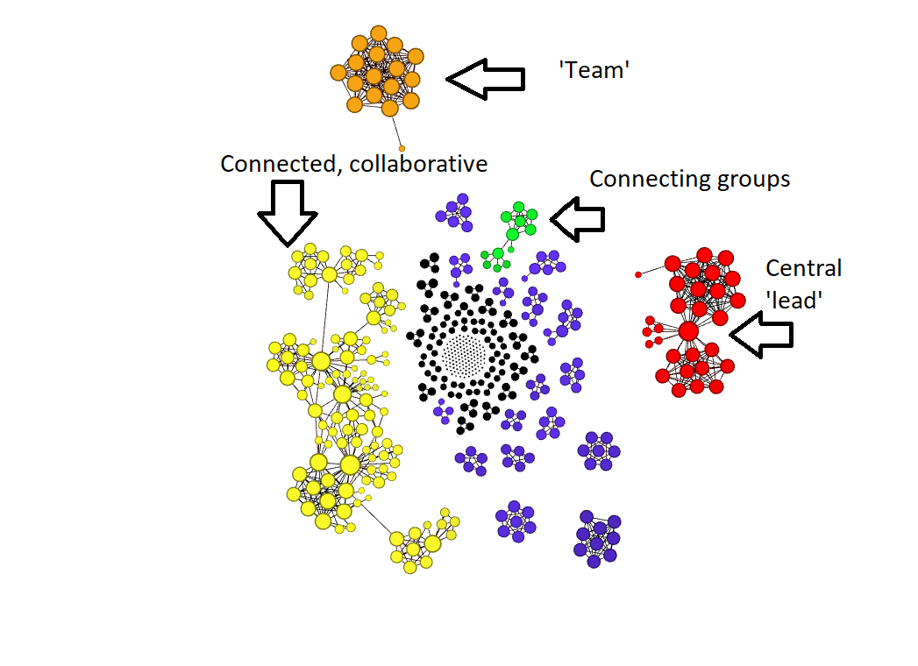

Slide 15
Yellow is the biggest group – links often centred around people connecting groups
Most in black are single authored work.
Red group and Green group is largely linked by one person in each group.
Conclusion: As seen by the Yellow, Red and Green groups – NTR does have the potential ability to increase connections.

Slide 16
Overall
Like SocMedHE23, it is a friendly community
Potential for connections
Get stats that you can use for promotion
Sharing is caring.

