Slide 1




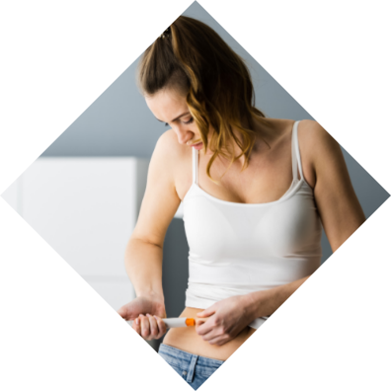




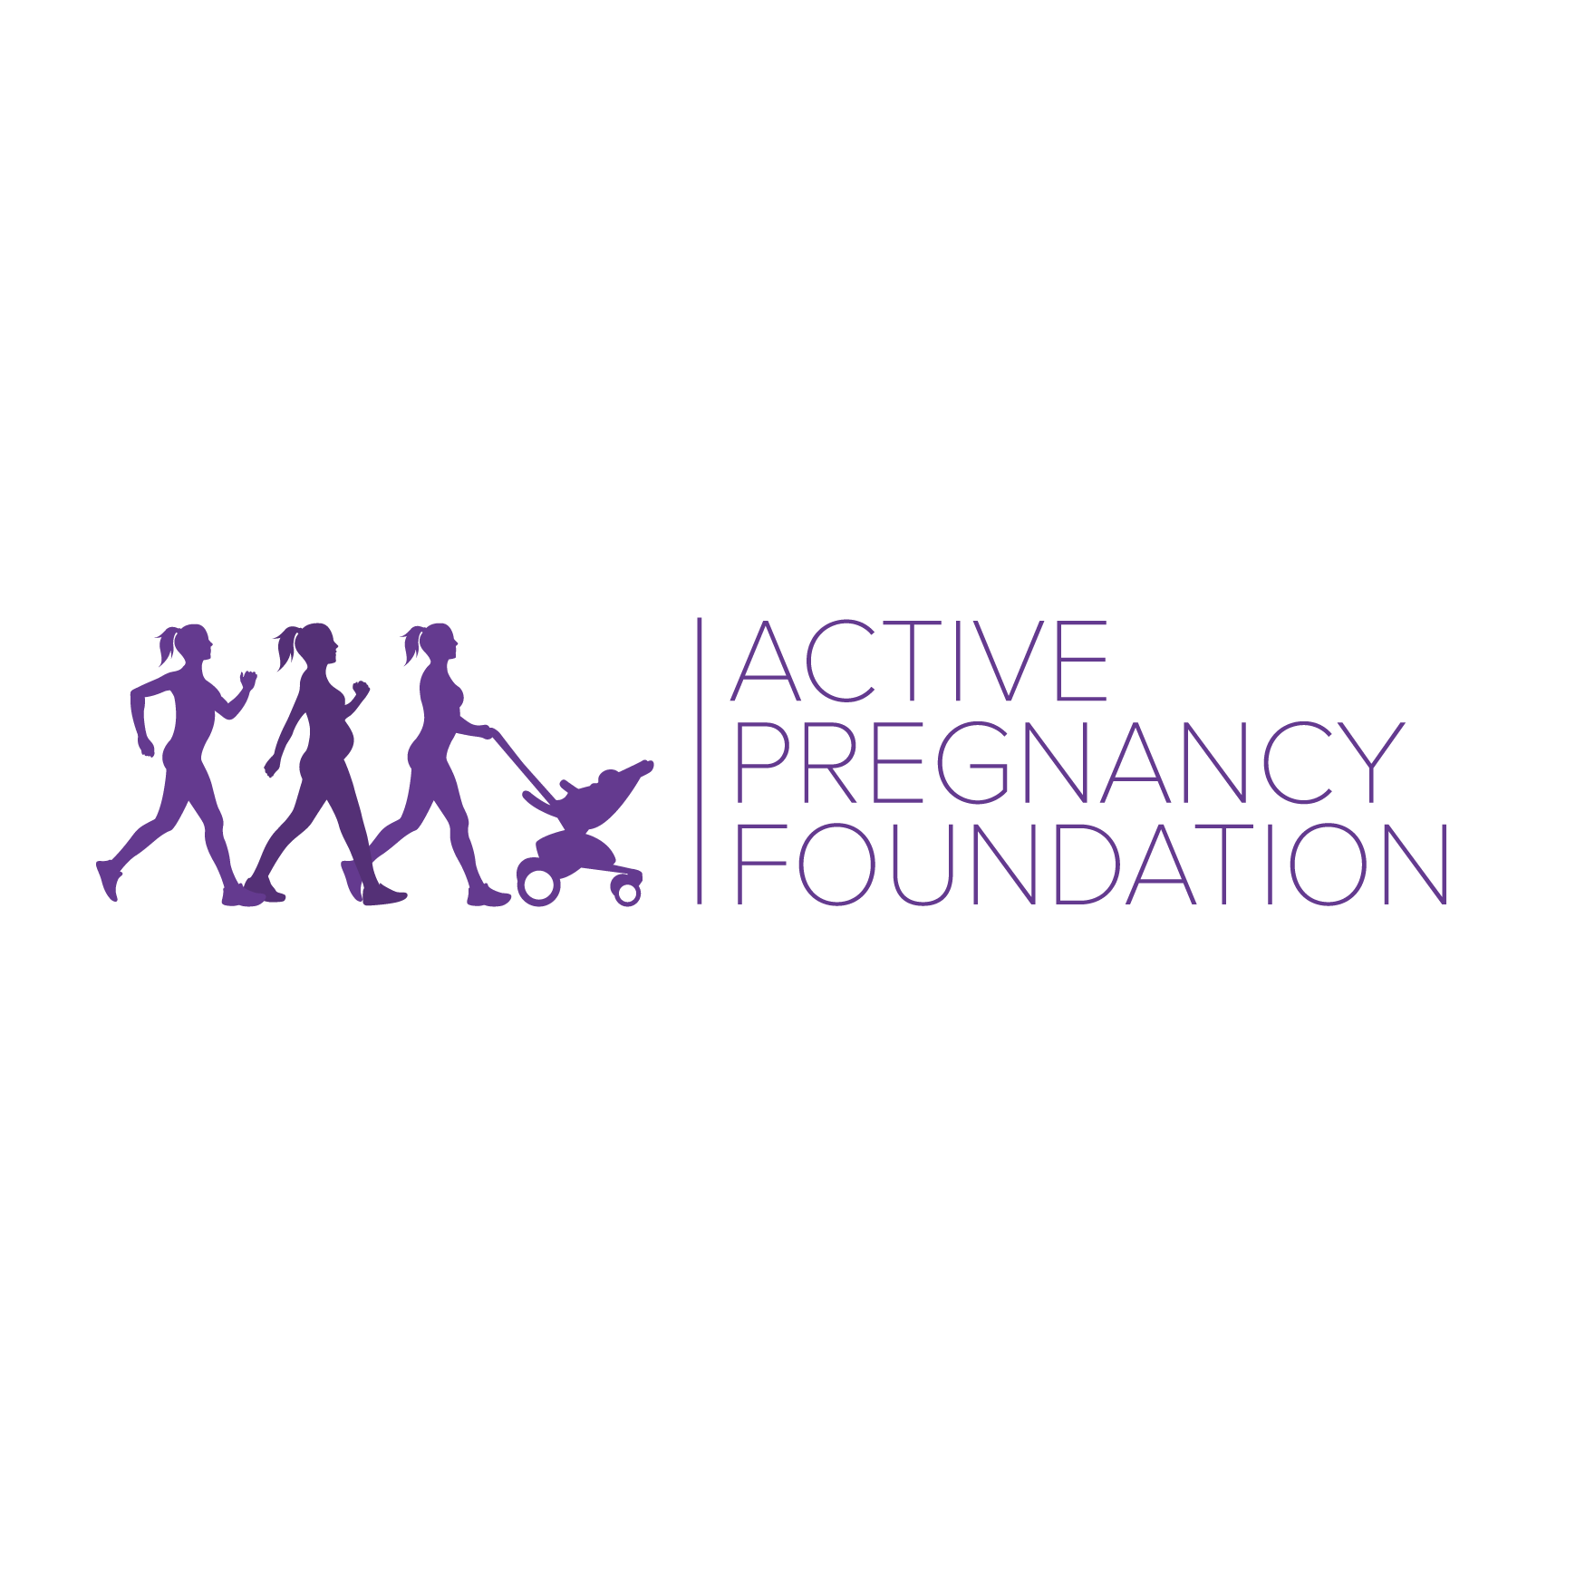


Exploring provision and impact of physical activity advice and guidance offered to women undergoing fertility treatment
Stacey Draper
Supervisors: Dr Marlize De Vivo & Dr Hayley Mills
stacey.draper@canterbury.ac.uk
Canterbury Christ Church University

Slide 2




Background and Rationale
Research demonstrates mixed findings but suggests physical activity can significantly affect fertility treatment outcomes.
inactive
extremely active
negative effect
frequency
intensity
type
moderately active
positive effect
There are currently no physical activity guidelines for women undergoing fertility treatment.

Slide 3







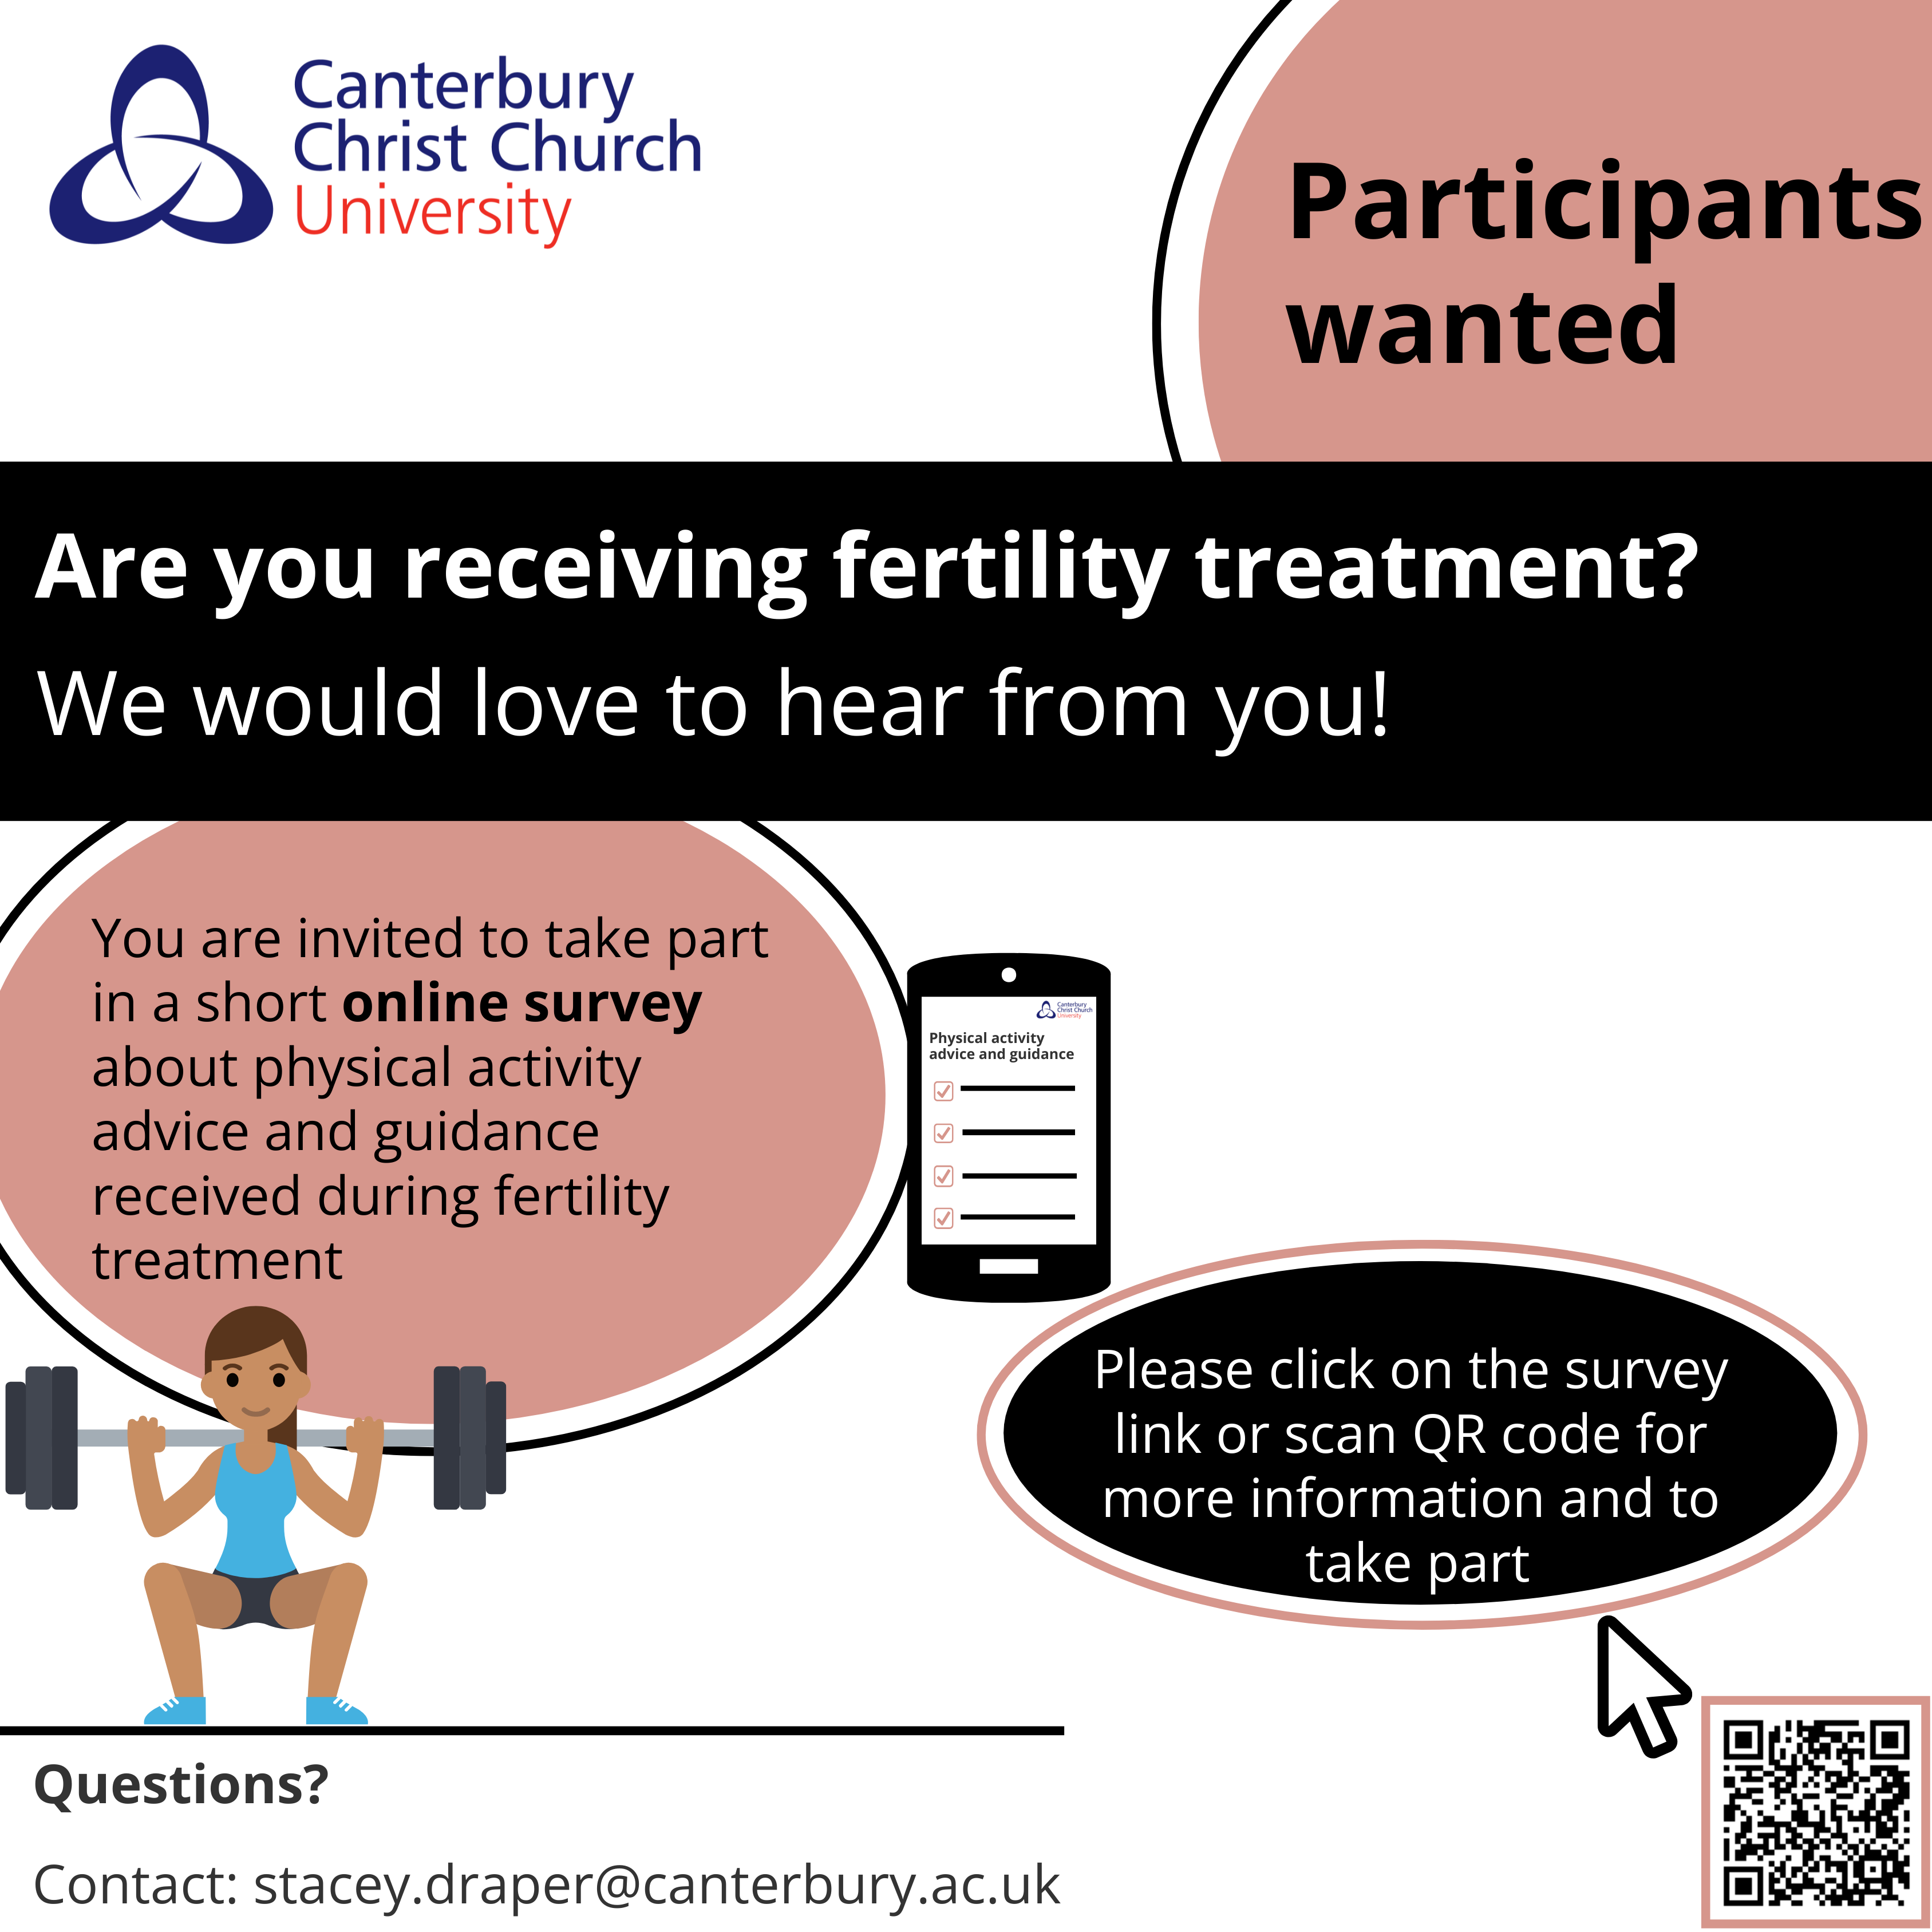




Method
HCP
Qualitative
(interviews)
Women
Quantitative
(survey)
(n=256)
Quantitative
(survey)
Qualitative
(interviews)
(n=11)

Slide 4


Results
Do women receive physical activity advice and guidance from their healthcare professional?
I did question a few times about going to the gym. Like once I’d gone in and had injections and things on the day at the clinic then I’d say well I’m planning on going to the gym later, can I do that? Their advice was “oh if you’re concerned just don’t risk it”.
(Aurora)
of women received physical activity advice and guidance. However...
I do remember at one of the earlier appointments asking the healthcare provider if I could still do things like go running but he cut me off and said “why would you want to go running if you’re trying to get pregnant?”
(Feyre)
of those women had to initiate the conversation themselves.
you might, you might go oh it’s a silly question to ask about exercise, right?
(Maya)

Slide 5



Results
women who received advice and guidance from their HCP decreased their activity levels significantly more than those who did not (p=0.01)
As soon as I start taking injections, I’ve tended not to do any strenuous exercise. So, I won’t run, I won’t do any swimming, I won’t do any like weights or anything, I’ll just do, I’ll just walk.
(Raven)
Their advice was to take it easy, walking is fine, gentle stretching and when I was in treatment not to do anything that involved twisting.
(Esme)
If you’re telling me not to exercise, I take that as I just need to sit on the sofa for two weeks.
(Riley)

Slide 6




Results
Has your physical activity levels changed since starting treatment?
"Risk and Reward"
79%
If I feel like I’m gonna impact something I’m not gonna risk it because I mean the risk and reward, it’s just not, you can’t even compare it.
(Riley)
Even when I wanted to run or jog my worry was well that could happen and I’d been told how dangerous that was from a torsion perspective and then I guess after transfer you’re then so scared of anything that might lead to another miscarriage.
17%
(Esme)
4%
Ok, now I’m in it I have to, I have to. It can be, it felt quite frustrating but then also, right well the greater good if it gets me to the end point that I want then in a way I was like suck it up.
I do less
I do more
No change
(Esme)

Slide 7





Results
Uncertainty around physical activity during fertility treatment
They take a bit of a cautious approach and so then that tends to influence also my thinking on it.
(Maya)
I guess, after transfer, you’re just so scared of anything that might lead to another miscarriage.
of women felt supported by their healthcare professional(s) to be physically active throughout their treatment cycle(s)
(Luna)
weightlifting and all these other things they are straight away like oh just don’t do that then.
(Matlida)

Slide 8


Results
Effects of limiting physical activity
So, the clinic recommended I didn’t do any exercise in that period. They basically recommend you have a slow walk and not anything else and it did make me go a little bit mad.
(Riley)
Just a case of like I just won’t do anything then. I won't do anything and ill just go to work or just sit at home or whatever and I won't do anything and I think that has a negative impact, I think, on the mind.
(Luna)
I gave it a go. Like, cut the exercise, put quite a bit of weight on and like they did improve slightly but then just not that much but then equally I wasn’t that happy.
(Martha)

Slide 9


Results
‘Helping people navigate that uncertainty’ – Support for Guidelines
I really think it would be useful to have some more specific information about this because I definitely found that it was lacking, and you do, you know, you do second guess yourself, right?
of women believe there is enough information available to inform decisions around physical activity during fertility treatment
8%
(Maya
of women believe it would be beneficial to have physical activity guidelines to refer to
What I was probably capable of doing was a bit less on the long protocol whereas the short protocol, I didn’t respond to that at all and I was just everything kind of stayed the same but other women on the short protocol obviously find that really intense so I think if you gave different scenarios and guidance within that then I think that would work really well. And I just think if we’re talking about vigorous exercise, giving people an idea of what that means.
100%
(Maya)

Slide 10
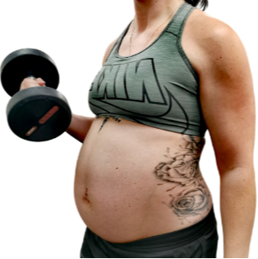
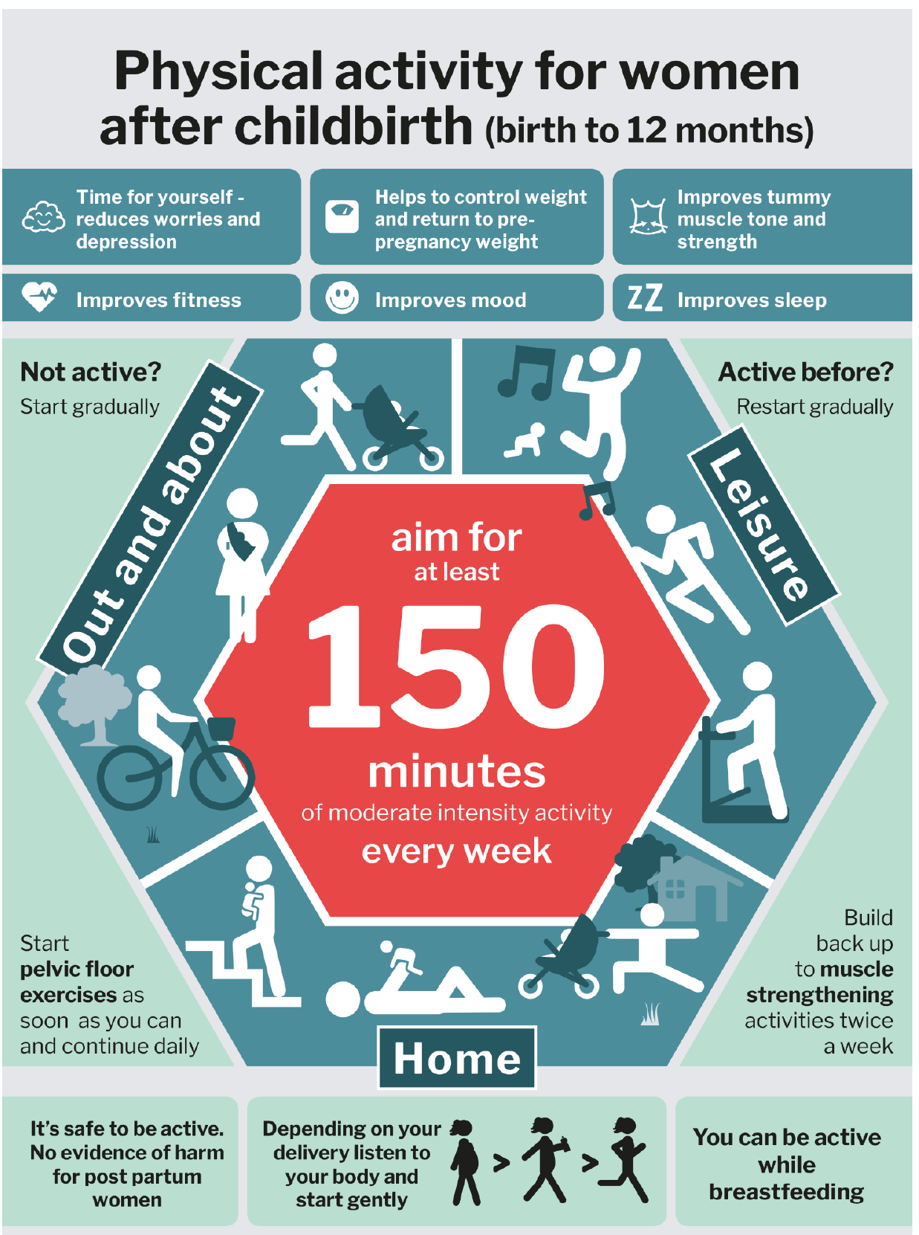
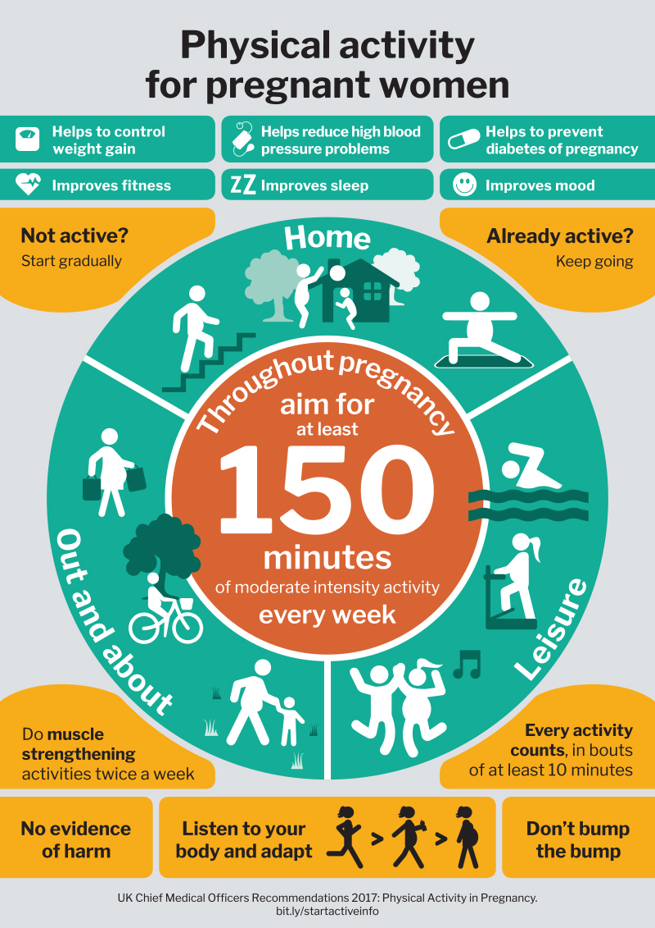
Reflections once pregnant
It’s not just about cardio it’s now, also about strength. Whereas before, during treatment I was always really scared to do anything strength focussed. Now that I’m pregnant and potentially with twins I think right I need to be really strong.
(Matilda)
I just find it interesting getting all this information now that I’m pregnant and having these guidelines telling me to do these things and feeling like oh how can I suddenly do all this now there’s a baby inside me but when there wasn’t anything I was told I couldn’t do it?
(Feyre)

Slide 11


Thank you for listening!
Any questions?

