Slide 1
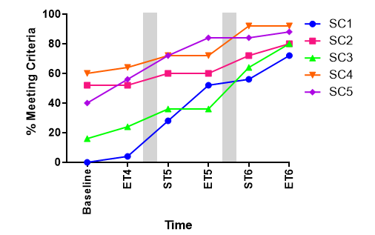
Supporting Young Children’s Physical Development through Tailored Motor Competency Interventions within a School Setting. Dr Kristy Howells and Ellie Huggett
Issue Overview
Children are developmentally behind in motor competency (MC) levels for fine, gross motor skills plus in core strength and coordination.
Children with poor levels of motor competency have issues with learning to read and write, and playing sports, since they find it difficult to hit, kick or catch a ball.
Challenges from inadequate hand-eye coordination may impact behaviour and the ability to pay attention.
Motor competency is critical for development of healthy bodies as well as social emotional wellbeing.
Evidence of Success
Motor competency levels can be improved and sustained through physical activity interventions within bespoke scheme of work.
Significant improvements for each of the success criteria for the skills: galloping, sliding, dribbling, underarm rolling, catching, use of scissors, hopping (see figure), running, climbing and kicking.
Intervention Strategy
Tailored MC interventions embed within Scheme of Work, (SOW), warm up activities, as well as play times to enhance physical development.
Skills were tracked over 19 weeks, (3 academic terms, terms 4, 5 and 6 in Spring – Summer) and were assessed at start and end of each term. SOWs were adapted to challenge and support the children in their progressions.
Call to Action
1) Motor competency interventions need to be implemented in all schools with support from practitioner / teacher observations.
2) Implementation into policy for national level school-based interventions to develop fine motor skills, gross motor skills, coordination and core strength in all children to improve physical development nationally leading to greater physical activity participation levels.
3) More training in schools as CPD and university settings as initial training of how to develop motor competencies and how to observe motor competency.
Key Reference:
Huggett and Howells (2024) Supporting Young Children’s Physical Development through Tailored Motor Competency Interventions within a School Setting. Children 11 (9), 1122. Accessible via the QR Code.

