Slide 1
The ‘Flipped Placement’: can blended learning enhance undergraduate general practice placements and alleviate capacity issues?
James Curtis & Catherine Neden
Kent and Medway Medical School (KMMS)
www.kmms.ac.uk

Slide 2
Background
Poor placement experiences
Primary care placements positively influence student career choices^{1,2}
Practice workloads and lack of physical space are major challenges in delivery of placements^{3,4}
Reduced GP recruitment
www.kmms.ac.uk
Notes:
Expansion of ARS staff
Richard Darnton paper talks about ‘death spiral’ where poor placement experiences may result in worse GP recruitment

Slide 3
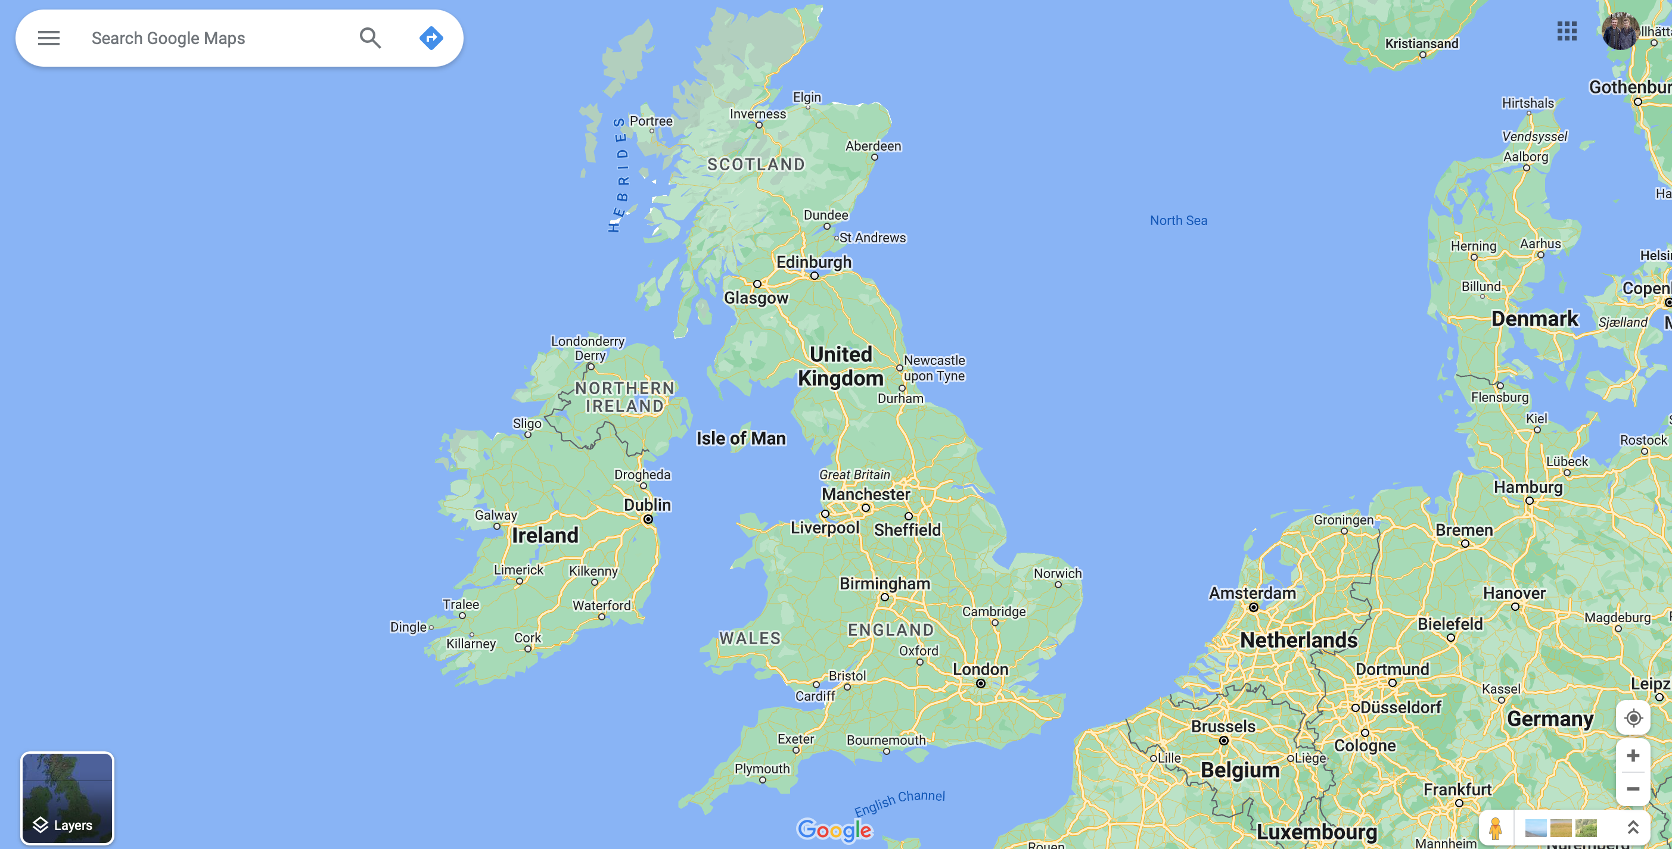
AMEE Glasgow

Slide 4
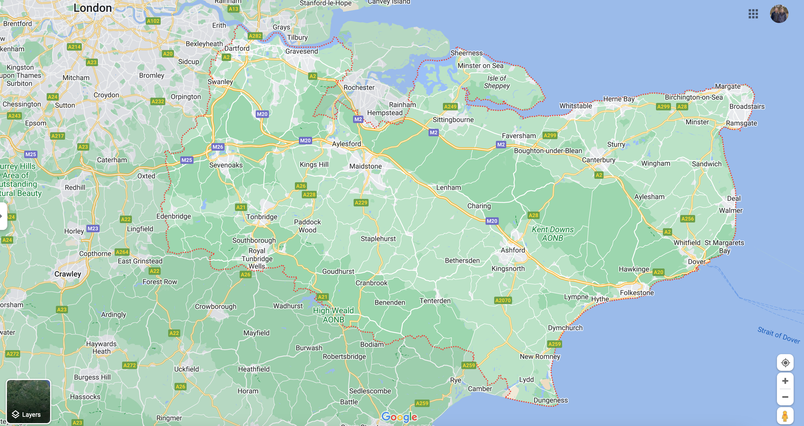
Notes:
1.8 million people
28 PCNs
After London, the South East has the highest numbers of patients per GP and per practice nurse (2022)
Deprivation, particularly along the coast

Slide 5
The Approach
KMMS students undertake six ‘immersion weeks’ per year
Immersion week structure changed 2022/23 to bring Mondays on-campus
Introduction of ‘asynchronous learning’ Monday
afternoons using Xerte software
www.kmms.ac.uk
Notes:
Six one-week-long immersion weeks per year
Each corresponds with on-campus systems-based modules

Slide 7
Rationale
Tailored, primary-care specific content
Utilises multimedia & interactive elements
Flexibility for students
Consistency of placement teaching
www.kmms.ac.uk
Notes:
Tailored content – can fit within systems-based modules to provide bridge between campus and placement teaching
Can embed external resources (e.g. Youtube videos) within the lessons
Interactive elements – e.g. quizzes, sorting exercises
Students allocated time but asynchronous so can complete when suits them
Aim to provide consistent primary care-themed learning – accounts for inherent variability between placements. Testable

Slide 8
Engagement
Proportion of students
Proportion of students completing asynchronous lessons
Notes:
129/131 (98%) year one students completed at least one asynchronous lesson and 113 (86%) completed all six.
106/106 (100%) year two students completed at least one asynchronous lesson and 84/106 (79%) completed all six.
Big drop off last two immersion weeks, esp for Y2. weeks 1-4 average 97% completion

Slide 9
19
47
10
13
10
27
47
16
5
5
Year 1 response rate 78/131 (60%) Year 2 response rate 85/106 (80%)
Notes:
*data from after 3rd IW*
Y1 response rate 78/131 (60%)
Y2 response rate 85/106 (80%)
Mostly positive - either agreed or strongly agreed: 52/78 (67%) of Y1 and 63/85 (74%) of Y2
Why did year 2 students prefer?
?used to independent learning
?experience with previous immersion week format
?less ‘conceptual’ topics

Slide 10
Positive Feedback
‘The asynchronous learning was very helpful and standardised the teaching for all students despite it being glitchy sometimes’ Year 2 student
‘The interactive asynchronous learning is good and with relevant information and teaching to prepare us for the week and the topics of system based modules’ Year 2 student
www.kmms.ac.uk

Slide 11
Limitations
‘The asynchronous learning often freezes and crashes’ Year 1 student
IT issues
Engagement
Relevance to primary care
‘Asynchronous learning sometimes feels like a repeat of what we’ve learnt in other modules’ Year 1 student
www.kmms.ac.uk
Notes:
Main limitation - IT issues - specifically integration with current virtual learning environment – inconsistent recording of ‘completion’ of learning. Moved mid-year to system where just recorded whether students accessed the resource, rather than evidence of ‘completion’ – eased issues however changing message to students caused uncertainty for some
Engagement – tick box vs useful learning resource - no way to ensure students are completing as planned – some students in anonymous feedback listed the learning being ‘quick’ as a highlight
Relevance to primary care – at times ?duplication of on campus teaching – balance between providing primary care-specific info while broad enough to be applicable to wide range of PCNs

Slide 12
Take Home Messages
A ‘flipped placement’ approach can provide a scaffold for learning in primary care placements
This can ease the ever-increasing capacity issues in primary care
www.kmms.ac.uk

Slide 13
Thank you james.curtis@kmms.ac.uk

Slide 14
Acknowledgements
Thank you to:
Susan Driver - Digital Education Manager
Dr Siobhan Cooke – Senior Lecturer in Medical Education
KMMS GP Team
www.kmms.ac.uk

Slide 15
References
Amin M, Chande S, Park S, Rosenthal J & Jones J. Do primary care placements influence career choice: What is the evidence? Education for Primary Care. 2018. 29:2, 64-67, DOI: 10.1080/14739879.2018.1427003
Wass V, Gregory S, Petty-Saphon K. By choice—not by chance: supporting medical students towards future careers in general practice. London: Health Education England and the Medical Schools Council. 2016 Mar 16.
Darnton R, Amey S, Brimicombe J. The nature and prevalence of threats to medical student placement capacity in primary care: a survey of East of England GP practices. BJGP Open [Internet]. 2022 Oct;6:BJGPO. DOI: 10.3399%2Fbjgpo.2022.0127
Hacker J. Nearly three quarters of GPs cannot house ARRS staff, survey finds. Pulse. March 28, 2023. Accessed June 30, 2023. https://www.pulsetoday.co.uk/news/pulse-pcn/nearly-three-quarters-of-gps-cannot-house-arrs-staff-survey-finds/
www.kmms.ac.uk

