Slide 1
Technologies for Transformative Learning

Slide 2
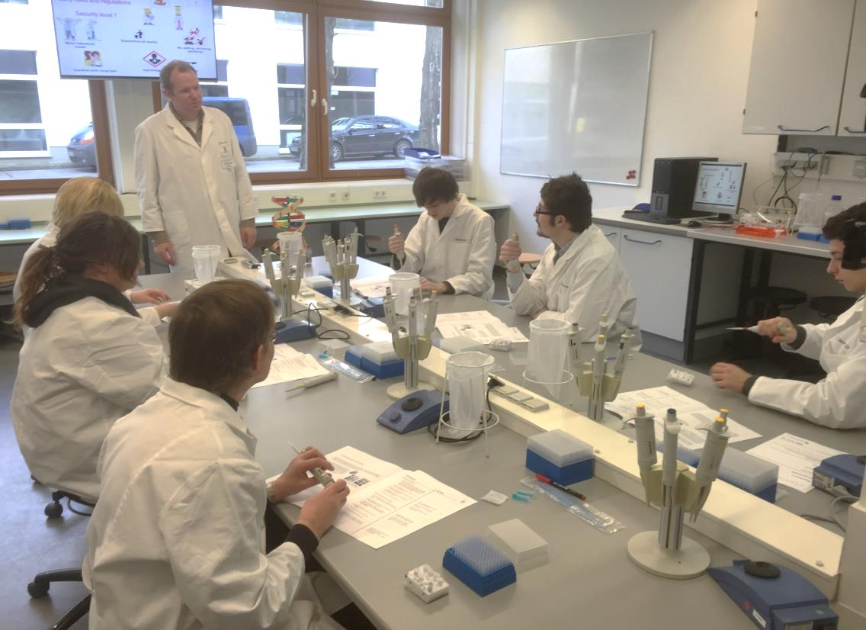
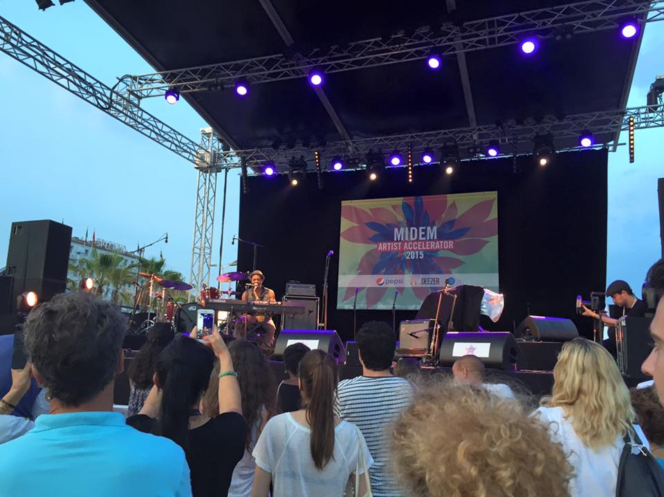
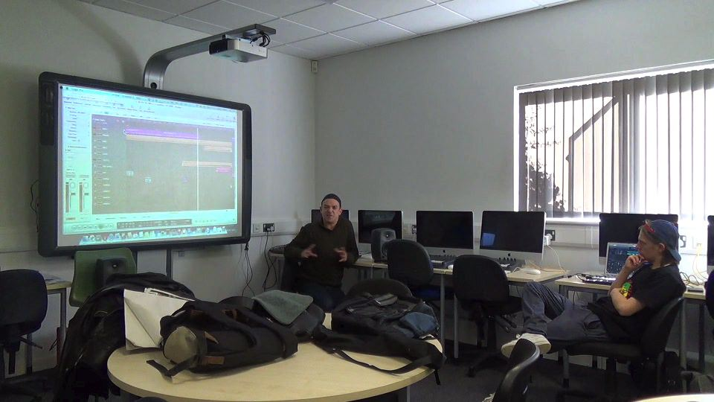
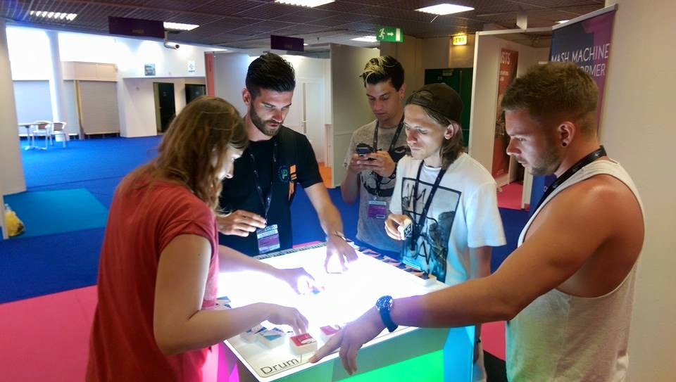
East Kent College students
Notes:
Best examples of using learning and sharing technology in the real world – what I see in partnerships EKC
Images show real students in context – technology is not something we give to students – it is ubiquitous today – they bring us to theirs and we enhance opportunities and ensure that we are stimulating and listening in equal measure
EKC students – Music Industry Conference in Cannes
Applied Biology students went to Berlin in 2015 and used the state-of-the-art facilities at the university in Berlin with sessions delivered by a current doctorate student with knowledge in current developments in research. The work centred on genetics which prompted provoking debates around national attitudes to modifications

Slide 3
BIS on FELTAG recommendations
“critical that our policy-makers, teachers, chief executives, principals, governors, and managers fully understand these technological developments and their implications for teaching, learning and assessment”
Capability and capacity of the Further Education and Skills workforce:
The entire workforce has to be brought up to speed to fully understand the potential of learning technology
2014
Notes:
Ofsted
ETF
Ward 2014

Slide 4
Partnership Means
Being uniquely positioned to impact upon quality of wider teaching and learning
Curriculum design development, delivery and strategy to enhance seamless learning experiences
Shared outstanding teacher development
Customised, flexible provision for achievement, progression and employability
Sharing research knowledge exchange
Notes:
Many examples of the above

Slide 5
Strategic Framework 2015 2020
Student Experience
opportunities for external engagement
Resources
infrastructure to support new innovations in teaching, learning, RKE in 24/7 environment
Research & Knowledge Exchange
curricula and teaching methods informed by staff research and scholarly activity
students are involved in research
provide stimulating subject teaching - research involved and research informed teaching
explore different models of curriculum delivery
Education
act on student feedback
24/7 access
distinctive curriculum experience
flexible modes of delivery
integration for progression

Slide 6
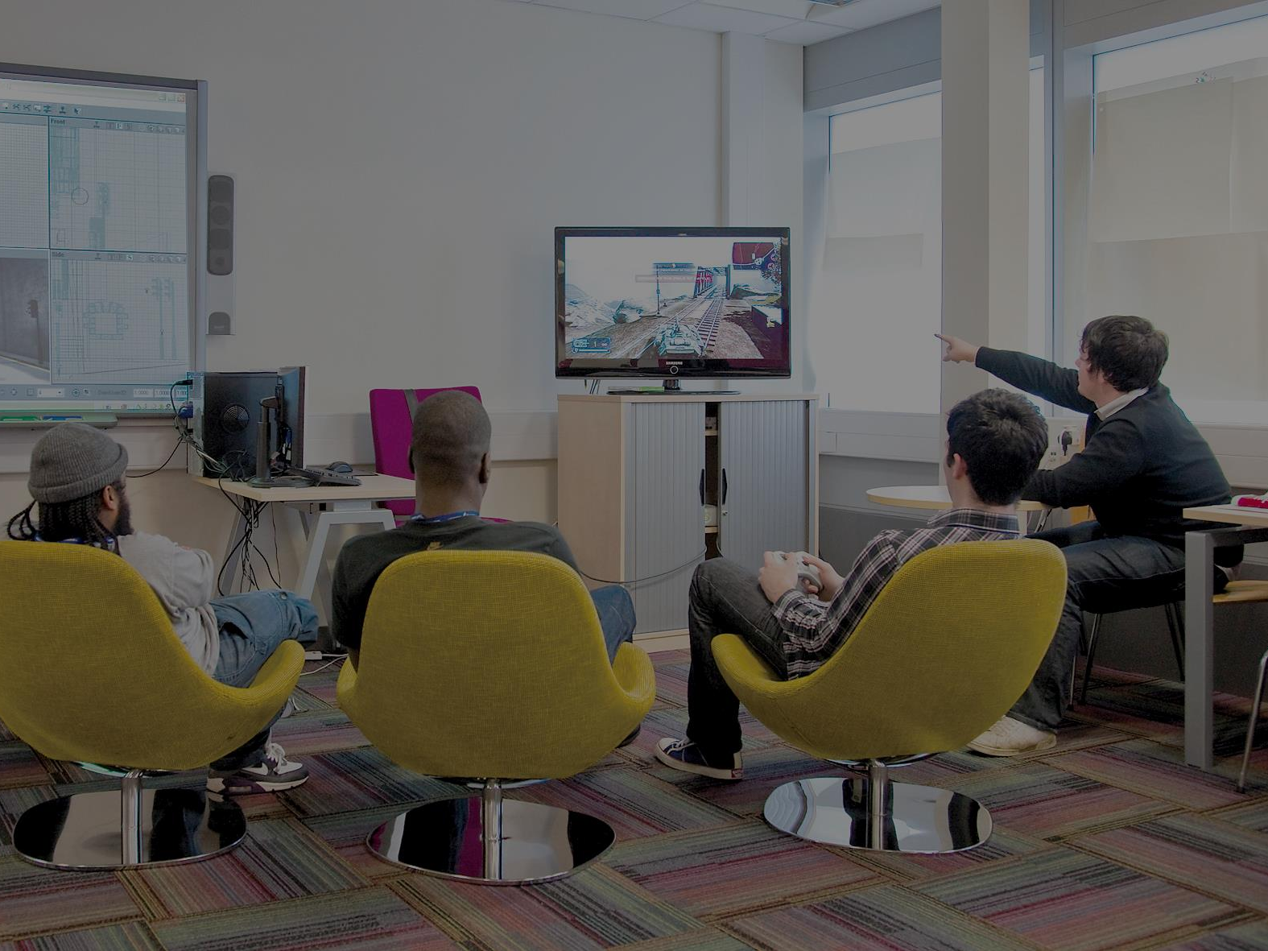
Student Directed Learning
Enhanced student agency
Facilitation of student voice
Commitment and belief
Engagement – students as partners
Continuity
Research
Sustainable strategies, structures and systems
Responsiveness
Internal and external partnership
image: 3D Modelling Competition | South Thames College
http://fecommunity.ning.com/profiles/blog/list?user=3if3922e5lrex | accessed 01/07/2015
Notes:
What does it mean – in other words what does it
Require
Provide

Slide 7
Peer Support
Informed by national and international peer mentoring and learning to learn developments, projects, research
Supported by student voice evidence national and local
Drawn from wider partner experience
Key constituent at all levels of learning and teaching
Essential element of future technology enhanced learning development
image: Support & Advice| East Kent College https://www.eastkent.ac.uk/life/support-and-advice | accessed 01/07/2015
Notes:
PRESTO Peer Related Education Supporting Tool www.prestoproject.eu (Comenius Multilateral, 2008-2010).The Project aims to improve learning to learn in students through peer education
PSS Promoting Social Skills Amongst Students (Comenius Multilateral, 2009-2011). The Project aims to improve social skills in students

Slide 8
Technology Enhanced Learning (TEL) principles driven
Photo by Jonathan Thorne CC - Creative Commons Attribution-NonCommercial License https://www.flickr.com/photos/69356033@N00
Created with Haiku Deck
Notes:
Principles driven – use of technology enhanced learning (TEL) is driven by core principles within our learning, teaching and assessment strategy
These slides link 6 principles with some examples of TEL we are developing
We hope this opens a principles-based discussion on use of technology

Slide 9
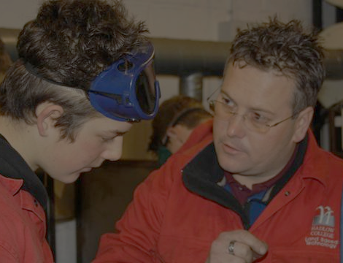
Principle: assessment is for learning
Formative online quizzes
Audience response systems
Feedback …
image: Teaching Qualifications at Hadlow College| Hadlow College http://hadlow.ac.uk/courses/teaching/ | accessed 01/07/2015
Notes:
Formative online quizzes – can self-check understanding and progress, instant and personalised feedback; promotes active learning (see for example Nicol, 2007)
Audience response systems – instant feedback – for learners and teachers; make lectures stimulating and interactive; promotes social and active learning using Eric Mazur’s peer instruction approach (see Mazur, 1997; Draper, 2009)
--
Draper, S. (2009). ‘Catalytic assessment: understanding how MCQs can foster deep learning.’, British Journal of Education Technology (special issue on e-assessment), 40(2): pp. 285-293.
Mazur, E. (1997) Peer Instruction. New Jersey: Prentice Hall
Nicol, D. (2007). 'E-assessment by design: using multiple-choice tests to good effect‘, Journal of Further and Higher Education, 31(1): pp. 53-64

Slide 10
Principle: feedback is timely and effective
Online tests
E-feedback on coursework
Photo by Cle0patra - Creative Commons Attribution-NonCommercial-ShareAlike License https://www.flickr.com/photos/91842374@N00
Created with Haiku Deck
Notes:
Online tests – fast and efficient feedback in a resource depleted environment (see Miller, 2009; Wilson et al, 2011; Hounsell, 2008); detailed and rich pre-programmed comments (see for example Nicol, 2007)
E-feedback on coursework – flexibility of online submission and feedback, instant delivery for marking and return of feedback reduces turnaround; potential for feedforward through criteria-related comments; potential efficiencies of feedback production; potential for increased engagement (inc. on-script comments and audio feedback)?
--
Hounsell, D. (2008). 'The trouble with feedback: new challenges, emerging strategies’ Interchange 2: pp. 1-10.
Miller, T. (2009). ‘Formative computer-based assessment in higher education: the effectiveness of feedback in supporting student learning’. Assessment & Evaluation in Higher Education, 34(2): pp. 181–192.
Nicol, D. (2007). 'E-assessment by design: using multiple-choice tests to good effect‘, Journal of Further and Higher Education, 31(1): pp. 53-64
Wilson,K. et al. (2011). ‘Improving student performance in a first-year geography course: Examining the importance of computer-assisted formative assessment.’ Computers & Education, 57 (2011) 1493-1500.

Slide 11
Principle: plagiarism is an education issue
Teaching with Turnitin
http://www.canterbury.ac.uk/turnitin > Teaching with Turnitin Toolkit
Photo by Kalexanderson - Creative Commons Attribution-NonCommercial-ShareAlike License https://www.flickr.com/photos/45940879@N04
Created with Haiku Deck
Notes:
University plagiarism policy is educate first, detect and punish later
Turnitin – engage students in reflection on academic writing, use of sources, paraphrasing etc., not on what plagiarism looks like and how to avoid it

Slide 12
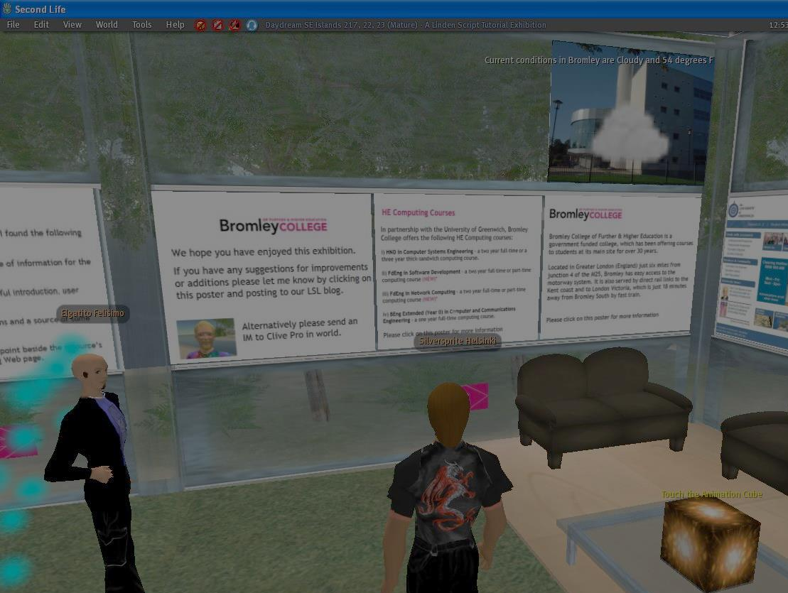
Principle: flexible learning is important
new audiences | work/life balance | growing cohort sizes | enhance employability
TEL increases flexible learning opportunities
image: Bromley College| Wordshore https://www.flickr.com/photos/silversprite/2304979067/in/photostream/ | CC BY-NC-ND 2.0 | accessed 01/07/2015
Notes:
reach new audiences e .g. CPD, International
supporting students’ work/life balance e.g. family/care commitments, earning while learning
managing growing cohort sizes e.g. where pressure on estates such a large lecture spaces
employability e.g. development of digital literacy

Slide 13
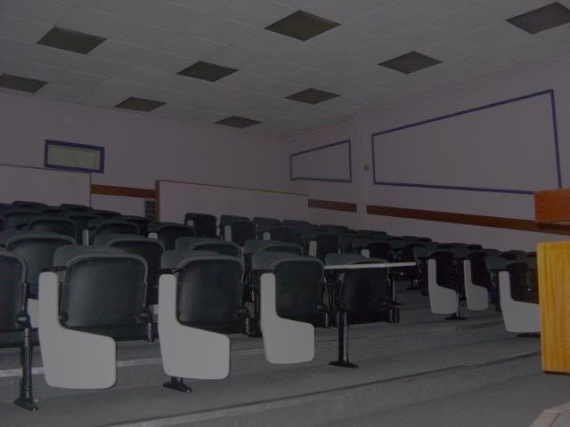
Flexible learning: flipped classroom
pre-recorded input
online learning resources
pre-session online quizzes
in-session quizzes
image: adapted from Mid Kent College, Horsted Campus| Rob http://www.geograph.org.uk/photo/1679242 | CC BY-SA 2.0 | accessed 01/07/2015
Notes:
Flipped classroom = taking traditional ‘input’ outside of class, moving it online, making more of face time for activity, discussion and Q&A
Pre-recorded input - PowerPoint (‘record slide show’ feature) / screen recording (e.g. Captivate, Kaltura)
Online learning resources – using available learning resources including video (e.g. YouTube, Khan Academy) and Open Education Resources (e.g. JORUM)
Pre-session online quizzes – enables learners to check understanding of subject matter pre-session and teachers to focus on key areas in session
In-session quizzes - audience response systems enable instant feedback for learners and teachers; make lectures stimulating and interactive; promotes social and active learning
Examples at CCCU:
Business School (TEL Pathfinder Project 2012/13)
- supporting students’ who work part-time
- flipping Taxation input into audioslides and podcasts & online mini-quizzes for consolidation
- students valued clarity of input via recordings and ability to self-test ahead of sessions
Faculty of Health & Wellbeing - undergraduate pre-registration common module (2013 – ongoing):
- breaking up ‘intensive’ days of face time in bursts over long/thin module, promoting study between bursts
- flipping theory input into audioslides, online mini-quizzes for consolidation, discussion boards for engagement between sessions
- currently being evaluated …
Across the sector:
SCALE Up at Nottingham Trent University
- wide scale trial of flipped classroom approach
- enquiry-based group-work approach using technology-rich classrooms scaffolded for the face time freed up by flipping the content
- workable with up to 100 learners to a single tutor!
- 13/14 - 30+ modules, 7 of 9 schools
- positive evaluation by students and staff, use growing in 14/15 …
see: http://www.ntu.ac.uk/adq/teaching/scale_up/index.html

Slide 14
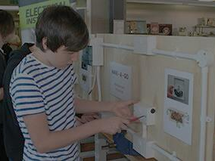
Principle: learning is active, not passive
“Learning is rooted in processes of exploration, inquiry, interpretation and meaning-making”
Selwyn, N. (2011). Education and technology: key issues and debates. London: Continuum.
Flipped approaches
Simulation / game-informed learning
Feedforward(?)
Image: Mid Kent college 'Have a go'| The Edge Foundation https://www.flickr.com/photos/edgefoundation/8977846395/ | CC BY-NC-ND 2.0 | accessed 01/07/2015
Notes:
Flipped approaches – engaging with pre-recording input and learning materials, and self-checking understanding with quizzes, are intrinsically more active than largely one-way lecturing, as is the more interactive space created in session
Simulation – safe space to trial expensive/risky things (e.g. virtual stock market, role play in virtual worlds) / game-informed learning – stimulate study out of class through group-based weekly leaderboard type quizzes
Feedforward – encourage ‘self-regulation’ (Nicol & McFarlane-Dick, 2006) by boosting connoisseurship of quality of work through used of criteria-related feedback comments and marked exemplars (see also Starr, 2013).
--
Nicol, D. & Macfarlane-Dick, D. (2006). 'Formative assessment and self-regulated learning: a model and seven principles of good feedback practice', Studies in Higher Education, 31(2), 199-218
Starr, S. (2013). Can use of re-usable comments in electronic feedback promote sustainable feedback? Assignment submission for MSc Digital Education Online Assessment course, University of Edinburgh. (copy of paper available on request)

Slide 15
Principle: for employability, how we learn is as important as what we learn
digital literacy
e-Portfolio
image: English, IELTS and ESOL| South Thames College http://www.south-thames.ac.uk/courses.html | accessed 01/07/2015
Notes:
digital literacy - use of TEL intrinsically helps this, but specifically:
- using industry techs e.g. webconferencing
- skills for the world of work e.g. working in virtual teams
- flipped learning requires active learning, itself a key employability issue
portfolio building - record of professional competencies record (e.g. using PebblePad); develop personal development planning skills; develop skills and artefacts to tell employers a story about yourself

Slide 16
Summary
Principles driving opportunities for using TEL
(note there are challenges!)
feedback is timely and effective
assessment is for learning
plagiarism is an education issue
flexibility is important
for employability, how we learn is as important as what we learn
learning is active, not passive
Which do we share? What might you add? What examples of TEL do you have?
Photo by Jonathan Thorne CC - Creative Commons Attribution-NonCommercial License https://www.flickr.com/photos/69356033@N00
Created with Haiku Deck
Notes:
Some challenges -
engagement with online activities:
- structure and direction needed (effort)
- assessment key: align of activities to learning outcomes (Biggs 2003), use assessments to encourage engagement with activities (Mc Gee and Reiss 2012)
- assess directly e.g. continuous assessment (burdensome) or
- make an enabler for assessment e.g. flip out core content online and highlight this is core, needed for writing assignments etc and/or
- link with assessment e.g. require evidence/reflection on online activities for assessments / portfolio
staff skills (see Sharpe et al, 2006; Walker et al, 2012)
(high end) materials creation
time for development (Walker et al, 2012)
pedagogy as ideology – staff engagement with active learning approaches?
is teaching online at the cost of some face time acceptable? Flipped rather than blended perhaps?
--
Biggs, J. (2003). Aligning teaching for constructing learning. The Higher Education Academy. Retrieved: 11 May 2015. https://www.heacademy.ac.uk/resources/detail/resource_database/id477_aligning_teaching_for_constructing_learning
McGee, P., Reis, A. (2012). 'Blended course design: a synthesis of best practices', Journal of Asynchronous Learning Networks, 16(4): pp 7-18 Sharpe, R., Benfield, G., Roberts, G., Francis, R. (2006). The undergraduate experience of blended e-learning: a review of UK literature and practice. Higher Education Academy. Retrieved: 11 May 2015. http://jisctechdis.ac.uk/assets/documents/archive/blended_elearning_full_review.pdf Walker, R., Voce, J., Ahmed, J. (2012). Universities and Colleges Information Systems Association (UCISA) Report: 2012 Survey of Technology Enhanced Learning for higher education in the UK. Retrieved: 11 May Dec 2015. http://www.ucisa.ac.uk/~/media/groups/ssg/surveys/TEL_survey_2012_final_ex_apps

Slide 17
Continue the discussion ..
Web: http://www.canterbury.ac.uk/LTEU
Twitter: @CCCUTEL
See our new blog at: https://cccutel.wordpress.com/ for a developing set of case studies
simon.starr@canterbury.ac.uk
Photo by ahh.photo - Creative Commons Attribution-NonCommercial-ShareAlike License https://www.flickr.com/photos/51052219@N00
Created with Haiku Deck

