Slide 1
The Sound of Feedback a metrical asymmetric epistemological linguistic…rap
A vicarious, various, vicious ^{*1}, viscous view
4! * 2 – (2 * 3) = HGTG/(U) constant^{*2}
Grant Gover
^{*2} Douglas Adams ^{*1} Sid

Slide 2
Introduction
A personal view from teaching—construction management—music PhD including TFT (Total Field Theory)
An inherent music in text, image and rhythm¹
Musings and conclusions
Apotheosis in TFT
Final postulated conclusions for discussion
¹Word Events, Perspectives on Verbal Notation, John Lely & James Saunders, 2012, London: Bloomsbury

Slide 3
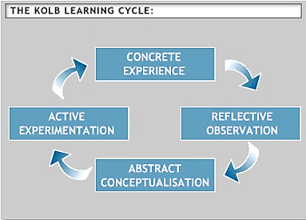
Kolb’s Experiential Learning Cycle
Plus 4 learning styles:
Diverging
Assimilating
Converging
Accommodating
Musical points:
rotary nature;
how creative
thinking works
https://www2.le.ac.uk/departments/doctoralcollege/training/eresources/teaching/theories/kolb

Slide 4
Feedback even in teaching is two-way
‘there is no sharp dividing line between assessment and teaching in the area of giving feedback on learning’ (Ramsden, 1992, p. 193). Feedback is part of the overall dialogue or interaction between teacher and learner, not a one-way communication.’(London Deanery, 2012)
‘Feedback may be written, verbal, or numerical’, also ‘non-verbal’ (body language), ‘formal’ and ‘informal’, ‘summative and formative (developmental)’, ‘directive’ or ‘facilitative’, can be ‘negative’ yet [obviously] better to be ‘constructive’ and ‘feeding forward’ to future oriented goals. (London Deanery, 2012)
Musical points:
analogous to
musical dialogue;
also needed
between actors,
composers,
performers,
listeners
2-way
typical teaching
speak
This one is interesting.
Carl Rogers famously
said, paraphrasing,
there is no such
thing as teaching, only
facilitating
https://faculty.londondeanery.ac.uk/e-learning/feedback/what-is-feedback
http://teachthink.weebly.com/lesson-5-theories-of-learning-humanist-approaches.html

Slide 5
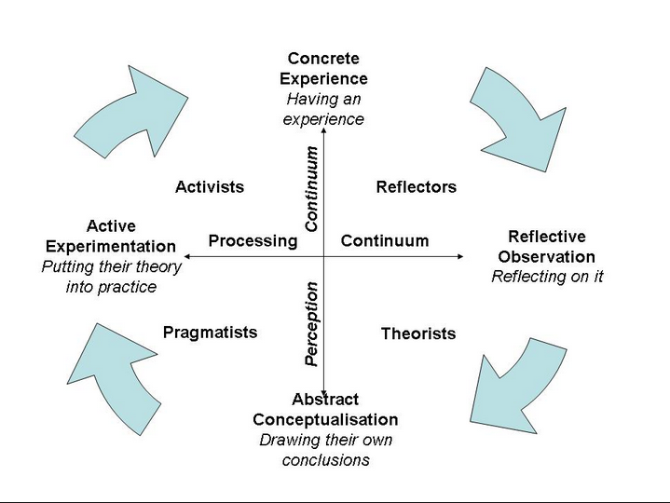
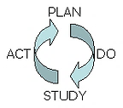
The Deming Cycle
Honey and Mumford
Musical point:
See next slide
A construction model: rather active, psychomotor—and proactive,
yet there is some theory there and intellectual activity
as Honey and Mumford
https://www.valuebasedmanagement.net/methods_demingcycle.html
https://uk.images.search.yahoo.com/search/images?p=Honey+and+Mumford+model

Slide 6
A Musical Paradigm postulated extending upon Honey & Mumford
pragmatist
Concrete experience
Musical
formulation,
composing,
performer
& listener
embodiment
Sensate
response
& thinking
activist
reflective
Abstract response,
theorising,
cognition,
imagining
theorist

Slide 7
Iraqi architectural research model
Musical points:
inclusion;
direction of
reading music
may be other
than standard,
still rotary
Figure (9) a simplified illustration of the steps of the strategic framework to be borrowed as a framework
Architect and formulating its strategy within the framework of ... Source: The researcher ..
A theory of research through which it is possible to collect and organize the themes of the context and the quality of education system
Improving the quality or architectural learning outcomes in Iraq. (2017). Alyousif, Ibrahim, J. K., Ali, Falah, Khalaf and Hameed, Ahmed, Talib

Slide 8
A synthesis of a typical construction management cyclical model
Musical point:
experimental
methodology?
Alter/ improve (7…)
Consider problem (1)
How to implement
(2)
Act/ implement
(3)
Assess/
Monitor
(4)
Feedback/ Report
(5)
continue
continue
Could be analogous to
scientific empirical method
Grant Gover, 2020
increase efficiency, quality

Slide 9
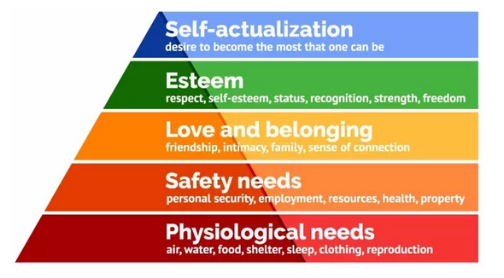
Maslow’s Hierarchy
Creativity
adapted
Feedback to oneself,
in oneself
to the world
Musical points:
musicians
need all these!
Feedback
from others
Pragmatic
Feedback
of basic
needs of
the world
See, also, the UN 17 SDGs and the Gaia principle—the world has needs too and
is feeding back to us
https://www.simplypsychology.org/maslow.html
https://aeon.co/essays/gaia-why-some-scientists-think-it-s-a-nonsensical-fantasy

Slide 10
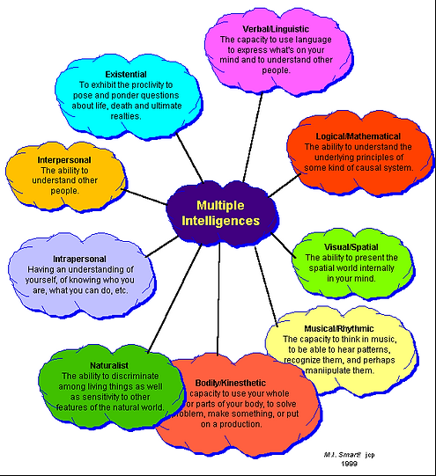
Howard Gardner’s Multiple Intelligences
Musical point:
musical intelligences
These are relational
with other people
and the world
involving thought processes
and integrated
mind-body processes—
there is feedback
and processing of feedback
going on all the time
Also:
IQ
EQ
SQ
information
relational
information
https://uk.images.search.yahoo.com/search/images?p=howard+garder+multiple+intelligences

Slide 11
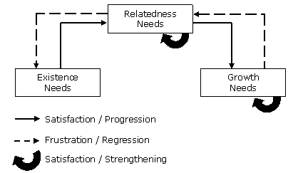
ERG Theory
Musical point:
still rotary, in a loop;
is there a parallel
with exigencies from
electronic sound
systems, things can
happen, be almost
created from within
something occurring
in the system?
Of Clayton P. Alderfer
An improvement on Maslow’s Hierarchy of Needs where feedback is constantly
sought and given in order to progress to the next level. Here, feedback is more
complex in a frustration regression/ satisfaction progression continuum and can
affect how a person performs.
Alderfer also talked about moving from a concrete continuum (see Kolb),
which could have resonances with musique concrète!?
https://www.valuebasedmanagement.net/methods_alderfer_erg_theory.html

Slide 12
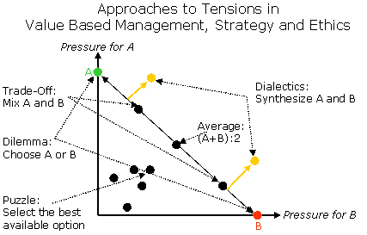
De Wit and Meyer
Musical point:
complexity in music,
electronically
something
generated
from a mixture of
design and chance
Instead of synthesizing a dialectical approach to solving complex problems,
as above, De Wit and Mayer propose a Process, Content, Context approach,
taking into account a range of ideas, focusing on critical points, reconciling opposites
and ‘providing a stimulus for creativity (to find a synthesis that is better than the
trade-off between the opposites)’. Could this be a model for Stockhausen points?
https://www.valuebasedmanagement.net/methods_dialectical_inquiry.html
https://www.youtube.com/watch?v=P3I9puBL5U8

Slide 13
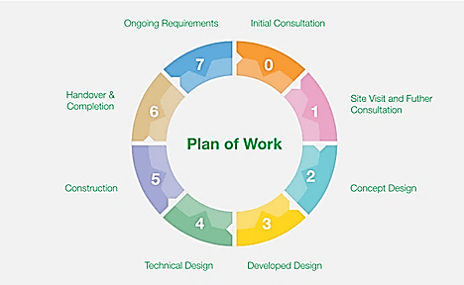
RIBA Plan of Work
Musical points:
still rotary and
ongoing; feedback
dictates universal
integrated
sustainability
BIM = Building Information Modelling
is fully
integrated—
this ties up
with BIM
which integrates
all disciplines,
centralises data,
uses advanced
planning,
intercommunication,
feedback from 3D models that avoids for instance ‘clashes’ of beams and pipework, generates
efficiency
Sustainability
There are many
points to discuss
some of which
have not yet been
touched on—no
time today, unless
raised in questions.
It is circular, ongoing,
changing
The RIBA Plan of Work is the classic model for architects
2019 updated version of 2013 which emanates to all architectural
and construction management students, hence to all significant clients and end users
https://architectureforlondon.com/news/the-riba-plan-of-work

Slide 14
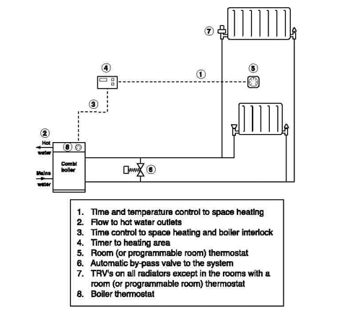
Central Heating System
Feedback from
users,
controls,
thermostats,
even, in a way,
from the water
itself
communicating via
induction, convection
and radiation—now:
SMART controls—
there is an acceleration
in pace of technology
There is a regulated
circular flow
Can materials per se
feed back information?
…and musically
https://www.miketheboilerman.com/central-heating-diagram.html
Consider ‘new materialism’
of Petra Lange-Berndt and others

Slide 15
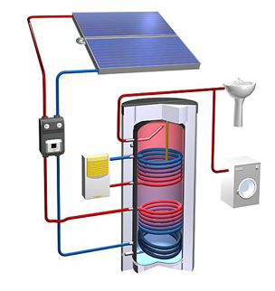
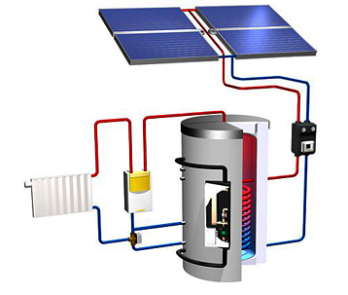
Solar Heating
Flow
Flow
controller
controller
Hot Water
Central Heating
Musically: is this a problem?
Controllers collect and process information about differential temperatures— and
prevent hysteresis, reverse circulation, a potential problem: is this a generic problem
of information flows?
http://www.solarta.com/en/installations-solar-energy/solar-thermal/systems-solar-thermal.php

Slide 16
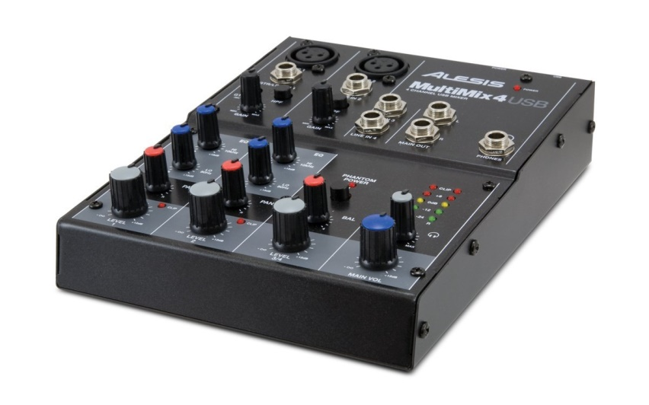
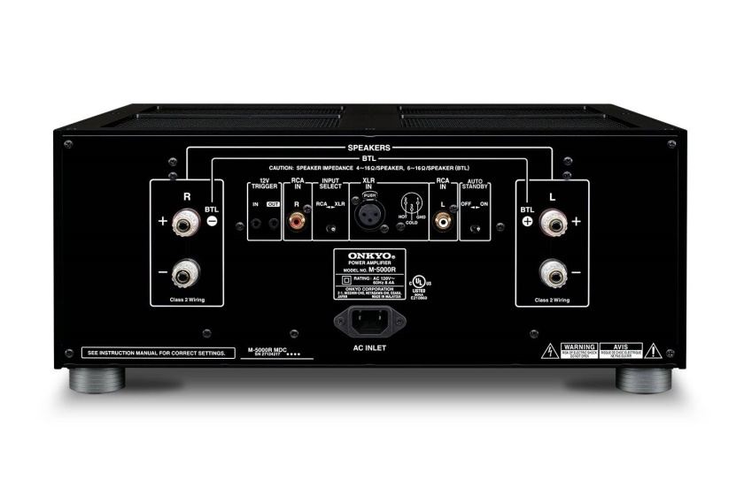
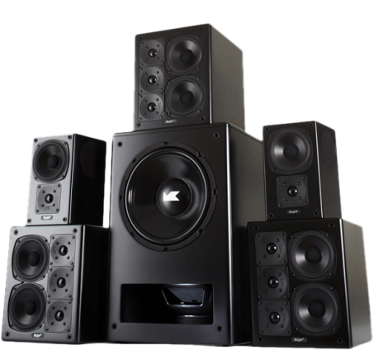
Sound systems
Room acoustics
Feedback
The Beetles
Jimi Hendrix
Gain > 1
EQ LFO
Flangers
Phasers
Filters

Slide 17
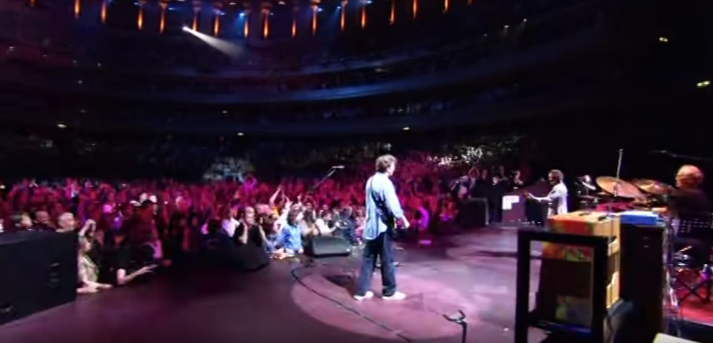
Good vibes in a rock show
https://www.youtube.com/watch?v=vyftaay-pFA
Positive feedback from the crowd makes playing better
which leads to more positive feedback
Cream—Sunshine of Your Love RAH 2005

Slide 18
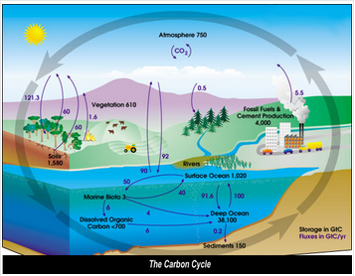
The Carbon Cycle
Musically:
reinforcing the loop
http://www.global-greenhouse-warming.com/graphs-diagrams-of-global-warming-and-climate.html#

Slide 19
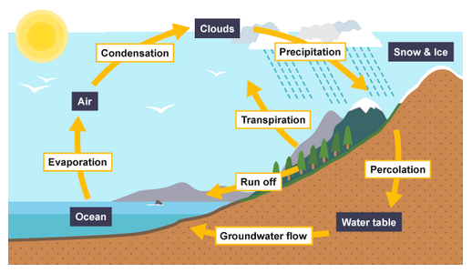
The Hydrological Cycle
Musically:
still the loop
in feedback cycles,
perhaps a generic
phenomenon
https://www.bbc.co.uk/bitesize/guides/z29ccdm/revision/1

Slide 20
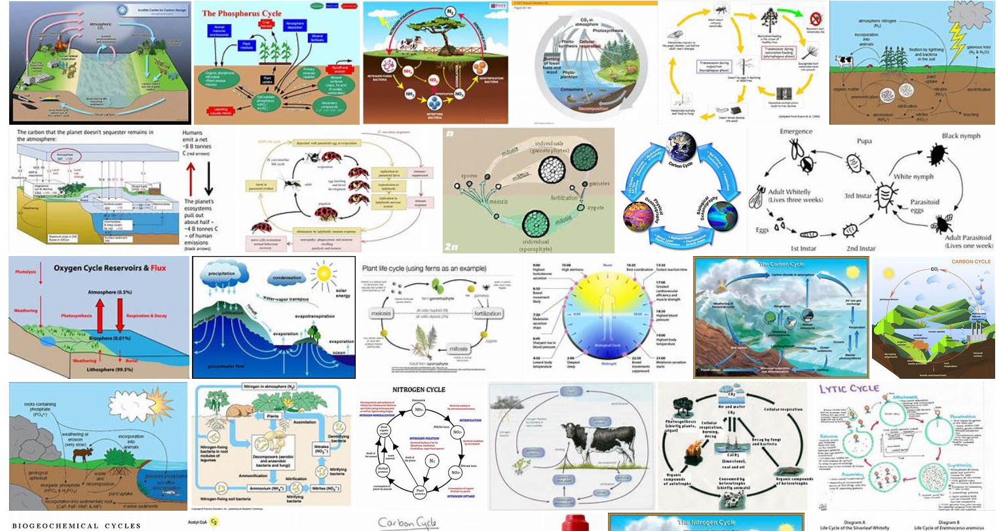
More loops
google images

Slide 21
Reduce Reuse Recycle
The now eternal
sustainability
cycle
https://toppng.com/reduce-reuse-recycle-diagram-of-reuse-reduce-and-recycle-PNG-free-PNG-Images_178166

Slide 22
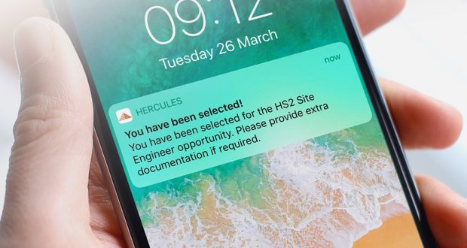
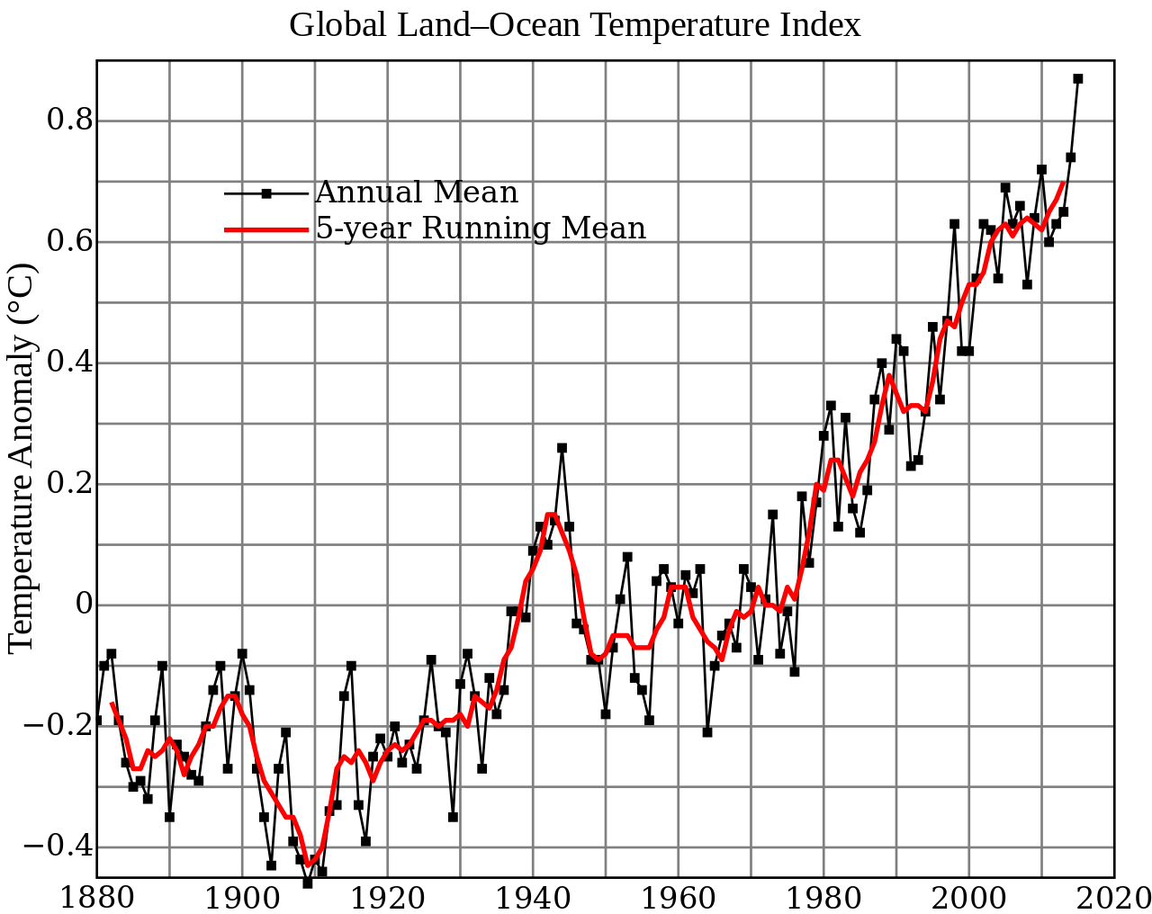
Statistical data feedback
Also directing
energies,
addressing needs
driving
technological
change,
for instance,
covering surges in
national grids
and electronic
systems in cars,
petrol, diesel,
biofuel, hydrogen,
hybrid, electric—
air conditioning—
then EMS,
environmental
management
systems, in
buildings,
intelligent
buildings, AI,
SMART controls,
sustainable future
integrated cities
Hercules
Musically: data
https://www.constructionnews.co.uk/partnership-publishing/game-changer-digital-recruitment-29-11-2019/
+ uninterruptible power supply
http://solidsystemsllc.com/prevent-data-loss/
Data
about data
i.e. causing
20% world
CO₂
_{BBC News Briefing 17.01.2020}
See also
Data
Protection
Act 1998 &
GDPR 2018 & consider
analytical metrics
This Photo by Unknown Author is licensed under CC BY-SA

Slide 23
The Cyclical Nature of History
repetition
the arrow of time
Musically:
a macro idea
about loops
loops, feedback?
Grant Gover, 2020

Slide 24
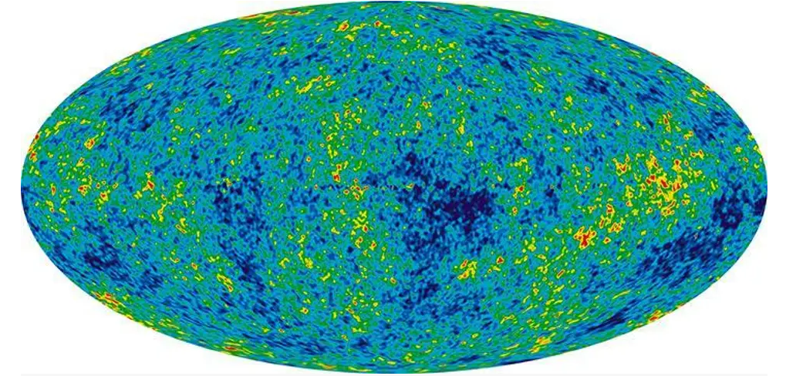
The Nature of Time (and space and gravity etc)
Musically: the whole picture, relating to the universe
Topology, cosmology, time travel?, worm holes, loops, multiverses, branes, inflation theory,
black holes, singularities, general relativity, quantum physics, symmetry, standard models—
computerised models, robotics, AI, the nature of data, information—
feedback
https://www.edge.org/conversation/paul_davies-time-loops
https://www.independent.co.uk/news/science/universe-nasa-space-pictures-latest-images-wilkinson-microwave-anisotropy-probe-a8091296.html

Slide 25
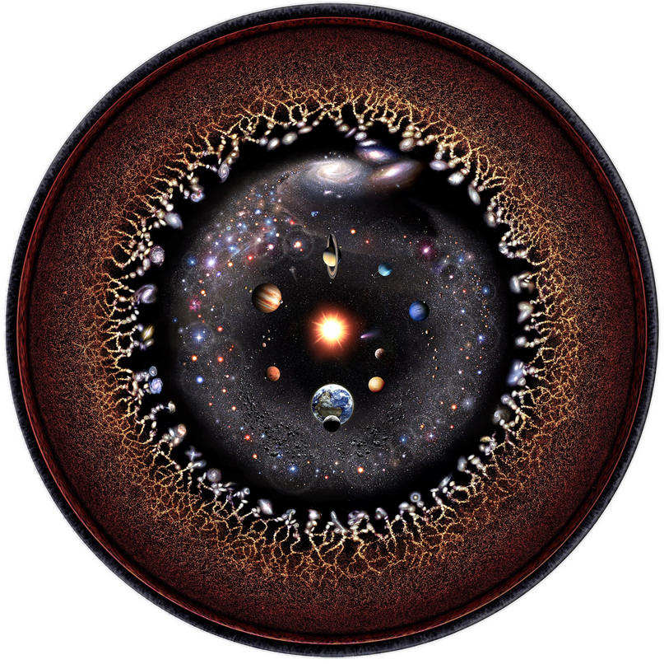
Or concentric
lens logarithmic view by
musician and artist
Pablo Carlos
Budassi
based on
information
from
Princetown
university,
NASA and
Sloan
Digital
Sky
Survey
(BEC Crew,
2018)
Musically:
Feedback can
be in different
versions
https://www.sciencealert.com/known-universe-in-one-single-image-logarithmic-artwork-pablo-carlos-budassi

Slide 26
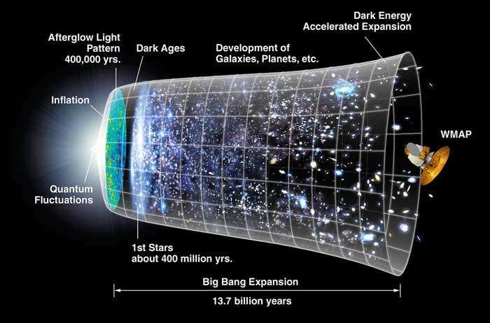
Yet again another view
Music and cosmology
https://www.newscientist.com/article/dn8862-best-ever-map-of-the-early-universe-revealed/

Slide 27
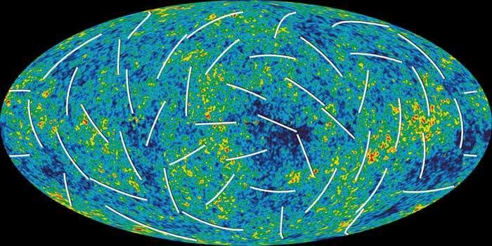
The latest WMAP view of the baby universe
Musically:
updated,
information
Stephen Battersby, new Scientist, 17 March 2006
Showing polarisation (white lines) ruling out
background radiation as waves bounced around by
ionised gas—when this effect is taken into account
inflation still pertains—this is feedback from the universe
13.7 billion years ago
https://www.newscientist.com/article/dn8862-best-ever-map-of-the-early-universe-revealed/

Slide 28
Time — some inserts
With apologies already (!): Deleuze thought that time in microcosm sort of occurred a split second before it happened—could this be like feedback that can occur in between the two hemispheres of the brain? Perhaps as with epilepsy as with Van Gough? This brings into question the nature of reality (see next slide) (Faulkner, 2004; Williams, 2019)
Bergson, physicists, mathematicians, musicians: too many to name. Perhaps, ad hoc, Weiner, Reimann, Hamilton, Feynman. How large is the universe, how many dimensions are there, what is the nature of space? How does communication happen over vast distances, such as with entanglement. Perhaps for the musicians Stockhausen could have it. Barbour (Edge, 2020) thinks time does not exist. How is this relevant? The topology of the universe matters in this context
Carlo Rovelli (Khalili, 2018) thinks that time virtually stands still in a black hole, that information comes back out but because time is so slowed down it would take billions of years to observe. Roger Penrose, the mathematician, too, thinks information comes back out and that black holes are just a bit smaller than golf balls (Ball, 2017—he does not mention the size except as a singularity—seen somewhere!). This is all relevant and needs sorting out in order to understand the connections between things. See my theory at the end.
Can feedback in the brain
affect reality and even theories,
including about time
How does time relate to the universe?
Time, space and connections relate to
TFT feedback

Slide 29
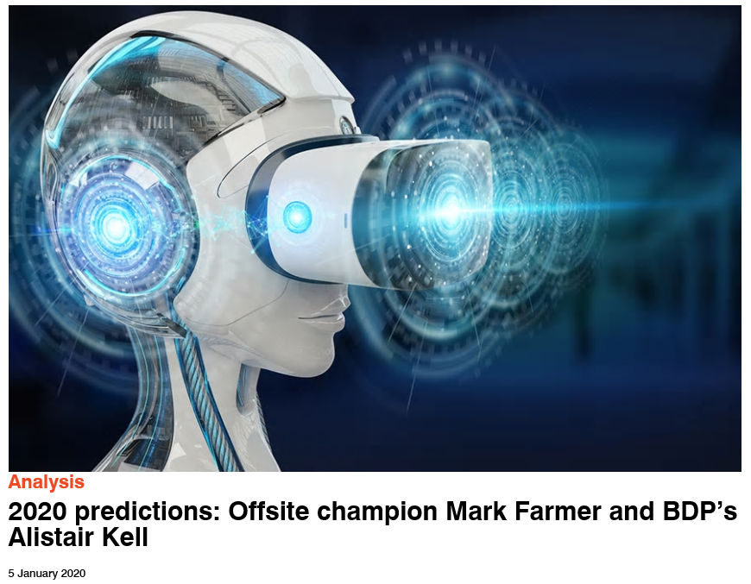
[AR & ‘onsite robotics and data capture’]
[Green technology, voice driven AI especially re H&S]
Question: what is the nature and reliability, truthfulness of Augmented Reality?
http://www.bimplus.co.uk/analysis/2020-predictions-offsite-champion-mark-farmer-and-/

Slide 30
Questions
Brian Green of Columbia University, New York, US, according to Battersby’s article (New Scientist, 2006) reckons that the initial fluctuations are due to quantum activity. This could be viewed as a sort of little asymmetry, a small wobble or two leading to later clumping, aggregation, formation of stars, the lights of the universe coming on in the meantime, then humans and other lifeforms developing:–
Are the interactions between particles, hydrogen atoms and so on: feedback? Are covalent bonds, even single bonds: feedback? Is feedback something else? Is feedback essential to the existence of the universe?
Big History of the universe is gained from feedback and interpretation of data
Do particle interactions
involve feedback?

Slide 31
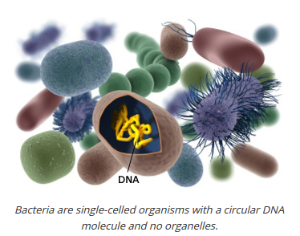
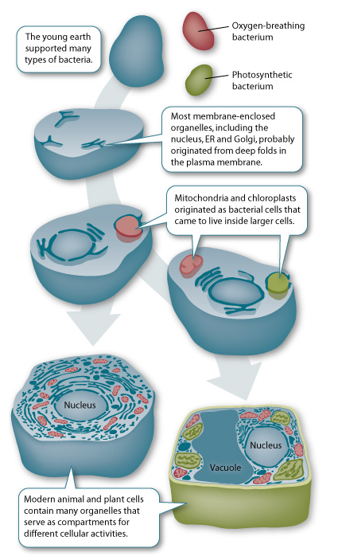
How does evolution work?
I believe free will exists in the process
Drover believed in ‘thrust’ in evolution
Whatever we think there must be much feedback going on
Chemicals banging their heads on the cave walls reacting to their environment—how much of this interaction is feedback, information flow, determined, accident—can quantum physics help understand what is going on, as Paul Davies thinks is a possibility?
What is the role of feedback
in evolution?
https://learn.genetics.utah.edu/content/cells/organelles/

Slide 32
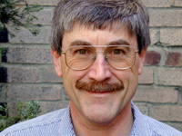
Musically;
feedback form
a variety of sources;
haptic considerations
https://www.edge.org/conversation/paul_davies-time-loops
“Although it is a two-way street, I would probably say that professional scientists are more influenced by science fiction than the other way around.”
sci
sci-fi
Witness: tricorders, tractor beams, replicators, transporters/ teleporters,
lasers, communicators, translators, ipads, laptops, cloaking devices—
ultrahaptics:
haptic
feedback
obtained
https://www.sciencenewsforstudents.org/article/feeling-objects-arent-there

Slide 33
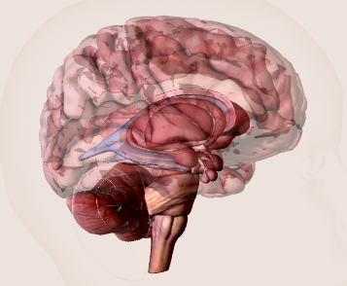
The Brain Feedback
Musically:
all the senses—
Feedback possibilities
Learning experience, vision, taste, smell, hearing, touch, limbic systems, chemicals,
neurons and other brain part functions, interrelationship with rest of body,
left and right hemispheres interaction, possibility of functions emanating from the
very interactions and feedback systems
https://www.healthline.com/human-body-maps/brain#brain-diagram

Slide 34
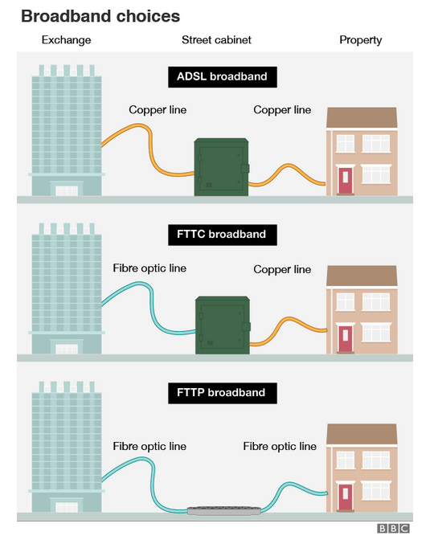
Coming to the conclusion and TFT
Musically and
theoretically:
cabling quality,
connections
https://www.bbc.co.uk/news/technology-49253071

Slide 35
Broadband types
Quoting the BBC
Musically:
increasing quality,
technological possibilities
https://www.bbc.co.uk/news/technology-49253071

Slide 36
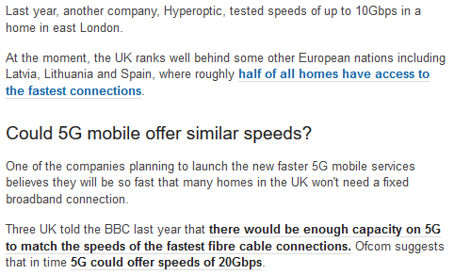
BBC Part 2 quoting
Musically:
what are the new
modes of making
music of the
future

Slide 37
Personalised view of Broadband and communication routes
Faster more rotations =
Better communication
B
B
Quantum packets
of information
take it in turns,
albeit with increasing
speed with increased
broadband efficiency
—on line gaming
streaming is like this
and needs maximum
capacity to avoid
stutter etc
A
Musically: a personal
conception of current
modes of transmitting information
A
Photos by Unknown Authors is licensed under CC BY-SA

Slide 38
But with TFT...!
Musically: what are
the possibilities,
with greater
communication
and efficiency,
perhaps of quantum
computers
No stutter, jitter, latency
No circuitous routing
Only one pipeline connection, as it were
Perfect connection
Perfect speed
Perfect communication, understanding
No noise, no reduction in information as Shannon bit (see later), full meaning integrated (ibid)

Slide 39
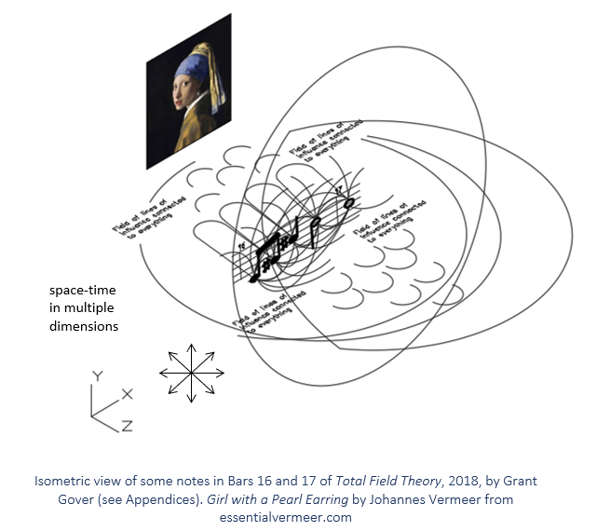
TFT Theory
The TFT started from
musical notes

Slide 40
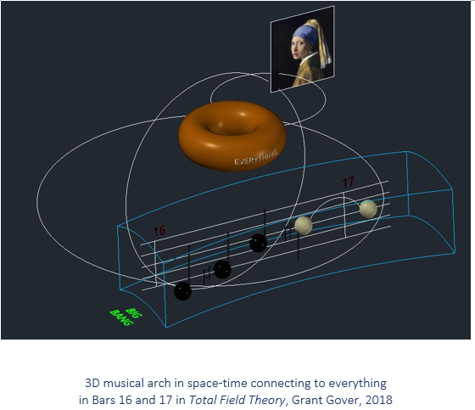

Slide 41
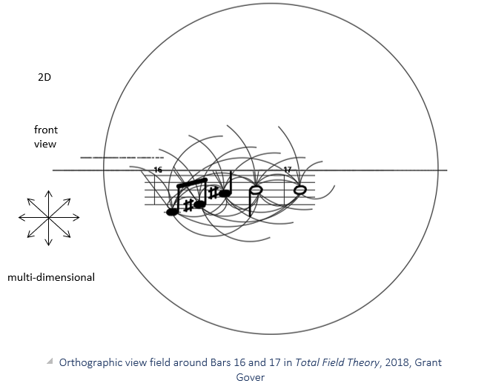
The notes relate like
expanding brackets,
yet more

Slide 42
TFT Conclusions
‘well-tuned’
Other concepts for discussion like are ‘grand design’, ‘goldilocks syndrome’,
‘standard model’, ‘asymmetry’, ‘chaos theory’ and undoubtedly more
In TFT lines of connection/ communication are direct
Everything is connected—everything! The exclusion principle fits
Explains entanglement (McGucken, 2017)
Suggests expanding universe and much more there than apparent i.e. 5% known universe accords with 23% dark matter and 72% dark energy posited by some as the force pushing the universe apart, avoiding the Big Crunch, so Linde et al (inflationists) would be right
Whether there are multiverses seems moot. The universe is so big it really doesn’t matter. Roger Penrose thinks that the probability of a at least one other universe is 10 to the 10 to the 123 against, at least another universe being so well organised as ours and bigger than our solar system (Holder, 2013).
Feedback in this sort of universe is the most efficient and it seems to me that there is much more that the universe is waiting to tell us. Everything falls within this so where there are inefficiencies are these non-positive? George Boole thought that logically there is no such thing as ‘absolute evil’ (see next slide). Maybe negatives can be seen as positive-negatives!?
Maybe there is after all a music of the spheres.
10¹⁰¹²³
‘well-tuned’

Slide 43
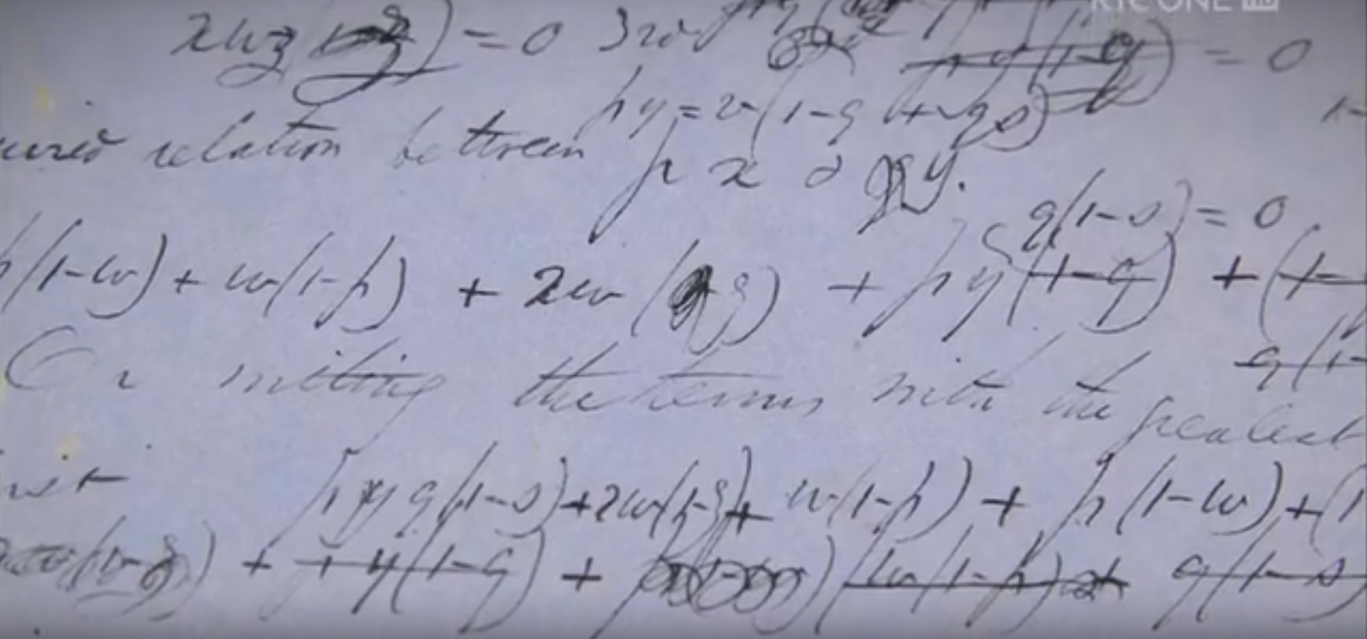
Copy of part of George Boole’s logical calculations to do with proving statements about God, including that there is no such thing as absolute evil (see last slide)
Boole was also highly instrumental in introducing binary digits 0 and 1 and or
and not operators assisting google searching and electronic interfacing of devices
and humans—the world of electronic communication, information flow and feedback
in many languages at many levels.
Also Claude Shannon (See next slide).
As presented by Dr Mark Hocknull, Visiting Senior Fellow, University of Lincoln
https://www.youtube.com/watch?v=Hljir_TyTEw

Slide 44
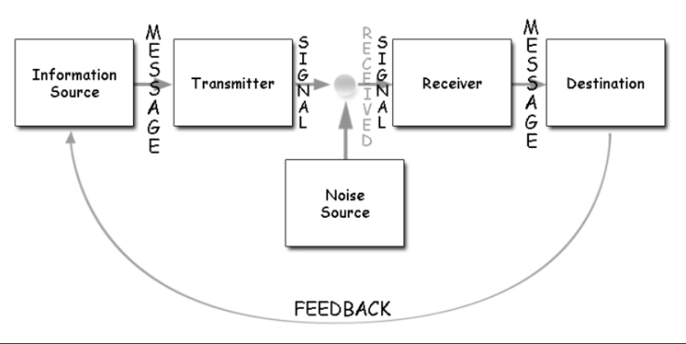
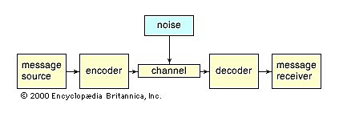
Information Theory
Shannon-Weaver–entropy–compression–noise–coding–cryptology–bandwidth–
signal to noise ratio–telecommunications–linguistics–data transmission–the brain–
autonomic system–11,000,000 bits per second processed, but only 50 bits per second
consciously (including reading and piano playing)=compression taking half a second
and automatic processes in less time and from roughly 100,000,000,000 brain cells
as many operations possibly per second.
(Markowsky, 2020)
Meaning and signal
message separated
Shannon & Weaver’s
Communication
model
noise is a factor
of the universe
as well as in thought
Shannon’s
Entropy formula
In TFT there
is no need
to lose information
Is there a corollary of the ratio of conscious thought
to total thought as to the 5% known universe to the
remaining 95% as yet unknown, although smaller, 50: 11 billion?
https://www.britannica.com/science/information-theory/Linguistics
https://uk.images.search.yahoo.com/search/images?p=shannon+and+weaver

Slide 45
General Conclusions
Musically from the general to the particular
Connectivity, the senses
Circularity, speed, acceleration—problems? Hysteresis, overload, ‘at or near the threshold’ (David Gilmour: Brown, 2006) which can be attractive (Hendrix). Is there a limit to the final speed? Is the tendency towards perfection? Can loops break? If so, can this be seen, at least aesthetically, as pleasing, positive? Does it need transmitters and receivers, does it need humans to interpose, can robots substitute? Are there feedback loops happening and not being detected? Overtly and non-overtly: I think: yes
Information flow, efficiency: communication, outcome effectiveness— in particular as regards music and contemporaneously electronic music
Feedback is inimical to everything: in a primary sense in teaching, in data flows, biology, in a pragmatic sense in construction management (more than syntactically, epistemologically and semiotically, the word ‘concrete’ is a common binder or node of thread connections) and Maslow type needs—and the universe. Is it, feedback, necessary for human and other life forms to exist? In other words can anything exist in splendid isolation? I think: no
Open Question: What are the implications of TFT connectivity, that is: the universe’s perfect feedback? Is it perfect? I think so
Somewhere in it all is possibly Deleuze
consider
also
hubs,
actor
networks,
grids,
meshes,
all fields,
matrices

Slide 46
Feedback taxonomies a start
From the universe to ‘specificialisation’, the specialised and specific
Feedback occurs at many levels and of different varieties
Eponymous
Affirmative, constructive critique: education, construction management
Communication
Closed
Open
Broken, inefficiencies, overheating, faults (aesthetics, humanity)
Systems, cybernetics
Gaia theory, communication with plants (for some debatable)
Moving, kinetic, rotary—direction as in spin—hysteresis
Information flow, direct, indirect, cause and effect, ripple effect
Time
Scientific, ontological, cosmological, teleological, electrical, electronic—musical
Societal, cultural—musical
Circular, elliptic, straight and curved as TFT direct
According to David Christian: 8 thresholds with new energy at each. 9 = sustainability? I contend that construction is like a threshold and defies entropy. Is this willpower, creativity, mankind’s positivity?
Final 2 points: 1. relates to my quest regarding objects and space, architecturally & musically
2. What is the role of Big History & enthalpy/ entropy seeming anomalies, including construction?

Slide 47
References
Adams, Douglas. (2002). The Ultimate Hitchhiker’s Guide to the Galaxy, Del Rey, The Random House Publishing Group.
Alyousif, Ibrahim, J. K., Ali, Falah, Khalaf and Hameed, Ahmed, Talib. (2017). ‘Improving the quality or architectural learning outcomes in Iraq’. University of Technology / Department of Architecture Al Mustansiriyah University/ Collage of Administration & Economics/ Department Of Economics 2, Iraq / Baghdad. Accessed: 02.01.2020.
Architecture for London. (2018). ‘The RIBA Plan of Work’, 04 November. Available at: https://architectureforlondon.com/news/the-riba-plan-of-work. Accessed: 14.01.2020.
Ball, Philip. (2017). ‘Roger Penrose and the vision thing’, 13 February. Available at: https://www.prospectmagazine.co.uk/magazine/roger-penrose-vision-thing-interview-maths-physics. Accessed: 14.01.2020.
Christian, David. (). Big History Project. [video]. Available at: https://www.bighistoryproject.com/chapters/1#. Accessed: 20.01.2020.
BBC. ‘The Global Hydrological Cycle’. Available at: https://www.bbc.co.uk/bitesize/guides/z29ccdm/revision/1. Accessed: 14.01.2020.
DMCA. (2020). ‘toppng, diagram of reuse reduce recycle’. Available at: https://toppng.com/reduce-reuse-recycle-diagram-of-reuse-reduce-and-recycle-PNG-free-PNG-Images_178166. Accessed: 14.01.2020.
Edge. (2020). ‘Time Loops, A Talk with Paul Davies, 11.01.00’, 14 January. Available at: https://www.edge.org/conversation/paul_davies-time-loops. Accessed: 14.01.2020.
Faulkner, Keith Wylie. (2004). ‘Deleuze and the Three Syntheses of Time’. PhD thesis, Warwick university, February.
Hocknull, Mark. (2018). ‘The Genius of George Boole – How to be a Genius’. [video]. https://www.youtube.com/watch?v=Hljir_TyTEw
Kolb, David. (n.d.). David Kolb. University of Leicester, Doctoral College. Available at: https://www2.le.ac.uk/departments/doctoralcollege/training/eresources/teaching/theories/kolb. Accessed: 29.11.2019.
Clapton, Eric, Bruce, Jack and Baker, Ginger. Cream—Sunshine of your love. Available at: https://www.youtube.com/watch?v=vyftaay-pFA. Accessed: 14.01.2020.
Global Greenhouse Warming. (2020). ‘Graph Diagrams of Global Warming and Climate’. Available at: http://www.global-greenhouse-warming.com/graphs-diagrams-of-global-warming-and-climate.html. Accessed: 14.01.2020.
Griffin, Andrew. (2017). ‘Scientists win prize for ‘baby picture’ of the entire universe soon after it is formed’. Independent, 04 December. Available at: https://www.independent.co.uk/news/science/universe-nasa-space-pictures-latest-images-wilkinson-microwave-anisotropy-probe-a8091296.html. Accessed: 14.01.2020.
Hercules. (2019). ‘A ‘game-changer’ for digital recruitment’. Available at: https://www.constructionnews.co.uk/partnership-publishing/game-changer-digital-recruitment-29-11-2019. Accessed: 14.01.2020.
Honey, P and Mumford, A. (1982). Manual of Learning Styles. London: P. Honey.
Lange-Berndt, Petra. (2015). Materiality – Documents of Contemporary Art. London: Whitechapel Gallery.
Lely, John and Saunders, James. (2012). Word Events, Perspectives on Verbal Notation. London: Bloomsbury.
London Deanery. (2012). Available at: https://faculty.londondeanery.ac.uk/e-learning/effective-feedback/what-is-feedback. Accessed: 14.01.2020.
Markowsky, George. (2020). ‘Information theory, mathematics’. Encyclopaedia Britannica. Available at: https://www.britannica.com/topic/intuitionism-philosophy-of-mathematics. Accessed: 16.01.2020.
McGucken, Elliot. (2017). Quantum Entanglement and Einstein’s Spooky Action at a Distance Explained, the foundational physics of quantum mechanics’ nonlocality and probability. 45 Epic Hero’s Odyssey Mythology Press.
McLeod, S. A. (2017). ‘Kolb - learning styles’. Simply Psychology, 24 October. Available at: https://www.simplypsychology.org/learning-kolb.htm. Accessed: 21.01.2020.
McLeod, Saul. (2018). ‘Maslow’s Hierarchy of Needs’. Simply Psychology. Available at: https://www.simplypsychology.org/maslow.html. Accessed: 14.01.2020.
Mike the Boilerman. (2019). @Central heating diagram’. Available at: https://www.miketheboilerman.com/central-heating-diagram.html. Accessed: 14.01.2020.
Northern Illinois University, Faculty Development and Instructional Design Centre. (n.d.). ‘Howard Gardner’s Theory of Multiple Intelligences’. Available at: https://www.niu.edu/facdev/_pdf/guide/learning/howard_gardner_theory_multiple_intelligences.pdf. Accessed: 17.01.2020.
Penrose, Roger. (2010). Cycles of Time, An Extraordinary New View of the Universe. London: The Bodley Head.
Ritchie, Hannah & Roser, Max. (2019). ‘CO₂ and Greenhouse Gas Emissions’, December. Global Change Data Lab, University of Oxford. Available at: https://ourworldindata.org/co2-and-other-greenhouse-gas-emissions. Accessed: 17.01.2020.
Ruse, Michael. (2013). Brigid Haines (ed.) ‘Earth’s Holy Fool?’. Aeon, 14 January. Available at: https://aeon.co/essays/gaia-why-some-scientists-think-it-s-a-nonsensical-fantasy. Accessed: 15.01.2020.
Sid Vicious (1959-1979). (2019). Biography, 02 October. Available at: https://www.biography.com/musician/sid-vicious. Accessed: 14.01.2020.
Slid State Systems. (2020) ‘How to Prevent Data Loss: 7 Ways to Safeguard Your Company’. Available at: http://solidsystemsllc.com/prevent-data-loss. Accessed: 17.01.2020.
Smith, Daniel and Protevi, John. {2020}. ’Gilles Deleuze’. The Stanford Encyclopedia of Philosophy ,Spring, Edward N. Zalta (ed.). Available at: https://plato.stanford.edu/archives/spr2020/entries/deleuze. Accessed: 20.01.2020.
Solarta Balear SL. (n.d.). ‘Schematic diagram of hot water and heating systems’. Available at: http://www.solarta.com/en/installations-solar-energy/solar-thermal/systems-solar-thermal.php. Accessed: 14.01.2020.
Stockhausen, Karlheinz. (1969). Punkte I-VI. NDR Sinfonieorchester. Available at: https://www.youtube.com/watch?v=P3I9puBL5U8. Accessed: 15.01.2020.
Teachthink. (n.d.). ‘Lesson 5: theories of Learning: Humanist Approaches’. Available at: http://teachthink.weebly.com/lesson-5-theories-of-learning-humanist-approaches.html#. Accessed: 17.01.2020.
Value Based Management. (2019). https://www.valuebasedmanagement.net. Accessed: 29.11.2019.
Williams, James, R. (2019). ‘Deleuze and the Time for Non-Reason, according to the French philosopher, rationalism is an illusion’. Changing How the World Thinks, 26 June, Issue 74. Available at: https://iai.tv/articles/deleuze-and-the-time-for-non-reason-auid-1243. Accessed: 14.01.2020.

