Slide 1
Use of Technology Tools and Learning Experience: Insight from Business School Students
Dr Olufunbi Adesina
Dr Mamunur Rashid
Dr Oluseyi Adesina
Notes:
1

Slide 2
Outline
02/07/2024
Introduction
Research objectives
Theoretical framework
Research findings & recommendations
Future-focused and sustainable quality education
Conclusion
The Use of Technology Tools and Learning Experience: Insight from Business School Students
2
Notes:
2

Slide 3
Introduction: use of technology tools
02/07/2024
Increasing need to understand the use of technology tools and the experience of the users in HEI is partially informed by the welcoming of machine learning, AI, and discipline specifics requirements (Tarabasz et al., 2018; Terkes et al., 2019; and McKinsey Global Institute, 2022).
Recent global events such as COVID-19 has changed business models, which informs changes to business schools' education (Laasch, 2022).
Digital technology-aided education without geographical boundaries also contributes to the use of technology tools for learning engagement and quality education.
Digital exclusion, which includes technology poverty, has been seen as one of the barriers to student learning engagement (Beaunoyer et al., 2020).
However, United Nations Sustainable Development Goal 4 (SDG4) emphasises quality education that embraces inclusive and equitable quality education and promotes lifelong learning opportunities for all students (United Nations, 2015).
The Use of Technology Tools and Learning Experience: Insight from Business School Students
3
Notes:
3

Slide 4
Research Objectives
02/07/2024
To provide insight into the use of technology tools, student learning experience and the potential impact on their learning engagement and quality education to achieve United Nations Sustainable Development Goal 4 (SDG4).
To recommend frameworks to address higher education students’ digital poverty/exclusion and student engagement issues.
The Use of Technology Tools and Learning Experience: Insight from Business School Students
4
Notes:
4

Slide 5
Theoretical & Conceptual Frameworks
02/07/2024
Theory of Planned Behaviour (TPB), and The Concepts of Compassion, Belonging, & Equity (CBE)
The research design is informed by the theory of planned behaviour (Ajzen (1991), which argues that there are three (attitude, subjective norms, & perceived behavioural control) independent determinants of intention.
The concepts of Compassion (Sinclair et al., 2016), Belonging (Maslow's 1943 and 1954), and Equity (Sen, 1999) are adopted to propose the HEP digital poverty/exclusion solution framework.
Compassion: addresses the suffering and needs of a person through relational understanding.
Belonging: a motivation derived from basic human needs.
Equity: enlarges human choices, enriches lives, and builds capabilities.
The Use of Technology Tools and Learning Experience: Insight from Business School Students
5
Notes:
5

Slide 6
Categories of Educational Technology Tools
Educational technology tools are resources that can support teaching delivery and content testing in an electronic, digital and physical fashion, for example, apps, platforms, and software.
Two main categories:
Academic oriented
Professional oriented

Slide 7
Methodology & Methods
02/07/2024
Research design
Empirical, quantitative and qualitative design.
Exploratory factor analysis, multiple regression analysis, mean difference tests
Unit of analysis
Five UK universities business schools’ students
Sources of data
Survey questionnaire with space for qualitative texts (107 respondents).
Focus group discussions (4 sessions).
The Use of Technology Tools and Learning Experience: Insight from Business School Students
7
Notes:
7

Slide 8
Respondents Profile
02/07/2024
The Use of Technology Tools and Learning Experience: Insight from Business School Students
8
Notes:
8

Slide 9
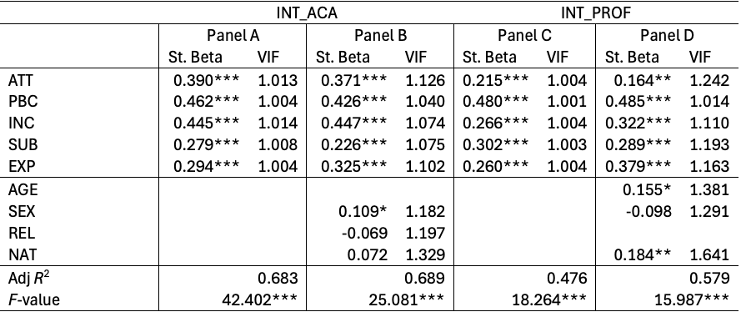
Multiple regression analysis
02/07/2024
The Use of Technology Tools and Learning Experience: Insight from Business School Students
9
Notes:
9

Slide 10
Quantitative Result
02/07/2024
Determinants of Intention to use technology tools
Five main determinants
Attitude
Perceived behavioural control (PBC)
Subjective norms
Technology inclusion
Prior exposure
All the five predictors strongly positively influence the intentions – both academic and professional contexts.
Among the five variables, PBC influences intention to use both academic and professionally-oriented tools more consistently and positively than others.
Most variables, except attitude, become even more important after controlling for demographic variables.
Sex, age, and nationality are the three significant demographic variables.
Overall, relatively matured, female, and non-British students with positive attitude towards the use of technology tools, positive peer effect, higher perceived control, decent past exposure, and higher tech inclusion are the primary target of the technology-centric education ecosystem.
The Use of Technology Tools and Learning Experience: Insight from Business School Students
10
Notes:
10

Slide 11
Qualitative Result
02/07/2024
Business Schools Students’ Engagement & Experience (BSSEE)
In addition to quantitative findings, BSSEE with technology tools shows the following:
Proficiency in using technology tools. However, more academic than professional-oriented.
Overwhelming positive impact of educational technology tools on learning engagement.
Most respondents agree that using educational technology tools enhances education quality.
Academic-oriented technology tools have been helpful and good for learning.
Respondents see the relevance of using professional-oriented technology tools in their studies.
Some values that motivate students to use technology tools include independence, creativity, knowledge, and social recognition.
Most respondents feel that educational technology tools help them to discover freedom/more freedom, flexibility, and manage time.
Areas of improvement include more hands-on learning, training and funding/loan for, and access to technology tools and devices.
The Use of Technology Tools and Learning Experience: Insight from Business School Students
11
Notes:
11

Slide 12
Future–focused and sustainable quality education with the adoption and usage of technology tools
02/07/2024
Recommendations
embrace compassion, belonging and equity in the design, delivery, and assessment of courses and modules;
prepare students with basics and advanced academic and professional oriented technology tools;
provide and promote training/loan for, and access to technology tools and devices;
make technology tools and devices available; and
develop students’ positive behaviour towards use of technology tools.
The Use of Technology Tools and Learning Experience: Insight from Business School Students
12
Notes:
12

Slide 13
Recommendation
02/07/2024
Attitude
HE Provisions
(underpinned by compassion, belonging, & equity)
Student Engagement
(using technology devices, proficiency, & positive behaviour (see Figure 1)
Perceived Behavioural Control
Intention to use … technology tools
Academic-oriented
Professional-oriented
Technology Tools
(adoption & usage)
Subjective Norms
Past Exposure
Tech Inclusion
Demographics
Sex
Age
Religion
Nationality
Sustainable
Quality Education
Figure 1: Business Schools Students' Intention to Use Technology Tools Framework
Figure 2: HE Digital Poverty/Exclusion Solution Framework
The Use of Technology Tools and Learning Experience: Insight from Business School Students
13
Notes:
13

Slide 14
Conclusion
02/07/2024
Quality education in UK business schools could be enhanced by adopting and using technology tools that promote compassion, belonging, and equity.
Technology tools training and funding/loans are the two main priorities to promote engagement and quality education.
Further research areas include further data collection across UK business schools, and the implementation of the proposed higher education institution digital poverty/exclusion solution framework.
The Use of Technology Tools and Learning Experience: Insight from Business School Students
14
Notes:
14

Slide 15
References
02/07/2024
Ajzen, I. (1991). The theory of planned behavior. Organizational behavior and human decision processes, 50(2), 179-211.
Beaunoyer, E., Dupéré, S. and Guitton, M., 2020. COVID-19 and digital inequalities: Reciprocal impacts and mitigation strategies. Computers in Human Behavior, 111, p.106424. doi: 10.1016/j.chb.2020.106424
Laasch, O. (2022) ‘COVID-19 and the new businesses of business schools.: Association to Advance Collegiate Schools of Business (AACSB). Available at: https://www.aacsb.edu/insights/articles/2022/08/covid-19-and-the-new-business-of-business-schools. (Accessed: 10 June 2024).
Maslow, A. H. (1943). A theory of human motivation. Psychological Review, 50(4), 370-96.
Maslow, A. H. (1954). Motivation and personality. New York: Harper and Row.
McKinsey & Company (2022). How technology is shaping learning in higher education. Available at: https://www.mckinsey.com/industries/education/our-insights/how-technology-is-shaping-learning-in-higher-education (Accessed: 12 June 2023).
Sen A., (1999) Development as freedom: pocketbook. Oxford Books.
Sinclair S, Norris J. M, McConnell S. J, Chochinov H. M, Hack T. F, Hagen N.A, McClement S., and Bouchal S.R (2016). Compassion: a scoping review of the healthcare literature. BMC Palliat Care. pp. 15-6.
Tarabasz, A., Selaković, M., & Abraham, C. (2018). The classroom of the future: Disrupting the concept of contemporary business education. Entrepreneurial Business and Economics Review, 6(4), 231.
Terkes, N., Celik, F., & Bektas, H. (2019). Determination of nursing students’ attitudes towards the use of technology. Japan Journal of Nursing Science, 16(1), 17-24.
UN General Assembly, 2015 UN General Assembly Transforming our world: The 2030 agenda for sustainable development United Nations, New York (2015).
The Use of Technology Tools and Learning Experience: Insight from Business School Students
15
Notes:
15

Slide 16
Thank you
02/07/2024
Dr Olufunbi Adesina, Dr Mamunur Rashid & Dr Oluseyi Adesina
The Use of Technology Tools and Learning Experience: Insight from Business School Students
16
Notes:
16

