Slide 1
Scope 3 emissions: the contribution of the student commute - and how to reduce this. Presented at Universities, sustainability and the climate emergency 2024. Universities UK, London. 18 January 2024. Dr Susan Kenyon Susan.Kenyon@Canterbury.ac.uk With thanks to John Hills, Alex O’Mara, Dr Peter Rands, Prof. Mike Weed.

Slide 2
Overview
The contribution of the student commute to our carbon footprint
Why count the student commute?
Case study: the student commute at CCCU.
Call to Action
Recognise the new commuter student culture in the UK.
Understand: collect consistent, comparable data.
Adapt our operations.

Slide 3
Why count the student commute?
Images taken from imdb.com.
‘We don’t have any!’
The enduring myth of the residential student.
Shapes HEI pedagogy; policy; processes.
Untrue for 40% of our students (1.1 million).
Widening participation: new cohort, unable to relocate.
Increasing every year.
More students; more diverse.
Post-Covid; cost of living; accommodation crisis.
Educational and environmental consequences.
8-28% of HEIs’ carbon footprint*; 1.2MtCO2e – 4.4MtCO2e**.
*11-28% (Helmers, 2021, 2 UK HEIs). 11% (HEFCE, 2010, 2005 data, all UK HEIs). 8% (The Royal Anniversary Trust, 2023, 500+ HEIs and FEIs). ** The Royal Anniversary Trust (2023) estimates the carbon footprint of the HE and FE sector to be 18.1MtCO2e, with HE accounting for 86% of this (15.6MtCO2e). Figure is 8% and 28% of 15.6MtCO2e.
Notes:
Relocates to attend university.
Lives on campus.
Immersive HE experience.
‘Part of the academy’.
Shapes HEI pedagogy; policy; processes.
Shapes government policy: HE; planning; transport…
Shapes data returns and regulation.
But the collective story persists.

Slide 4
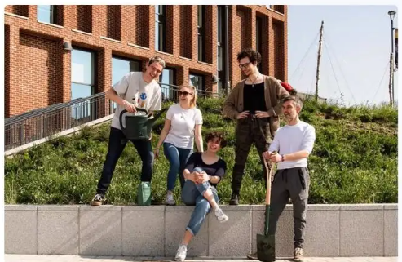
Case study: the student commute at CCCU
‘Our Response to the Climate Emergency’*.
Baseline emissions.
Set targets.
Implement strategies to reduce.
Method.
Literature review.
Review of existing data.
Student survey.
Accessibility analysis (TRACC).
*Available via: https://www.canterbury.ac.uk/asset-library/about-us/sustainability/Our-Response-to-the-Climate-Emergency-Final.pdf, viewed 16 January 2024. All images from canterbury.ac.uk.

Slide 5
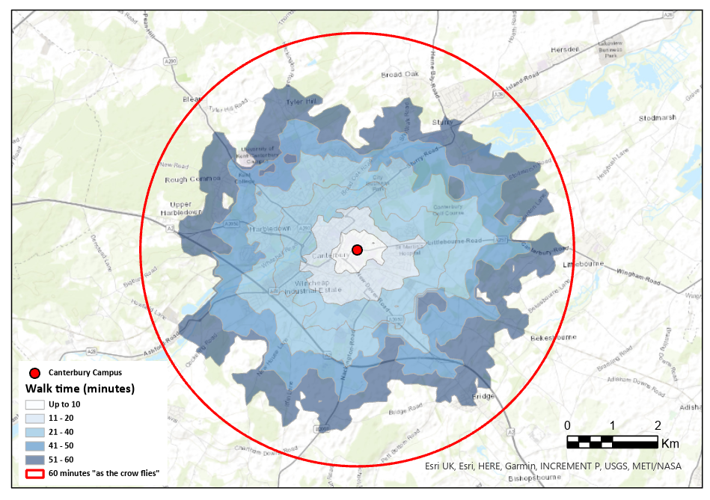
Case study findings: the student commute at CCCU
Total annual emissions from the student commute are 6,800 tCO2e.
0.64 tCO2e per student; 15% of total emissions.
63% of CCCU students are commuter students*.
Varies significantly by campus, Course, demographics, home/international.
Likely to increase.
Recruitment and outreach activities.
Student body is moving further away.
Commuters drive; residential students walk.
The majority have no ‘reasonable’ alternative.
Commuters attend significantly fewer days than they are
timetabled to attend.
*‘Students who continue to live at home whilst studying, rather than moving into student accommodation’(Kenyon, 2023).

Slide 6
Our next steps: understand how to reduce
Are our students able to change?
Are our students willing to change?
Could our education be more sustainable?
Pedagogy, policy, processes.
Would students welcome this?
Travel behaviour change
Remode
Reduce
Retime
Reroute

Slide 7
What does this mean for the sector?
The student commute is important.
To reduce it, we need to recognise it.
To reduce it, we need to understand it.
Short term: Experiment with what we have; understand what we need.
Long term: Collect consistent, comparable data.
To reduce it, we may need to adapt our operations.
Increase ability and willingness to change.
Adapt pedagogy, policy and processes.
Recognise
Understand
Call to Action
Adapt

Slide 8
Increasing understanding: data needs
Understanding what data we need.
To calculate carbon emissions.
TRACC software.
‘Must know, should know, could know’.
To change carbon emissions.
Travel behaviour science.
Basic data needed to calculate emissions
How many commuter students
How far do they travel
How many times a week
What mode do they use
Data needed to change behaviour
Ability to travel differently
Willingness to travel differently

Slide 9
Increasing understanding: data needs
Explore existing data.
HESA student return.
Home/term-time postcode.
Origin/destination.
UKES data.
Hours spend commuting.
Be aware of data quality.
Data needed to calculate emissions | Available?
How many commuter students | Yes
How far do they travel | Yes and No
How many times a week | No
What mode do they use | No
Data needed to change behaviour | Available?
Ability to travel differently | Yes and No
Willingness to travel differently | No

Slide 10
Increasing understanding: data needs
Collecting new data.
Must know; should know; could know.
Address data gaps.
Achieve high response rate.
Educate and engage.
Replicability and comparability.
Thinking about this Semester…
How do you usually travel to campus? If you use more than one, please select the mode that you use for the longest distance. Bus. Bicycle. E-Bike. Diesel or petrol car – alone. Diesel or petrol car – with others. Electric or hybrid car – alone. Electric or hybrid car – with others. Motorbike/moped. Taxi or other private hire car. Train. Walk. Other. On average, how many days a week do you usually come to the Canterbury campus? On average, how many days a week are you timetabled to attend Canterbury campus? What is your term-time postcode? Is your term-time postcode different to your home postcode?
Data needed to calculate emissions | Available?
How many commuter students | Yes
How far do they travel | Yes
How many times a week | Yes
What mode do they use | Yes

Slide 11
Institutional responses: adapting our operations
(1) Facilitating travel behaviour change.
Ability to change: provide transport; reduce costs; childcare contingency...
Willing to change: incentives; marketing.
(2) Facilitating sustainable education.
Pedagogy: online and/or flipped learning.
Policy: attendance.
Processes: compressed timetables, campus adaptations, support services and resources.
Travel behaviour
Biology and psychology
Built environment and Transport system
Activities and lifestyle
Society and culture
Kenyon, S. 2020. Travel Behaviour Science. The Future of Mobility. 30 September, 2020. University of Portsmouth, Portsmouth, UK.

Slide 12
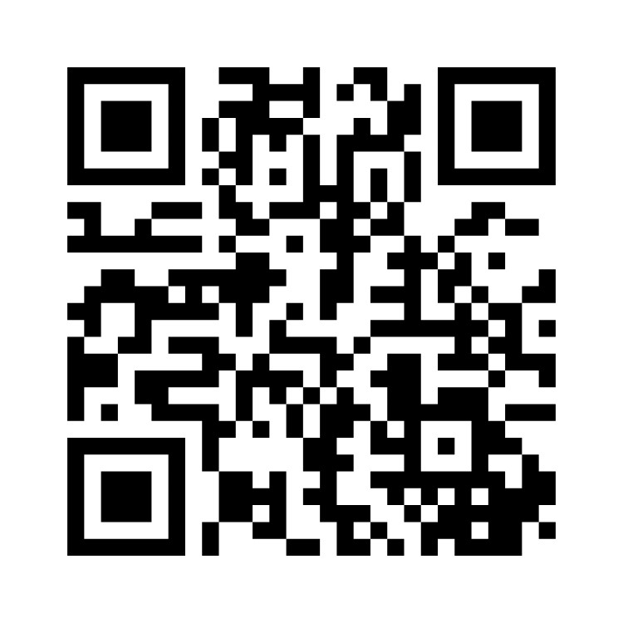
Scope 3 emissions: the contribution of the student commute - and how to reduce this. Presented at Universities, sustainability and the climate emergency 2024. Universities UK, London. 18 January 2024. Dr Susan Kenyon Susan.Kenyon@Canterbury.ac.uk With thanks to John Hills, Alex O’Mara, Dr Peter Rands, Prof. Mike Weed.

