Slide 1
ARMISTICE, REMEMBRANCE & SACRIFICE
A CENTURY OF COMMEMORATION & REFLECTION

Slide 2
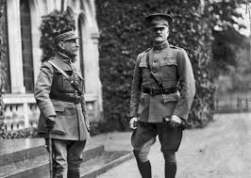
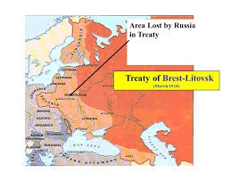
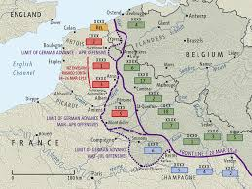
1918

Slide 3
1918
‘ Many amongst us now are tired. To those I would say that Victory will belong to the side which holds out the longest. The French Army is moving rapidly and in great force to our support.
There is no other course open to us but to fight it out. Every position must be held to the last man: there must be no retirement. With our backs to the wall and believing in the justice of our cause each one of us must fight on to the end. The safety of our homes and the Freedom of mankind alike depend upon the conduct of each one of us at this critical moment.’
Field Marshal Haig 11 April 1918

Slide 4
ARMISTICE
ALLIED & US PREPARATIONS FOR MAJOR AIR & LAND OFFENSIVES IN 1919.
29 SEPTEMBER 1918 BULGARIANS SIGN ARMISTICE
4 OCTOBER GERMAN GOVERNMENT APPEALS TO PRESIDENT WILSON FOR ARMISTICE & NEGOTIATIONS
30 OCTOBER TURKEY SURRENDERS
3 NOVEMBER AUSTRO-HUNGARY SIGNS ARMISTICE WITH ITALY
3 NOVEMBER NAVAL MUTINY WILHELMSHAVEN
4 NOVEMBER ALLIED SUPREME WAR COUNCIL ACCEPTS 14 POINTS
7 NOVEMBER GERMAN DELEGATION MEETS ALLIED COMMAND
9 NOVEMBER KAISER FLEES & REPUBLIC DECLARED
1100 11 NOVEMBER CEASE FIRE

Slide 5
SACRIFICE
ATTRITION & SLAUGHTER ON THE BATTLEFIELD
MURDER & WARFARE ON THE HIGH SEA
BLOCKADE
AWARENESS OF MAGNITUDE OF DEATH & DESTRUCTION
TOTAL WAR – BRITAIN FROM 1916
HUMAN COST ACROSS EMPIRE
INDIAN ARMY, KING’S AFRICAN RIFLES, WEST INDIES REGIMENT, JEWISH LEGION
CANADA, AUSTRALIA, NEW ZEALAND & SOUTH AFRICA
EUROPE, AFRICA , ASIA & THE OCEANS

Slide 6
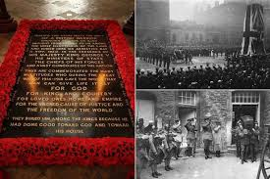
REMEMBRANCE
A CENTURY OF COMMEMORATION & REFLECTION
NATIONAL - UNKNOWN SOLDIER & CENOTAPH

Slide 7
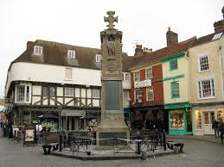
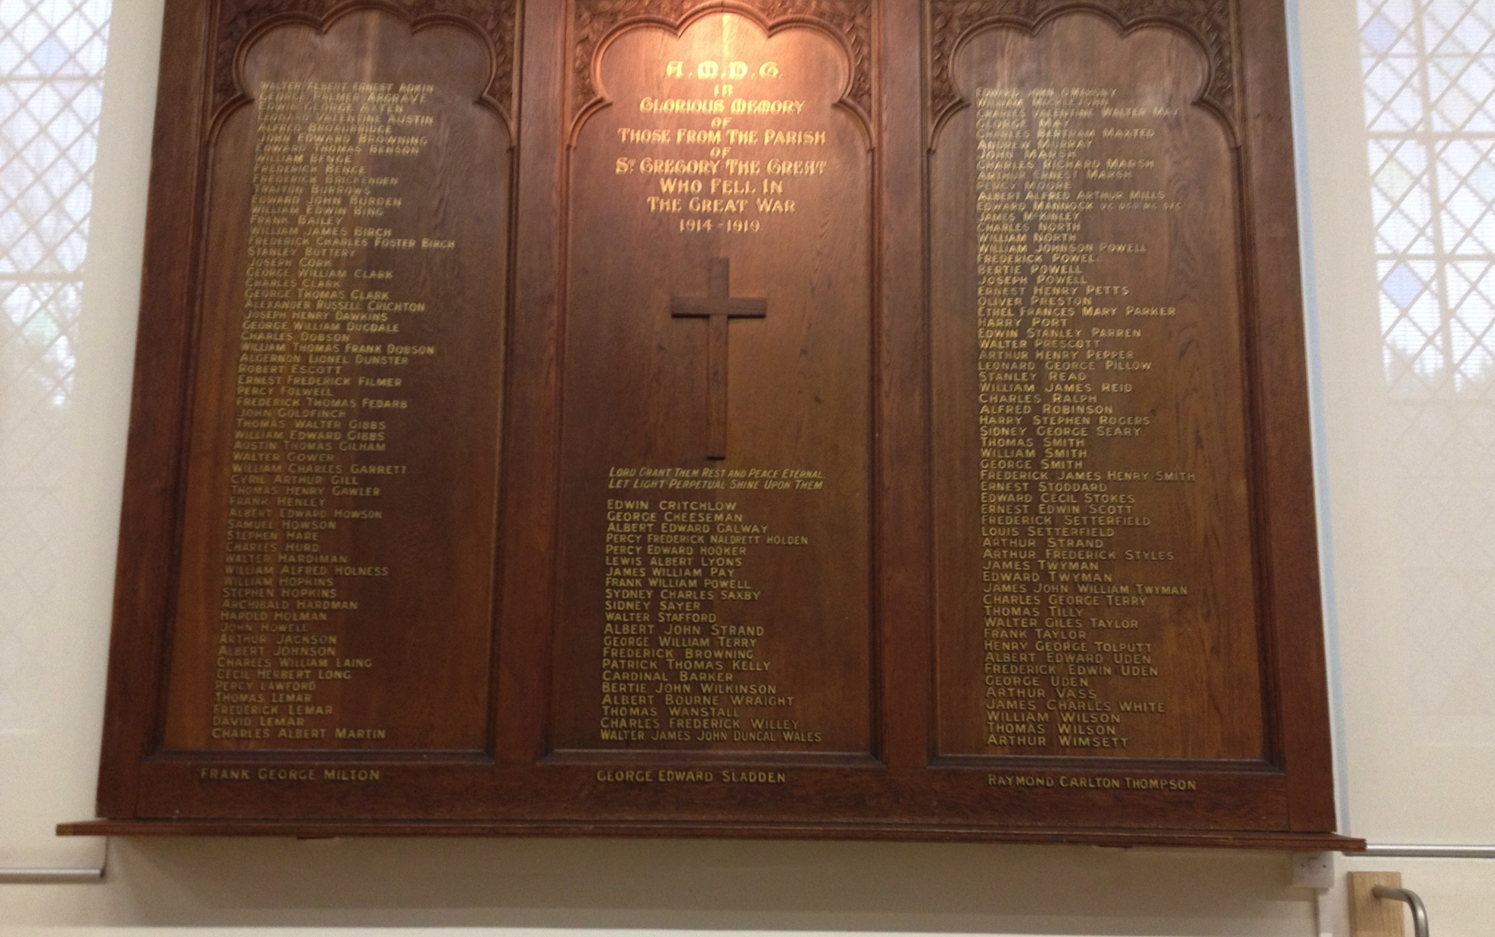
REMEMBRANCE
A CENTURY OF COMMEMORATION & REFLECTION
COMMUNITIES - CENTENENNIAL PROJECTS
BEARSTED & CHILHAM

Slide 8
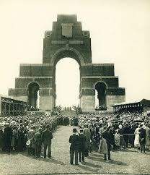
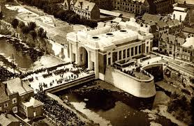
REMEMBRANCE
A CENTURY OF COMMEMORATION & REFLECTION
THE PILGRIMAGE

Slide 9
REMEMBRANCE
A CENTURY OF COMMEMORATION & REFLECTION
CWGC – SIR FABIAN WARE 1917
SOLDIER’S POLLS & FAMILY PETITIONS
HAIG – BRITISH LEGION & CAMPAIGNING FOR VETERANS
HAIG’S FUNERAL 1928
1929 – ECONOMIC COLLAPSE ALTERS VIEW OF WAR
DISABLED, SUFFERING & THE BEREFT
MODERN COMMEMORATION

Slide 10
REMEMBRANCE
“Common remembrance of the dead is the one thing, sometimes the only thing, that never fails to bring our people together.”
Sir Fabian Ware 1920
“Remembrance is not a call to jingoistic fervour, but a time for silence and reflection.”
Squadron Leader Rana Chhina July 2016

