Slide 1
Understanding barriers to sustainable travel: exploring the persistence of the car culture amongst young people in the UK. Dr Susan Kenyon and Francesca Gould Susan.Kenyon@Canterbury.ac.uk FranGGould@gmail.com Presented at Political Studies Association Conference 2024. University of Strathclyde, Glasgow, UK. 25-27 March 2024.

Slide 2
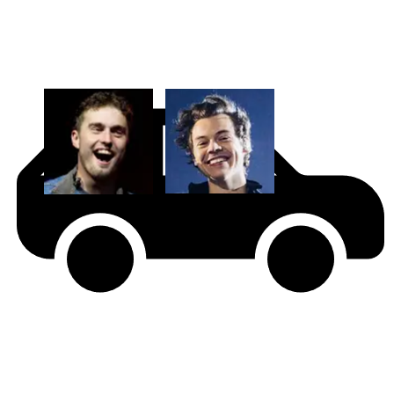
Overview
Harry Styles
Sam Fender
Supporting travel behaviour change
Next steps?
The car in popular culture
The role of culture in travel behaviour

Slide 3
Travel behaviour change
Travel behaviour change
Remode
Reduce
Retime
Reroute
Are people able to change?
Are people willing to change?

Slide 4
Travel behaviour
Travel behaviour
Biology and Psychology
Built Environment and Transport System
Activities and lifestyle
Society and culture

Slide 5
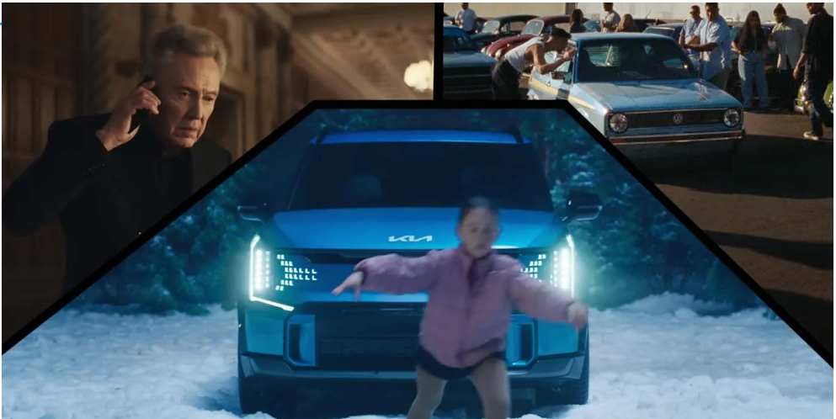
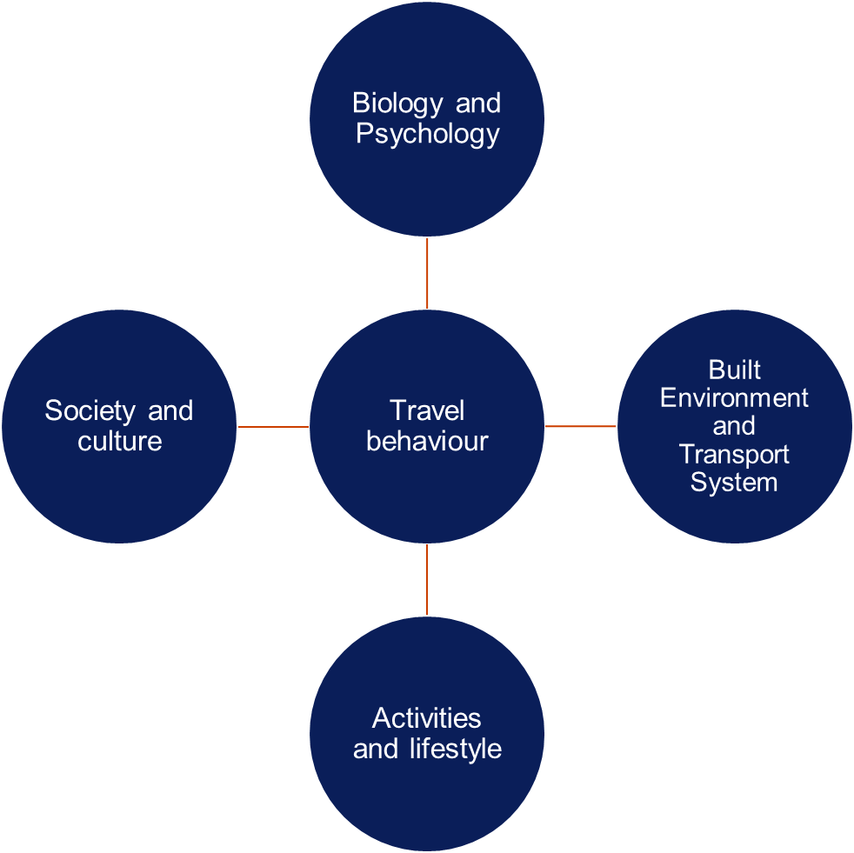
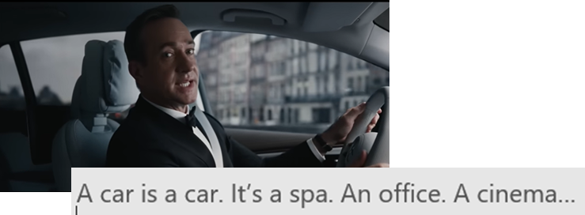
Car culture: shaping individual choices

Slide 6
Car culture: shaping policy and planning

Slide 7
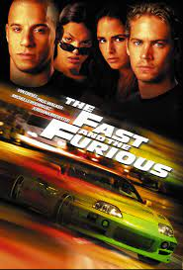
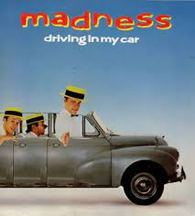
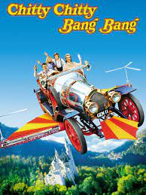
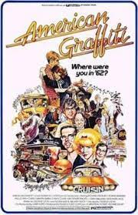
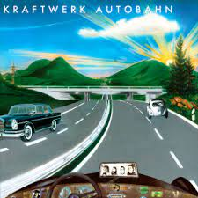
The car culture: perpetuated in popular culture

Slide 8
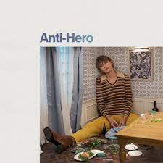
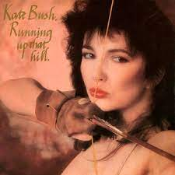
Method
Artist | Song title
Harry Styles | As it was
Glass Animals | Heatwaves
Dave | Starlight
Kate Bush | Running up that hill
Sam Fender | Seventeen going under
Taylor Swift | Anti-hero
Drake | Search and rescue
Ed Sheeran | Eyes closed
Harry Styles | Watermelon Sugar
Kanye West | Heartless

Slide 9
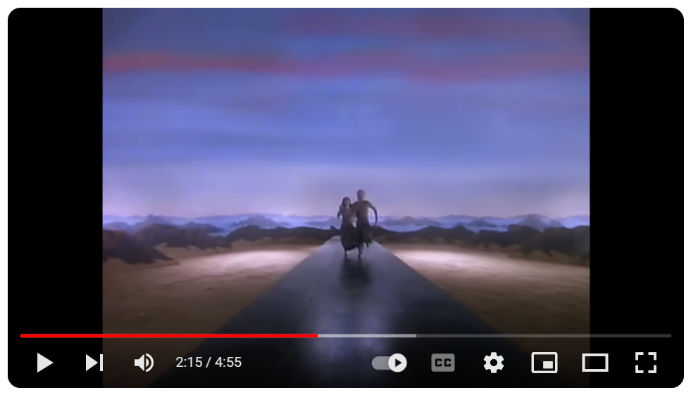
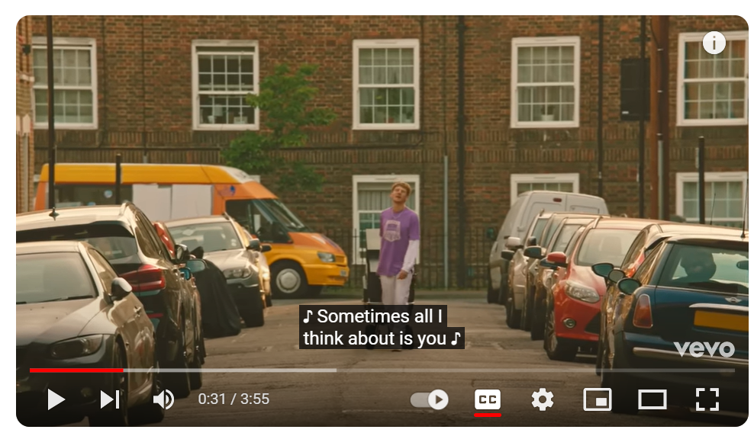
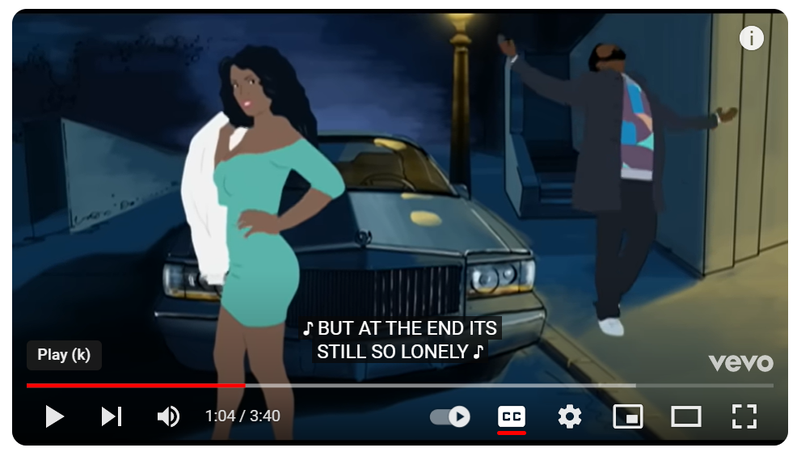
Five categories emerged
Movement as a metaphor for transition, change, progress, freedom, escape.
Power and powerlessness, restriction, control.
Materialism, conspicuous consumption, image, halo effect.
Masculinity, women as both commodities and threats.
Disorientation, imbalance, deception.

Slide 10
Movement as a metaphor for progress, freedom, escape.

Slide 11
Power and powerless, restriction and control

Slide 12
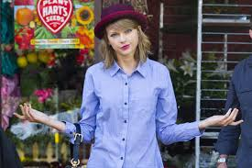
Next steps?
Limitations.
Sample: songs; listeners; streaming service.
Are we looking too hard?
So what?
The car in popular music.
Larger sample of songs: 100.
Precise sample: demographics; streaming service.
Songs or videos?
Comparative study: previous decades to now.
Is there an influence?
Methodology?

Slide 13
Understanding barriers to sustainable travel: exploring the persistence of the car culture amongst young people in the UK. Dr Susan Kenyon and Francesca Gould Susan.Kenyon@Canterbury.ac.uk FranGGould@gmail.com Presented at Political Studies Association Conference 2024. University of Strathclyde, Glasgow, UK. 25-27 March 2024.

