Slide 1
The Evidence for Arts and Dementia Care: Recent Research Findings
Prof. Paul M. Camic
Department of Applied Psychology
Canterbury Christ Church University
Salomons Campus, Tunbridge Wells
Notes:
Good morning and welcome to this day of exploration and discussion.
In my presentation today I am going to provide a brief overview for those of you who are considering undertaking research involving the arts and dementia care;
This will include:
Directing research towards different audiences
Consideration for the stage of dementia you want to address and the venue of the project
Some background on the different types of research evidence to consider
What the arts have been successful at addressing for this population
And the briefest of reviews of recent research

Slide 2
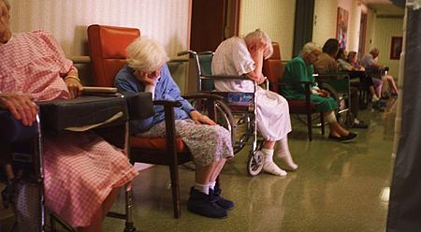
Why the Arts?
Notes:
Although I have had a longstanding interest in the arts, I am trained as a clinical health psychologist and clinical researcher and am not an artist by profession or vocation.
My training and most of my professional experience have occurred in traditional clinical and academic settings where the arts were rarely discussed or considered.
“interventions” in these settings have been mainly oriented toward medical or psychological approaches to care…some have been successful while others have not been.
Clearly, medical and psychological research and care remain crucial in supporting people with a dementia and their family and professional carers
But these approaches do not supply all the answers.
In my clinical and research experience the arts have shown enormous potential to address such issues as apathy; behavioural issues such as anxiety, depression and aggression; cognitive and emotional engagement
The arts have promise as a part of care for the PWD as well as for family carers and professional staff caring for PWD.

Slide 3
Designing a research project: Who is the audience?
Who will ‘consume’ the research?
Commissioners
National Institute of Clinical Excellence (NICE)
Community residents
Academics writing in journals
BBC Radio 4
People with a dementia and their caregivers
At what level/stage of dementia?
A local arts organisation
Notes:
There are different types of research for different audiences, which may involve different questions, a range of research methods, resources and outcomes.
A local arts organisation, for example, running a dance programme for PWD and carers will have different outcome expectations than commissioners, who may differ from what NICE will expect
Sometimes, the outcomes that satisfy a PWD do not appear to hold scientific rigour and will not impress academic researchers, but may get the attention of the BBC because a PWD has reported a benefit from participating. For the person with a dementia that is often all that matters.
For those of you here today from arts or health care organisations, I would recommend thinking carefully about outcome goals and expectations and to consult with service user groups about what they need and want. Research in dementia care should be user-led and in partnership with others.
One issue to consider is the stage of dementia best suited to your planned project and the best venue in which to carry out the project. Should it be open to all who want to come or do you want to tailor it to people in the early, middle or later stages? Will you involve family carers?

Slide 4
What do you consider evidence?
Numbers (statistics)
Words and numbers
Words
Photos
Photos and words
Photos, words and numbers
Notes:
In nearly all funded research projects either at a national or local level some type of evidence needs to be produced to evaluate the project.
Different audiences value different types of evidence and it is important to get the right match when designing the project. In order for arts organisations or health care trusts to receive funding for arts-based interventions from government funders, rigourous evidence is usually required. That evidence, for the Dept of Health, for example, is nearly always in the form of statistical data from a randomised controlled trial.
Yet, standardising arts-based interventions is often very difficult to do and may not be possible or desirable.
In a project I am presently involved with at the Dulwich Picture Gallery and Nottingham Contemporary Gallery looking at the impact of different types of art on PWD and family carers, a carer reported to me just last week “I’ll fill in your questionnaires, of course, because I know that is necessary, but they are not going to tell you about how wonderful this project is and how it has shed light into our lives. They won’t tell you that this is making a great difference at this point in my and Louise’s life”. Capturing this type of evidence can help bolster support for the arts but it may not be sufficient for all audiences.
Involving the arts in dementia care would be considered a complex intervention by the Medical Research Council, with many potential variables and issues to consider. Complex interventions can benefit from a multiple sources of evidence, which may help to best support the argument to include the arts.

Slide 5
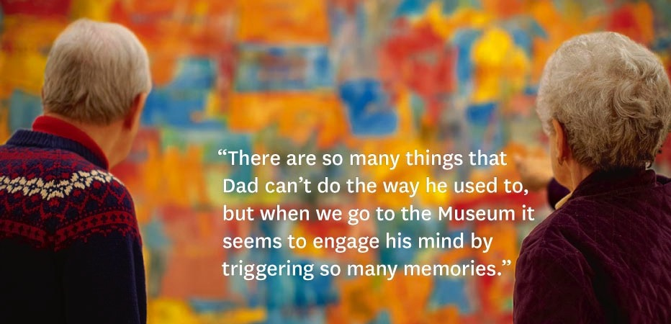
Notes:
You are looking at some of the evidence presented to potential funders of the Meet Me at MoMA programme for PWD at the Museum of Modern Art in New York.
Although this type of evidence is difficult to quantify, when repeated by dozens and dozens of participants over a five year period we know something positive is going on that needs further exploration.
It is not the type of evidence that has gotten the attention of health care services in the US but it did get the attention of a private foundation who has provided a generous grant for it to continue.

Slide 6
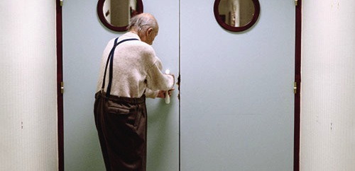
Notes:
If you have ever visited an inpatient older adults mental health ward this photograph will not look unfamiliar.
Without jumping to premature conclusions from a photograph, we can at least draw up some tentative hypotheses about what might be happening or what might not be happening for this man

Slide 7
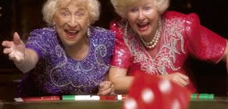
Notes:
Quite a bit different for these women at a fancy dress games night at a community health centre

Slide 8
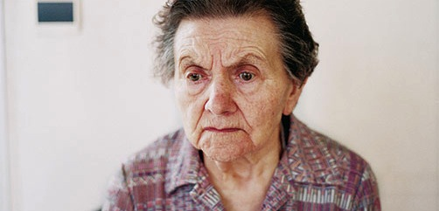
Notes:
And different still for this woman

Slide 9
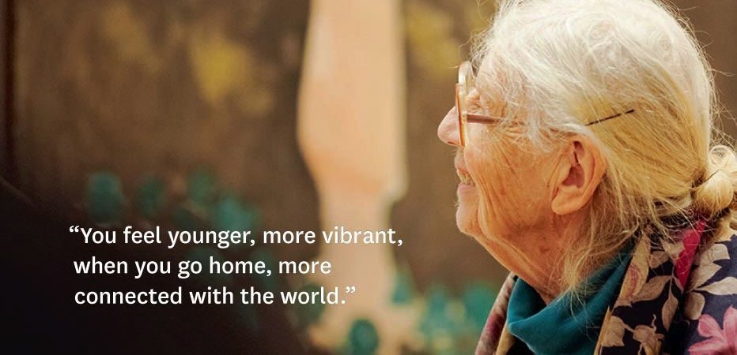
Notes:
Back again to New York with a woman with dementia. For her, these words tell us the benefit she received from the arts programme.
The arts programme does not have a goal to stop her Alzheimer’s disease or even to slow it down.
It’s goal is to improve the quality of her life and it appears to have done so if this is a kind of evidence you and your funding source value.

Slide 10
Outcome options in arts and dementia care research
For the person with a dementia, the family caregiver, and the professional carer
Quality of life (PWD, FC, PC)
Wellness (PWD, FC, PC)
Episodic memory (PWD)
Temporary enhancement of cognitive functioning
Reminiscence (PWD)
New leaning (PWD)
Notes:
I would like to conclude with 5 areas that can be addressed by the arts for PWD and carers:
QoL and wellness, while related, are different aspects of living well even if you are living with a life threatening or debilitating illness or disease
Episodic memory---memory associated with specific autobiographical events (times, places, associated emotions, and other contextual knowledge)
Reminiscence, while related to episodic memory, is more associated with recalling stories and incidences of an earlier time in life that is stimulated by an object, ( such as a advert for war bonds, an earlier model automobile, a kitchen appliance)
The most controversial on this list is new learning; I have included it because too often a person diagnosed with a dementia can be thought of strictly in terms of being on a slippery slope to cognitive oblivion and that there is no point in introducing anything new in their lives because it will be forgotten.

Slide 11
Recent international projects
Singing in residential care
MoMA: Viewing modern art in a gallery
Singing at an early to mid stage
DPG/NC: Viewing 16th/17th European art or contemporary art and making art
Music and engagement
Le Louvre: Pour Lutter Contre Alzheimer!
Le premier atelier de musicothérapie organisé par l'association France Alzheimer
Notes:
--Eva Gotell and colleagues in Sweden with professional carers in residential care
--MoMA
--Singing together study in Hove
--DPG/NC
--An Australian RCT looking at live music and its effect on QoL and depression in PWD
--A programme at the Louvre museum
--Music therapy programmes

