Slide 1
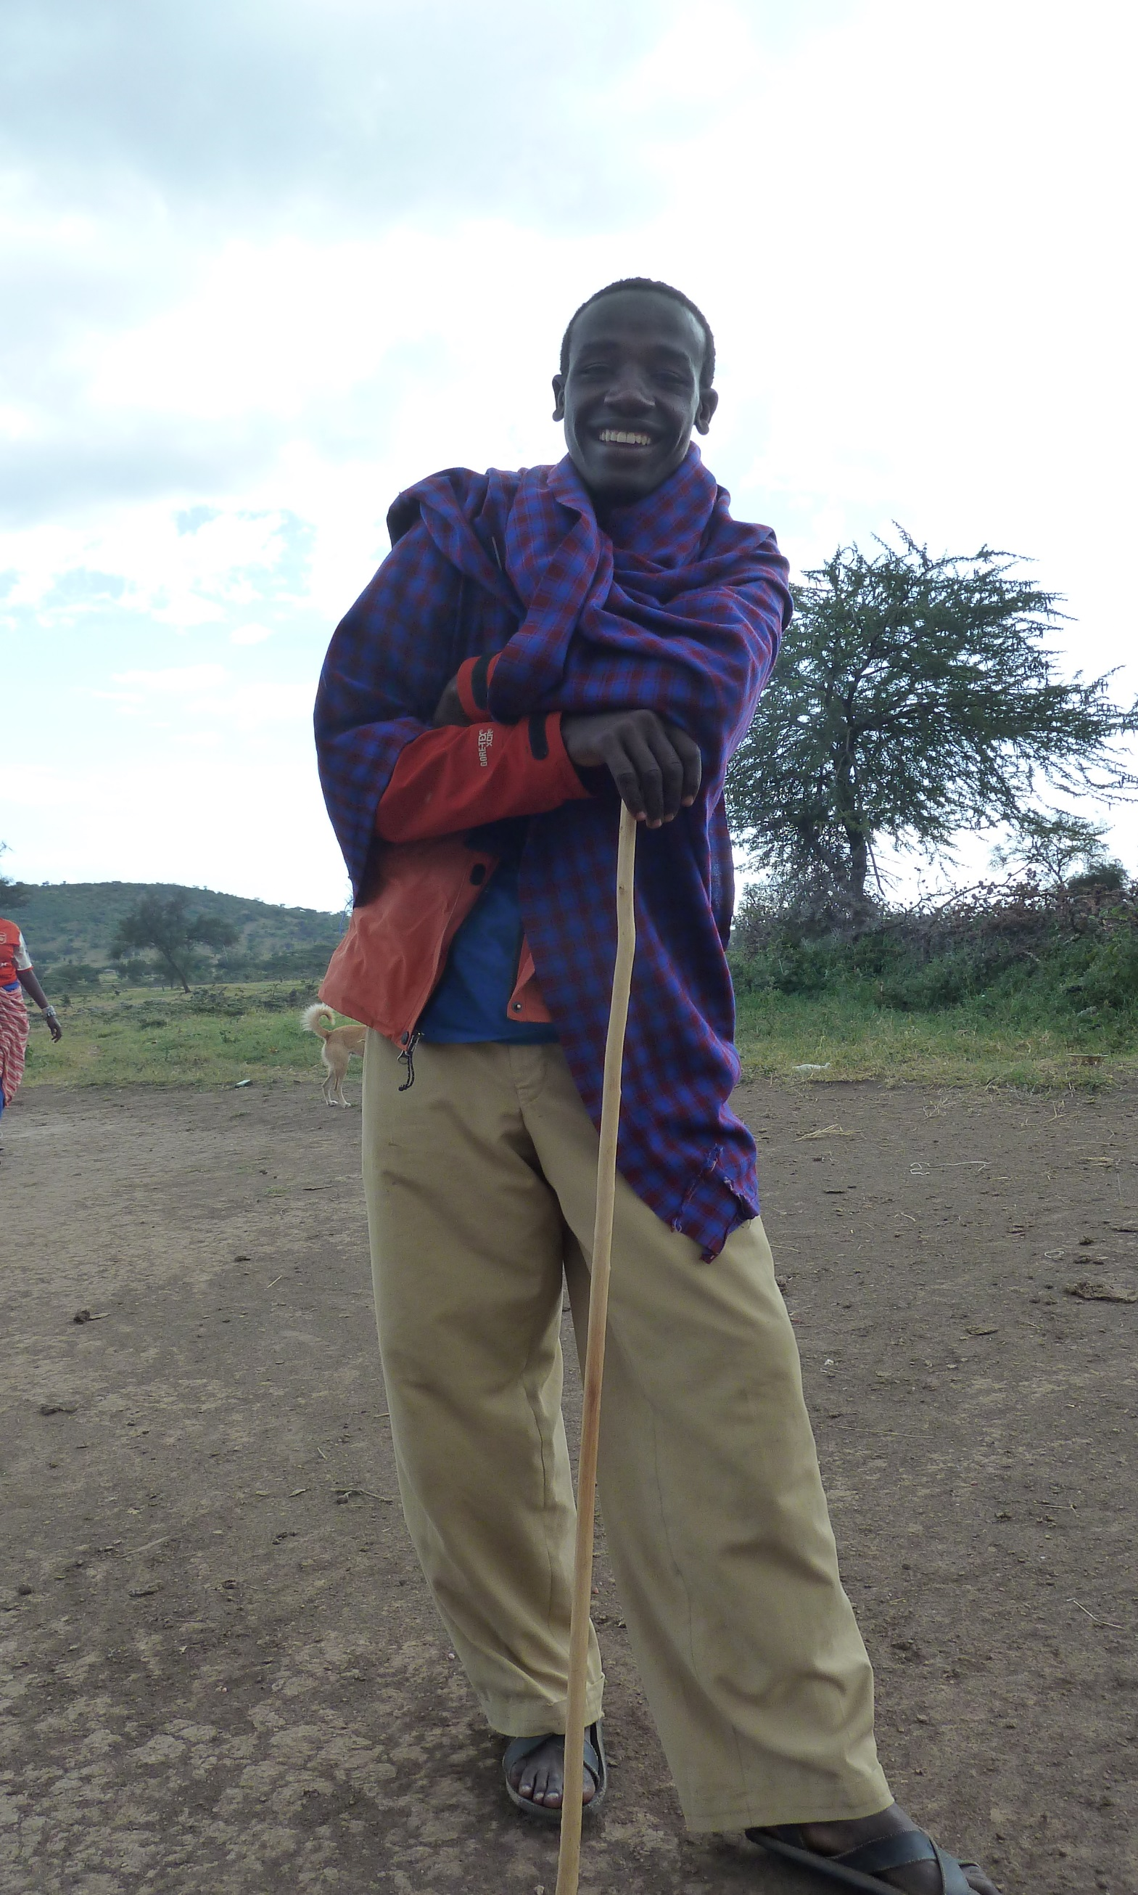
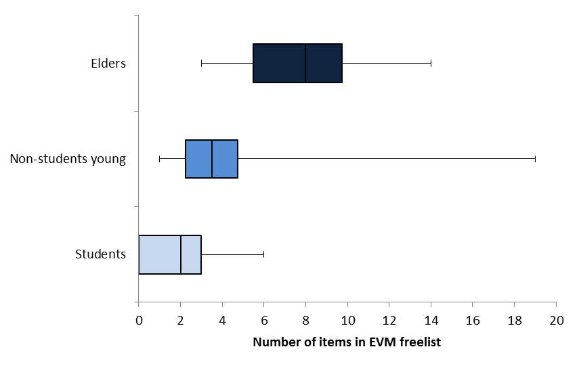
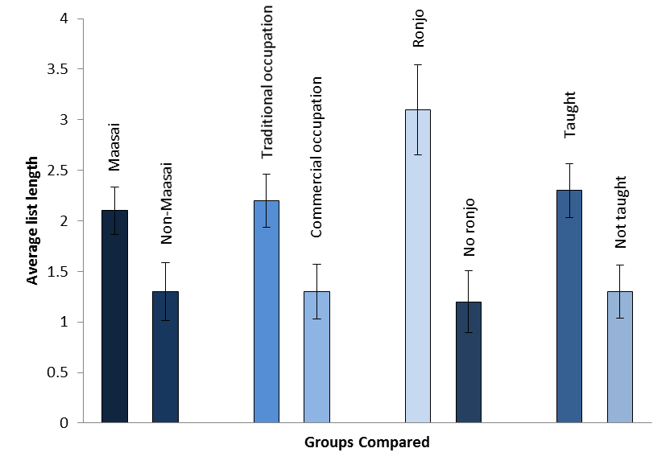
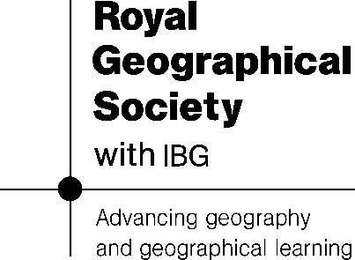
Investigating the relationships between formal schooling and ethnoveterinary knowledge in Eluwai village, Tanzania
Jennie.Harvey@Canterbury.ac.uk
Introduction:
Studies have shown that traditional knowledge (TK) is generally learnt in the home or other cultural environments through informal teaching during work, play, and community activities (Zarger 2011). Formal education may contribute to the development of a 'generation gap' in TK by reducing young peoples’ exposure to traditional practises and their interaction through 'learning networks' with holders of TK (Zarger 2011, Zent 2001). TK is often subverted to western scientific knowledge (WSK) in formal education systems the world over, and local institutions and innovations gain little recognition in curricula (Alexiades 2009, Ellen and Harris 2000). Livestock are crucial to Maasai life for subsistence and as a social currency, and Maasai have an extensive system of ethnoveterinary knowledge (EVK) to care for them. Like other forms of TK, EVK is under threat from changing lifestyles and attitudes.
Field work was carried out in Monduli District, northern Tanzania, in the "Maasai Steppe-proper", characterised by arid land and tree savannah dominated by Acacia and Commiphora species. About 86% of households in Monduli district are rural. Over 50% of the rural population lives below the Basic Needs Poverty Line and literacy is as low as 38%; as few as 6% of children in rural areas live within 30 minutes of a secondary school (EDI 2005).
Noonkodin Secondary School is an intercultural school in the village of Eluwai, run by UK-based NGO Serian UK. Noonkodin’s broad aims are to develop self-esteem and cultural identity, and to reduce out migration of young people to go to school or join the workforce in cities.
Methods:
Results:
Objectives | Methods | Sample | Analysis
1. Determine most salient diseases and ethnoveterinary medicines known to students and non-students | Freelisting | Students n=80 Non-students n=20 (10 young, 10 elders) | Quantitative: Anthropac- frequency and Smith's salience
2. Investigate attitudes toward ethnoveterinary medicine among students and non-students | Questionnaires | Students n=79 | Qualitative
 | Semi-structured interviews | Students n=10 Non-students n=20 (10 young, 10 elders) | Qualitative
 | Informal discussions | Not measured- opportunistic
3. Compare lexical knowledge of students and non-students | Freelisting | Students n=80 Non-students n=20 (10 young, 10 elders) | Quantitative: SPSS- t-tests/ Mann-Whitney tests
4. Explore variation in naming ability among students | Questionnaires | Students n=79 | Quantitative: SPSS- t-tests on freelists of groups
5. Compare substantive knowledge of students and non-students | Semi-structured interviews- knowledge scored | Students n=80 Non-students n=20 (10 young, 10 elders) | Quantitative: SPSS- t-tests/ Mann-Whitney tests
Figure 2. Pie chart showing use of traditional and conventional medicines among students at Noonkodin school and their families, and residents of Eluwai village.
Figure 1. Methods and analysis
Figure 3. Box and whisker plots showing the means and variance in length of freelist of ethnoveterinary medicines (EVM) between elders, unschooled youths, and students
Figure 4. Bar chart showing attributes which bore a significant relationship to students‘ EVK
Discussion/Conclusions:
This study highlighted the continued importance of ethnoveterinary medicine (EVM) to an agro-pastoralist Maasai community in Monduli District. In Eluwai, EVM was found to be used complementarily to conventional veterinary medicines, but often preferably.
Noonkodin students' positive attitudes and interest in learning EVK suggest that the intercultural curriculum, location of the school, and presence of local teachers have a positive impact on students' cultural pride and attitudes toward TK, and may help to reduce TK loss, acculturation, and out-migration of young people to cities.
While formal schooling was found to be negatively related to young peoples' EVK in this study, there is clearly a complex array of factors that contribute to knowledge erosion among indigenous students. Factors such as parents’ occupation and active teaching at the home appear to interact with formal schooling in their impact on EVK, suggesting that families, communities and educators should work together to preserve TK among the younger generations.
EVK was positively related to practical experience, supporting previous research at Noonkodin and elsewhere suggesting that practical and contextual learning is important in the learning of TK (e.g. Zarger 2011, Wyndham 2009, Zent 2001:57). One student could not remember the name of a disease treated by a particular plant but was able to recall the preparation, location, and animal treated, suggesting that contextual knowledge is more easily remembered than lexical knowledge. In a selection of Maasai students who demonstrated lexical EVK there was no significant difference in substantive knowledge compared to unschooled peers or elders, suggesting that those students who are learning EVM outside of formal education are gaining practical EVK.
Figure 5. Bar chart showing the mean scores for substantive EVK of students, their unschooled peers, and elders, with standard error.
“There are so many (ethnoveterinary medicines) but I forget them because I'm learning other things at school, so I forget the names of those trees. But there are more..." Noonkodin student, May 2013.
References:
Alexiades, M. N. (2009). The Cultural and Economic Globalisation of Traditional Environmental Knowledge Systems. In Heckler, S. (Eds) Landscape, process and power: re-evaluating traditional environmental knowledge. Berghahn Books. pg 68-98.
EDI (Economic Development Initiative) (2005). Monduli District CWIQ Baseline Survey on Poverty, Welfare and Services in Monduli District, Implemented by EDI.
Ellen, R.F. and H. Harris. (2000). Introduction. In Bicker, A., Ellen, R., Parkes, P. (Eds.) Indigenous Knowledge and its Transformations: Critical Anthropological Perspectives. Pages 1-33, Amsterdam, Harwood Academic Publishers
Wyndham, F. S. (2009). Environments of Learning: Rarámuri Children’s Plant Knowledge and Experience of Schooling, Family & Landscapes in the Sierra Tarahumara, Mexico. Human Ecology, 38(1), 87–99.
Zarger, R. (2011). Learning Ethnobiology: Creating Knowledge and Skills about the Living World. In Anderson, E. N., Pearsall, D., Hunn E., Turner, N. (Eds), Ethnobiology. Wiley-Blackwell. Pg 371-386.
Zent, S. (2001). Acculturation and Ethnobotanical Knowledge Loss among the Piaroa of Venezuela. In Maffi, L. (Eds) On Biocultural Diversity: Linking language, knowledge and the environment. Smithsonian Institutional Press. Pg 19-211.

