Slide 1
Re-centring the Social Work Curriculum: Reflections on a Decolonizing Framework Dr Charles Fonchingong Che charlesfonchingong.che@canterbury.ac.uk
Notes:
Re-calibrating the narratives on social work, exploring other voices and perspectives to impact student learning are vital in re-shaping the social work curriculum.

Slide 2
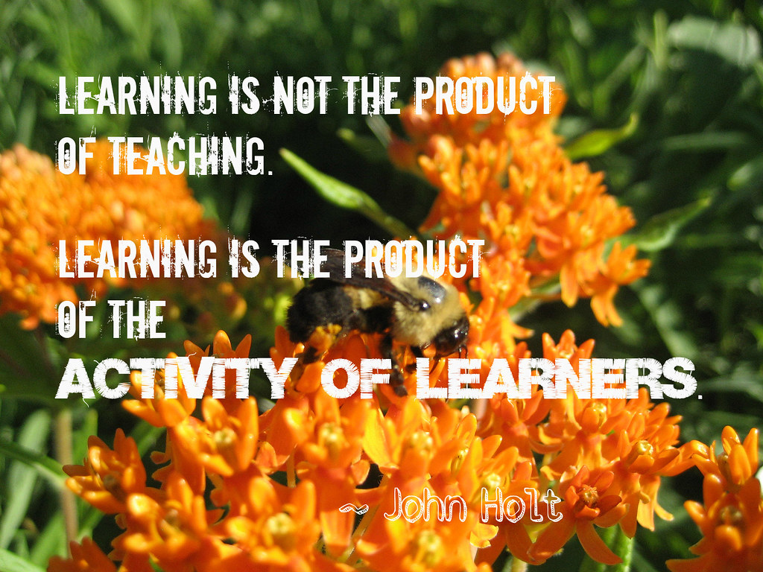
Introduction and Context
IFSW (2018) global definition – Social Work ‘underpinned by theories… and indigenous knowledges’
Social Work England (2020) professional standards on Diversity (1.1) – Emphasis on strengths of individuals and communities
Different perspectives and voices in the classroom and within higher education landscape (Arday and Mirza 2018, Laing 2021, Moosavi 2020, Pedler et al. 2022)
CCCU framework on decolonizing
Diversifying social work curriculum
Thrust on re-centring grounded in liberated pedagogy, curriculum transformation, inclusive content

Slide 3
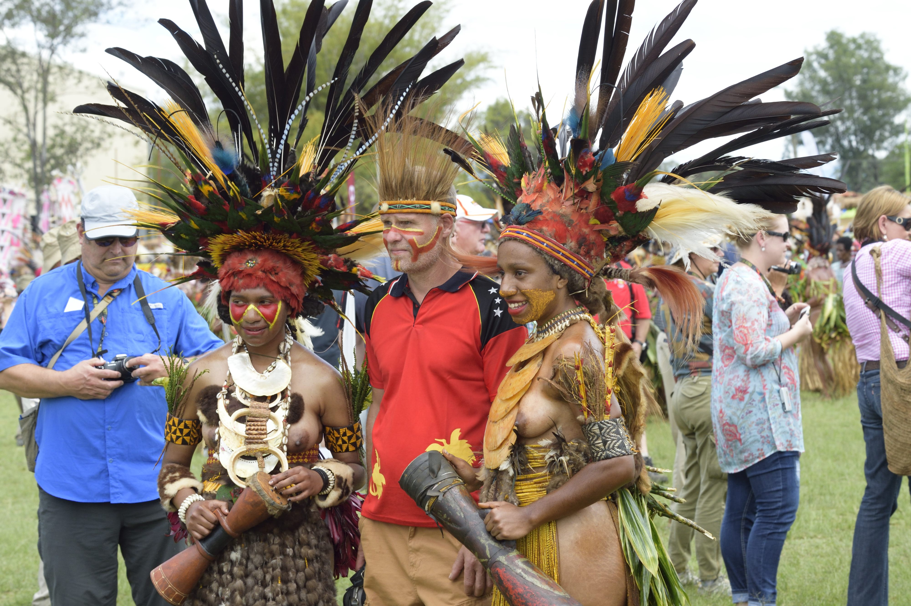
Decolonializing framework
CCCU framework - Decolonising the curriculum
Action Planning at Course, module, and institutional levels
Inclusive, diverse and decolonised curricular
Addition of voices, perspectives and practices that have previously been omitted
Paradigm shift in culture, mindset and practices
Consider what is social work knowledge, its acquisition, value, dissemination, what is included/excluded and why?
Teaching and Learning Enhancement
Opportunity to critically reflect, dismantle our assumptions, unlearn, relearn and rebuild together
by Unknown Author is licensed

Slide 4
Theoretical Proposition
Relational Epistemology
Making theory contextual -strategies at course and module levels to engage in dialogue and meaningful conversations on curriculum diversification
Decolonialised curricular - potential to improve a sense of belonging and engagement
Promoting equality, diversity and inclusion, relevant towards an inclusive and justice-based approach
Move towards an equity and justice-based approach to curriculum design (Ahmed-Landeryou 2023)
Lens to interrogate ambiguities related to decolonising the curriculum
Rethink colonialist patriarchal epistemological worldview in re-shaping the curriculum(Ahmed-Landeryou 2023)
Re-integrating knowledges and authors that are pushed to the margins/devalued (Pedler et al., 2022)
Multi-centric Perspectives
Notes:
Application of theory to practice environment, diverse perspectives and critical analysis, theories as tools for reflection

Slide 5
Re-centring Strategies at Course Level
Identity, Sense of Belonging and Community
Mentoring and support of students from minoritized populations
Widening pool of members of staff to encourage diversified curriculum
Minority Ethnic Guest speakers/ Sessional lecturers/ Experts by Experience (EbEs)
Levers of measurement
Engaging with complexity (does the ccurriculum explore and acknowledge complex and intersectional identities)
Embedding diversity in course design, development and assessments with collaboration and input from diverse students
Building on cultural capital and exploring cross-cultural perspectives
Course induction/information on range of cultural, religious, racial, ethnic, gender, sexual orientation and social economic backgrounds

Slide 6
Re-centring Strategies at Module Level
Identity, intersectional Complexities and multi-centric perspectives
Explore identity, ethics and societal impact –Aspects of social, economic, ethnicity with influence, outcomes, and perspectives
Incorporating specific case studies that avoid stereotyping of minoritized populations
Foster good relationships in students, based on a compassionate classroom pedagogy?
Levers of measurement
Debates on diversity and topics on personal experiences and views
Range of assessment formats to support diversity of student body
Assessments & opportunities drawing upon students’ cultural background
Inclusion of different perspectives outside Social work Country context related to race and ethnic diversity
Develop students’ critical thinking and awareness of different perspectives on issues around diversity in race, ethnicity, culture, nationality, sexuality, gender, class
Reading list and resources from a diverse range of authors from different races, ethnicities and perspectives
Using more case studies and other resources for teaching that challenges stereotypes

Slide 7
Key Strategies at Module Level
Explore data, scholarly research and theories that relate to social work, and ethnic diversity
Enable Students to unpick theories and research that resonates with them.
Challenging scholarship based on colonial assumptions
Explore cultural and intergenerational knowledge from different communities and cultures
Decolonize the curriculum - de-centering perspectives

Slide 8
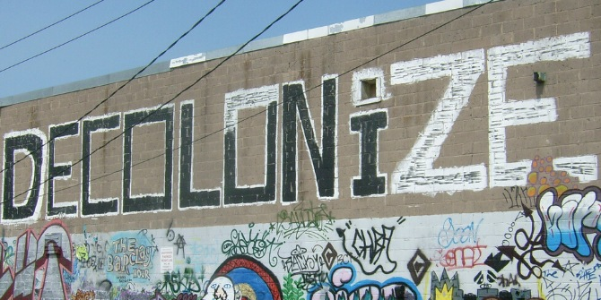
Rationale
-Reconsidering the evidence base, alternative voices, perspectives
-Acknowledging challenges and tensions
Inclusive Content and Reading List
Diverse learning environment embedded in course and module content + Essential Reading
Critical Learning and Reflection incrementally
Critical Learning as part of incremental approach, building on knowledge gaps
Liberated and Compassionate Classroom Pedagogy
Multiple learner voices, identity capture and complexities of intersectionality and difference
Framework for Re-centring
Social Work Curriculum
Impact
-Diverse summative assessments and layered formative assessments
-Reconsidered/Broader approach
-Theoretical Reconstruction/De-construction
-Inclusive content and cross-cultural perspectives

Slide 9
REFERENCES
Ahmed-Landeryou, M. (2023). Developing an evidence-Informed decolonising curriculum wheel – A reflective piece. Equity in Education & Society, 0(0). https://doi.org/10.1177/27526461231154014
Arday, J. and Mirza, H.S. (eds.) (2018) Dismantling race in higher education: Racism, whiteness and decolonising the Academy. London: Palgrave. ISBN:978-3-319-60261-5
Laing A. (2021) Decolonising pedagogies in undergraduate geography: student perspectives on a Decolonial Movements module, Journal of Geography in Higher Education, 45:1, 1-19, DOI: 10.1080/03098265.2020.1815180
Canterbury Christ Church University Closing Our Gap Blackboard page: https://learn. canterbury.ac.uk/webapps/blackboard/content/listContentEditable.jsp?content_ id=_1956359_1&course_id=_9875_1
Moosavi L (2020) The decolonial bandwagon and the dangers of intellectual decolonisation. International Review of Sociology 30(2): 332–354
Pedler ML, Willis R, Nieuwoudt JE (2022) A sense of belonging at university: student retention, motivation and enjoyment. Journal of Further and Higher Education 46(3): 397–408.

