Slide 1
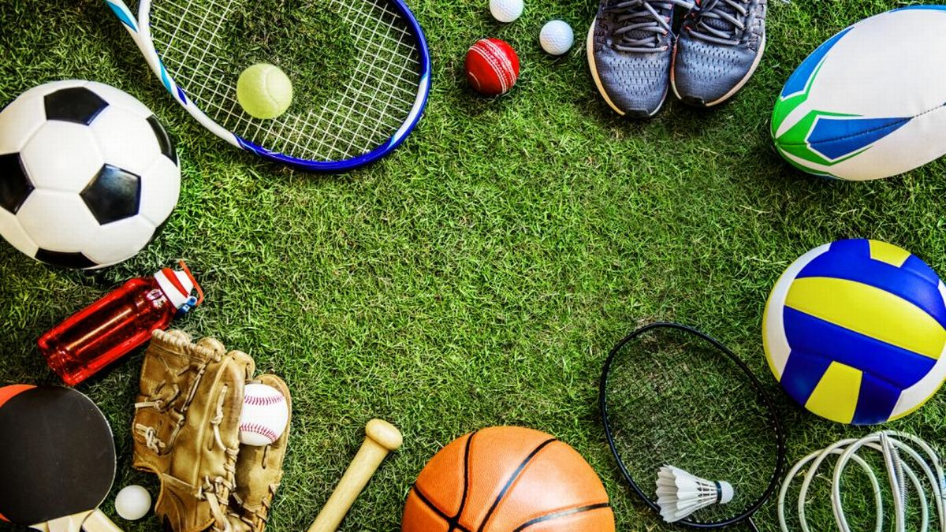
FEMINISM, WOMEN AND SPORTS FOR DEVELOPMENT PROGRAMS TOWARDS FEMALE PARTICIPATION IN SPORTS CULTURE IN RURAL AREAS IN MALAYSIA
NOORHIDAYU ISMAIL
(100089499)

Slide 2
Agenda
TYPE OF DEVELOPMENT (SPORT)
WOMEN AND SPORTS FOR DEVELOPMENT
WOMEN'S SPORT IN MALAYSIA
THE SPORT PLUS/PLUS SPORT
SPORT FOR DEVELOPMENT IN MALAYSIA

Slide 3
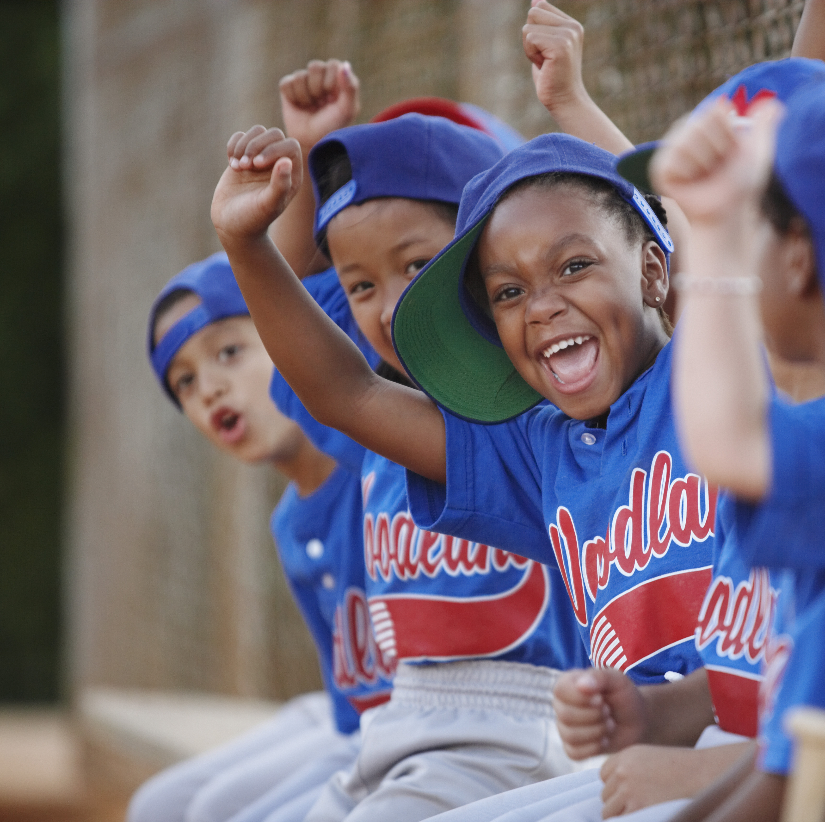
SPORT DEVELOPMENT
GRASSROOTS PARTICIPATION
TALENT IDENTIFICATION AND DEVELOPMENT
SPORT INSFRASTURCUTRE
COACH AND OFFICIAL DEVELOPMENT
SPORT GOVERNANCE
HIGH PERFORMANCE SPORT
Notes:
Sport Development encompasses the overall growth and improvement of sport at various levels, including grassroots participation, talent identification, coaching, infrastructure development, and organizational structures. It focuses on building and enhancing the sporting system by nurturing athletes, improving sport governance, fostering talent pathways, and increasing opportunities for participation. Sport development initiatives aim to create sustainable and inclusive sports environments, providing individuals with access to quality sports experiences Chalip (2006).

Slide 4
SPORT FOR DEVELOPMENT
HEALTH AND WELL BEING
ENHANCING EDUCATION
SOCIAL INCLUSION
PEACEBUILDING AND CONFLICT RESOLUTION
COMMUNITY DEVELOPMENT
Notes:
Sport for Development refers to the intentional use of sport and physical activity to achieve specific social, educational, and health-related objectives. It involves structured programs and initiatives that utilize sports as a means to promote social inclusion, youth empowerment, gender equality, health promotion, and other positive outcomes. SFD programs often target disadvantaged communities and marginalized populations, aiming to address various social issues through sport-based interventions based on (
Houlihan and Malcolm, 2016).
Health and Well-being: Sports programs can be designed to promote physical activity, combat obesity, and prevent non-communicable diseases. They can also contribute to mental health by providing an outlet for stress relief and improving overall well-being.
Education: Sports-based educational programs can enhance school attendance and engagement by incorporating sports into the curriculum. They can also teach important life skills, such as leadership, teamwork, and problem-solving.
Social Inclusion: Sport can bring people from different backgrounds together and break down barriers. It can promote gender equality by encouraging the participation of girls and women in sports, challenging stereotypes, and empowering them.
Peacebuilding and Conflict Resolution: Sports have been used as a means to bridge divides, foster understanding, and promote peace in conflict-affected areas. They can help create a sense of community, promote dialogue, and build relationships between different groups.
Community Development: Sports programs can revitalize communities by providing recreational opportunities, promoting social cohesion, and creating safe spaces for youth. They can also address social issues like crime prevention, substance abuse, and gang violence.

Slide 5
SPORT FOR DEVELOPMENT AND PEACE
CONFLICT RESOLUTION AND PEACE BUILDING
SOCIAL INCLUSION AND EMPOWERMENT
HEALTH AND WELL BEING
EDUCATION AND LIFE SKILL DEVELOPMENT
GENDER EQUALITY AND WOMEN EMPOWERMENT
COMMUNITY DEVELOPMENT
Notes:
Sport for Development and Peace refers to the utilization of sport as a catalyst for social change, peacebuilding, and conflict resolution. SDP initiatives aim to address social divisions, promote dialogue, and foster understanding and cooperation among individuals and communities affected by conflict, violence, or social unrest. By using sport as a tool, SDP programs promote values such as tolerance, teamwork, respect, and fair play to bridge divides and promote peace and social cohesion. Levermore 2008

Slide 6
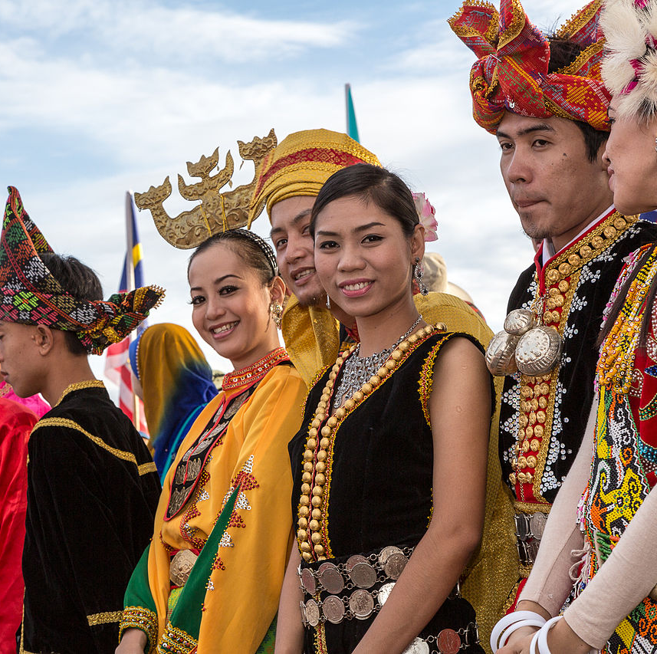
methodologies
WHO
Answer "WHY" questions
DATA TYPE
Observation, symbol, word
APPROACH
observation
interpretation
DATA ANALYSIS
Grouping of common data
Non-statistical analysis
Notes:
WHO
For answer "why" questions (RQ)
AIM / objective
To examine the presence of sport for development program in rural areas of malaysia and explore the relationship with feminism theories with specific focus on how these program address gender dynamic and promote women empowerment
RQ1 how do sport for development program in rural areas of malaysia. Address gender dynamic and promote empowerment considering the intersection with feminism theories?
DATA TYPE
Observation, interview, word and symbol
APPROACH
Observation, interview
DATA ANALYSIS
Nonstatistical analysis/ grouping common data

Slide 7
FOUR POSITIVE OUTCOMES FROM SPORT FOR DEVELOPMENT (S4D)
EDUCATION
SOCIAL INCLUSION
CHILD PROTECTION
EMPOWERMENT
Notes:
The goal of the research is to map current initiatives and present evidence on focusing the power of sports to improve the lives of children and youth.
These programmed that which sport based been able to encourage participation and build individual and community capacity.
Have potential benefits include better health, reduced stress and depression, improved confidence and self-esteem plus in the education sector improved learning abilities and academic performance. While for child protection reduces involvement in violence and crime related including the use of drugs.

Slide 8
EDUCATION
Increase student engagement in education
Including those most at risk of leaving school
Improving children's lives as sports activities increase access to participation
Including the most marginalized group
Contributed to positive educational outcomes
Student engagement, attendance, enjoyment and behaviour
Notes:
Education is the process of learning and gaining the knowledge, skills and competence that all children and young people need to achieve to which they have right regardless of their circumstances.
Education focused on sport for development initiatives have the potential to address the challenges education face by contributing to positive educational outcomes such as student engagement, attendance and enjoyment in school at the same time improving their behavior and relationship between teacher and friends which is a key for a positive learning environment.

Slide 9
SOCIAL INCLUSION
Sense of belonging and acceptance (the relational)
Through interaction with friends or another social interaction such as sports activities
(functional) social inclusion
Improve social skills facilitated by sport programmed focusing on skill development
Physical Social inclusion
The availability and sustainability of safe space for marginalized groups spaces to interact and participate in social life
Notes:
Social inclusion refer to a multidimensional concept adapted from Bailey (2005) which focuse on three dimensions with link with sport.
The relational to ensuring the sense of belonging and acceptance through interaction with friends, or other social interaction. Sports programs are shown to facilitate this form of inclusion through team sports and increase the participation of young people from marginalized group.
the second one is fuctional social inclusion encompasses the improvement of skills that is facilitated by a sports program that focuses on skill development or focusing on girl empowerment.
Physical social inclusion refers to the availability stainability of safe space for marginalised group to interact and participate in social life as well as to address their physical needs or preferences.
Based on the three factors best to said that sport program will perform the best in making sure the social inclusion can be done to improve young people and marginalized groups' social engagement.

Slide 10
CHILD PROTECTION
Contribute
Contribute to protection of children and young people
Promotion of social capital and relationship that lead to education
Set
Set for a safe place that provide sense of security without stigmatization
Fair play and with discipline for violations
Reduce
Reduce gender inequalities and gender-based violence
Generating discaussion related to violence involving female and male, athletes, and coaches.
Notes:
Child protection refers to the prevention of and response to violence, exploitation and abuse against children and youth. These program focus on children with vulnerabilities to abuse, which may include those who live without access to parental care, and those in conflict with the law or war (UNICEF, 2006)​.
The result showed that sports can contribute to possitive child outcomes through the reduction of violence and risky behaviore. (vandalism, non-violence crime).
S4d programmes contributed to protection of children and young people through development of promotion of social capital and relationship of support that can lead to education.
S4d programe are set in a safe place that provide the sense of security to socialize without stigmatization. Develop conflict resolution with fair play with discipline for violations such as penalties.
S4d to help reduce gender inequalities and gender-based violence by generating discussion related to violence involving male, females, coaches and athletes.

Slide 11
EMPOWERMENT
Individual empowerment
Self determination
Group empowerment
Team sport for common goal
Community empowerment
Enhancement of local community for sustainable development
Notes:
The concept of empowerment is divided by three categories such as individual empowerment, group empowerment and community empowerment.
For individual empowerment refer to self-determination which children and youth experience while participating in the sport that motivated them to master sport skill and being able to practice them.
Group empowerment refer to working and playing in a group towards a common goal for an example team sport
Community empowerment enhancement of local community for civic engagement and contributed to sustainable development. Most team sports are community-based and involved in community activities.

Slide 12
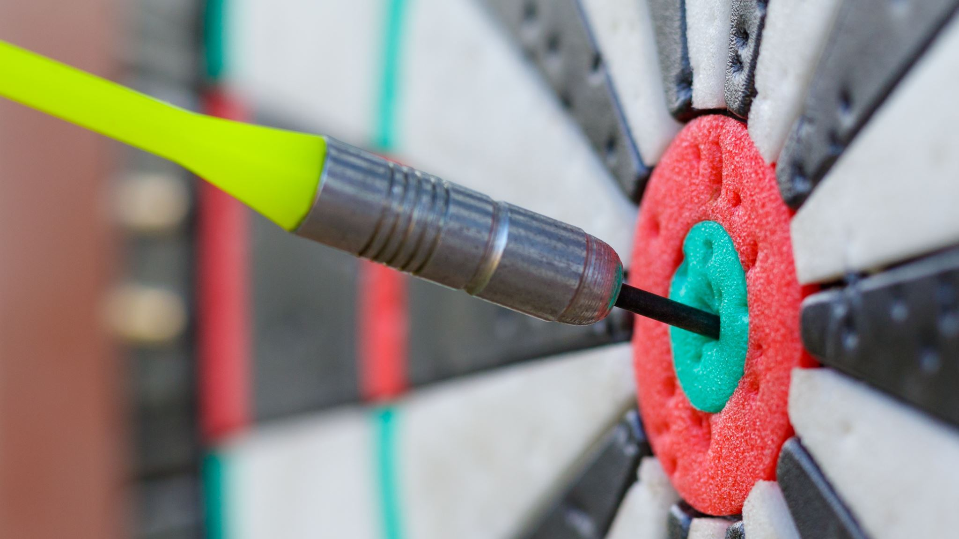
Women and sport for development
Notes:
Sport can be a powerful and potentially radical and transformative tool in empowering women and affecting gender norms and relations throughout society.
The relationship between both gender and sport suggests possibilities for the intersection of the two factors for development interventions.
However, seeking to empower female through sport is somewhat paradoxical given that the world of sport can be manipulated by male dominance.

Slide 13
Barriers in participation
practical
Personal
Social and cultural
Notes:
Participation among women and girls are much lower rather than male in sport activities especially at grassroots levels. This gender gap is caused by several factors
Which may be categorised as "practical" "personal" and "social and cultural". these factors of barries play a significant role in shaping women's and girls' attitudes and behavior.
Practical barries
Lack of time ( as they take on greater responsibility for housework and taking care of children)
Lack of money (low income families may not be a able to afford to invest in sport club membership or paid for equipment​.
Lack of transport (this particular problem for women with young children, elderly women and women and girls with disability that lived in rural areas)
Personal safety
Safety concern in public transport, on the street, in and around the sport and community venues
Safety concern regarding the marginalized group such as women with hijab, black and minority ethnic.
People with disability are often the target of bullying and abuse.
Access to facilities
Often sport facilities prioritize male rather than female when it comes to pitch time and their prefered times rather than
female.
Access to sporting facilities is particularly limited for women with disability. As one-third of young people with ability feel excluded from the local sports opportunities
Personal barries
Body image (women are far more self-conscious than men when taking part in sports and physical activities
Clothing and equipment (clothing can be expensive) and some sport clothing can be reveling which create problem towards body image and cultural as mention before.
Some equipment can also be inappropriate for women and r. For an example in field hockey they tend to be force to play with equipment that based on universal standard to c to cut financial expenditure.
Social and cultural barries
The male dominated culture sport
Attitudes and prejudices about sexuality (homophobic)
Sexual harrasment and abuse
Lack of media representations

Slide 14
Sport for development in malaysia

Slide 15
One student one sport policy
Sport for all
"NO ONE LEFT BEHIND"
Notes:
One student one sport policy being introduced on 9th June 2011 for sport for development and developing well balance student in term of physical, mental and emotional.
The policy is in line with the Malaysia National Sports Policy to cultivate sport in the community through "sport for all" and ensuring that no one is left behind.
One student one sport policy objective is to provide access to obtaining benefits from involvement in sports, especially for less privileged, different health backgrounds or disability, and less active students and provide opportunities to all students with talents and potential to be polished to a higher level. It’s compulsory for students to have a sport to participate with. So every y Wednesday. middle and high school students will stay back for another 2 hours to continue the co-curriculum and it’s compulsory.
According to the Malaysia Education Ministry, the main objective of this policy is to have a healthy social school environment and to work alongside the Ministry of Health that involve with health issues and the Ministry of Youth and sport which involve with sports for the development. Plus according to Malaysia's sport policy itiatives o on sports for development, the main objective is to empower people and ensure inclusiveness and equality which need to be started in the grass root level.

Slide 16
Women sport in Malaysia

Slide 17
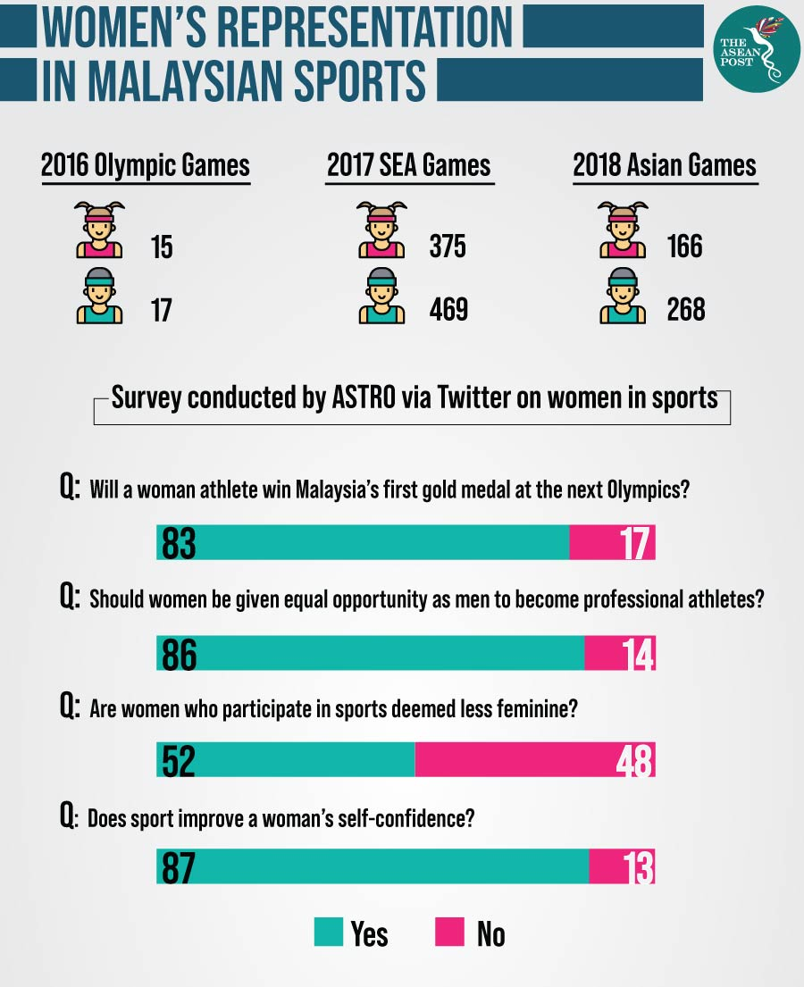
WOMEN IN SPORT (WIS) PROGRAMME
Notes:
Sport is one of the great platforms for gender equality which is an important factor in achieving the United Nations' sustainable development goal and sport for development objective. But in malaysia women sportment lack of support and recognition rather than male. The viewed of sport also different as gender disparity still exist.
Based on the education blue print 2013 – 2025 the government makes the requirement for every student to participate in sports and seen progress in more girls taking up sports but access may still limited in certain rural areas where careers in sports are less demanding.

Slide 18
THE SPORT PLUS / PLUS SPORT

Slide 19
SPORT PLUS
resources
equipment
coaching
Notes:
The main objective for these programme is to increase participation in sports which is using a non-profit and CSR program by sport organization or partnership with sport clubs by
Providing resources, equipment, and coaching.
Barcelona and Chelsea are two examples of sport plus because these two giant football clubs share their knowledge of football through a foundation established by the sport clubs by providing training, equipment such as stadiums and football equipment, and their professional athletes and coaches as representatives to teach young children.
Traditionally, it is much simpler to prove the results of a sport plus programming since the sport plus group can show the amount of money that they utilised to offer for the programme.

Slide 20
PLUS SPORT
individual
Improve personal skills
Improve social emotional well being
Safeguarding
Reduce crime
Reduce gang violence
Notes:
The sport was promoted as a medium for social development by the nation. The primary purpose is to improve non-sporting outcomes such as good self-motivation and academic performance, as well as to minimize gang violence and crime, particularly among young adults.
Because this strategy is primarily focused on social issues and societal transformations, organizations typically struggle to prove particular results.
In addition, sports are specifically meant to increase cognitive and social emotional well-being, individual skills and health and education.

Slide 21
Thank you
NOORHIDAYU ISMAIL
AI512@canterbury.ac.uk

