Slide 1
Exploring the impact of the Solihull Approach Understanding Your Pupils Behaviour on a range of teacher variables and on their perceptions of their work with young people
4th European Conference on Child and Adolescent Mental Health in Educational Settings
University of Lausanne, 5-6 February 2015
Dr Alex Hassett
Principal Lecturer and Senior Consultant
Salomons Centre for Applied Psychology

Slide 2
Overview of the Talk
Background to the training and research
An overview of the Solihull Approach Understanding Your Pupil’s Behaviour training
The Research
  Quantitative and Qualitative Results
Personal Reflections

Slide 3




Background to the study
Part of a consultancy and training and development programme based run by the Salomons Centre for Applied Psychology in Canterbury Christ Church University in Kent in collaboration with Solihull Approach
Funded by the Local Authority and Primary Care Trusts

Slide 4
Partnership with Solihull Approach
Solihull Approach – initially aimed at community health practitioners
Part of a broader workforce development programme in Kent
Trained over 2500 staff many of them pastoral staff from schools
Issue of how do they take this back to the school?

Slide 5



Role of schools in promoting emotional wellbeing

Slide 6
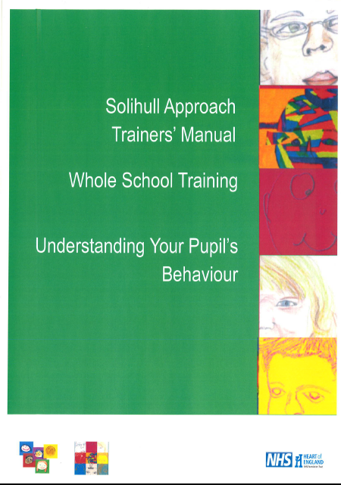
The Solihull Approach: Understanding Your Pupil’s Behaviour
Based on the original Solihull Approach Framework

Slide 7
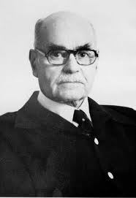
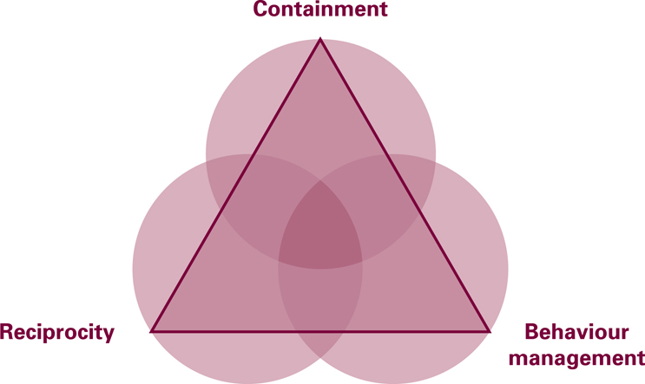
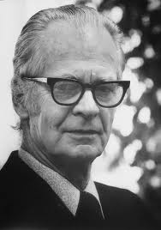
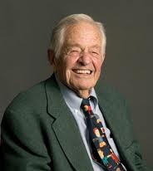
The Solihull Approach -
supporting relationships to improve outcomes
Psychoanalytic theory (Bion)
Child Development research (Brazelton)
Behaviourism (Skinner)
Notes:
Solihull Approach: solihullapproach@solihull-ct.nhs.uk Solihull Approach Antenatal 2 day Foundation Training
Solihull Approach Antenatal 2 day Foundation Training
7

Slide 8
Aims of the Solihull Approach Training
Provide the framework of the Solihull Approach model for understanding your pupil’s behaviour to support pupils to learn
Understand how relationships affect behaviour
Understand the importance of relationships for brain development
Provide a ‘framework for thinking’ when learning about behavioural techniques
Notes:
8

Slide 9
Aims of the Solihull Approach Training
Enable practitioners to apply their knowledge of behavioural techniques more effectively through understanding their pupils’ behaviour
This training does not aim to teach behaviour management techniques. There are many other trainings and resources available for this. This training aims to put behaviour management techniques into a framework that will increase their effectiveness

Slide 10
Why the Solihull Approach maybe useful
Helps with professional responsibilities and stress
Provides a framework to help 'contain' their role as a professional worker
Containment from colleagues may be especially helpful when working with particularly challenging or difficult situations
Provides a shared language
Helps decision making
Supports the safeguarding process – capacity to think and calm communication
10

Slide 11
The relational context of behaviour management
Emphasises the relationship between educator and pupil and the relational context of effective behaviour management

Slide 12
Brains develop in the context of a relationship

Slide 13
The Solihull Approach
THEORETICAL MODEL

Slide 14
Containment
Bion – psychoanalyst
Understanding emotional communication
Helping to process it
Emotion is experienced as tolerable and manageable
Restores capacity to think

Slide 15
Containment for Learning
Thinking about the impact of emotions on our capacity to concentrate, think and learn.

Slide 16
Containment in Schools
Effective teaching and learning take place in a containing environment
Teachers need to feel contained enough to teach and pupils contained enough to learn

Slide 17
Containment and the brain
Parallel process

Slide 18
The Solihull Approach
THEORETICAL MODEL

Slide 19
Reciprocity
Brazelton – Child Development Research
Attunement
Two-way interaction
Dance of reciprocity – initiation, regulation and termination

Slide 20
Reciprocity In The School
Rhythm of building up and calming down
Link to containment – are children in the best state for thinking, is their arousal system lower, are they calmer and ready to learn?
Reciprocity in lessoning planning – building up to an activity or piece of learning and then winding down

Slide 21
Reciprocity
Look away
Chase and Dodge
Rupture and Repair
Good enough parenting

Slide 22
The Solihull Approach
THEORETICAL MODEL

Slide 23
The relational context of behaviour management
Links the role of containment and reciprocity to pupils’ behaviour
Links the role containment and reciprocity in enabling learning
Thinking not only about the relationship/ interaction between child and educator but also within the broader school context

Slide 24
What is meant by Behaviour for Learning?
the containment of children’s emotions/ anxieties so that the child can concentrate and think
reciprocity between the teacher and child so that the child is regulated enough to take in and process information
optimal brain development so that the child has neural pathways to both self regulate and to learn
24

Slide 25
The Research
What impact does the Solihull Approach Understanding Your Pupil’s Behaviour on teacher levels of stress, anxiety, mood, sense of teacher efficacy, self-esteem at 6 months after the training

Slide 26
Rationale for Measuring Teacher Outcomes
Hypothesis
It is argued that by understanding and using the approach teachers will feel more contained themselves and will be in a better position to be attuned to their pupils’, the parents’ and colleagues’ behaviour
In doing this they will be less stressed and feel more able to do their jobs

Slide 27
Methodology
The study focused on a group of teachers from 2 primary schools in Kent. One the experimental group received the training the other the control (this group received the training after the research if they are interested).
In order to assess the impact of the training a pre-test follow-up at 6 months design was be used.
Interviews were conducted with teachers from the school receiving the training

Slide 28
Measures
Stress, burnout and compassion saitifaction - Professional Quality of Life Scale (PROQOL) (Stamm, 2009).
The Robson Self Concept Questionnaire (Robson, 1989)
Teacher Efficacy Scale - Guskey, T. R., & Passaro, P. D. (1994)
The Generalized Anxiety Disorder Assessment Version 7 (GAD 7; Spitzer, Kroenke, Williams, et al; 2006)
The Patient Health Questionnaire (PHQ-9, Kroenke, Spitzer, Williams; 2001)

Slide 29
The participants
School 1: Received the training
3 twilight session
26 staff including teachers, support staff and administrators
Had 6 monthly follow up sessions with approximately 10 staff members.
School 2: Control
30 staff including teachers, support staff and administrators

Slide 30
Quantitative Results

Slide 31
Findings
School A – Six month after receiving the training showed a statistically significant:
  increase in satisfaction with their helping role
  decrease in feeling burnt out/stressed
  increase in self-esteem
  increase in teacher efficacy scores
School B – which received no training only showed an improvement in teacher efficacy over the period.

Slide 32
Qualitative Data Collection
7 staff were interviewed from School 1
A semi-structured interview asking about their views on the training, whether there had been any impact, what they felt had facilitated and hindered the process
A thematic analysis of the interviews was undertaken

Slide 33
Qualitative Results

Slide 34
Teachers’ Views on the Training
Overall teachers found the following useful:
Offered a framework that underpinned all aspects of the work they do
Focus on the relationships not only with pupils but teachers and support staff and parents as well
Focus on well-being and its link with learning

Slide 35
Teachers’ Views on the Training
All the interviewees felt that the overarching framework had provided the theory and ‘scientific’ back-up for what they were doing.
For example:
Children who had experienced trauma, fidgeting made sense not as naughtiness but as an attempt to self-regulate
Having time to share your struggles with colleagues now made sense in terms of containment

Slide 36
Teacher Views on the Impact
Staff reported that it had impacted on their interactions with:
The children,
The parents and
Other staff members

Slide 37
Impact on Interactions with Children
Offered a different perspective on behaviour
Taking the child's perspective
Understanding where certain behaviours may be coming from
Understanding the theory behind why children may behave the way they do

Slide 38
Changed perspective on behaviour
Move away from simple solutions
Example:
“Firstly I didn’t realise how big behaviour was, which is quite strange I’ve been teaching now for a million years anyway … I’ve been looking for like a quick fix for a particular child and then I realised that it needed to be bigger than that”

Slide 39
Changed perspective on behaviour
Move away from labelling to understanding
Example:
“It’s changed my views of behaviour. So sometimes when I see, what I would ascribe to not doing as they were told, you know, fidgeting, or so-and-so’s definitely got ADHD, now I’m looking more perhaps, thinking why are they behaving this way, what’s the behaviour showing me apart from the surface impression. So I’m perhaps more lenient? I don’t know, I try to be more understanding perhaps”.

Slide 40
Taking the child's perceptive
Rupture and repair = falling out and building bridges
“the whole dance of when you’re falling out and building bridges, that, those were the two bits that really I think about and could use. And I can sort of see it in children now when they’re trying to, like if I’ve been cross with them for doing something I can see now that they’re trying to, when they come up and say ‘Oh can I just show you this Miss X’ and I know it’s because they’re trying to build bridges again and now that I’m more aware of it and of why I sort of tend to maybe give them more time with that or make sure that I’ve actually responded rather than thinking that oo hang on I’ve just got to do this, I try and make a point of saying ‘yeah, you know, that’s great, well done I’m really pleased’ so that they know that everything’s fine whereas I didn’t really know to think about that before I just thought ‘oh how lovely’”.

Slide 41
Taking the child's perceptive
Chase and Dodge
Examples:
Realising that making children look at you when you’re talking to them is not always useful – particularly if they are already stressed (or if you’re stressed out)

Slide 42
Using containment with behaviour management
There’s somebody in my class who joined quite recently, quite challenging behaviour. And as well as very firm boundaries I have used the reflecting back to him how he is feeling and erm, yeah it’s worked.
In terms of what you’ve noticed about the response to that?
When I say it’s worked, it’s enabled him to calm down and be more reflective himself to work out a bit more in other words to think he’s actually said ‘it’s helped me to think twice’ so I think that’s got to be rather good.
Yeah it’s also really good that HE could say it’s helped me think twice’
Yes, I know he doesn’t always think twice but at least he realises that you can think twice, you know. He’s a very intelligent child, but erm he needs to take charge of his emotions rather than just let them run riot

Slide 43
Impact on themselves
Feeling less stressed
Own well-being
Confidence in their ability
Several teacher mentioned that having a different perspective and support from other staff has made them feel more relaxed

Slide 44
Containing Teachers Anxieties Lead to them Being More Reciprocal
Talking about her difficulties managing a young boys behaviour as she knew he had been abused and felt that as she was not a mental health specialist she may do something that would be damaging to him and so found it hard to respond to him a teacher said:

Slide 45
Containing Teachers Anxieties Lead to them Being More Reciprocal
“I sort of could use that with him and that made me again more relaxed with him so that I could sort of, erm because I was worried I was doing the wrong thing … having someone’s input in that way helps me think that I’m not going to do him damage by acting the wrong way. Because particularly because he’s got certain needs, so generally I don’t worry about that so much but when there’s certain children that you know certain things have happened in the past, it’s definitely more of a worry that you’re going to do more damage so having someone to then talk about things you just get the reassurance that actually it’s ok and you know you can adapt things and everything. So in that way, I’ve definitely used that as well.”

Slide 46
Impact on Interactions with Parents
Containing parents feelings
Understanding their perspective

Slide 47
Impact on Interactions with Other Staff Members
All the staff reported that staff relationships / interactions had changed:
More sharing and openness
A willingness to show vulnerability
Not reacting so fast to things
People being more amenable to discussions with other staff
Felt the SA offered a structured way to think about their interactions

Slide 48
Led to changes in support structures
Morning briefings
Planning, Preparation and Assessment time
Phase Group Time
Staff Meeting Time
Focus Group
All focused on joint working and sharing information about pupils particularly those with challenging behaviour

Slide 49
Limitations
Sample size
Matching of schools
Could not exclude other factors
However still showing promising signs

Slide 50
Challenges Around Measuring Outcomes for Preventative Interventions and Training Initiatives
What do we measure?
How do we know it was due to the training?
Challenge around measuring outcomes on children from training delivered to practitioners
Long-term studies needed

Slide 51
Tentative Conclusions
Both the quantitative and qualitative data suggest that the Solihull Approach Understanding Your Pupils’ Behaviour has had a positive impact on teachers
The quantitative data suggests there has been an impact on teachers interactions with their pupils, the parents and colleagues and it has led to wider school changes.

Slide 52
Extended Due to Interest
Trained the control school and 2 other schools offered to participate based on the response from the 2 initial schools

Slide 53
Support session
All schools were offered 6 follow up support sessions
Only School 1 took up the six sessions.

Slide 54
Data from the other schools
School B: increase in compassion satisfaction on ProQol
School C: no significant difference
School D: no significant difference
Suggests that the support sessions are a key to embedding the ideas from the framework. However this needs further research.

Slide 55
Challenges
Not all staff taking up the approach
Time and funding
Support sessions take up and how they are structured
Parents not having the same information

Slide 56
Facilitators
Trained as a whole staff – importance of including support staff and admin
Working across the years
Support in place

Slide 57
Learning from the experience
Not being a teacher
Making a relational model fit in a classroom / school environment
Using whole school, classroom and individual examples
Size of the group
Composition of the group matters

Slide 58
Some teacher’s views that were challenging
Not having time – how much time spent on not planning around disruptive behaviour
You are making excuses for poor behaviour / poor parenting
It is not possible to use the approach when dealing with the range of needs in a class
It’s not fair, we need to treat all children equally
Children getting one up on you

Slide 59
alex.hassett@canterbury.ac.uk

