Slide 1
An ethnographic study of the identity construction of people engaged in university work who have come from outside the UK: A consideration of the role of language in cultural identity
Amina Kebabi

Slide 2
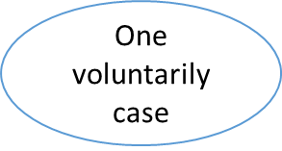
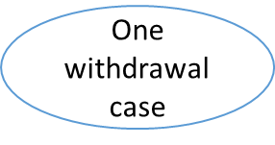
The process of collecting data
Invitation through university e-mail
Eighteen academics from different schools and Departments (CCCU, outside CCCU)
Interview
Places that I chose
Ten replies
Places that they chose
Academic setting
Skype
Co-participants from different parts of the world
cafe

Slide 3
Researcher: In the meeting we had last time, I remember you said you always felt that your home is here in the UK…
Interviewee 1: [em] maybe well I grew up kind of with whole notion that [em] you know as [as] from colonies [em] the wealth of the colonies the wealth of our people were used to build this country so I always thought I had a place here… so for me it was always like [em] well [em] part of home that didn’t quite know about I have never experienced before so it was the first time but I always knew I kind of belong there kind of ye so (laughing)
Researcher: [mm] you said that you always felt that you belong here, what about (X)?
Interviewee 1: maybe not belong is the word maybe I always felt I had a stick you know to have a stick (gesture with hands) so I have something I could I had a claim to ye so maybe belong is not the word but I had a claim to be here.
Interviewee 2: yes [yes]
Researcher: what about (X) and (Y)?
Interviewee 2: no [no] I don’t want to be somewhere else and yes I feel completely home I felt completely at home from those very few first months.
Researcher: Is it because you now feel that you belong to the British culture more than to (X) and (Y)?
Interviewee 2: yes [yes], I think I understand it, I think I like it and yes, I feel well integrated in that sense you know I read certain behaviours.

Slide 4
Immersion
Researcher: Do you think that you’re immersed in British society?
Interviewee 1: For me I think immersion in society is about it’s a deliberate thing I mean I know OK let me give you an example. I mean it’s at different levels I know some people who came [em] from (X) for example I will hold to (X) I talk about (X) because I know them better and [em] I was an adult when I came here and some of them where adults when they came here well, I still speak with my (X) accent they speak with a British accent to them that’s immersion coz you listen to them you think they were born here. I made a deliberate choice that I am not going to try and learn the accent I just gonna try my best to speak as clear as I can but I’m not going to try and copy the accent.
Interviewee 2: Now? Ah yes or at least you know I don’t think you never be you always be in that sense an outsider. I think we spoke about this the fact that I do believe and I know for a fact that you know sort of [em] our physical traits, accent, language, the way I dress everything you know says that I’m not British.
Interviewee 4: The idea of my own identity I say black person is prescribed in my skin that once people see me the first thought is not associate me being British or English or whatever they associate me with somebody who does come from outside… [ye em] so for me the identity is ascribed before I even speak you will already put me somewhere.

Slide 5
Interviewee 5: So for me, I think I’ve become quite accustomed to being in the UK [em] I think over the years I have a love-hate relationship with this country over the years sometimes I loved it sometimes what I am doing here?
Or sometimes I feel no, I don’t wanna go back home I prefer to stay here so it just kind of various depending on whatever is happening at the time.

Slide 6
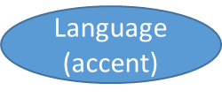
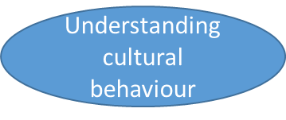
VS
re-
construction
of the self

Slide 7
Thank you

