Slide 1
Uncovering Women’s Stories in Dungeness’s RNLI History A sociocultural study into the history of the RNLI women volunteers of Dungeness
RACHEL HANCOCK

Slide 2
Introduction
The ‘lady launchers’ of the Dungeness RNLI represent a core piece of not just the RNLI’s history (RNLI, 2024), but also that to Dungeness’s as this project further explores gender roles, identity, community and kinship and the impact of space and place on their lives.
Notes:
Opening hook: "In the official RNLI rescue records from Dungeness, they were simply listed as 'other helpers' - a number, not even names."
Brief overview of the 'lady launchers' - who they were, their role at Dungeness
Core research question: How have women in the RNLI been represented in the past, looking at their contribution and roles as volunteers?

Slide 3
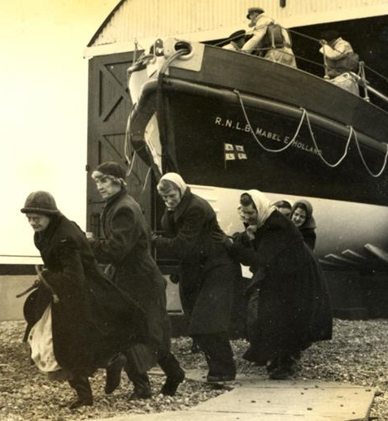
Historical Context
Women have been launching lifeboats at Dungeness Lifeboat Station in Kent since at least the 1800s
Women for a long-time were still seen to be ‘unlucky’ to have on board a vessel.
Rural coastal communities such as Dungeness were fishing villages and work evolved around this, but most women were found as Mother’s and care-givers.
Notes:
all weather conditions, day and night, and often only wore their coats and scarves for protection.
The Dungeness Lifeboat Station received its first launching tractor in 1977, ending the era of the Lady Launchers.

Slide 4
Notes:
The women, who were often the wives of the crew members, would: Drag wooden skids (the woods) across the shingle beach, Lay the skids under the lifeboat's keel, Haul the lifeboat into the water using ropes, Repeat the process to recover the lifeboat.

Slide 5
“…it’s certainly not women’s work.”

Slide 6
Historical Context
Example from your archival research showing how women were recorded.
Notes:
Taken from the record 11th Feb 1974
Rescue of an injured man from the motor vessel Merc Texco.
The lifeboat was launched into very dangerous surf conditions and was manoeuvred alongside the vessel on two occasions before the injured man, with the help of the assistant mechanic who boarded the vessel, could be taken off. Thanks of the Institution inscribed on Vellum were accorded to the other five members of the lifeboat crew and to the launchers and the shore helpers. For this service Coxswain Tart received the Maud Smith Award for the bravest act of lifesaving in 1974.

Slide 7
Historical Context
Notes:
Taken from the record 11th Feb 1974
Rescue of an injured man from the motor vessel Merc Texco.
The lifeboat was launched into very dangerous surf conditions and was manoeuvred alongside the vessel on two occasions before the injured man, with the help of the assistant mechanic who boarded the vessel, could be taken off. Thanks of the Institution inscribed on Vellum were accorded to the other five members of the lifeboat crew and to the launchers and the shore helpers. For this service Coxswain Tart received the Maud Smith Award for the bravest act of lifesaving in 1974.

Slide 8
My connection to the research
Joan Bates
Served for 37 years

Slide 9
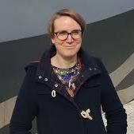
Interviews
Hayley Whiting
Judith Richardson
Kim Bates
Janet Ovenden
RNLI Heritage Team
Lady-Launcher
Lady-Launcher
Lady-Launcher
Betty Paine
Pat Copson
Sheila Bunney
John Poole
Lady-Launcher
Lady-Launcher
Daughter of Betty
Retired RNLI Dungeness Crew

Slide 10
Judith Richardson
Judith Richardson is a well decorated RNLI volunteer with over 50 years of service given to the Dungeness RNLI.
She was awarded in 1977 with the RNLI Framed Vellum on retiring as a ‘lady launcher’, and in 2023 received the King’s British Empire Medal (BEM) for her service to the RNLI.
Notes:
Judith joined the ‘lady launchers’ in 1967 when she met her then to-be-husband before they married and settled in 1968. Judith along with Betty have been locally dubbed the ‘last of the lady launchers’, having served up until 1977 when the work of the ‘lady launchers’ became redundant with the build of the new RNLI lifeboat station.
Judith remained a full-figure at Dungeness RNLI being a continued volunteer and fundraiser as well as their Press Officer and Management Committee member.
Underplayed her role and significance in the part she has played over the years (female way of talking)
Just seen to be doing “what must be done”
RNLI has always been at the fore-front for her and this is passed on to her sons – rural community, being part of the same circle.
Talks about acceptance by the other women, becoming part of the “family” and a networked community in Dungeness
Kept talking more about the job rather than Motherhood, shows the importance this work has had and the impact of her life socially.

Slide 11
Betty Paine
Joined the ‘lady launchers’ in 1963 and remained in service until they were stood down in 1979.
Continued to play a key role in the station’s fundraising team, now for over 55 years and also served as Chairperson of a number of years.
Notes:
Betty joined the ‘lady launchers’ in 1963 and along with Judith, remained in service until they were stood down in 1979. Betty continued to play a key role in the station’s fundraising team, now for over 55 years and also served as Chairperson of a number of years.
Talked more about the social aspect of the role – Basis in “the Shed” whilst waiting for the men to return and how the women together helped each other – try not to think of it as dangerous and more just what needed to be done.
The work is always thought of a necessity rather than something extra ordinary.

Slide 12
Telling their stories
Evidence of Historic Invisibility
Male-Centric Documentation
Stories not told due to institutional and social factors
Contemporary Recognition
Notes:
rescue service records see women's contributions were consistently minimized. This systematic erasure of individual identity reflects how women's vital contributions were historically documented
Historical accounts primarily written by male authors * Reference Ray Kipling's 1979 'Women's Work' article - written from male perspective * Publications focusing on rescues and achievements of male crew members * Maritime histories centred on men at sea rather than shore-based support
INSTITUTION: RNLI's historical focus on sea-going crew * Record-keeping practices that prioritized certain roles * Women's work seen as 'auxiliary' rather than essential
SOCIAL: * Women's modesty about their contributions * Quote from Betty Paine: "We just did what needed doing" * Cultural expectations about women's roles
took until 2023 for Judith Richardson to receive her British Empire Medal for services to the RNLI. This 50-year delay between service and recognition exemplifies how women's contributions have been historically undervalued.

Slide 13
Impact & Legacy
Reshaping Maritime Historical Understanding
Contemporary Relevance
Impact on Heritage and Community Memory - Local Impact
Notes:
The stories of Dungeness's 'lady launchers' fundamentally change how we understand coastal rescue operations. Through women like Judith Richardson and Betty Paine, who served until 1979, we see that saving lives at sea was truly a community effort, not just the work of those on the boats.
Reference modern women crew members like Maria Bull * How understanding historical roles influences current recruitment * Changes in RNLI culture and recognition of women's contributions
Preservation of Dungeness's unique cultural heritage * Family legacies: three generations of women volunteers * Quote from Sheila Bunney about her mother's influence
As we preserve these stories, we're not just recording history - we're creating a new understanding of maritime heritage that recognises all contributors. This work continues to influence how we think about gender roles in emergency services today.
Link between historical understanding and current practice - Connection between individual stories and broader social change - Relationship between local history and national heritage - Impact on future generations

Slide 14
Their story lives on…
Through their dedication, physical labor, and unwavering commitment, they challenged traditional gender roles while maintaining vital emergency services that saved countless lives.
Notes:
As we've seen today, the story of the 'lady launchers' of Dungeness is far more than a footnote in local and marintime history. These women - who were recorded simply as 'other helpers' in official documents - were in fact crucial to the operation of the lifeboat service for generations.
Their legacy lives on not just in the proud histories of families like the Richardsons, Paines, and Bates, but in how they demonstrate the often-invisible roles women played in maritime communities. As Judith Richardson's British Empire Medal in 2023 shows, recognition of these contributions is long overdue.
As the generation who served as 'lady launchers' reaches their later years, it becomes increasingly urgent to capture and preserve their stories. These narratives not only enrich our understanding of local history but challenge us to reconsider whose stories we tell and how we tell them. In doing so, we ensure that future generations will know that the history of the RNLI, and indeed of Dungeness itself, is not just a story of men at sea, but of entire communities - women and men - working together to save lives.

Slide 15
Thank you
RACHEL HANCOCK
rlh29@canterbury.ac.uk

