Slide 1
WHY ARE TODAY’S STUDENTS SO FRAGILE?
Dr Jennie Bristow, Senior Lecturer in Sociology, Canterbury Christ Church University
Heads of University Counselling Services Meeting, 9 June 2017
jennie.bristow@canterbury.ac.uk

Slide 2
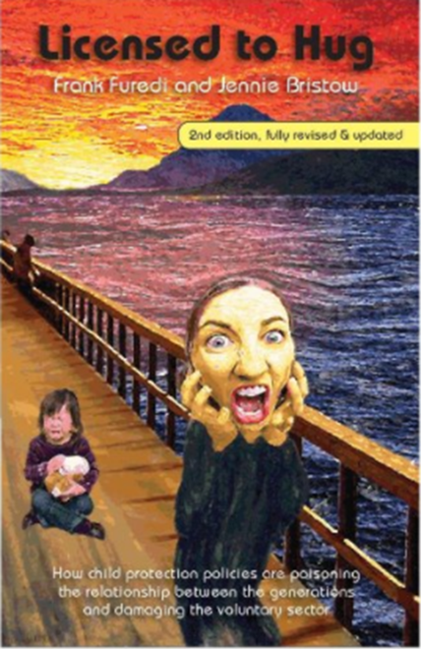
Research interests
Sociology of generations
Sociology of education
Parenting culture
‘Generational encounters in higher education’

Slide 3
Starting points
Are today’s students particularly fragile?
What do we mean by fragile anyway?
Which students are we talking about, and why?
How do we separate students’ difficulties and experiences from the cultural script describing them?

Slide 4
Are students fragile?
oN ONE HAND…
ON THE OTHER…
Reports of increasing levels of mental health difficulties among students
Increasing demand for concessions, special arrangements, support services
Sense of entitlement among ‘Millennial’ generation
Hyper-sensitivity to language (cultural appropriation, trigger warnings etc)
Demand for academic practice to orient around these concerns
Do mental health difficulties necessarily equate to fragility?
Structure of university courses may medicalise reasons for extensions
Demanding, needy students follow the cultural script of the ‘good student’
Articulated by a particular section of students – and pre-empted by academics
Possible over-reliance on centralised student support services

Slide 5
Health and illness / ‘wellness’
Stigma attached to mental health problems has diminished
People can talk about their problems more, both informally and with services
But ‘normalisation’ of mental health problems can also lead to re-categorisation of existential anxieties as problems of mental health
Mental illness becomes a ‘normal’ feature of life
Concept of ‘wellness’ implies the opposite is the norm
What do we mean by ‘stress’, ‘anxiety’, ‘depression’ in this context?

Slide 6
Cultural script of fragility
Assumption that students and young people experience increasing mental health difficulties, requiring a particular response
Support services
Psychological/psychiatric interventions
‘Kid gloves’ management by academics
Students talk about ‘the rise of mental health’ (not illness)
Construction of claims: ‘the meanings that people construct need to make sense of the world they inhabit’ (Best 2008, pp.11-12)
Not a ‘made-up’ problem
But is this how students and young people are encouraged to give meaning / explanation to existential distress?

Slide 7
YouGov survey, 9 August 2016
https://yougov.co.uk/news/2016/08/09/quarter-britains-students-are-afflicted-mental-hea/

Slide 8
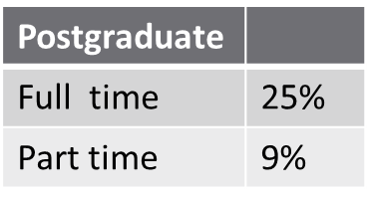
‘The extent of mental health problems in UK universities has been laid bare in a new YouGov survey of Britain’s students. ’
Total students
1061
Full time undergraduate
First year | 15%
Second year | 19%
Third year | 15%
Fourth year | 6%
Fifth year or longer | 3%

Slide 9
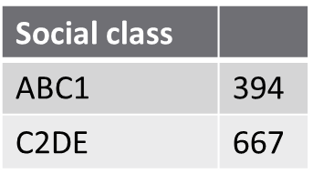
Gender
Male | 524
Female | 537
Sexuality
Straight | 770 | 73%
Gay | 86 | 8%
Bisexual | 97 | 9%
Other | 26 | 2%
Don’t know | 33 | 3%
Prefer not to answer |  | 5%

Slide 10
Prevalence of mental health problems among students
More than a quarter of students (27%) report having a mental health problem of one type or another.
Female students are more likely to say they have mental health problems than males (34% vs 19%)
LGBT students have a particularly high likelihood of mental health problems compared to their heterosexual counterparts (45% vs 22%)

Slide 11
The problem of self-definition
Do you suffer from a mental health problem?
Base | 1061
Yes | 27%
No | 58%
Prefer not to answer | 4%
Don’t know | 12%

Slide 12
Depression and anxiety
Depression and anxiety are by far the most common reported mental health ailments.
Of those who suffer, 77% have depression-related problems, and 74% have anxiety related problems.
74% of students with an anxiety-related problem also have a depression-related one.
‘These two issues dwarf all the rest’, with eating disorders being the next most common at 14%, followed by behavioural or developmental issues at 5% and learning disabilities, also at 5%.

Slide 13
Pick a broad category…
Which of these best describes your mental health problem(s)? (Select all that apply)
Base | 284
Depression-related | 77%
Anxiety-related | 74%
Eating disorder | 14%
Behavioural/Developmental (e.g. ADD and ADHD) | 5%
Learning disability | 5%
Other | 4%
Prefer not to answer | 2%
Don’t know | -

Slide 14
Carrying on
How much does your mental health interfere with your day-to-day life?
Base | 284
I cannot complete even simple tasks | 4%
I have trouble completing some daily tasks | 47%
I can carry on normally with medication | 24%
I can carry on normally without medication | 23%
Prefer not to answer | 1%
Don’t know | 1%

Slide 15
‘Anxiety and stress’
Anxiety and stress are commonplace among students, and the effects are often obstructive.
Six in ten (63%) students say that they feel levels of stress that interfere with their day to day lives.
‘Perhaps unsurprisingly’, study is the primary cause of stress among students.
Seven in ten (71%) say that work from university is one of their main sources of stress.
The next biggest concern for students is finding a job after university (39%), followed by their family (35%).
Jobs and relationships (23% each) and friends (22%) account for the majority of the other sources of stress.

Slide 16
Stress and everyday life
Have you ever felt a level of stress or anxiety that has interfered with your day-to-day life?
Base | 1061
Yes, I sometimes have to take time and collect my thoughts to calm myself down | 28%
Yes, there are some points where I cannot function in a normal manner due to high levels of anxiety | 35%
No, I suffer from stress and anxiety from time to time, but it never interferes with my day | 26%
No, I rarely feel any significant levels of stress or anxiety | 9%
Prefer not to answer | 1%
Don’t know | 1%

Slide 17
Sources of student stress
What are your main sources of stress? (Select all that apply)
Base | 1061
Work from university | 71%
Family | 35%
Friends | 22%
A romantic relationship | 23%
A job or internship | 23%
Employment prospects after University | 39%
Other | 15%
I don’t get stressed | 4%
Don’t know | 5%

Slide 18
Student support services
‘Fortunately’, students are broadly aware that mental health services are provided by their university.
Three quarters of students were aware that their university had a counselling service they could access.
Only 14% weren’t aware of any services available to them.
Nearly one in five (18%) of students have already made use of university mental health services, the vast majority of whom (89%) had visited a counsellor.

Slide 19
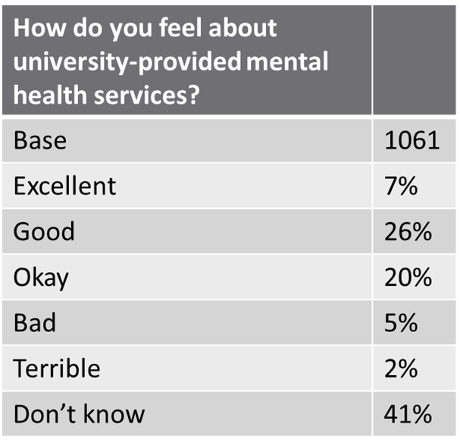
Which of the following are you aware of your university providing as a mental health service? (Select all that apply)
Base | 1061
University counselling | 75%
Referrals to outside help | 32%
24 hour crisis hotline | 34%
Periodic events focused on mental wellbeing and stress management | 38%
Doctors on site to prescribe medication if necessary | 24%
Peer health advisors who are other students | 16%
Other | 3%
None of the above | 14%
Prefer not to answer | 14%
Have you ever used one of your university’s mental health services?
Base | 1061
Yes | 18%
No | 79%
Prefer not to answer | 2%
Don’t know | 1%

Slide 20
Satisfaction with student support services
Satisfaction levels are relatively high, with 30% saying that they found the service very helpful and a further 45% saying it was somewhat helpful.
‘There is much room for improvement though’, with one in five (21%) said that it was not helpful at all.
Additionally, half of students who have made use of university mental health services also make use of professional health through other means.

Slide 21
What service did you utilise? (Select all that apply)
Base | 192
University counselling | 89%
Referrals to outside help | 13%
24 hour crisis hotline | 3%
Periodic events focused on mental wellbeing and stress management | 11%
Doctors on site to prescribe medication if necessary | 16%
Peer health advisors who are other students | 3%
Other | 5%
Don’t know | 2%
How helpful did you find the service?
Base | 192
Very helpful | 30%
Somewhat helpful | 45%
Not helpful at all | 21%
Prefer not to answer | 1%
Don’t know | 3%

Slide 22
Talking about it informally
‘For students who are suffering from mental health issues, it will hopefully provide a crumb of comfort to know that their peers are aware of and accept their mental health problems’.
More than half of students (52%) know between one and five people that suffer from a mental illness, whereas just 8% know no-one with mental health problems.

Slide 23
Absent friends, family, and tutors?
Other than university provided services, what other avenues toward help for mental health or stress do you utilise? (Select all that apply)
Base | 192
Friends | 62%
Family | 44%
A romantic partner | 49%
Professional help through other means | 49%
I don’t utilise other services | 7%
Other | 6%
Don’t know | 2%

Slide 24
Acceptable responses to mental illness
‘[W]hereas in days gone by the seriousness of mental health problems might be trivialised, this is no longer the case.’
The overwhelming majority of students (84%) accept that mental illness is as serious as physical illness. Just 6% felt that physical ailments were more serious than mental ones (a further 5% felt that mental illness was more serious).
Students are also sympathetic to mental health sufferers.
Upon finding that a person had mental health problems, the vast majority of students (74%) say that they would show concern and be mindful of that person’s troubles.
A further 19% say that they wouldn’t react as it wouldn’t change how they saw that person, whilst a mere 3% say that they would be more cautious around a person with mental health issues.

Slide 25
What’s the right answer?
What would be your initial response to finding out a person has a mental illness?
Base | 545
I wouldn’t react at all, as this would change nothing | 19%
I would show concern and be mindful of troubles the person might be facing | 74%
I would be more cautious around him or her | 3%
Other | 0%
Don’t know | 4%
What would be your initial response to finding out that a friend has a mental illness?
Base | 516
I wouldn’t react at all, as this would change nothing for our friendship | 15%
I would show concern and be mindful of troubles my friend might be facing | 78%
I would be more cautious around him or her | 2%
Other | 2%
Don’t know | 3%

Slide 26
Medicalisation of everyday problems
How often do you feel lonely?
Base | 1061
Never | 4%
Rarely | 23%
From time to time | 42%
Fairly often | 16%
Very often | 10%
Almost constantly | 5%
Prefer not to answer | 1%
Don’t know | 0%

Slide 27
Coping with loneliness
How bad are your feelings of loneliness when they occur?
Base | 1004
Not too bad. They never really interfere with my day. | 34%
I sometimes feel upset or anxious, but am able to collect myself fairly easily | 45%
There are some points where I cannot function in a normal manner | 19%
Prefer not to answer | 1%
Don’t know | 1%

Slide 28
‘Fear of failure’
77% of all students report that they have a fear of failure, with one in five of these saying that this fear is very prevalent in their day to day life.
Do you have a fear of failure?
Base | 1061
Yes | 77%
No | 18%
Don’t know | 5%
How prevalent is this fear in your day-to-day life?
Base | 814
Very prevalent | 21%
Somewhat prevalent | 44%
Not very prevalent | 33%
Prefer not to say | 1%
Don’t know | 1%

Slide 29
Questions
For psychiatry / psychology:
Causes, consequences, treatment and management of mental health problems
When confronted with a suicidal student, don’t call a sociologist!
For sociology:
Blurring line between mental health and mental illness
Changes in the University, and student experience
Validation of vulnerability and identity of grievance
Problems of socialisation and adult authority

Slide 30
Simon Wessley: ‘A slice of student life’
‘What was obvious everywhere is that interest in mental health is soaring. Sooner or later I was asked about why there has been a rise in mental disorders on campus, and what should we do about it. As I don’t know the answer to either question I would usually ask the audience. Inevitably there was a range of opinions and solutions, although not many went beyond the need for more counsellors.
‘Many quoted the recent NUS survey (or indeed had carried out similar surveys on their own campus) that found that 80% of students had “mental health problems”, but fewer seemed to be willing to critically evaluate this unlikely finding.
‘It’s important that we apply some critical thinking and appreciate the difference between “mental health” and mental disorder. But NUS surveys aside, mental disorder is indeed on the rise, at least among women who are aged between 18 and 24. However, the best estimate is a prevalence rate of 26%, not 80%. So we can agree that there are more students needing more support, including on occasion specialist support from psychiatrists…

Slide 31
‘…in order to encourage more critical thinking I sometimes ask the audience how many of them are making friends that they would keep for life - 80% raise their hands, and then how many were being intellectually stimulated by their studies (a similar proportion) and finally how many were having better sex lives (we don’t vote on this, but judging by the smiles it was also a majority).
‘I did this to suggest some continuity – university remains a time of challenge and change, incorporating both the negative (such as loneliness, isolation, exam stress) and the positive (such as emotional growth, friendship, stimulation and experimentation), and that we should be cautious of invoking mental health problems for all of these.
‘Of course, there are also discontinuities – social media acts as a great amplifier of both the bad and good, but we should be careful of blaming the medium for the message. Parenting styles and risk obsession have changed over a generation. And let’s not forget the additional burden of debt...
‘But whatever the answer to rises in mental ill health, and at the moment I think we have to say we don’t really know, the challenge for us in psychiatry is to harness this interest into making more psychologically minded doctors in general, and more psychiatrists in particular.’
http://www.rcpsych.ac.uk/discoverpsychiatry/thepresidentsblog1.aspx

Slide 32
Being a student has changed
Impact of expansion:
Larger proportion of young people with mental health problems
Additional responsibilities shouldered by some students
Clash between field and habitus / expectation and experience
University as ‘another brick in the wall’
Growth and impersonality of university courses
Instrumental high stakes for the ‘degree generation’ (Bathmaker et al 2016)
Debt and employment
‘Fear of failure’ – and uncertain script for success
Transition from school / home to independent life and study
Universities as ‘finishing schools’ (Gouldner 1979); emphasis on socialisation
Tension between pastoral responsibilities of academic staff and role of student support services – ‘lost’ students?

Slide 33
But…
Why do these problems take the form of individual, mental health problems?
Students come to university with a diagnosis, and it is affirmed:
Problems of attendance, performance, and submission of work increasingly managed through a medicalised process
How has University come to be seen as threatening?

Slide 34
Therapy culture
Distinct from therapy, as a clinical approach to mental illness
Cultivation of a generalised sense of vulnerability, leading to therapeutic governance and management (Furedi 2003)
Defining everyday distress as a mental health problem can mean it is experienced as such
Individual, pathological, in need of and susceptible medical intervention
Services for those in most need are over-burdened
(Over)emphasis on language, interpersonal behaviour as a cause of harm and a site of regulation

Slide 35
Parenting culture and ‘entitled’ Millennials
Students often describes as:
Consumers
Emotionally needy
Wanting to be spoon-fed
Infantile
Consequence of parenting culture and schooling
‘Child centred’ – without space to be a child!
Reluctance to socialise into adult culture

Slide 36
Identity politics
Vulnerable identities are politicised (Furedi 2017)
Safe spaces, trigger warnings, microaggressions
‘Safe space’ implies that free debate is dangerous
Hyper-sensitivity strikes at the very heart of University life
Academic study becomes positioned as a psychic insult
Mental health problems mobilised to demonstrate extent of grievance
Restrictions on speech, expression, and debate suppress questions and contradictions: worrying ourselves sick?

Slide 37
Truth Seeking, Democracy, and Freedom of Thought and Expression - A Statement by Robert P. George and Cornel West
‘…It is all-too-common these days for people to try to immunize from criticism opinions that happen to be dominant in their particular communities. Sometimes this is done by questioning the motives and thus stigmatizing those who dissent from prevailing opinions; or by disrupting their presentations; or by demanding that they be excluded from campus or, if they have already been invited, disinvited. Sometimes students and faculty members turn their backs on speakers whose opinions they don’t like or simply walk out and refuse to listen to those whose convictions offend their values. Of course, the right to peacefully protest, including on campuses, is sacrosanct. But before exercising that right, each of us should ask: Might it not be better to listen respectfully and try to learn from a speaker with whom I disagree? Might it better serve the cause of truth-seeking to engage the speaker in frank civil discussion?
‘Our willingness to listen to and respectfully engage those with whom we disagree (especially about matters of profound importance) contributes vitally to the maintenance of a milieu in which people feel free to speak their minds, consider unpopular positions, and explore lines of argument that may undercut established ways of thinking. Such an ethos protects us against dogmatism and groupthink, both of which are toxic to the health of academic communities and to the functioning of democracies.’
https://jmp.princeton.edu/statement

Slide 38
Concluding questions and thoughts
Fragility of today’s students is real, not imagined
Social and cultural causes play a significant role
However, fragility is often over-stated and exacerbated by assumptions and mechanisms to deal with it
Lack of validation for those who want to avoid label of ‘sympathy seeker’
Outsourcing of existential distress to student support services
Tendency to downplay importance of friends, family, tutors
Presentation of speech and debate as a cause of harm positions University as a site of danger
Failure to equip young people for academic life and for life after University

Slide 39
The beleaguered self:
‘The danger of personal disintegration encourages a selfhood neither “imperial” nor “narcissistic” but simply beleaguered’. One consequence is ‘a kind of emotional retreat from the long-term commitments that presuppose a stable, secure, and orderly world’ (Lasch 1984, p.16)
How do we create an environment for young people that mitigates against this sentiment of beleaguered selfhood, and cultivates the aspiration for independence, encounter, and challenge?

Slide 40
Bibliography
Bathmaker, A-M., Ingram, N., Abrahams, J. (2016) Higher Education, Social Class and Social Mobility: The Degree Generation. Basingstoke: Palgrave Macmillan
Best, J. (2008) Social Problems. New York: Aldine de Gruyter
Furedi, F. (2003) Therapy Culture: Cultivating Vulnerability in an Uncertain Age. London and New York: Routledge
Furedi, F. (2017) What’s Happened to the University? A sociological exploration of its infantilisation. London and New York: Routledge
Gouldner, A. W. (1979) The Future of Intellectuals and the Rise of the New Class. London: The Macmillan Press
Lasch, C. (1984) The Minimal Self: Psychic survival in troubled times. New York and London: WW Norton and Company

