Slide 1
Embedding sustainability: without doing any extra work!
Dr. Joanne Woodman (School of Media, Art and Design) and Dr Ken Powell (Director of Curriculum)

Slide 3
Why teach it? Link between Sustainability and Employability
Shifting global perspectives on corporate behaviour require educators to integrate business ethics and corporate responsibility into curricula.
Teaching sustainable practices requires that curricula advocate a “triple bottom line” approach …. ecological, social and financial - referred to as the three P’s: people, planet and profit (Elkington, 1994).

Slide 4
Background
Level 5 Module, “Public Relations the Media and Sustainability”
Developed to embed sustainability and employability into BA Media and Communications and BA PR, Media and Marketing
2nd/3rd year students doing work experience/volunteering with SGO (links sustainability and employability)
Student understanding of CSR at CCCU provides basis for employability and sustainability literacy (briefs awareness raising or problem solving on issues such as bottled water, energy, sustainable transport, fair trade products, use of the estate, diversity and wellbeing.
Students as partners, Student engagement with academics across years

Slide 5
QAA Sustainability Definition
Global citizenship | Environmental stewardship | Social justice, ethics and wellbeing | Futures-thinking

Slide 6
Methodology for Impact study
Embedding Education for Sustainable Development (ESD) in one module
QAA/HEA ESD guidance gives 38 graduate outcomes
12 fitted the module aims and ethos
ESD embedded into module teaching
Pre and post module survey of understanding over 2 years

Slide 7
QAA/HEA Graduate outcomes – linked to learning outcomes
Are you aware that both sustainable and unsustainable practices take place in organisations, which require new plans and strategies to be adopted?
Do you understand the importance of drawing on scientific evidence and scholarly research to understand the impact of human activity on the environment?
Can you identify the reasons for encouraging changes in actions/behaviours which have a negative impact on the human and natural environment?
Are you aware that decisions about the use of resources should consider risks to future ecological, social and cultural well-being in addition to economic viability?
Can you explain how Public Relations can contribute to issues relating to sustainability?
Can you critically analyse real-life examples of issues relating to sustainability within Media and Communications?
Can you describe the complexity of a specific issue related to sustainability and communicate about it succinctly both orally and in writing?
Can you implement or contribute to the promotion of change that leads to improved sustainability?
Can you effectively engage with a real-life problem relating to sustainability?
Can you use your understanding of the consequences of past actions to shape change?
Can you formulate and explain your own views on ways that sustainability can be achieved in organisations?
Can you evaluate the impact of an organisation's actions?

Slide 8
Pre-module results
All graduate outcomes evaluated on 4 point Likert scale
Graduate outcomes:
  12 averages ranged from 1.8 to 2.8 with overall average of 2.3
Students also asked to define “CSR”:
  44% incorrect

Slide 9
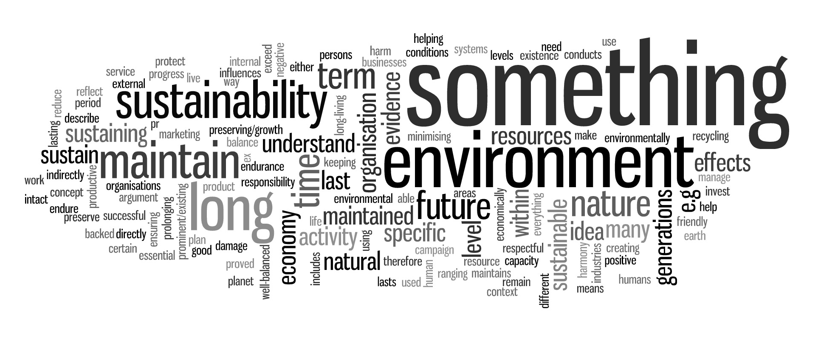
Pre-module results
Students also asked to explain sustainability

Slide 10
Post-module survey – cohort 1
Based on QAA sustainability graduate outcomes
evaluated on 4 point Likert scale
Graduate outcomes:
  12 averages ranged from 3.1 to 3.7 with overall average of 3.5
  Average increase of 1.2
Students also asked to define “CSR”:
  0% incorrect (44% pre-module)

Slide 11
Post-module survey – cohort 2
Same questions as previous year
Graduate outcomes:
  12 averages ranged from 3.1 to 3.7 with overall average of 3.2
  Average increase of 0.7
Students also asked to define “CSR”:
  12% incorrect (34% pre-module)

Slide 12
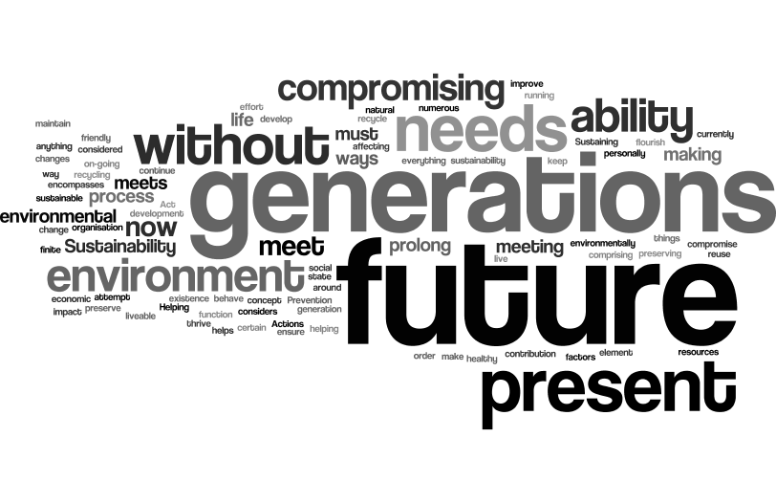
Post-module survey – cohort 1
Students also asked to explain sustainability

Slide 13
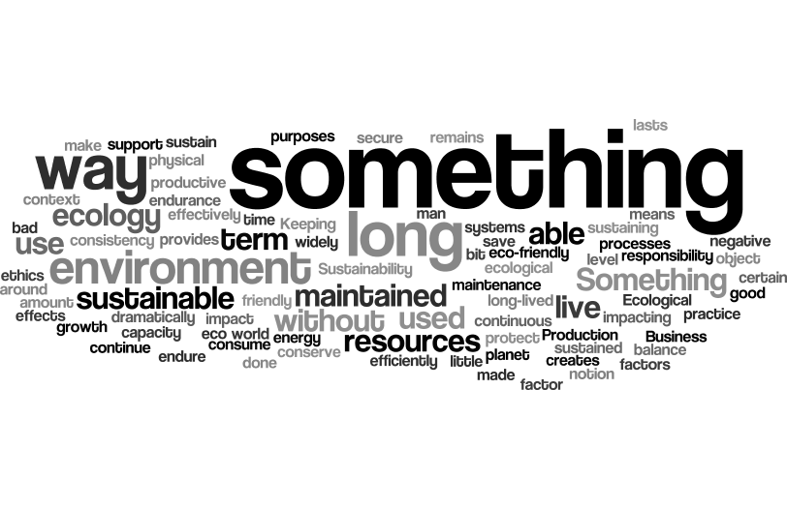
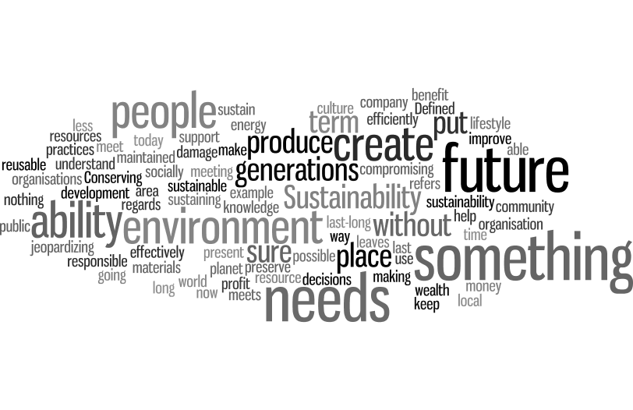
Post-module survey – cohort 2

Slide 14
Final Assessment
All students demonstrated ability to define and exemplify sustainability
Examples
  ‘Development meeting the needs of the present without compromising the needs of future’.
  ‘Enabling needs of Future generations to be met’ (United Nations Brundtland Report, 1987).
Students identified Three ‘pillars’ of sustainability- as: economic, social and environmental factors (United Nations World Summit, 2005).
Sustainability in organisations as the ‘Triple bottom line’ ecological, social and financial - referred to as the three P’s: people, planet and profit (Elkington, 1994).

Slide 15
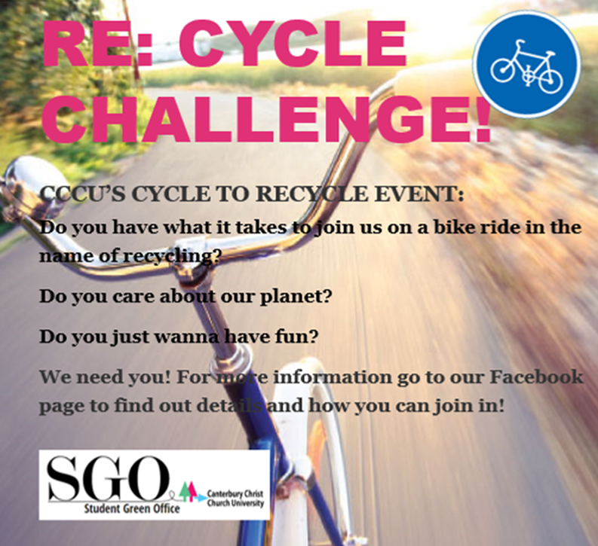
Student engagement – results/materials
21% 23% gained firsts
67% 69% gained 2.1
12%/ 2%gained 2.2
No thirds or fails – 6% gained 3rd

Slide 16


Edible Campus
Grow into a healthy life

Slide 17
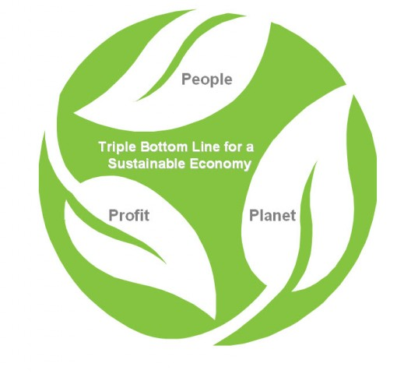
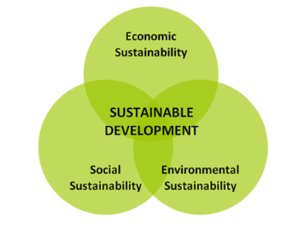


WHY DOES FAIRTRADE MEAN
SUSTAINABLE TRADE?
“They’re both about people and meeting their needs today
without compromising the need to people in the future”
3 Pillars of sustainability
[J. Elkington 1994]
3 areas in which
Fairtrade is sustainable
Notes:
LARA

Slide 18


Slide 19
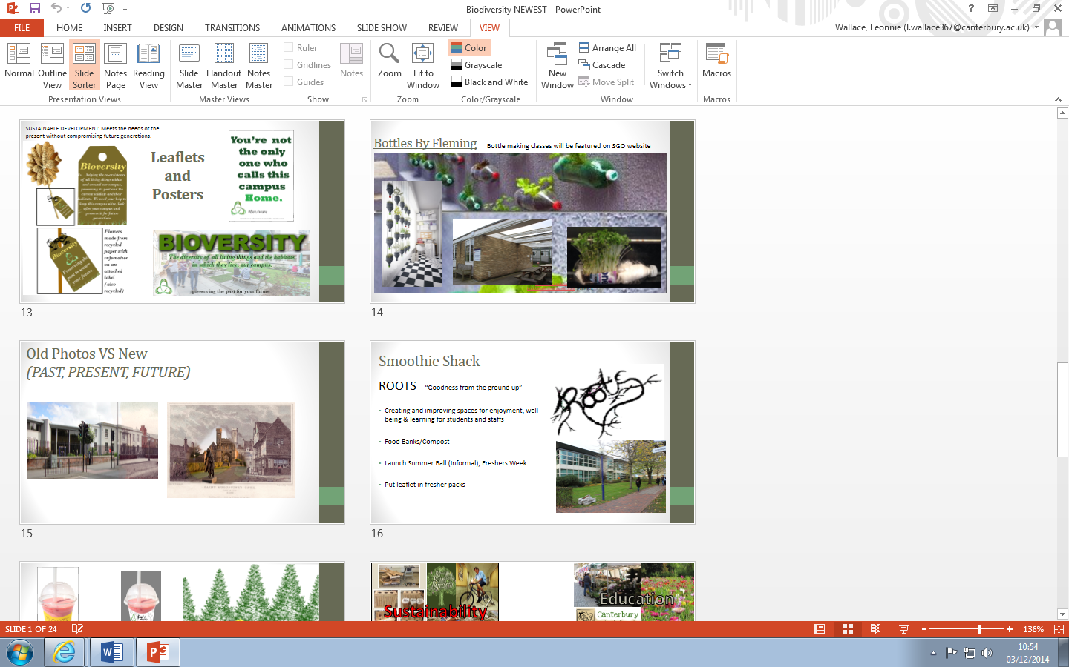

Slide 20


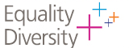
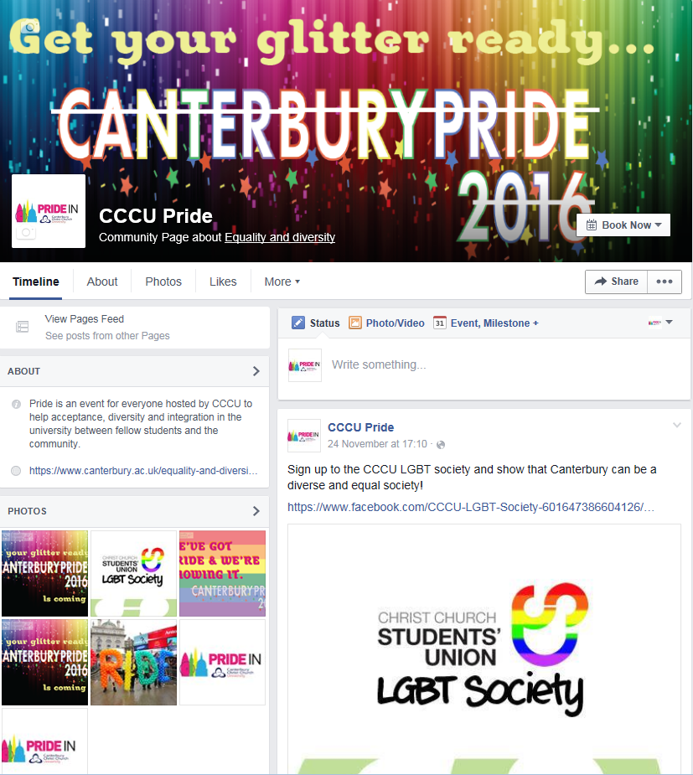
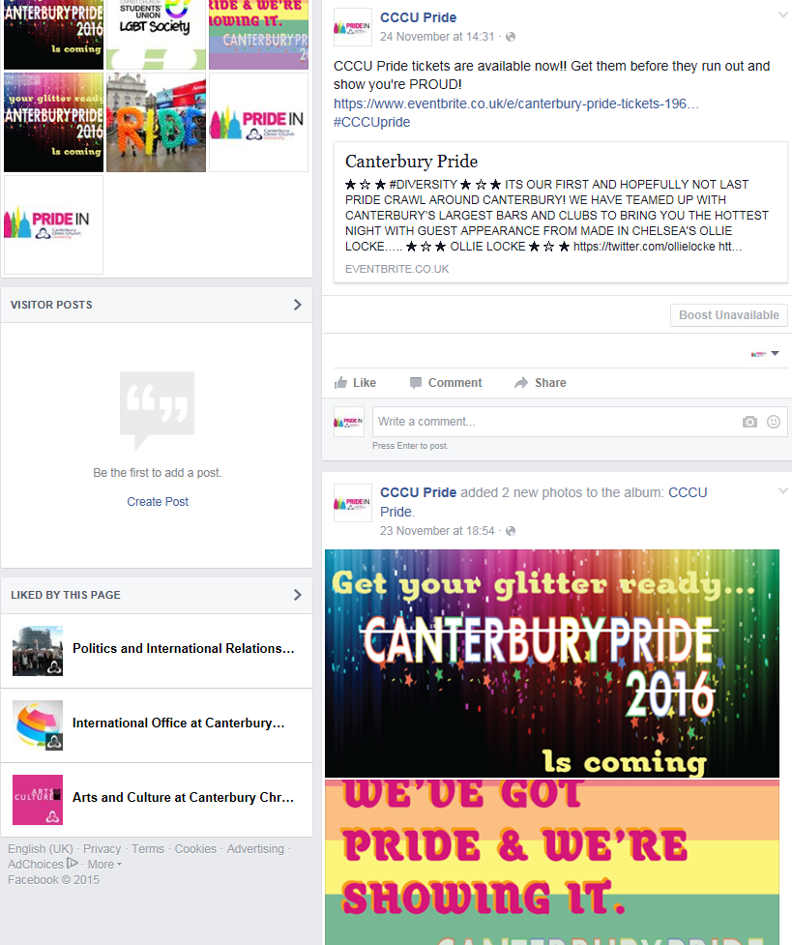
Social Media
Notes:
ASH

Slide 21

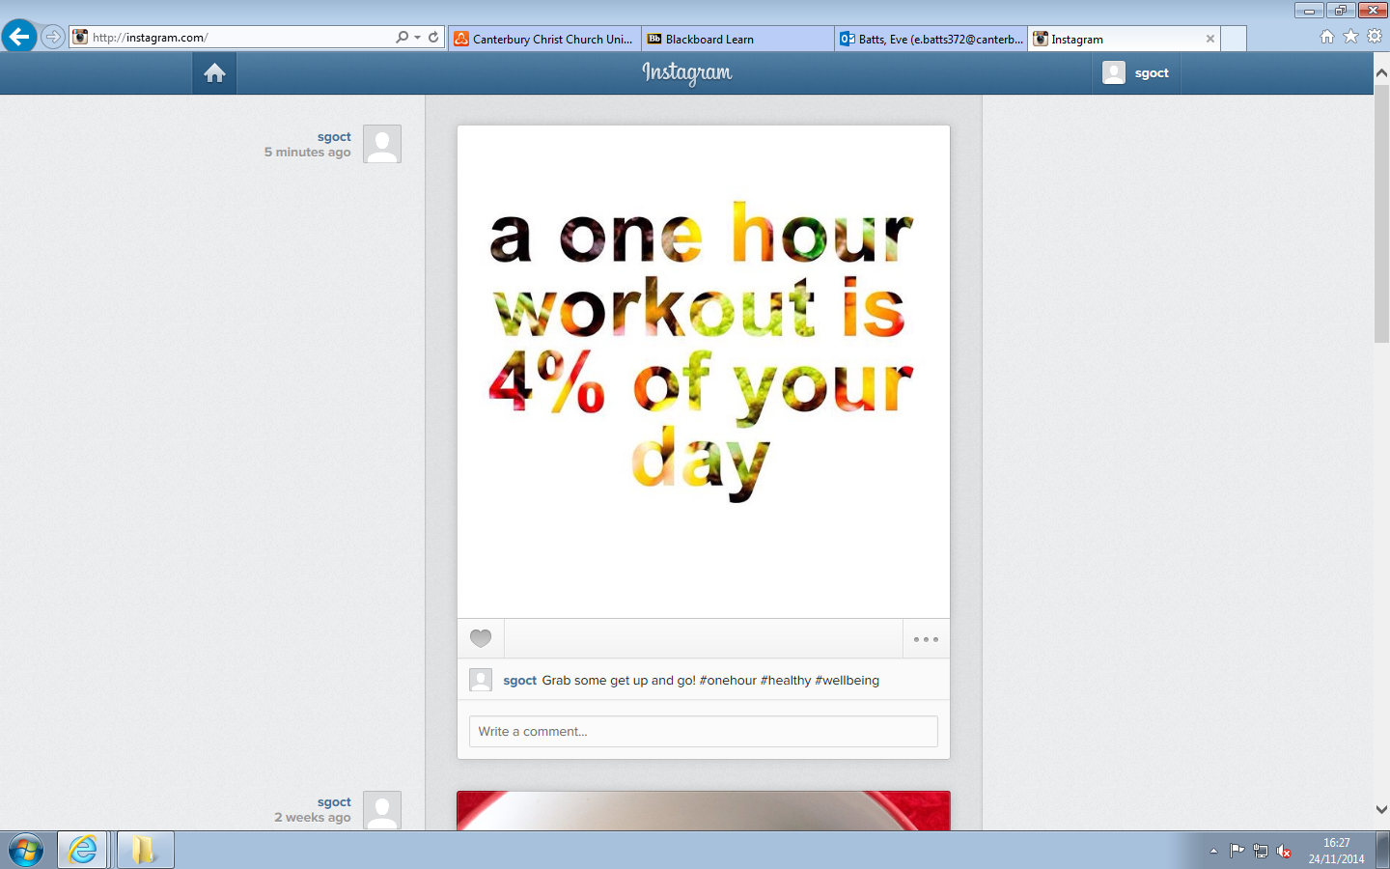
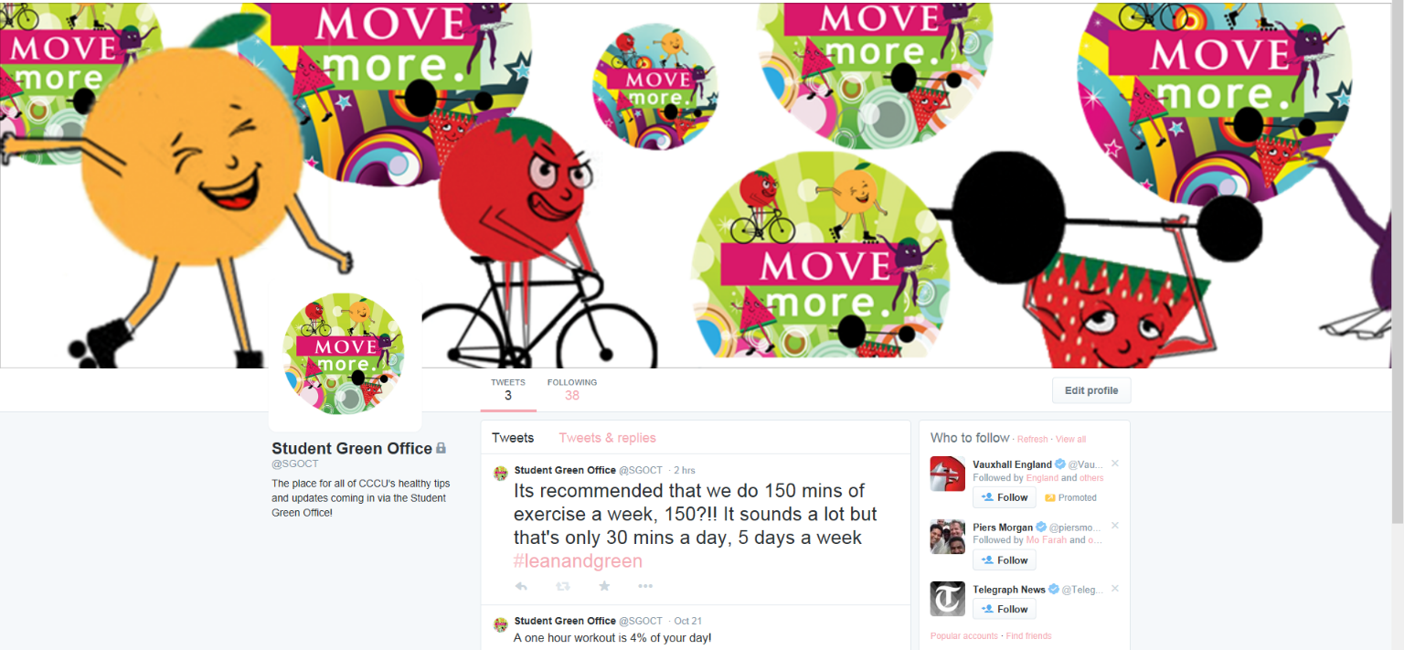
student
campaigns

Slide 22
External examiner comments 17th June 2015/July 2016
‘Highly commendable module, clear focus on sustainability and ethics which chartered institute of public relations will love in terms of professionalism. Very clever use of campus and resources demonstrating sustainable development in practice’
‘This module has a good industry-related focus and uses campus facilities in a comprehensive and original way. The student work shows a good understanding of PR practice and is very diverse. The module also has an excellent ethical focus.’

Slide 23
Bibliography
Claudia M. Bridges and Wendy Bryce Wilhelm, ‘Going Beyond Green: The “Why and How” of Integrating Sustainability Into the Marketing Curriculum’ Journal of Marketing Education, April 2008 vol. 30 no. 1 33-46
Elkington,J (1997). Cannibals with Forks: The Triple Bottom Line of Twenty-First Century Business. Capstone, Oxford
Marquez, A and Charles J. Fombrun ‘Measuring Corporate Social Responsibility’ Corporate Reputation Review Volume 7 Number 4 N.Y 2005
QAA Guidance on Education for Sustainable Development http://www.qaa.ac.uk/en/Publications/Documents/Education-sustainable-development-Guidance-June-14.pdf)

