Slide 1
‘Defiant objects’: non-standard research outputs on CReaTE
Claire Choong
Learning & Research Librarian
(Scholarly Communications)
13th June 2017

Slide 2
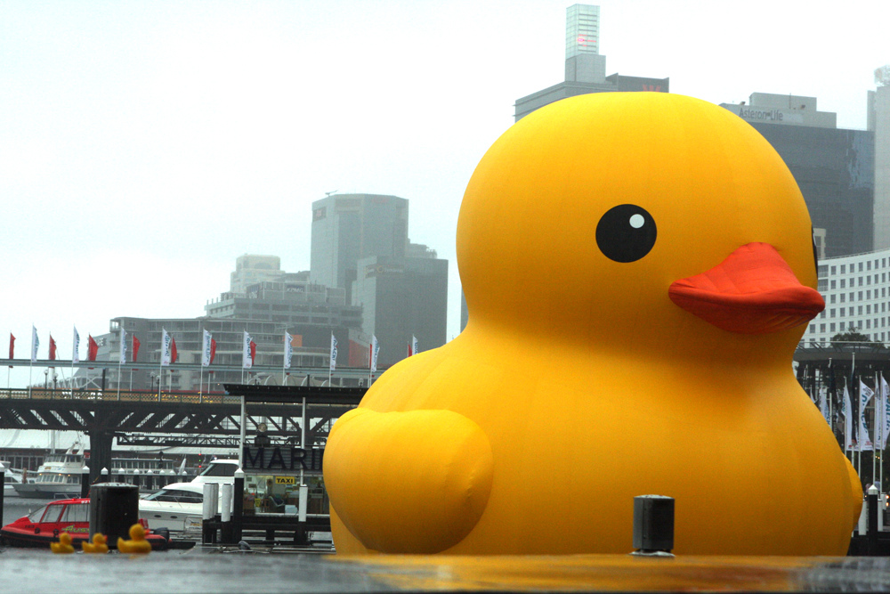
We love non-standard
Notes:
Lovely practice based research outputs
- need to disseminate, access and reuse research outputs beyond REF

Slide 3
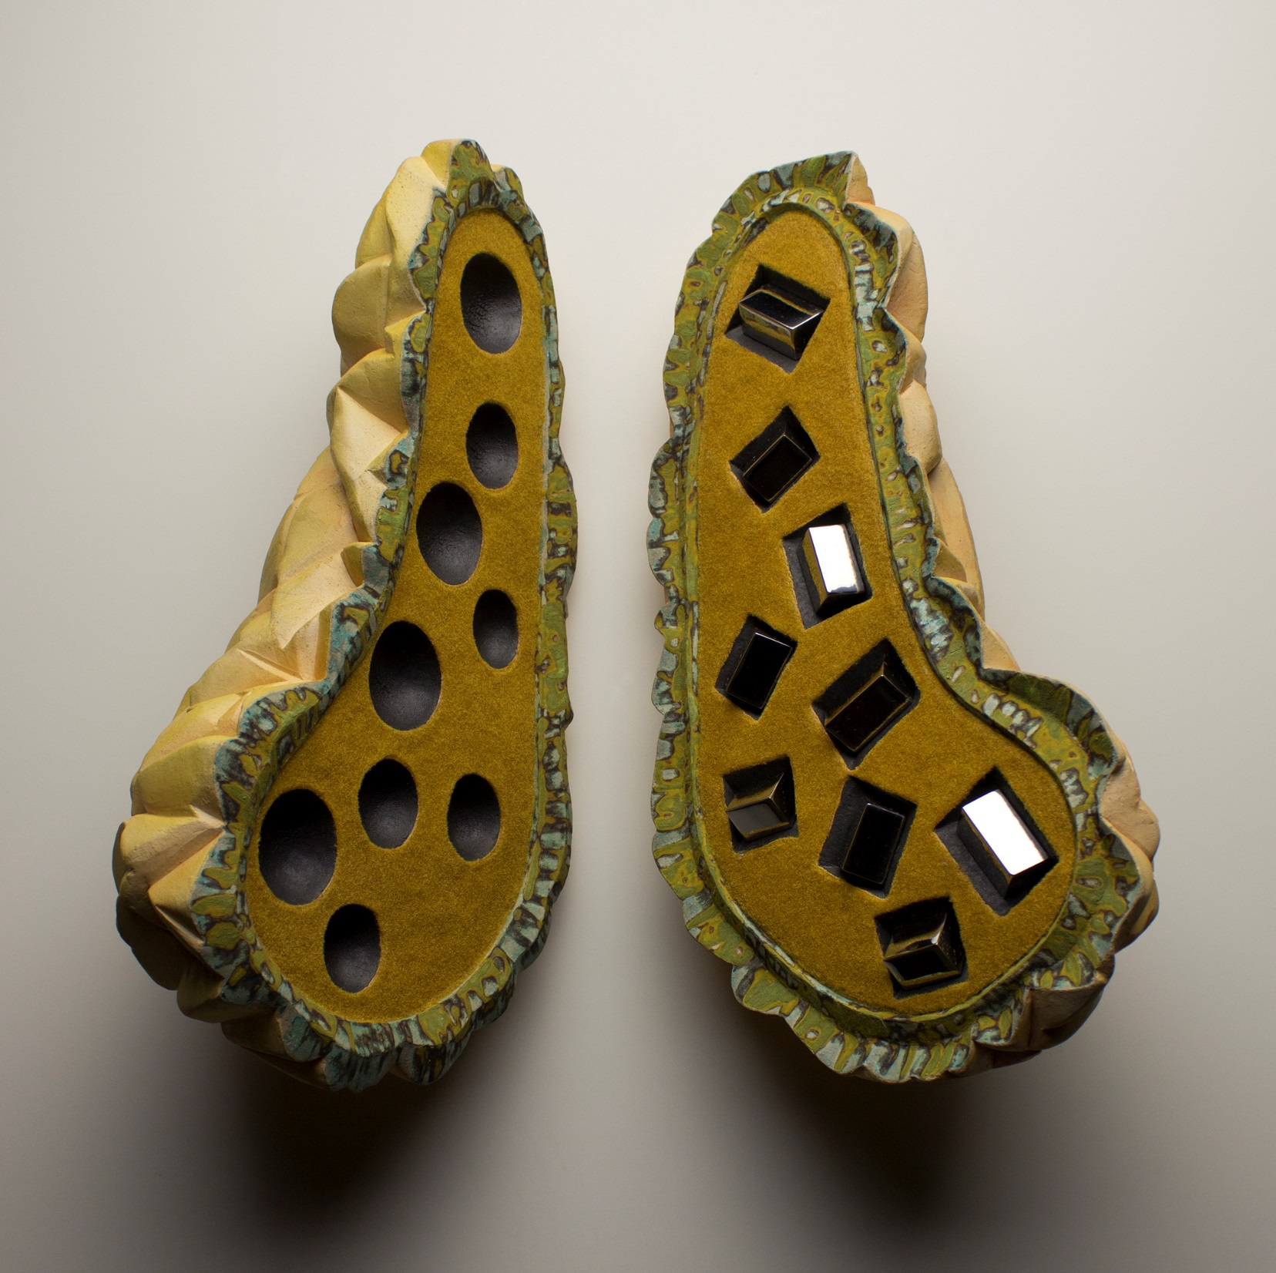
but
Notes:
Title: Square Peg Round Hole http://bit.ly/2s4HXhV
Creator: Steve Belz
Issues with PBRA on repositories (not just CReaTE)
Examples:
- images/works not always self explanatory (sometimes on purpose)
- how much text do we ned to understand research outputs - where should this text go? There is no specific field for this in CReaTE
How do we know what item type to use (e.g. performance/composition, artefact/exhibition
How do we untangle what is the outcome and what is info about the outcome?
How to “define practice based research that has a life of its own?” Rocio van Jungenfeld
Much wider variety of research outputs than standard text-based outputs
Difficult to separate insights from data
------ Defiant objects

Slide 4
and also
Notes:
Copyright
- Who owns it?
- 3rd party
- Creative commons (which licence to use)

Slide 5
‘Defiant objects’ project
Notes:
https://defiantobjects.files.wordpress.com/2013/05/deposit_guide_final_web_version.pdf
https://defiantobjects.wordpress.com/ - click image in slide
Completed 2013
Defiant Objects is a 18-months London E-prints Access Project’s (LEAP) research project headed by Tahani Nadim (Goldsmiths) with research assistance from Rebecca Randall (Goldsmiths). It follows on from work carried out by the LEAP Media Working Group.
LEAP is the consortium of University of London repositories which includes Birkbeck, Goldsmiths,Imperial College, Institute of Cancer Research, Institution of Education, King’s College, London School of Economics, The School of Pharmacy, Queen Mary College, Royal Holloway, School of Advanced Study, School of Oriental and African Studies, and University College London.
Institutional repositories have now been set up in all 1994 and Russell Group universities and their contents have grown rapidly in the last five years. This development is also reflected in the kinds of research outputs deposited in IRs: No longer “straightforward” paper publications, repositories – particularly those run by universities with arts-based departments – see a steady influx of research outputs that do not easily fit the categories offered by IR systems. We have termed such outputs that escape conventional classification “defiant objects”. But rather than curtail their complexities, we wish to find ways in which best to accommodate these objects in existing IRs.
Defiant Objects will address a number of questions that have arisen in conjunction with the increase in non-standard deposits. A comprehensive “literature review” will provide an overview of current practices and address the following questions: How to identify types of research output and core metadata required for each type? How to decide on appropriate file formats for access and preservation? How do metadata sets map to workflows? What kinds of controlled vocabulary and standard thesauri are and/or should be used?
Following on from this, Defiant Objects will produce a guide and recommendations for supporting non-standard deposits (“defiant objects”) in institutional repositories, especially those in non-textual formats. The guide will be aimed at depositing researchers and repository staff working in research-led universities that encompass arts-based disciplines. The project will also translate its findings into a new workflow for depositing non-standard objects in repositories. This will be installed in a test environment, run on EPrints 3.3, and will be made available for testing.

Slide 6
The (almost) ideal: repository solutions for the arts
Notes:
KULTUR – UAL http://kultur.eprints.org/
Kultur was JISC-funded project that created a model of an institutional repository for use in the creative and applied arts.
While institutional repositories are proficient in managing text-based research such as articles, books, and theses, they are not yet attuned to the requirements of images and time-based media.
The Kultur project aims to change this by creating a flexible multimedia repository that will be able to showcase a wide range of outputs, from digital versions of painting, photography, film, graphic and textile design, to records of performances, shows and installations.
This was a two year project scheduled for completion in March 2009. The project partners were the University of Southampton, University of the Arts London, University for the Creative Arts, and the Visual Arts Data Service. Leiden University is an associate partner.
UCA research online http://www.research.ucreative.ac.uk/ - click on link in slide
Also look at http://ualresearchonline.arts.ac.uk/1669/
and RADAR (Glasgow SA) http://radar.gsa.ac.uk/

Slide 7
What we can do
Notes:
- Metadata guides – working with what we have
Making the big guide
- Copyright guidance - http://copyrightuser.org/ and coming soon Copyright Cortex
Workshops
One to one sessions
Changing some headings (if possible)
Asking for help

Slide 8
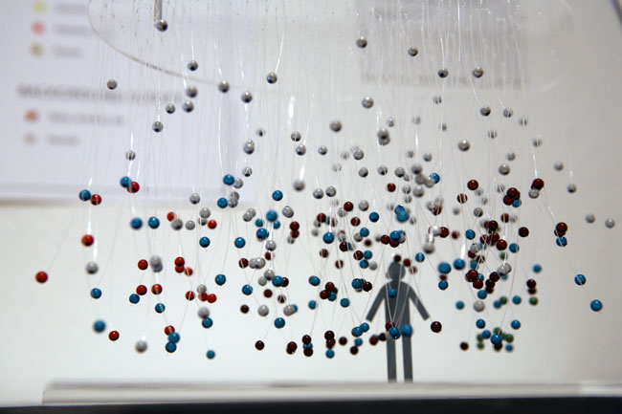
Pioneers
Kate McLean: Modelling Scentscape Experience
Notes:
Examples of PBRA on CReaTE:
Kate McLean – click on slide image
Tim Jones - http://create.canterbury.ac.uk/13267/
Eddie McMillan - http://create.canterbury.ac.uk/14688/

Slide 9
Help!
claire.choong@canterbury.ac.uk
create.library@canterbury.ac.uk
x3220
http://create.canterbury.ac.uk
Notes:
Look at CReaTE

Slide 10
Sources
Belz, S. (2013) Square Peg Round Hole. Available at: https://www.flickr.com/photos/58149446@N06/10110970933/ (Accessed: 12th June 2017)
McLean, K. (2016) Modelling Scentscape Experience. Available at: http://create.canterbury.ac.uk/15084/ (Accessed: 12th June 2017)
Randall, R. (2013) ‘Defiant Objects deposit guide’ Defiant Objects, May 3rd. Available at: https://defiantobjects.wordpress.com/2013/05/03/defiant-objects-deposit-guide/ (Accessed: 12th June 2017)
Rinaldi, E. (2013) Rubber Duck. Available at: https://www.flickr.com/photos/evarinaldiphotography/8375875252/ (Accessed: 12th June 2017)
Van Jungenfeld, R. (2014) ‘Non-standard research outputs’ Research Data Blog, May 27th. Available at: http://datablog.is.ed.ac.uk/2014/05/27/non-standard-research-outputs/ (Accessed: 12th June 2017)

