Slide 1
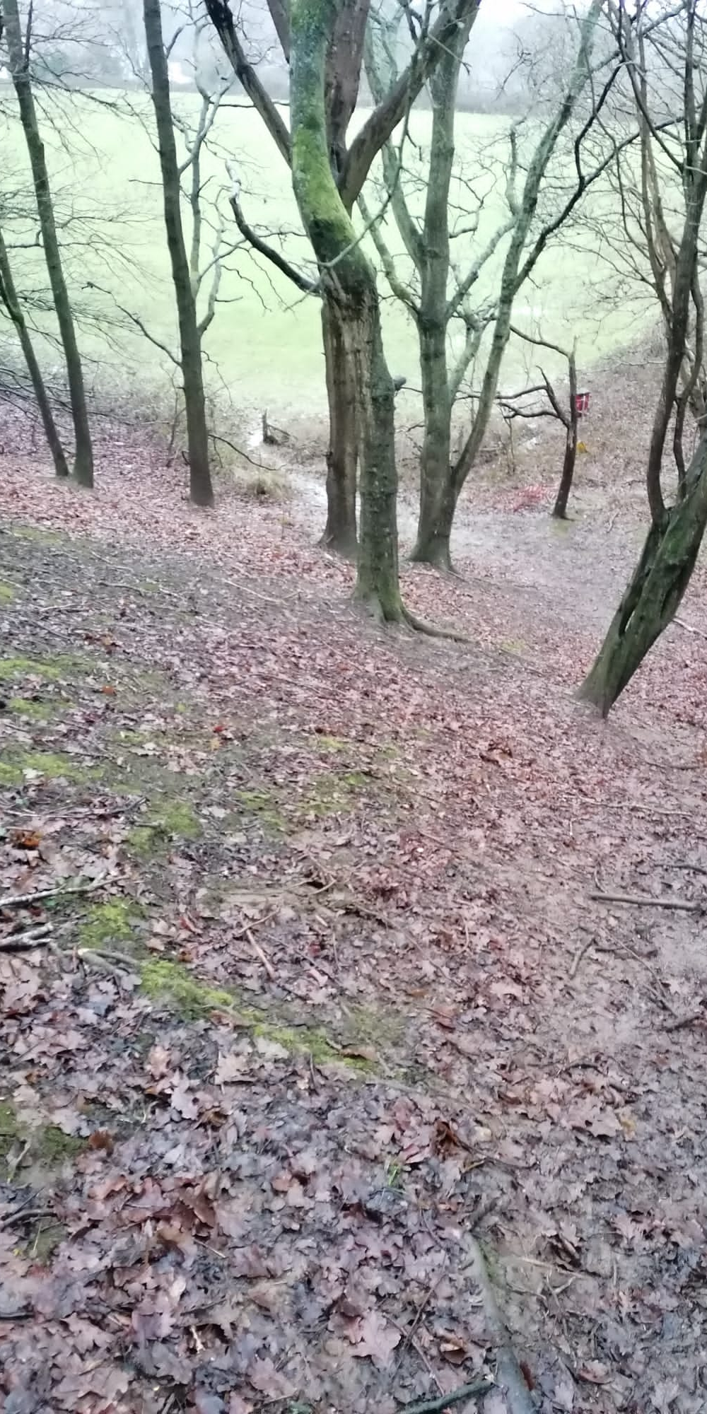
"If I see a man walking alone without a dog, without a person, I always feel a bit uneasy": safety perceptions of female trail runners Laura Gubby Canterbury Christ Church University laura.gubby@canterbury.ac.uk

Slide 2
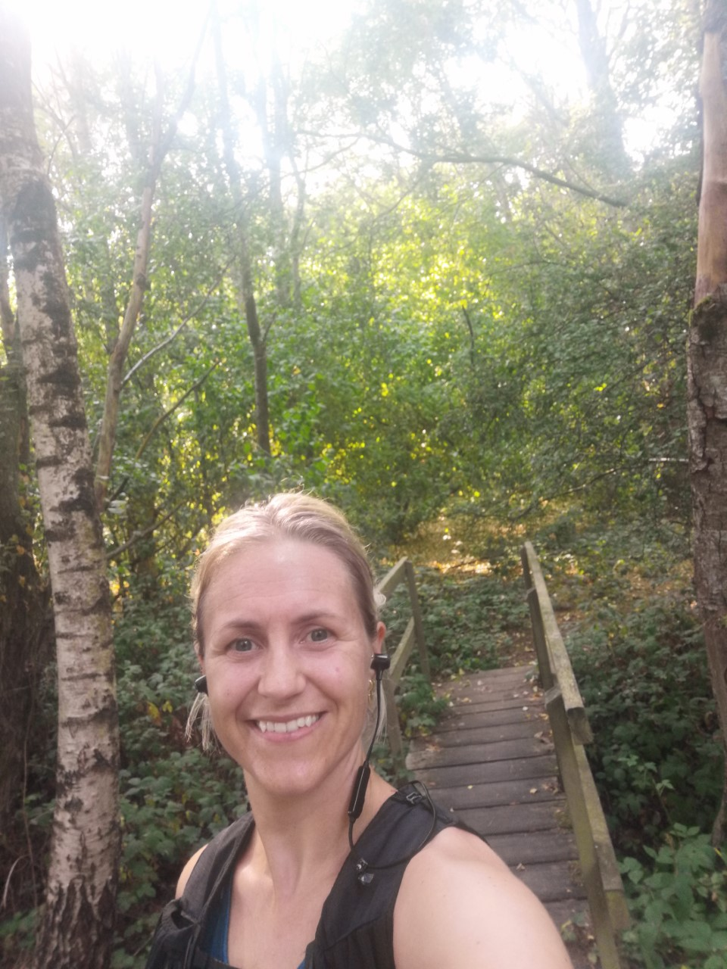
Introduction
Media coverage of gender-based violence has heightened awareness of the daily considerations that many women make in relation to their safety.
This research aims to better understand the risk and safety perceptions of female off-road runners in rural areas by unpacking specific experiences and previous encounters.
Rural areas have been chosen as off-road spaces in these areas usually have more woodland and fields which are further from roads and have less density of people than urban parks.

Slide 3
Broad Research Questions:
What do female runners believe constitutes safety and risk when off-road running by themselves?
Do females assess risk in relation to the presence of others based on who it is they encounter and where they are?
How do females negotiate moments of perceived risk of harm by others when running in rural areas?
What notable experiences have female runners had which relate to concerns of safety when running in off-road, rural areas?

Slide 4
Previous Research
Running helps with emotional/significant life-events (Willer, 2020); the sensory experiences of cross-country running, including changing terrain underfoot and unpredictability, the experience of the elements (Allen-Collinson & Jackman (2021); challenge and freedom from ‘normal’ daily life (Atkinson, 2016); feelings of empowerment, strength and being powerful (Allen-Collinson, 2010; 2013)
Female road runners wanted to run around others more than men (quieter routes), in well-lit streets; women feared other people, personal safety violation and the chance of assault more than men; women run at ‘safer’ times of day, in ‘safer’ areas and with or around other people more (Schuurman, Rosenkrantz & Lear, 2021)
Dangers of harassment and attack; personal experiences of physical contact by others and comments related to female anatomy; feelings of vulnerability in relation to the female body: and running on high-alert down dark streets or narrow alleyways (Allen-Collinson, 2010; 2013)
Constant negotiation of feeling empowered and powerful, but also vulnerable.

Slide 5
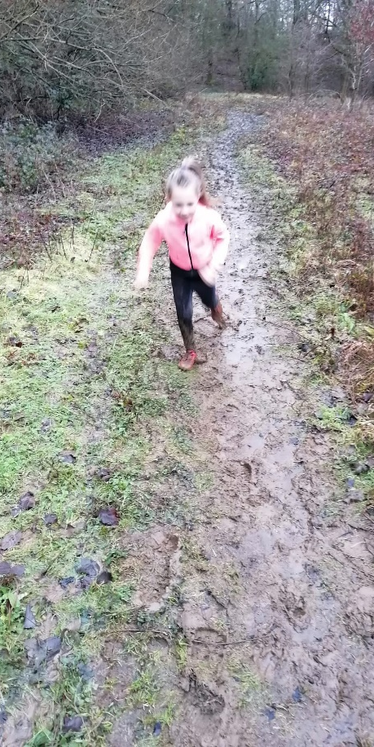
Previous Research
Girls are influenced by experiences of harassment, threat of sexual violence and discourses related to female vulnerability which create fear and label girls as ‘at risk’, which can regulate their outdoor activities e.g. running (Clark, 2015)
Baxter (2021): some females do not want to run in remote fields alone, but would with someone else (so road run if alone). General feeling that roads/towns (if not ‘rough’) are safer than fields and more remote locations

Slide 6
Methodological Approach
Individual, semi-structured mobile interviews (Smith and Sparkes, 2016) with 16 female trail runners.
Participants: female runners who run off-road in rural areas by themselves at least sometimes.
Interviews took place whilst walking through trail routes chosen by the participants and lasted approximately 45-60 minutes, and were recorded with a Dictaphone
Natalia
Michelle
Fiona
Nicki
Lola
Gemma
Zoe
Megan
Leyla
Rachel
Charlotte
Abby
Becky
Tasha
Jane
Helen

Slide 7
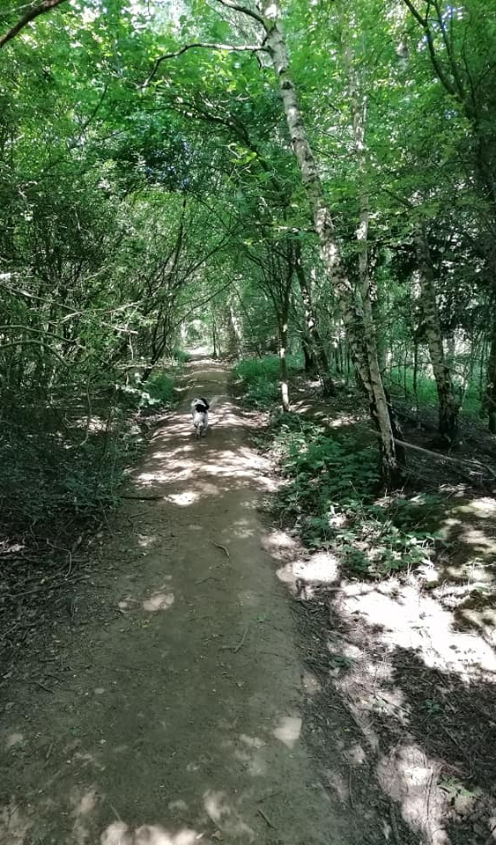
Mobile Interviews
Address power between participant and researcher - their space, they are in charge (Lynch & Mannion, 2016)
Can link their words to places:
hear the birds and that cool, nice temperature and running through the woods and the dappled light; it’s lovely (Gemma)
Judge their perception of ‘remoteness’

Slide 8
Jane: So, this is very similar to what I would do, a lot of the time. Because I just like all the little trails, and the logs, and the-
I: So, since we've been out, we saw that lady with the two dogs. Is that all we've seen?
Jane: Yes.
I: Yes, so it is really remote, isn't it? You're definitely not-
Jane: I generally don't see anybody really.

Slide 9
Mobile Interviews
Address power between participant and researcher - their space, they are in charge (Lynch & Mannion, 2016)
Can link their words to places:
hear the birds and that cool, nice temperature and running through the woods and the dappled light; it’s lovely (Gemma)
Judge their perception of ‘remoteness’
Could see their areas of most concern/events that have happened – contextualises what they worry about
Memory prompts/reminders (Sparkes and Smith, 2016)

Slide 10
Helen: That’s the hill I was talking to you about. So I was going up there and then there’s another road.
I: And that’s where the car was, at the top of that hill?
I: Yes, sure. But I get this, because it’s a treeline, isn’t it? I’m trying to describe it, so that when I come back to this I remember what it’s like. It’s a treeline, and it’s actually quite flat behind the trees.
Rachel: So it’s quite a cosy spot, actually, you wouldn’t be uncomfortable.

Slide 11
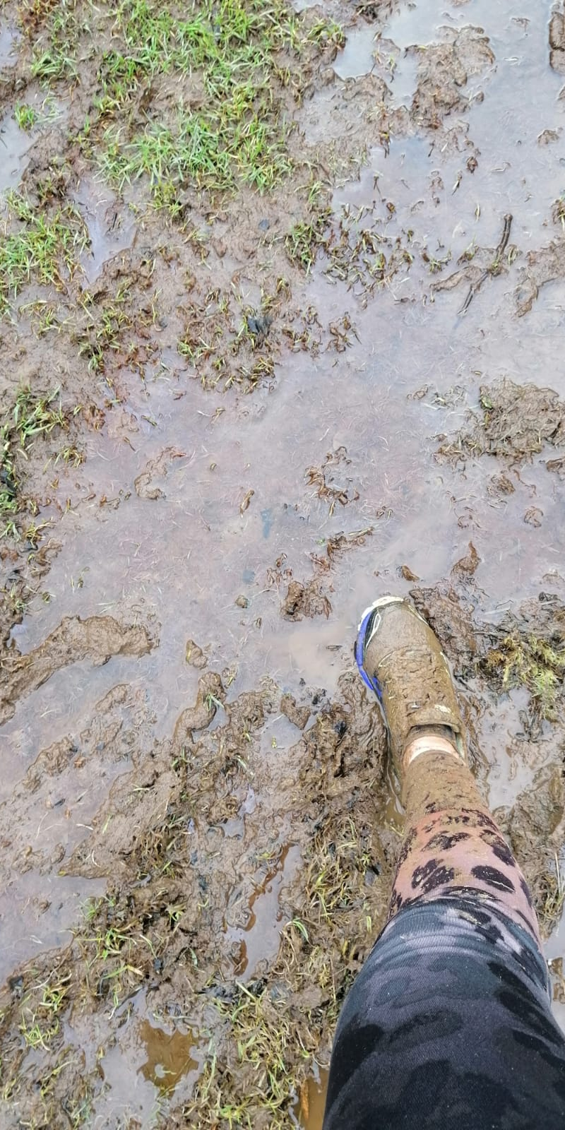
Mobile Interviews: Difficulties
Terrain and environmental difficulties

Slide 12
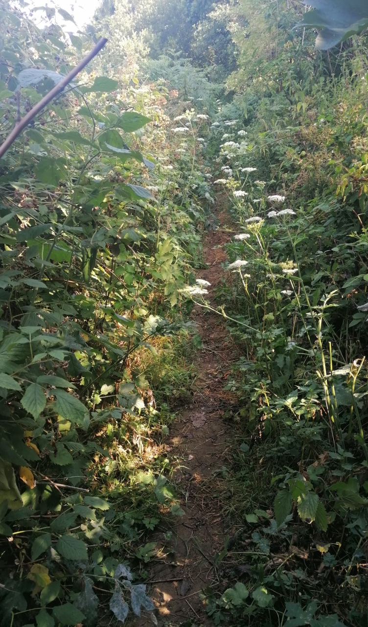
Jane: It clears up, honestly.
I: You said that a minute ago, and I think it's getting worse. (Laughter) I'm only joking. I don't care. That's why I wore trousers on purpose because I thought, "Well, if we end up going overgrown, an overgrown bit, it will be fine."
Jane: So, as you can see, no one is going to be hiding here.
I: I don't think anyone would want to.
Jane: In the nettles.
I: In the stinging nettles, yes. (Laughter) Very dedicated if they are.

Slide 13
Mobile Interviews: Difficulties
Terrain and environmental difficulties
Leyla: ethical parking
Leyla: private land
‘Walk through woods with me: away from density of people and roads’:
‘my husband said, ‘what if she’s the murderer?’ [laughs] that would be very clever [laughs]’ (Jane)

Slide 14
Preliminary Findings
Fear, vulnerability and ‘fight or flight’, often brought on by seeing a lone male, or the possibility of doing so.
Diverting routes, running back on themselves, increasing speed when feeling concerned, and looking over shoulders for reassurance
Runners tended to ensure that they knew routes out of the trails, changed routes and times that they run to avoid predictability
When uncomfortable on a run, they turned their music down to improve their senses, or got their phones out in readiness or as a deterrent to those around them.

Slide 15
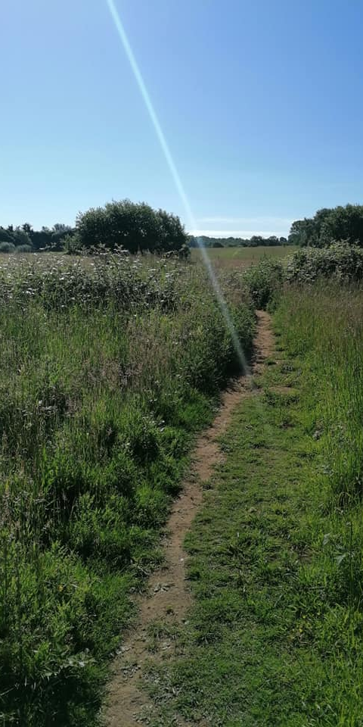
Safety Concerns
Concerning Encounters
Protective Strategies
Trails as a Safe Space

Slide 16
SAFETY CONCERNS
A big flag for me is someone running past me very fast, or trying to overtake in a rush […] So, that, to me, now, if that happens, I will go backwards (Jane)
I wouldn't with a group of men because I've not really ever experienced anything with more than one. I mean, my experiences have been- I have had someone jump me a couple of times, and one of them was quite bad, in the respect that he'd already planned- he'd cut the gates to an allotment, he had rope (Jane)
Definitely men. I know that sounds terribly sexist, but any man. It doesn’t matter if he’s a round dumpy man or a really athletic man, I get that automatic awareness, I think it is (Rachel)
That someone’s going to rape me. Honestly, I mean, I come from South Africa. So that to me, this is just the perfect place to drag someone into a bush and rape them (Rachel)
I probably wouldn’t get that close to a man on his own out, unless he was clearly out doing a dog walk. Then, I feel like, it’s quite clear why they’re out. You’re not up to no good because you’ve got a dog. You’ll be walking your dog instead (Fiona)
It sounds horrible but if I was to see someone without a dog, male, I think I do get a bit nervous but I shouldn’t. Why should I be nervous? I have every right to be running around here (Natalia)

Slide 17
CONCERNING ENCOUNTERS
Jane: I've had one when I was running around the lake which I said was a high - a lot of people walking there - a guy stopped. He'd gone past me, stopped, and he just had his back- he was just standing there with his back and I didn't think anything of it. And I just carried on running, and as I came past him, he had his willy out.
I: Oh, my God.
Jane: And I thought he was having a wee, and I said, "Oh, I'm sorry." And ran past, and as I got passed, I thought, "That was set up deliberately for me."
I: No.
Jane: Because why would - there was loads of people. You don't need to do that there. It was a path.
I: No. Oh, gosh. How horrible.
Jane: And it was that stillness, in hindsight now, the man just standing there still, waiting for me to come past. I should have…
I: How did you feel after? Once you had that moment.
Jane: I felt angry. Because I was annoyed that I said sorry. (Laughter)

Slide 18
CONCERNING ENCOUNTERS
“Oh, I don’t want this man to ruin my run, why should I be scared?” I just started walking at that point, I was like, “Shall I just run past him?” “He looks quite fat, maybe he can’t catch me” and then I was like, “Oh, what if he goes for the dog?” “What if he hits the dog?” And all this stuff was going through my head. I was like, “Oh do you know what, don’t be so bloody stupid. Running past someone with a bat is putting yourself in danger” and I just ended up taking a left and going off and doing… (Helen)
I did have an incident once where I was running and a guy crossed in front of me, like facing me- […] He was running as well. He was running up the hill, I was running down, and he said, “Hello” to me so I was like, “Hi” and carried on. When I turned around, he had turned around and waited for me... Because I carried on down, then I'll double back to come up and he was waiting for me. Then when I ran up to where there was a fork, he ran that way and I ran that way because I thought, “I’m going to run in a different direction.” When I turn around five minutes later, he had changed direction and was behind me […] I didn't go back running at those times for a long time (Rachel)

Slide 19
PROTECTIVE STRATEGIES
Look over shoulder: I have had moments where I’ve had to look over my shoulder. Yeah, you’re just looking, just checking that they’re not coming. If it’s dark, nine times out of ten they’ve got lights on […] Yeah, so you can then see them. But then I’m always like, well, what if they turn the light off and take a shortcut? And all this stuff goes through your head. But I just try and focus and then just look behind me and do what you can and then just carry on (Helen)
Change time of runs: Yes, because I was like, “I don’t want to meet this man ever again.” (Laughter) Because I don’t know what you do. What do you do? You’re tired, you’re panting, I’m not a natural runner so it’s not like I would outrun him. So yes, I just stopped going in the mornings at that time, for a while (Rachel)
Move over: I kind of move over a bit, as far as I can to keep distance, like width ways, if we're going across each other. Also, once we've passed I always take out one of my earphones, just so that I can hear if they've turned around and doubled back on me (Rachel)

Slide 20
PROTECTIVE STRATEGIES
Confront the fear: I've found that in the past when I've- because I'm quite shy and nervous, I would not really make eye contact. And now, I make sure that I completely look them up and down. Check out, make eye contact because the more you look at someone that wants to do something like that, the more you know about them, or what they look like, the less they are likely to do it (Jane)
Phone a friend: They are really good [bone conduction headphones]. I rang him. I don’t know what I thought he was going to do, but you know someone knows exactly where you are at that moment in time, don’t you? Actually, I suppose, in some ways, there was a bit of a perception of maybe somebody else would also know that somebody knows where you are. They don’t know how far away he is, do they? He could be in the house there. So, it’s a deterrent also, possibly (Fiona)
Look strong: It’s really strange, but I always think about my form when I’m feeling intimidated […] “Look strong. Look fast. Look like you could kick butt,” yes […] Yes, pace goes up, body upright. Yes, always […] Always. Look like I could run away, even when I’m dying inside (Becky)

Slide 21
Trails as a Safe Place
Yes, it is. They're not going to sit in the woods here, or wherever, waiting for that one jogger […] If I see them a bit like hunters, and you're not going to go to a lake with one fish in it, and sit there all day waiting. You want a high opportunity because they're checking out to see which opportunity they can take. So, yes (Jane)
Out here I’m thinking if you’re going to go out and attack someone and rape someone, you’re not going to go to the effort of nearly breaking your neck in the dark. And the same with the rain, are they going to go out in the rain? (Helen)
Again, this is a really backward way of thinking, but I think the chances of being attacked are more likely if you live in an area where there are more people to be attackers (Becky)
I feel more safe around here because I don’t see anybody (Megan)

Slide 22
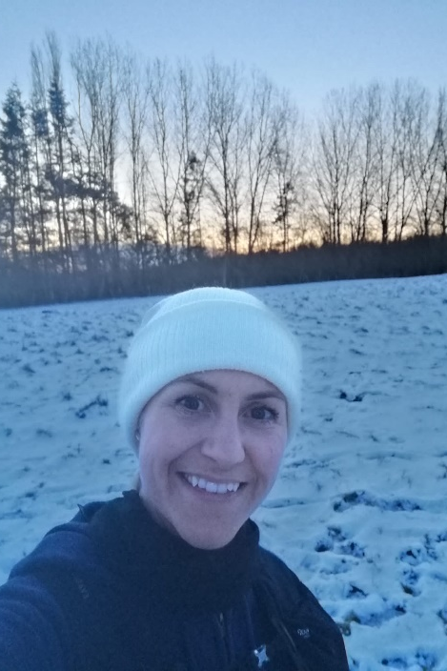
Final Thought…
Discussing the lived experiences of women helps reveal how the fear of gender-based violence impacts upon their everyday lives, but also how discourses about risk and the way this regulates women and their actions
Despite perceived vulnerability, people feel powerful and strong when they run, and they refuse to stop doing it, but adopt strategies that they feel help them cope in given moments

