Slide 1
Medway Festival of Learning and Teaching
'It mixed normal life with academic life. I felt safe and more engaged.' How an assessment accidentally build community, confidence and belonging.
Ruth Phillips and Bláthnáit Robinson, BA (Hons) Politics students.
Dr Susan Kenyon, Faculty Director of Learning and Teaching and Principal Lecturer, Canterbury Christ Church University.
Medway Festival of Learning and Teaching, 10 September 2020. Conducted online via www.gre.ac.uk/medway-festival.

Slide 2
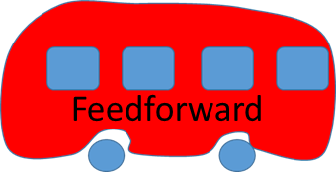
Transport: Politics and Society assessment
Assessment 1: Verbal briefing
Week 6
Choose own problem and decision maker
3 Powerpoint slides; 5 minutes
Receive feedback and feedforward
Assessment 2: Written options and decisions paper
Week 12
Same problem and decision maker
2,000 words max
Given structure (‘Working with Ministers’)

Slide 3
Summary
Feedback
Feedforward
Attendance and engagement increased.
Built employability and academic skills.
Built community – academic and home.
Build confidence.
Feedback literacy.
Felt safe in the classroom.
Positive well-being impacts.
Alternatives for anxious students.
Integrate learning tasks throughout taught session.
Include students as partners in assessment evaluation and design.
Explore possibility of staged assessments in other modules.
Explore possibility of linking assessments to real world in other modules.

Slide 4
Ruth Phillips and Bláthnáit Robinson, BA (Hons) Politics students.
Dr Susan Kenyon, Faculty Director of Learning and Teaching and Principal Lecturer, Canterbury Christ Church University.
Susan.Kenyon@Canterbury.ac.uk.
Medway Festival of Learning and Teaching

