Slide 1
Inclusive transport, sustainability and travel behaviour change. Presented at Sustainable Transport Roundtable: Facilitating Behaviour Change. Canterbury Christ Church University, Kent. 11 March 2024. All slides copyright Dr Susan Kenyon 2024. For further information, please contact Susan.Kenyon@Canterbury.ac.uk. Please do not distribute without permission and do not publish without attribution.

Slide 2
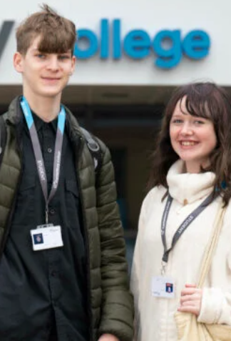
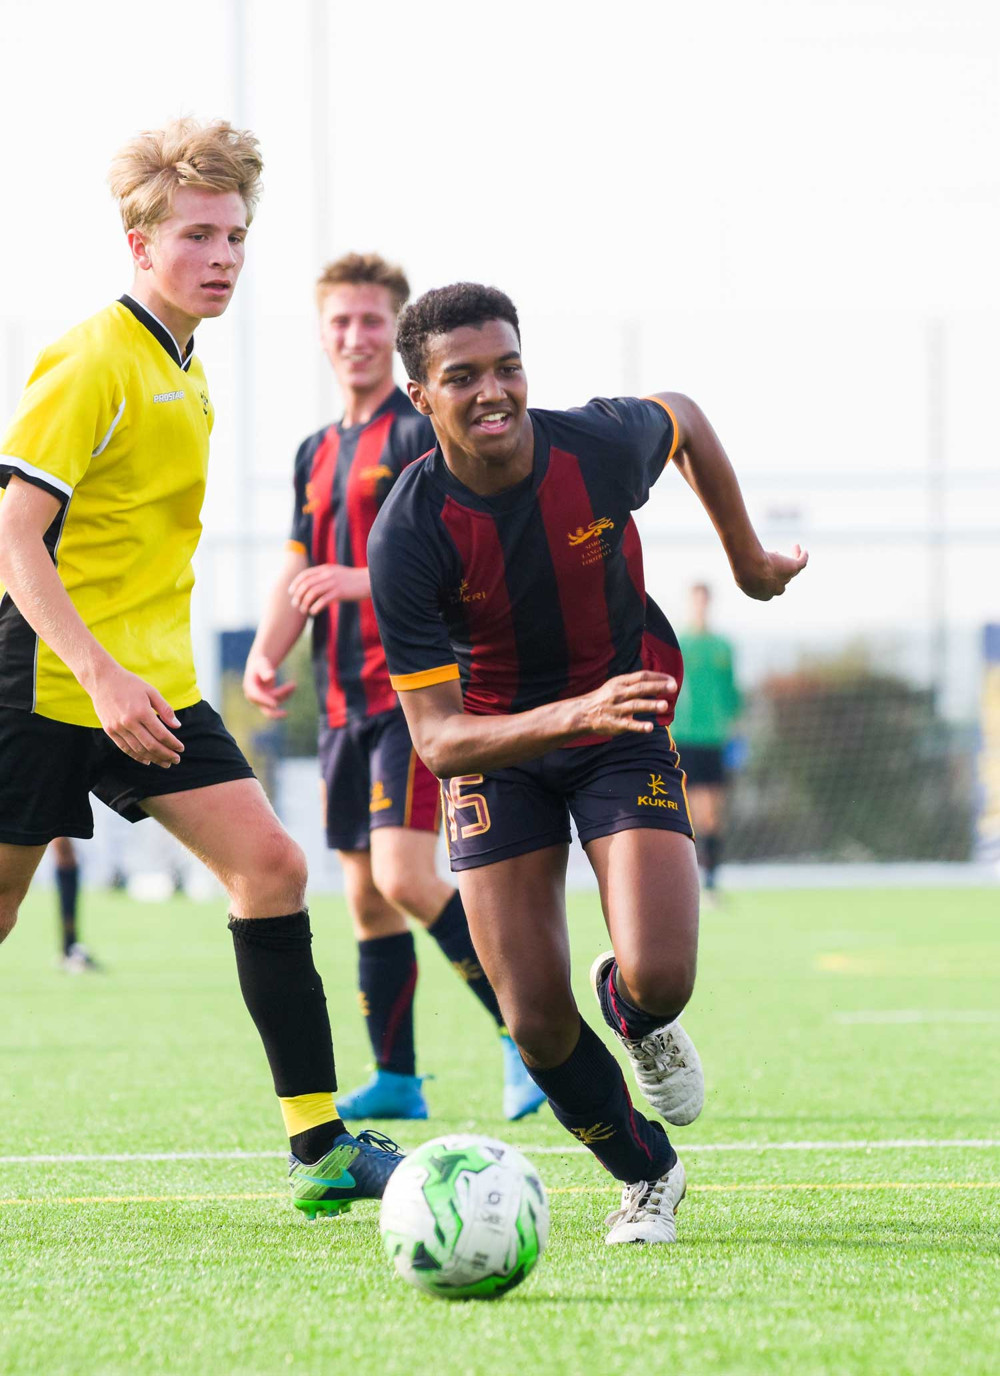
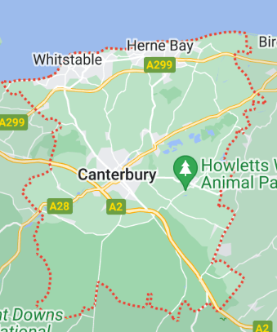
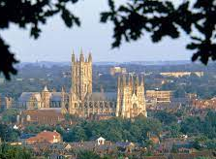
Our common aim
A transport system for the Canterbury District that is:
More inclusive;
More sustainable; with
More choice.

Slide 3
Supporting different choices
Inclusive Sustainable Choices
Available
Affordable
Accessible
Acceptable
Travel behaviour change
Remode
Reduce
Retime
Reroute

Slide 4
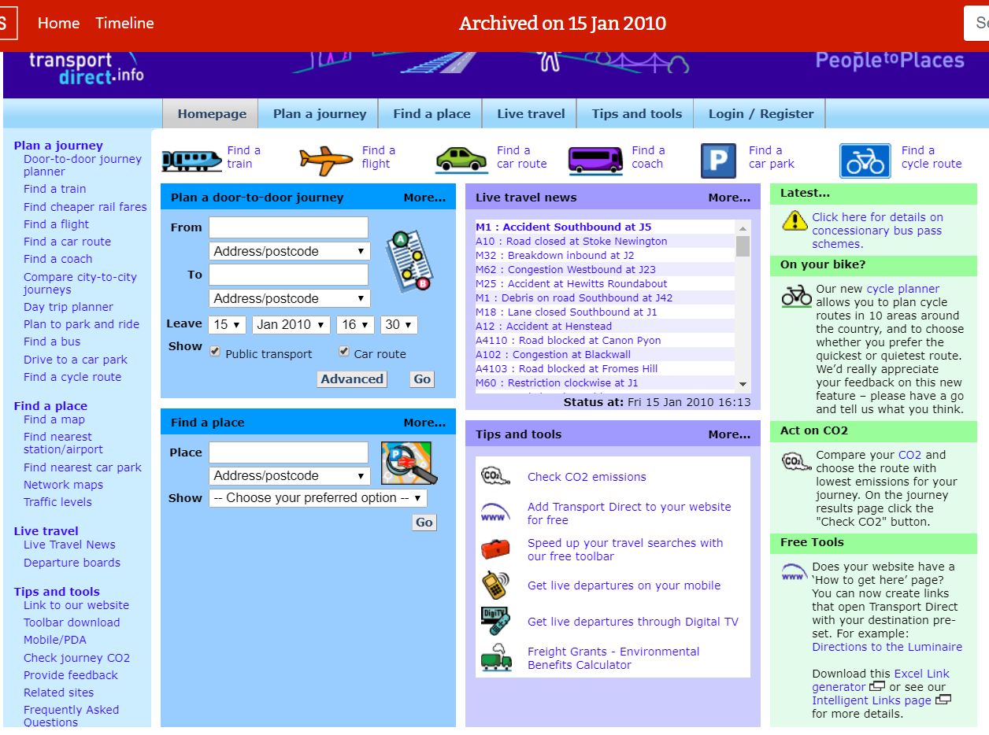
Information and travel behaviour: 1998-present

Slide 5
Four key influences on travel behaviour
Travel behaviour
Biology and psychology
Built environment and Transport System
Activities and lifestyle
Society and culture
Are people able to change?
Are people willing to change?

Slide 6
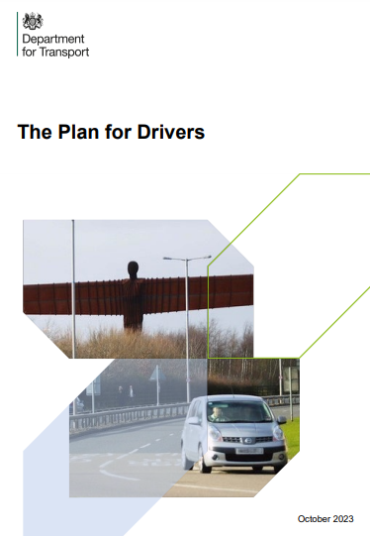
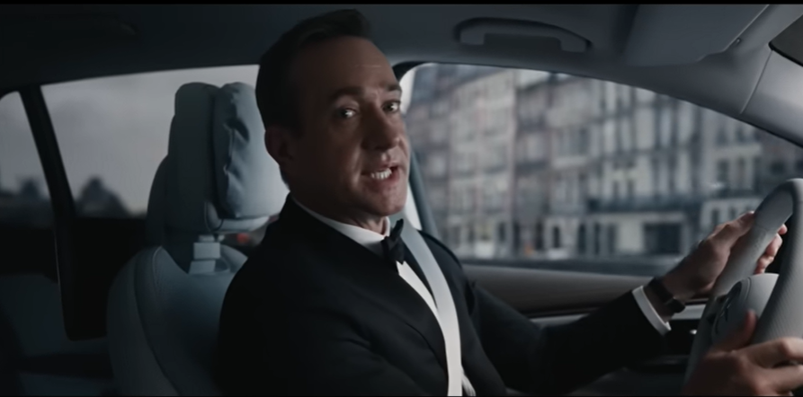
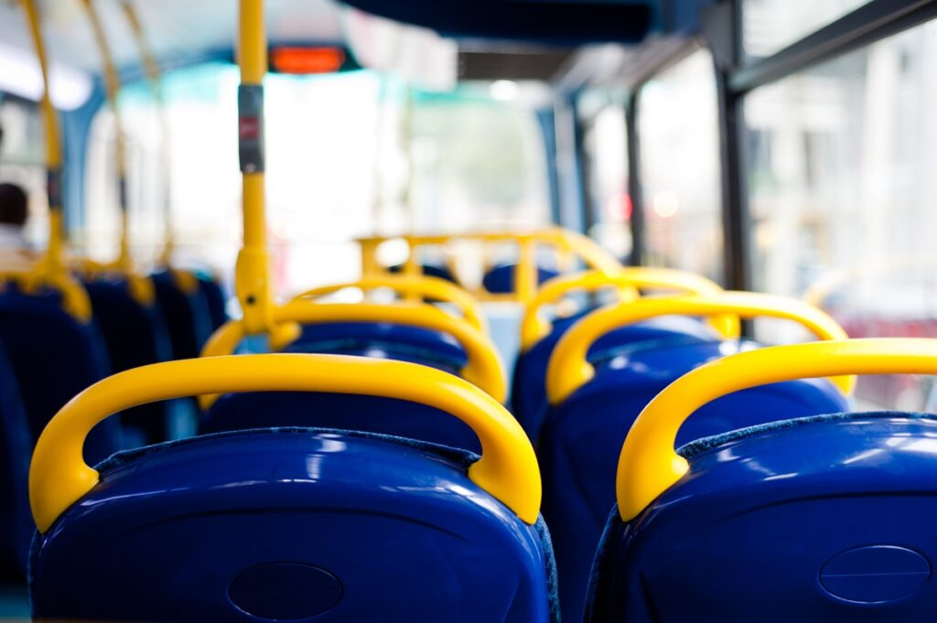
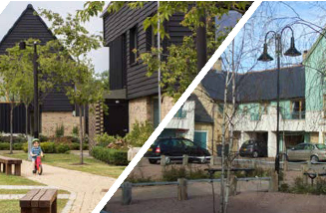
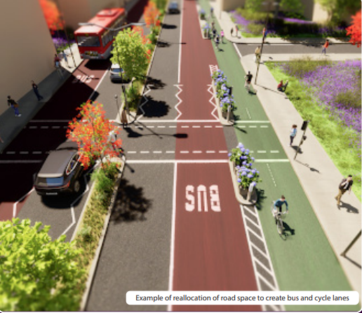
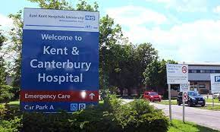
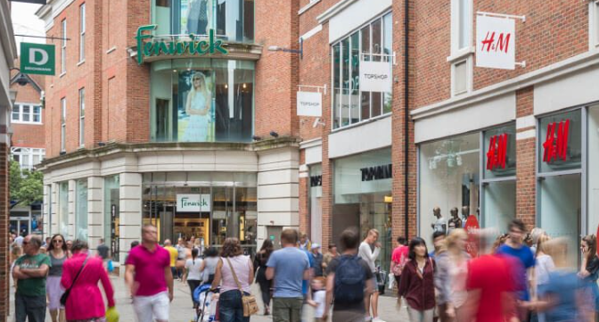
Travel behaviour
Biology and Psychology
Built Environment and Transport System
Activities and lifestyle
Society and culture

Slide 7
Understanding and supporting your community
I am able to change and I am willing to change.
I am able to change, but I am not willing to change.
Information
Community
Incentives
Partnerships
Social marketing
Trickle down
I am not able to change, but I am willing to change.
I am not able to change and I am not willing to change.
4’A’s
Infrastructure
Services
Non-Transport
Acceptance
Appropriate car use
Communicate through other issues e;g. crime and housing

Slide 8
Inclusive transport, sustainability and travel behaviour change. Presented at Sustainable Transport Roundtable: Facilitating Behaviour Change. Canterbury Christ Church University, Kent. 11 March 2024. All slides copyright Dr Susan Kenyon 2024. For further information, please contact Susan.Kenyon@Canterbury.ac.uk. Please do not distribute without permission and do not publish without attribution.

