Slide 1
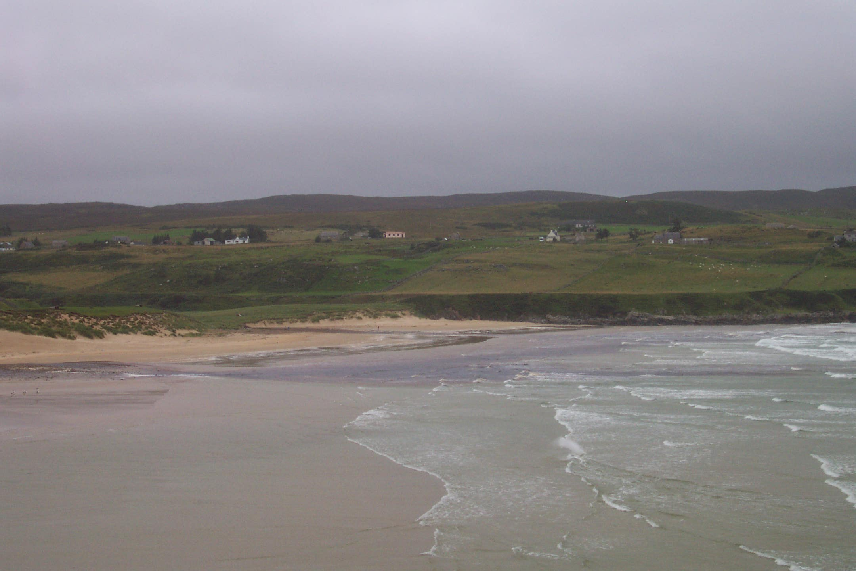
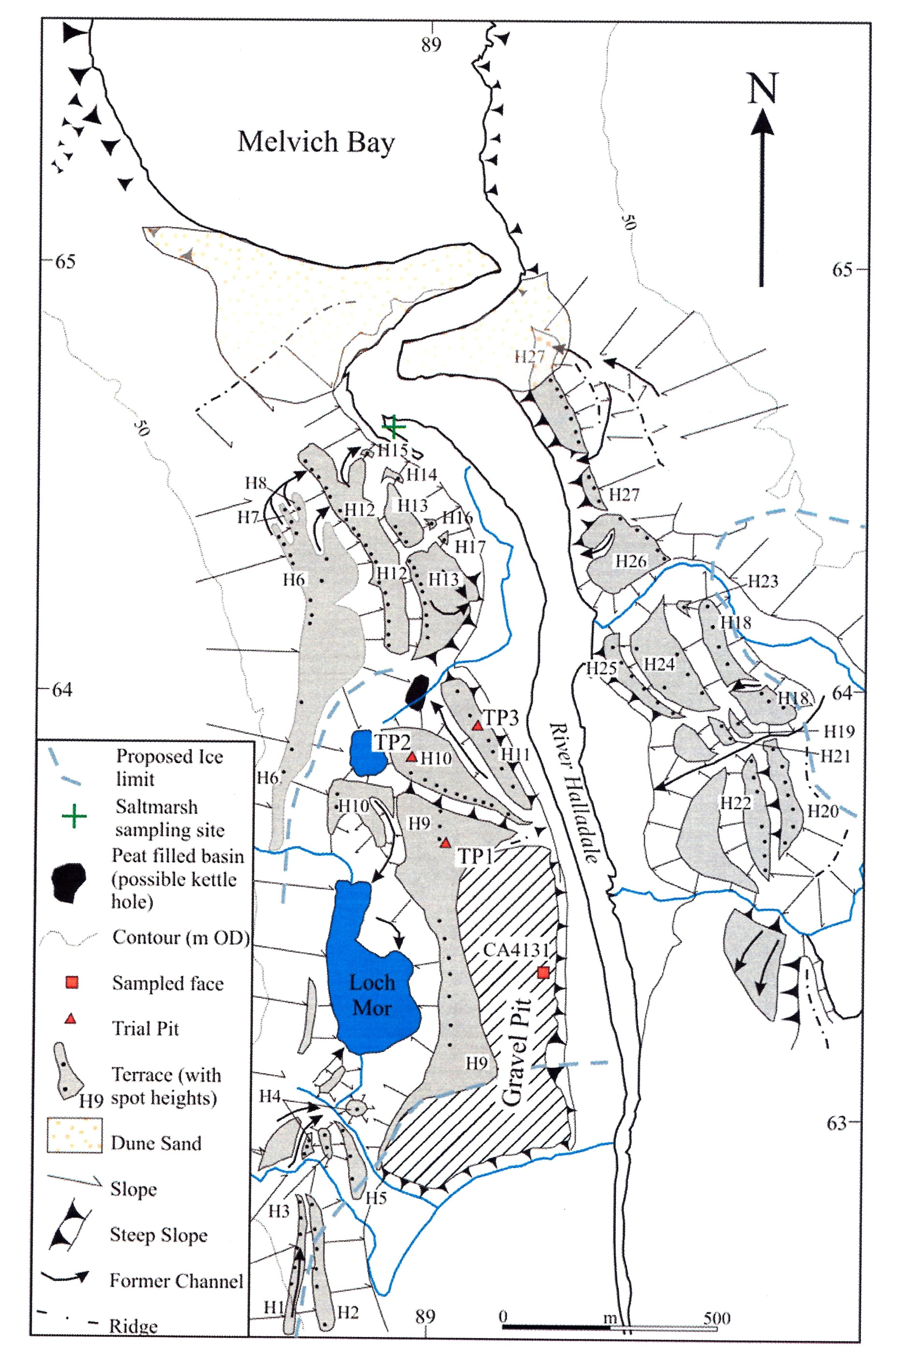
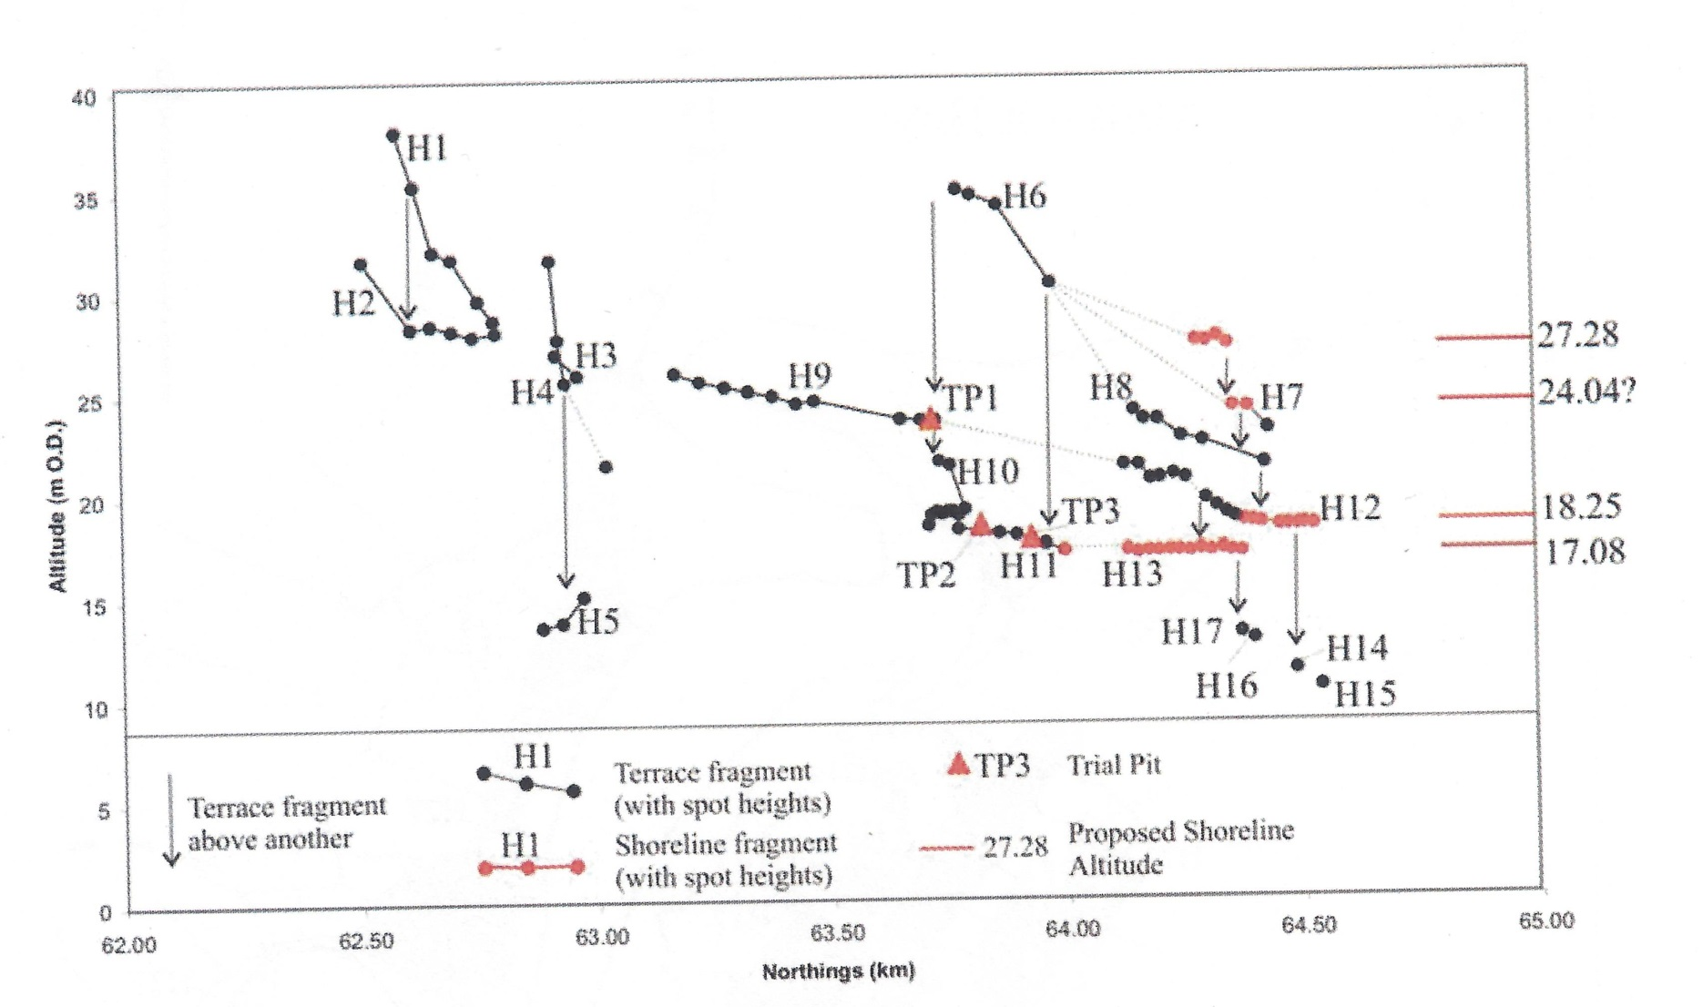
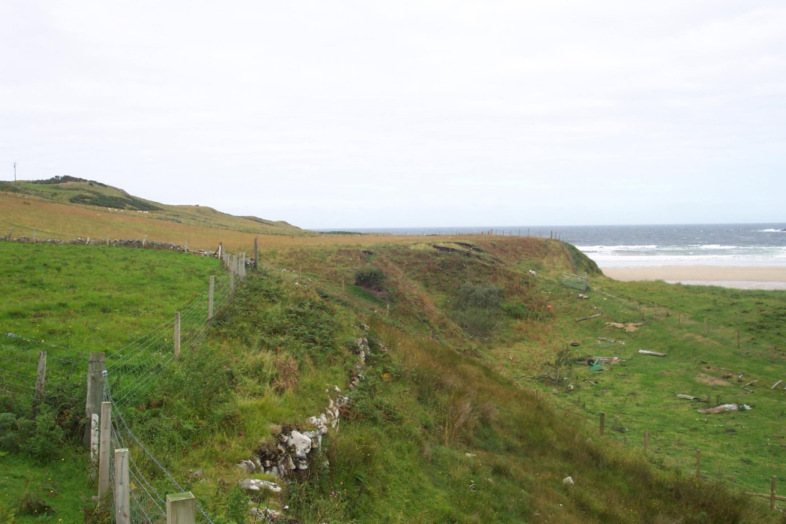
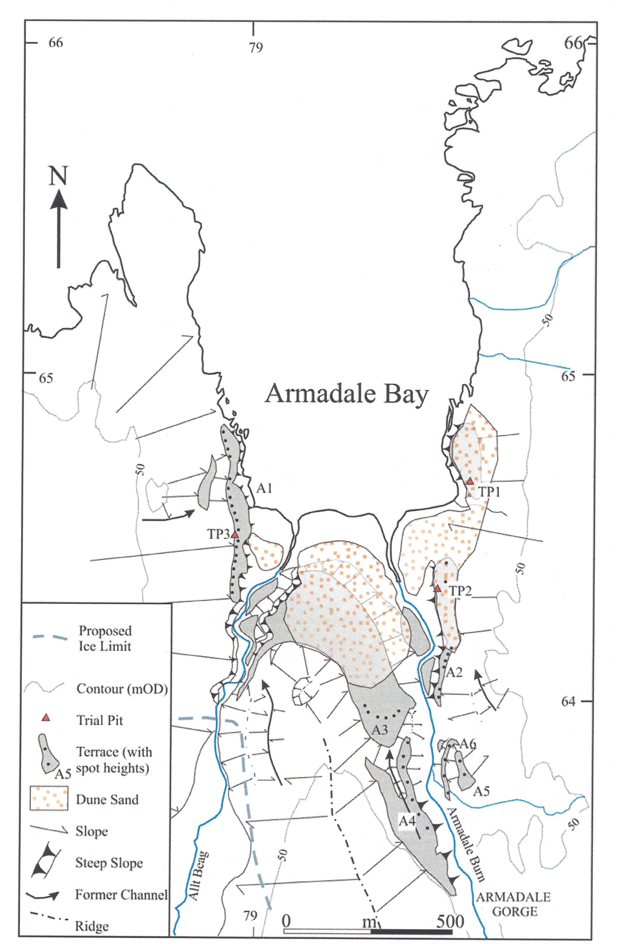
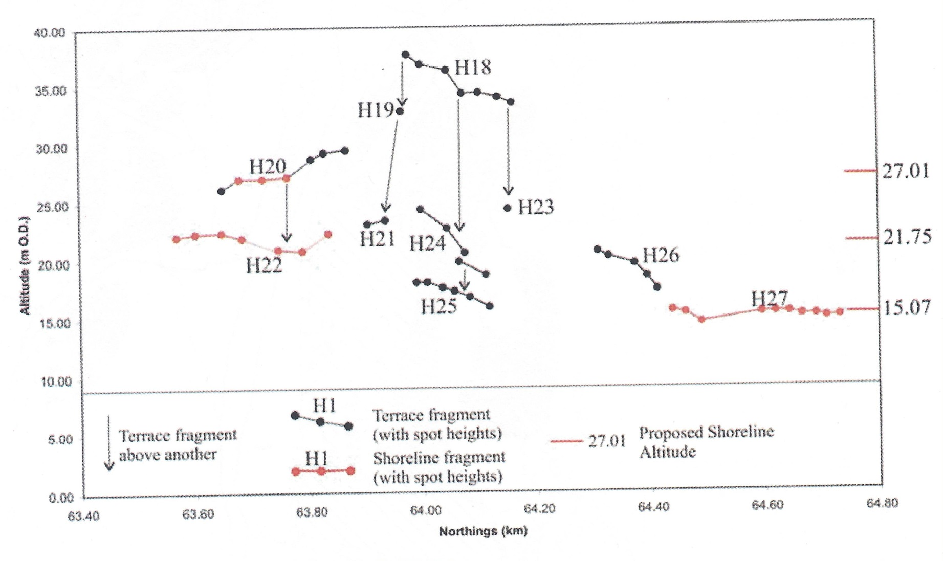
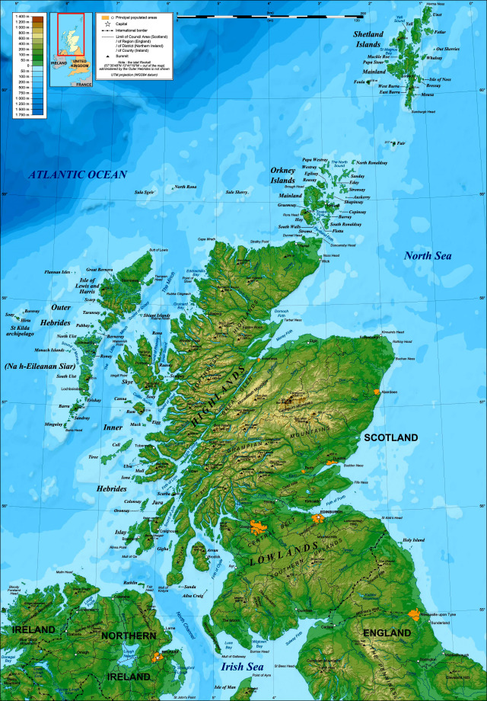
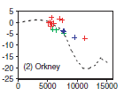
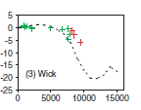
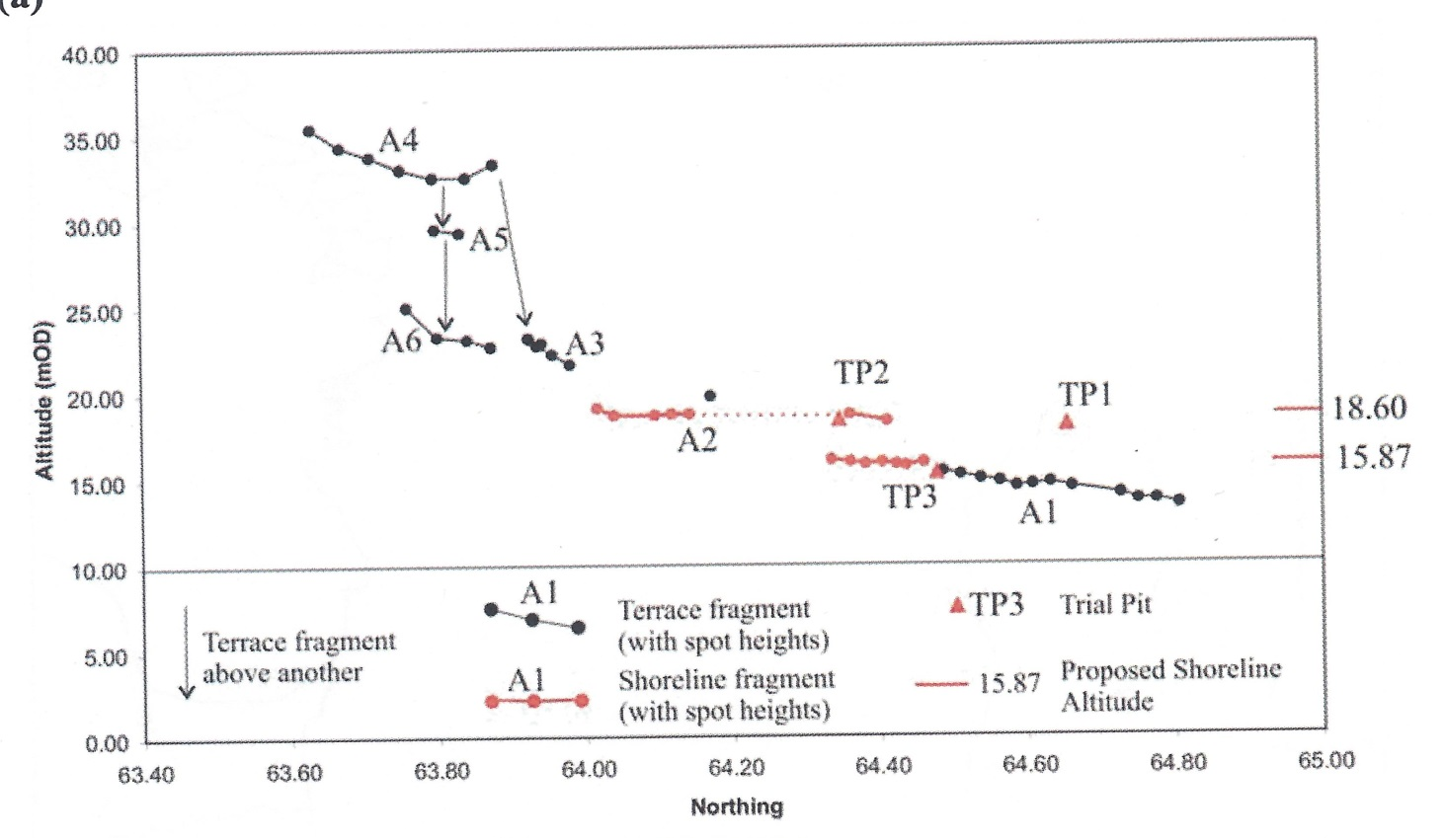
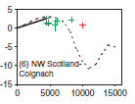
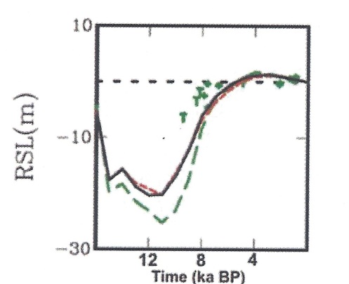
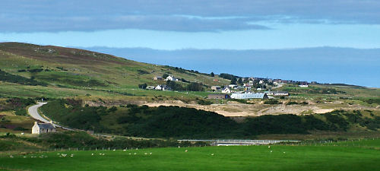
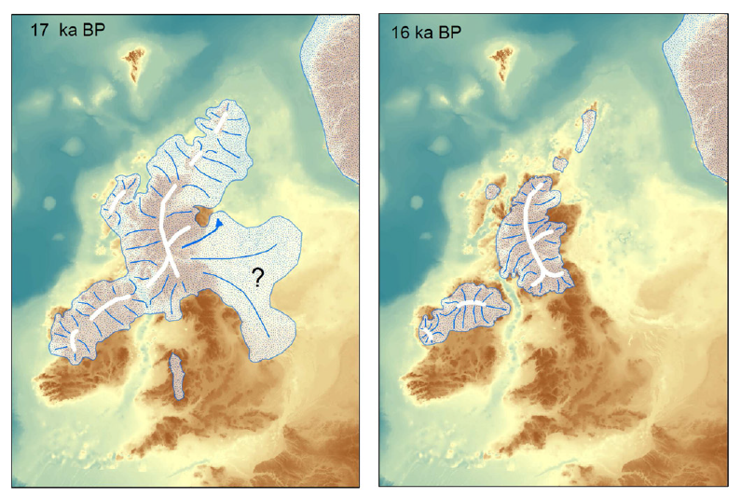
Field Evidence to Constrain Models of Glacio-Isostatic Uplift in Scotland, UK
Callum R Firth¹, David E Smith², Stephen Pearson³ & Clive Auton³
¹ Faculty of Social & Applied Sciences, Canterbury Christ Church University, North Holmes Road, Canterbury, CT1 1QU, UK, email callum.firth@canterbury.ac.uk ² Oxford University Centre for the Environment, South Parks Road, Oxford OX1 3QY, UK, email david.smith@ouce.ox.ac.uk ³British Geological Survey, Keyworth.
Introduction
The wealth of relative sea-level data combined with local ice sheet history has made the British Isles a key location for the development of glacial isostatic adjustment (GIA) models (Lambeck et al., 1996; Johnston and Lambeck, 2000; Peltier et al., 2002; Bradley et al., 2011).The models have been used to constrain the viscoelastic structure of the earth, the global meltwater signal and the regional ice sheet chronology. Whilst the early GIA models (e.g. Lambeck 1993a,b; Lambeck et al., 1996) did not include the underlying topography more recent models have included topography, relative sea level data from the UK and Ireland and GPS measurements of present-day vertical land motions (Bradley et al., 2011). The models are then used to predict present-day sea-level changes and vertical land uplift. The GIA models tend to provide a relatively good fit for Holocene relative sea level changes but often provide a poorer estimate of Lateglacial sea level changes.
This study presents new data from northern Scotland which indicates that the GIAs significantly under estimate Lateglacial relative sea levels.
Methodology
The landforms and Quaternary sediments of the valleys of Strath Halladale, Strathy and Armdale Bay were mapped at a scale of 1:10,000. Trial pits were dug at a number locations with detailed stratigraphical and lithological analysis. Samples were also collected from the trial pits for OSL dating of quartz and feldspar grains. The altitude of the inner margins of fluvial, fluvio-glacial and marine terraces were determined at 20-50m intervals by using a Leica 350 SR GPS. These measurements allowed the horizontal marine features to be distinguished from sloping fluvial and fluvio-glacial landforms.
Strath Halladale
Armadale Bay
Western
stern
Figure 5: Looking west across Armadale Bay at the distinctive outwash delta that grades into a shoreline at 15.87 mOD. The inset is looking north along the shoreline fragment..
Study Area
Predictions of Relative Sea-Level and Deglaciation
There have been very few studies of relative sea level changes along the northern coast of Scotland . Holocene relative sea level data is available from Wick, Orkney and Coignach and GIA model predicted relative sea-level curves have been produced (Fig. 1). All of the GIA model curves suggest that Lateglacial relative sea-levels lay below modern day sea level (e.g. below 0m). Similarly the deglaciation of the area is poorly understood . Clarke et al. (2012) suggest that there was an eastward retreat of the ice sheet along the northern coast of Scotland, before the ice retreated into the northern valleys and a separate ice cap was present over Orkney (Fig. 2). This suggests that the coast became ice free around 16,000 years ago at which point relative sea level should have stood at about -5 to -10 m OD.
Figure 3: Morphological map of Strath Halladle and the altitude of terrace fragments on the eastern and western side of the valley.
Figure 6: Morphological map of Armadale Bay and the altitude of terrace fragments in the area.
Armadale Bay is feed by two northward draining streams, the Armadale Burn and Allt Beag. These rivers dissect an extensive sand and gravel terrace that descends northwards to grade into shoreline fragments at 18.6 mOD on the eastern side of the valley and 15.87 mOD on the western side. It is however noteworthy that in the central part of the Bay and on its eastern side extensive dune deposits cover some of the features. The morphology indicates that ice lay within the Allt Beag basin whilst relative sea level so at 15.87 m OD.
OSL dates from the trial pits yielded ages between 48,000 and 10, 000 years ago. These samples were associated with outwash gravels and as a consequence may not have been fully bleached. The raised shoreline features are certainly Lateglacial in age.
Figure 1: Location of site and relative sea-level curves derived from GIA models.
Figure 4: The gravel pit and outwash terrace at Melvich
The north-south aligned Strath Naver enters the North Sea near the village of Melvich (Fig. 3). On the western side of the valley there are a series of kame terraces and fluvio-glacial outwash fans which descend to shoreline fragments at 27m, 24m (?), 18.25m and 17.08m. The features indicate that the ice margin retreated southward about 750m whilst relative sea level fell 10m. On the eastern side of the valley isolated terrace fragments are also present with shoreline fragments identified at 27m, 21.75m and 15m. The shoreline fragments merge into a terraced outwash fan that indicates that ice lay to the east of the valley whilst the features were formed.
OSL dates from the trial pits and sand and gravel pit yielded ages between 60,000 and 24,000 years ago (Auton et al, 2005). These samples were associated with outwash gravels and as a consequence may not have been fully bleached. The raised shoreline features are certainly Lateglacial in age.
Conclusions
The morphological features in Strath Halladale and Armadale Bay demonstrate clear shoreline fragments at 15-20 mOD and possibly up to an altitude of 27 mOD. These shoreline fragments are considered to be marine terraces and as a consequence they indicate that relative sea-level reached altitudes that were far higher than those predicted by GIA models.. Whilst the models generally fit the Holocene sea level data they fail to predict the Lateglacial sea levels. This implies that either the volume of ice used in the models is in error or the viscoelastic structure of the earth is incorrect.
Figure 2: Model of ice sheet decay (Clarke et al., 2012)
Auton C.A., Firth C.R., Pearson S.G. and Spencer J. 2005. Onshore evidence for Late Quaternary sea-level changes in the Dounreay area. British Geological Survey Commissioned Report CR/05/008.
Bradley S.L., Milne G.A., Shennan I and Edwards R. 2011. An improved glacio-isostatic adjustment model for the British Isles. Journal of Quaternary Science, 26, 541-552.
Clarke C.D., Hughes .L.C., Greenwood S.L., Jordan C. and Sejrup H.P. 2012. Pattern and timing of retreat of the last British-Irish ice sheet. Quaternary Science Reviews, 44, 112-146.
Dawson, S. and Smith, D.E. (2000) The sedimentology of middle Holocene tsunami Facies in northern Sutherland, Scotland, UK. Marine Geology, 170: 69-79.
Johnston PJ, Lambeck K. 2000. Automatic inference of ice models from postglacial sea level observations: theory and application to the British Isles. Journal of Geophysical Research – Solid Earth, 105, 13179–13194.
Lambeck K. 1993a. Glacial rebound of the British Isles. I. Preliminary model results. Geophysical Journal International, 115, 941–959.
Lambeck K. 1993b. Glacial rebound of the British Isles. II. A high resolution, high-precision Model. Geophysical Journal International, 115, 960–990.
Lambeck K, Johnston P, Smither C, et al. 1996. Glacial rebound of the British Isles. III. Constraints on mantle viscosity. Geophysical Journal International, 125, 340–354.

