Slide 1
UNIVERSITIES AT MEDWAY LEARNING AND TEACHING CONFERENCE 2024 Conference Theme: Courage, Compassion & Trust: Helping students see the value of Higher Education
26th June 2024

Slide 2
Assessment Feedback: student and staff views on written and audio feedback
Dr Gemma van Vuuren Cassar
Email: Gemma.van-vuuren-cassar@cantebury.ac.uk
LinkedIn: Gemma van Vuuren-Cassar

Slide 3
OVERVIEW
Assessments: summative and audio feedback in higher education
Student Perspective – preliminary results of surveys 2021 & 2024
Staff Perspective - survey and focus group (2021)
Conclusions and recommendations
Student focus group (2024)

Slide 4
ASSESMSENT SUMMATIVE FEEDBACK “The quality and depth of marking and assessments is an issue of real importance to students” (Advance HE and HEPI, 2024, pg. 63)
Written Feedback
Audio feedback
Written feedback goes unread or uncollected (Cann, 2014).
While students were broadly positive about audio feedback, they indicated a strong preference for written feedback due to visually being able see their strengths and areas to improve on their work (Morris and Chikwa, 2016; Sarcona et al, 2020).
Summative feedback type did not impact on students’ grades in the subsequent assignment (Morris and Chikwa, 2016).
A ‘voice comment’ made the assessment feedback more personalised (Carruthers et al, 2015; Sarcona et al, 2020).
Audio feedback is highly acceptable to students but is underused (Cann, 2014).
Students found difficulty to match the teachers’ comments on the audio recordings with their written document causing emotional reactions (Carless and Boud, 2018) of reduced self-esteem (Rowe, 2017),d stress and anxiety following feedback (Lynam and Cachia, 2018).

Slide 5
WHY AUDIO FEEDBACK?
Audio feedback was trailed across one Academic School for Semesters 1& 2 of the academic year 20-21 since teaching was online and students were not on campus. A ‘voice comment’ made the assessment feedback more personalised (Carruthers et al, 2015). Audio feedback used for the last 3 years.
Generating voice comments and less written comments in text potentially saved time and made explanations tailored for the student’s work. Students would like to have both audio and written assessment modalities as they appreciated the personal nature of hearing the instructors’ voice (Sarcona et al, 2020).
Students received feedback via Turnitin: assessment rubrics, a grade, audio feedback, and in the ‘text comment’ instruction of how to access audio feedback.
Staff used the integrated ‘voice comment’ functionality in Turnitin (3 minutes) - audio-feedback. Staff provided with training for the voice recording; templates of texts of instructions to paste; and a script to use for the recording.
Notes:
S

Slide 6
EVALUATION OF STUDENT PERSPECTIVES
2021: Supply type questions; Likert scales and open-ended responses on
What is most important to students?
Accessibility, engagement and quality of audio feedback
Perspectives on audio and written feedback
Student views on feedback
formative and summative assessment
focus and general feedback
2024: added questions about self-esteem and anxiety
JISC Surveys
JISC Online Survey Bournemouth University (2006-2022)

Slide 7
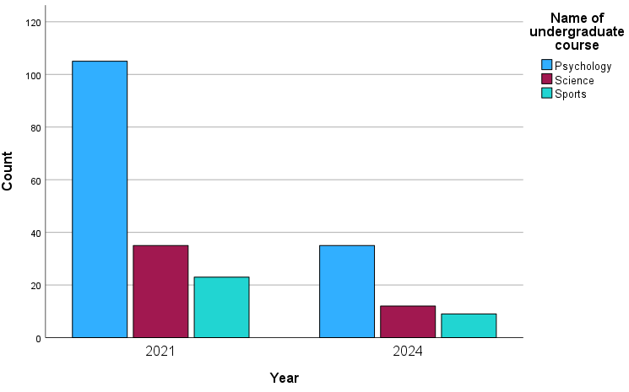
STUDENTS Year of study Courses Levels

Slide 8
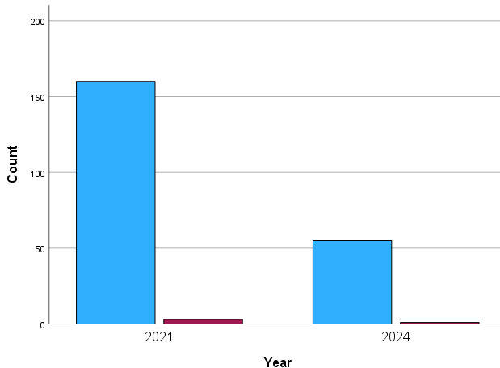
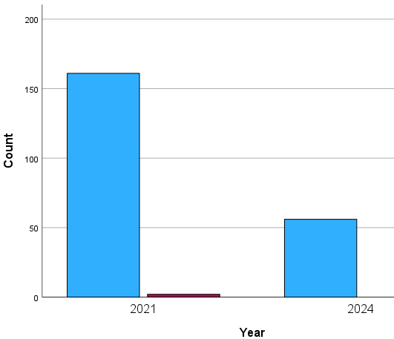
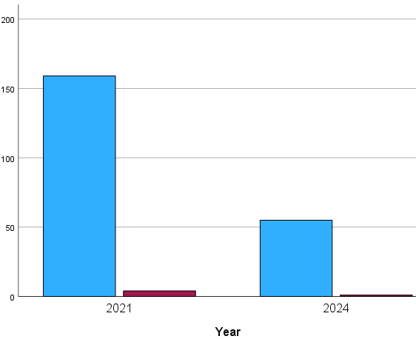
FEEDBACK ON SUMMATIVE ASSESSMENT: What is important to students ….
Easy to Access & year
DETAIL & YEAR
Timely- 15 WORKING DAYS & YEAR

Slide 9
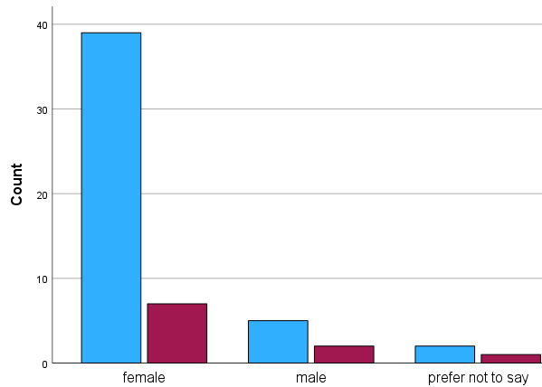
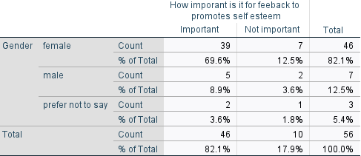
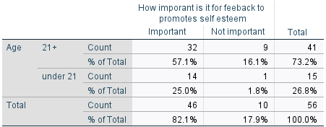
FEEDBACK ON SUMMATIVE ASSESSMENT: What is important to students ….
Personalised & YEAR
Self-Esteem & Age
Self-Esteem & Gender

Slide 10
STUDENTS AND SUMMATIVE ASSESSMENT FEEDBACK (preliminary data analysis) *2024 students only
Statements (5 Strongly Agree – 1 Strongly Disagree) | N | Mean | SD
I listened to each recorded piece of audio-feedback all the way through. | 219 | 4.25 | 1.262
It was easy to find and play the recorded audio-feedback. | 219 | 4.10 | 1.222
*I wish I could download the transcript of the recorded audio feedback from Turnitin | 56 | 3.95 | 1.78
I could hear and understand what the marker(s) were saying clearly. | 219 | 3.85 | 1.320
The sound quality of the recorded audio-feedback was very good. | 219 | 3.74 | 1.314
I listened to each recorded piece of audio-feedback several times. | 219 | 3.68 | 1.351
The recorded audio-feedback made clear the weaknesses of my work. | 219 | 3.60 | 1.283
*I am more anxious about the grade that I receive and less on what is said in the recorded audio or written feedback | 56 | 3.54 | 1.709
The recorded audio-feedback made clear the aspects of my work I need to pay attention to in my future assessments. | 219 | 3.52 | 1.345

Slide 11
STUDENTS AND SUMMATIVE ASSESSMENT FEEDBACK (preliminary data analysis) *2024 students only
Statements (5 Strongly agree – 1 Strongly Disagree) | N | Mean | SD
*The feedback (3mins) was long enough | 56 | 3.37 | 1.727
The marker(s) providing my recorded audio-feedback sounded interested. | 219 | 3.34 | 1.389
The recorded audio-feedback is more personalized than written feedback | 219 | 3.11 | 1.348
I took notes when listening to my recorded audio-feedback. | 219 | 3.01 | 1.453
*I get anxious before I listen to the feedback | 56 | 3.00 | 1.935
I am more likely to contact my lecturer to discuss recorded audio-feedback than written feedback. | 219 | 2.93 | 1.215
I am more likely to act on recorded audio-feedback than on written feedback. | 219 | 2.79 | 1.286
I am more likely to review recorded audio-feedback than written feedback when I'm working on my next assessment. | 219 | 2.78 | 1.338
Recorded audio-feedback goes into more detail than written feedback. | 219 | 2.85 | 1.436
It depends on the assessment type which type of feedback I prefer (recorded audio-feedback or written feedback). | 219 | 2.79 | 1.224
It causes me less anxiety listening to recorded audio-feedback than reading written feedback | 219 | 2.50 | 1.272

Slide 12
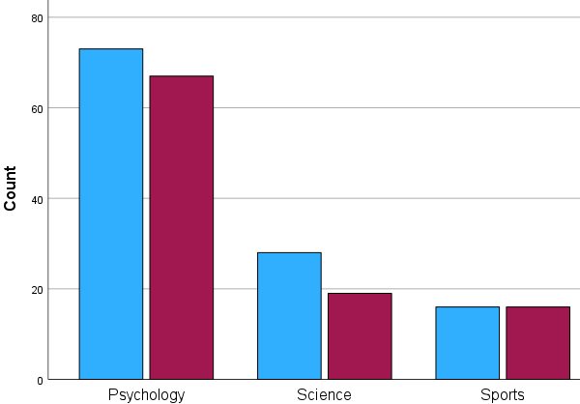
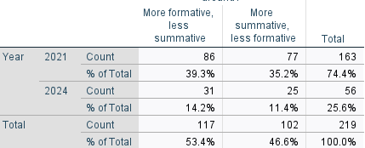
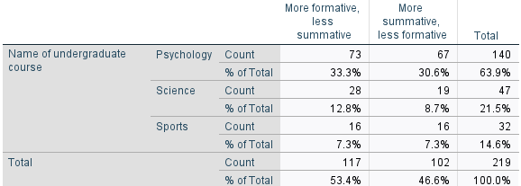
WOULD YOU RATHER HAVE FEEDBACK THAT IS…

Slide 13
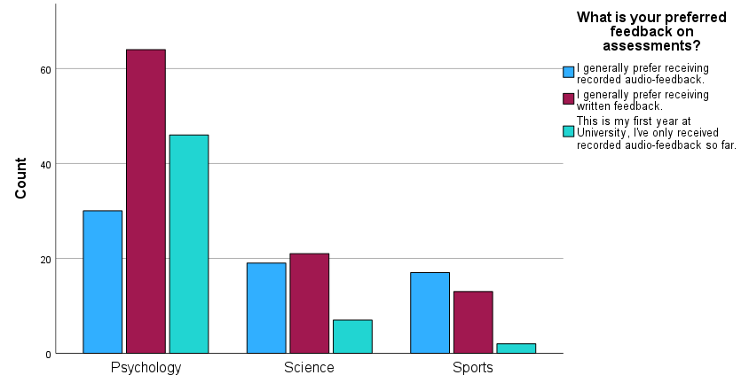
PREFERRED FEEDBACK by course X² (4, N=219 )= 20.76 , p=<.001*
There is a slight preference for written feedback by psychology students (N=64) - this is statistically significant*

Slide 14
Student focus group (2024) Experience of assessments and feedback
Exams
Grade and Audio feedback release day
“the word exam puts fear into students regardless of what platform and what sort of shape it takes place.
For me, it's a fear of failing, a fear of not doing well, so I was always anxious …
I prefer online exams- a relaxed approach being 24 hours online rather than, say, 2 hour exam in person.” P1
“personally, I was incredibly anxious, but I was also furious .. I have auditory sensory issues - I have been fighting with a disability team to get a cover slip, saying my feedback has to be given written”P1
“I can tell by the feedback if someone actually has taken the time to probably read it, understand it, and actually being a little bit inspired and, you know, have learnt something from it, some feedback that I've received has been quite generic”.P2

Slide 15
EVALUATION OF STAFF EXPERIENCE (2021): AUDIO FEEDBACK
Staff- JISC Survey
Staff -Focus Group on Audio Feedback
46 Participants (30%)
Open-ended questions
Using the audio feedback template
Time to complete audio feedback
Recording the audio feedback
6 opt in participants
Semi structured questions on
Use of template
The process and technical matters
Time to complete audio feedback
Perceptions of audio feedback and written feedback

Slide 16
AUDIO FEEDBACK
Structure of and using template
Time - Technical issues
Similar to what we already had for written feedback
Works well for essay type assignments but not for exercises and research reports
Makes you focus on specific feedback
Coherent and consistent approach to each student
Not as detailed as written feedback … with annotations in text.
Modified feedback to suit our needs/programmes … resulting in inconsistency
Level of detail was reduced … generic and not specific to their work
Harder to use for low achieving students…; higher level modules … and dissertations
3 minutes not enough to do the full Strengths-Weaknesses-Key Points going forward
Process quicker than written feedback
Rerecord and cancelling a few times / forgot to press the Save button
Easier to type written feedback, and templates can be copied and pasted in written feedback.. Text can be edited
Write feedback in words for students with hearing impairment
….staff receive proper training, particularly for modules with large amounts of sessional markers.
Moderation takes longer

Slide 17
EXPERIENCE OF DELIVERING RECORDED AUDIO-FEEDBACK
Technical issues
staff autonomy & students
Files there but no sound
Background noise when working from home
Audio feedback not downloadable for students or External Examiners
… some colleagues that apparently forgot to press the Save button
RE- Recording!
….staff receive proper training, particularly for modules with large amounts of sessional markers.
Prefer the freedom to use it in combination with in-text comments and quick marks
audio feedback is not always the most appropriate format. To force all staff to use audio feedback removes any professional autonomy. Staff to chose audio / written feedback…. it would be nice to have flexibility.
Students requested tutorial - they could not understand where in their work they fell down on marks nor how it related to the audio-feedback.

Slide 18
CONCLUSIONS AND RECOMMENDATIONS
STUDENTS
STAFF
Students value
detailed, timely and personalised assessment feedback
concise feedback that emphasises areas for improvement
formative and summative feedback
Students
engage with audio feedback recordings
would like a transcript of the recording
feel that it is important for assessments to promote self-esteem, especially for female students.
Some anxiety is experienced before seeing the grade; and whe the feedback is audio or written.
psychology students prefer written summative feedback
Further investigations on
“how” and “when” formative feedback will benefit students is recommended for different types of assessments.
Staff value
Guidance (templates) for consistency of practice of audio feedback for summative assessments
Support through training, resources, workshops and technical support to use audio feedback.
Professional judgement of staff and flexibility of use of audio and written feedback.
Further studies on
time allocation for staff to providing timely and detailed formative and summative feedback for assessments
staff and student efficacy of summative and formative assessment feedback in higher education
staff and student perceptions of summative and formative assessment feedback and different types of assessments (exams, coursework, practical, authentic..)

Slide 19
REFERENCE LIST
Advance HE and Higher Education Policy Institute (HEPI) (2024) Student Academic Experience Survey 2024. Available at: https://advance-he.ac.uk/knowledge-hub/student-academic-experience-survey-2024. (Accessed: 20/6/20204)
Cann, A. (2014) Engaging Students with Audio Feedback, Bioscience Education, 22:1, 31-41.
Carless, D and Boud, D (2018) ‘The development of student feedback literacy: Enabling uptake of feedback’, Assessment and Evaluation in Higher Education, 43 (8): 1315-1325.
Carruthers, C., McCarron, B., Bolan, P., Devine, A., McMahon-Beattie, U., and Burns, A. (2015). “‘I like the Sound of That’ – An Evaluation of Providing Audio Feedback via the Virtual Learning Environment for Summative Assessment.” Assessment & Evaluation in Higher Education 1 (3): 353–370.
Lynam, S and Cachia, M (2018) ‘Students’ perceptions of the role of assessments at higher education’, Assessment and Evaluation in Higher Education, 43 (2): 223-234.
Morris, C., and Chikwa, G. (2016) Audio versus written feedback: exploring learners’ preference and the impact of feedback format on students’ academic performance. Active Learning in Higher Education, 17 (2), 125-137.
Sarcona, A., Dirhan, D., Davidson, P. (2020) An overview of audio an written feedback from student’s and instructors’ perspective. Educational Media International, 57 (1), 47-60.
Van Vuuren-Cassar, G. and Harvey, C. (2022) Undergraduate students’ perspective of summative and audio feedback. International Network of Assessment in Higher Education Conference, Manchester, UK. (22nd June 2022)

