Slide 1
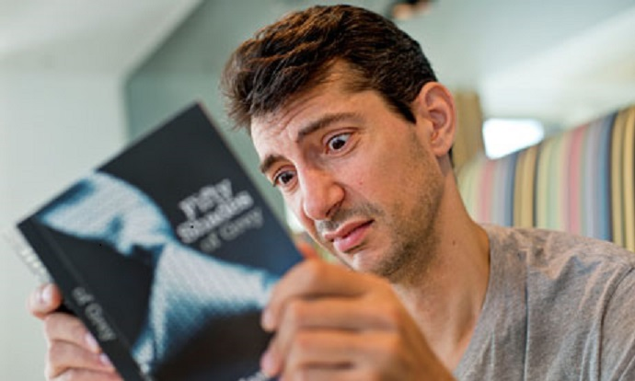


Changing UK Society’s whole approach to psychosis: articulating a genuinely psychosocial approach
Anne Cooke

Slide 2
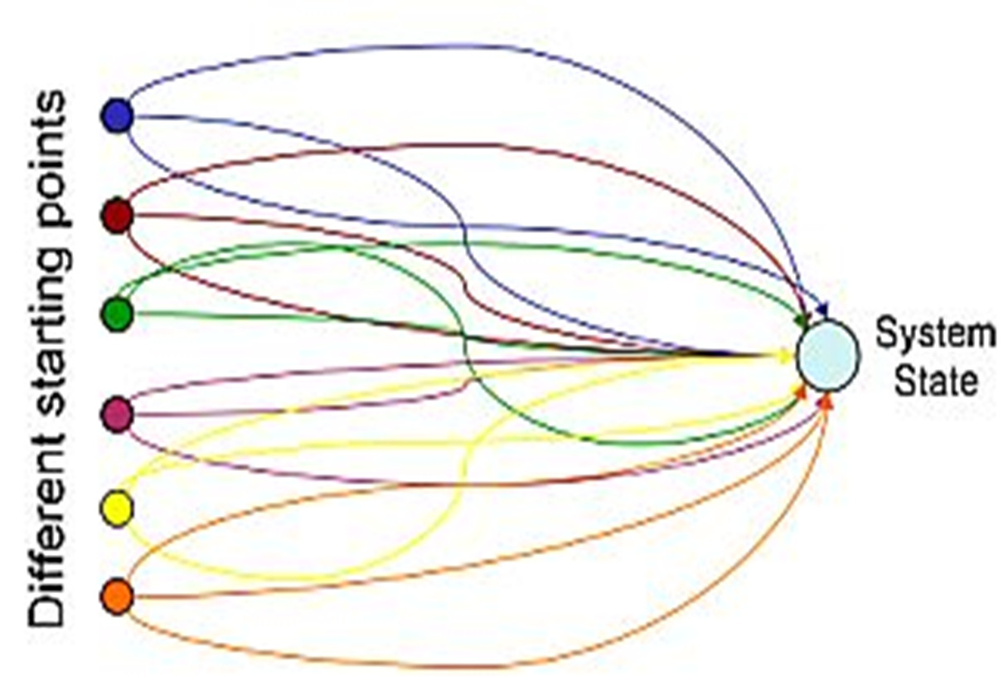
Equifinality

Slide 3
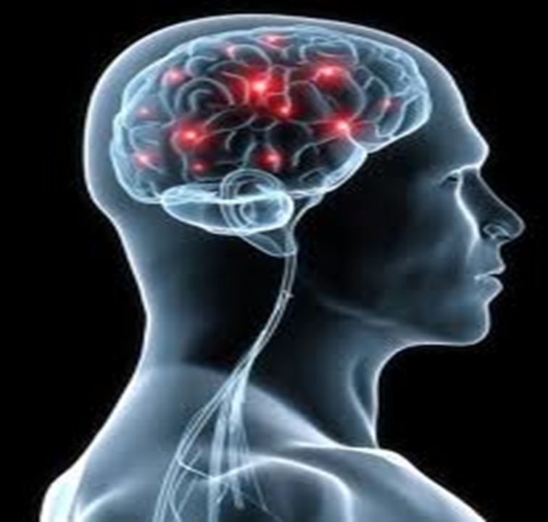

Slide 4
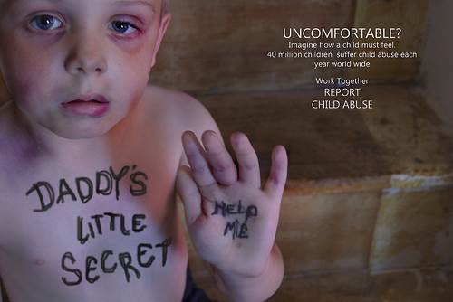
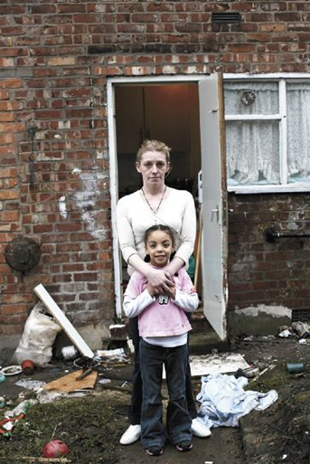
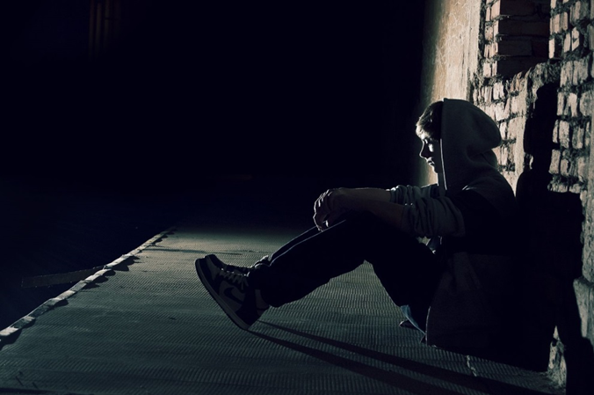

Slide 5


Slide 6
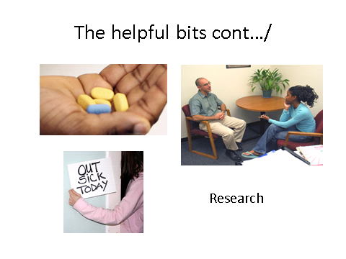

Slide 7
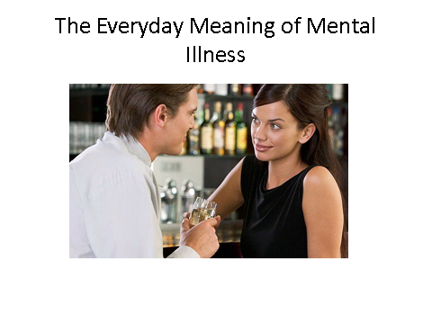

Slide 8
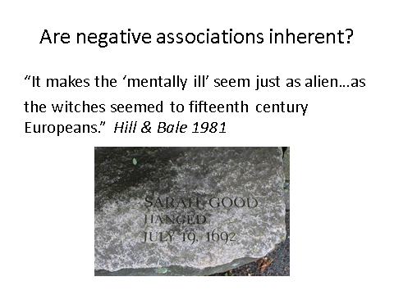

Slide 9
There are practical consequences for people who are diagnosed
Notes:
Anne.

Slide 10
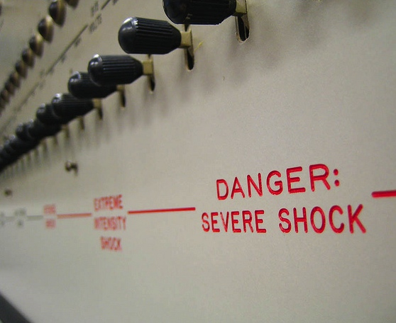
Practical Consequences
Avoidance and Harsh Treatment
Mehta & Farina experiment – more electric shocks to those seen as having a disease
Notes:
Describe the experiment – re run of the famous Stanley Milgram electric shock obedience experiments

Slide 11
Practical Consequences
Unemployment and Financial Disadvantage
High rates of unemployment appear to be due to discrimination rather than impairment
Notes:
Anne..

Slide 12

Practical Consequences
Loss of rights
Notes:
Only if you have a diagnosis can you be locked up without having committed a crime, and forcibly injected

Slide 13
Problems with the idea of mental illness
Psychological Effects of diagnosis
Notes:
That’s the practical effects, but the idea of having a mental illness also has psychological effects on people who are diagnosed.

Slide 14
Psychological Effects
Hopelessness
“I’m sicker than I thought I was” Anon

Slide 15
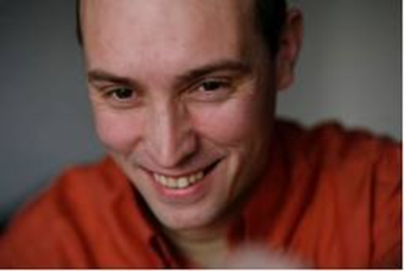
Accepting my diagnosis would have led to a long term career as a psychiatric patient
Rufus May
Notes:
Anne

Slide 16
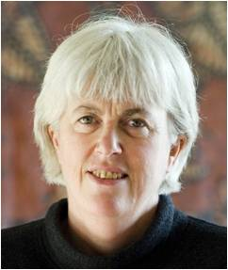
Psychological Effect 5
Denial of the positive aspects of experience
How different my mood swings would have been if they were judged to be a talent rather than an illness. Patsy O’Hagan, 1993
Notes:
Anne.

Slide 18
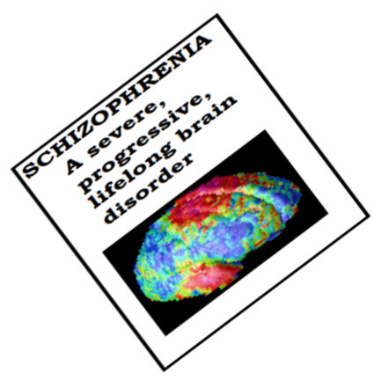
NNNarratives of Despair

Slide 19



Misunderstanding
Narratives of Despair
“The often violent and irrational behaviour of schizophrenics frequently sparks fear in others”
NEWS
OF
THE
WORLD
“Many mental health patients are like timebombs - it is only a matter of time before they go off.”
NEWS
OF
THE
WORLD
“Free to kill - lunatics left to roam streets butcher 90 people a year.”
“The lunatic had already plunged a seven-inch knife into Harrison's chest … celeb-crazed wackos fantasize about killing their idols”
“£1m probe into deadly instincts of mentally ill”
Notes:
Good – again see what you think of the real press cuttings when they come through

Slide 20

The stereotype
A person who has psychotic experiences is:
Different from normal people…
Because his brain is abnormal...
probably because of his genes...
He is A SCHIZOPHRENIC...
who is not understandable...
is dangerous...
has no legitimate voice...
and requires control through drugs.
Oh and incidentally:
The drugs are wonderful, pleasant, work for anybody who can be forced to take them, have no adverse effects, and actually target the brain disorders that we all know are really responsible.
Notes:
Really nice idea, with and without makeup – but I don’t like the pic – sorry – think its OTT and likely to cause offence – at this conf anyway. Secy (whose name is Alison by the way!) is also now faxing some real copies of news cuttings with (I think) suitable images – see what you think. I’m not sure the horror figure is really = the schizophrenic stereotype.

Slide 21
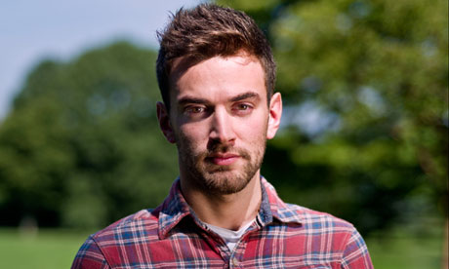
Jonny Benjamin
‘I felt like I’d been given a life sentence’

Slide 22
‘All I knew was what I read in the papers – that people with schizophrenia are violent and incapable of recovery’

Slide 23
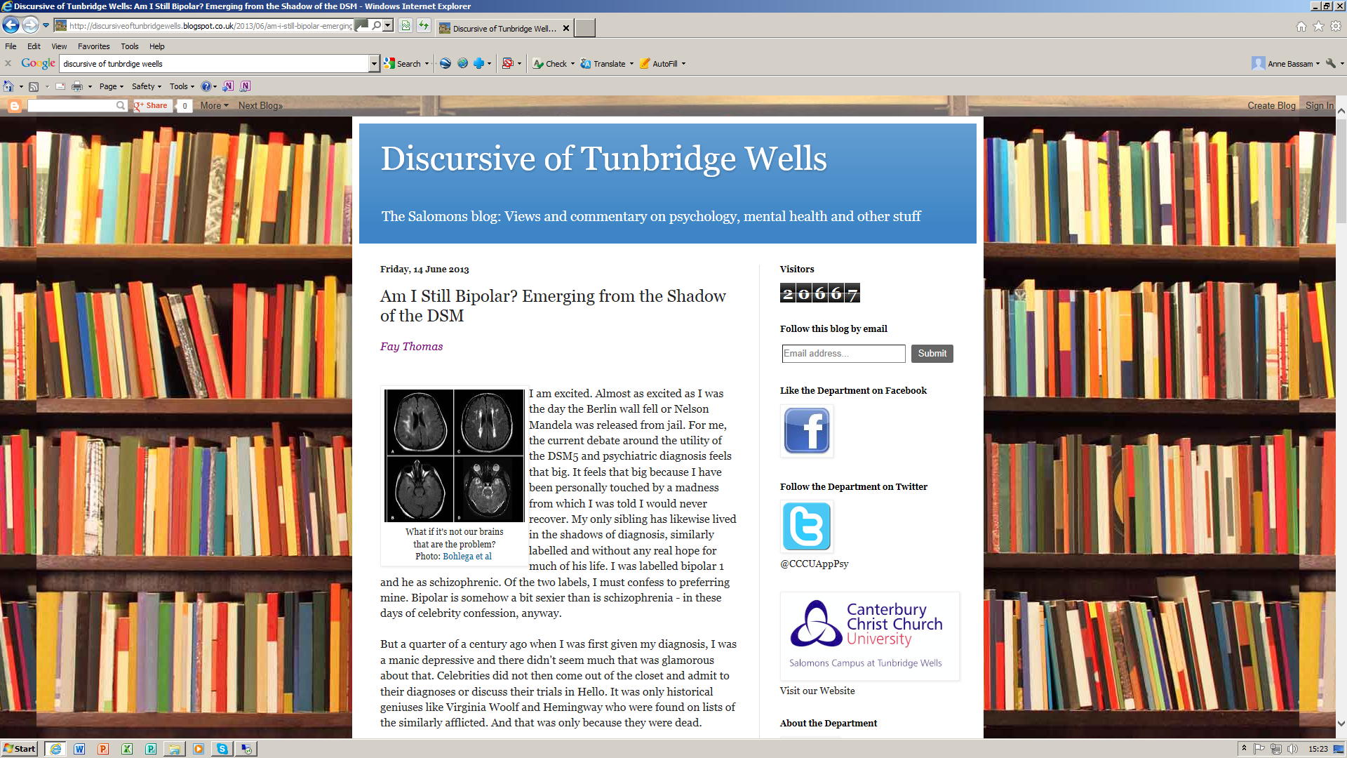
Notes:
Plug for our blog – here’s one by someone who was given a diagnosis and felt defective as a result. As you can see she’s excited by this debate

Slide 24
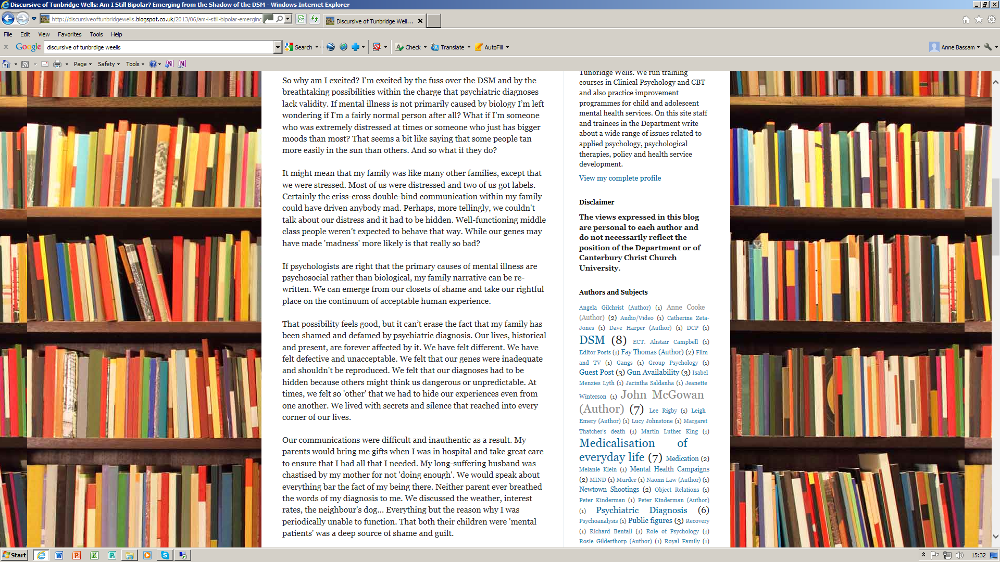
Notes:
Read out the paragraph my family has been shamed…

Slide 25
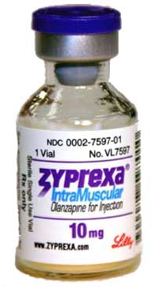

‘Schizophrenia is a devastating brain disorder’
Zyprexa.com
Notes:
Anne. And with schizophrenia. These aren’t the only ways people think about these things but it’s worth remembering that they often end up dominating the conversation. Going back to history this is very much where we are now. Is that a fair comparison though?

Slide 26

Challenging the Narrative of Despair

Slide 28


Slide 29
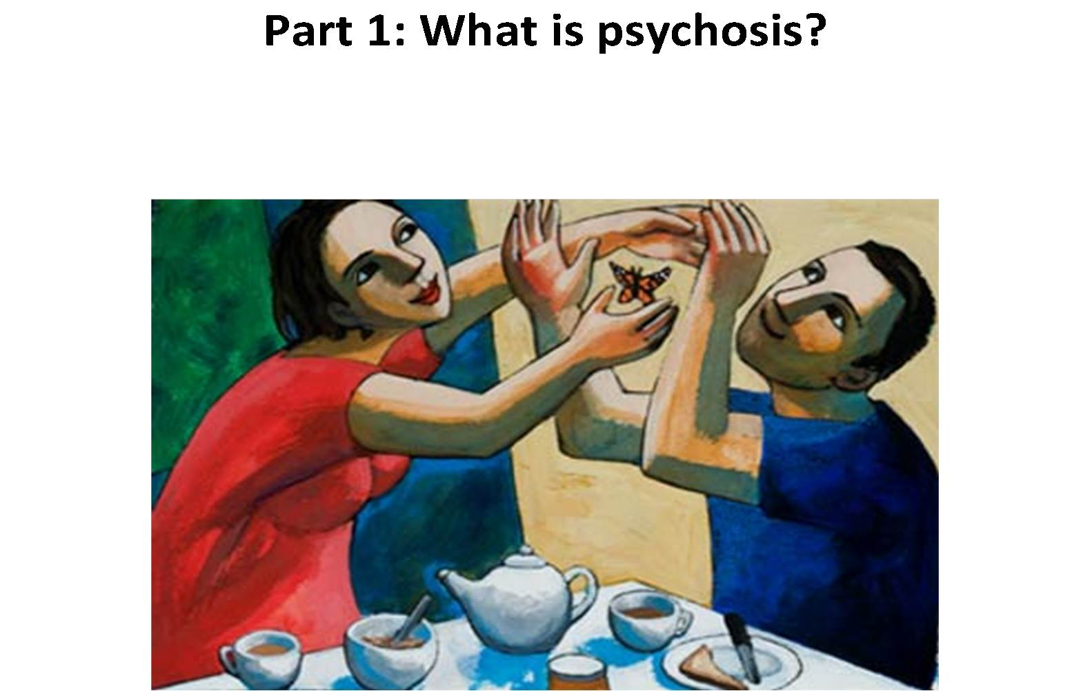
Notes:
Some of the key messages. Four parts to the report.

Slide 30
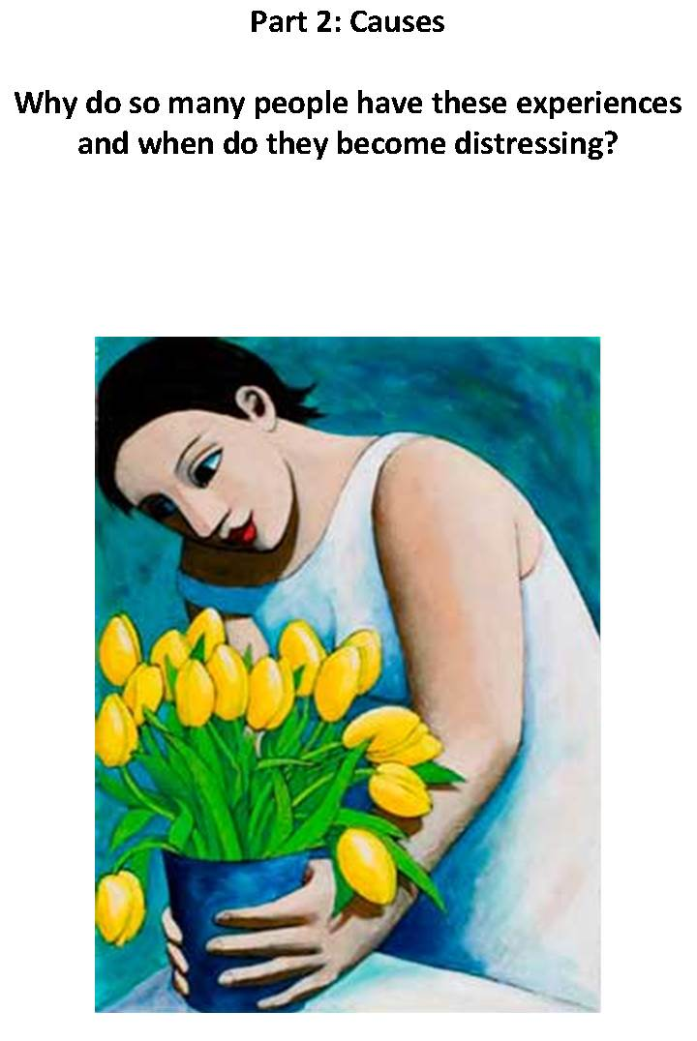

Slide 31
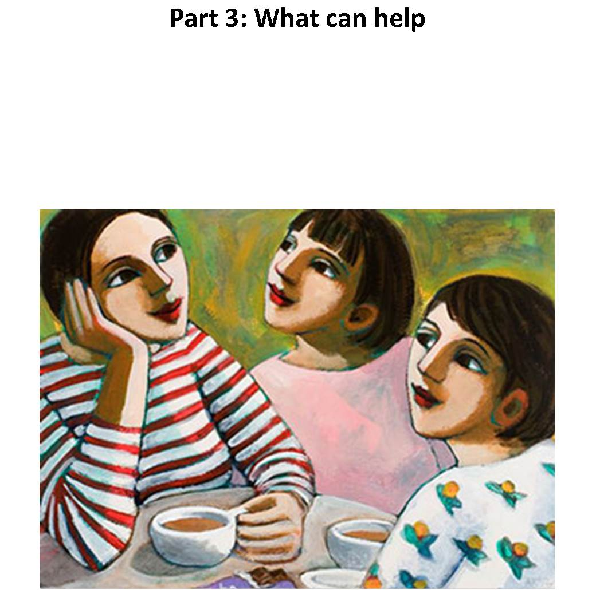

Slide 32
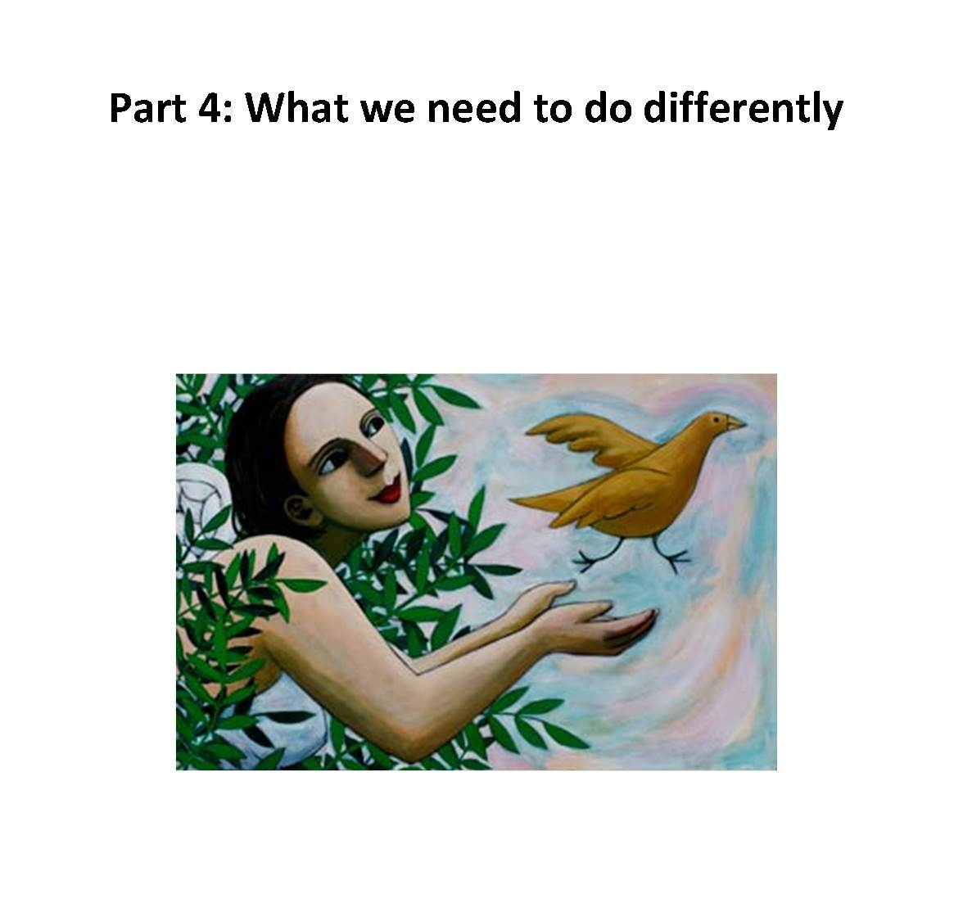

Slide 33

Hearing voices or feeling paranoid are common experiences which can often be a reaction to trauma, abuse or deprivation. Calling them symptoms of mental illness, psychosis or schizophrenia is only one way of thinking about them, with advantages and disadvantages
Notes:
Some of the key messages

Slide 34
There is no clear dividing line between ‘psychosis’ and other thoughts, feelings and beliefs: psychosis can be understood and treated in the same way as other psychological problems such as anxiety or shyness.

Slide 35
Some people find it useful to think of themselves as having an illness. Others prefer to think of their problems as, for example, an aspect of their personality which sometimes gets them into trouble but which they would not want to be without.

Slide 36
In some cultures, experiences such as hearing voices are highly valued.

Slide 37
Each individual’s experiences are unique – no one person’s problems, or ways of coping with them, are exactly the same as anyone else’s.

Slide 38
For many people the experiences are short-lived. Even people who continue to have them nevertheless often lead happy and successful lives.

Slide 39
Psychological therapies are very helpful for many people. However most people are currently unable to access them and we regard this situation as scandalous.

Slide 40
More generally, it is vital that services offer people the chance to talk in detail about their experiences and to make sense of what has happened to them. Surprisingly few currently do.

Slide 41
Professionals should not insist that people accept any one particular framework of understanding, for example that their experiences are symptoms of an illness.

Slide 42
Many people find that ‘antipsychotic’ medication helps to make the experiences less frequent, intense or distressing. However, there is no evidence that it corrects an underlying biological abnormality. Recent evidence also suggests that it carries significant risks, particularly if taken long term.

Slide 43
The British Psychological Society believes that services need to change radically, and that we need to invest in prevention by taking measures to reduce abuse, deprivation and inequality.

Slide 44
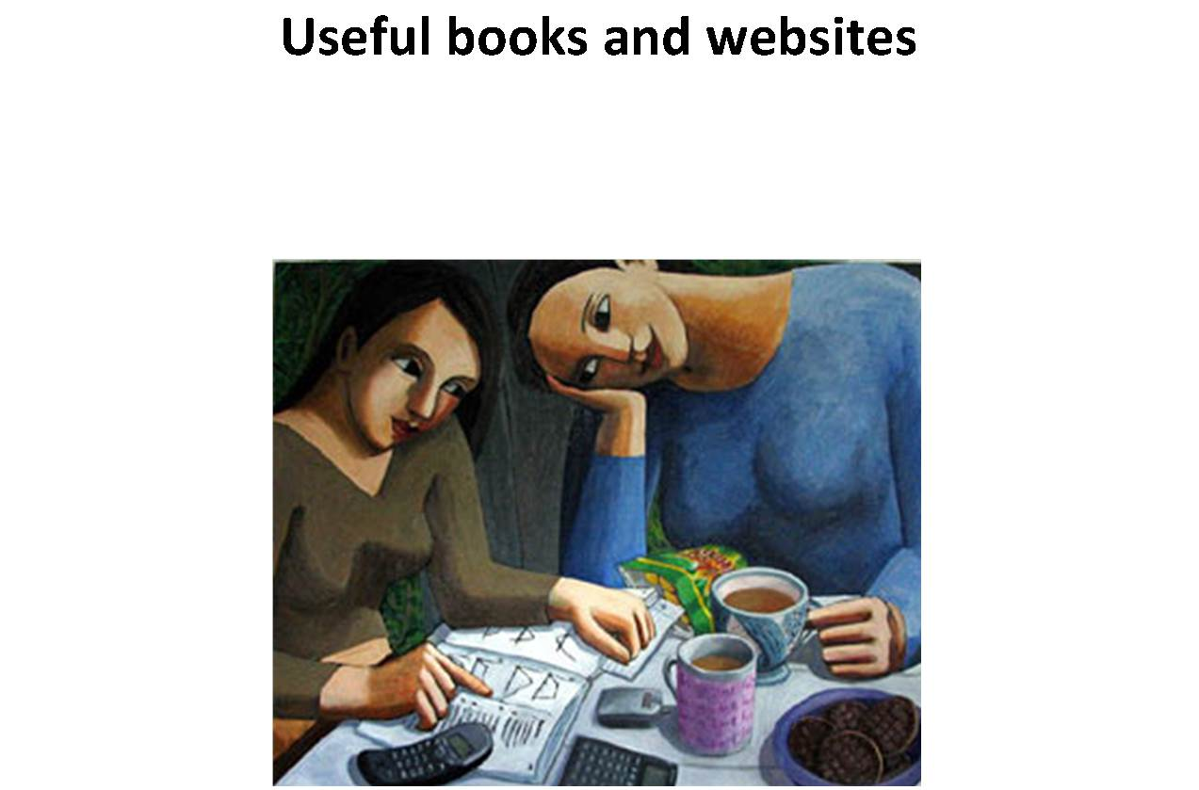
Notes:
There’s a section at the end where we’ve brought together every resource we could find on this approach

Slide 45



anne.cooke@canterbury.ac.uk
@annecooke14
www.understandingpsychosis.net
www.discursiveoftunbridgewells.blogspot.co.uk
Notes:
That’s all folks. My contact details.

