Slide 1
Gen Z, identity politics, and the problem of belonging
Dr Jennie Bristow
Senior Lecturer in Sociology, Canterbury Christ Church University
Clout Culture: Youth Cultures in Changing Societies, Budapest, 8 September 2023

Slide 2
Talking about generations
Everybody seems to be talking about generations, but what do they mean?
Generation has both biological and social meanings and can be used to describe family relationships, peer groups and political and cultural identities.
Generation is a ‘mutable’ concept, which ‘has been subject to change in the flow of history and circumstance in which it has been put to work’; it ‘has been charged with being too empty and slippery to be of much use; yet these characteristics are a function of its survival over thousands of years and the diversity of human formation and experience which it has named’ (Burnett 2010, p1).
Beware the problem of generationalism:
‘The systematic appeal to the concept of generation in narrating the social and political’ (White 2013).
‘[A] special form of historicism, by which generations are interpreted as collective actors and the succession of generations as the primary engine of history’. In overemphasizing the characteristics of different generations, this way of thinking results in ‘mere caricatures’, between which ‘artificial confrontations’ become instigated (Purhonen 2016, p.914).

Slide 3
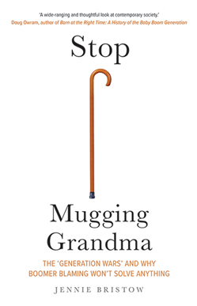
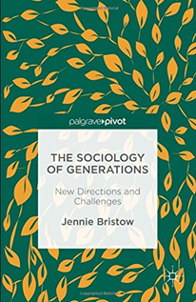
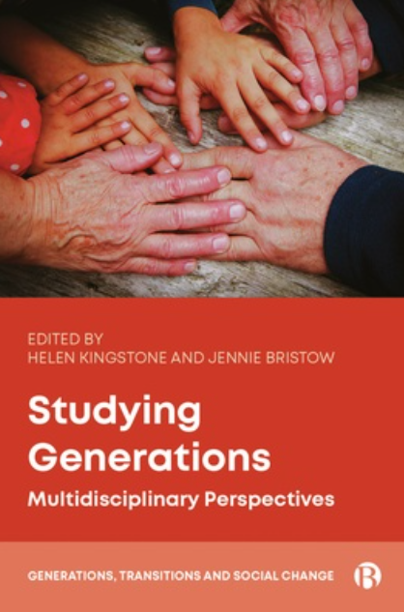
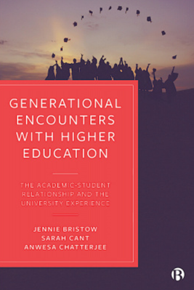
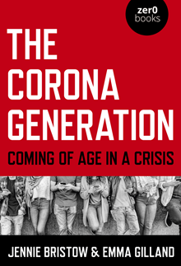
So what do we do with it?

Slide 4
Conceptual confusions
Rudolph and Zacher (‘“The COVID-19 generation”: A cautionary note’, 2020) discuss how ‘generationalized rhetoric’ around the Covid-19 pandemic reproduced ‘the various conceptual, methodological, and practical problems associated with the (mis)application of generations for making sense of uncertain times’ (p.139).
These include longstanding empirical difficulties in the study of generations, such as the problem of separating:
cohort effects (‘differences in attitudes, values, or behaviors that can be tied to birth year differences’),
from age effects (‘the influence of developmental processes’),
and period effects, which ‘are typically taken as evidence for the influence of contemporaneous time, including the role that important current events play (e.g., economic conditions, national conflicts, one-off events, the onset of the COVID-19 pandemic) in shaping attitudes, values, and behaviors’ (p.141).
Sociological approaches:
Kinship descent
Cohort
Life stage / life course
Historical period
(Kertzer, 1983)

Slide 5
Generations and the sociology of knowledge (Mannheim, 1952 [1928])
The ‘problem of generations’ is about knowledge and meaning: how a society understands itself and its history, and how knowledge is constructed and reconstructed over time.
Mannheim’s contribution provided a framework for understanding the emergence of generational consciousness in relation to wider social and cultural events.
What we know about the world cannot be decoupled from how we come to know it: society’s ‘accumulated cultural heritage’ is not something static that is merely passed down, but is continually transmitted to, and refreshed by, ‘new participants in the cultural process’, who make ‘fresh contacts’ with our society.
People born at a particular point in history embody, and internalize, the experience of their time; which is distinct from those who have come before them. Thus, generational consciousness is developed within, and informed by, the experience of coming of age in a particular time and place.
Generational ‘labels’ are widely understood as the cultural expression of ‘social generations’: cohorts of people who share an outlook shaped by the historical moment in which they come of age, which both reflects and shapes the Zeitgeist and is often at odds with that of their elders.

Slide 6
‘Social generations’: common labels and dates
Intergenerational Commission (UK, 2016)
Jean Twenge (US, 2023)
Label | Born
Forgotten Generation | 1896-1910
Greatest Generation | 1911-1925
Silent Generation | 1926-1945
Baby Boomers | 1946-1965
Generation X | 1966-1980
Millennials | 1981-2000
The latest generation | 2001-2015
Label | Born
Silents | 1925-1945
Boomers | 1946-1964
Generation X | 1965-1979
Millennials | 1980-1994
Generation Z | 1995-2012
Polars | 2013 --

Slide 7
How can a generational lens help us to understand social and historical change?
The relationship between history and biography (Mills, 1959)
The problem of knowledge (Mannheim, 1952): how meaning is transmitted and recreated
The problem of time: personal, social, and fragmented
The embodied relationship between past, present and future
A cohort’s social experience in time and place can develop a distinctive consciousness of the world as it is
‘Baby Boomers’, ‘Millennials’, ‘Covid generation’
Leads to a different orientation towards the world than that of older and younger generations
‘Digital natives’, ‘Child of the 60s’
Knowledge (both tacit and formal) is passed on and reconstructed by collaboration between older and younger generations

Slide 8
Generational consciousness and conflict
A distinctive generational consciousness does not arise simply from the passage of time, as is implied by current generationalist narratives.
Rather, it is the outcome of social and cultural conflict, when the knowledge and experience of the past comes starkly into tension with the present day.
According to Mannheim (1952), the emergence of an ‘actual generation’ involves ‘more than mere co-presence’ at a particular time and place – it requires ‘participation in the common destiny of this historical and social unit’ during a process of ‘dynamic destabilization’.
The destabilization provoked by accelerated social change can result in a shared consciousness amongst those coming into adulthood, as young people, being closer to the problems of their time, ‘are dramatically aware of a process of de-stabilization and take sides in it’.
It can also result in a schism between the generations, as ‘the older generation cling to the re-orientation that had been the drama of their youth’.
Conflict between generations, and the development of a distinctive ‘generational consciousness’, is both the product of a wider social and cultural conflict, and contributes to it.

Slide 9
The problem of ‘kids today’
Leccardi and Ruspini (2016) write of the differences between debates about youth that characterized the 20th century, which focused on how to integrate young people into the norms and roles of adult society, and those marked by ‘more recent history’, which ‘is characterized by fragmentation, the outcome of the lack of a true centre from which conflicts may radiate’:
One consequence of this has been ‘a restructuring of inter-generational relations’, in particular between parents and children’, and a notable change in life-course patterns, ‘moving from de-standardization and growing contingency in identity’ (pp1-2).
Regarded as the product of a late modern ‘risk society’, in which boundaries and transitions have become increasingly blurred, and discourses of ‘fluidity’ sit uneasily alongside attempts to categorize and generalize (Furedi, 2020).

Slide 10
‘[T]hese new characteristics of social time and their reflections on the construction of biography reverberate directly on the condition of youth’:
By definition, youth has a dual connection to the time dimension not only because it is ‘limited’, destined inevitably to reach a conclusion, but also because young people are asked by society to delineate the course of their own biographical time, to build a meaningful relationship with social time. This means constructing significant connections between an individual and collective past, present and future. In this process, meaning is given to overall living time. (Leccardi, 2016, pp.15-16)
Development of sociological terms such as ‘choice biography’, or ‘“risk biography”’, characterized by individualization in the context of uncertainty (Leccardi, 2016, p.17).
Trend in recent years – institutions have sought to reshape these ‘significant connections’ around present-day imperatives, through the phenomenon of generational distancing
Implications for relations between generations, for knowledge, and for belonging.

Slide 11
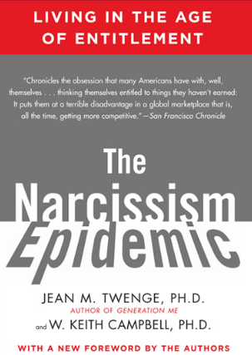
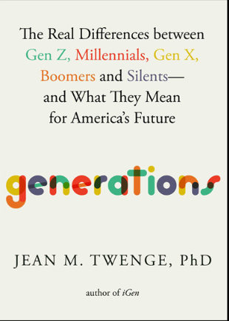
‘Gen Z’ (in the US)
Jean Twenge, Professor of Psychology at San Diego State University
Label | Born
Silents | 1925-1945
Boomers | 1946-1964
Generation X | 1965-1979
Millennials | 1980-1994
Generation Z | 1995-2012
Polars | 2013 --

Slide 12
Gen Z ‘traits’
Gender Fluidity
More Lesbian, Gay, and Bisexual People
Less Sexually Active
Growing Up Slowly
Restricting Speech
Interest in Physical and Emotional Safety
Racial Consciousness
Dissatisfied and Depressed
More Online Communication
Less Likely to Be Physically Healthy
Pessimism
Perceiving Discrimination and Having an External Locus of Control
Political Polarization
Political Activism and Increased Voter Turnout
Liberal Unhappiness and Depression
Shaped by the Pandemic

Slide 13
A socially depressed generation?
‘A 21-year-old from an all-Gen Z consulting company was on stage, detailing the characteristics of his generation… “We’ve learned that the world is a harsh place, and that things are tough,” he said. “Things are worse than ever.”
‘For older generations, that statement is a bit of a head-scratcher, especially given the context: It was January 2020, before the COVID-19 pandemic hit the US. At the time, the economy was booming and the unemployment rate was at a record low. Yes, the world faced big issues like climate change, but was Gen Z’s situation in early 2020 really worse than that of Millennials, who had graduated into the Great Recession? Was it worse than Gen X coming of age during the violent crime wave in the 1990s? Was it worse than Boomers getting drafted to fight in Vietnam?
‘Especially given the rise in depression among young people, statements like the young consultant’s got me thinking about the power of perception: Is Gen Z depressed because the world is a harsh place? Or do they think the world is a harsh place because they are depressed? By definition, depression involves perceiving the world around you in a more negative light.’ (Twenge, 2023, pp. 418-9)

Slide 14
Pessimism about past, present, and future
Gen Z less optimistic about personal prospects than older generations
Young adults are less likely to believe that ‘America is a fair society where everyone can get ahead’:
‘3 out of 4 Gen Z’ers think we should, in effect, tear it all down and start over, saying “significant changes” to the government’s “fundamental design and structure” are necessary. The old way of doing things, they feel, doesn’t work anymore.’
(Twenge, 2023, p.421)
Origin stories:
‘Most stunning is this: 4 out of 10 Gen Z’ers believe that the founders of the United States are “better described as villains” than “as heroes”. Somewhere along the line, a significant proportion of young adults developed the idea that America’s founders were more evil than good. Fewer than 1 in 10 Silents or Boomers… agree, creating a substantial generation gap.’
‘This result also argues against the idea that Gen Z is pessimistic because things really are worse: They are negative not just about the current world but about a time 250 years in the past.’

Slide 15
Fatalism and polarized thinking
Dichotomous thinking (related to political polarization)
‘The cards are stacked against me’: Perceiving discrimination (especially gender, race) and having an external locus of control
‘If you have an internal locus of control, you believe you are in control of your life. An external locus of control is the opposite: the belief that nothing matters, because it’s all up to luck and powerful other people to determine what happens.’ (Twenge, 2023, pp. 428-9)
Fundamental change in cultural values – from a ‘dignity culture’ to a ‘victimhood culture’ (Campbell and Manning, in Twenge, 2023, p. 431)
‘Real discrimination exists and deserves to be called out and stopped. But when teens are convinced discrimination is increasing when it is actually diminished, it can undermine the case of those pointing out real harms. It can also impact their views of their own efficacy. Convinced that the world is against them, some young people have decided there’s no point in trying, a viewpoint linked to failure. Countering this view will be one of the biggest challenges of the next decade.’ (Twenge, 2023, p. 431)

Slide 16
The problem of belonging
Crisis of shared meaning, and confidence about what to transmit to younger generations, seen during the pandemic:
Symbolized by school closures: difficulty adult society had in expressing need to educate young people during a time of immediate emergency, or the meaning of education
Intersects with existing trends towards ‘generational distancing’ observed in education, parenting culture, and policy, where the behaviours, conventions, and knowledge associated with ‘the past’ were already held in question
Further unsettling of adult authority and responsibility
Tainted ‘origin stories’, and the institutionalization of a ‘Year Zero’ sensibility
Summed up by narrative that the problems presented by pandemic, and solutions derived to deal with it, were ‘unprecedented’ – that there was nothing we could learn from the past (and older generations).

Slide 17
Conclusion: ‘Presentism’ and generational conflict
The events of 2020 and beyond represent a new epoch far more significant than the expressions of social change that have often previously been highlighted as the makings of a generation: eg the turn of the Millennium, or the ubiquity of social media.
Distinctive implications for those coming of age, at the point where they were ‘really questioning things’: rites of passage rendered ‘irrelevant’ to present-day emergency.
The disruption of social time, and the upheaval of taken-for-granted ways of living and interacting, gave social distancing measures an intimate quality that impacted every dimension of life.
The closure of schools and universities as core institutions of education and socialization, raised profound questions about the value that contemporary ‘risk society’ places on the transmission of ‘the accumulated cultural heritage’ to the young.

Slide 18
Disruption of the generational transaction
Temporal schism, and continual unsettling of adult authority, creates potential for genuine generational conflict.
Mediation between past, present and future
Relentless focus on the present – denigration of knowledge and norms
The presentist imagination is inherently unstable:
Only constant is change
Every day is an ‘emergency’
The challenge is how to defend and develop meaningful relationships between the past and the present, in order to provide a genuine orientation towards the future.

Slide 19
References
Bristow, J. and Gilland, E. (2020) The Corona Generation: Coming of age in a crisis, John Hunt Publishing.
Burnett, J. (2010) Generations: The time machine in theory and practice, Routledge.
Furedi, F. (2020) Why borders matter: Why humanity must relearn the art of drawing boundaries, Routledge.
Generations Network (2021) ‘Talking about generations: 5 questions to ask yourself’ https://blogs.kent.ac.uk/parentingculturestudies/files/2021/03/Talking-about-generations.pdf
Kertzer, D.I. (1983) ‘Generation as a sociological problem.’ Annual Review of Sociology, 9(1), pp.125-149.
Leccardi, C. and Ruspini, E. (2016) A New Youth? Young people, generations and family life, Routledge.
Leccardi, C. (2016) ‘Facing uncertainty. Temporality and biographies in the new century’, in C. Leccardi and E. Ruspini (eds) A New Youth? Young people, generations and family life, Routledge.
Mannheim, K. (1952) Essays on the Sociology of Knowledge. Edited by Paul Kecskemeti. London: Routledge & Kegan Paul Ltd.
Mills, C. W. (1970 [1959]) The Sociological Imagination. Harmondsworth: Penguin Books Ltd.
Purhonen, S. (2016) ‘Generations on paper: Bourdieu and the critique of ‘generationalism’, Social Science Information, 55(1), pp.94-114.
Rudolph, C.W. and Zacher, H., 2020. “The COVID-19 generation”: A cautionary note. Work, Aging and Retirement, 6(3), pp.139-145.
Twenge, J. M. (2023) Generations: The real differences between Gen Z, Millennials, Gen X, Boomers, and Silents – and what they mean for America’s future, New York: Atria Books.
White, J. (2013) ‘Thinking Generations’, British Journal of Sociology, 64 (2), pp.216-47.

