Slide 1
"Internet of Everything – How secure should it be?"
Abhaya Induruwa
Director of PhD Research in the School of Law, Criminal Justice and Computing
Canterbury Christ Church University, UK
And
Samaranayake Endowed Professor of Computing
University of Colombo School of Computing, Sri Lanka

Slide 2
“The Internet of Things is more than just cars, clocks and coffeemakers.
It's about an entirely new frontier of networked devices that affect enterprise security both directly and indirectly.”
Kevin Beaver
Information Security Consultant
Principle Logic, LLC
Notes:
Kevin Beaver’s statement summarises it all!

Slide 3
My talk …
What is its relevance to the conference?
How does it relate to previous speakers on Big data and computation, fuzzy algorithms, etc
Recognise that Internet is the largest open distributed platform
What is IoE? IoT and its various incarnations such as IIoT, MIoT, IoT in Medicine, etc
How does IoT security compare with the Internet security?
What makes IoT security difficult?
How is IoT security different from Internet security?
What are the available IoT security solutions?

Slide 4
What Gartner said about IoT in 2015 …
Gartner, Inc. forecasts that “4.9 billion connected things will be in use in 2015, up 30 percent from 2014, and will reach 25 billion by 2020”
Gartner, Press Release, “Gartner Says 4.9 Billion Connected "Things" Will Be in Use in 2015” November 2014
http://www.gartner.com/newsroom/id/2905717

Slide 5
What Gartner says now …
In its latest forecast, Gartner Inc. predicts that nearly 6.4 billion connected "things" will be in use in 2016, up 30% from 2015.
According to Gartner, the enterprise will shell out a total of $868 billion on Internet of Things (IoT) next year on cross-industry and vertical-specific connected things -- everything from smart light bulbs and HVACs to hospital monitors and trackers.

Slide 6
Internet becomes big!
When do you think the first billion users got connected to the Internet?
2005!

Slide 7
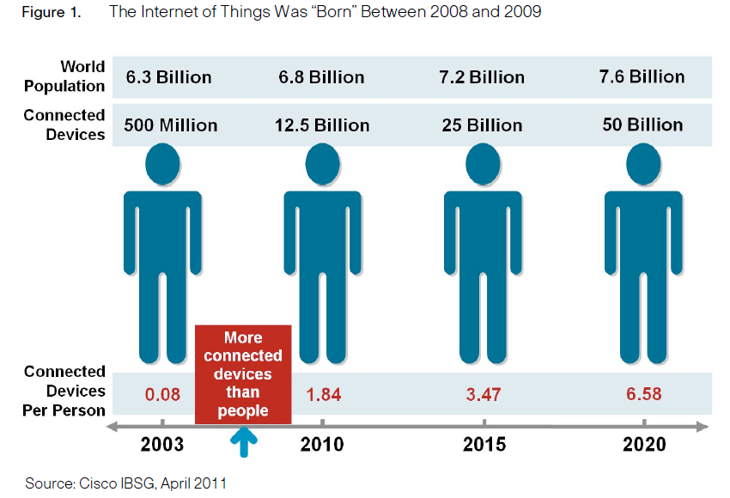
IoT is born
Cisco estimates that 50 billion devices and objects will be connected to the Internet by 2020.
Yet today, more than 99 percent of things in the physical world remain unconnected.
The growth and convergence of processes, data, and things on the Internet will make networked connections more relevant and valuable than ever before. This growth creates unprecedented opportunities for industries, businesses, and people.

Slide 8
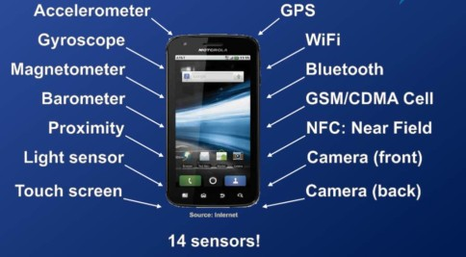
How do we get these colossal numbers?
Today, there are about 14 billion objects connected to the Internet. Industry analysts estimate the number of connected devices could be anywhere from 20 billion to 100 billion by 2020. — A report by the UK Government
UK Government, The Internet of Things: making the most of the Second Digital Revolution — A report by the UK Government Chief Scientific Adviser, Sir Mark Walport –
https://www.gov.uk/government/uploads/system/uploads/attachment_data/file/389315/14-1230-internet-of-things-review.pdf
How many devices do you carry?
Source: Google images

Slide 9
Why is IoT important?
Because of its impact on all walks of life
Day- to-day chores
Businesses
Industry
Healthcare/Fitness
Enterprise
Government
etc.
Because productivity and efficiency gains can be had in business and the enterprise
Because the enterprise can provide better functionality, have the ability to transfer data from mobile devices to smart boards or monitoring screens, robots or other devices that connect workers to big data across the enterprise, or even the world

Slide 10
Why connected cars and homes?
Auto manufactures
Wireless and Internet service providers
Repair and maintenance facilities
Insurance companies
are investing heavily in connected cars BECAUSE
The data generated and collected can help these industries to personalise/customise services towards their customers
Apple invested in the connected car with CarPlay, which is compatible with iOS 7. The company is also releasing a connected-home option, called HomeKit, which will be available for use with iOS 8 SDK.

Slide 11
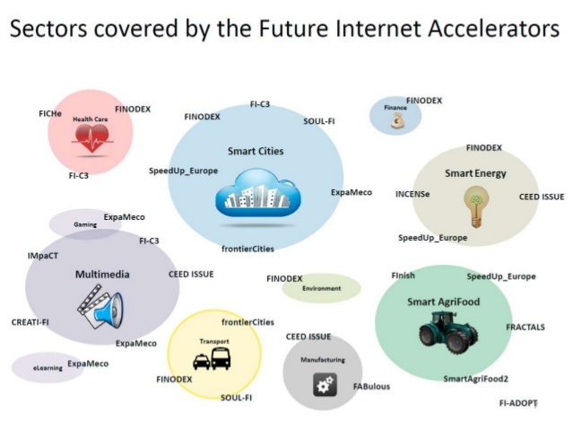
IoT sectors with the biggest impact
Connected Healthcare
Industrial IoT
Smart Homes/Cities
Smart Farms/Agriculture
Smart Energy – Electric & Gas
Connected Transport
Wearables
Robotics
Connected Retail
Smart Supply Chain
Smart Factories
Source: Google images

Slide 12
IoT Revenue
The IoT revenue is estimated to grow from $4.8 trillion in 2012 to $8.9 trillion by 2020,
according to International Data Corporation (IDC) in How connected cars, IoT devices will drive enterprises by Matt Schulz
http://searchmobilecomputing.techtarget.com/tip/How-connected-cars-IoT-devices-will-drive-enterprises

Slide 13
Big Data - IoT side effect?
Application of IoT will generate colossal amounts of data from the connected assets
Companies sit on huge amounts of data
Right now they merely take up storage space without providing added intelligence
IoT Cloud with their connected databases can turn this big data into smart data

Slide 14
Importance of IoT Security
Growing number of IoT security threats
How to prevent and defend against IoT security threats and attacks
The future of IoT security threats

Slide 15
This shows how big the problem is!
Symantec Secures More Than 1 Billion Internet of Things (IoT) Devices
25/08/2015
including everything from televisions and cars to smart meters and critical infrastructure
http://investor.symantec.com/investor-relations/press-releases/press-release-details/2015/Symantec-Secures-More-Than-1-Billion-Internet-of-Things-IoT-Devices/default.aspx

Slide 16
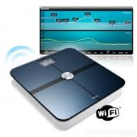
Fine line between privacy and security
Danger of generating and consuming large amounts of personal data
Internet connected bathroom scale
Example of a celebrity on an IoT bathroom scale
Source: Google images

Slide 17
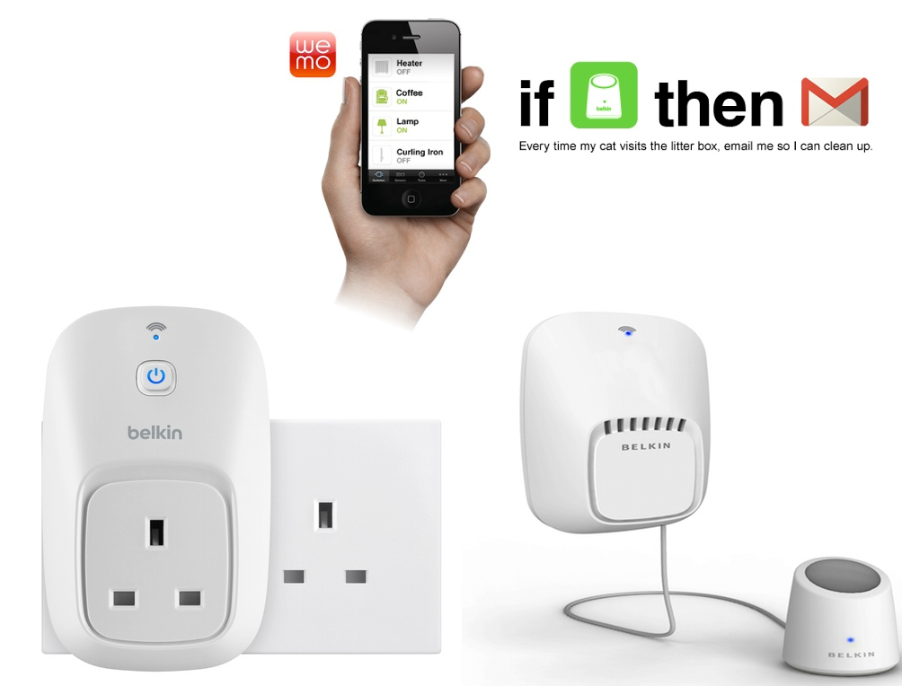
Internet Enabled Litter Box ☺

Slide 18
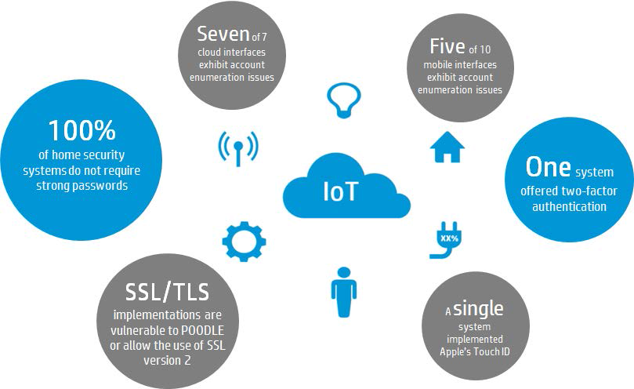
Current State of IoT Security HP Study of 10 modern Home Security Systems
100% allowed the use of weak passwords
100% lacked an account lockout mechanism that would prevent automation attacks
100% were vulnerable to account harvesting, allowing attackers to guess login credentials and gain access
Four of seven systems that had cameras, gave the owner the ability to grant video access to additional users, further exacerbating account harvesting issues.
Two of the systems allowed video to be streamed locally without authentication
A single system offered two-factor authentication
50% exhibited improperly configured or poorly implemented SSL/TLS
HP Home Security Systems Report

Slide 19
Fact or Fiction ?
Hacking Medical Devices For Fun And Insulin: Breaking The Human SCADA System
https://media.blackhat.com/bh-us-11/Radcliffe/BH_US_11_Radcliffe_Hacking_Medical_Devices_WP.pdf (05/08/2011)
Insulin pump hack delivers fatal dosage over the air
http://www.theregister.co.uk/2011/10/27/fatal_insulin_pump_attack/ (27/10/2011)
A hacker can give you a fatal overdose
Modern hospital equipment can be hacked, research says
http://www.lasvegasnow.com/news/a-hacker-can-give-you-a-fatal-overdose (10/06/2015)
Cars can be hacked by plug-in insurance discount trackers
Research raises serious questions about how dangerous it is to use them
http://www.lasvegasnow.com/news/cars-can-be-hacked-by-plugin-insurance-discount-trackers (12/08/2015)

Slide 20
Internet of Things – Wireless Hack

Slide 21
Fact or Fiction?
The Internet of Things is Here: 5 Connected Devices that Can Already Be Hacked
http://www.tripwire.com/state-of-security/security-data-protection/cyber-security/the-internet-of-things-is-here-5-connected-devices-that-can-already-be-hacked/ (03/11/2014)
How to Build a Safer Internet of Things: Today's IoT is full of security flaws. We must do better
http://spectrum.ieee.org/telecom/security/how-to-build-a-safer-internet-of-things (25/02/2015)

Slide 22
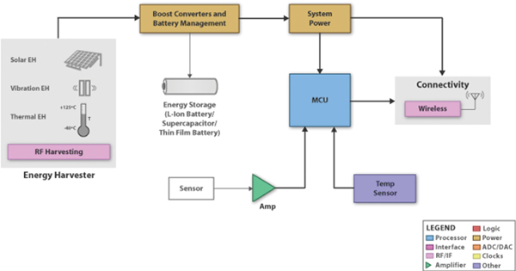
Before we look at IoT security – Anatomy of an IoT device
Capability of IoT devices
Typically small MCU
Small memory/storage
Limited battery capacity
Cannot have
Sophisticated OS
Sophisticated logic
Sophisticated access control
Sophisticated encryption
Source: Google images

Slide 23
Types of IoT threats (IoT threat vectors)
IoT devices are generally exposed to the same type of attacks as other familiar devices in the enterprise such as computers, servers, etc
They could suffer from
DDoS attacks
Threats arising from not changing default accounts/passwords

Slide 24
How is Internet security different from IoT security?
Internet 1 billion servers
Only several million security experts
How?
Fairly well understood OSs
Use of Enterprise Firewalls, IDS/IPS
Mature communication/security protocols
Standardised configurations
If every house is having a network of 20 different devices?

Slide 25
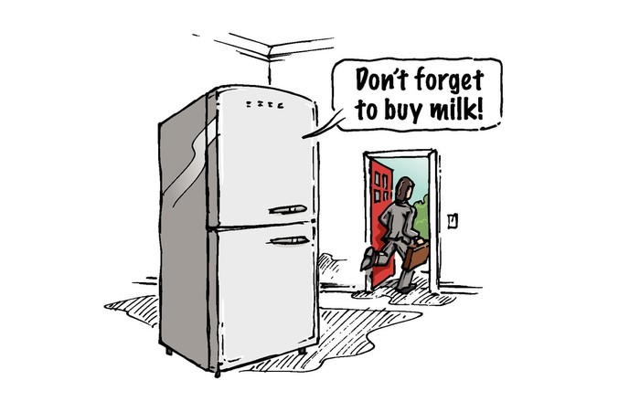
Nature of IoT
The difference between previous computing paradigms and IoT is that
in the Internet of Things,
the “things” talk back!!!
Makes deploying security extremely challenging.
Top Ten Security Considerations for the Internet of Things by Gunnar Peterson and Mark O’Neill
Axway, 2015
Source: Google images

Slide 26
An example IoT attack surface
Involves insecure IoT devices
Taken individually their attack surface is smaller than traditional computers
When added together even a minor security incident can amplify into a major issue
Use SSDP (Simple Service Discovery Protocol)
Send SSDP requests to IoT devices with insecure configurations
Direct responses – from billions of IoT devices – to the target network
DDoS attack
It is reported that this type of attack has a bandwidth amplification factor of about 30
More information at: Quick Analysis of a DDoS Attack Using SSDP, Rodrigo Montoro, (Sept 2014) https://blog.sucuri.net/2014/09/quick-analysis-of-a-ddos-attack-using-ssdp.html

Slide 27
What could you do to prevent IoT attacks
Few simple things
Secure the use of SSDP
Limit SSDP usage to specific networks
Limit bandwidth usage to minimise the traffic it generates if attacked
Scan and identify insecurely configured IoT devices
If found secure them or disable
At least limit them to restricted networks
OS or software upgrade (if available) to patch SSDP vulnerabilities

Slide 28
Prevent IoT threats
Routinely scan IoT assets
Typically every IoT device should belong to a known device profile category
Isolate any new IoT device that doesn’t match a known device profile
Have them send their traffic to a registration portal or net management system that automatically checks device security
Move them to a network segment with strong access restrictions

Slide 29
A closer look at IoT Security Threats
as discussed in:
“Top Ten Security Considerations for the Internet of Things” by Gunnar Peterson and Mark O’Neill
Axway, 2015

Slide 30
IoT Security Threats (1) Protocol Proliferation
Recent developments were all centred around the web and mobile apps
Predominantly based on HTTP and other request/response protocols
Architecting security is straight forward
Typically by layering security protocols such as TLS
One protocol does it all!
In IoT, in addition to HTTP, there are numerous other protocols
CoAP, XMPP, AMQP, MQTT, SSDP, etc.
Suitable for constrained environments
Makes it extremely difficult to ensure security
There is no one security that does it all!
For a comparison between CoAP, XMPP and MQTT
http://blogs.cisco.com/ioe/beyond-mqtt-a-cisco-view-on-iot-protocols
Notes:
CoAP – Constrained Application Protocol
XMPP – Extensible Messaging and Presence Protocol
AMQP Advanced Message Queuing Protocol
MQTT – Messgae Queue Telemetry Transfer
SSDP – Simple Service Discovery Protocol

Slide 31
IoT Protocol Comparison
http://blogs.cisco.com/ioe/beyond-mqtt-a-cisco-view-on-iot-protocols

Slide 32
How does MQTT work?
Requires user name & password for authentication
TCP connections secured by SSL/TSL
subscribes to topic temperature

Slide 33
How does MQTT work?
Client A publishes
All subscribed clients get it

Slide 34
IoT Security Threats (2) Role of the Server
In the Internet, the ‘Server’ plays fairly well defined roles in a client/server architecture
Handles:
Presentation
Logic
Data access (authentication/encryption, etc)
Allows the client to be ‘thin’
In IoT systems, most of the servers play a multitude of roles, in addition.
Manage the client environment including
Client registration
Life-cycle management
Software patching/updates
Other related tasks

Slide 35
IoT Security Threats (3) Access Keys – storage and distribution
Most IoT devices currently have hard-coded access keys
Make them vulnerable to brute force, spoofing and similar attacks by a determined hacker
Can be stored on the server but distribution becomes difficult
Need to address authentication, integrity and confidentiality issues
Type of key, how they are used, and how they are bound to the system, will depend on the purpose
IoT needs a solid key management system that:
Generates the keys
Distributes the keys
Revokes the keys when the session terminates or end of life is reached

Slide 36
IoT Security Threats (4) Naming
(Name, Key) pair enables authentication
Critical for IoT access control
Yet, there is no consistent naming in IoT
For others we have Active Directory, LDAP, etc which are mature

Slide 37
IoT Security Threats (5) Constrained Devices
Small processing, storage, communication bandwidth, energy capacities
Makes security enforcement challenging
Use of token based solutions on the server side

Slide 38
IoT Security Threats (6) Absence of Time Services
Many IoT devices do not encompass time
SIM and other NFC enabled devices (RFID, MEMS) are examples
They neither have real-time clocks nor connections to a time server
Why is this an issue?
All authentication protocols/services use time as a primary defense mechanism
Number of retries cannot be throttled based on a time-based retry count
Logging who did what and when is not possible
Notes:
MEMS – Micro Electro Mechanical Systems

Slide 39
IoT Security Threats (7) Usability Hacks
Humans can be exploited using social engineering
IoT devices can be reverse engineered to understand their behaviour, and can be exploited
Kerberos, X.509, OAuth, etc become useful
Newer protocols, specifically for IoT devices, may have to be developed
IoT devices suffer from constrained capacities and are unable to perform some duties
A gateway can act as an intermediary between IoT devices and the server
Gateway can perform security duties, and other chores, on behalf of the IoT device

Slide 40
IoT Security Threats (8) Software Updates and Patching
Can you predict when a bug in software is found?
Requires software updates and patches
Resource constrained IoT devices are incapable of managing the update/patching process
Human intervention can neither be expected nor feasible
Requires the server or an intermediate gateway to take responsibility for local updates/patching

Slide 41
IoT Security Threats (9) Stunt Hacking
More interesting is the device, hacking will be more impressive
For monetizing the results of the hack
Glorification of the hack
Simply too many targets to choose from and attack
But targets involving payment systems will be more attractive
IoT devices can’t be hidden from the radar of the hackers
“Security by Obscurity” is not an option

Slide 42
Architecting IoT security
Never assume network trust
Employ strong Internet border protection
Filter and allow only approved inbound traffic
Segment into their own network; especially if they are new devices
Monitor regularly and identify anomalous traffic
Take action if detected

Slide 43
Architecting IoT security
Never assume network trust
Plan for security threats and incidents
Always include security into IoT products from the design stage
Never plan to back engineer security into your product
Evaluate software engineering practices to understand how information security practices are embedded in a product’s software
If an IoT device needs to be accessed across the Internet:
it must be placed in its own network
Strict network access control must be in place
Adopt IETF’s Best Current Practices (BCP) 38

Slide 44
What is BCP 38?
RFC 2827 (updated by RFC 3704) – Network Ingress Filtering: Defeating DoS Attacks which employ IP Source Address Spoofing
Makes the device to drop spoofed IP traffic
Device cannot participate in a DDoS attack
If attacker can’t send spoofed traffic to the device then the device can’t send DDoS traffic!

Slide 45
How to make IoT secure?
In the longer term
Adopt “Secure-by-default” designs
Configurations built on top of “secure-by-default” operating systems
Only provide core operating system functionality
Disable all other – unnecessary – functionality
Secure the core functionality

Slide 46
Emerging IoT Security Standards
The Industrial Internet Consortium
The Open Interconnect Consortium
ISO Special Working Group on the Internet of Things
IEC 62443/ISA99 – Industrial Automation & Control System Security
IEEE Standards that can be applied to IoT
IEEE P1363 – standard for public key cryptography
IEEE P1619 – encryption of data on storage devices
IEEE P2600 – security of Printers and Copiers
IEEE 802.1AE and IEEE 802.1X – MAC layer security
http://spectrum.ieee.org/telecom/security/how-to-build-a-safer-internet-of-things

Slide 47
Thank You!
Questions?

