Slide 1

a social history of the British arcade
Dr Alan Meades
Principal Lecturer
Canterbury Christ Church University
alan.meades@canterbury.ac.uk
Notes:
Hello everyone, my name is Dr Alan Meades. I am a Principal Lecturer in the School of Media, Art and Design at Canterbury Christ Church University. I’m very proud to have been invited to speak at the BACTA convention today, [thank you Phil Silver in particular] and BACTA members for letting me talk to you about Arcade Tales, a project about British arcade culture...

Slide 2

Notes:
I’ve worked at Canterbury Christ Church University’s Broadstairs campus for nearly twenty years, where alongside the day-to-day teaching of students from Margate, Ramsgate, Herne Bay and the surrounding areas, I’ve been conducting research into videogames, play cultures and play histories. During this time I obtained a PhD, becoming a Doctor of play studies, and an ethnographer, and wrote a well received book on the history and cultures of videogame hacking. To do this I spent five years with groups of hackers, learning what mattered to them, their views of play, and how their lives worked. Telling their authentic story.

Slide 3
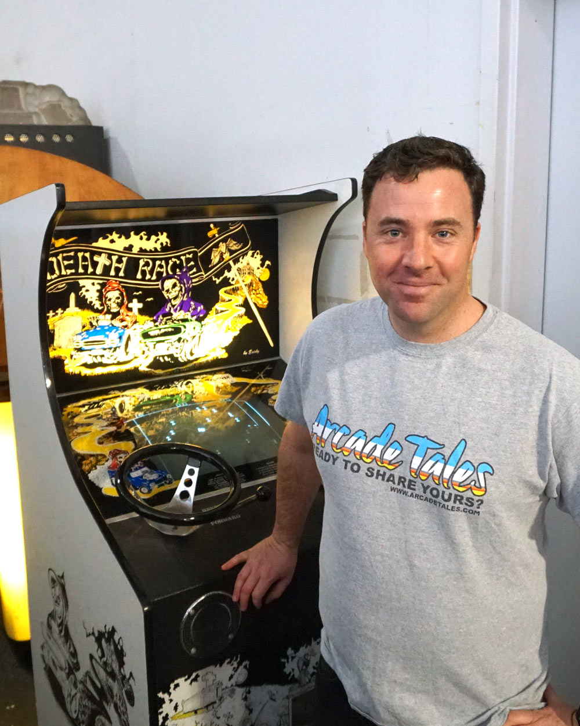
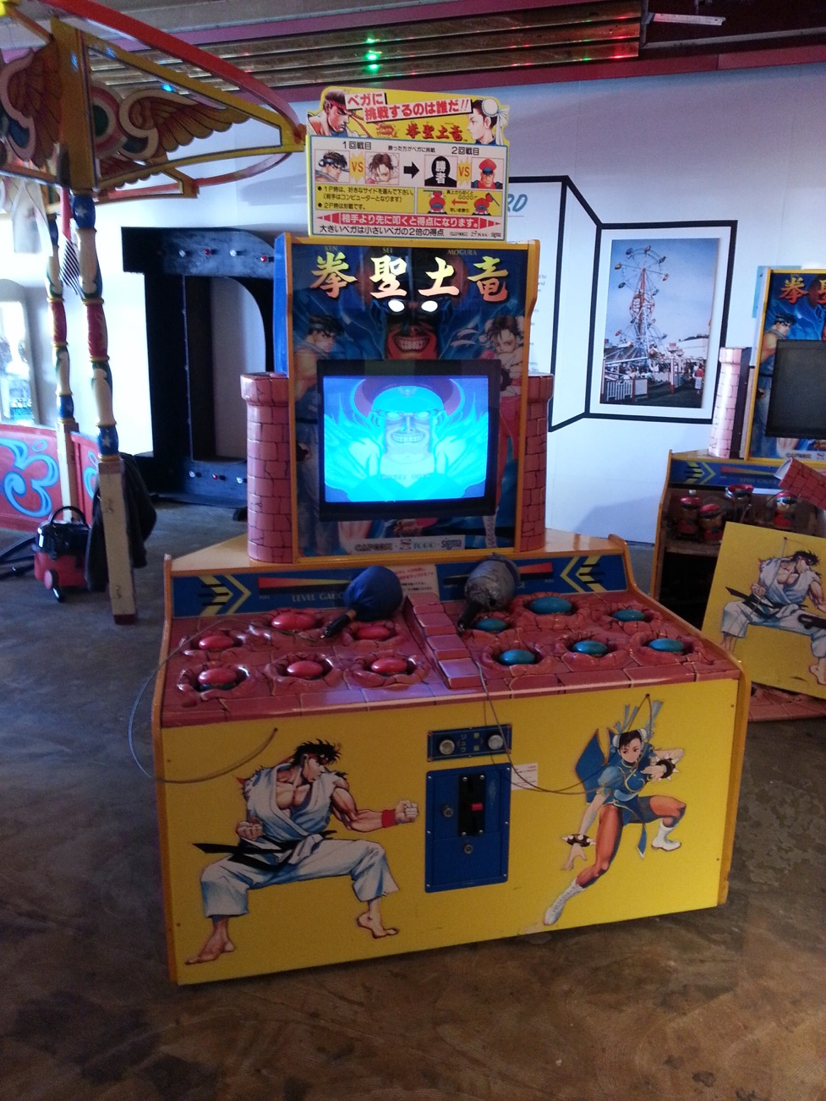
Notes:
Being someone born and bred at the British seaside resort of Broadstairs during the 1980s, it will come as no surprise, that arcades were enormously important to me. I spent many, many, pleasurable years in Broadstairs Amusements, Pleasurama Ramsgate, The Flamingo, Nobles, and Treasure Island Margate, and in Cain’s Amusements Herne Bay. This game me a love of the arcade, and, as I was one of the arcade locals, what I believe was an understanding and appreciation of the role the arcade played in growing up – and then more broadly in British culture.

Slide 4

Notes:
It was then with absolute disappointment, as I read book after book telling the history of videogames, and the importance of the arcade in that… that there was next to nothing about the positive influence of the arcade, next to nothing about the role of the arcade within British culture… and actually very little about the arcades that I grew up in, and now visit regularly with my children. Here we have Tristan Donovan’s generally excellent “Replay the history of videogames” – it’s a very good book that talks about Ralph Baer, about Nolan Bushnell and Atari, about the “appearance” of arcades in the early 1980s… and then their crash and disappearance in 1983… (aside from the odd arcade that had managed to reposition itself as a Chuck-E-Cheese). The SINGLE SAD LITTLE GREEN POST-IT NOTE is important as it shows the closest to which the book comes to recognising UK arcades… when it talks of Atari’s Tipperary plant and the rapid shift to home videogames.

Slide 5
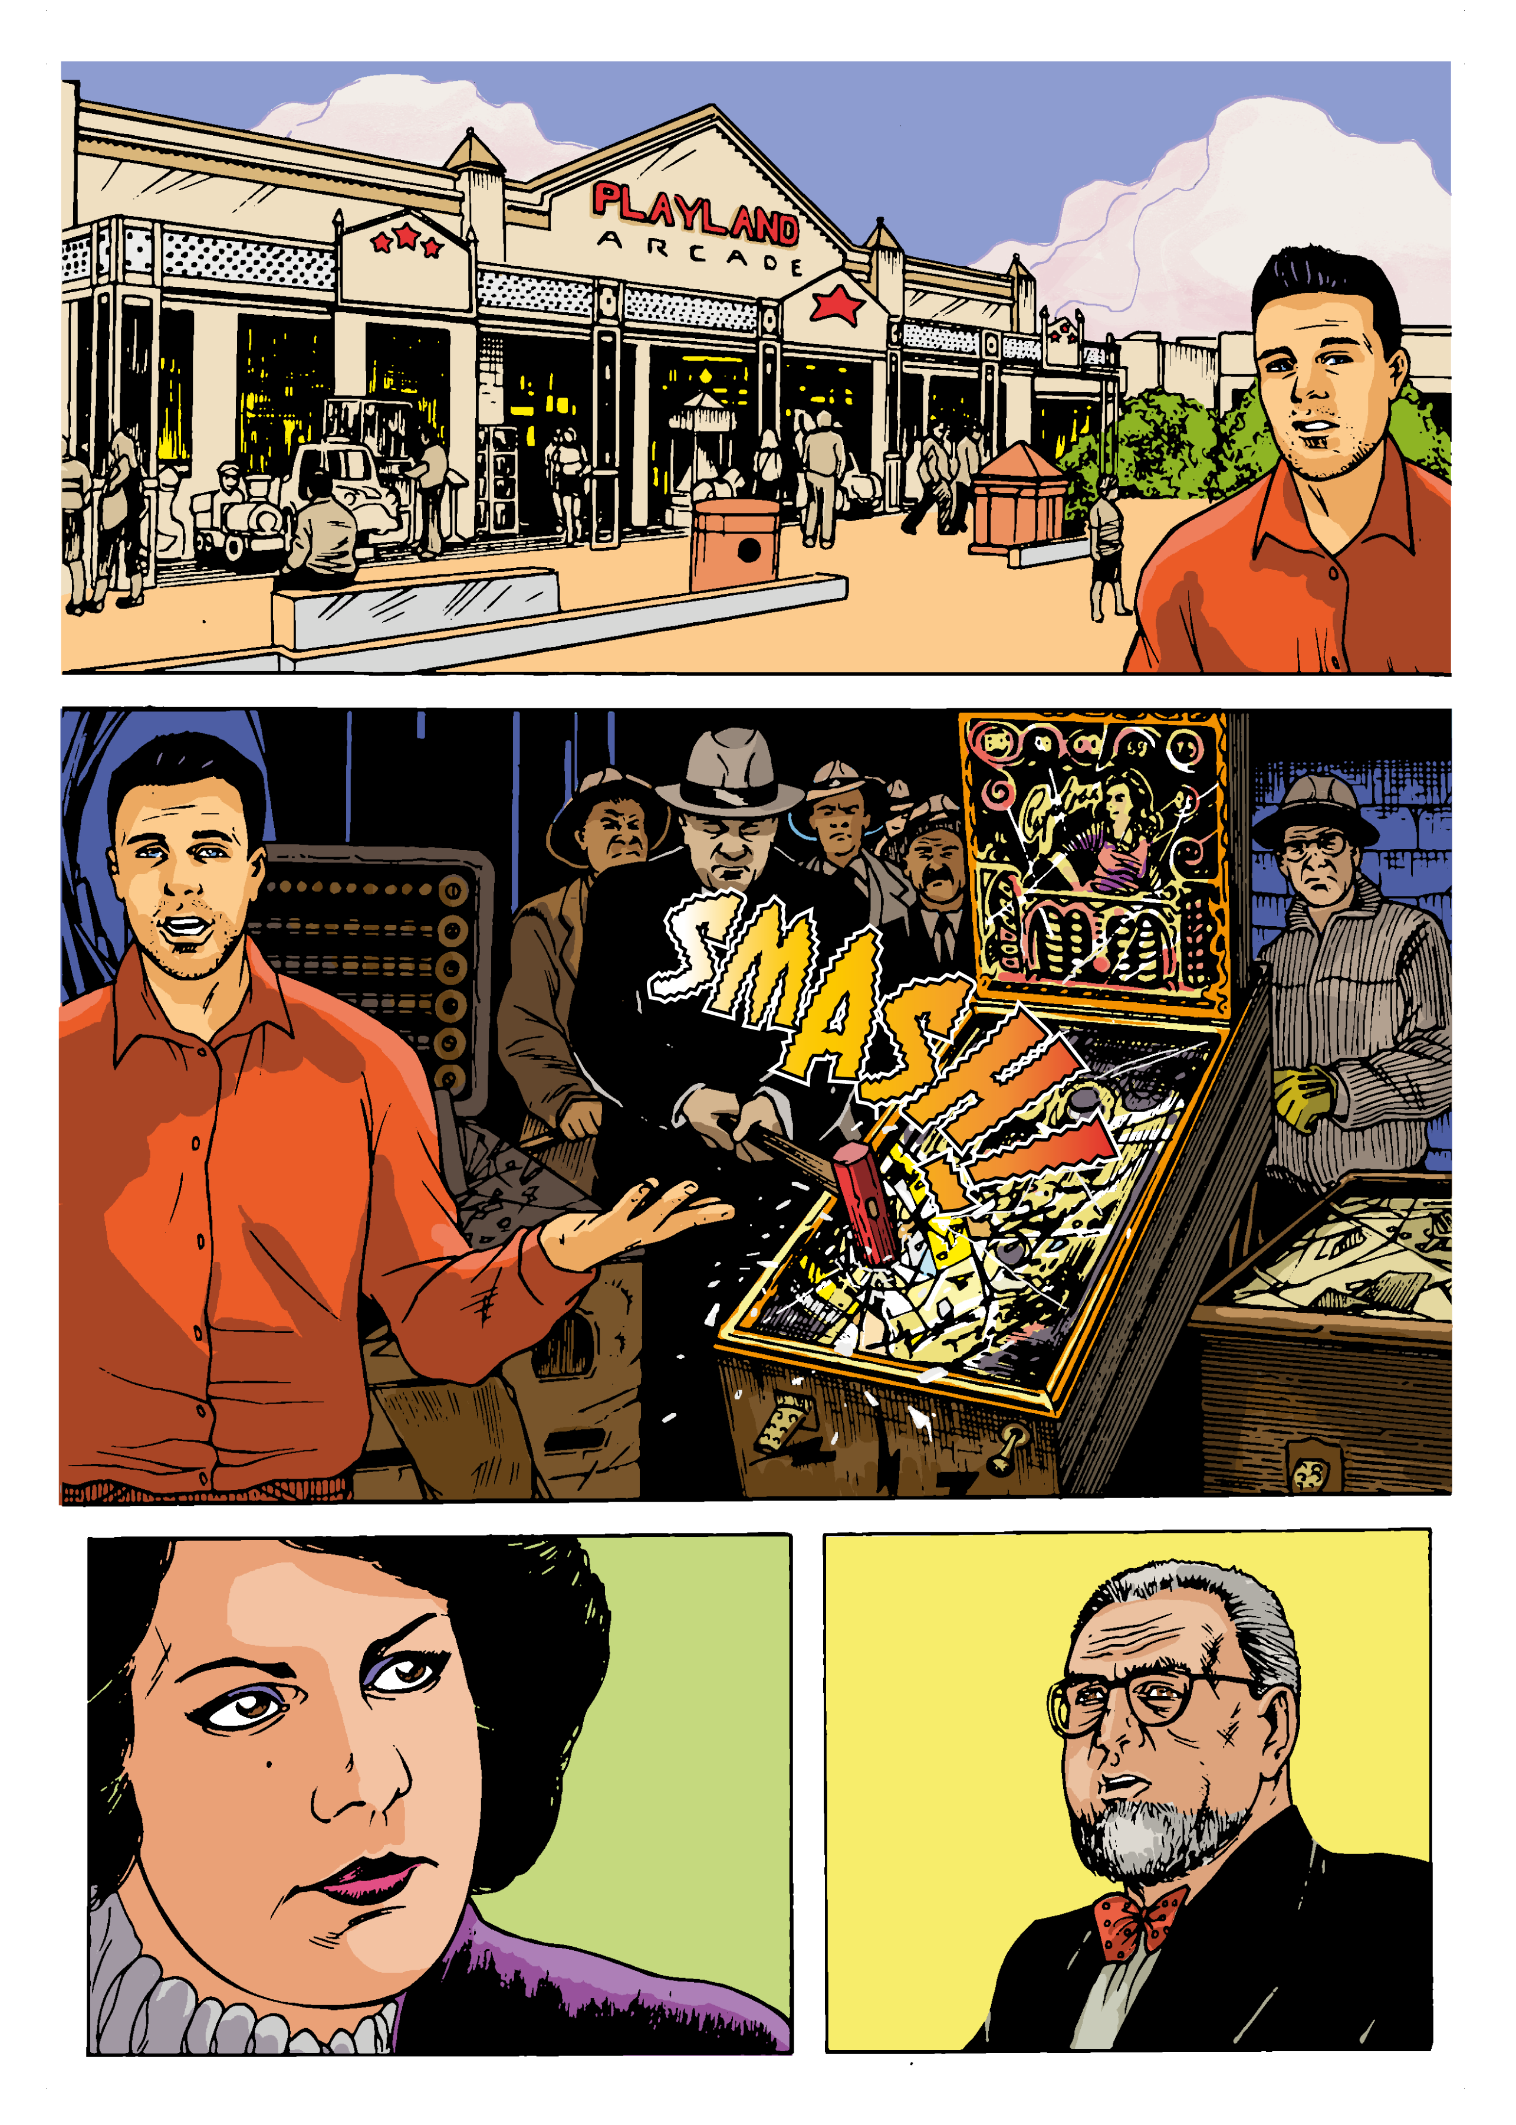
Notes:
Now, perhaps it is unfair to single out that book – it’s not a book about arcades as such - but from an American academic perspective, the thing being taught to students now studying games, play, and amusement --- the arcade is largely a footnote in the tale of the videogame industry. The British arcade, its characters, innovations, and importance, is not told of at all. Instead we learn of Fiorello La Guardia’s famous 1942 pinball machine ban… the crash of 83… the vision of Nolan Bushnell… etc.

Slide 6
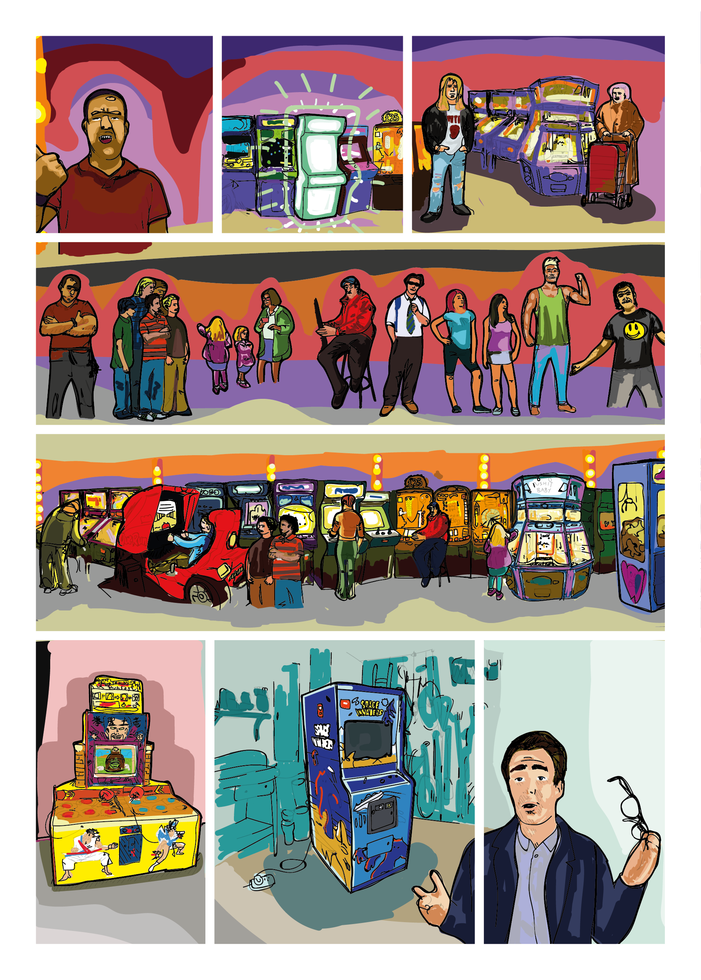
Notes:
We hear nothing of the people who play in arcades, the communities that arcades are part of, the pleasures and fun of the arcade. We hear nothing about the operators who know their customers, the pioneers who established the industry, we hear nothing of the relationships between UK, the States, and Japan, the enormous contribution of the Travelling Showmen. We don’t hear of the pusher, the crane, the importance of the fruit machine. Put shortly – the existing histories fail to tell the story of the British arcade, fail to tell the story of the arcade players, and entirely fail to celebrate the importance of the industry – Your industry – in British culture.

Slide 7
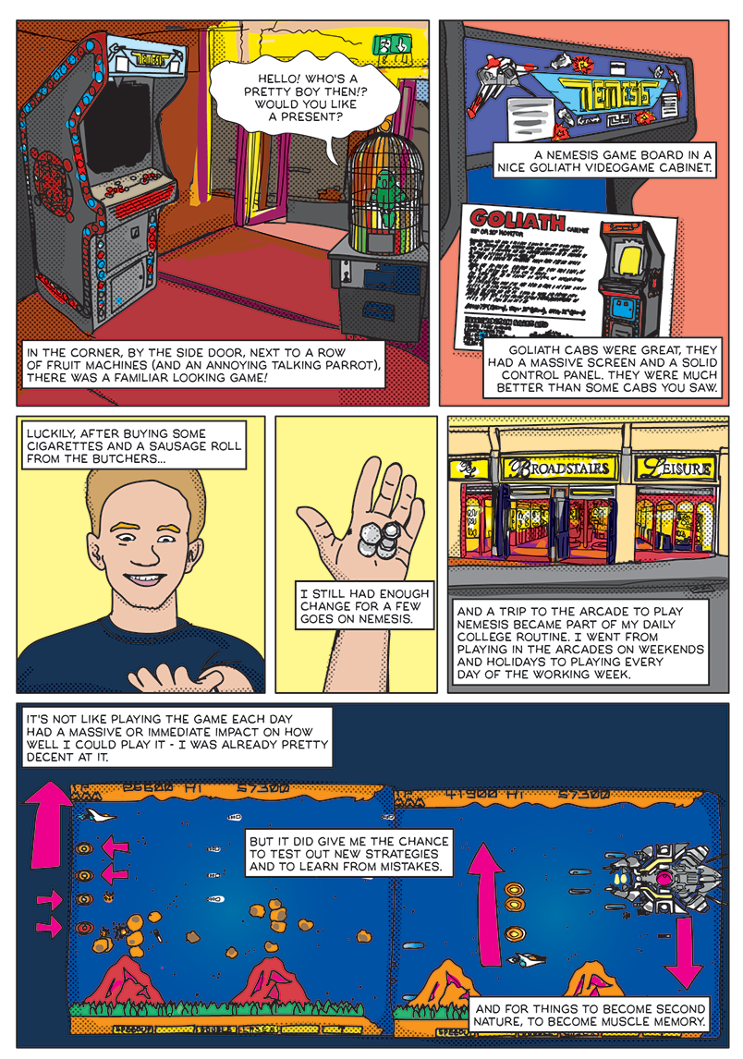
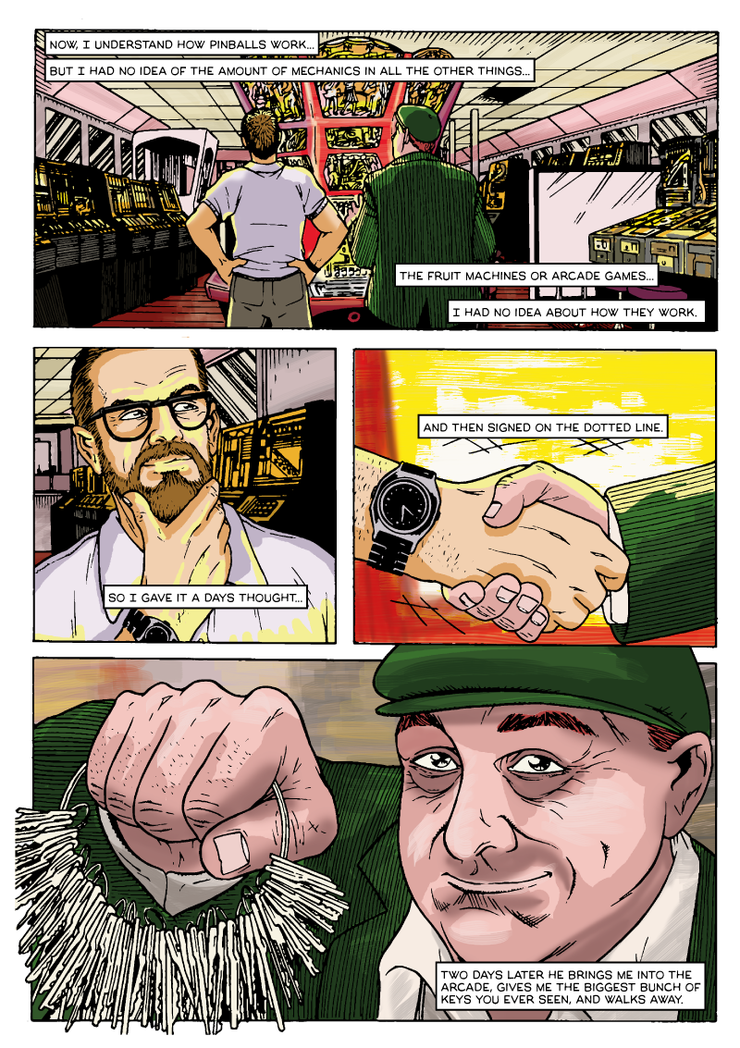
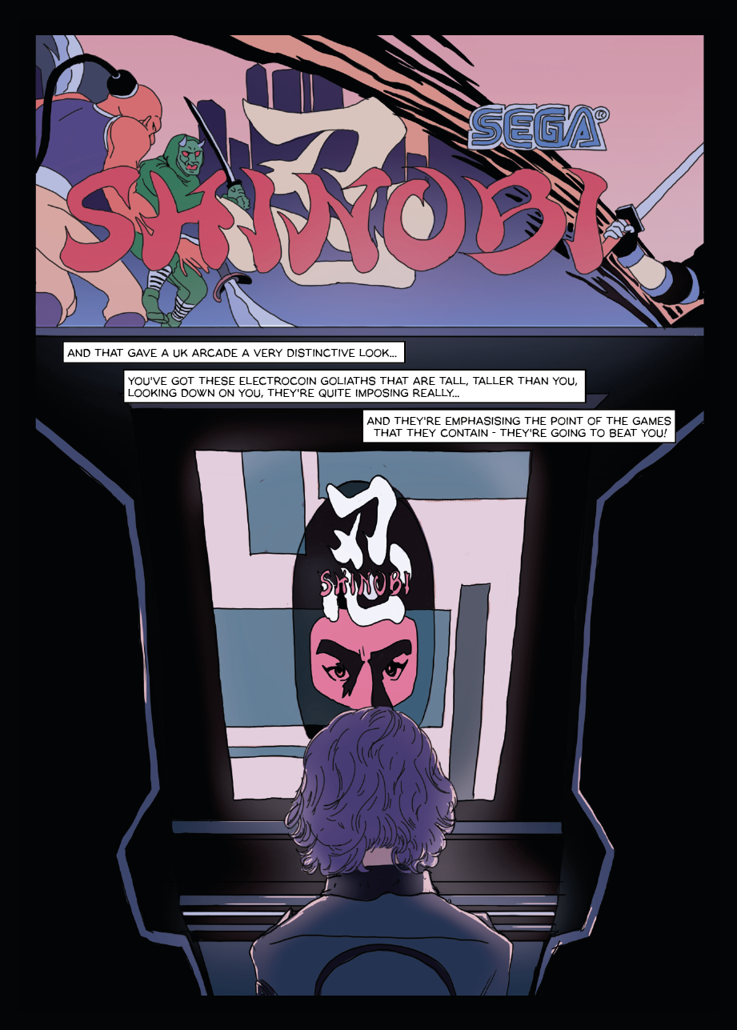
Notes:
So, two years ago I began to try and address this as best I could. I set up a project called Arcade Tales, and with my own funds and support from Canterbury Christ Church University, began to interview people about arcades – players, operators, anyone. I told them that their stories matter – as they are the oral history or social history of British play. And, having produced a rather dry academic book previously, I decided to turn these stories into comics.

Slide 8
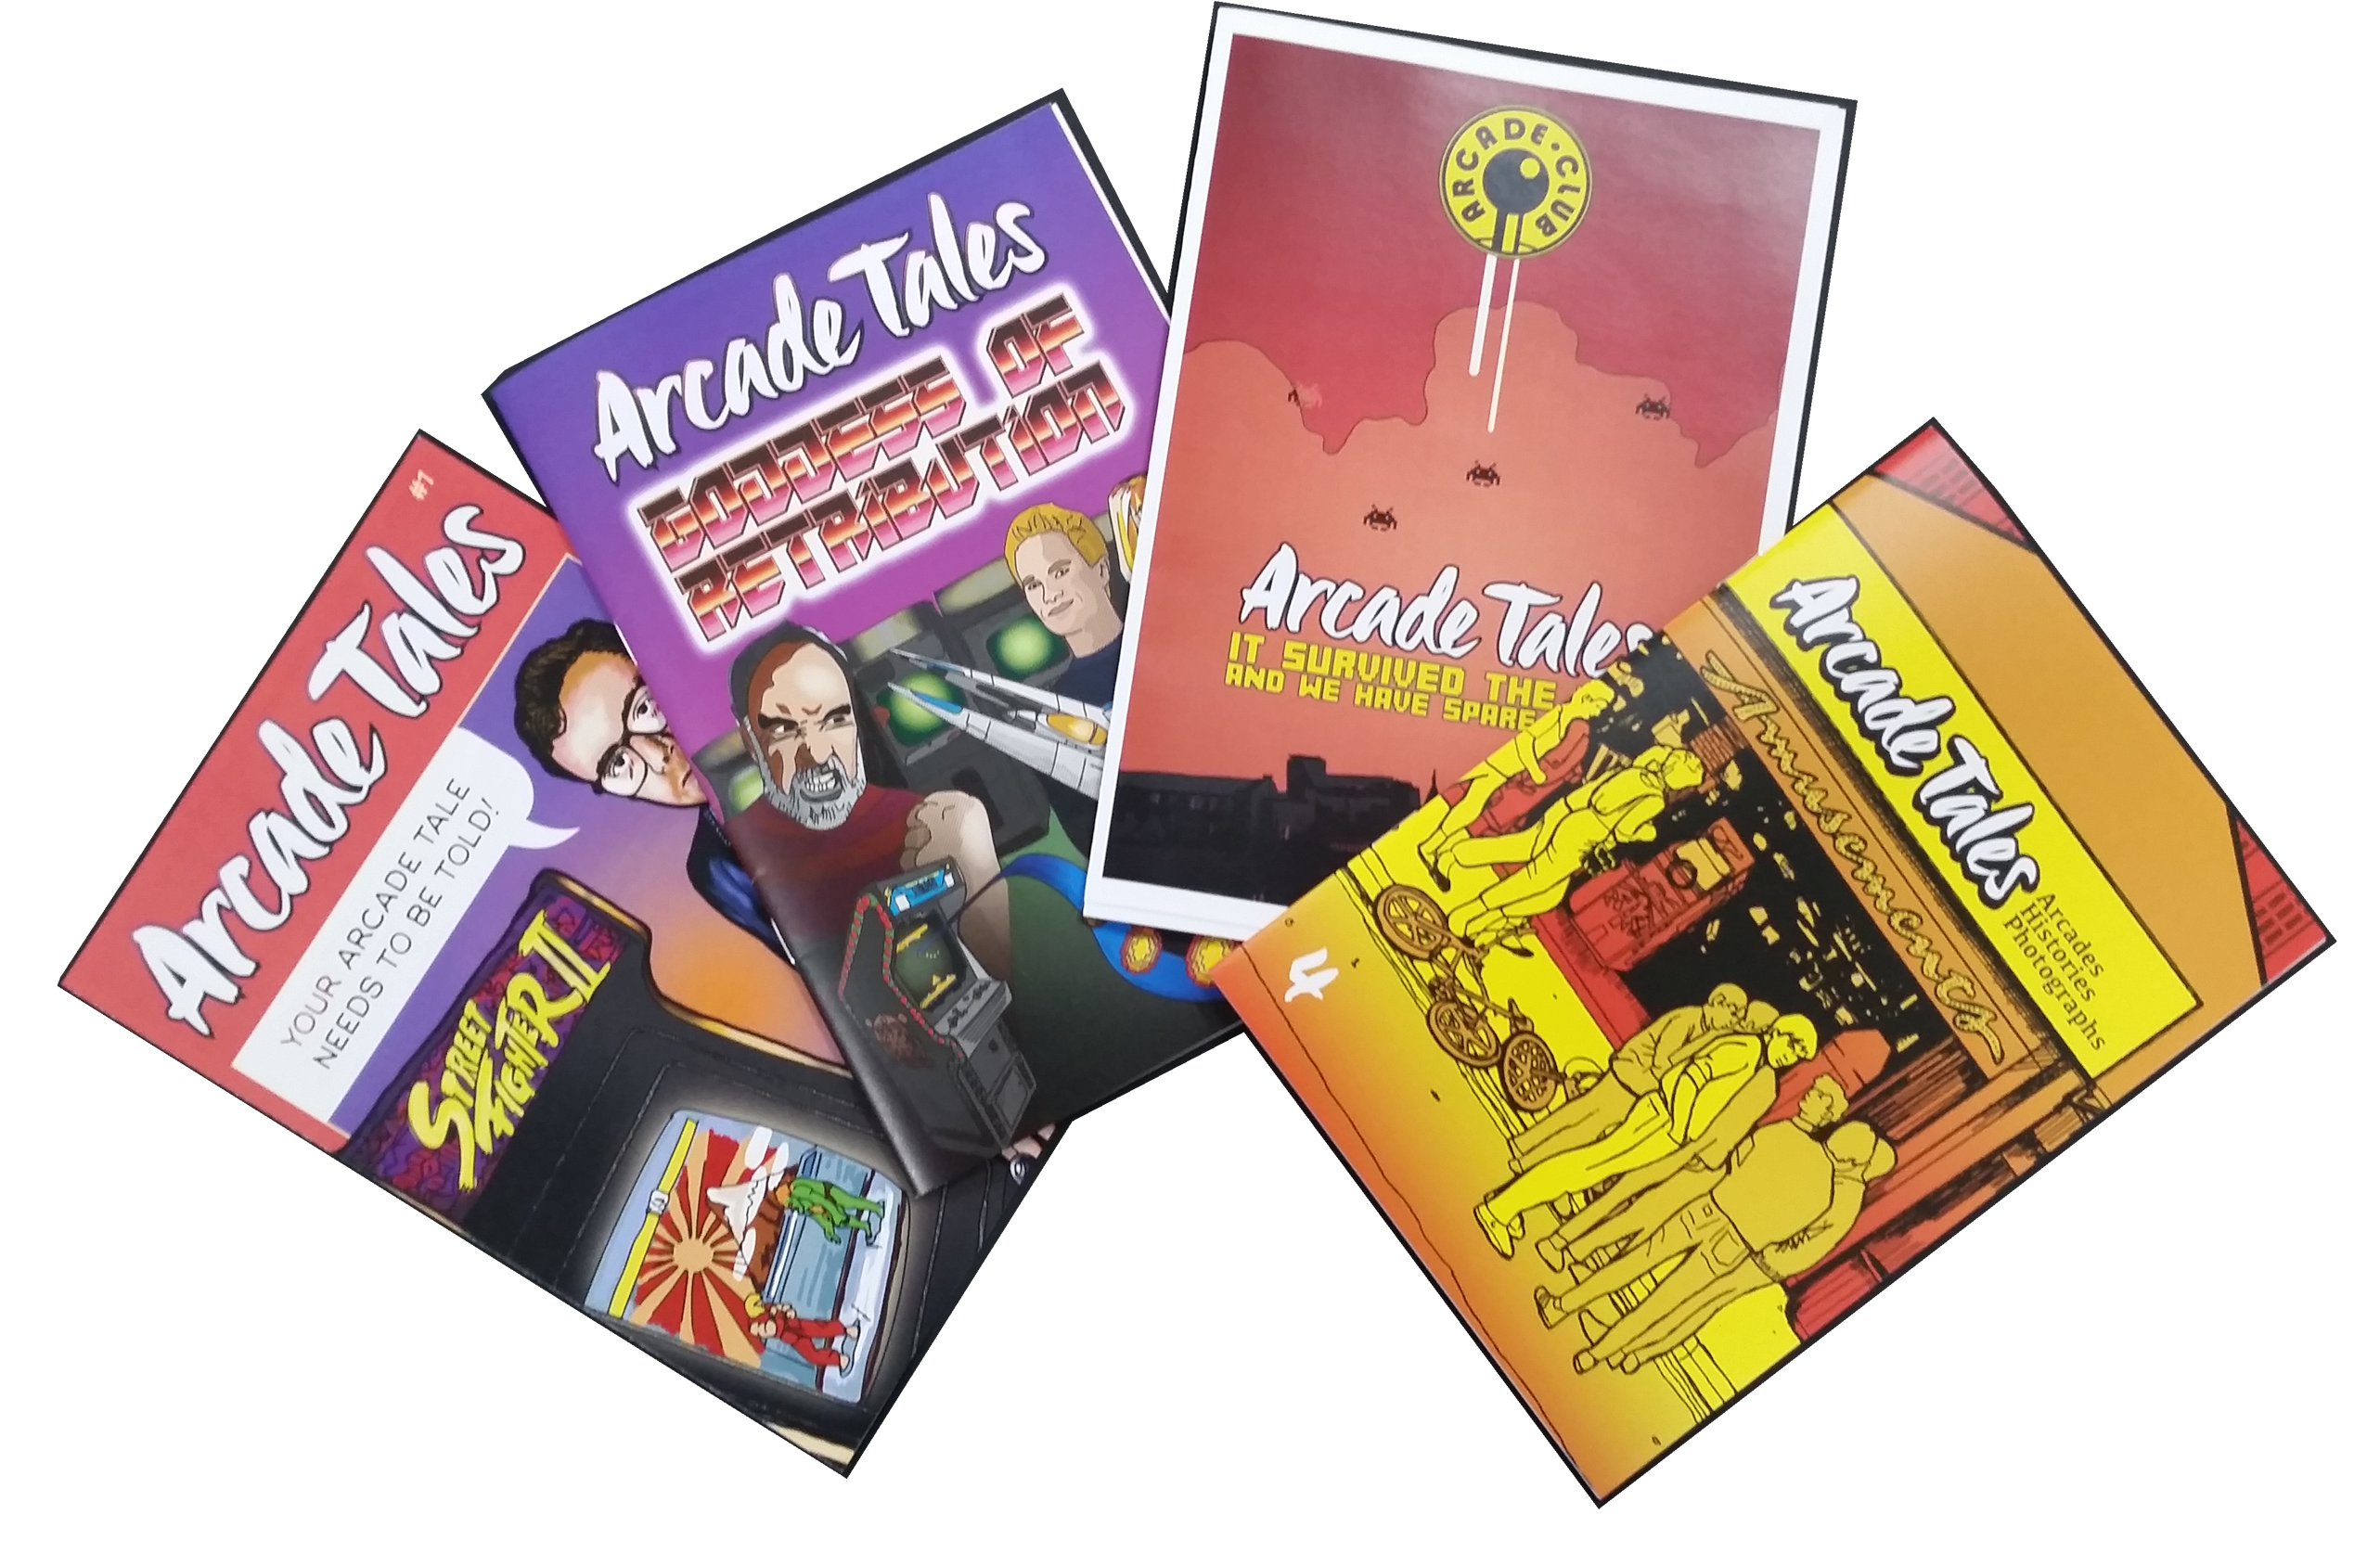
Notes:
These comics are freely distributed until they ran out. You should find one in each delegate pack. These are not the stories of the game designers, but of the visitors, workers and owners… they offer a very British perspective compared with what is out there. The comic has been is a useful mechanism to spread the word of the project – it speaks more clearly, and louder than an academic book… and as a result more people have stepped forward to help. And more people have become interested in the project.

Slide 9
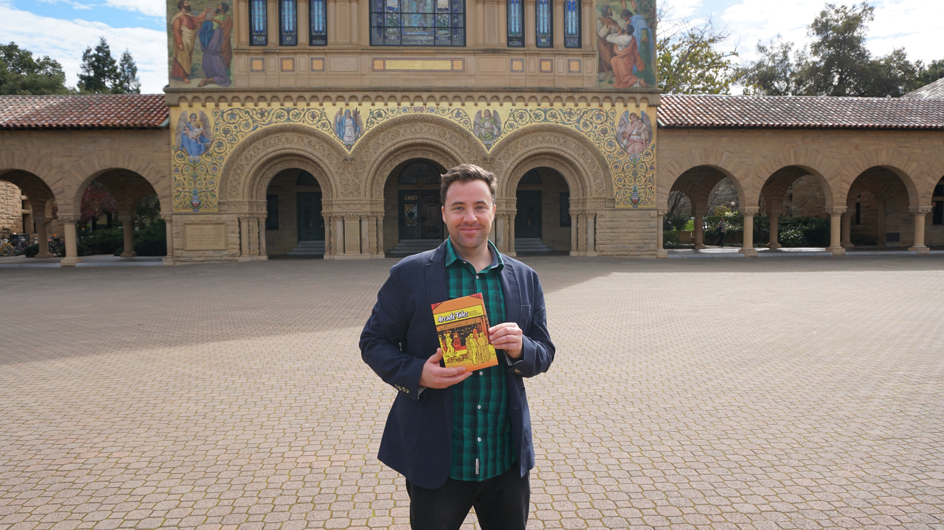
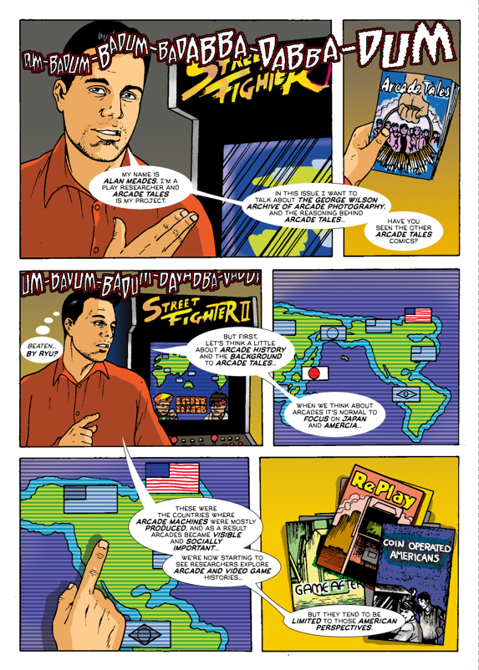
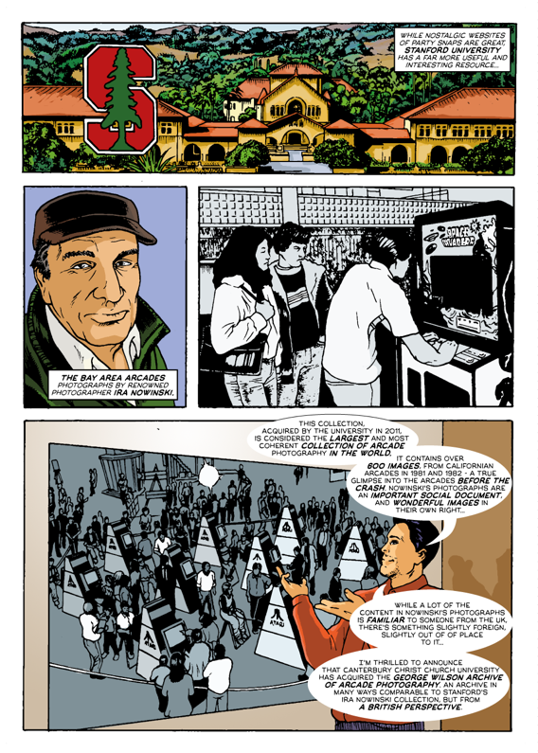
Notes:
Earlier this year Stanford University, USA. Considered the second best university in the States, invited me to go to California to speak about the project, to meet the arcade photographer, Ira Nowinski, and to see whether there were differences between the UK and US arcades. The visit went very well, and following it I was asked by MIT Press, whether I would be interested in writing a book that tells the story of the British arcade. … one that might include the odd comic page… and I said I’d love to. That’s where I am now.

Slide 10
Notes:
The project – and its wider activities have also been seen by others – the Financial Times ran a feature about the George Wilson arcade photographs taken in the early 1980s in Cain’s Amusements Herne Bay… [these are wonderful photographs of the British arcade, thank George Wilson, Scott Turner and David Cain for their support]

Slide 11
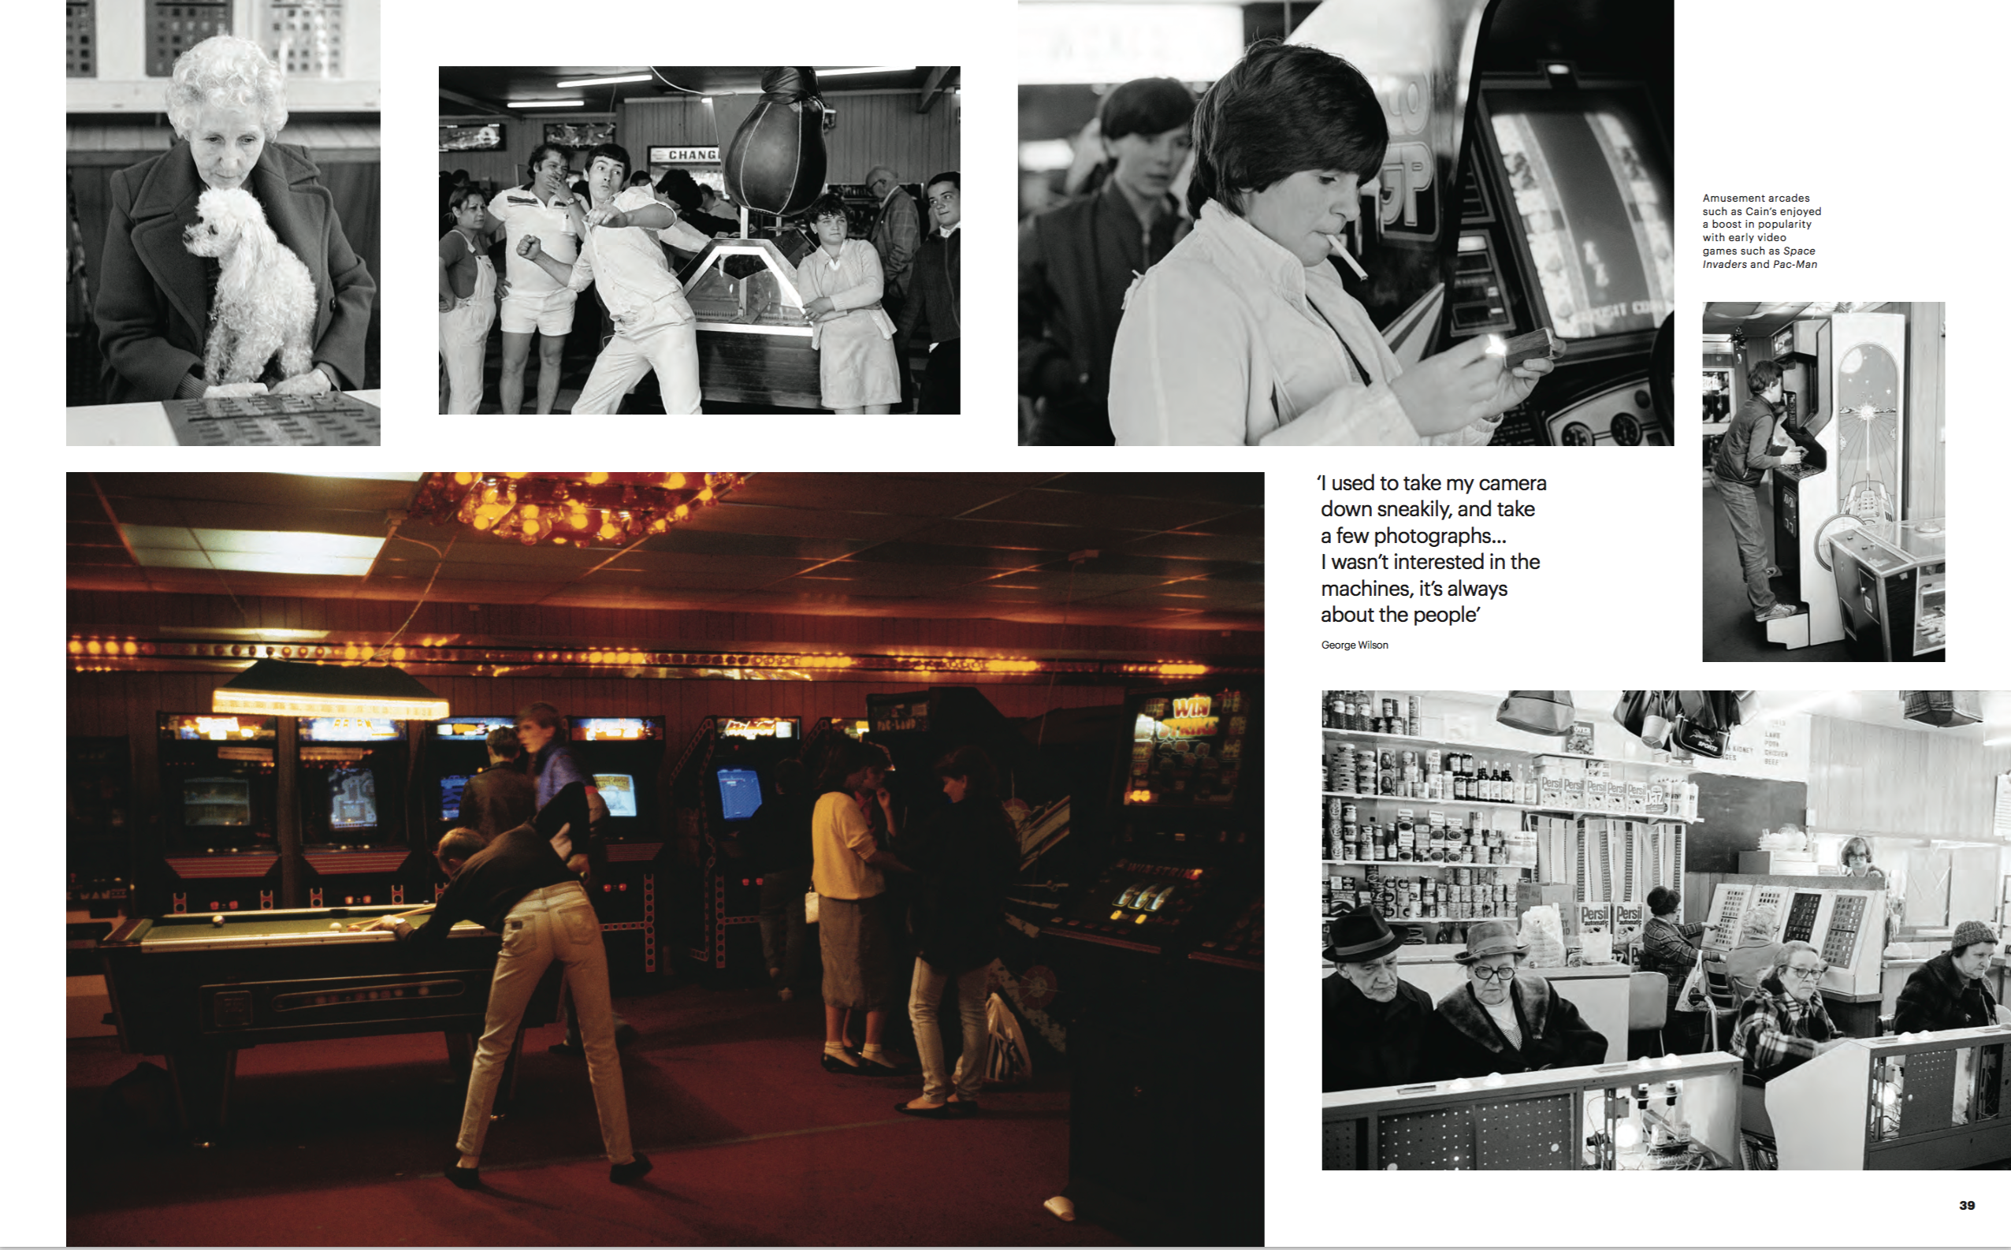
Notes:
Something else to point out, is that despite of the occasional negative story in the press there is enormous public good will and warmth towards the British arcade. Lots of people wishing to tell their stories of why the arcade matters. And I for one want not only to tell the story of the British arcade, but to celebrate it – celebrate its innovation, celebrate the people who built it, and celebrate what BACTA and its members do for British culture.

Slide 12
Notes:
I have already interviewed some BACTA members, I hope that some of you will be interested in stepping forward and sharing your Arcade Tales. So that we can correct the omission represented by that single, sad little green post it note.

Slide 13
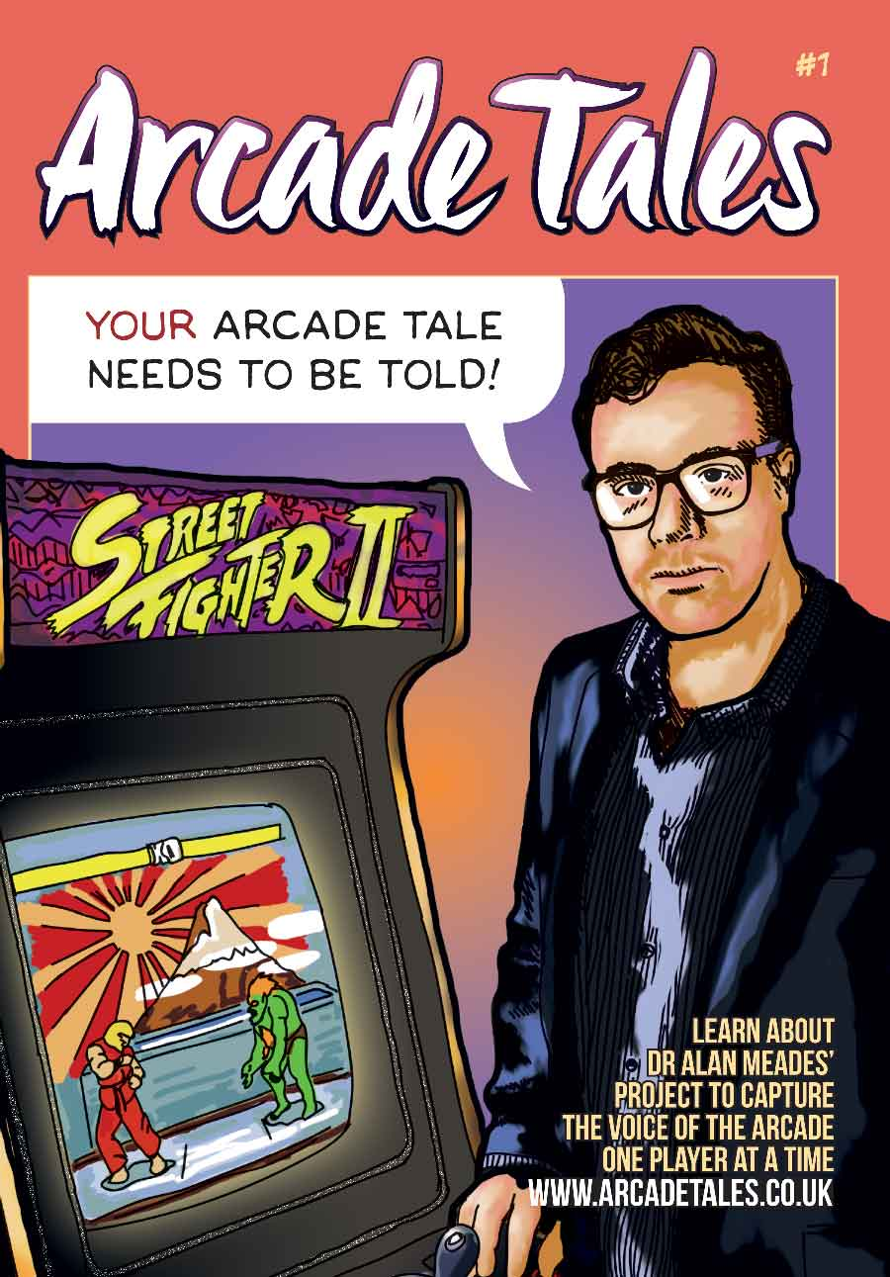

Dr Alan Meades
Principal Lecturer in Media, Art & Design,
Canterbury Christ Church University.
www.arcadetales.com
alan.meades@canterbury.ac.uk
Notes:
You should all hopefully have a copy of one of the Arcade Tales comics in your delegate pack, so you can see the aims of this project, and at the back you’ll find my contact details and my hope to set up a research centre supporting study – and perhaps advocacy – of the British amusements industry. Thank you for your time, I hope that the project is of interest, and that some more BACTA members would be interested in sharing their stories. Thank you.

