Slide 2
whatpricemusic
Peter Self

Slide 3
Research title…
“Would re-thinking the monetising of Intellectual Property within the music industry result in ‘devalued commoditisation’ as creative elites argue or is separating the values associated with rights ownership and product delivery a viable alternative?”

Slide 4
Research title…
Or a more ‘street friendly’ version:

Slide 5
Topic…
The dilemmas created by low/no-cost digitised content access and the dichotomy between rights-owners’ desires to control access to their creative content and the increasing shift towards cloud based file access

Slide 6
Key questions…
Do music consumers recognise or care about the concept audio quality?
Are demands for low/no-cost music access compatible with expected artist and label remuneration?
Are artists re-evaluating their perceptions and expectations of the monetisation of IP?
What is the narrative behind music industry elites’ continuing aggressive demands in controlling music access?

Slide 7
And a final question…
Can IP be financially separated from delivery?

Slide 8
Importance…
The Internet as a means of file exchange has had a profound effect on businesses whose products can be digitised
The global music industry was one of the first and least prepared for the resulting disruption to its established business model and its reaction was to engage in litigation and mechanical restrictions

Slide 9
Importance…
Despite extensive research into potential solutions to remedy falling recorded music revenues, there has been no resolution to the dichotomy between monetising rights ownership and the avalanche of previously unimagined product accessibility models

Slide 10
Reasoning…
Firstly, my research seeks to address these issues from the viewpoint of music consumers
their perceptions of entertainment and monetary value
whether audio quality is an issue
their music acquisition habits
the methods adopted consciously or unconsciously in music discovery

Slide 11
Reasoning…
Secondly, from the viewpoint of key industry elites
Artists
Composers
Labels
Distributors
by understanding the narrative that drives their desire, need and authority to earn from their ‘rights’ in their musical creations

Slide 12
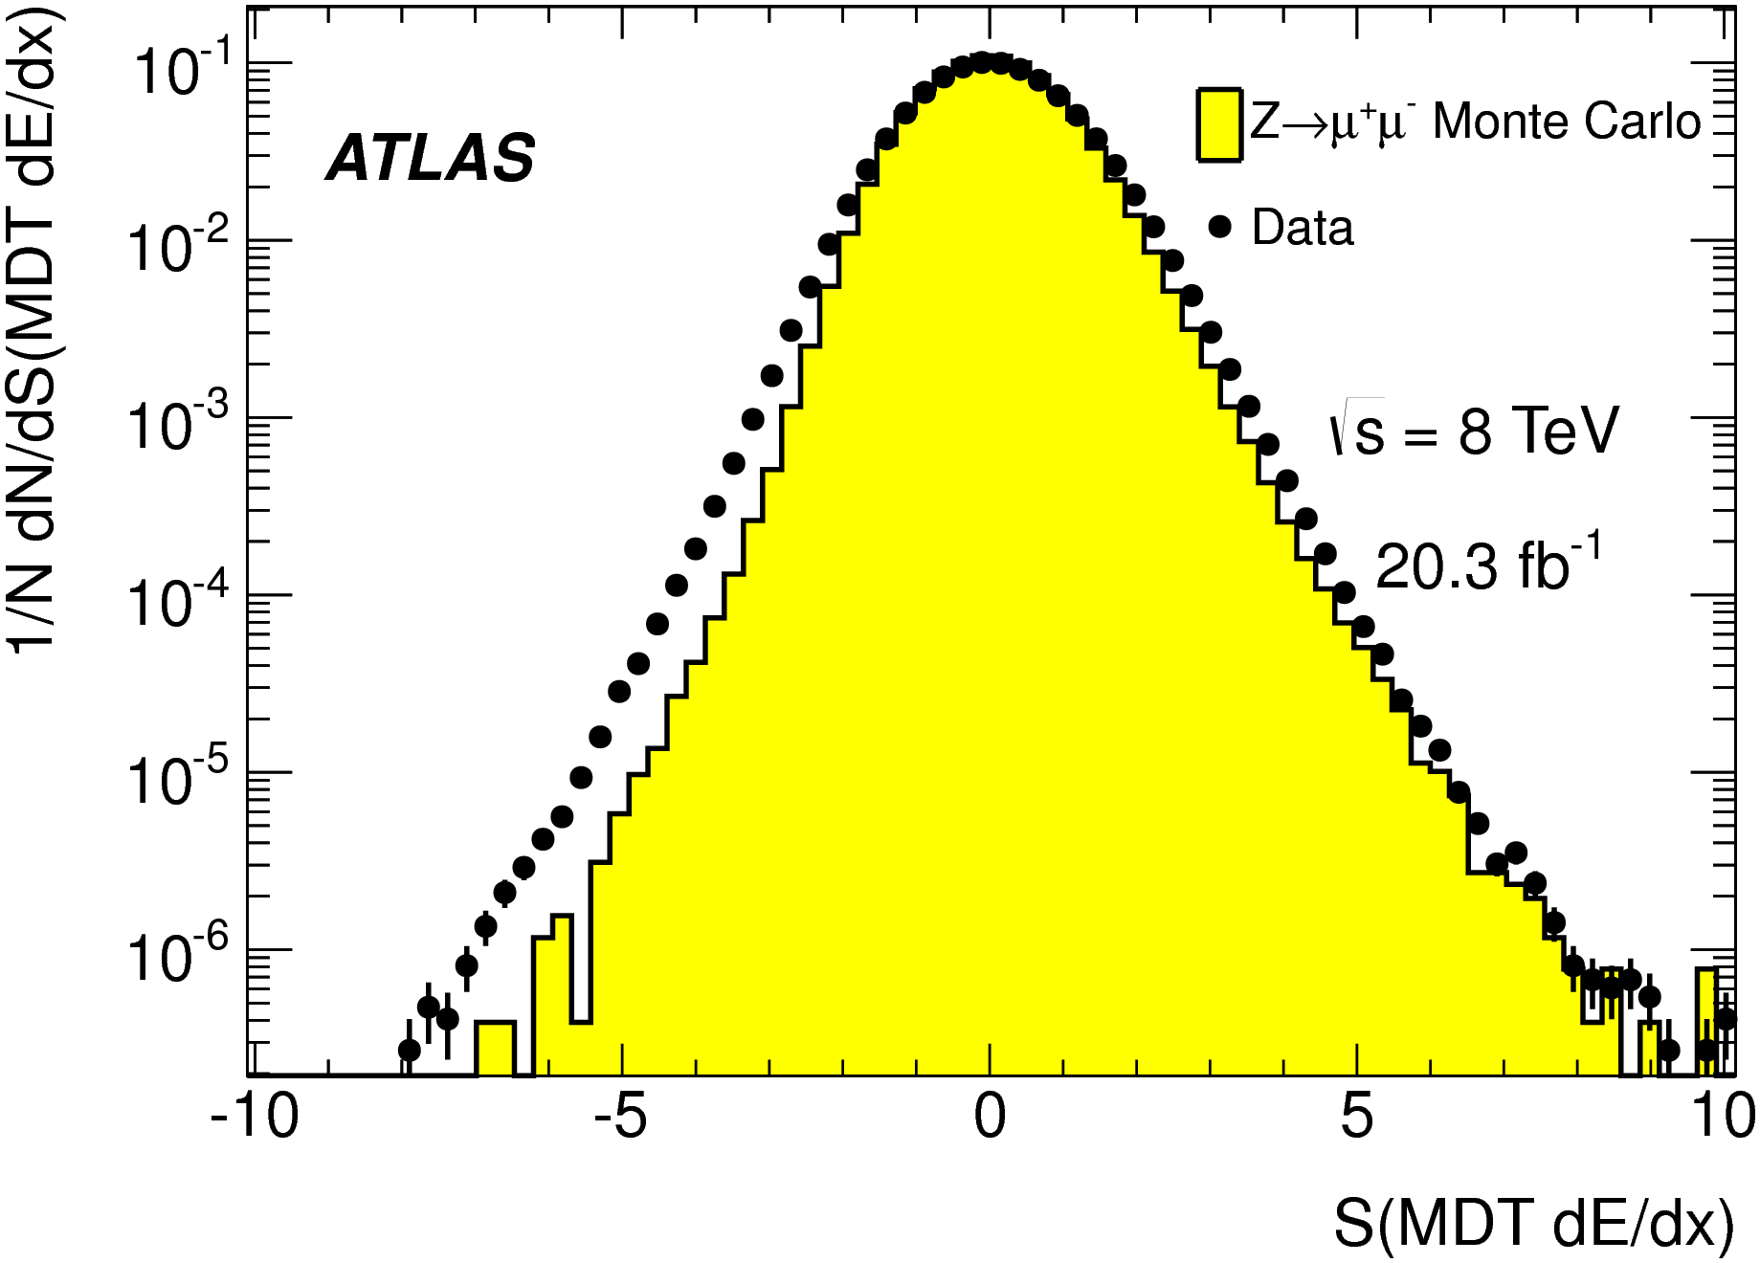
Reasoning…
Thirdly, by analysing raw listening, sales and revenue data resulting exclusively from the distribution element of recorded musical

Slide 13
Underpinning literature…
The historical and theoretical underpinnings for the development of Intellectual Property and Copyright concepts and developing legal implementation. Relates to the historical background to current IP and Copyright implementation uncertainties and provides a grounding for the entire research project as well as when considering and developing alternative music industry models.
Curtis, G. (1847) A Treatise on the Law of Copyright. Boston: C.C. Little and J. Brown
Drahos, P. (1996) A Philosophy of Intellectual Property. London: Dartmouth
Hegel, G. (1821) Hegel: Elements of the Philosophy of Right. Translated by H Nisbet. Cambridge: Cambridge University Press

Slide 14
Underpinning literature…
The philosophy, morality and ethics of controlling the Intellectual Commons and the valuing of artistic endeavour. Relates to the recognition, financially or otherwise, of creatives’ outputs and supports discussion as to output ownership and monetisation. Will also inform analysis of industry elites’ perceptions of own creative worth balanced against their position in society.
Adorno, T. and Horkheimer, M. (1947) Dialectic of Enlightenment. Translated by E. Jephcott. Redwood, CA: Stanford University Press, 2007
Fleischacker, S. (2009) A Short History of Distributive Justice. Cambridge, MA: Harvard University Press
Mitchell, H. (2005) The Intellectual Commons: Toward an Ecology of Intellectual Property. Lanham, MD: Lexington Books

Slide 15
Underpinning literature…
The philosophy of Internet and Cloud technologies. Recent developments are redefining society’s core suppositions and values regarding access to and ownership of commodities. Will underpin and inform the requirement to re-evaluate existing societal models from a future-centric perspective including concepts such as commodities losing scarcity becoming status and value free.
Feenberg, A. (1995) Alternative Modernity: The Technical Turn in Philosophy and Social Theory. Berkeley, CA: University of California Press
Lanier, J. (2013) Who Owns The Future? London: Allen Lane Penguin
Morozov, E (2013) To Save Everything, Click Here: Technology, Solutionism, and the Urge to Fix Problems that Don't Exist. London: Allen Lane Penguin

Slide 16
Methodology…
A mixed/multiple methods approach with a fundamental underpinning of and informed by ethnographic and narrative methodologies

Slide 17
Methodology…
Ethnographic and narrative elements will be based around the longitudinal interviewing of a range of demographic groups with additional groups centred around creative and music industry elites
This data will be used in its own right as qualitative data but would also be subject to coding and quantifying so as to be used in conjunction with pure quantitative data harvested from various distribution and music access platforms
There is a proposed offer to be able to access a streaming platform’s anonymised listening data which would introduce the concept of ‘big data’

Slide 18
So which ‘Method’?
Well – maybe Grounded Theory…
According to ‘Grounded Theory’ theory:
a research method that will enable you to
develop a theory which
offers an explanation about
the main concern of the population of your substantive area and
how that concern is resolved or processed
http://www.groundedtheoryonline.com/what-is-grounded-theory

Slide 19
Practicalities - interviews…
Consumer Groups:
Children & young people in compulsory education
Young people in post-compulsory education or vocational training
People working, not-working or retired
Other specialist groups
Music Industry Groups:
Artists, songwriters & composers
Major & indie label executives
Recorded music distributors
Other specialist groups

Slide 20
Practicalities - surveys…
Music Listening Methods survey
Analyses the various ways people access & listen to music
Paper – targeted individually and in groups
Online – mass completion
Audio Quality Survey
Analyses peoples’ perceptions of audio quality & their ability to discern quality differences
Presentation based - electronic or paper voting
Non-skilled administered – online feedback
Linked to Personal Questionnaire

Slide 21
Practicalities – big data…
Music listening habits
Analyses of raw major download platform data
Analyses of raw major streaming platform data
Physical product buying habits
Analyses of CD and niche physical product high street sales
Analyses of CD and niche physical product online sales

Slide 22
Practicalities - visibility…
Website:
http://www.whatpricemusic.org
Facebook/Twitter/Blog:
Coming soon
Branding:
Grey/Yellow/White, Great Vibes font

Slide 23
whatpricemusic

